Slide 1

Prototype of Agentic ai Radiogenomics
Presentation subtitle

Slide 2
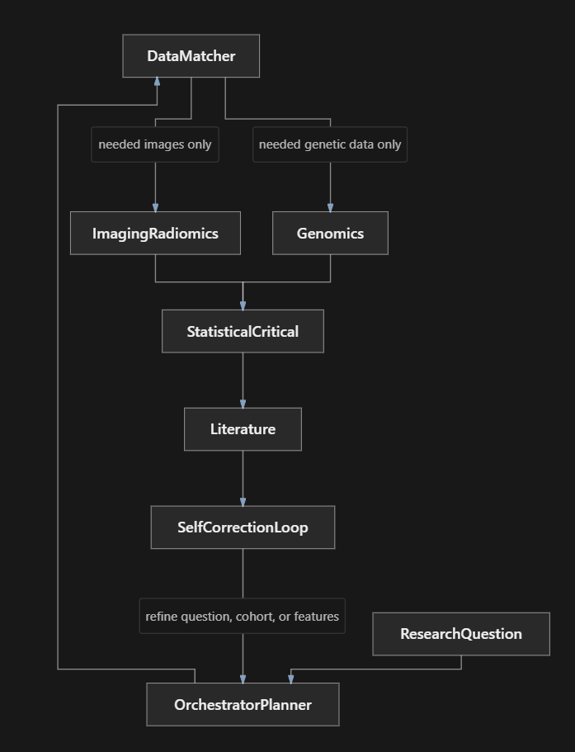

structure

Slide 3
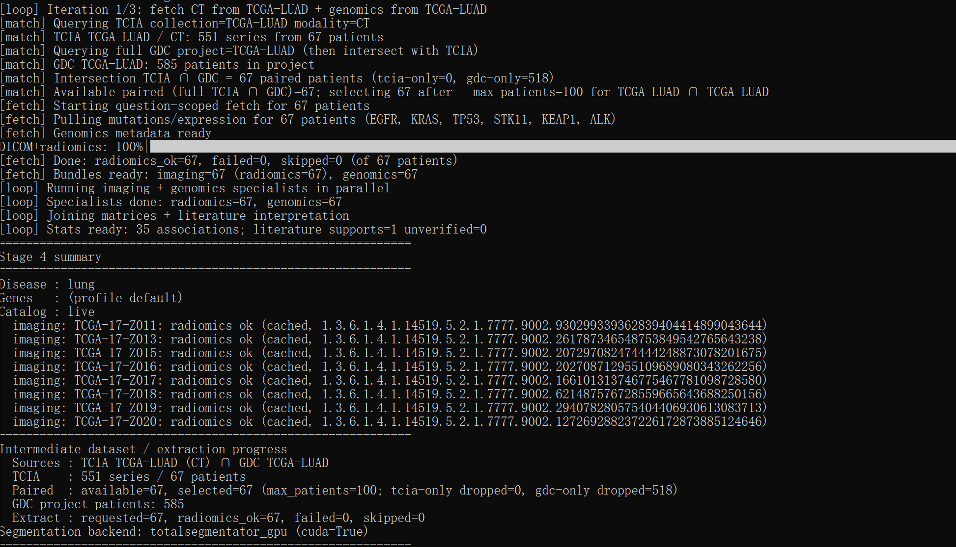
Lung cancers’ attempt
python -m agentic_radiogen --stage 4 --catalog live --approve-download --max-patients 100 --out outputs/stage4_live.json --question "Which imaging features are associated with specific genomic alterations in lung cancer?"

Slide 4
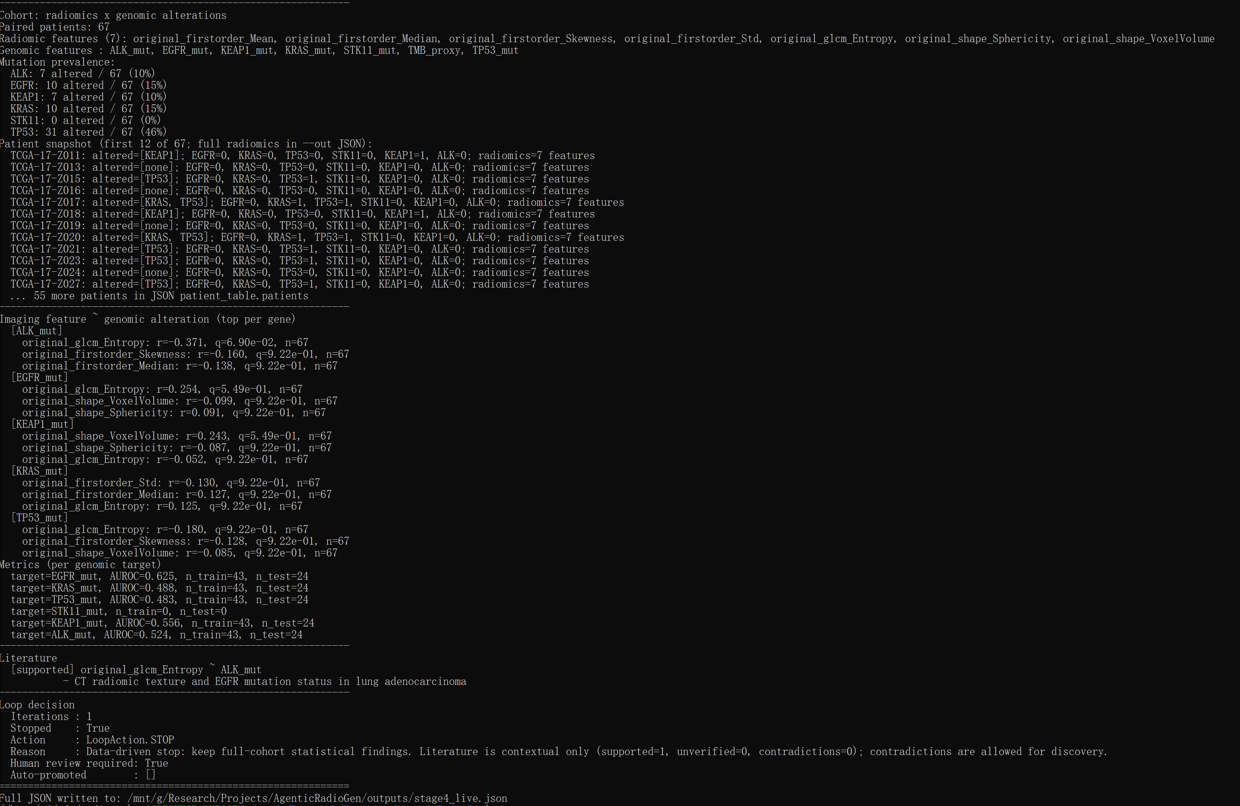
Lung cancers’ result
This version based on literature

Slide 5
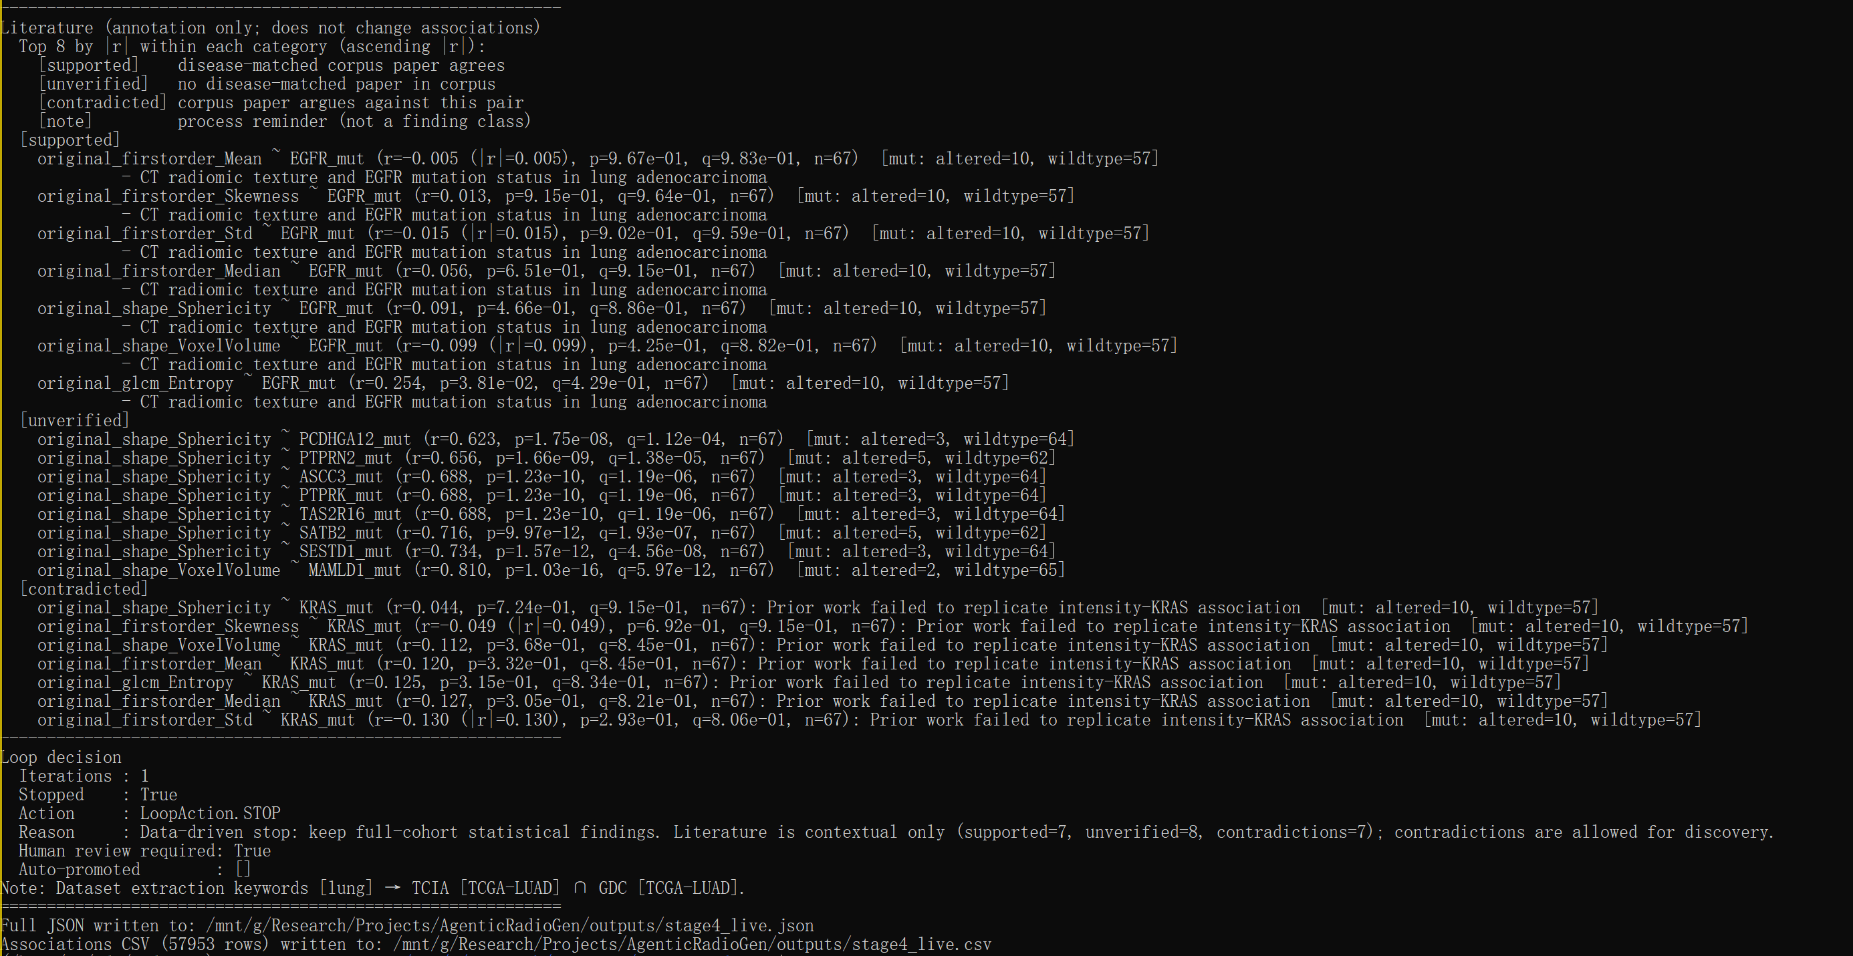
Latest version

Slide 6
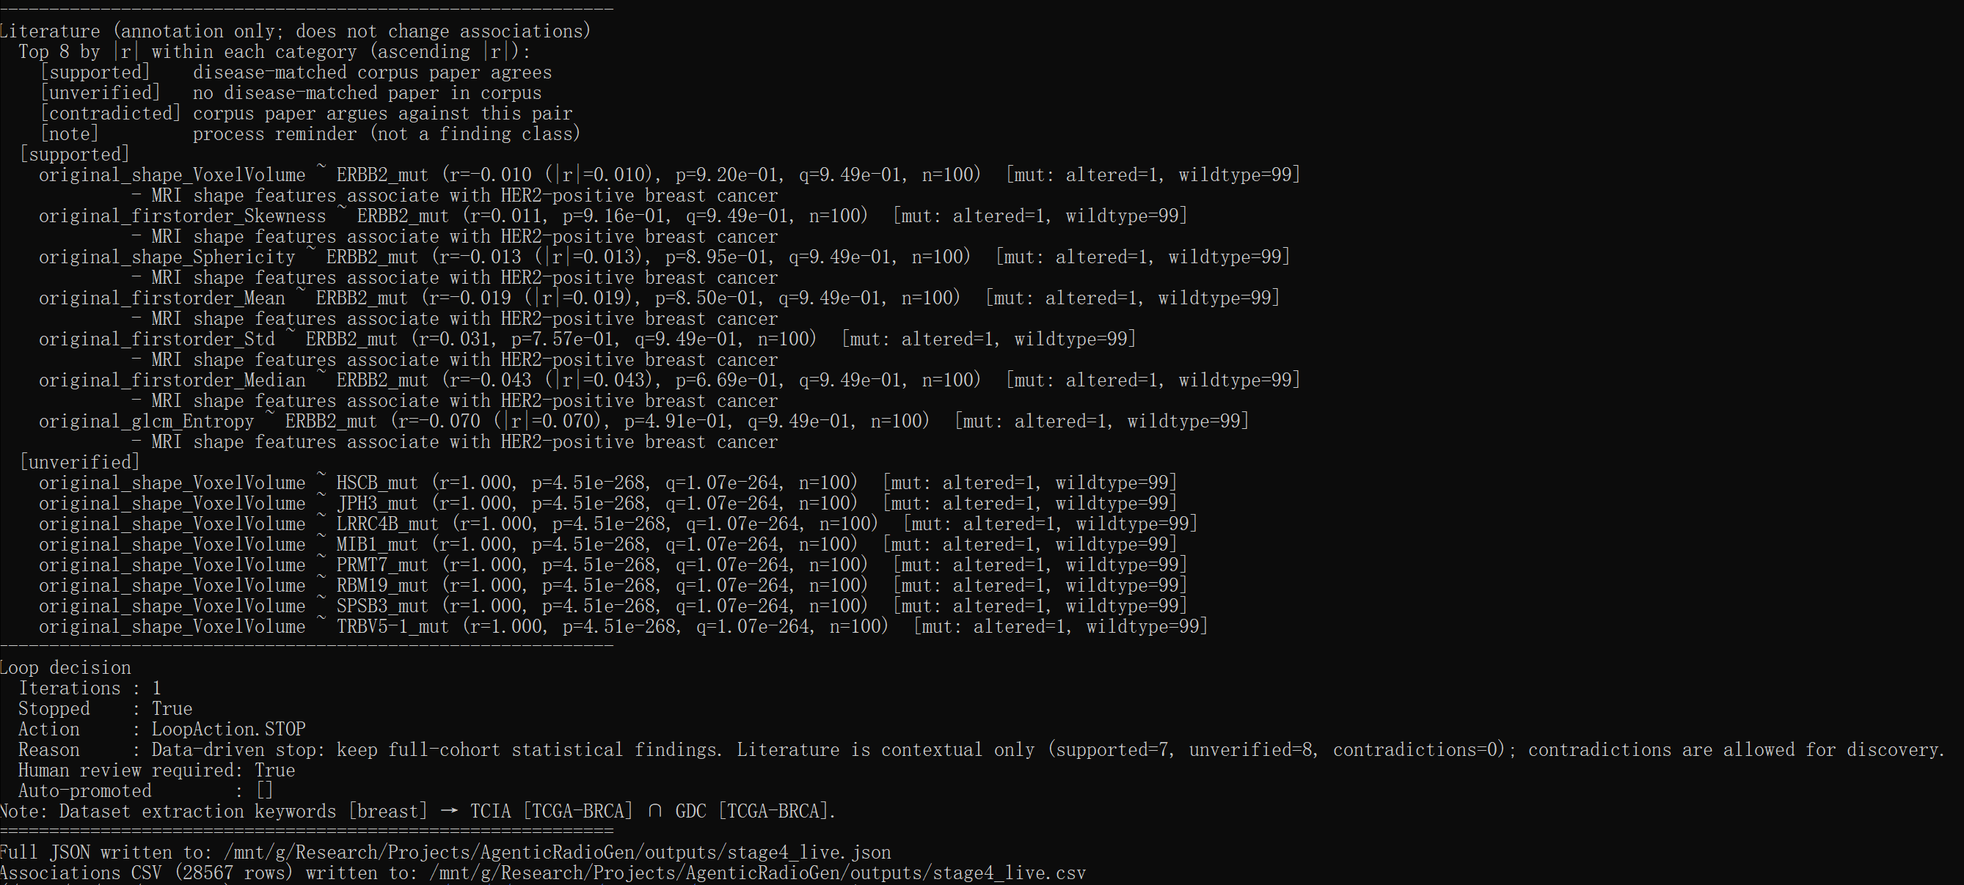
Breast cancer result

Slide 7
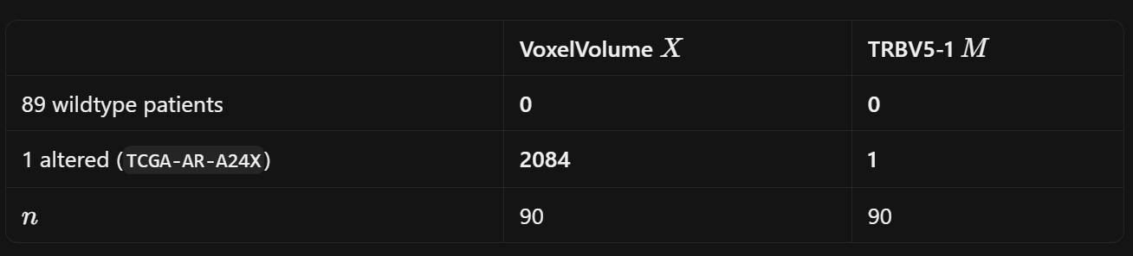
Q&A
Limited cohort with overlap patient id (TCIA/GDC)
Self-correct loop, the agent only shrinks the cohort
What other stats are suitable for measure association rather than pearson correlation (it isn’t always reliable):
      Pearson correlation =1.0
Many cancers are unable to find enough patients who have both images and genomic data

