Slide 1


Driver Distraction Detector
Nancy Sea
Weicong Feng

Slide 2


Driver Distraction Detector
The problem
Distracted Driving Behaviors
Relative Work
Our System
Drowsy & Talking
Head Pose Estimation
Perspective-n-Point
Out of Road Distraction
Results

Slide 3
The problem
ADAS (Advanced Driving Assistance Systems)
Pedestrian detection/avoidance
Lane departure warning/correction
Traffic sign recognition
Automatic emergency braking
Blind spot detection
Adaptive Cruise Control
Driver Drowsiness Detection
Driver Monitoring System
Notes:
When you buy a new car today, most of new models include an ADAS, shorted for advanced driving assistance system.
It can reduce the workload and risks for the drivers and pedestrian.
According to WHO, 1-1.25 million people die and 20-50 million people are injured because of road accidents per year.
Research shows that distraction and inattention account for somewhere between 25% and 75% of all crashes and near crashes.

Slide 4
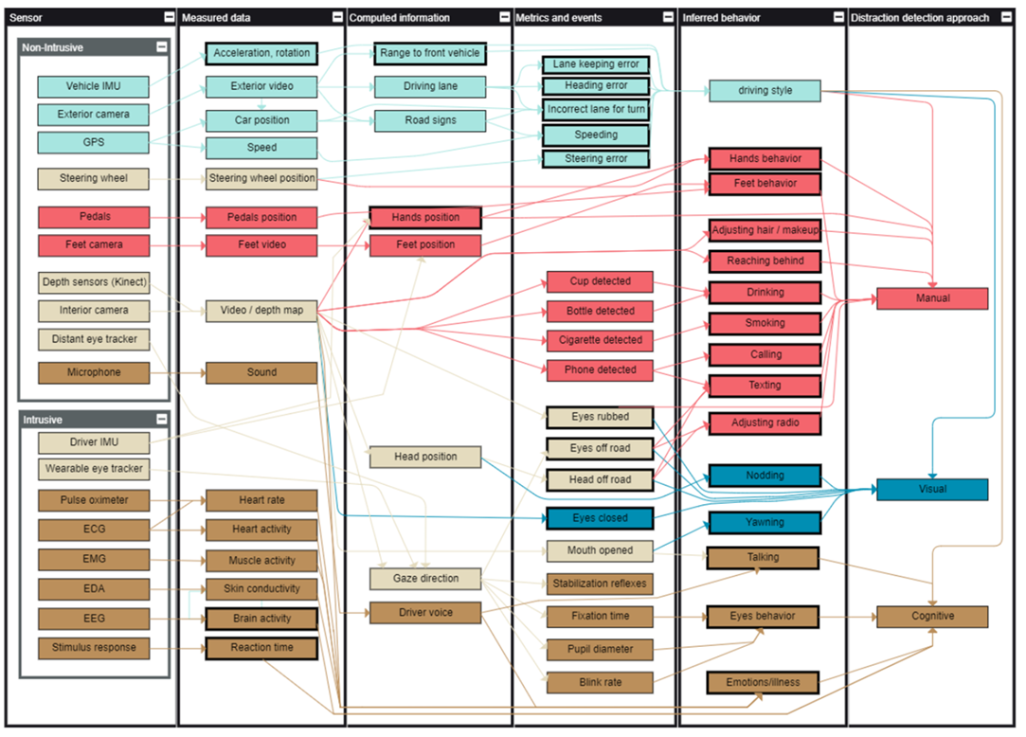
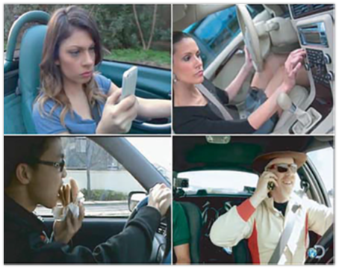
Distracted Driving Behaviors
Notes:
Research has identified numerous behaviors that compromise driving safety. This project only consider 3 of common behaviors, drowsiness, talking, vision out of the road.

Slide 5


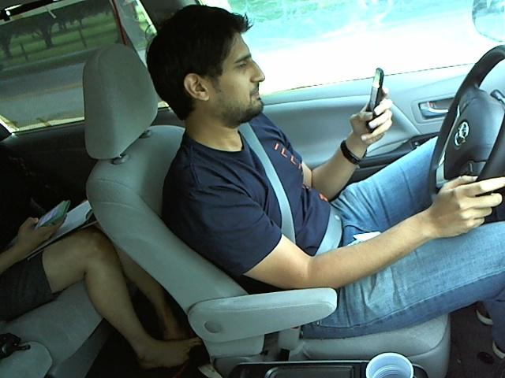
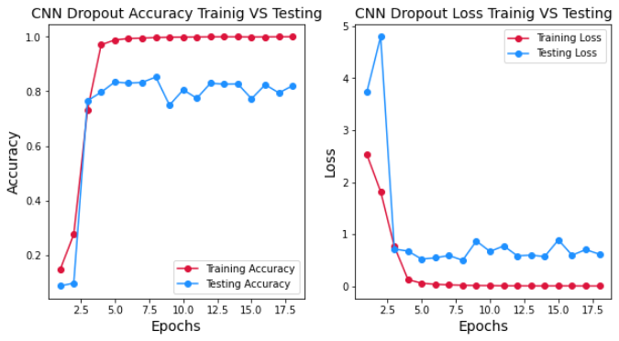
Related Works
CV vs DL
Negar Moslemi et al (2020), Computer vision-based recognition of driver distraction: A review
Sung Joo Lee, Jaeik Jo (2011), Real-Time Gaze Estimator Based on Driver’s Head Orientation for Forward Collision Warning System
Data set issue
Notes:
There are two major approaches in distracted driver detection, CV and DL. However, the data sets in distracted driver are very limited. One of the most popular data sets is State Farm dataset. Although more and more turn to dl solution, however, high training and testing accuracy doesn’t mean useful in real-world application. Most data set you can find use the camera angles like this. It can make recognition easy, but I never seen an ADAS use this direction.

Slide 6
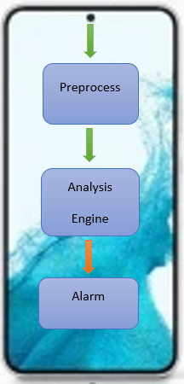

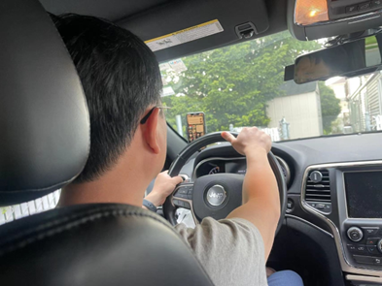
Our System
Application
Experiment
Emulator
Drowsy
Module
Videos
Preprocess
Analysis
Engine
Speaking
Module
Head Pose
Module
Estimation
Module
Notes:
The left side shows the application architecture. An app installed in a smartphone, which uses the front camera capture the driver video real-time, and send the video stream to our analysis engine. If a dangerous behavior is detected, an alarm is launched, it usually is a sound alarm. In this project, smartphone UI is not the point, while we focus on the analysis engine, the detail is shown on the right side. In our experiment, we recorded videos by smartphone and store in hard drive. Three major modules are developed, the emulator is used to imitate the real application, the estimation module is used to estimate the performance of the algorithm. The most important module is the core module, analysis engine, the emulator and estimation will call the analysis engine. The analysis engine has three sub-module, drowsy, speaking, head pose, respectively.

Slide 7
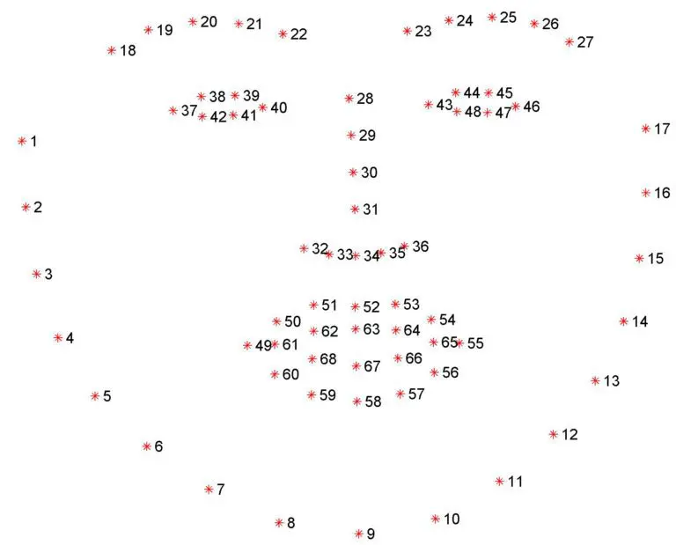

Drowsy & Talking
Weak-perspective projection model
$x=f\frac{X}{\overline{Z}}$, $y=f\frac{Y}{\overline{Z}}$
Face detection => landmarks
Calculate Euclidean Distances
Concern about time periods
Notes:
In drowsy and talking, the key is the distance between landmark points. When we falling sleep, the gap between our upper eyelids and our lower eyelids goes smaller. Talking is similar. Due to the difference of depth on our eyes and mouth is very small, so we can use weak-perspective projection model. What does the temporal factor mean? For example, closing eyes is normal even during driving because we need blink. So, we can’t judge drowsy by single frame with closing eyes. We only can say drowsy happen when the closing eyes continue in 20 frames or more.

Slide 8
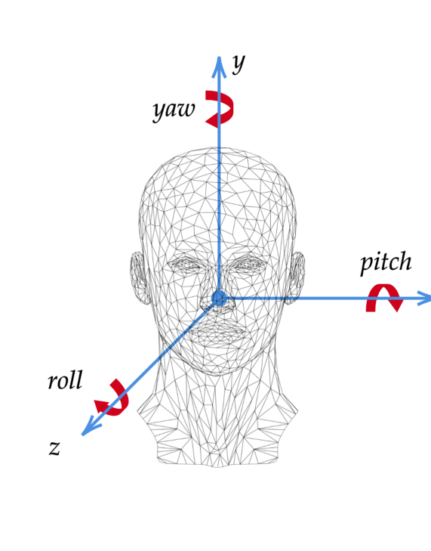
Head Pose Estimation
Given a 2D image, we want to know the pose of the human head in the 3D world, particularly the pitch, roll and yaw.
Parameters needed for estimation:
Camera intrinsic parameters
Corresponding 2D to 3D points of the face
Method used for estimation: Perspective-n-Point

Slide 9
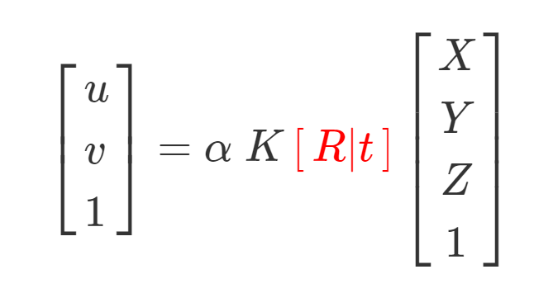
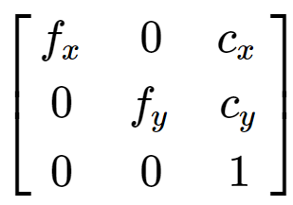
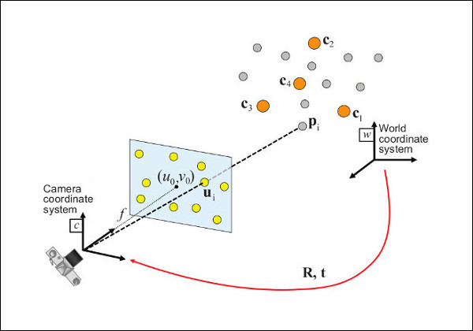

Perspective Projection Model
Where K =
Assumptions of the parameters:
$$f_{x}= f_{y}=h and c_{x}=\frac{w}{2},c_{y}=h/2$$

Slide 10
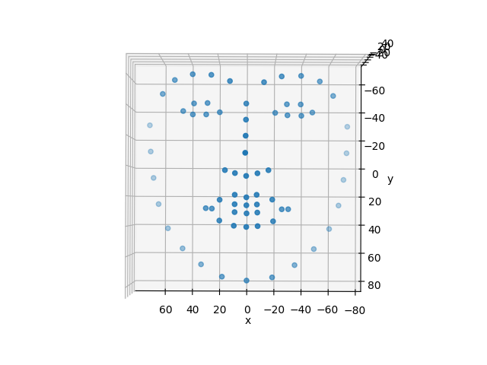
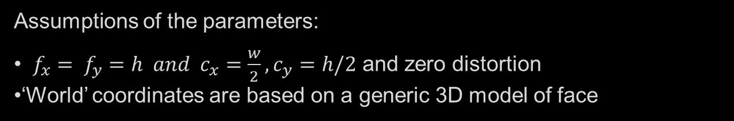
Perspective Projection Model
Assumptions of the parameters:
$f_{x}= f_{y}=h and c_{x}=\frac{w}{2},c_{y}=h/2$ and zero distortion
‘World’ coordinates are based on a generic 3D model of face

Slide 11
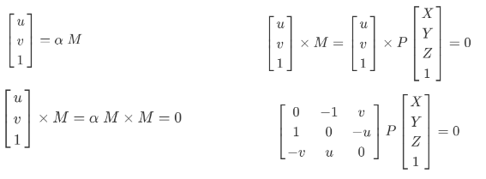
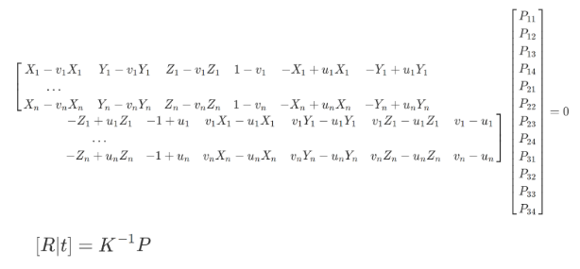
Perspective-n-Point
Estimates pose of camera given n corresponding 3D-2D points and the intrinsic parameters of the camera

Slide 12
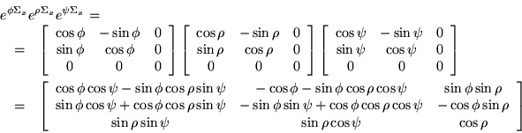
Obtaining the Euler Angles

Slide 13
Out of Road Distraction
The angles obtained from the head pose estimation of each frame is then used o detect if the driver is distracted.
We set a threshold for allowed movement in all three directions as well as the threshold allowed to exceed that movement (to account for head turn while turning the vehicle)
If the pose exceeds the threshold, an alarm will alert the user telling them they are distracted

Slide 14
Result
Data – actual driving videos recorded by iPhone front camera
Results
 | CV | CV with Temporal | DL – VGG16
Accuracy | 69.5% | 91.6% | 1.66%
Notes:
The data we used to estimate the performance of our algorithms are 13 videos I recorded by iphone front camera when I was driving, total 9890 frames. The experiment result is shown as above table. The VGG with a test accuracy of 80% has only 1.66% in this experiment environment setting. I think the reason is the difference of camera angle, leading to the training data distribution totally different from my data set, the minor reason is it doesn’t consider the temporal factor. Hence, you can find the computer vision without temporal information method only has an accuracy of near 70%, however, with Temporal information can achieve 91.6%. Of course, deep learning can use a new data set which is similar as our environment to retrain the model, and combine the temporal information outside of the model. But that is another topic.

