Slide 1

Propensity Model for Predicting User Conversion
Applications in Google Marketing Platform

Slide 2
Background & Objectives
Background:
Client attended a predictive analytics conference; interested in intra-session/real-time conversion modeling.
Provided raw data to build a propensity model and predict transaction likelihood.
Objectives:

Slide 3
Key Use Cases on Google Marketing Platform
Spend Optimization:
Goal: Target high-likelihood converters with increased bids, optimized email campaigns or targeted video ads.
Metric: Precision.
Budget Optimization:
Goal: Prioritize budget toward high-likelihood users.
Metric: Recall.
Hybrid Approach:
Goal: Target high-likelihood users and retarget non-converters.
Metric: Both precision and recall.

Slide 4
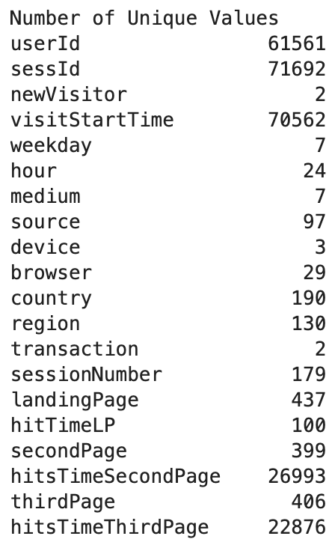
Data Overview
Dataset: Google Analytics Merchandise data (example data structure shown).
Core Variables: User behavior, temporal, session info, device, medium, landing page, transaction.
Data Size: 71,796 entries, 20 columns, 4 columns contain Null.

Slide 5
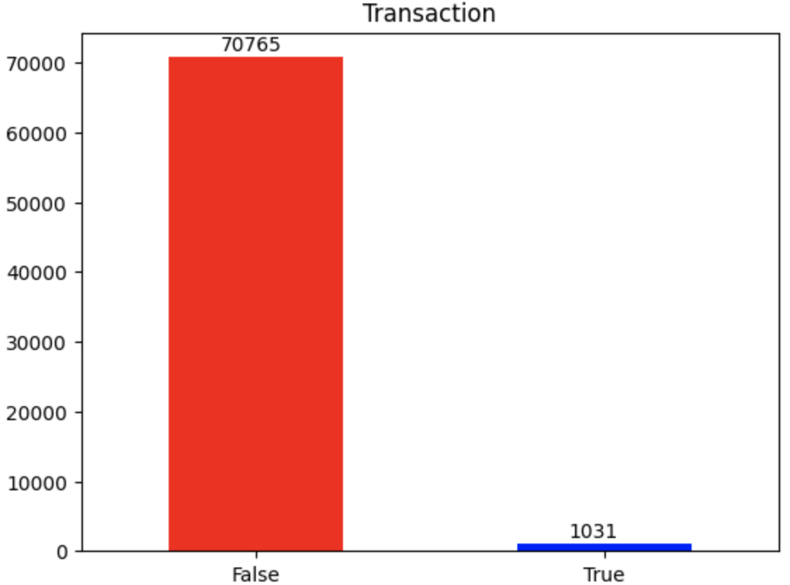
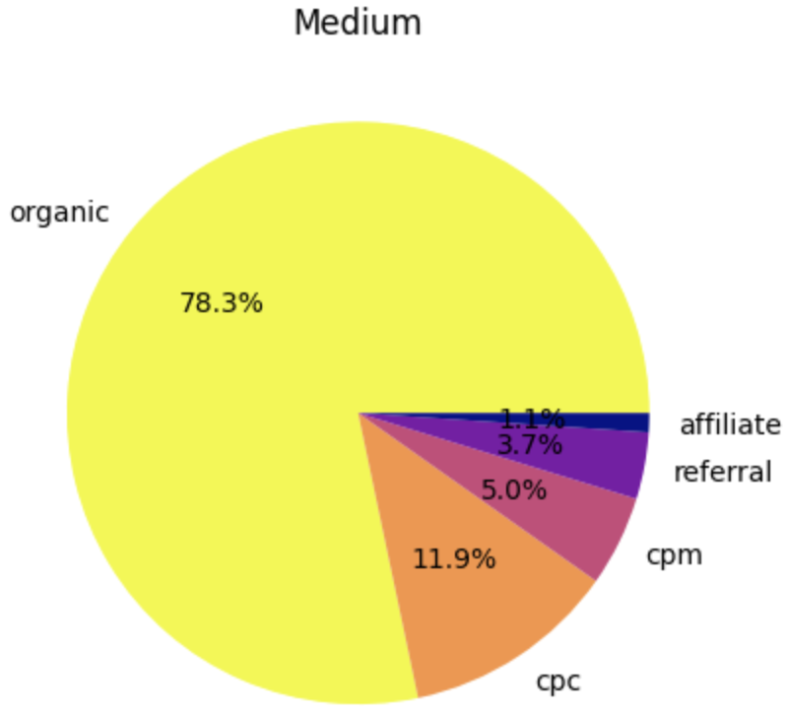
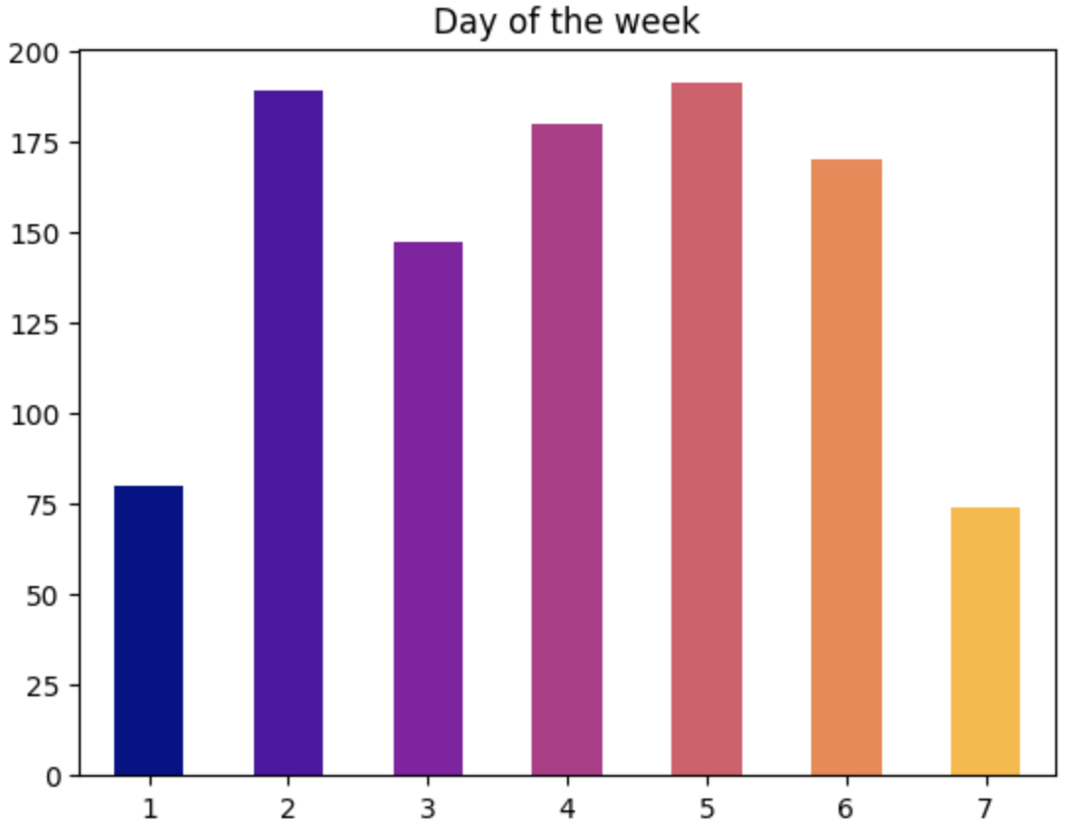
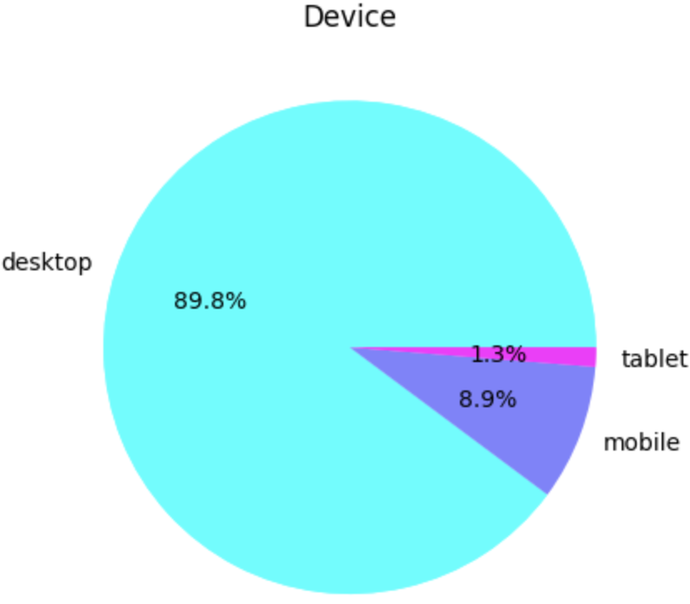
Exploratory Data Analysis (EDA)
Highly imbalanced dataset with <2% transactions.
Business likely to acquire customers via organic.
Most transactions happened during weekday.
Almost 90% of transactions made using desktop.

Slide 6
Data Preprocessing
Handling Low-Frequency Data:
Group low-frequency values
Feature Engineering:
Categorized landing pages and created binary indicators for visit sequences (second and third).
Encoding:
One-hot encoding for categorical features with <10 levels.
Target encoding for categorical features with >10 levels.

Slide 7
Modeling Approach
Model Selection:
Random Forest Classifier
Feature Selection:
20 key variables, including user type, temporal, session details, source, browser, landing pages, etc.
Target Variable:
Transaction (conversion)

Slide 8
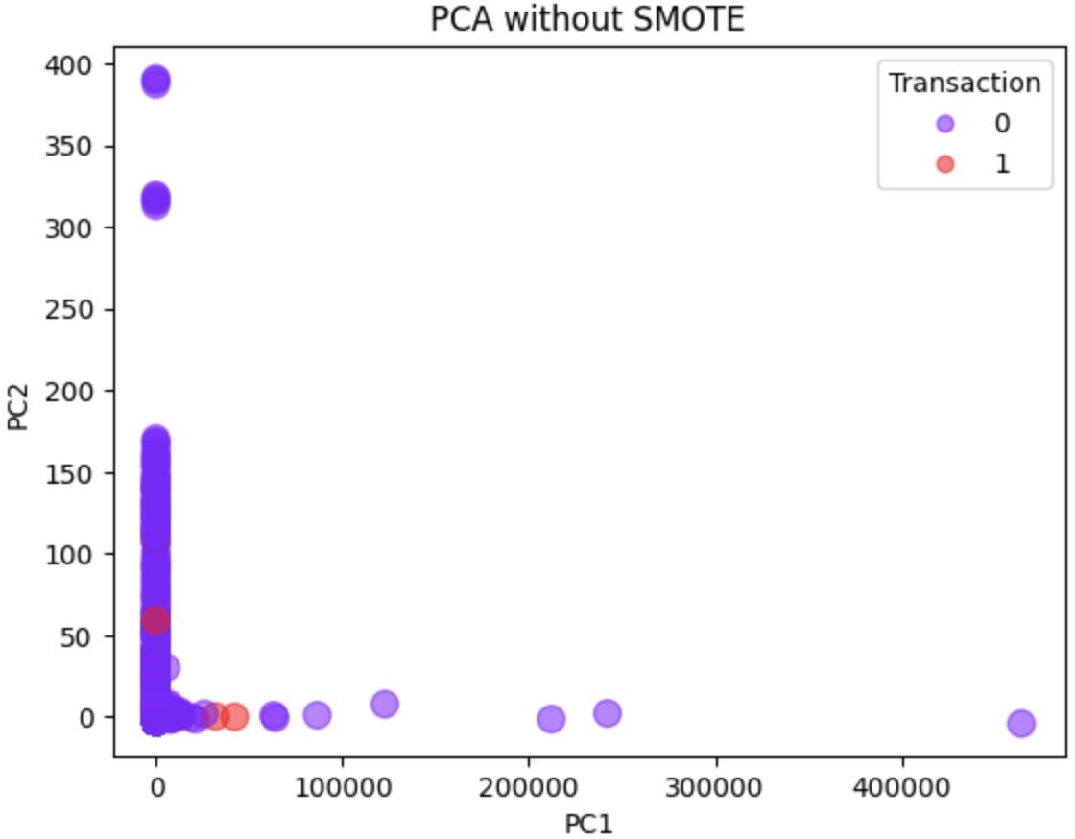
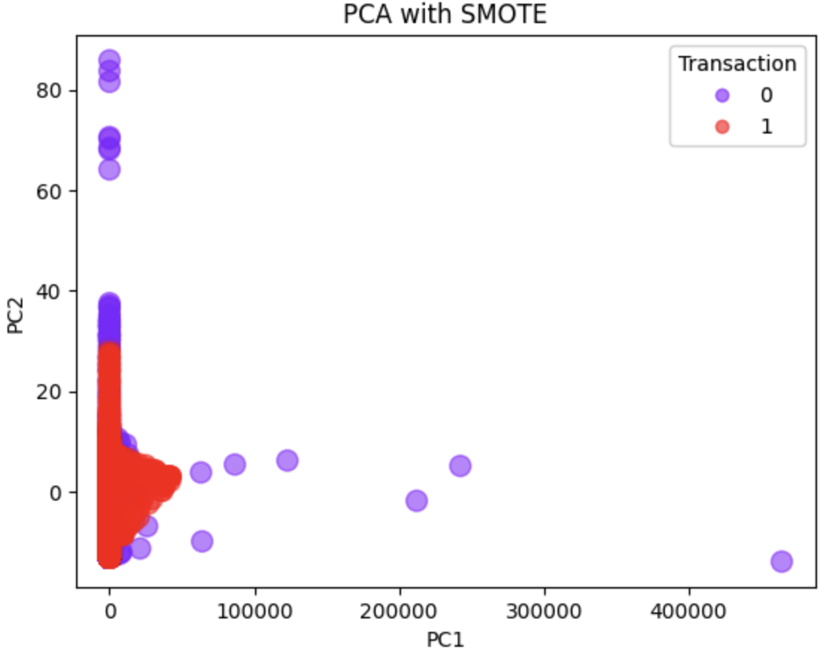
Dealing with Class Imbalance
Class Imbalance:
Original imbalance in transaction (0:49528, 1:729).
Solution:
Applied SMOTE to oversample minority class and improve decision boundary.
Balanced dataset post-SMOTE (49528 for both classes).

Slide 9
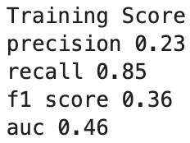
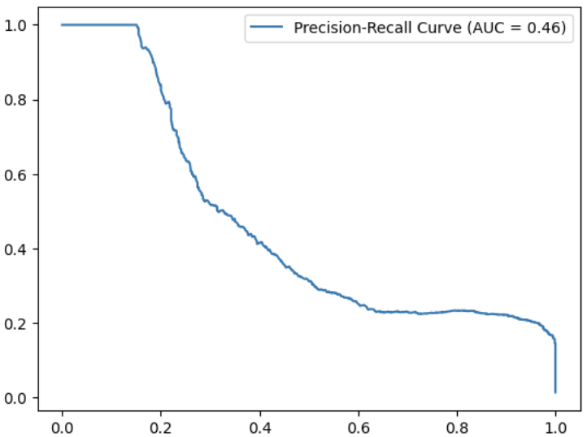
Model Evaluation on Train Data
Evaluation on Training Set:
Precision, Recall, F1 Score, AUC.
Observations:
Low precision, but high recall, indicating model over predicts positive (minority) class, even SMOTE was applied to improve decision boundary.
0.46 AUC indicating model unable to distinguish positive and negative class.

Slide 10
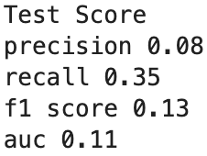
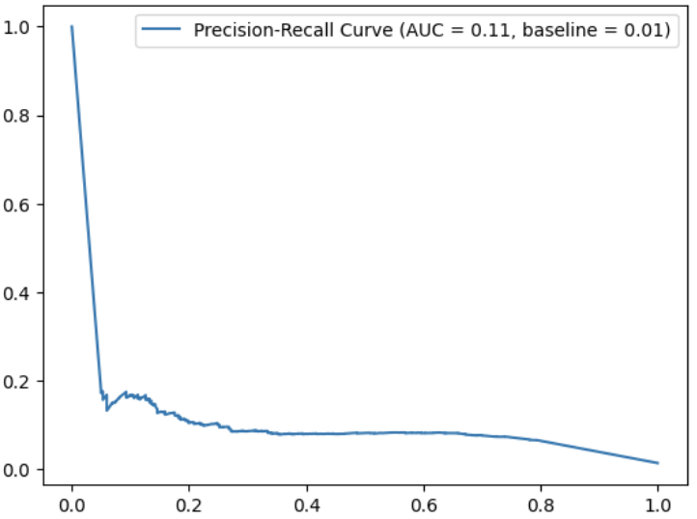
Model Evaluation on Test Data
Observations:
Low precision, slightly higher recall.
Even though the AUC (0.11) is low, it’s 10x higher that the baseline (0.01).

Slide 11
Conclusion & Next Steps
Summary:
Training score is moderate, with higher recall but lower precision.
Model over predicts minority class.
Next Steps:
Resampling and apply class weights
Additional feature engineering, such as mapping countries to continents/GDP, categorizing regions by income level, etc.
Implement K-fold cross validations and fine-tune model for further accuracy.

