Slide 1
Loan Repayment Prediction for Rent Relief Underwriting
Enhancing underwriting accuracy through predictive modeling
Wen-Fong Goh Nov 26, 2024

Slide 2
Project Overview
Objective: Develop a predictive model to evaluate the likelihood of loan repayment for rent relief applicants, with a focus on maintaining a conservative approach to fund disbursement.
Significance: Support automated underwriting decisions, minimize default risk and charge-off rates, and promote program sustainability.
Key Tasks: Initial Analysis, Model Development, Diagnostics & Improvement, Final Model & Predictions.

Slide 3
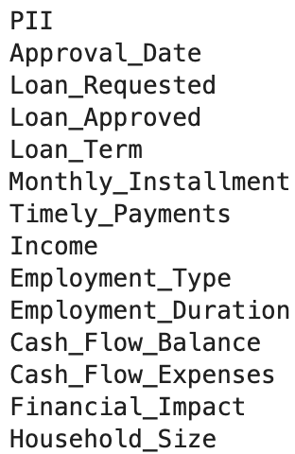
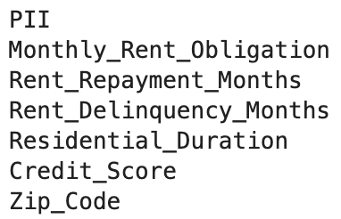
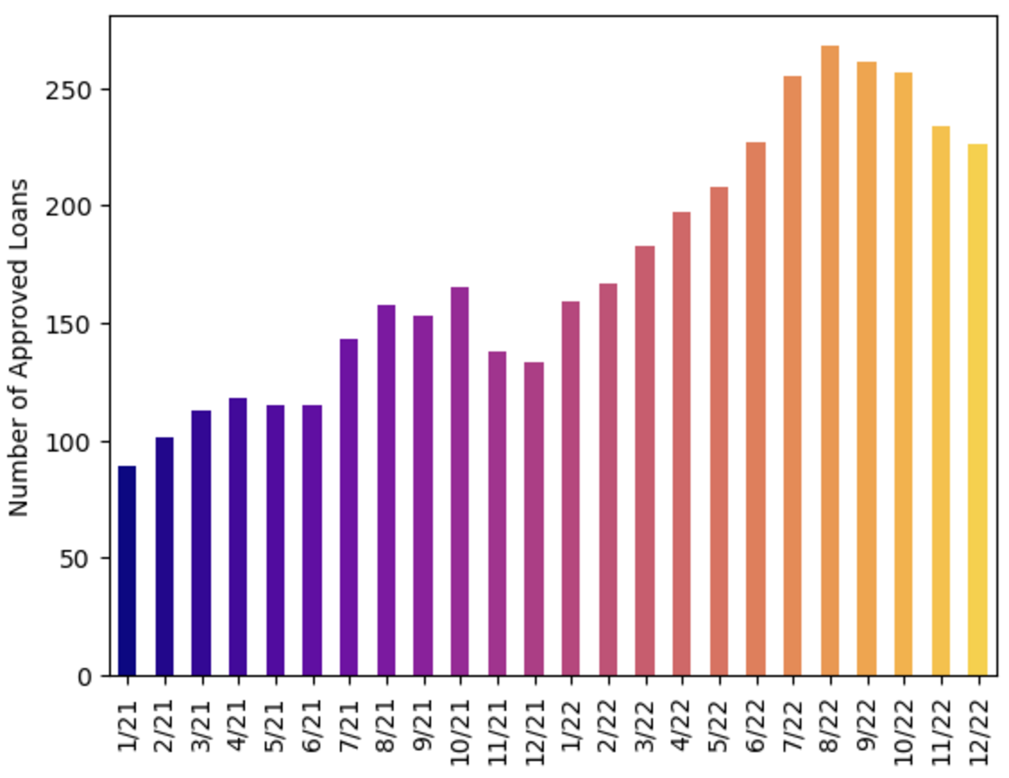
Data Overview
PostgreSQL
MongoDB
Data overview
PostgreSQL stores rent relief data from 2021 to 2022.
MongoDB stores rent reporting data.
Approximately 4,000 data rows were obtained by joining PostgreSQL and MongoDB using PII (e.g., name, date of birth, address, email and phone number), while the remaining 20,000 rows could not be matched.
The dataset includes 18 columns: one categorical variable, one text variable, and the rest are numerical.
4 columns - credit score, income, financial impact, and employment type and duration - contain missing values.
Target Labeling
Given that loan terms range from 3 to 24 months, timely payment was defined as repayment status within the first 3 months.
70% of borrowers fully repaid their loans after maintaining timely payments during the first 3 months.

Slide 4
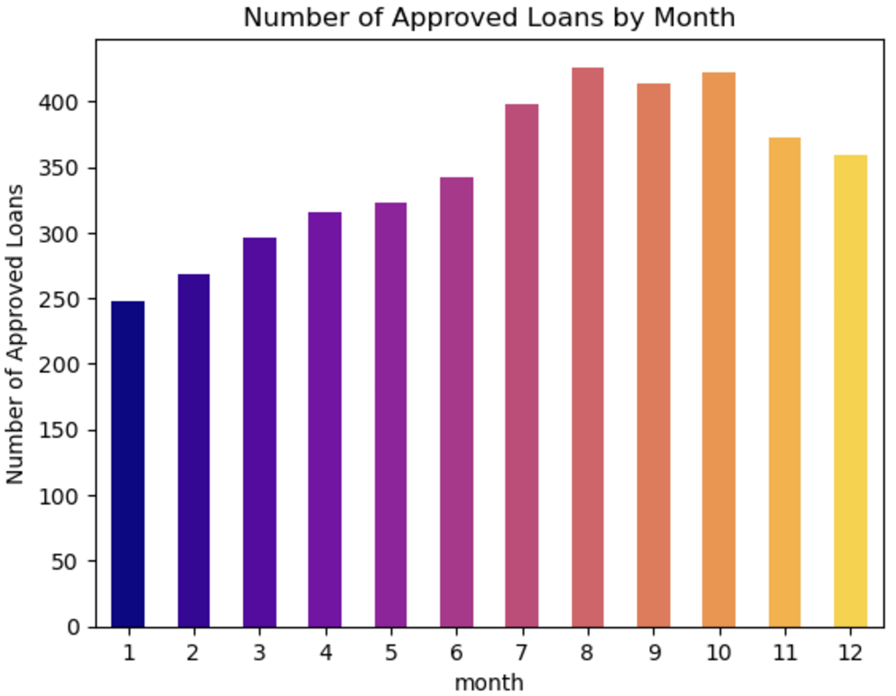
Data Exploration
Notes:
First challenges: label creation.

Slide 5
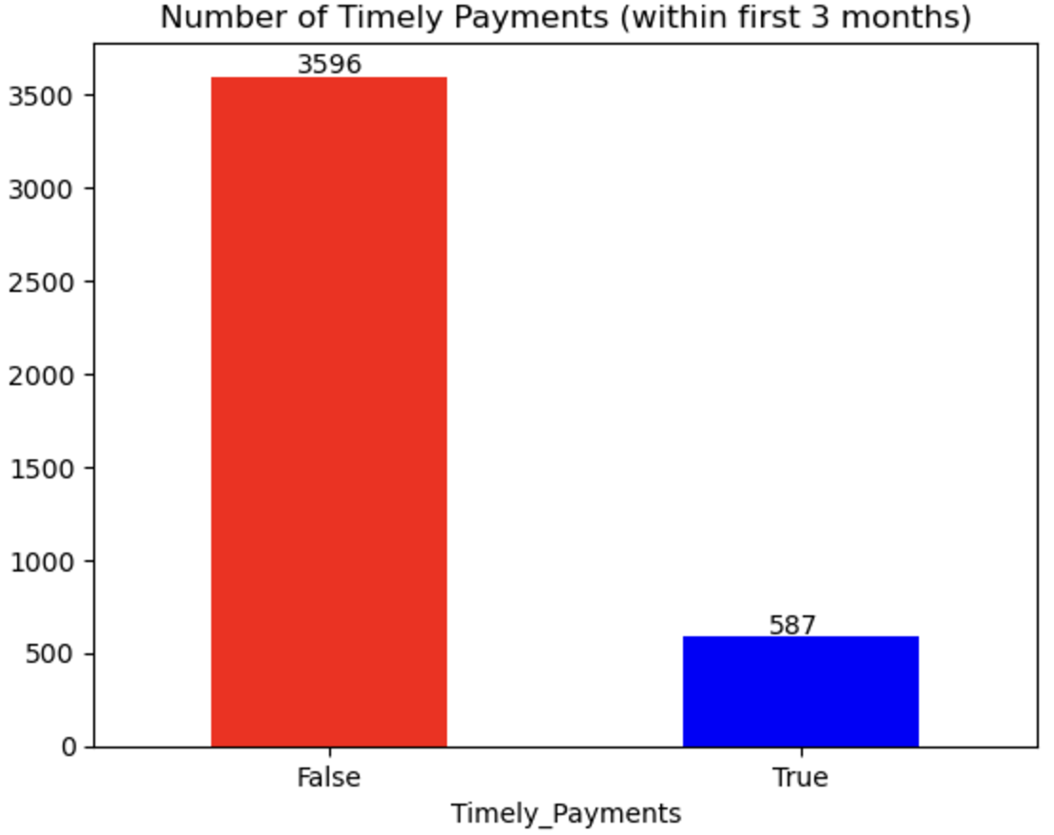
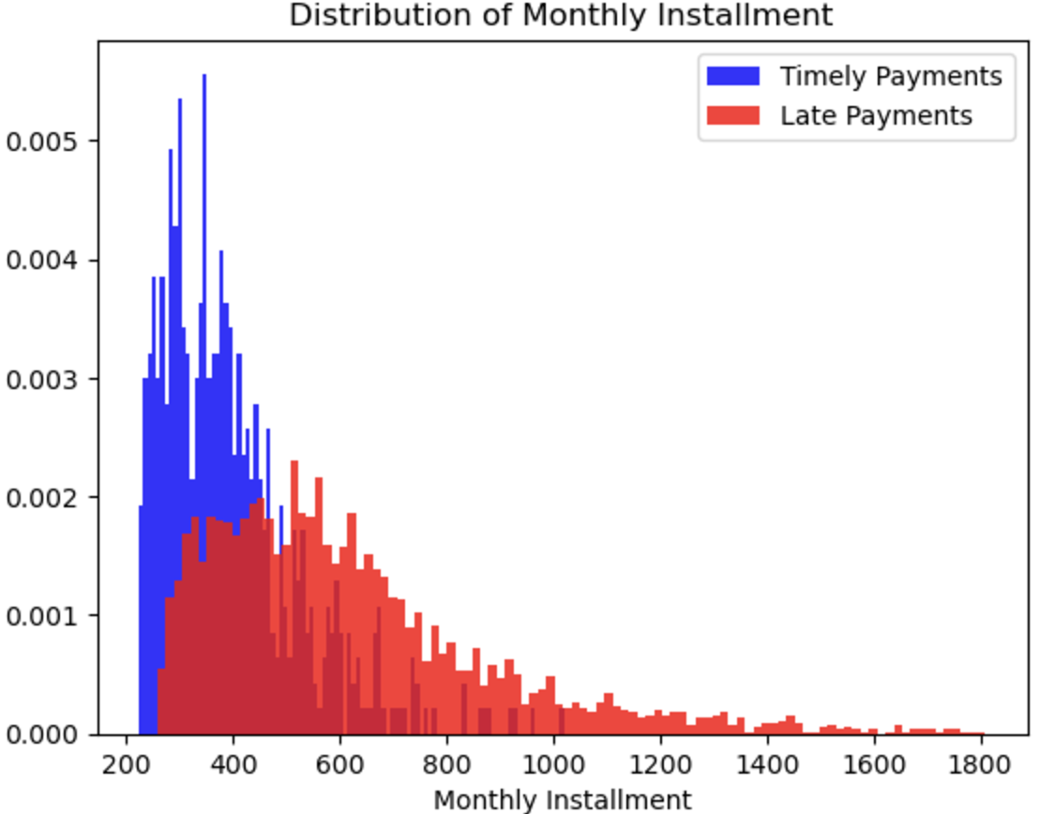
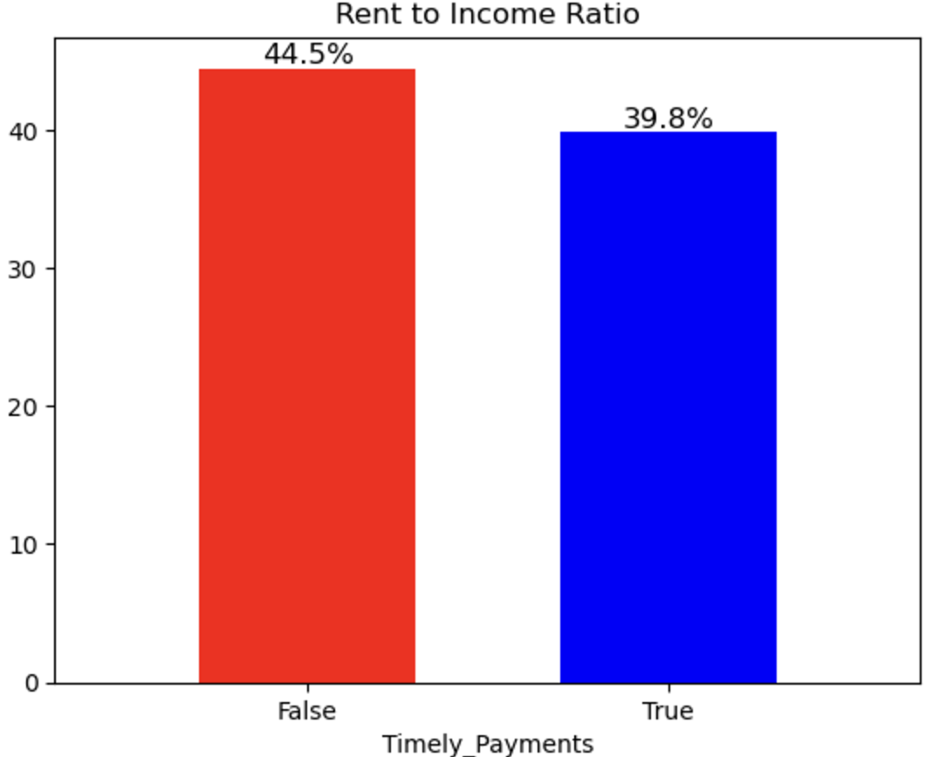
Data Exploration
The distribution of monthly installments is right-skewed, with the median for timely payments being lower than that for late payments.
The rent-to-income ratio is a strong indicator for distinguishing between timely and late payments, as it is lower for those who make timely payments.
The dataset is imbalanced, with only 15% classified as timely payments.
Notes:
First challenges: label creation.

Slide 6
Data Processing
Feature Engineering
Extracted geographical census data, including unemployment rate, household income, and type of urban area, based on zip code.
Encoding and embedding
Applied one-hot encoding to categorical feature, such as employment type.
Used embeddings to extract key information, such as job loss, reduced income, and rent hikes, from text variable like financial impact.
Data Transformation
Missing data was imputed using a KNN imputer.
Notes:
First challenges: label creation.

Slide 7
Modeling Approach
Model Selection
XGBoost Classifier.
Pros:
Accounts for variable interactions
No scaling required
Robust to multicollinearity and outliers
Cons:
Requires more computational power compared to logistic regression
Less interpretable than logistic regression
Demands extensive hyperparameter tuning
Model Training
Mitigated overfitting, especially given the small dataset, by tuning parameters such as learning rate, gamma, and regularization using Bayesian optimization.
Split the dataset into training and testing sets using an 80:20 ratio.
Applied stratified k-fold cross-validation
Feature Selection
Selected 20 key variables, including credit score, rental payment history, rent-to-income ratio, employment type, loan tenure, EMI, monthly cash flow (via Plaid), household size, area unemployment rate, etc.
Target Variable
Timely Payments
Notes:
First challenges: label creation.

Slide 8
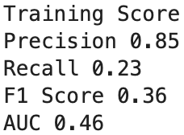
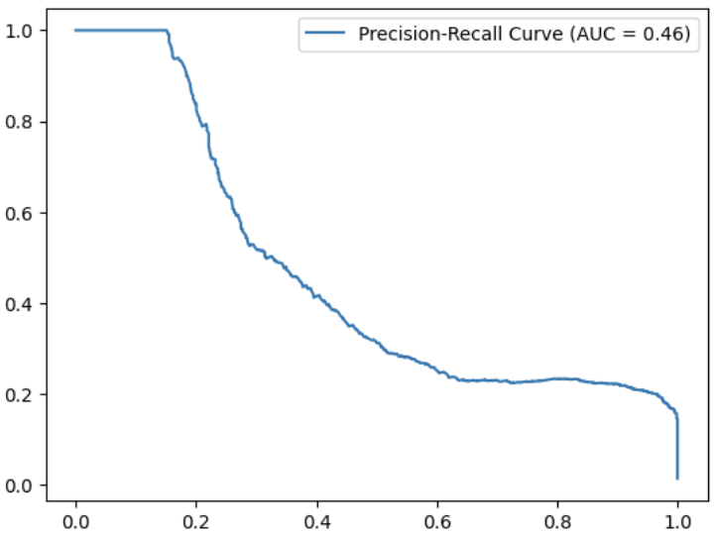
Model Evaluation on Train Data
Evaluation on Training Set:
Precision, Recall, F1 Score, AUC.
Observations:
High precision, but low recall, indicating model over predicts negative (majority) class.
0.46 AUC indicating model unable to distinguish positive and negative class.
Solution:
Apply sampling technique to solve the imbalance data issue

Slide 9
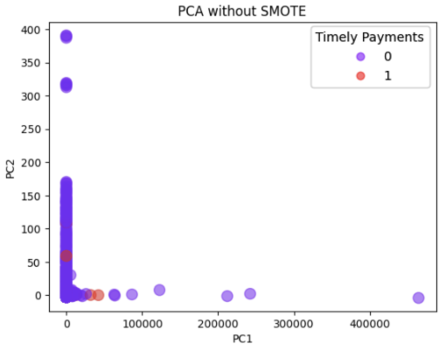
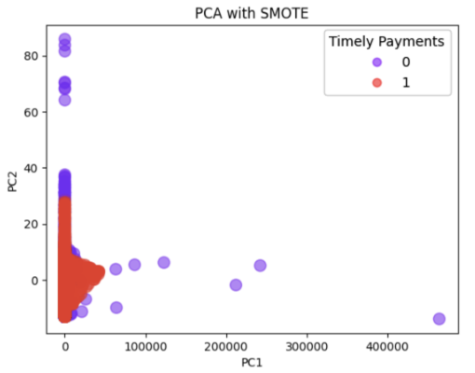
Dealing with Class Imbalance
Class Imbalance:
Original imbalance in transaction (0:3596, 1:587).
Solution:
Applied SMOTE to oversample minority class and improve decision boundary.
Balanced dataset post-SMOTE (3596 for both classes).

Slide 10
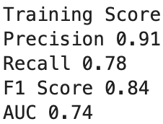
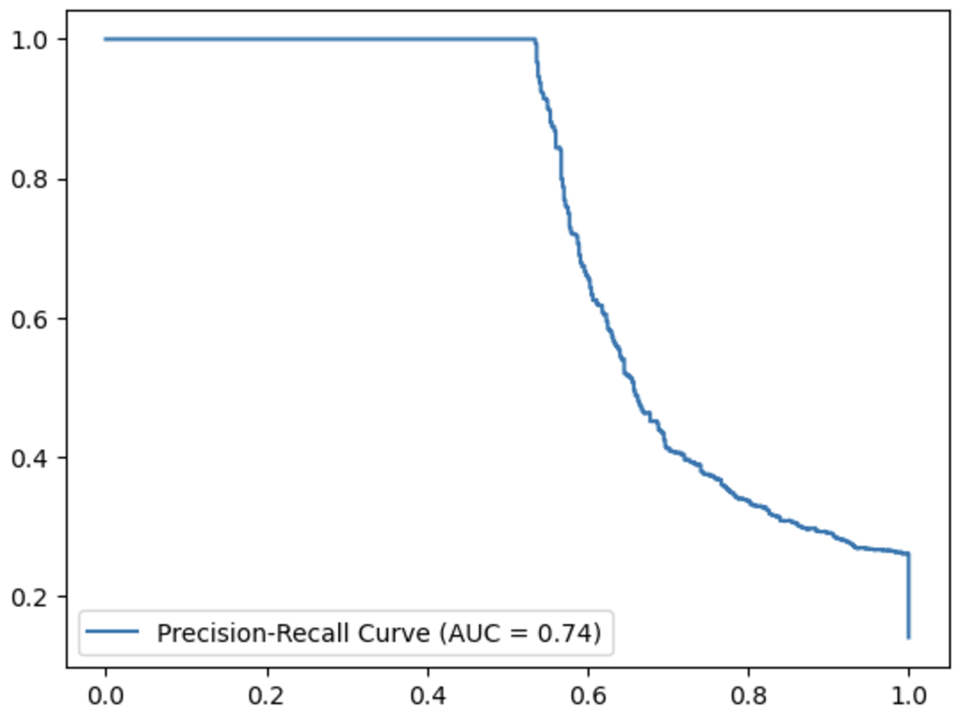
Evaluation on Train Data before and after SMOTE
High precision, but low recall, indicating model over predicts negative (majority) class.
0.46 AUC indicating model unable to distinguish positive and negative class.
Notes:
Challenges: Cost to act is high, opportunity cost is lower (but not zero).

Slide 11
Model Evaluation on Test Data
Evaluation on test data:
Precision, due to higher cost to act, lower opportunity cost
Prediction
Increase threshold to 0.7 to maximize repayment likelihood, while minimizing false positives
Allow us to be conserve on the number of loan disbursed.
Achieved 0.72 on precision on test data.
Notes:
Challenges: Cost to act is high, opportunity cost is lower (but not zero).

Slide 12
Interpretation with Shapley Values
Notes:
Challenges: Cost to act is high, opportunity cost is lower (but not zero).

Slide 13







Model Deployment and Servicing
Rent relief portal
Deployed model via batch inferencing in Glue.
Applied classifier to detect drift in data distribution.
Visualized key metrics in Tableau dashboard
Eg. number of loan approved, disbursement, repayment, etc.
Notes:
Challenges: Cost to act is high, opportunity cost is lower (but not zero).

Slide 14
Conclusions and Limitations
Business impact:
Predictive modeling significantly enhances underwriting accuracy and supports automated and informed decision-making.
Ongoing improvements will further refine predictions and expand applicability.
Reduced charge off rate from 30% to 20% and recovered over $600,000 since model inception.
Limitation:
Timely payments within the first 3 months does not guarantee fully payments for the entire loan term. There is a need to redefined target label.
Isolation of rent reporting and rent relief databases leads to data record loss during matching - engineers are currently working on integrating the two systems to address the underlying issue.
Lack of understanding on model biasness.
Notes:
Other challenges: Lack of documentation, hyperparameters tuning time consuming

