Slide 1

Loan Repayment Prediction for Rent Relief Underwriting
Enhancing underwriting accuracy through predictive modeling
Wen-Fong Goh Nov 26, 2024

Slide 2
Project Overview
Objective: Develop a predictive model to evaluate the likelihood of loan repayment for rent relief applicants, with a focus on maintaining a conservative approach to fund disbursement.
Significance: Support automated underwriting decisions, minimize default risk and charge-off rates, and promote program sustainability.
Stakeholders: Rent Relief team.
Beneficiaries: Renters and property managers.

Slide 3
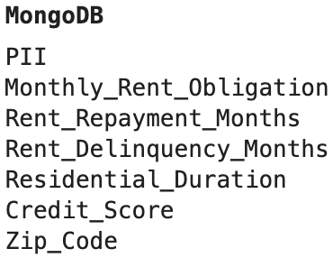
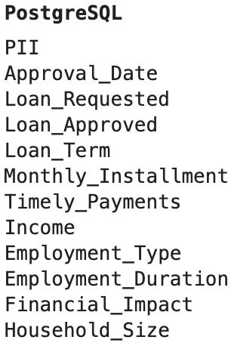
Data Overview
PostgreSQL stores rent relief data, while MongoDB stores rent reporting data.
Approximately 4,000 data rows were obtained by joining PostgreSQL and MongoDB using PII (e.g., name, date of birth, address, email and phone number), while the remaining 20,000 rows could not be matched.
The dataset includes 17 columns: one categorical variable, one text variable, and the rest are numerical.
4 columns - credit score, income, financial impact, and employment type and duration - contain missing values.

Slide 4
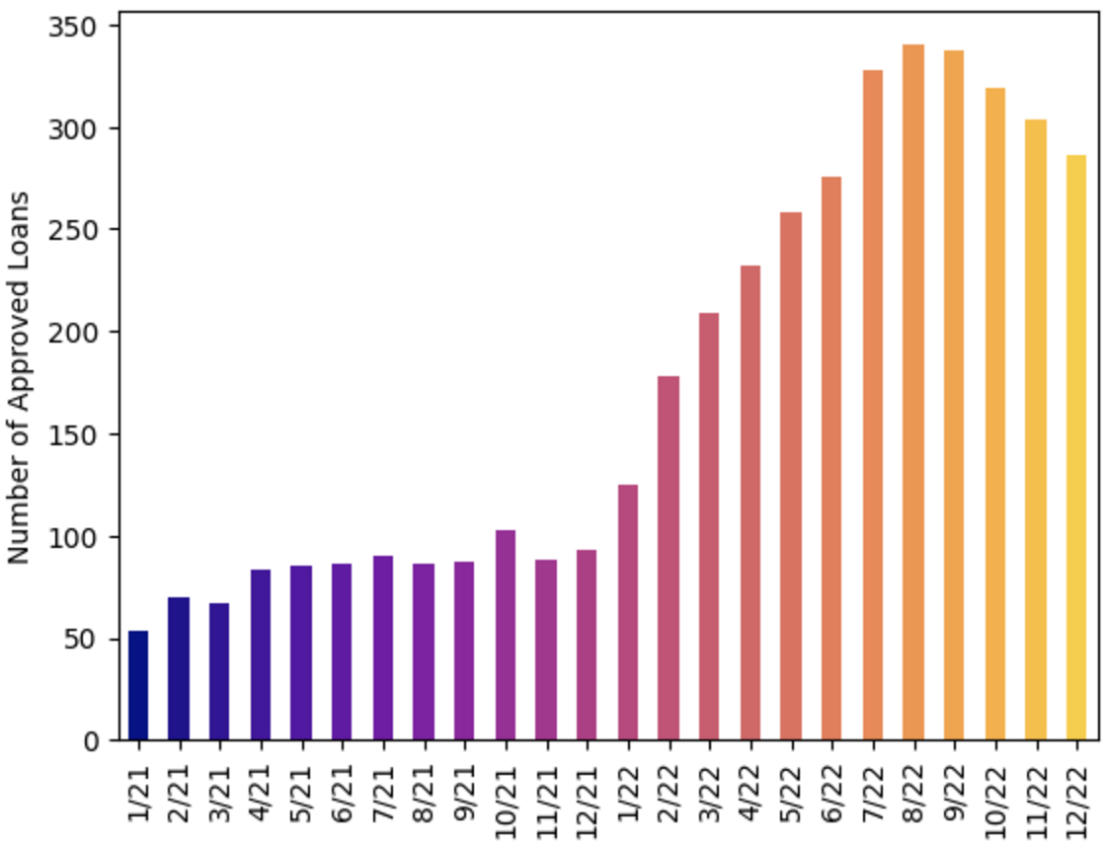
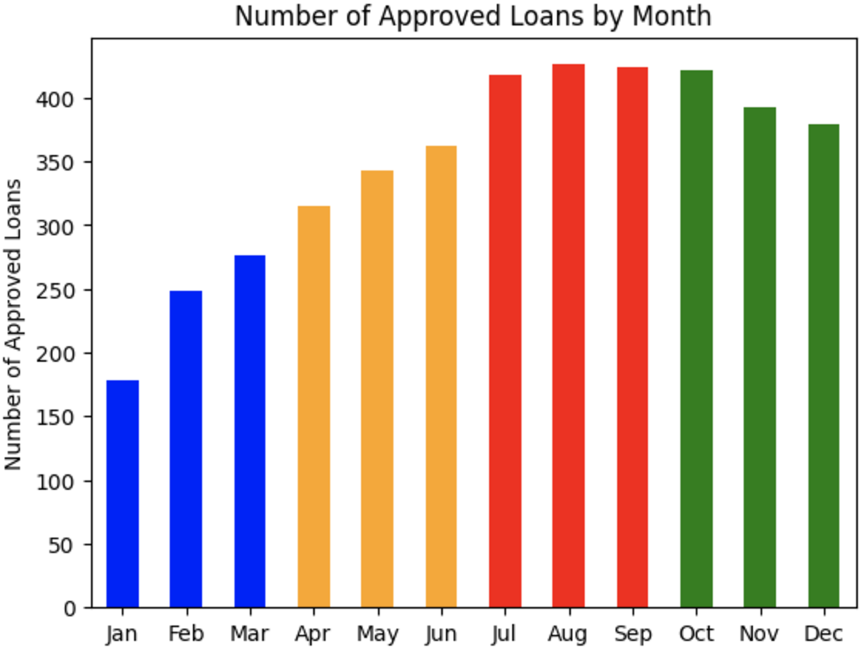
Target Labeling
Considered rent relief data from 2021 to 2022.
75% of the rent relief applications were approved in 2022.
Given that loan terms range from 3 to 24 months, “timely payment” was defined as repayment within the first 3 months.
70% of borrowers fully repaid their loans after maintaining timely payments during the first 3 months.

Slide 5
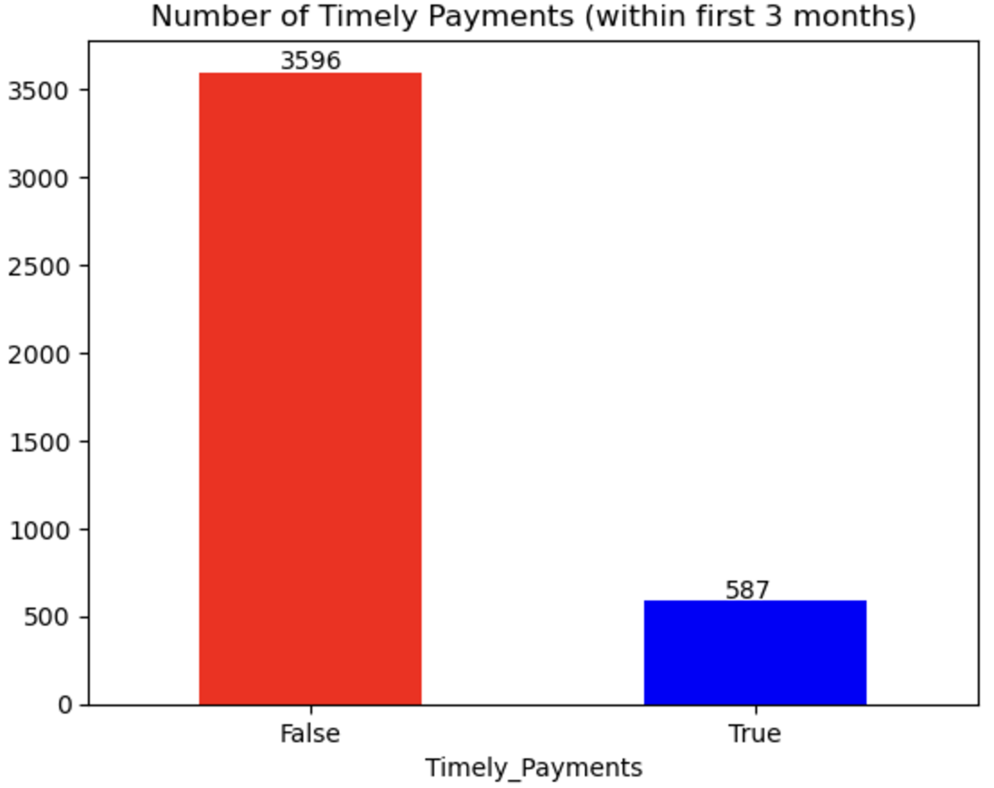
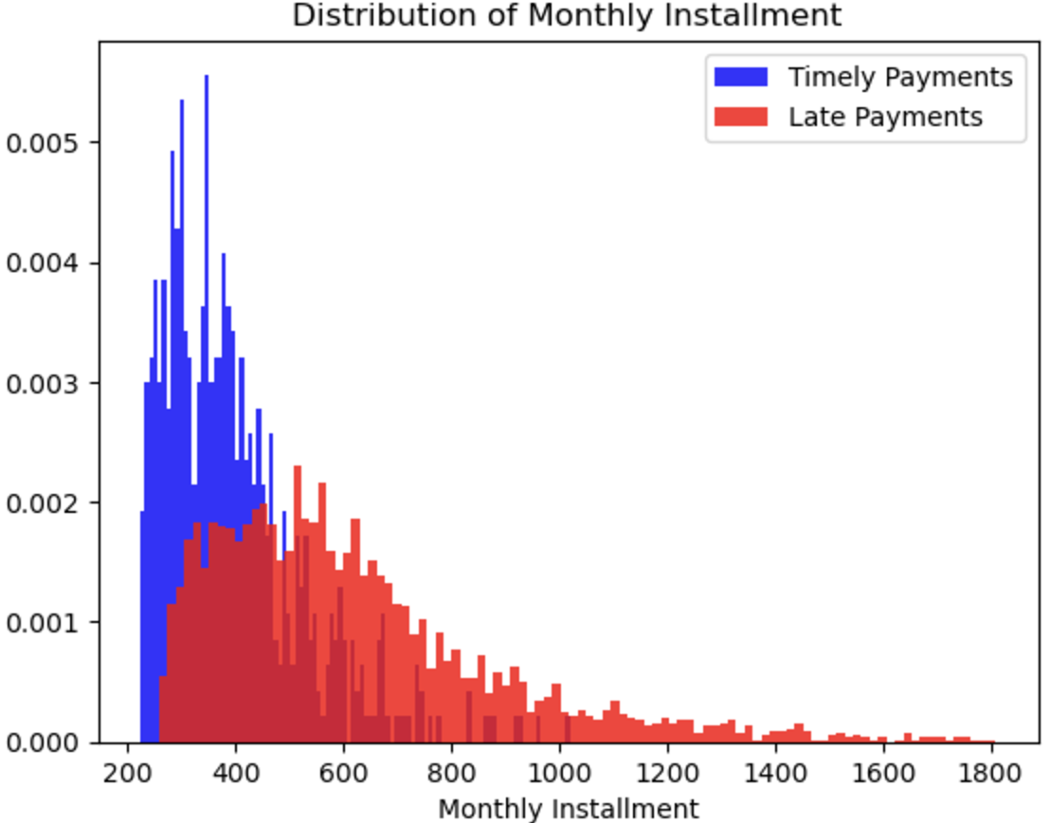
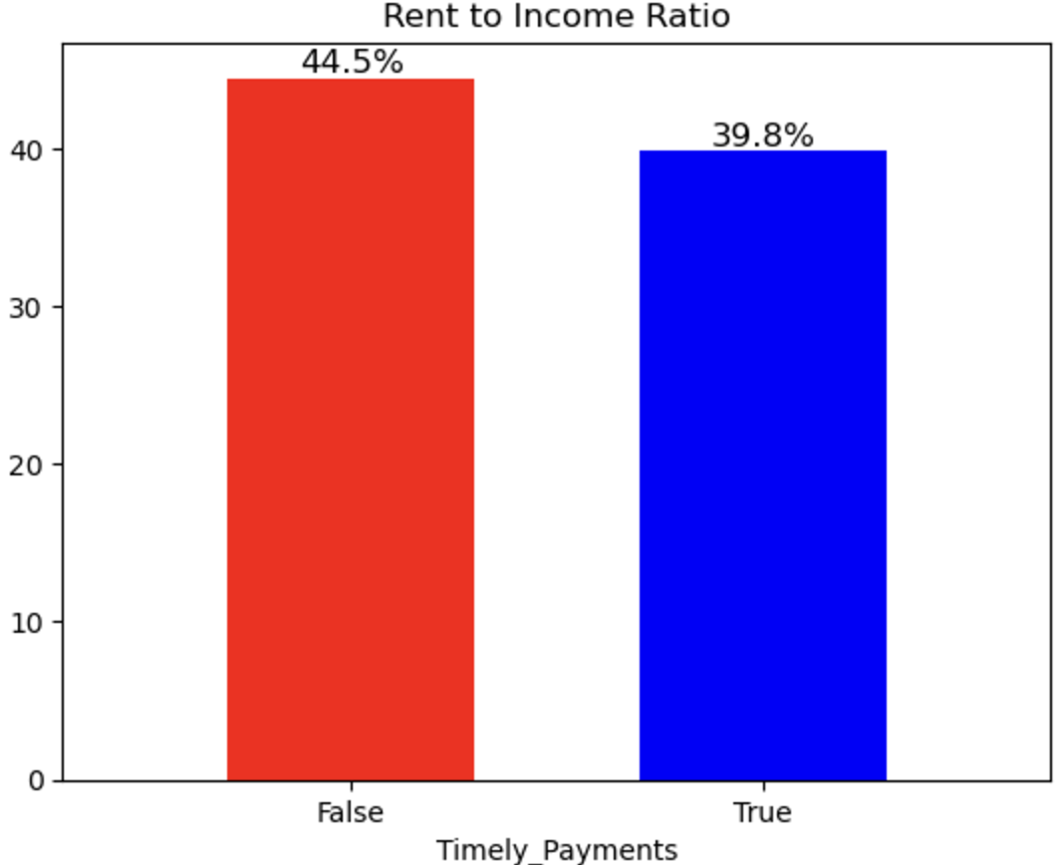
Data Exploration
The distribution of monthly installments is right-skewed, with the median for timely payments being lower than that for late payments.
The rent-to-income ratio is a strong indicator for distinguishing between timely and late payments, as it is lower for those who make timely payments.
The dataset is imbalanced, with only 15% classified as timely payments.

Slide 6
Data Processing
Feature Engineering
Extracted geographical census data, including unemployment rate, household income, and type of urban area, based on zip code.
Encoding and Embedding
Applied one-hot encoding to categorical features, such as employment type.
Used embeddings to extract key information, such as job loss, reduced income, and rent hikes, from text variable like financial impact.
Data Transformation
Missing data was imputed using a KNN imputer.

Slide 7

Modeling Approach
Model Selection
XGBoost Classifier.
Pros:
Accounts for interactions between variables
No scaling required
Robust to multicollinearity and outliers
Cons:
Requires more computational power compared to logistic regression
Less interpretable than logistic regression
Demands extensive hyperparameter tuning
Model Training
Split the dataset into training and testing sets using an 80:20 ratio.
Mitigated overfitting, especially given the small dataset, by tuning parameters such as learning rate, gamma, and regularization using Bayesian optimization.
Applied stratified k-fold cross-validation
Feature Selection
Selected 20 key variables, including credit score, rental payment history, rent-to-income ratio, employment type, loan tenure, EMI, household size, area unemployment rate, etc.
Target Variable
Timely Payments

Slide 8
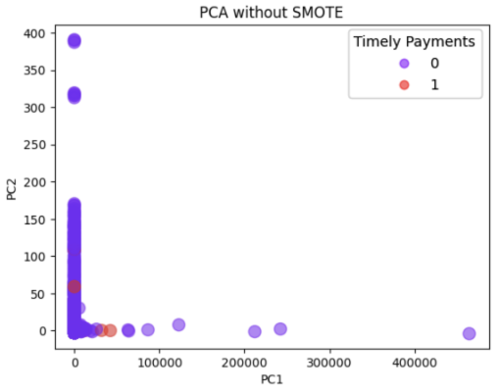
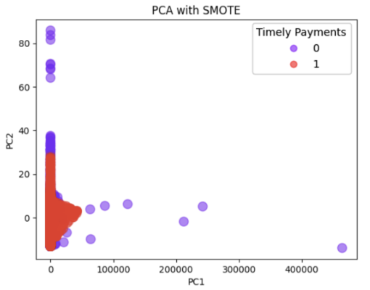
Dealing with Class Imbalance
Class Imbalance:
Original imbalance in transaction (0:3596, 1:587).
Solution:
Applied SMOTE to oversample minority class and improve decision boundary.
Balanced dataset post-SMOTE (3596 for both classes).

Slide 9
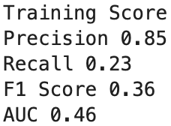
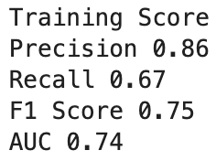
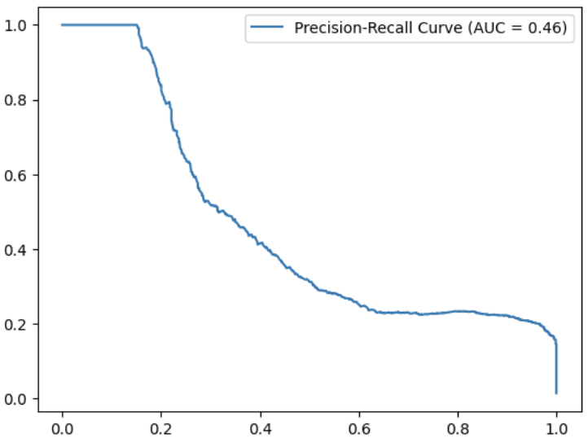
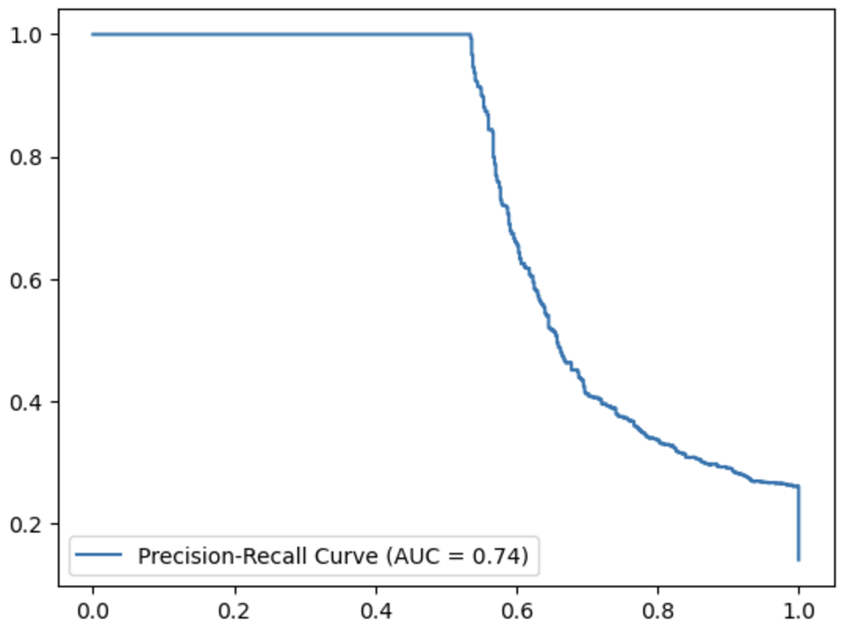
Evaluation on Train Data before and after SMOTE
Before Applying SMOTE
After Applying SMOTE
High precision, but low recall, indicating model over predicts negative (majority) class, due to model being undertrained for the positive class.
0.46 PR AUC indicating model unable to distinguish positive and negative class.
Precision and Recall are now higher.
0.74 PR AUC indicating model distinguishes positive and negative class well.

Slide 10
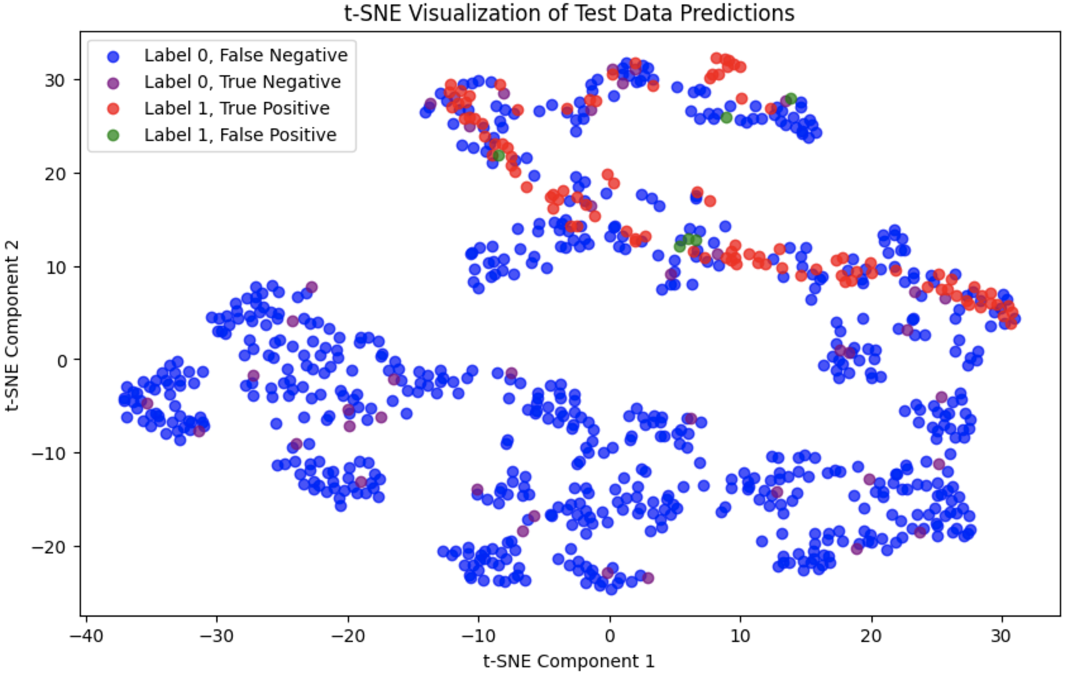
Model Evaluation on Test Data
Evaluation on test data
Achieved 0.72 on precision on test data.
Focus on precision, due to higher cost to act ; lower opportunity cost.
Visualization on test data predictions
True Positive and False Positive cluster together indicates that the model has identified a pattern in the feature space that it associates with the positive class, but it may be overgeneralizing or misclassifying some points.
Potential refinement
Introduce additional features to better separate classes.
Increase the decision threshold to minimize false positives (e.g., increasing precision at the cost of recall).

Slide 11
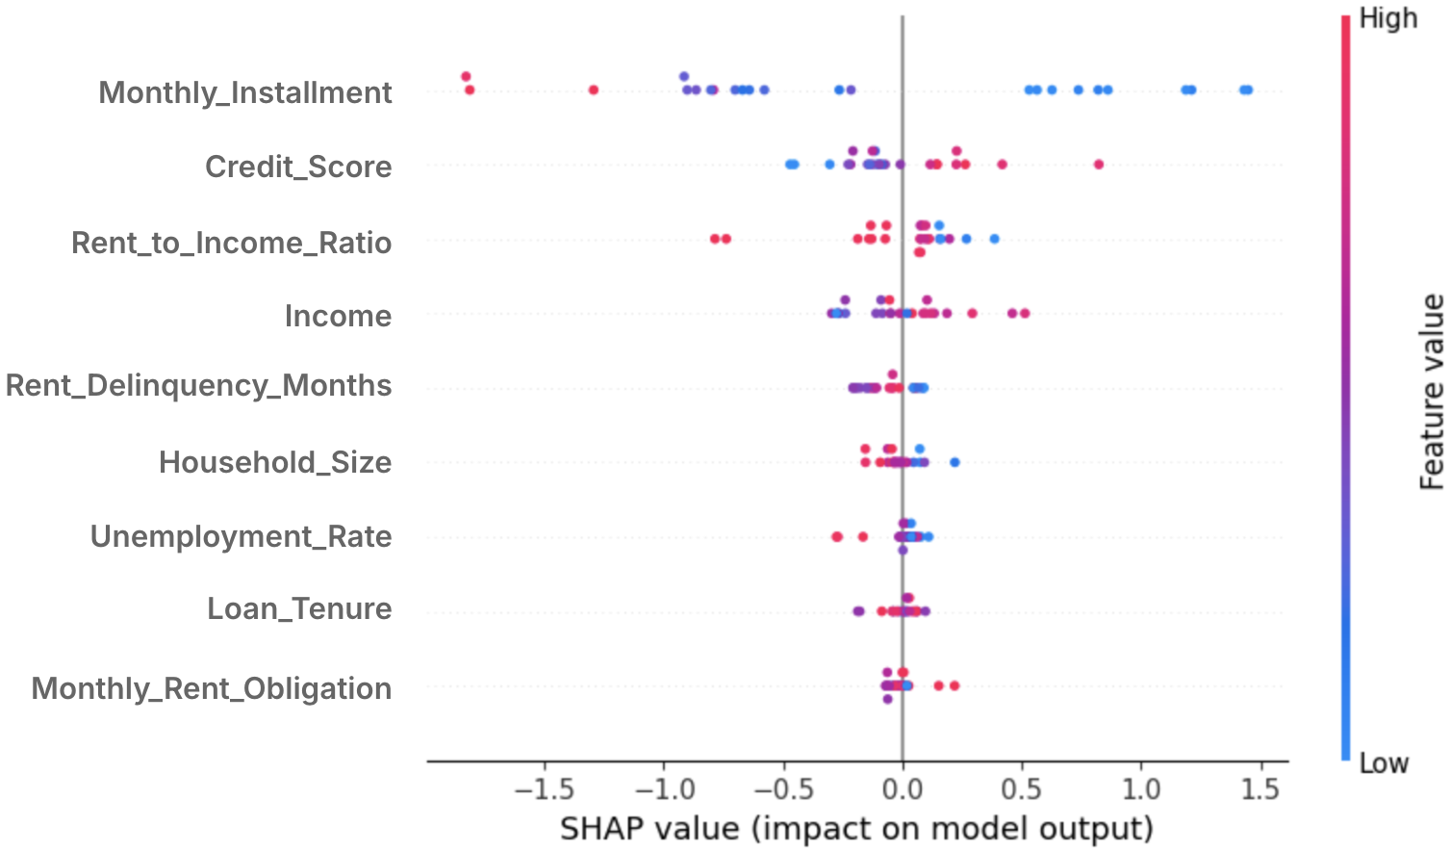
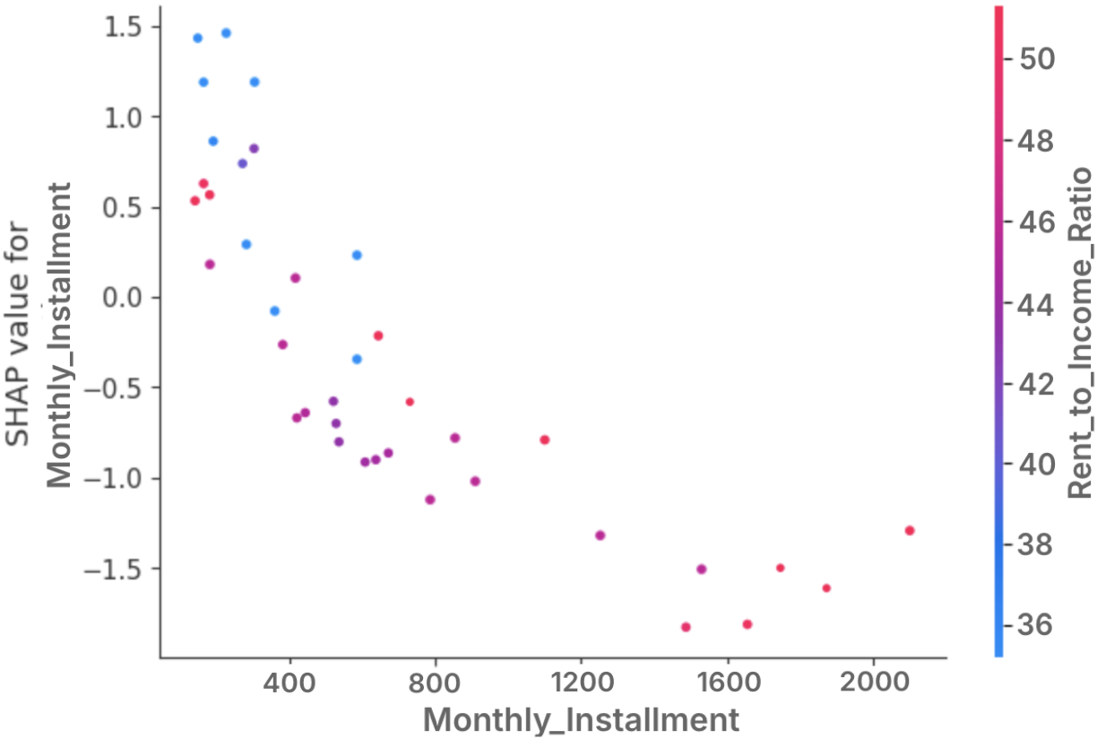
Interpretation with Shapley Values
Sharpley values explain how each features contributes to predictions.
Features are ranked by their impact, from high to low, with “monthly installment” being the most impactful feature, and its higher value decreases prediction.
The dependence plot show how “monthly installment” interacts with the “rent to income ratio”.

Slide 12
Conclusions and Limitations
Business impact:
Predictive modeling significantly enhances underwriting accuracy and supports automated, informed decision-making.
Ongoing improvements will further refine predictions and expand applicability.
Reduced charge off rate from 30% to 20%, recovering over $600,000 since model inception.
Limitations:
Timely payments within the first 3 months do not guarantee full payments over the entire loan term. There is a need to redefine the target label.
Isolation of rent reporting and rent relief databases results in data record loss during matching. Engineers are currently working on integrating the two systems to address this issue.
There is a lack of understanding regarding model biases.

