Slide 1

Propensity Model for Predicting User Conversion
Applications in Google Marketing Platform

Slide 2
Background & Objectives
Background:
Client attended a predictive analytics conference; interested in intra-session/real-time conversion modeling.
Provided raw data to build a propensity model and predict transaction likelihood.
Objectives:

Slide 3
Key Use Cases on Google Marketing Platform
Spend Optimization:
Goal: Target high-likelihood converters with increased bids, optimized email campaigns or targeted video ads.
Metric: Precision.
Budget Optimization:
- Goal: Prioritize budget toward high-likelihood users.
- Metric: Recall.
Hybrid Approach:
- Goal: Target high-likelihood users and retarget non-converters.
- Metric: Both precision and recall.

Slide 4
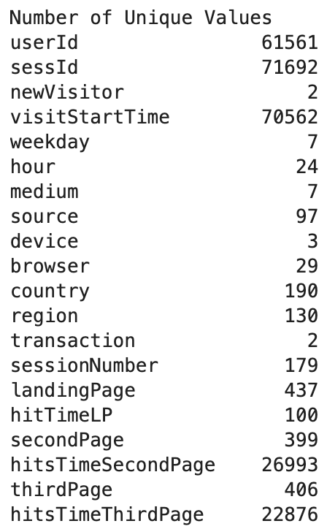
Data Overview
Dataset: Google Analytics Merchandise data (example data structure shown).
Core Variables: User behavior, temporal, session info, device, medium, landing page, transaction.
Data Size: 71,796 entries, 20 columns, 4 columns contain Null.

Slide 5
Exploratory Data Analysis (EDA)
User Insights:
- Unique users, sessions, media, devices, sources.
Conversion Trends:
- Distribution of media types and devices.
- Source and medium with highest user volumes.
Observations:
- Initial conversion rates and traffic segmentation.

Slide 6
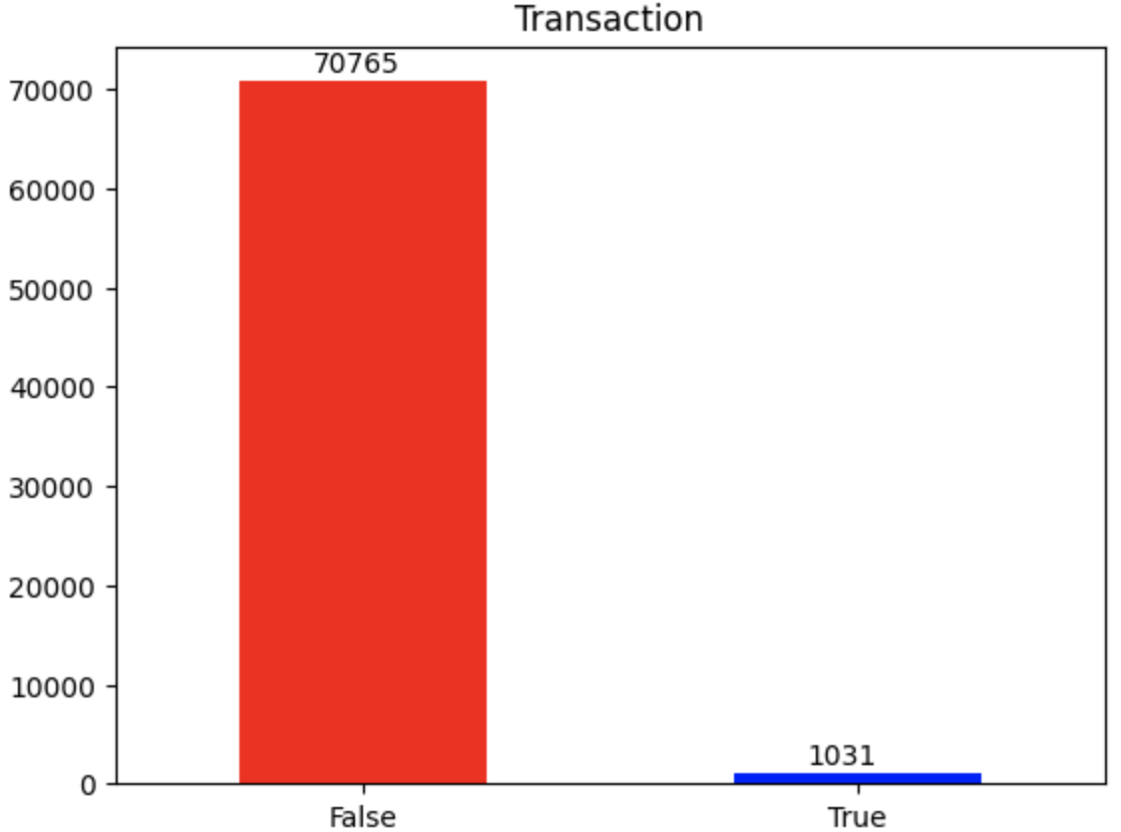
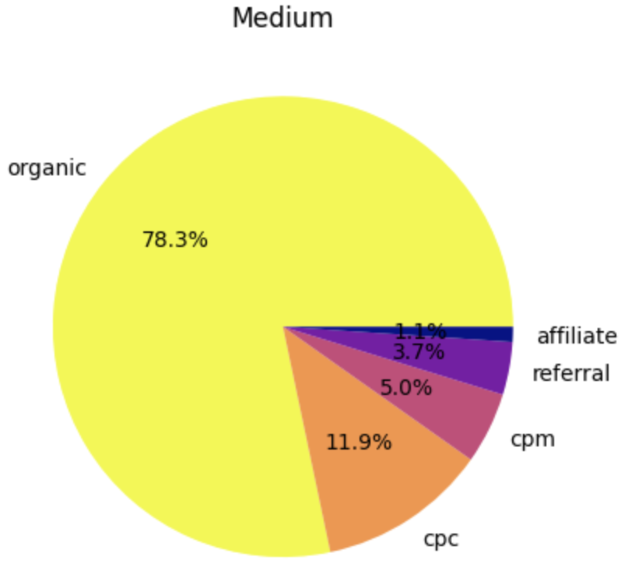
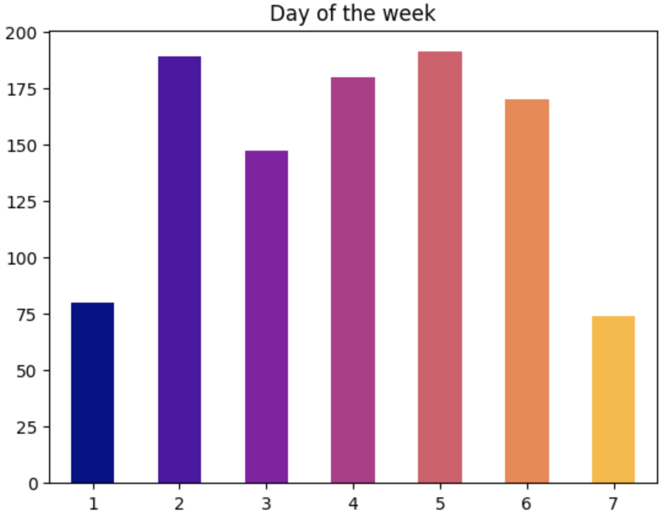
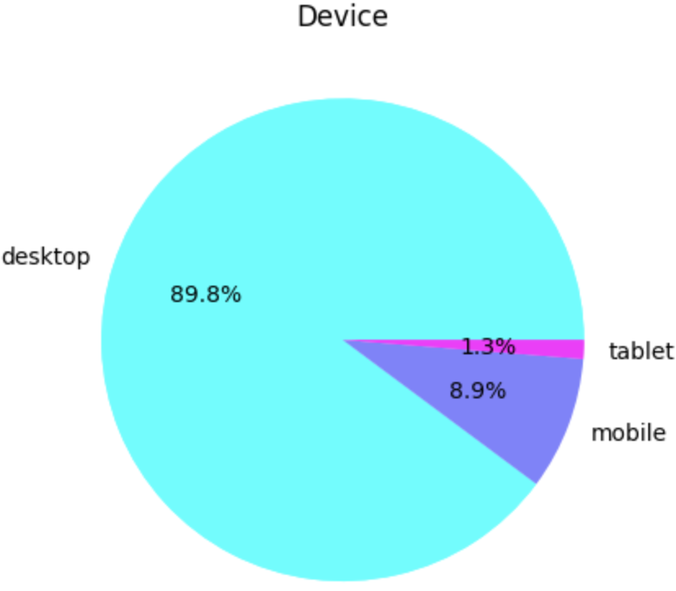
Exploratory Data Analysis (EDA)
Highly imbalanced dataset with <2% transactions.
Business likely to acquire customers via organic.
Most transactions happened during weekday.
Almost 90% of transactions made using desktop.

Slide 7
Data Preprocessing
Handling Missing and Low-Frequency Data:
Leave missing values intact
Group low-frequency values
Feature Engineering:
Categorized landing pages and created binary indicators for visit sequences (second and third).
Encoding:
One-hot encoding for categorical features with <10 levels.
Target encoding for categorical features with >10 levels.

Slide 8
Modeling Approach
Model Selection:
Random Forest Classifier
Feature Selection:
20 key variables, including user type, temporal, session details, source, browser, landing pages, etc.
Target Variable:
Transaction (conversion)

Slide 9
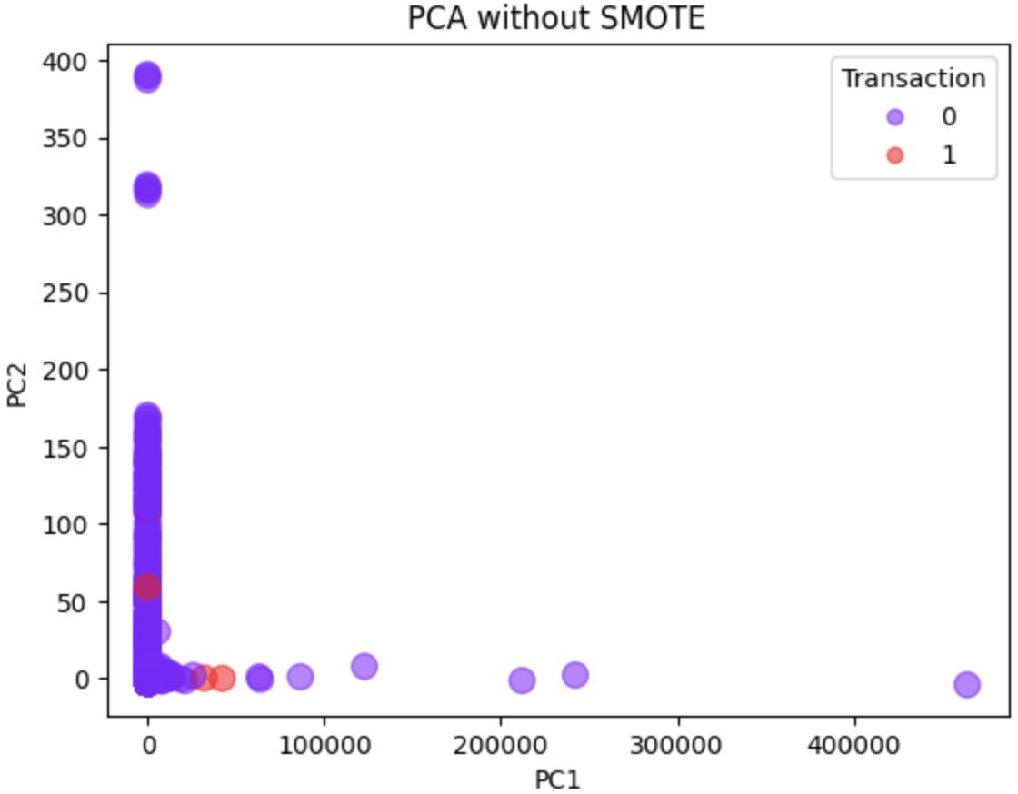
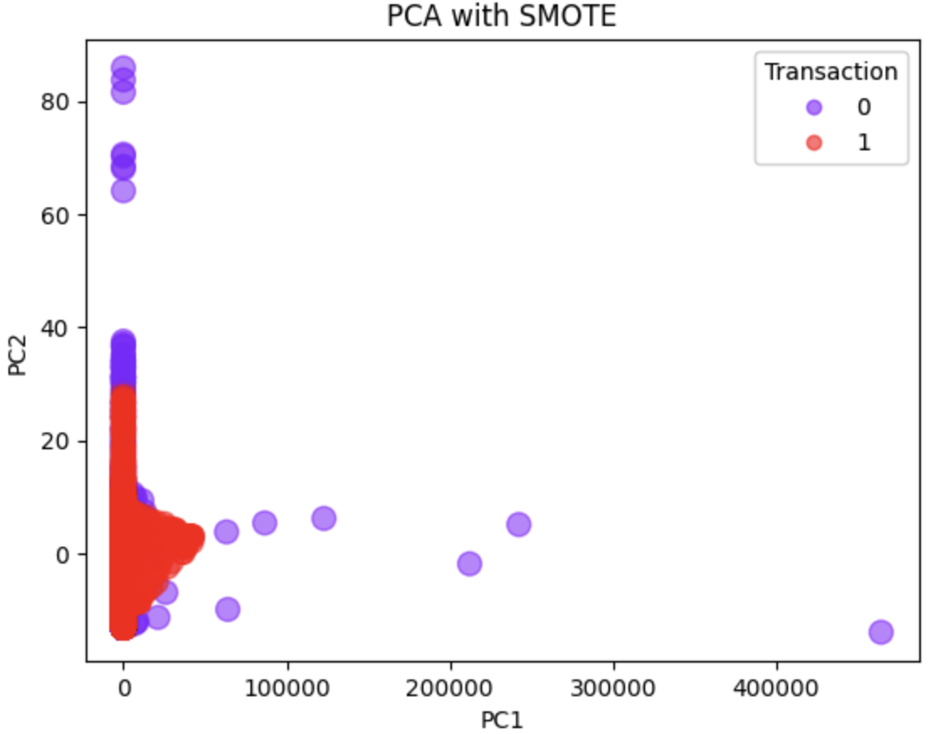
Dealing with Class Imbalance
Class Imbalance:
Original imbalance in transaction (0:49528, 1:729).
Solution:
Applied SMOTE to resample minority class.
Balanced dataset post-SMOTE (49528 for both classes).

Slide 10
Model Training and Results
Training Model:
Random Forest on resampled data.
Evaluation on Training Set:
Precision, Recall, F1 Score, AUC.
Observations:
Model precision and recall scores indicating potential for both targeted spend and broader budget strategies.

Slide 11
Model Evaluation on Test Data
Evaluation Metrics:
- Test Precision, Recall, F1 Score, and AUC.
Precision-Recall Tradeoff:
- Model performance for precise targeting vs. broader recall.
- Precision-Recall Curve and AUC interpretation.

Slide 12
Conclusion & Next Steps
Summary:
Training score is moderate, with higher recall but lower precision.
Model over predicts minority class.
Potential Next Steps:
Resampling and apply class weights
Additional feature engineering, such as mapping countries to continents/GDP, categorizing regions by income level, etc.
Implement K-fold cross validations and fine-tune model for further accuracy.

