Slide 1
Para-virtualized XV6 on Composite OS
Yitian Huang
Xinhua Fan

Slide 2
Goal
Make XV6 run on Composite OS through para-virtualization
Composite Component-based OS is a research OS
XV6 is a simple Unix-like teaching OS developed by MIT (https://pdos.csail.mit.edu/6.828/2016/xv6.html)
-2-

Slide 3
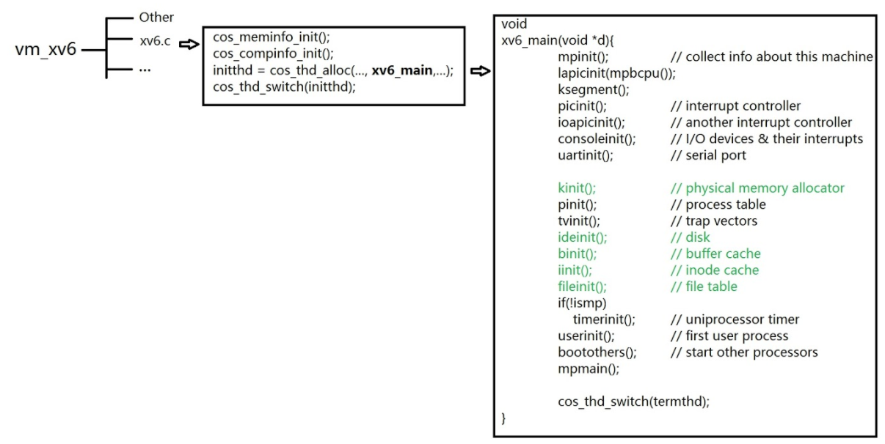
Structure of Code
-3-
Notes:
Create a component in file xv6.c
Initialize it by calling cos_thd_switch()
Jump to xv6_main(), the structure of xv6_main()

Slide 4
Conventions
Remain variable, function, and file names the same as xv6 source code, only modify them when necessary
Prefer using functions from xv6 rather than C built-in library functions
Changing memset(...) to xv6_memset(…)
Marking modified code by using multi-line comment symbol
-4-

Slide 5
Done List
Memory Allocator
Virtual File System
-5-

Slide 6
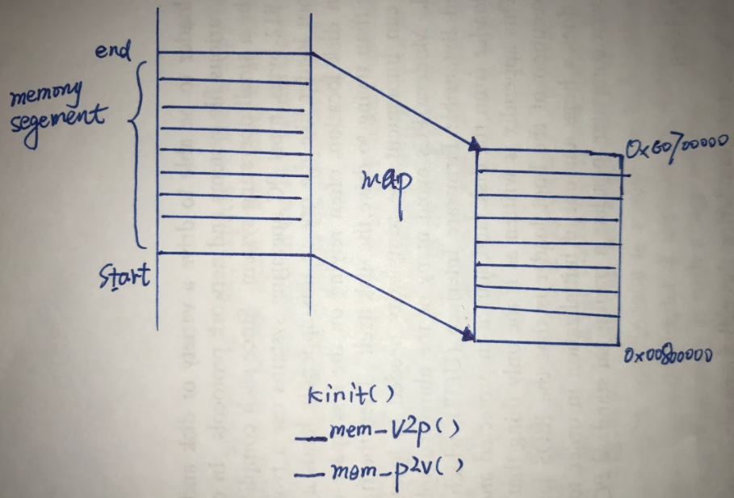
Memory Allocator
-6-
Notes:
We allocate a segment of memory from composite OS
We consider this segment of memory as the VM's physical address space with 1MB
We didn’t implement the exact mapping functions here, instead, we simply provide two functions named __mem_v2p and __mem_v2p in kalloc.c to demonstrate the transformation idea.

Slide 7
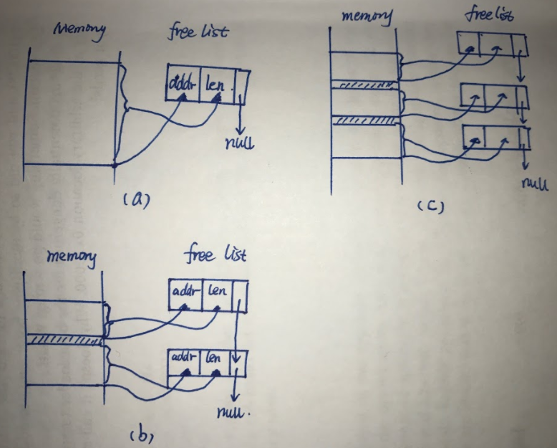
Memory Allocator - freelist
-7-
Notes:
Xv6 uses a sorted linked list called freelist to manage its memory space. The freelist shows how much memory are currently free, each node in freelist has three elements - address, length, and next pointer.
For example, in figure (a), the freelist only has one single node as the free memory space is continuous,
in figure (b), figure (c), after one or two segments of memory are allocated, then the free list has two or three nodes to indicate the separate free memory space.
And when some of the allocated memory are freed, then the continuous free memory space will be combined and indicated by a single node as figure (a)
The implementation of freelist can be found in kalloc() and kfree()

Slide 8
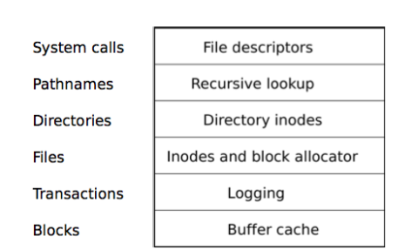
Layers of XV6 File System
-8-
Notes:
Xv6 has a 6 layers of file systems.

Slide 9
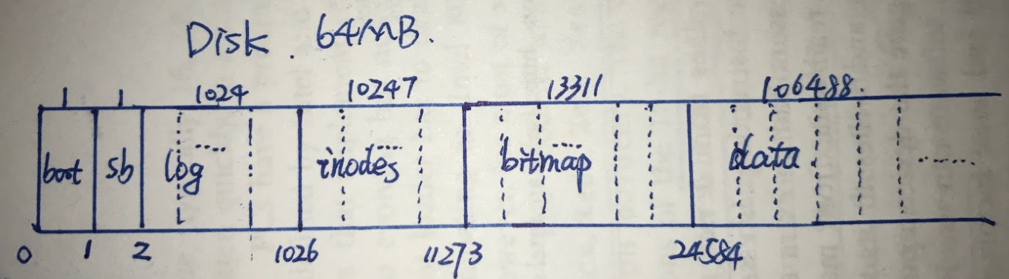
Implementation - Disk
Using a char array to represent a virtual disk with size of 64MB
diskread() and diskwrite() in disk.c
-9-
Notes:
Xv6 divides disk into several blocks. The first block is remained for bootloader, the second block is super block, it includes file systems’ metadata information.
the coming 1024 block are used for the logging. for the inodes block, it can have more than one inodes.
The virtual disk is constructed by sectors (or blocks), each sector is 512KB, in the figure, numbers at top represent the number of blocks that the corresponding section has, and numbers at bottom represent the start block of each part.

Slide 10
Implementation – Buffer Cache
Disk cache
LRU as its replacement policy
Rewrite iderw() to make it work with our virtual disk
-10-

Slide 11
Implementation – Inode, Directory and Pathname
Inode – on-disk inodes and in-memory inodes
On-disk inodes (physical data stored on the disk)
In-memory inodes (served as a “cache” to the on-disk inodes)
It could represent a file, a directory, or a special device
Directory – construct the tree structure of logical file system
Pathname – mainly used to resolve paths, like “/root/sys/init.conf”
-11-

Slide 12
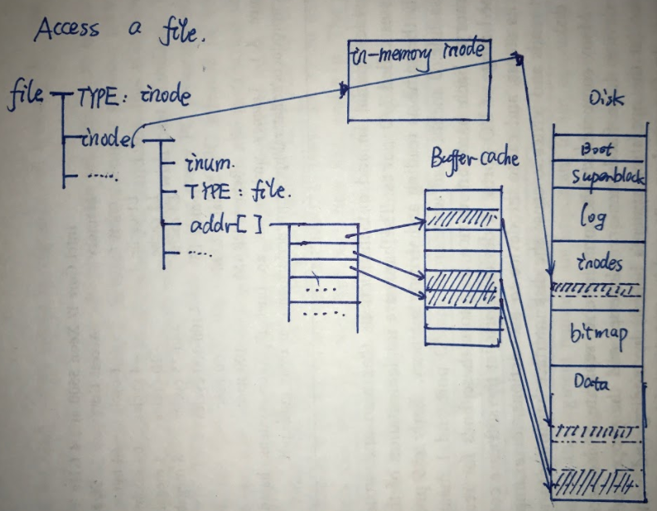
Implementation – File Descriptor
-12-
Notes:
A file can either comes from a pipe, or an inode, we only discuss inode here.

Slide 13
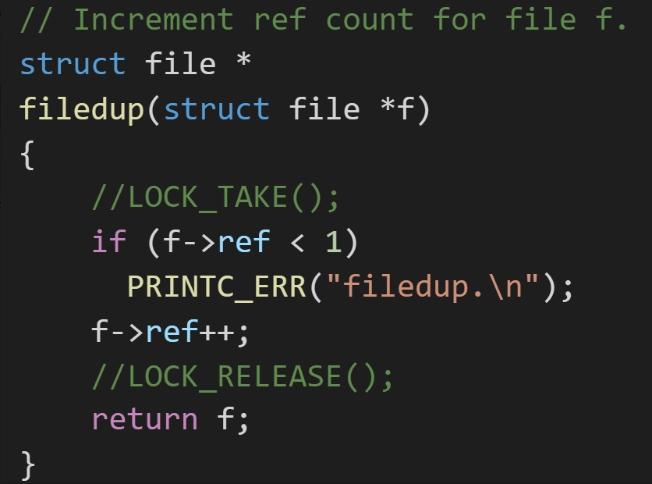
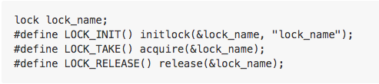
Issue
Not complete implement lock
Comment all code related to lock
Understand the implement logic but not code yet
-13-

Slide 14
Todo List
(short term) Modify and implement lock and pipe
Re-read source codes of XV6
(long term) Modify and implement the rest of xv6
-14-

Slide 15




Thank You !
https://github.com/wfgydbu/paravirtualization
-15-

Slide 16

Thank You !
-16-

