Slide 1
Project Benson Women in Tech Gala Recruitment Analysis: Kristin, Wen Fung, Torin

Slide 2
Goal: Recruit people to women in tech gala
Specifically: Choose the best stations to collect emails at
Our approach:
Define target audience
Identify stations used by target audience
Choose highest traffic stations of interest in early summer
Notes:
Data time frame = April 28 – June 15 2018

Slide 3
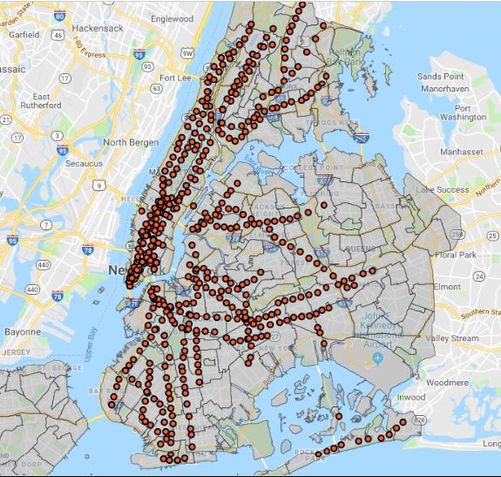
Define target audience
Women in technology fields
Women working in other fields
Other genders in technology fields
Students
NTA demographic data
NTA demographic data
Map data
Maps titled “NTA Map” & “Subway Stations” are available on NYC Open Data

Slide 4
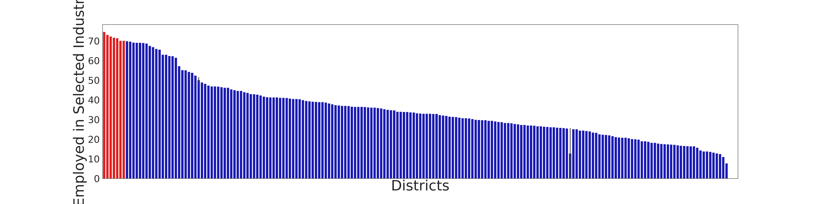
Filter – neighborhoods with most tech workers
% of people working in business, management,
science, and art – by neighborhood
* Neighborhood tabulation area data was collected in 2012 by the City of New York and available at: https://data.cityofnewyork.us/City-Government/Demographics-and-profiles-at-the-Neighborhood-Tabu/hyuz-tij8

Slide 5
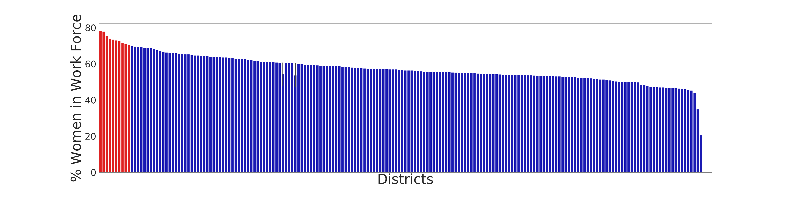
Filter – neighborhoods with most employed women
* Neighborhood tabulation area data was collected in 2012 by the City of New York and available at: https://data.cityofnewyork.us/City-Government/Demographics-and-profiles-at-the-Neighborhood-Tabu/hyuz-tij8

Slide 6
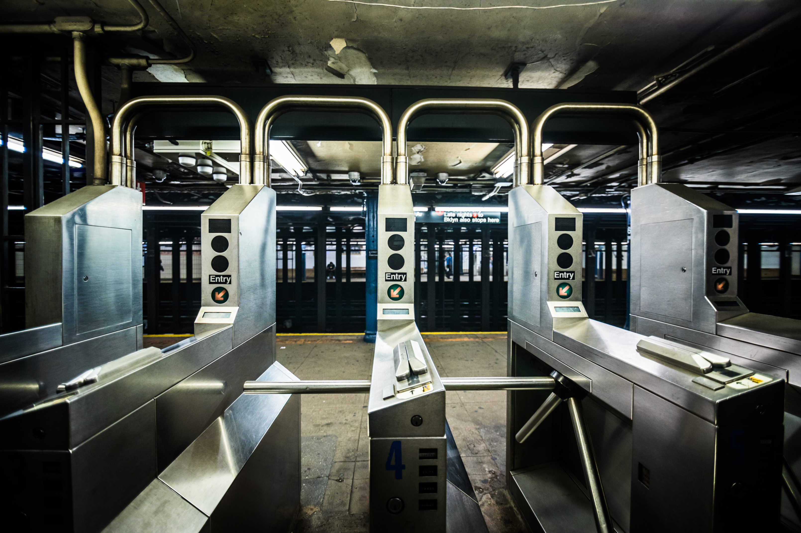
Data Set
MTA Turnstile Data
Tracks traffic at New York train stations.
Tracks by entries and exits per turnstile machine.
Contains station information to identify stations.
Notes:
MTA Turnstile Data – MTA turnstile data from the MTA site, summing MTA traffic per week, April 28 – June 15 2018
Demographic Data -

Slide 7
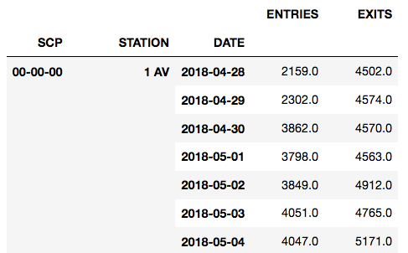
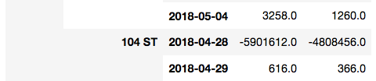
Challenges – Data Manipulation
Poorly Documented
Many Outliers
Inconsistent
Connecting to other data sets
Notes:
Poorly Documented
- Turnstiles are the focus but it wasn’t clear what a turnstile is
Many Outliers
- Results in the billions and millions within a 4 hour period
Inconsistent
Different 4 hour tabulation intervals for each turnstile

Slide 8
Solutions
Identify outliers and assess/eliminate
Find relevant station and turnstile markers
Design algorithm to properly sum traffic by markers
Merge data sets by marker
Notes:
Cross Referencing

Slide 9
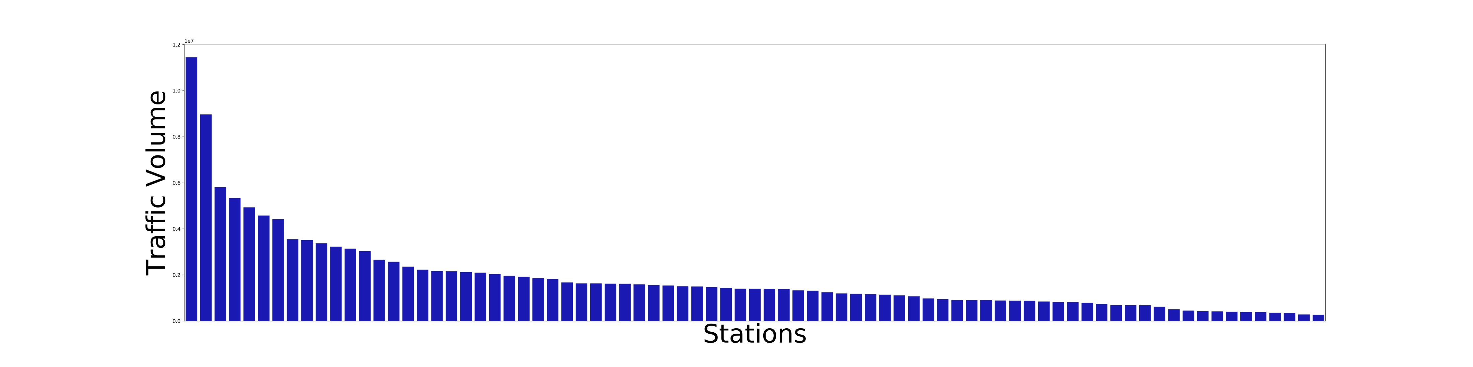
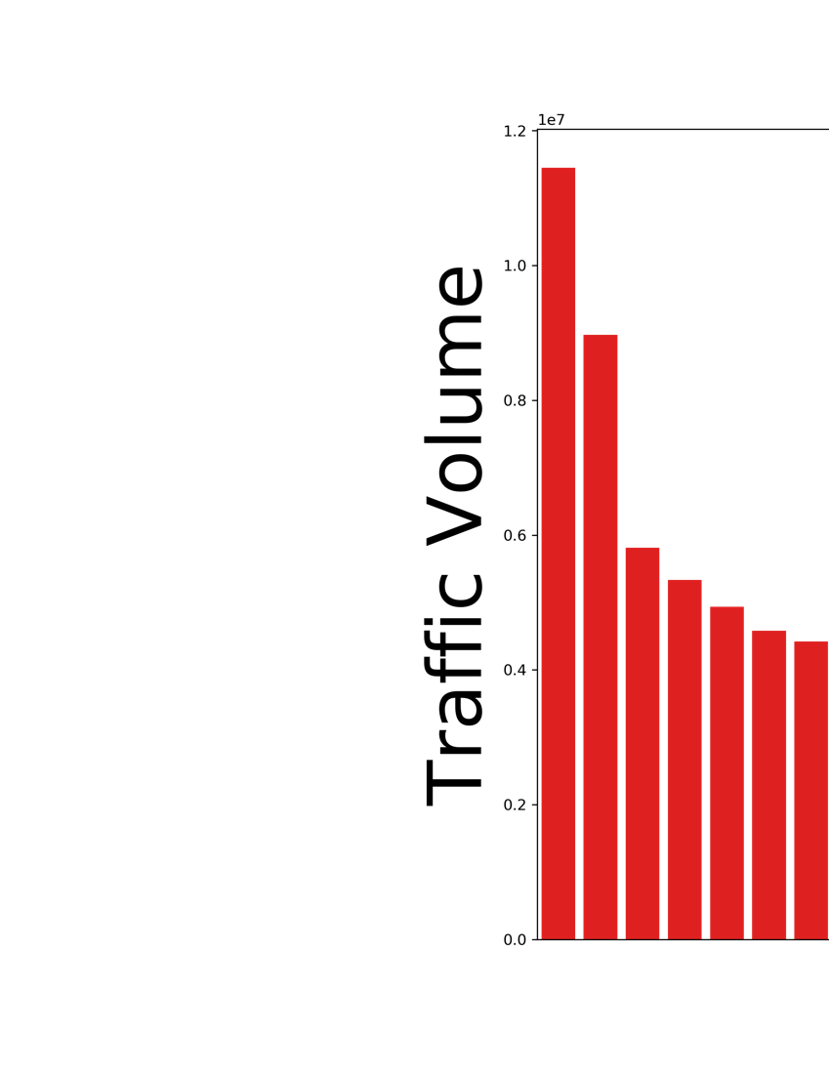
Which stations (of our filtered stations) have the most traffic?

Slide 10
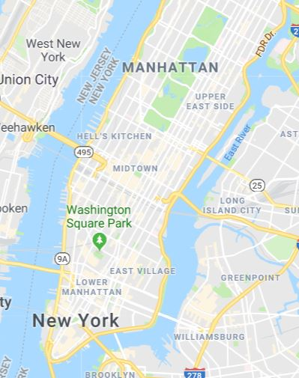
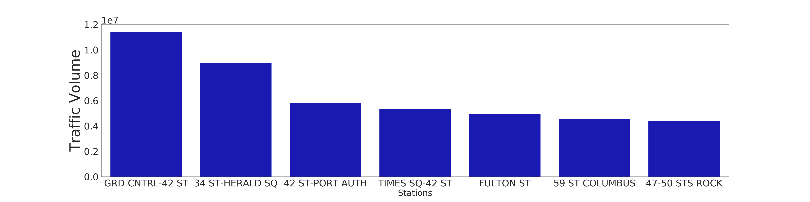
Recommendations
cv
cv
cv
GRAND CENTRAL – 42nd ST
34th St. – Herald Square
42nd St. – Port Authority
Times Square – 42nd St.
Fulton St.
59th St. Columbus
47-50 Streets - Rockefeller Center Subway Station

Slide 11
Future Work
Find algorithm to determine train stations in district
Explore other demographic data for potential attendees
Optimize recommendations for time of day
Use feedback collected through this study to inform future work

Slide 12





Tools
Python
Pandas
Jupyter
Excel
Google
Stack Overflow
Notes:
Python = programming language
Pandas, Jupyter , Excel = data manipulation and exploration
Google, Stack Overflow = Problem Solving

Slide 13
Appendix

Slide 14
Algorithm
Zero out values over a certain threshold (10k < 1.5%)
Groupby SCP and STATION for individual turnstiles
pd.df.shift() function for total traffic
Groupby STATION and LINENAME for unique stations
Notes:
Cross Referencing

Slide 15
Data Cleaning: whitespace
Index(['C/A', 'UNIT', 'SCP', 'STATION', 'LINENAME', 'DIVISION', 'DATE', 'TIME',
'DESC', 'ENTRIES',
'EXITS '],
dtype='object')
Remove whitespace
Index(['C/A', 'UNIT', 'SCP', 'STATION', 'LINENAME', 'DIVISION', 'DATE', 'TIME',
'DESC', 'ENTRIES', 'EXITS'],
dtype='object')

Slide 16
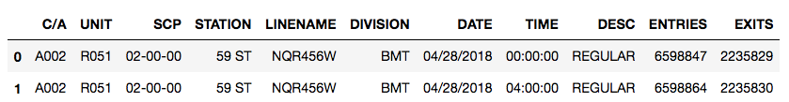
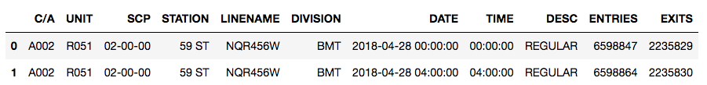
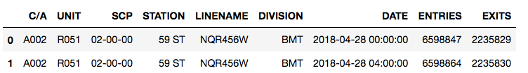
Data Cleaning: reformatting and irrelevant labels
Reformatting DATE
Drop TIME and DESC

Slide 17
Data Exploration: Errors
...

Slide 18
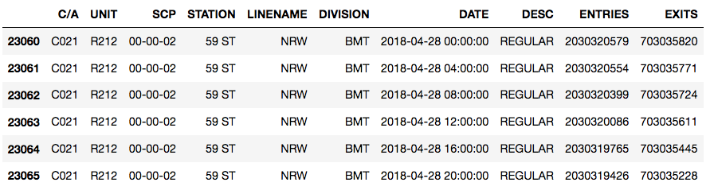
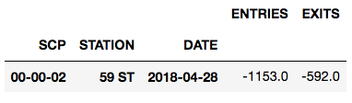
Data Exploration: Investigate

Slide 19
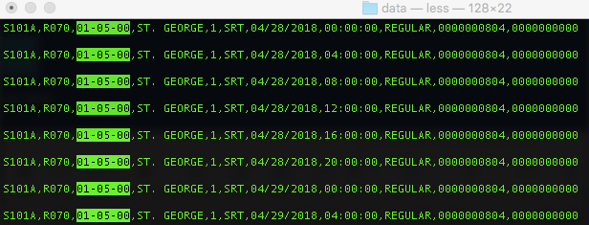
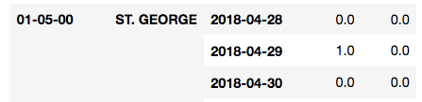
Data Exploration: zeros

Slide 20
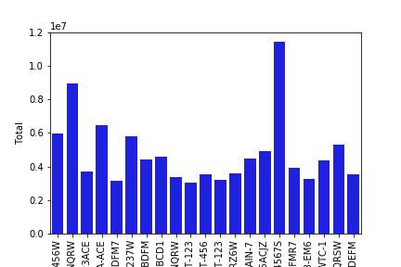
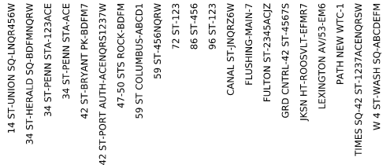
Total
Stations
( > 3mil )

