Slide 1
I’m not paying for HTTP.
Breaking out of closed source.
Notes:
I’m Pretty.

Slide 2
<table id=‘table’>Contents</table>
Who Am I
HYENA, and what we do.
Hardware Interaction & Industrial Automation
Not your normal Hardware (PLC vs PC)
Realtime vs REALtime
PreemptRT
Why are we using PLCs
Disclaimer
The good, the bad and the ugly
Pay to Play (IO)
Pay to Play (Technology)
The Community Problem
Licenses, Licenses, Licenses.

Slide 3
<table id=‘contents_2’>Contents</table>
The $75 TCP request that never was.
Scaling Problems.
Walled Garden.
Realtime vs Non-Realtime requirements.
Proposing the Split.
Getting Management on board.
Making a Compromise.
MQTT to our favorite cloud provider (4.2.0.69:42069)
Solved? Not quite.
Safety and Security.
Targeting where you make changes.
Results.

Slide 4
<table id =‘table_iii>Contents</table>
But we still have a problem
PLCs built for the modern era.
Why are there no open source versions of this?
Proposed Solutions.

Slide 5
Why are we here
Who is charging you for HTTP? Just use Python AIOHTTP?
Yea.. well. About that.

Slide 6
Who? Me?
Warren Fletcher
(Reformed) Web Scale Programmer ~ 10 years
Bsc. in Electrical Engineering.
Been programming since I was small (well, smaller)
Staff Systems Engineer at Hydrogen Energy Applications

Slide 7
HYENA
We make diesel-generator alternatives.
Cleaner, Quieter, Smarter.
Based in Muizenberg, Cape Town, South Africa

Slide 8
HYENA
<INSERT PHOTO OF HYENA STAFF>

Slide 9
HYENA
We convert the hydrogen in LPG to electricity via a fuel cell.
Transitionary technology to the Green Hydrogen Economy
Build units in the 5 – 20 Kw range.

Slide 10
HYENA
We are a ‘hardtech’ spinout from UCT.
It hurts. It itches. It burns.

Slide 11
Industrial Automation
Computers controlling Hardware
Read Input -> Process -> Write Output
Everything is Async and Cyclical
Every cycle needs to start exactly ‘on time’

Slide 12
Industrial Automation
This is an entire industry (268 Billion USD 2025)
Started in the 1980s, and well, stayed there.
Think…. Huge Projects.

Slide 13
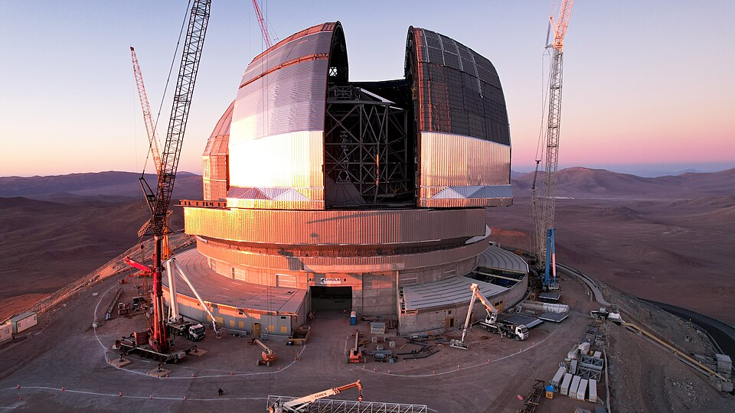
Like Telescopes

Slide 14

Like Dams

Slide 15
Like Generators
<INSERT PHOTO OF SEXY POWERPOD>

Slide 16

Hardware Vendors
(Logos of many different kinds of vendors)

Slide 17
Care to Share (Your source)?
No.
Closed off.
Fragmented Community
Stuck in their own ways.

Slide 18
Conventions
…are convenient
…are restrictive
…enforce a norm (dictated by industry)

Slide 19
Disclaimer
I <3 our vendors.
This practice is pervasive.

Slide 20
The Good
Debugging in cycles is amazing

Slide 21
The Bad
Who even learns this stuff?

Slide 22
The Ugly
Windows Only (This is changing!)

Slide 23
The really Ugly
Black Box Development
‘Error:Error’
Perpetual BSOD Loop

Slide 24
Put a price tag on this.

Slide 25
Why this is… ok (sort of)
Hardware is… hard. This stuff has material costs.
When a project is in the Millions of USD. What’s the problem?
Honestly, paid software comes with a lot of social expectations that need to be enforced *

Slide 26
Insert Clippy telling you to fuck off.

Slide 27
Why this is… ok (sort of)
Hardware is… hard. This stuff has material costs.
When a project is in the Millions of USD. What’s the problem?
Honestly, paid software comes with a lot of social expectations that need to be enforced *
*Windows 11 excluded.

Slide 28
Licenses, Licenses, Licenses
... And this is where a line needs to be drawn.

Slide 29
Hotel California.
It’s comfy.
It’s convenient.
And the more time you spend here, the more it’s going to cost.
And a lot of these costs are hidden.

Slide 30
Walled Garden
This is why we have so little open-source.

Slide 31
What now?
I cannot, in good faith, continue.
But this is ‘the way it’s done’. Pay Up. Shut up.
* Insert German quote here.

Slide 32
We need a rewrite!
No you don’t*
You need to rewrite a part of this. But where?
*unless you’re windows 11

Slide 33
What do we rewrite?
We can’t put everything on commodity hardware.
We still need the Realtime control, But only for hardware IO

Slide 34
How to Justify this?
Use money. Managers speak that language.
CapEx cost per unit.
Reinventing (Many) wheels.
Skills Shortage.
Don’t block critical path.

Slide 35
Justification
We had a working, just very flimsy version.
Use this for hardware testing.
Skills Development.

Slide 36
Who is going to do this?
Us, of course.
Us, two juniors and a web-scale developer with zero experience

Slide 37
Hello Dunning-Kruger my old friend
I first estimated we could do this in about 3 months.
Our first working alternative took about 6… oops.

Slide 38
Picture of Dunning Kruger

