Slide 1
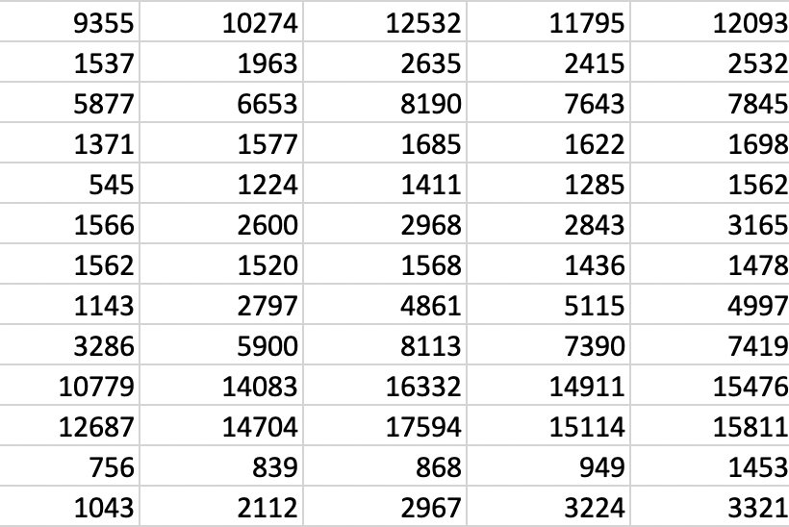
Learn how to analyse and visualise data using R
A free workshop for anyone who wants to learn practical data science skills
Raw data
Analysis
Visualisation
The workshop will cover:
Why we should use R for consistency and reproducibility
Installing and running R
Best workflow practices
Reading and manipulating real-world data
Performing exploratory visual analysis
Presenting you data in:
Charts
Maps
Web apps

