Slide 1
Does living far away from the capital city reduce per-worker income?
Let’s find out

Slide 2
Higher incomes closer to the city
Minutes drive to state’s capital city (log scale) and average income by region
Average income
Notes: Income by Statistical Area 3 (2011) used. Google Maps API used to calculate driving time to same-state capital city
Source: ABS

Slide 3
Why we use data
1. Have a question or idea you would like to explore
(or a point to prove to your housemates)
2. Find (or wrangle) and check relevant data
Check and re-check your data and data source
Check and re-check your data and data source
Check and re-check your data and data source
Maybe we can mutate our data to be more suitable?
Maybe we can generate better data?
3. Analyse your data: answer your question
4. Present data in a way that draws the reader to your message

Slide 4
1. Have a question or idea you would like to explore
Must be testable
Does income go down as people move further away from the city?
Should have sound theory behind it
Remoteness means fewer opportunities for work, which means income could be lower. People move to the city in search of higher pay. Etc.

Slide 5
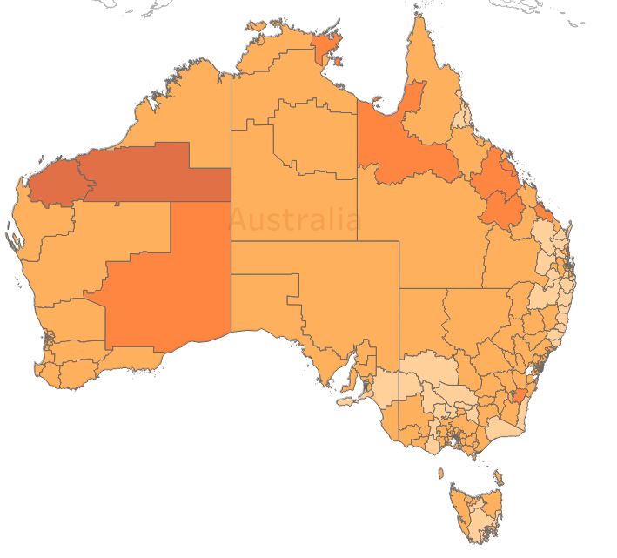
2a. Find relevant data
We are concerned with income per worker by location relative to the state’s capital city
Luckily, ABS is great for this kind of data.
Example:
Estimates of Personal Income for Small Areas, 2011-15
Contains 2011 data on incomes by SA3 area
Table 3 ESTIMATES OF PERSONAL INCOME, Total Income, 2010/2011, Statistical Area Level 3
Statistical Area 3 boundaries.
Source: ABS

Slide 6
2b. Documenting your work
“Hit by a bus” rule
Make sure your work is replicable
Make sure your work is easy to read/understand by others

Slide 7
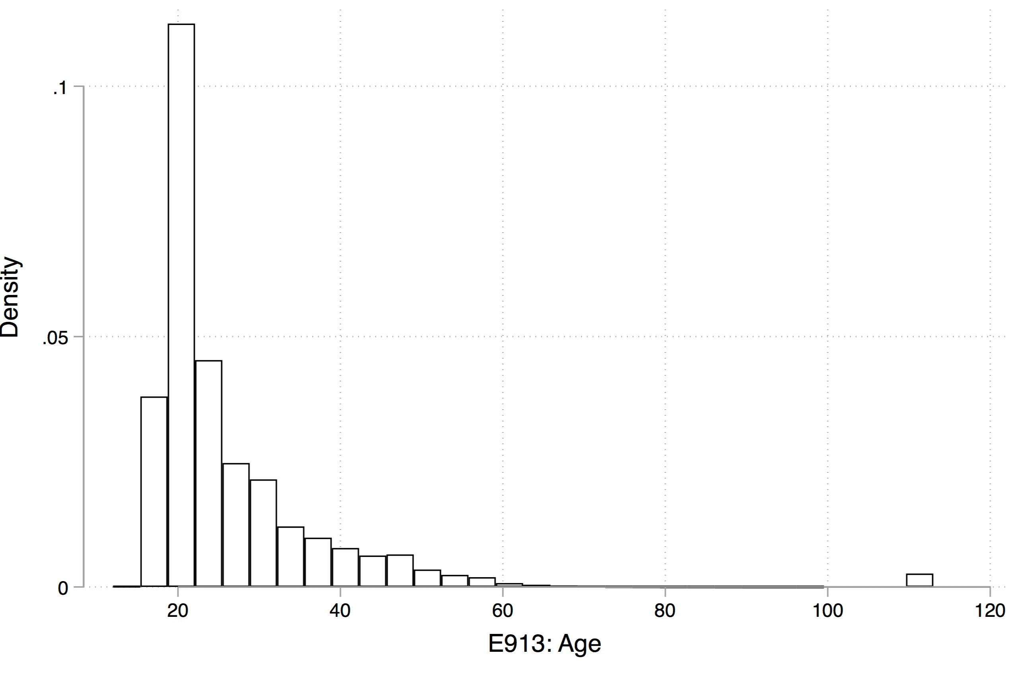
2c. Check data
(eg) Density of higher education enrolments 2005 – 2015 by age
Sensibility checks:
Does this look right?
Coding issues:
Why are there so many 114 year olds going to uni?
If a Department defaults 1901 for an unknown birth year, it could significantly affect your mean calculation.
What happens to inevitable missing values?
How else is data coded? What do the codes mean?
?

Slide 8
2c. Check data
Sensibility checks:
Does this look right?
If not, why? What could be going on?
Read explanatory notes/data appendices/etc
Data coding issues
Why are there so many 114 year olds going to uni?

Slide 9
2d. Generating more useful data
Income per person
Easy!
Google Maps API
Relatively easy, but you’ll need to back it up
Collecting new data
Difficult, and takes a lot of work,
but nice if you can do it

Slide 10
2e. Check data again
Routinely check your dataset

Slide 11
3. Analyse your data
Simple or complex
Defensible
Reasoned
Annotated
Documented
etc.

Slide 12
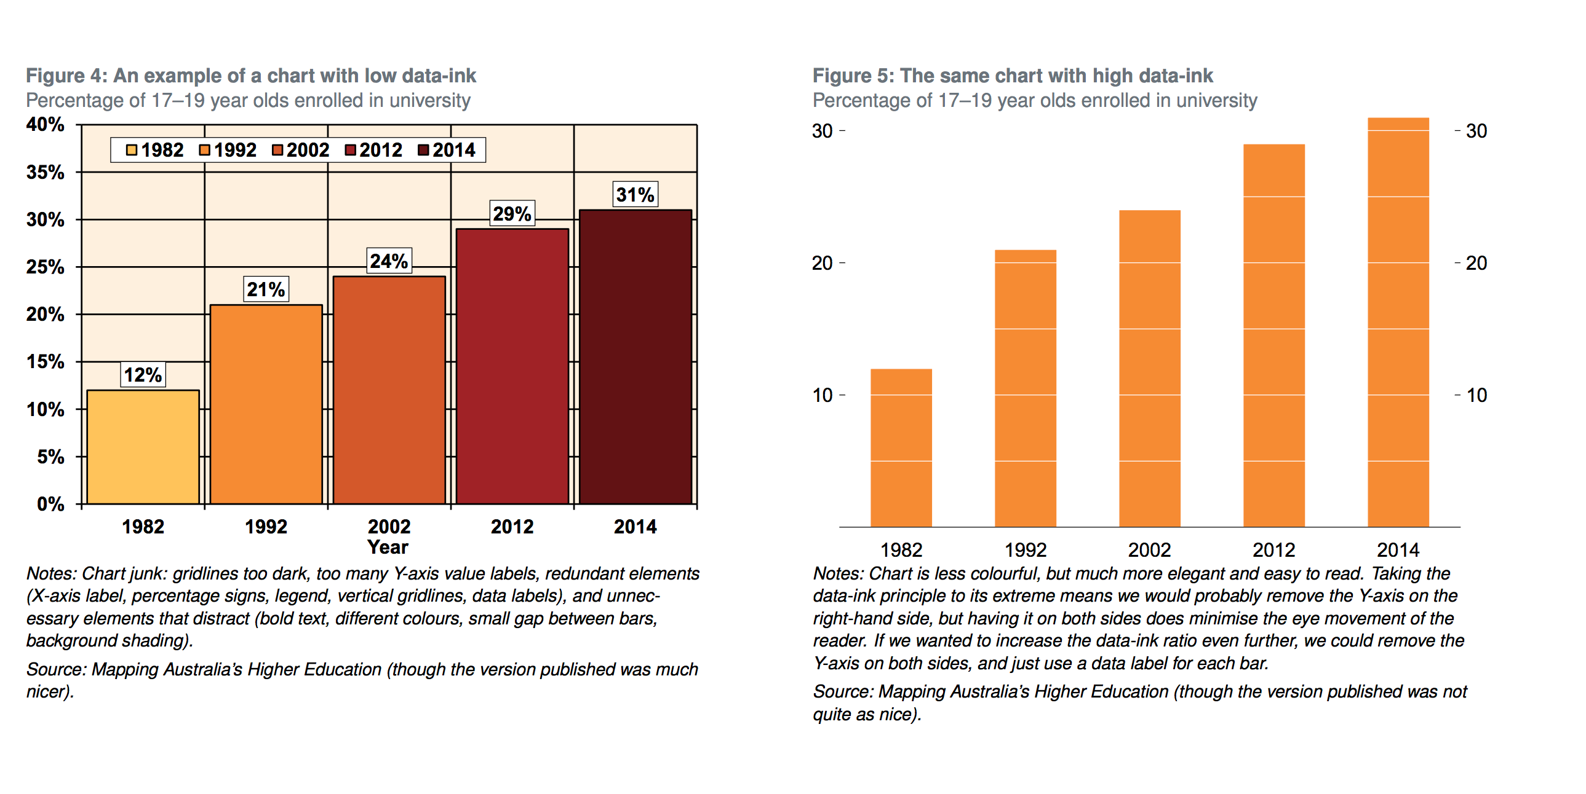
4. Present your analysis
“Make the complex simple, and the simple engaging”
Best to do this visually or verbally (depending on the audience)
ie not in a large table of regression results
Make your charts clear and engaging.

Slide 13
Extra resources
Attached to this class’ documentation are:
Grattan chart templates (includes examples)
Chart guidebook
CPI calculator
Writing Style Guide (not at all data-related, but an enjoyable read)

Slide 14
Introduction to Excel concepts

Slide 15
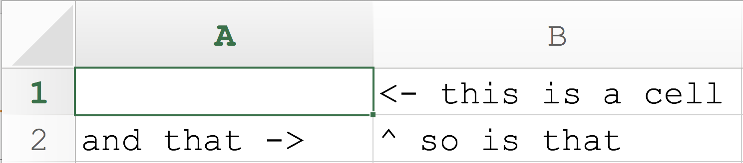
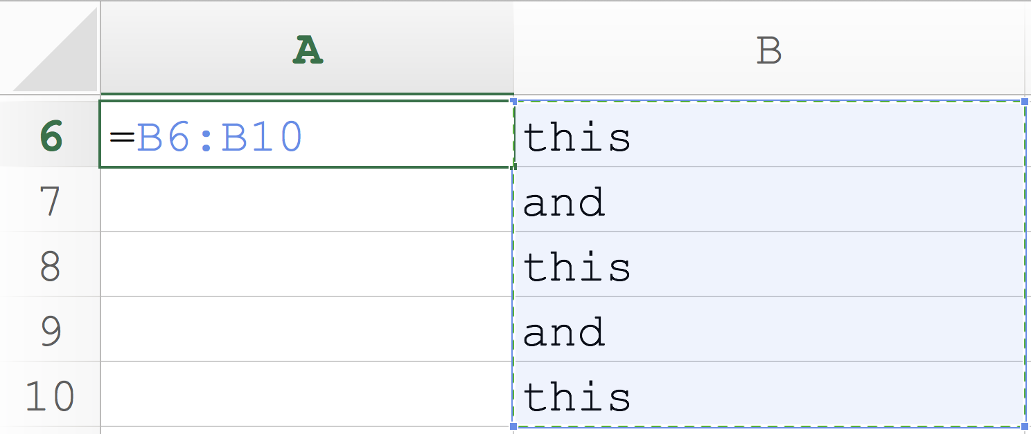
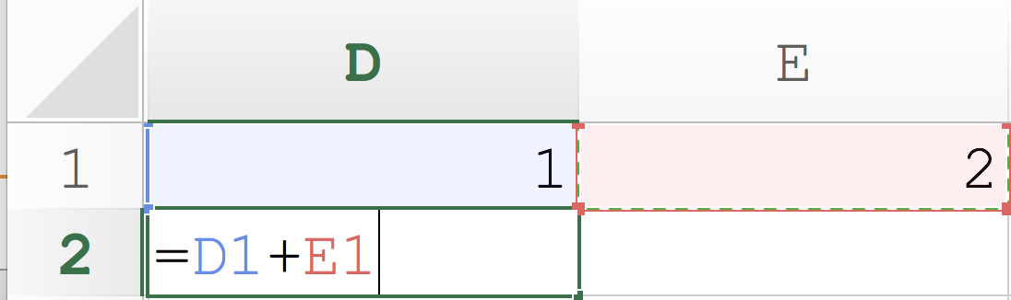
What is Excel?
What is a cell? What is a cell range?
How can we use ‘cells’?
Store data: strings [text], numbers, dates
Cells can talk to other cells

Slide 16
What is a function?
A function takes inputs (aka arguments) and turns them into outputs.
James listening to numbers being yelled out and summing them in his head and returning an answer.
In Excel, we could write:
=sum(A1:A5)
The function is sum, that takes the arguments A1:A5
and will return the sum of all numbers in the range.

Slide 17
What can functions do?
Anything you want. Limited only by the program (eg Excel, Stata) or language (eg R, Python) you are using, and by what other gorgeous people have written.
Some programs/languages are better for some things, worse for others.
Functions are usually the answer to the thought:
“ugh, this is taking ages I wish the computer could do this automatically”.

Slide 18
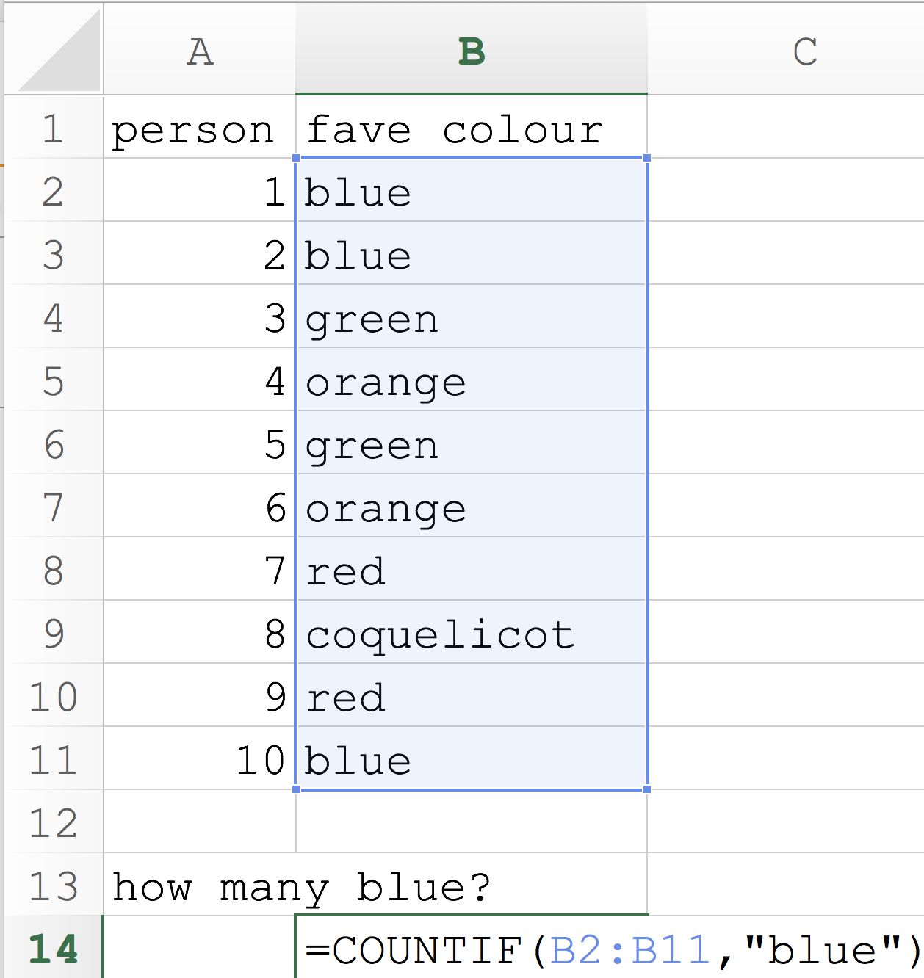
What can functions do? Excel:
How many blue?
range
function
arguments
“Look at all the cells and count them if they say the word “blue”

Slide 19
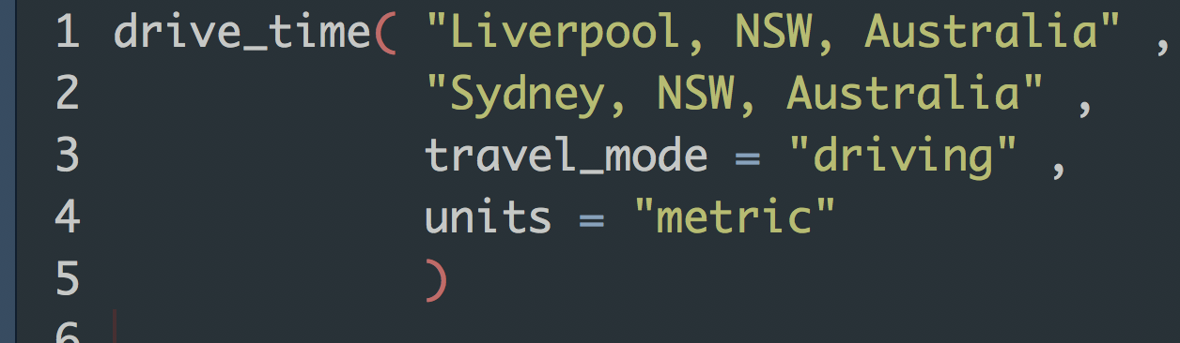
What can functions do? R:
function
arguments
“Look at Google Maps and find the time and distance in metrics units to drive between Liverpool, NSW, Australia and Sydney, NSW Australia.”

