Slide 1
Do people living outside of a capital city have lower incomes?
Let’s find out using ~data~

Slide 2
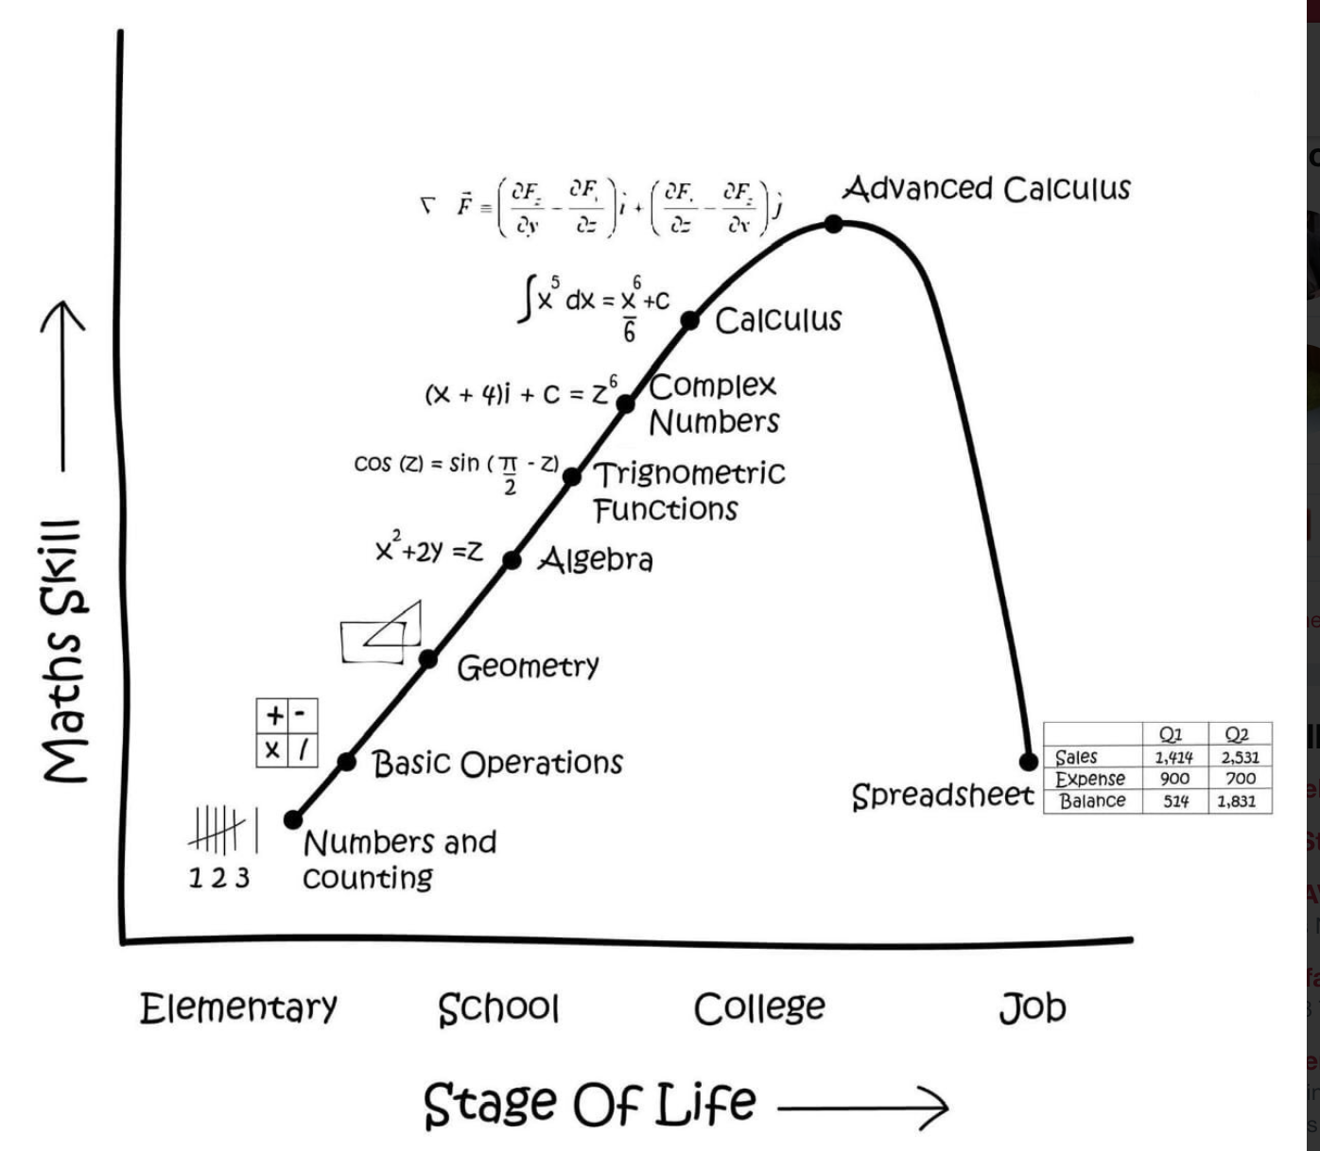
Data can feel scary, but most of what we need to do is mathematically simple
Us right now

Slide 3
Using data
1. Have a question or idea you would like to explore
(or a point to prove to your housemates)
2. Find, clean and check relevant data
Clean your data to make it usable
Document the steps you take
Check your data source: what does it actually contain?
Check and re-check your data
Check and re-check your data
Check and re-check your data
Can we mutate our data to be more suitable?
Can we generate more/better data?
3. Analyse your data and answer your question
4. Present your analysis in a way that draws the reader to your message

Slide 4
1. Have a question or idea you would like to explore
Must be testable
Does income go down as people move further away from the city?
Should have sound theory behind it
Remoteness means fewer opportunities for work, which means income could be lower.
People move to the city in search of higher pay.
Etc.

Slide 5
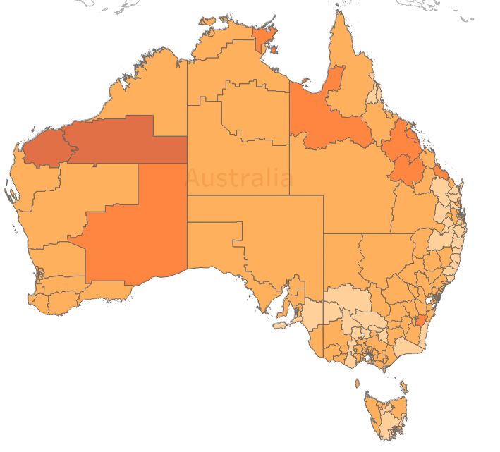
2a. Find relevant data
We are concerned with income per worker by location relative to the state’s capital city
Luckily, ABS is great for this kind of data.
For example, the dataset
Estimates of Personal Income for Small Areas, 2011-15
contains 2011 data on incomes by SA3 area
Table 3 ESTIMATES OF PERSONAL INCOME, Total Income, 2010/2011, Statistical Area Level 3
Statistical Area 3 boundaries
Source: ABS

Slide 6
2b. Documenting your work
“Hit by a bus” rule:
Make sure your work is replicable
Make sure your work is easy to read/understand by others
Using a ‘script-based’ program – like R, Python, Stata, etc – means the steps you have taken to go from original data to output is clear to you.
But notes explaining why you have done some things are important.
In Excel, you will need to take care in documenting your steps:
Make sure anyone can pick it up and know what you have done, and why you have done it.
Recreating a sequence of point-and-clicks is impossible for others, and near-impossible for you when you look at your work six-months later.

Slide 7

2c. Check the data source
What is the data you have?
Is the population restricted?
“Australian citizens over the age of 20”
Have observations been excluded?
“Areas with fewer than 10 people are ignored”
When is the data from?
Example
On Monday, NYT released a visually-beautiful report on inequality in China, called
“The American Dream Is Alive. In China.”
https://www.nytimes.com/interactive/2018/11/18/world/asia/china-social-mobility.html

Slide 8


2c. Check the data source Example
It featured a statistic that China’s GINI coefficient was about 0.27.
This figure was based on a report called Fair Progress? Economic Mobility across Generations around the World:
But this figure was for the previous generation; it was a statistic from the 1980s.
After being called out on Twitter, the NYT changed their graphic.
See full thread there. Very entertaining: https://twitter.com/Noahpinion/status/1064342405564919808

Slide 9
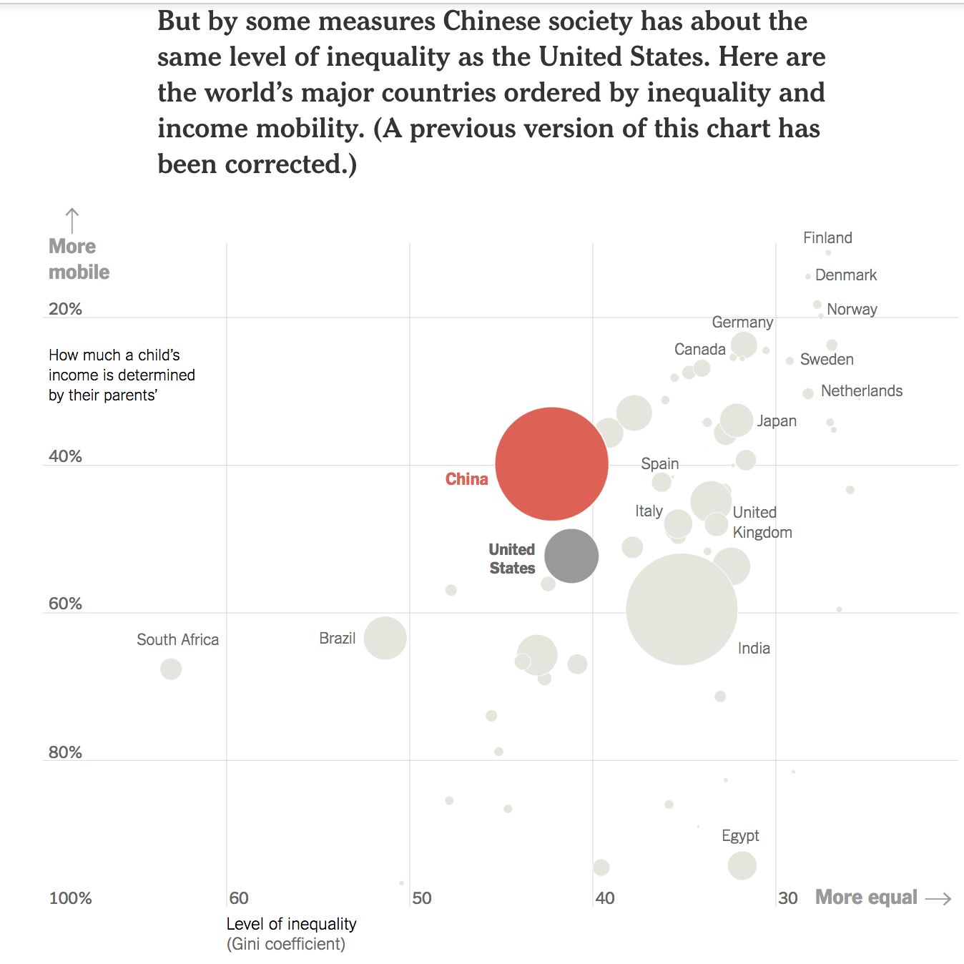

2c. Check the data source
“…society is now the more equal of the two countries.”
Updated
Original
But, the incorrect data point spreads:

Slide 10
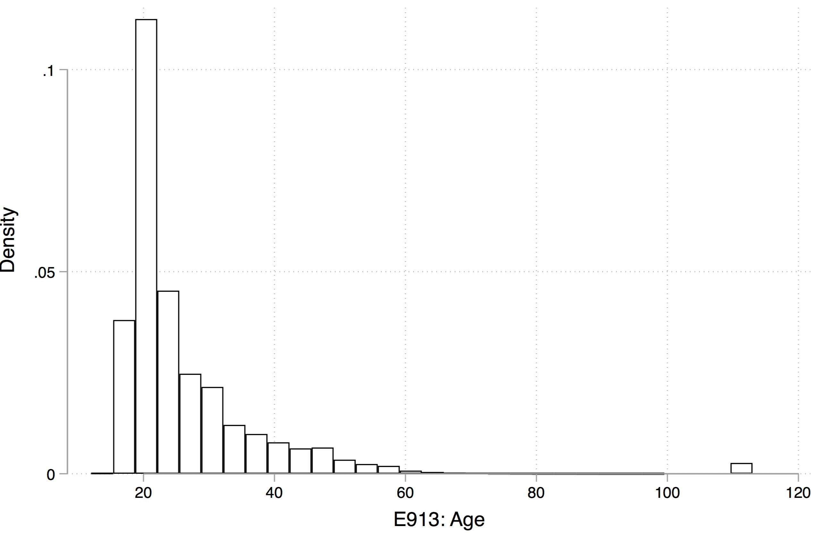
2c. Check the data
(eg) Histogram of higher education enrolments 2005 – 2015 by age
Sensibility checks:
Does this look right?
Coding issues:
Why are there so many 114 year olds going to uni?
If a Department defaults 1901 for an unknown birth year, it could significantly affect your mean calculation.
What happens to inevitable missing values?
How else is data coded? What do the codes mean?
hey why are there so many ~112 year-olds?

Slide 11
2c. Check the data
Sensibility checks:
Does this look right?
If not, why? What could be going on?
Read explanatory notes/data appendices/etc
Data errors
Why are there so many 112 year-olds going to uni?
Data coding issues
Wait, why is the average ATAR score of university students 140?
Addressing data coding issues
How will this affect our analysis if unaddressed?
How should we address it?
Where should we document any changes made?

Slide 12
2d. Generating more useful data
Income per person
Easy!
Google Maps API
Relatively easy, but you’ll need to back it up
Collecting new data
Difficult, and takes a lot of work,
but nice if you can do it

Slide 13
2e. Check data again
Routinely check your dataset
Summing and finding a percentage are easy.
But are the numbers right?

Slide 14
3. Analyse your data
Simple or complex, your data and analyses need to be:
Defensible
Make sure you understand what you have done, and why you have done it.
(this process helps think through your analysis, too)
Reasoned
Annotated
Documented

Slide 15
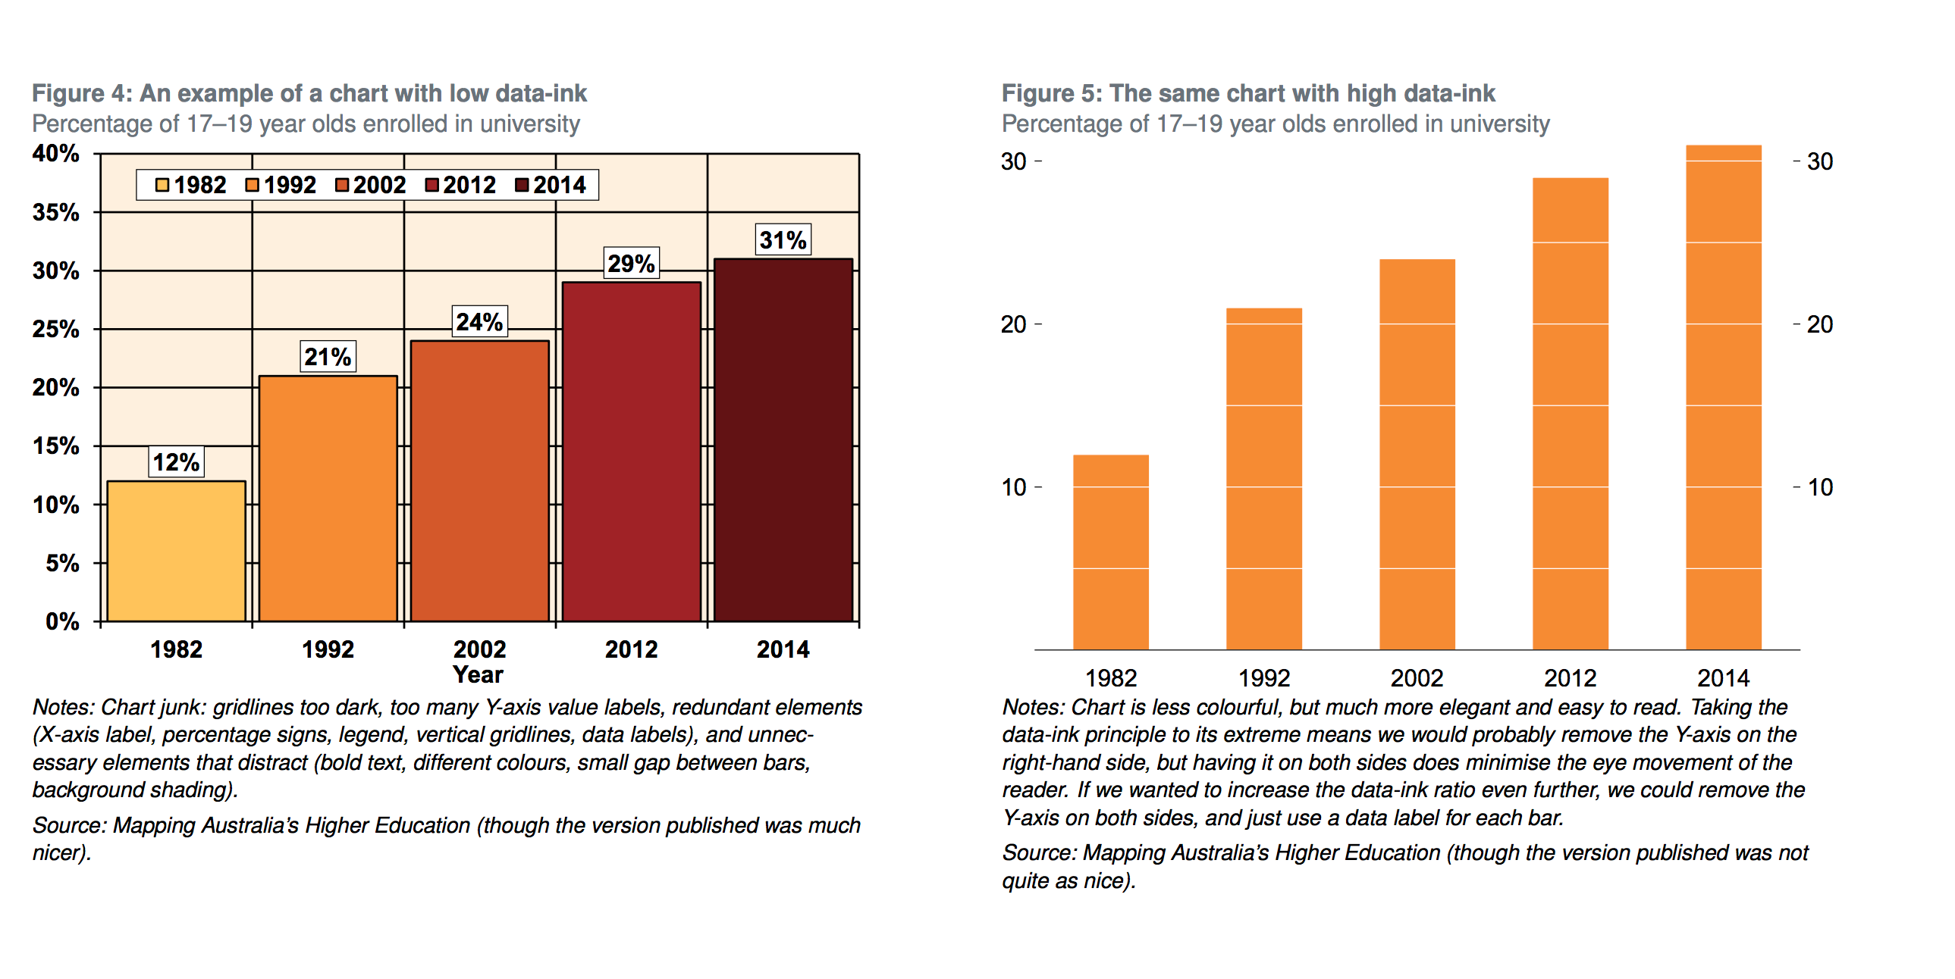
4. Present your analysis
“Make the complex simple, and the simple engaging”
Convery the message.
What are you trying to say?
Best to do this visually or verbally (depending on the audience)
ie not in a large table of regression results
Make your charts clear and engaging: minimise chart ‘junk’

Slide 16
4. Present your analysis
Use the Grattan chart template to create your charts.
This will do a lot of the work for you.
See Charts for presentations.potx for examples of Grattan-style charts.
(found in the additional_resources folder of the data class folder, or on Dropbox/Grattan Team/Templates/Charts)

Slide 17
Extra resources
Attached to this class’ documentation are:
Grattan chart templates (includes examples)
Chart guidebook
CPI calculator
Writing Style Guide (not at all data-related, but an enjoyable read)

Slide 18
Introduction to Excel concepts

Slide 19
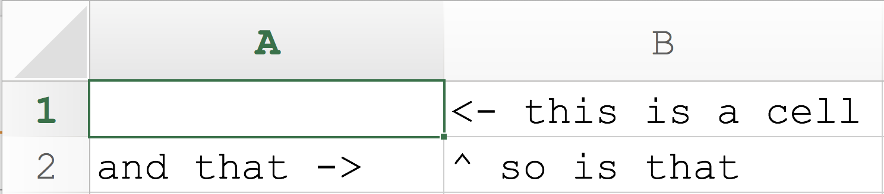
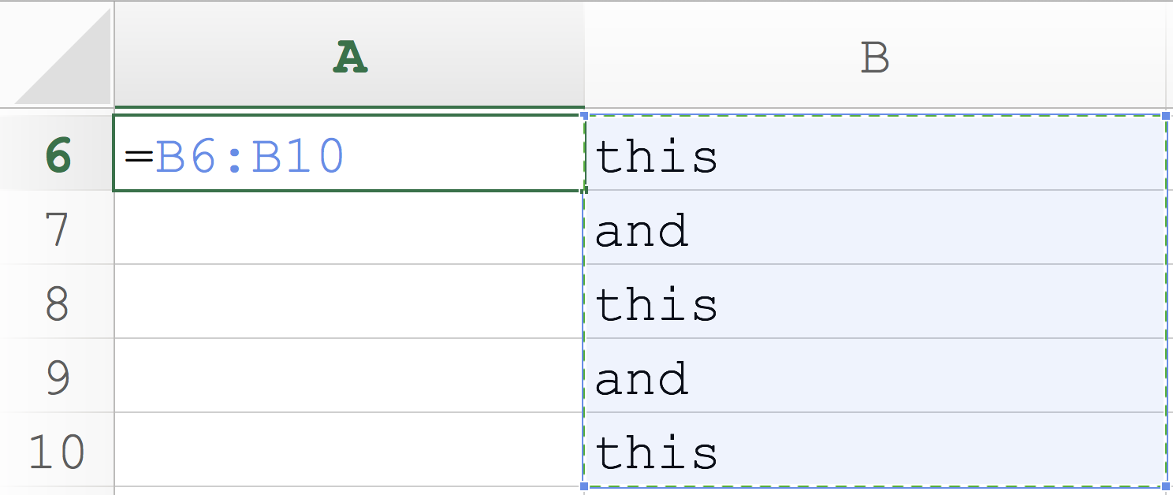
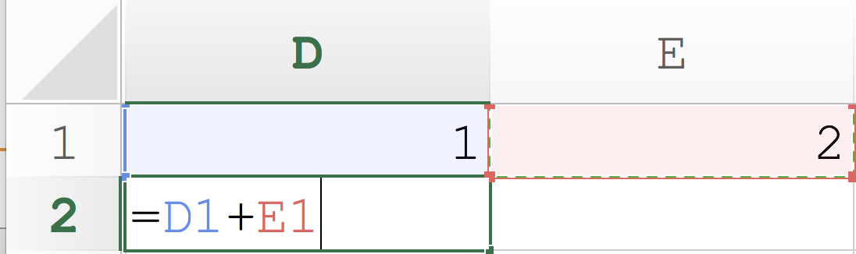
What is Excel?
What is a cell? What is a cell range?
How can we use ‘cells’?
Store data: strings [text], numbers, dates
Cells can talk to other cells

Slide 20
What is a function?
A function takes inputs (aka arguments) and turns them into outputs.
Federica listening to numbers being yelled out and summing them in her head and returning an answer.
In Excel, we could write:
=sum(A1:A5)
The function is sum, that takes the arguments A1:A5
and will return the sum of all numbers in the range.

Slide 21
What can functions do?
Anything you want. Limited only by the program (eg Excel, Stata) or language (eg R, Python) you are using, and by what other gorgeous people have written.
Some programs/languages are better for some things, worse for others.
Functions are usually the answer to the thought:
“ugh, this is taking ages I wish the computer could do this automatically”.

Slide 22
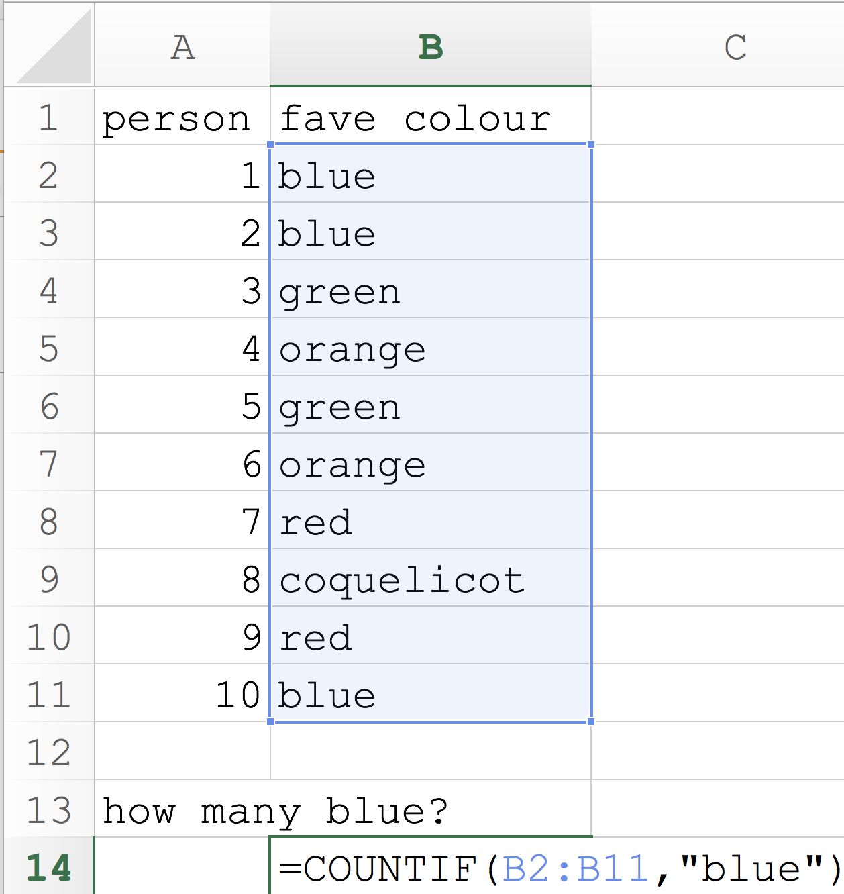
What can functions do? Excel:
In Excel, the COUNTIF function will count the number of cells that match a condition that you specify:
=COUNTIF(cells-that-I-am-looking-at,
my-condition)
[cells-that-I-am-looking-at]
Known as the ‘range’ in Excel.

Slide 23
What can functions do? Excel:
How many cells say “blue”?
range
function
arguments: this-is-my-condition
“Look at all the cells and count them if they say the word “blue”

Slide 24
What can functions do? R:
They can do the same thing in R (and much much more)
Given a series [vector] of numbers (just like a one-column range in Excel), it can return the mean.
First we define an object (we’ll call it range) as a vector of numbers using the function combine: c(10, 12, 40, 21). This is saying: combine the following numbers into a single vector.
Then we use the function mean which takes a vector of numbers as its argument: mean(range). This is the same as writing:
mean(c(10, 12, 40, 21))
The R code would look like this, along with what it would return. Note that <- means “define the left as the right”:
range <- c(10, 12, 40, 21)
mean(range)
[1] 20.5
= range

Slide 25
What can functions do? R: continued
In R, the script would look like this. Note that <- means “define the left as the right”.
range <- c(10, 12, 40, 21)
mean(range)
We can also look at the maximum, minimum or median:
max(range)
min(range)
median(range)
What is the median as a % of the maximum?
median(range) / max(range)
Storing this value as an object called myFunStat.
myFunStat <- median(range) / max(range)

Slide 26
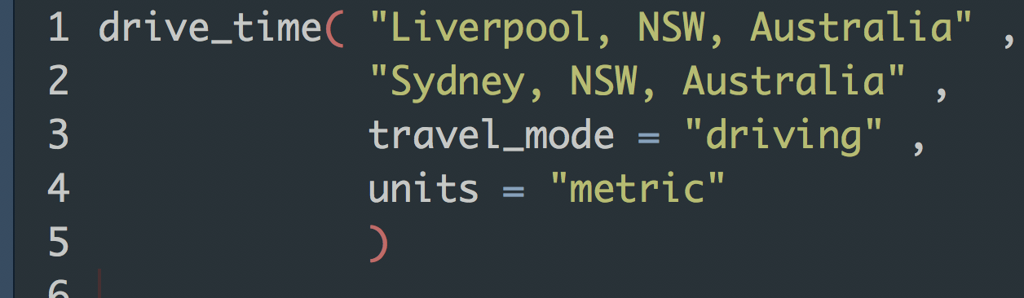
What else can functions do? R:
Line number
function
arguments
“Look at Google Maps and find the time and distance in metrics units to drive between Liverpool, NSW, Australia and Sydney, NSW Australia.”
(we’ll use this later)

Slide 27
Let’s get into it, starting with Excel and moving to R

