Slide 1

MapReduce
分布式并行计算模型

Slide 2


01
词频统计
WordCount
CONTENTS
02
map task工作机制
03
reduce task工作机制

Slide 3

词频统计
01
WordCount

Slide 4
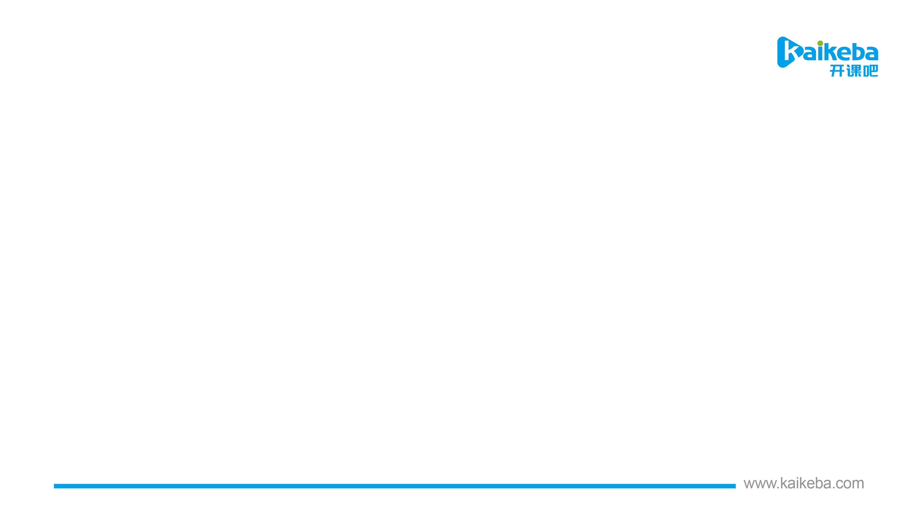
需求：有一些英文小说，现需统计每个单词出现的次数；结果：首字母是a~n的写入一个文件，o~z的写入一个文件
每个分片对应一个map task
map task
②map()接受kv，实现业务逻辑，输出新的kv
(bear, 2)
(car, 1)
(dear, 2)
分片1
map(k, v, ctx){
v -> line行数据
line.split(“空格”) -> words数组
每个word -> (word, 1)
输出(word, 1)
}
(bear, 2)
(bear, 3)
(bear, 3)
dear bear river
dear car
gone with the wind
……
bear, List(2,3,3)
(0,dear bear river)
reduce task
(boy, 2)
(boy, 2)
Gone With The Wind
200M
reduce(k, vs, ctx){
sum = 0;
vs中每个值v累加sum
求出最终sum
ctx.write(k, sum)
}
(bear, 3)
(boy, 2)
①InputFormat的RecordReader读取分片数据，每行生成一个kv对
(car, 2)
(car, 1)
……
③对kv分区
⑦reduce
(bear, 3)
(car, 2)
分片2
map task
(dear, 1)
(bear, 1)
(dear, 1)
(car, 1)
(bear, 1)
(river, 1)
(gone, 1)
(with, 1)
(the, 1)
(wind, 1)
(gone, 1)
(dear, 2)
The Three Musketeers
100M
……
⑥分组
④排序
⑧OutputFormat的RecordWriter写出结果
⑤combine可选
分片1
map task
0分区
1分区
HDFS
……
(bear, 3)
(boy, 2)
(gone, 2)
(river, 1)
(the, 1)
(gone, 1)
(gone, 1)
(river, 1)
(the, 1)
(wind, 1)
(with, 1)
(bear, 1)
(bear, 1)
(car, 1)
(dear, 1)
(dear, 1)
(bear, 2) (car, 1)
(dear, 2)
(gone, 2)
(river, 1)
(the, 1)
(wind, 1)
(with, 1)
0分区
1分区
(bear, 3)
(car, 2)
(gone, 2) (the, 1)
(wind, 3)
…
分组
每组调用一次reduce()
…
reduce task
0分区
1分区
…

Slide 5
02
map task工作机制

Slide 6
map task
②map()接受kv，实现业务逻辑，输出新的kv
分片1
map(k, v, ctx){
v -> line行数据
line.split(“空格”) -> words数组
每个word -> (word, 1)
ctx.write(word, 1)
}
dear bear river
dear car
gone with the wind
……
(0,dear bear river)
Gone With The Wind
200M
①InputFormat的RecordReader读取分片数据，每行生成一个kv对
③OutputCollector对kv分区
HashPartitioner.getPartition(k,v,num) -> (partition,k,v)
分片2
map task
The Three Musketeers
100M
……
100m内存-环形缓冲区
包含众多的(partition,k,v)
写满80%开始溢出
分片1
map task
……
(dear, 1)
(bear, 1)
(dear, 1)
(car, 1)
(bear, 1)
(river, 1)
(gone, 1)
(with, 1)
(the, 1)
(wind, 1)
(gone, 1)
合并
④排序
client将打成jar包的程序，提交集群运行
hadoop jar xxx.jar WordCount /input /output
(bear, 5)
(car, 7)
(dear, 9)
(gone, 4)
(river, 6)
(the, 5)
(wind, 8)
(with, 5)
⑤combine可选
(gone, 2)
(river, 1)
(the, 1)
(wind, 1)
(with, 1)
0分区
1分区
(bear, 2) (car, 1)
(dear, 2)
(gone, 1)
(gone, 1)
(river, 1)
(the, 1)
(wind, 1)
(with, 1)
client
(bear, 1)
(bear, 1)
(car, 1)
(dear, 1)
(dear, 1)
(bear, 2) (car, 3)
(dear, 4)
(gone, 1)
(river, 2)
(the, 3)
(wind, 5)
(with, 2)
client计算分片信息：分片1、2……
(bear, 5)
(car, 8)
(dear, 3)
(river, 6)
(wind, 7)
(with, 3)
将分片信息、配置文件、jar包提交hdfs
split信息
wc.jar
job.xml
application 提交yarn运行
hdfs
yarn
mrappmaster
…
…
(gone, 8)
(river, 7)
(the, 9)
mrappmaster启动map task或reduce task
(car, 7)
(dear, 9)
…
…
每个分片对应一个map task
启动mrappmaster
…

Slide 7
03
reduce task工作机制

Slide 8
当map task2完成，分区0数据量大于num2，数据直接拷贝到reduce，落磁盘
当map task1完成，分区0数据量小于num2，数据直接拷贝到reduce内存
当map task3完成，分区0数据量小于num2，数据直接拷贝到reduce内存
reduce task1
map task1
num1=jvm堆内存的70%
num2=num1*25%
(bear, 5)
(car, 7)
(dear, 9)
(gone, 4)
(river, 6)
(the, 5)
(wind, 8)
(with, 5)
内存
(bear, 5)
(car, 7)
(dear, 9)
(bear,5)
(car, 7)
(car, 7)
(dear,9)
(dear,9)
…
(bear,5)
(bear,5)
(car, 7)
(car, 7)
(car, 8)
(dear,9)
(dear,9)
(dear,3)
merge后的、排过序的溢出文件
map端的数据全部拷贝完
⑥数据分组GroupingComparator(k,knext)
0分区
1分区
(car, 7)
(dear, 9)
(bear,5)
(bear,5)
(car, 7)
(car, 7)
(car, 8)
(dear,9)
(dear,9)
(dear,3)
…
map task2
(bear,5)
(bear,5)
(bear,3)
(bear,List(5,5,3))
(bear, 5)
(car, 8)
(dear, 3)
(river, 6)
(wind, 7)
(with, 3)
……
⑦reduce(k, vs, ctx){
…
ctx.write(k, sum)
}
(bear, 5)
(car, 8)
(dear, 3)
(car, 7)
(car, 7)
(car, 8)
(car, 2)
(car,List(7,7,8,2))
map task3
后台线程将磁盘文件合并成排过序的大文件，一次合并10个
(gone, 8)
(river, 7)
(the, 9)
(dear,9)
(dear,9)
(dear,3)
(dear,List(9,9,3))
(car, 7)
(dear, 9)
……
⑧OutputFormat的RecordWriter写出结果
……
……
…
map task4
……
……
map task5
……
……
……
内存中当①数据量达到num1*66%
或②文件数大于1000个，内存中的数据开始合并(merge)，然后生成溢出文件
reduce task2
HDFS
part-r-00000
逻辑同上
part-r-00001
Notes:
num1 -> mapreduce.reduce.shuffle.input.buffer.percent=0.70
源码 -> private static final float DEFAULT_SHUFFLE_MEMORY_LIMIT_PERCENT = 0.25f;
mapreduce.reduce.shuffle.merge.percent -> 0.66 mapreduce.reduce.merge.inmem.threshold -> 1000
mapreduce.task.io.sort.factor -> 10

Slide 9

THANK YOU FOR WATCHING

