Slide 1
Learning Atari with a Dueling Double DQN
By William Fraher

Slide 2
Goals of this project
AI and Atari

Slide 3
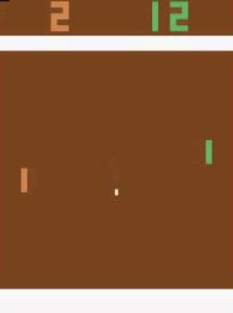
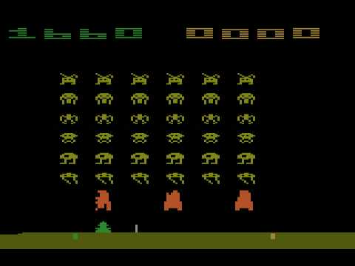
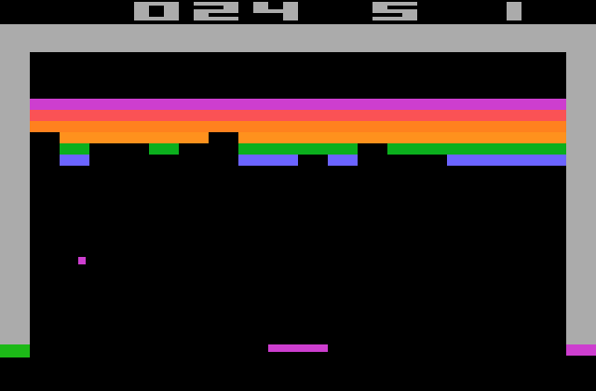
Goals of this project
AI and Atari
Could one AI learn how to play any Atari game?

Slide 4
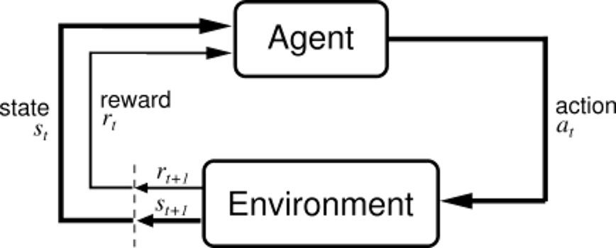
Reinforcement Learning
(Sutton and Barto, Reinforcement Learning: An Introduction, 1998)
We want to find a policy which maps states to actions. These actions ideally maximize future rewards.

Slide 5
Reinforcement Learning
maps from states to actions given parameters .
In reinforcement learning, our goal is to find the best .

Slide 6
Reinforcement Learning
maps from states to actions given parameters .
In reinforcement learning, our goal is to find the best .
We collect rollouts, or episodes in our environment, of transitions.

Slide 7
Reinforcement Learning
How do we actually find ?

Slide 8
Reinforcement Learning
How do we actually find ?
Each transition contains a reward. We want to maximize

Slide 9
Reinforcement Learning
In some cases, we can just use the reward.

Slide 10
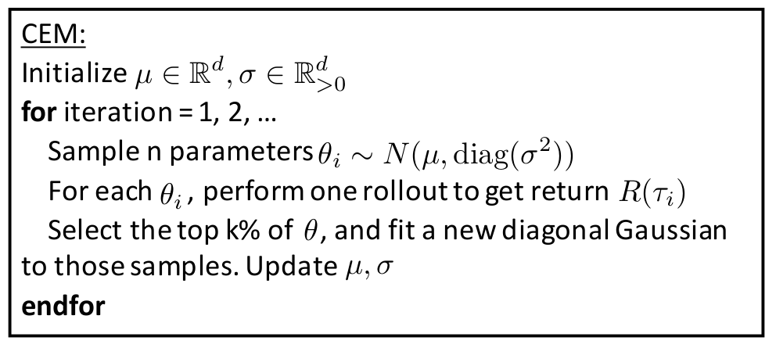
Reinforcement Learning
In some cases, we can just use the reward.
One such algorithm is CEM.
(image from Berkeley Deep RL Bootcamp, Peter Chen, John Schulman, Pieter Abbeel)

Slide 11
Reinforcement Learning
We could use supervised learning.

Slide 12
Reinforcement Learning
We could use supervised learning.
Supervised learning problem: Map states to actions.
Supervised learning techniques: Linear regression, neural nets.

Slide 13
Neural Nets
Extremely sophisticated supervised learning technique.

Slide 14
Neural Nets
Extremely sophisticated supervised learning technique.
Uses training data of pairs. Attempts to find a function that maps new values to their values.

Slide 15
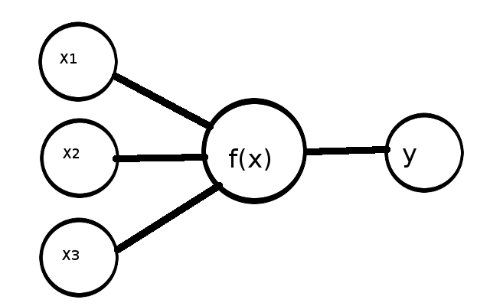
Neural Nets

Slide 16
Neural Nets
computed with a weight vector.

Slide 17
Neural Nets
computed with a weight vector.
: Take a linear combination of weights and inputs.

Slide 18
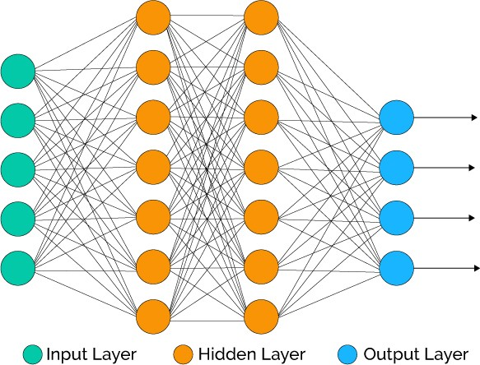
Neural Nets
(image from medium.com)

Slide 19
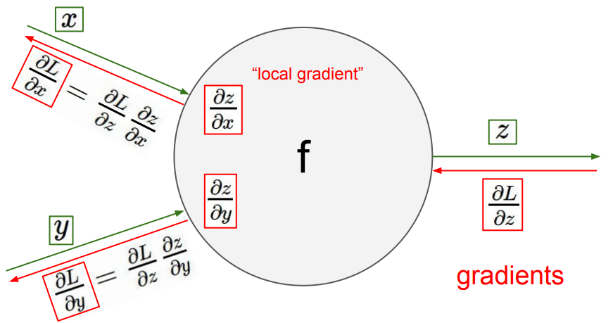
Neural Nets
Uses a procedure called backpropagation to tune itself. This is why we need outputs.
(image from Stanford CS231 course)

Slide 20
Neural Nets
Computes a hypothesis, we need an error to tune it accordingly.

Slide 21
Neural Nets
Computes a hypothesis, we need an error to tune it accordingly.
Mean squared error is one way to do this. We tune the weights of our neural network with respect to this error.

Slide 22
Neural Nets
How do we create training examples?

Slide 23
Neural Nets
How do we create training examples?
In reinforcement learning, we try to estimate rewards.

Slide 24
Deep Q-Learning
Q-Learning: An algorithm which approximates the value of state-action pairs (Watkins, 1989). Works by building a table of state-action pairs.

Slide 25
Deep Q-Learning
Q-Learning: An algorithm which discovers the value of state-action pairs (Watkins, 1989). Works by building a table of state-action pairs.
Approximate Q-Learning: Uses a function approximation to estimate the value of state-action pairs.

Slide 26
Deep Q-Learning
Q-Learning: An algorithm which discovers the value of state-action pairs (Watkins, 1989). Works by building a table of state-action pairs.
Approximate Q-Learning: Uses a function approximation to estimate the value of state-action pairs.
Deep Q-Learning: Uses a multi-layer neural network to approximate the value of state-action pairs.

Slide 27
Deep Q-Learning
Given a state, we approximate the value of actions.

Slide 28
Deep Q-Learning
The values of state-action pairs are called Q-values.
This is written as , the Q-value of action a at state S.

Slide 29
Deep Q-Learning
Instead of having a given as in supervised learning, we need to specify a target.

Slide 30
Deep Q-Learning
Instead of having a given as in supervised learning, we need to specify a target.
In Deep Q-learning, we tune the network with respect to the following target:
Where is a discount factor.

Slide 31
Deep Q-Learning
When training the network, we use the following loss:
This operates over a single transition, and gives us everything we need to test it.

Slide 32
OpenAI Gym
OpenAI Gym: Used to benchmark RL algorithms.
We will experiment with the pole balancing problem.

Slide 33
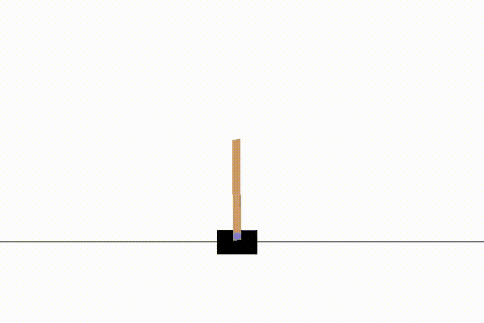
OpenAI Gym
OpenAI Gym: Used to benchmark RL algorithms.
We will experiment with the pole balancing problem.

Slide 34
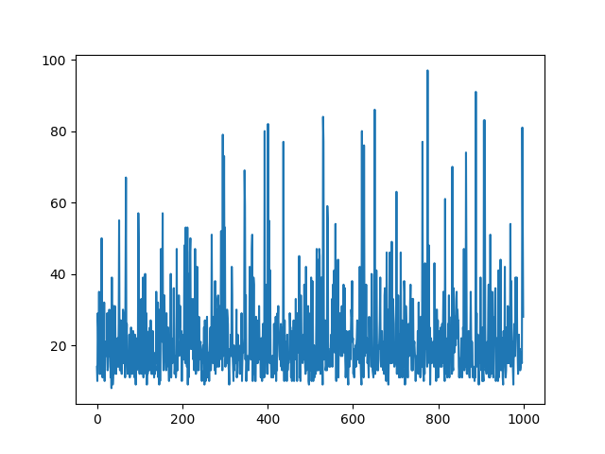
OpenAI Gym
An agent that acts randomly gets the following scores:

Slide 35
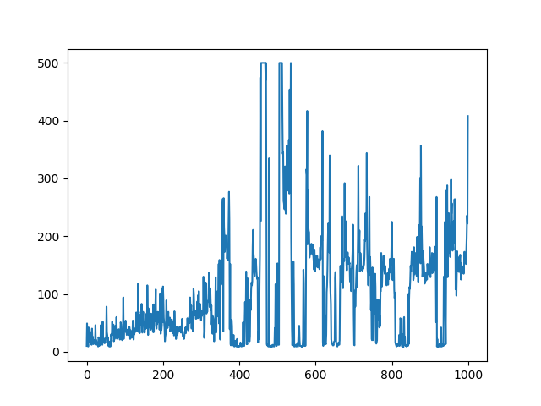
OpenAI Gym
A neural network using Q-Learning gets the following scores:

Slide 36
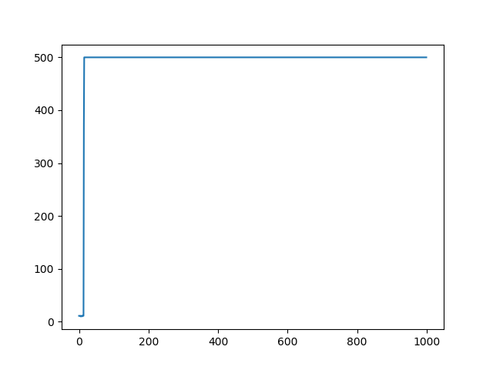
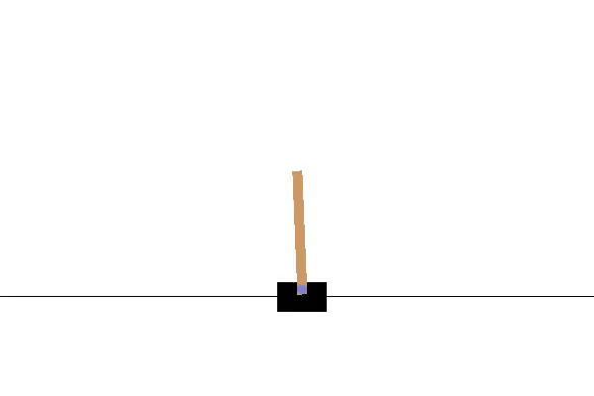
OpenAI Gym
CEM, while simpler, is better here.

Slide 37
OpenAI Gym
Why use Q-Learning?

Slide 38
OpenAI Gym
Why use Q-Learning?
Deep Q-Learning might be sub-optimal here, but CEM cannot handle large parameter vectors.

Slide 39
OpenAI Gym
Why use Q-Learning?
Deep Q-Learning might be sub-optimal here, but CEM cannot handle large parameter vectors.
To learn Atari, we will need to use Deep Q-Learning with several optimizations.

Slide 40
Experience Replay
Each transition is stored in a memory buffer and sampled at random.

Slide 41
Experience Replay
Each transition is stored in a memory buffer and sampled at random.
A variation of this is called Prioritized Experience Replay, which selects transitions by error.

Slide 42
Target Network
We use the following loss
is a second network used to evaluate the next state.
We update the second network every training steps.

Slide 43
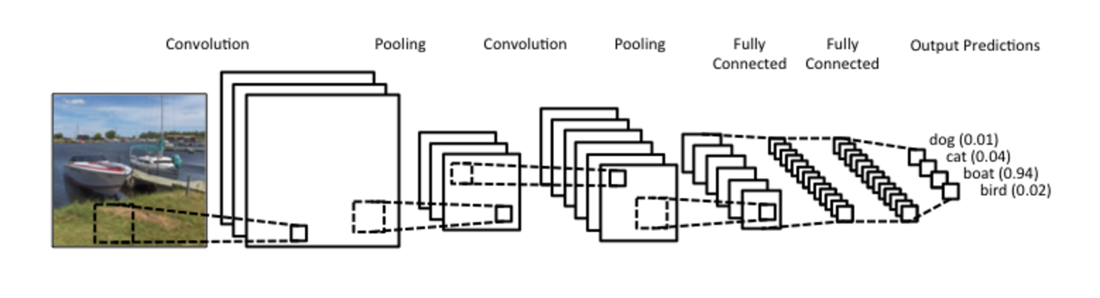
Convolutional Neural Networks
Instead of multiplying matrices, we could convolve over them to generalize spatial information.
(image from WildML.com)

Slide 44
Double DQN
Instead of taking the max Q-value from our second network, we decouple the step.
This has been proven to increase stability of DQN (van Hasselt et al. 2015).

Slide 45
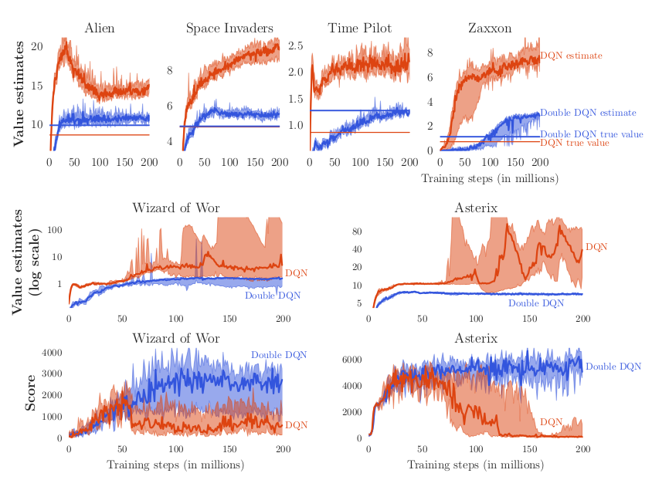
Double DQN
Why does Double DQN work?
(image from van Hasselt et al, 2015)

Slide 46
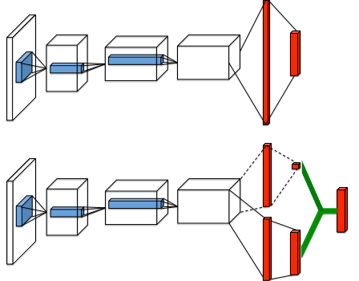
Dueling DQN
Splits the network’s output into two streams.
(image from Wang et al. 2015)

Slide 47
Dueling DQN
By splitting the network into two streams, we estimate the value of the state and the action separately.
Thus the new Q-value is the sum of the state value and action value for that state-action pair.

Slide 48
Dueling Double DQN
Combining these techniques allows us to learn Atari games.

Slide 49
Dueling Double DQN
Combining these techniques allows us to learn Atari games.
(DQN agent is on the right)

Slide 50
It works!
I claim this works for other Atari games.

Slide 51
It works!
I claim this works for other Atari games.
Proof:

Slide 52
It works!
I claim this works for other Atari games.
Proof:

Slide 53
Possible Enhancements
Prioritized experience replay: Selects transitions based of TD error

Slide 54
Possible Enhancements
Prioritized experience replay: Selects transitions based of TD error
Dramatically increases learning speed.

Slide 55
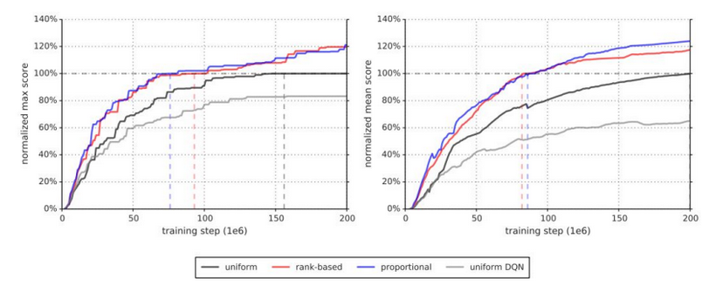
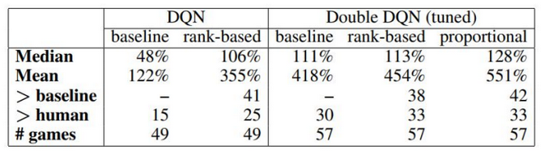
Possible Enhancements
(images from Schaul et al. 2016)

Slide 56
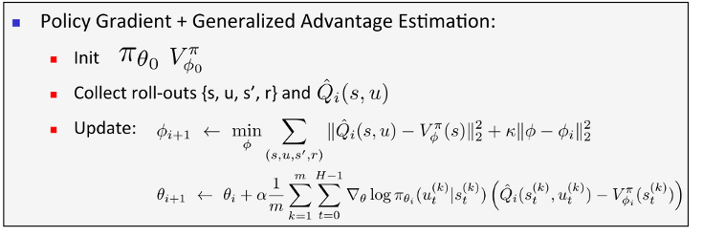
Possible Enhancements
A3C: Uses Q-Learning to tune an Actor-Critic network.
(image from Berkeley Deep RL Bootcamp, Pieter Abbeel, John Schulman, Peter Chen)

Slide 57
Possible Enhancements
(video from Google Deepmind)

Slide 58
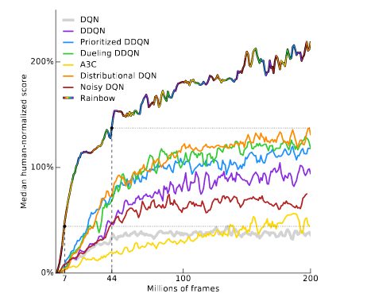
Possible Enhancements
Rainbow DQN
(image from Hessel et al. 2017)

Slide 59
Why do I care?

Slide 60
Why do I care?
ROBOTS!!!
(Trust region policy optimization)

Slide 61
Questions?

Slide 62
Resources
https://wfraher.github.io/
UC Berkeley – CS188
David Silver – Reinforcement Learning
Andrew Ng - Coursera

