Slide 1
z
L
e−
y
L
L
x

Slide 2
20
(4,1,1)
(1,4,1)
(1,1,4)
(3,2,2)
(2,3,2)
(2,2,3)
15
(3,2,1)
(2,3,1)
(1,2,3)
(3,1,2)
(2,1,3)
(1,3,2)
(2,2,2)
10
(3,1,1)
(1,3,1)
(1,1,3)
(2,2,1)
(1,2,2)
(2,1,2)
5
(2,1,1)
(1,2,1)
(1,1,2)
(1,1,1)
zero point energy
0

Slide 3
z
z
e⁻
e⁻
r₂−r₁
φ
r
e⁻
r₁
r₂
p⁺
y
He²⁺
y
θ
x
x

Slide 4
ok
Closed-shell
singlet
No-no!
ok
Closed-shell
singlet
ψ₂
ψ₁

Slide 5
ψ^{β}_{2s}
ψ_{2s}
ψ_{2s}
ψ^{α}_{2s}
Lithium 1s²2s¹
ψ^{β}_{1s}
ψ_{1s}
ψ_{1s}
ψ^{α}_{1s}
“RHF”
artificial
singlet
ROHF
Pure doublet
UHF
Doublet
+ higher-order spin contributions

Slide 6
Each of these points in 3N-dimensional space is a solution to electronic Schrödinger equation
z
r_{2b}
H⁺
r_{1b}
E_{PES}
e⁻
r₁₂
{R}
r_{2a}
e⁻
y
R_{ab}
r_{1a}
x
H⁺

Slide 7
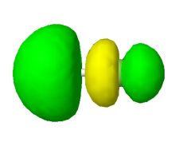
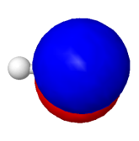
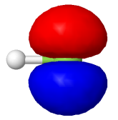
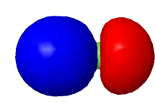
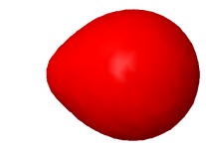
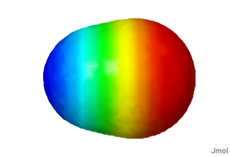
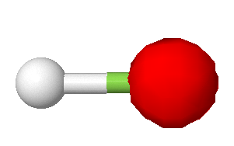
16 eV
1.05 H_{1s} + 0.82 F_{2pz} – 0.52 F_{2s}
“LUMO”
-12.6 eV
1.0 F_{2px} 1.0 F_{2py}
“HOMO”
-15.6 eV
0.70 F_{2pz} – 0.53 H_{1s} + 0.41 F_{2s}
HF/STO-3G
H-F: 0.9556 Å
E= -98.57284 Hartree
μ = 1.25 Debye
Electrostatic potential
-39.7 eV
0.95 F_{2s} – 0.25 F_{1s} + 0.15 H_{1s}
-704.9 eV
0.99 F_{1s}
H
F
z

Slide 8
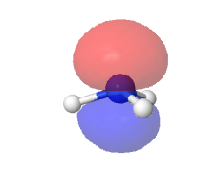
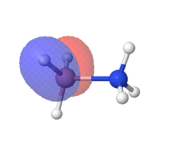
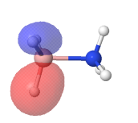
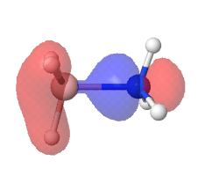
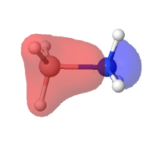
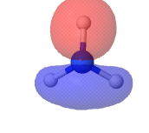
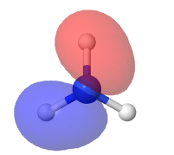
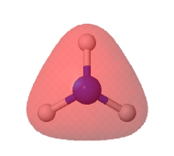
[ [ (-33.8749231543 eV) ]
[ (-19.7881274643 eV) ]
[ (-19.7881274643 eV) ]
[ (-18.9636221533 eV) ]
[ (-13.6446104984 eV) ]
[ (-11.1085083536 eV) ]
[ (-11.1085083536 eV) ]
[ (5.62513986445 eV) ]
[ (8.10409807677 eV) ]
[ (8.10409807677 eV) ] ]
[ [ (-30.4816620228 eV) ]
[ (-16.8838551262 eV) ]
[ (-16.8838551262 eV) ]
[ (-10.5830562891 eV) ] ]

Slide 9
Saddle point
“Transition state”
E_{PES}
Which H is biggest? Smallest?
q
g
Minimum
F1
F1
H4
d1
F2
H2
H4
d1
H3
H2
H1
H3
F2
H1

Slide 10
F1
F1
F1
H4
d1
F2
H2
F2
H4
H2
d1
d1
H3
H2
H1
H3
F2
H1
H3
H4
H1
Saddle point
“Transition state”
E_{PES} (kJ/mol)
Local
Minimum
Global
Minimum

Slide 11
F1
F1
H2
r2
r3
r3
H4
a1
H2
H4
C1
r1
C2
a2
d1
r3
a2
H3
r3
r2
H3
H1
H1
F2
F2

Slide 12
E_{PES}
−h
h

Slide 13
Newton’s method for finding a minimum at q´ from information at q
Taylor expand about q:
q
q´
y
O
x
H₁
H₂

Slide 14
Initial guess for geometry & Hessian
Choose basis and make initial guess for MO coefficients
Calculate energy and gradient
Minimize along line between
current and previous point
Update Hessian
(Powell, DFP, MS, BFGS, Berny, etc.)
Take a step using the Hessian
(Newton, RFO, Eigenvector following)
Check for convergence
on the gradient and displacement
yes
DONE
no
Update the geometry

Slide 16
ψ₋=N₋(1s_{A} − 1s_{B})
1s_{A}
1s_{B}
ψ₊= N₊(1s_{A} + 1s_{B})
H₂ molecule
Covalent configurations
Ionic configurations

Slide 17
Complete active space (CAS): consider all excitations within some space of “active” orbitals
σ₋
π₋
MCSCF: selectively include a few excited determinants
2p_{x,y,z} _{A}
π₊
2p_{x,y,z} _{B}
σ₊
Hartree-Fock: single determinant
N₂ molecule

Slide 18
 | E_{HF} | 0 | dense | 0
 | 0 | dense | sparse | very sparse
 | d e n s e | sparse | sparse | really sparse
 | 0 | very sparse | really sparse | …

Slide 19
excludes “quadruple” excitation
ψ₋=N₋(1s_{A} − 1s_{B})
ψ₋=N₋(1s_{A} − 1s_{B})
ψ₋=N₋(1s_{A} − 1s_{B})
includes “quadruple” excitation
ψ₊= N₊(1s_{A} + 1s_{B})
ψ₊= N₊(1s_{A} + 1s_{B})
ψ₊= N₊(1s_{A} + 1s_{B})
H₂ molecule
Two H₂ calculated separately
Two H₂ calculated at very large separation

Slide 20
Correlation
 | HF | MP2 | CCSD | CCSD(T) | … | FCI
SZ |  |  |  |  |  | FCI/SZ
DZ
DZP
TZ2P |  |  |  | CCSD(T)/TZ2P |  | FCI/TZ2P
…
Complete basis | HF limit | MP2 limit |  |  |  | exact
Basis

Slide 21
e−
e−
e−
e−
e−
e−
e−
e−
e−
e−
0
λ
1
Notes:
21

Slide 22
A
B
{R}
E_{PES}
ΔU(0)
ΔE^{elec}

Slide 23
C (s, 298 K, 1 bar)
+
2 H₂ (g, 298 K, 1 bar)
CH₄ (g, 298 K, 1 bar)
Exp’t or calc.
Exp’t or calc.
C (s, 0 K, 1 bar)
Exp’t or calc.
2 H₂ (g, 0 K, 1 bar)
CH₄ (g, 0 K, 1 bar)
ZPVE
ZPVE
C (g, 0 K, 1 bar)
+
2 H₂ (0 K, rigid)
calc.
CH₄ (0 K, rigid)

Slide 24
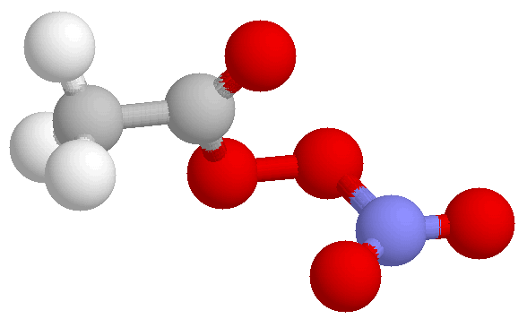
Supercell Models
(peroxyacetyl nitrate)
(MgO bulk)
(MgO slab)
c
c
b
a
b
a
“cluster” models
Isolated molecule in vacuum
(or dielectric continuum)
Gas-phase
Solution-phase
“Localized” chemistry
Amenable to highly
accurate calculations
“supercell” models
3-D periodic boundary conditions applied to atomic configuration
Bulk solids
Bulk liquids
Surfaces and Interfaces
“Delocalized” chemistry
Amenable to highly
efficient calculations

Slide 25
a
Atoms:
H
H
H
H
H
H
H
H
H
H
PBC
e⁻
e⁻
e⁻
Potential:
Basis:
Wavefunctions:
.
.
.
.
.
.
Bloch’s Theorem:
(recall e^{ikr} is like a cosine function)
Wavefunctions can be written as product of unit-cell-invariant part (1s function here) and cell-periodic part
Readily extensible to three dimensions (real k → vector k)
Domain of k called “first Brillouin zone”
“Special” k points assigned names, e.g. k = 0 called “Γ point”

Slide 26
.
.
.
energy
energy
H
H
0
k
π/a
H
H
H
H
H
Molecular orbital diagram
Band structure diagram
Discrete orbital energies become continuous band of energies, indexed by k
Width (“dispersion”) of band determined by overlaps between neighboring cells
Larger supercells → smaller dispersion
In practice, sufficient to determine orbitals at a discrete number of k points
“k-point” sampling
Monkhorst-Pack algorithm used for choosing efficient k-point mesh

Slide 27
2a
Diatoms:
H
H
H
H
H
H
H
H
H
H
PBC
e⁻
e⁻
e⁻
Potential:
Basis:
Brillouin zone halved in size
Wavefunctions:

Slide 28
Square lattice
2-D Square Brillouin zone
X
M
a_{ij}
k_{y}
Γ
X
k_{x}
Reciprocal lattice vectors

Slide 30














Crystal system | Bravais lattices
triclinic | P
monoclinic | P | C
orthorhombic | P | C | I | F
tetragonal | P | I
rhombohedral (trigonal) | P
hexagonal | A
cubic | P | I | F

Slide 32
Basis Sets
H
H
H
H
H
H
H
Atom-centered:
χ= ∑ χ^{1s}
Plane waves:
m=1, G=2π/a
m=2, G=4π/a
.
.
.
a
Input
System – lattice, potential
Plane-wave cutoff
k-point sample
Output
Band coefficients
Band energies at k-points
Total electron density
Total energy

Slide 33
Plane-wave Basis
Expand ψº(r) in plane-waves (Fourier expansion)
Periodic boundary conditions restrict allowable plane wave frequencies
ψº(r) = Σ_{G} c_{G}e^{iGr}, G = 2πn/a, n ∈ I
Coefficients c_{G} determined by variational principle
Kohn-Sham equations assume convenient form
Kinetic energy term diagonal
⟨e^{iGr}| -½∇² | e^{iG’r}⟩ = ½G² δ_{GG’}
Potential energy term given by Fourier transform of V(r)
⟨e^{iGr} |V(r)| e^{iG’r}⟩ = V(G – G’)
Solve (# k-points) Kohn-Sham matrices of dimension (# PW) x (# PW)
direct diagonalization or iterative techniques
“Kinetic energy cutoff” (single parameter!) determines # plane waves
n_{max} chosen such that ħ²G_{max}²/2m_{e} < KE_{cutoff}
n_{max} ~ 10⁵ - 10⁶

Slide 34
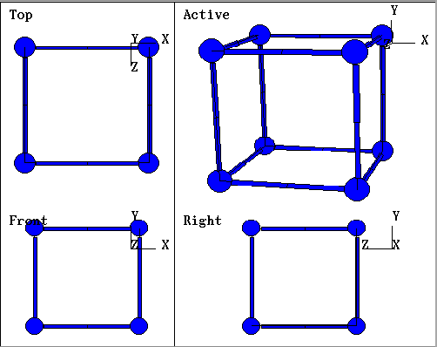
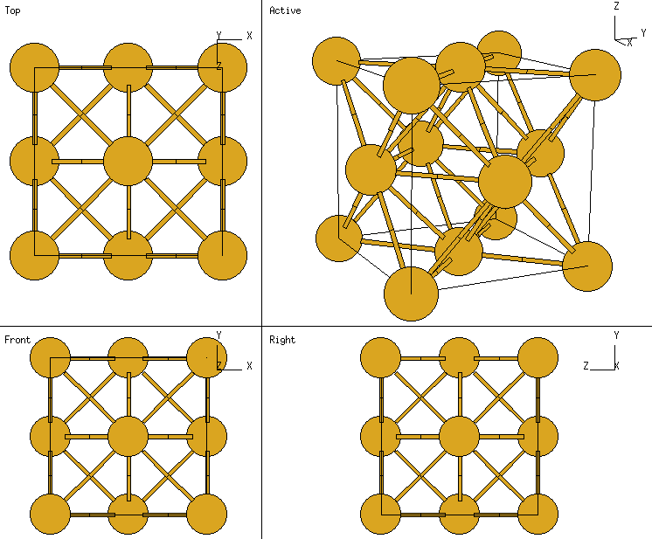
Simple cubic
example Po
Face-centered cubic
example Cu

Slide 35
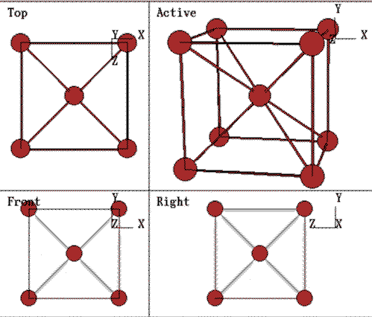
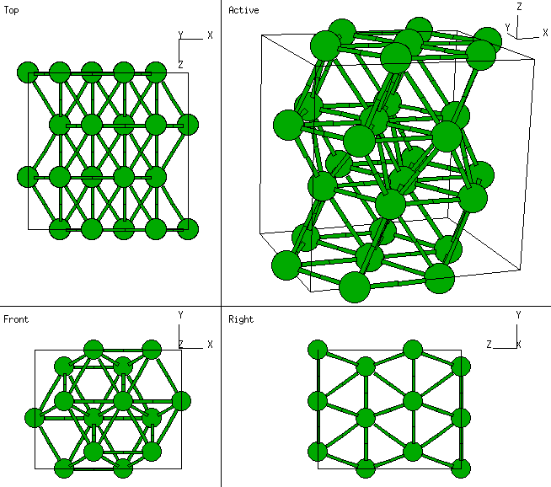
Body-centered cubic
example Fe
Hexagonal close packed
example Ru
Two-atom basis:

