Slide 1
Lecture 20-21: Introduction to Reinforcement Learning

Slide 2
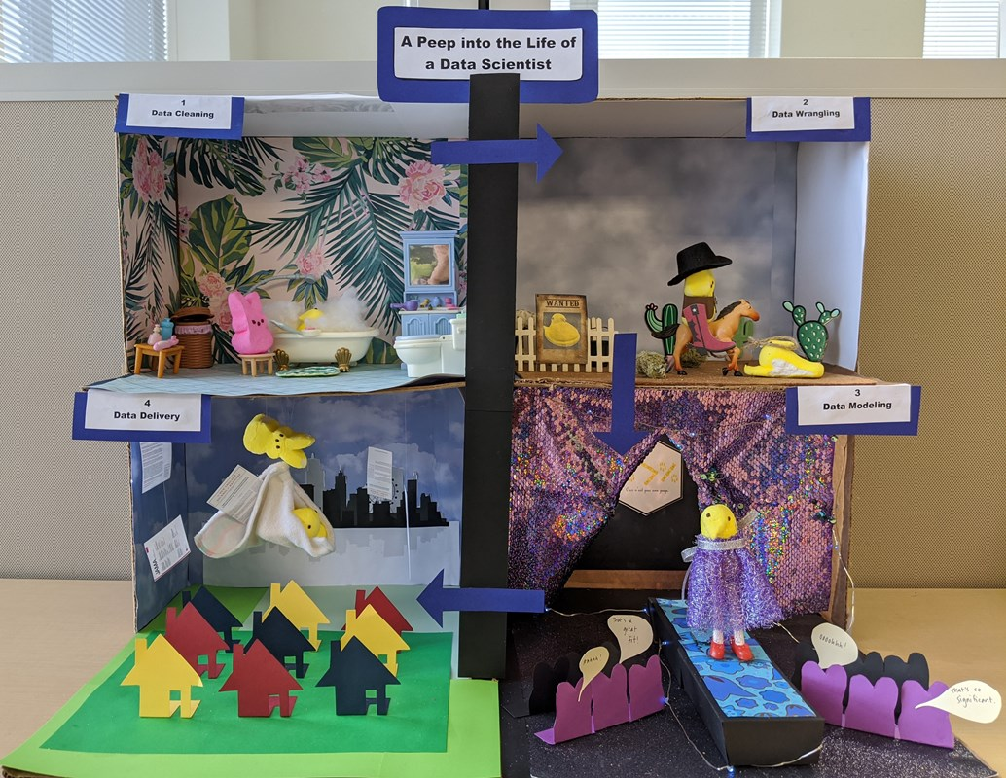

Slide 3
Outline
What is Reinforcement Learning?
RL Formalism:
Reward
The agent
The environment
Actions
Observations
Markov Decision Process:
Markov Process
Markov Reward Process
Markov Decision process
Learning Optimal Policies
Model Based (knowing the transition matrix):
Value Iteration
Policy Iteration
Model Free (not knowing the transition matrix):
Q-Learning
SARSA

Slide 4
Outline
What is Reinforcement Learning?
RL Formalism:
Reward
The agent
The environment
Actions
Observations
Markov Decision Process:
Markov Process
Markov Reward Process
Markov Decision process
Learning Optimal Policies
Model Based (knowing the transition matrix):
Value Iteration
Policy Iteration
Model Free (not knowing the transition matrix):
Q-Learning
SARSA

Slide 5
The setting
Mouse
A maze with walls, food and electricity
Mouse can move left, right, up and down
Mouse wants the cheese but not electric shocks
Mouse can observe the environment
Lapan, Maxim. Deep Reinforcement Learning Hands-On

Slide 6
The setting
Mouse => Agent
A maze with walls, food and electricity => Environment
Mouse can move left, right, up and down => Actions
Mouse wants the cheese but not electric shocks => Rewards
Mouse can observe the environment => Observations
Lapan, Maxim. Deep Reinforcement Learning Hands-On

Slide 7
What is Reinforcement Learning ?
Learn to make sequential decisions in an environment to maximize some notion of overall rewards acquired along the way.
In simple terms:
The mouse is trying to find as much food as possible while avoiding an electric shock whenever possible.
The mouse could be brave and get an electric shock to get to the place with plenty of food—this is a better result than just standing still and gaining nothing.

Slide 8
What is Reinforcement Learning ?
Learn to make sequential decisions in an environment to maximize some notion of overall rewards acquired along the way.
Simple Machine Learning problems have a hidden time dimension, which is often overlooked, but it is crucial to production systems.
Reinforcement Learning incorporates time (or an extra dimension) into learning, which puts it much close to the human perception or artificial intelligence.
Notes:
To improvised in real time. Many systems are not stationary so RL tries to learn online.

Slide 9
What don’t we want the mouse to do?
We do not want to have the best actions to take in every specific situation. Too much and not flexible.
Find a magic set of methods that will allow our mouse to learn how to avoid electricity and gather as much food as possible.
Reinforcement Learning is precisely this magic toolbox.

Slide 10
Challenges of RL
Observations depend on the agent’s actions. If the agent decides to do stupid things, then the observations will tell nothing about improving the outcome (only negative feedback).
Agents need to not only exploit the policy they have learned but to actively explore the environment. In other words, maybe by doing things differently, we can significantly improve the outcome. This exploration/exploitation dilemma is among the open fundamental questions in RL (and in my life).
Reward can be delayed from actions. Ex: In cases of chess, it can be one single strong move in the middle of the game that has shifted the balance.
Notes:
Observations = reward…. And next states … Strickly speaking observations depend on the current state
We do not know the environment or consequence the hidden treasures. You need to explore.

Slide 11
Outline
What is Reinforcement Learning?
RL Formalism:
Reward
The agent
The environment
Actions
Observations
Markov Decision Process:
Markov Process
Markov Reward Process
Markov Decision process
Learning Optimal Policies
Model Based (knowing the transition matrix):
Value Iteration
Policy Iteration
Model Free (not knowing the transition matrix):
Q-Learning
SARSA

Slide 12
﻿RL formalisms and relations
Agent
Environment
Communication channels:
Actions,
Reward, and
Observations:
Maxim Lapan: Deep Reinforcement Learning Hands-On
Notes:
Agent
Environment
Actions,
Reward, and
Observations:

Slide 13
Reward

Slide 14
Reward
A scalar value obtained from the environment
It can be positive or negative, large or small
The purpose of the reward is to tell our agent how well they have behaved
﻿reinforcement = reward or reinforced the behavior
Examples:
Cheese or electric shock
Grades: Grades are a reward system to give you feedback about you are paying attention to me.
Notes:
Once in a lifetime usually means all zeros until the end
Frequency: it can be every second or once in a lifetime.
Purpose: Give an agent feedback about its success

Slide 15
Reward (cont)
All goals can be described by the maximization of some expected cumulative reward.

Slide 16

The agent

Slide 17
The agent
An agent is somebody or something who/which interacts with the environment by executing certain actions, taking observations, and receiving eventual rewards for this.
In most practical RL scenarios, it's our piece of software that is supposed to solve some problems in a more-or-less efficient way.
Example:
You

Slide 18
The environment
Everything outside of the agent.
The universe!
The environment is external to an agent, and communications to and from the agent are limited to rewards, observations and actions.

Slide 19
Actions
Things the agent can do in the environment.
Can be:
moves allowed by the rules of play (if it's some game),
doing homework (in the case of school).
They can be simple such as move pawn one space forward, or complicated such as fill the tax form.
Could be discrete or continuous
Notes:
Self driving cars. Contnuous actions (accelerate or varying speed)

Slide 20
Observations
Second information channel for an agent, with the first being a reward.
Why?
Convenience
Notes:
Need to know enviroment, but also learn probabilities …. )observation tells us the state …

Slide 21
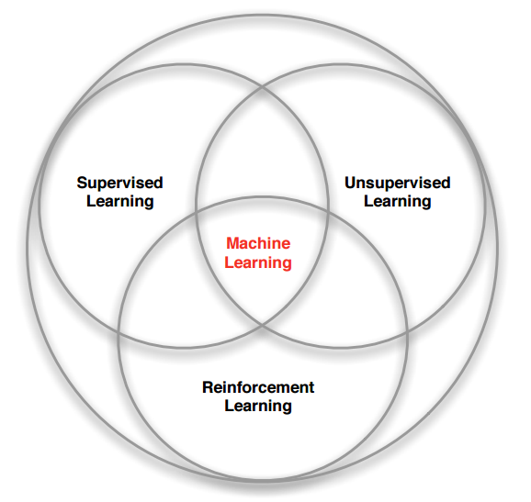
RL within the ML Spectrum
What makes RL different from other ML paradigms ?
No supervision, just a reward signal from the environment.
Feedback is sometimes delayed (Example: Time taken for drugs to take effect).
Time matters - sequential data
Feedback - Agent’s action affects the subsequent data it receives ( not i.i.d.).
Notes:
This diagram is not my favorite

Slide 22
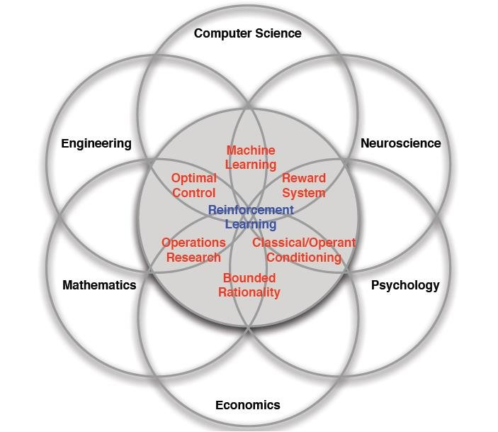
Many Faces of Reinforcement Learning
Defeat a World Champion in Chess, Go, BackGammon
Manage an investment portfolio
Control a power station
Control the dynamics of a humanoid robot locomotion
Treat patients in the ICU
Automatic fly stunt manoeuvres in helicopters
Notes:
﻿Machine learning (ML): RL, being a subfield of ML, borrows lots of its machinery, tricks, and techniques from ML. Basically, the goal of RL is to learn how an agent should behave when it is given imperfect observational data.
.
Neuroscience: We saw the dopamine system as our example, and it has been shown that the human brain acts closely to the RL model. Psychology: This studies behavior in various conditions, such as how people react and adapt, which is close to the RL topic.
Economics: One of the important topics is how to maximize reward in terms of imperfect knowledge and the changing conditions of the real world. Mathematics: This works with idealized systems, and also devotes significant attention to finding and reaching the optimal conditions in the field of operations research.
Engineering (especially optimal control): This helps in taking a sequence of optimal actions to get the best result

Slide 23
Outline
What is Reinforcement Learning?
RL Formalism:
Reward
The agent
The environment
Actions
Observations
Markov Decision Process:
Markov Process
Markov Reward Process
Markov Decision process
Learning Optimal Policies
Model Based (knowing the transition matrix):
Value Iteration
Policy Iteration
Model Free (not knowing the transition matrix):
Q-Learning
SARSA

Slide 24
Markov Decision Process
More terminology we need to learn before proceeding:
state
episode
history
value
policy

Slide 25
Markov Process
Example:
System: Weather in Boston.
States: We can observe the current day as sunny, rainy or windy.
History: A sequence of observations over time forms a chain of states, such as:
[sunny, sunny, rainy, sunny, …],

Slide 26
Markov Process
For a given system we observe states.
The system changes between states according to some dynamics.
We do not influence the system just observe.
There are only finite number of states (could be very large).
Observe a sequence of states or a chain => Markov chain.
…..
Notes:
finite number of states (continuous domain)

Slide 27
Markov Process (cont)
A system is a Markov Process, if it fulfils the Markov property.
The future system dynamics from any state have to depend on this state only.
Every observable state is self-contained to describe the future of the system.
Only one state is required to model the future dynamics of the system, not the whole history or, say, the last N states.

Slide 28
Markov Process (cont)
Weather example:
The probability of sunny day followed by rainy day is independent of the amount of sunny days we've seen in the past.
Notes:
This example is really naïve, but it's important to understand the limitations.
We can for example extend the state space to include other factors.

Slide 29
Markov Process (cont)
Transition probabilities is expressed as a transition matrix, which is a square matrix of the size N×N, where N is the number of states in our model.
 | sunny | rainy
sunny | 0.8 | 0.2
rainy | 0.1 | 0.9
Notes:
Cont. P(xt|x_{t-1})

Slide 30
Markov Process (cont)
In practice, we rarely know the exact transition matrix. A more realistic scenario is when we have only observations of our systems’ states, which we call episodes:
Episodes:
rainy, cloudy, cloudy, sunny
cloudy, cloudy, sunny

Slide 31
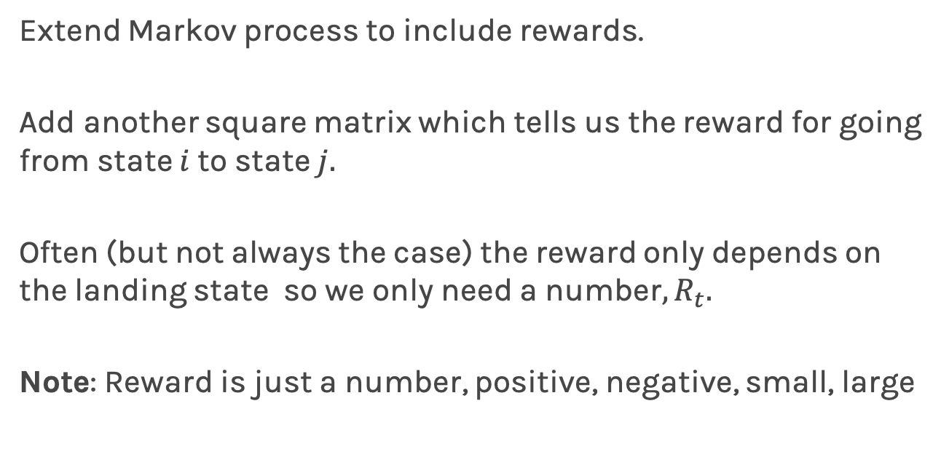
Markov Reward Process (MRP)
Extend Markov process to include rewards.
Add another square matrix which tells us the reward for going from state $i$to state $j.$
Often (but not always the case) the reward only depends on the landing state so we only need a number, $R_{t}.$
Note: Reward is just a number, positive, negative, small, large

Slide 32
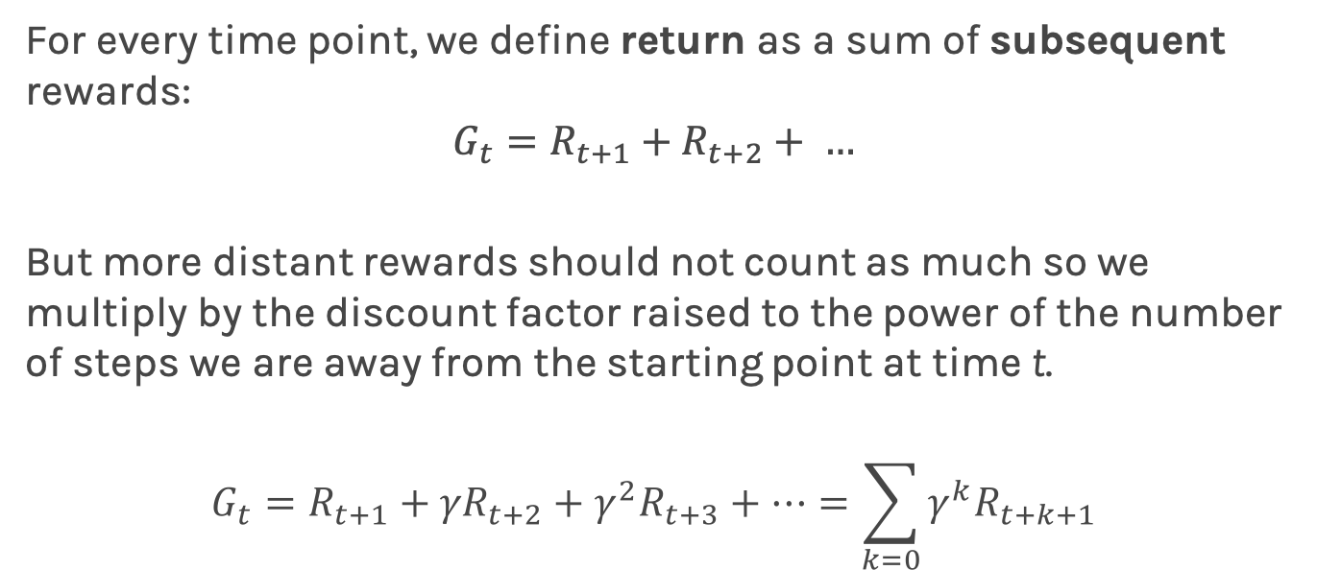
Markov Reward Process (cont)
For every time point, we define return as a sum of subsequent rewards:
$$G_{t}=R_{t+1}+R_{t+2}+ …$$
But more distant rewards should not count as much so we multiply by the discount factor raised to the power of the number of steps we are away from the starting point at time t.
$$G_{t}=R_{t+1}+{γR}_{t+2}+γ^{2}R_{t+3}+…=\sum_{k=0}{γ^{k}R_{t+k+1}}$$

Slide 33
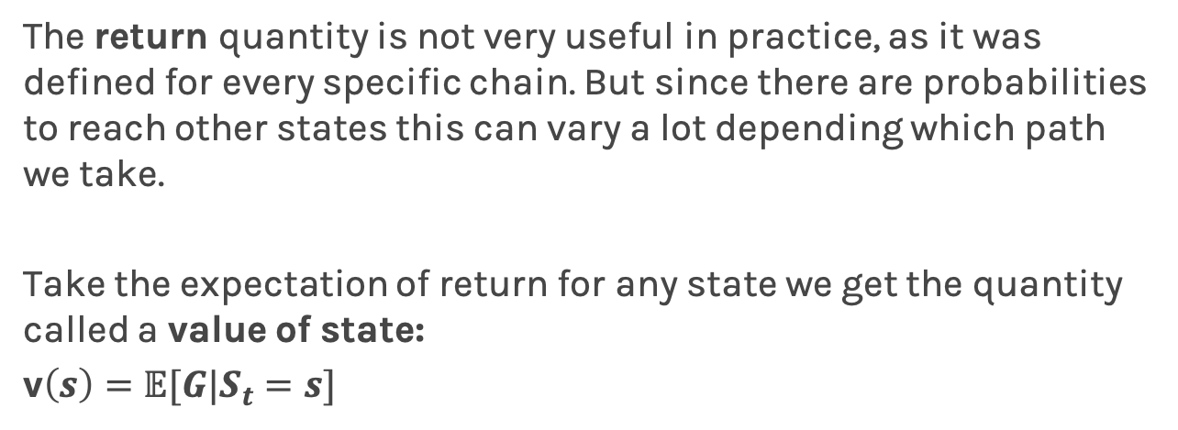
Markov Reward Process (cont)
The return quantity is not very useful in practice, as it was defined for every specific chain. But since there are probabilities to reach other states this can vary a lot depending which path we take.
Take the expectation of return for any state we get the quantity called a value of state:
v$\left(s\right)=𝔼[G|S_{t}=s]$
Notes:
It is all paths integrated with the Transition Probabilities

Slide 34
Markov Decision Process (MDP)
How to extend our Markov Return Process (MRP) to include actions?
We must add a set of actions (A), which has to be finite. This is our agent's action space.
Condition our transition matrix with action, which means the transition matrix needs an extra action dimension => turns it into a cube.

Slide 35
Markov Decision Process (cont)
Lapan, Maxim. Deep Reinforcement Learning Hands-On

Slide 36
Markov Decision Process (cont)
By choosing an action, the agent can affect the probabilities of target states, which is GREAT to have.
Finally, to turn our MRP into an MDP, we need to add actions to our reward matrix in the same way we did with the transition matrix: our reward matrix will depend not only on state but also on action.
In other words, it means that the reward the agent obtains now depends not only on the state it ends up in but also on the action that leads to this state. It's similar as when putting effort into something, you're usually gaining skills and knowledge, even if the result of your efforts wasn't too successful.

Slide 37
Markov Decision Process
More terminology we need to learn
state ✓
episode ✓
history ✓
value ✓
policy

Slide 38
Outline
What is Reinforcement Learning?
RL Formalism:
Reward
The agent
The environment
Actions
Observations
Markov Decision Process:
Markov Process
Markov Reward Process
Markov Decision process
Learning Optimal Policies
Model Based (knowing the transition matrix):
Value Iteration
Policy Iteration
Model Free (not knowing the transition matrix):
Q-Learning
SARSA

Slide 39
Policy
We are finally ready to introduce the most important central thing for MDPs and Reinforcement Learning:
policy
The intuitive definition of policy is that it is some set of rules that controls the agent's behavior.
﻿
Notes:
For example, the robot in the grid world, the agent can have different policies, which will lead to different sets of visited states. For example, this robot can perform the following actions: Blindly move forward regardless of anything Try to go around obstacles by checking whether that previous forward action failed Funnily spin around to entertain its creator Choose an action randomly modelling a drunk robot in the grid world scenario, and so on …

Slide 40
Policy (cont)
Even for fairly simple environments, we can have a variety of policies.
Always move forward
Try to go around obstacles by checking whether that previous forward action failed
Funnily spin around to entertain
Choose an action randomly

Slide 41
Policy (cont)
Remember: The main objective of the agent in RL is to gather as much return (which was defined as discounted cumulative reward) as possible.
Different policies can give us different return, which makes it important to find a good policy. This is why the notion of policy is important, and it's the central thing we're looking for.

Slide 42
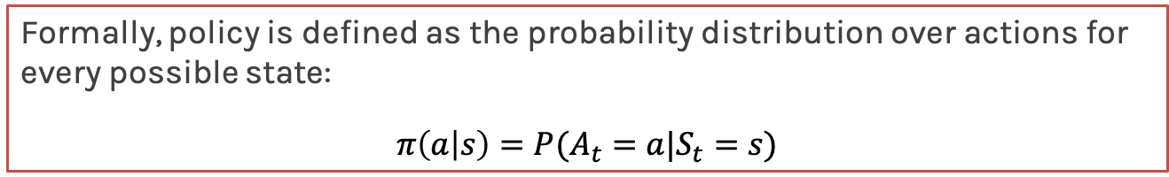
Policy (cont)
Formally, policy is defined as the probability distribution over actions for every possible state:
$$π\left(a | s\right)=P(A_{t}=a|S_{t}=s)$$
An optimal policy 𝛑* is one that maximizes the expected value function :
𝛑* = argmax_{𝛑} V_{𝛑}(s)

Slide 43
Markov Decision Process
More terminology we need to learn
state ✓
episode ✓
history ✓
value ✓
policy ✓

Slide 44
🙌

Slide 45
Learning Optimal Policies
Dynamic Programming Methods (Value and Policy Iteration)

Slide 46
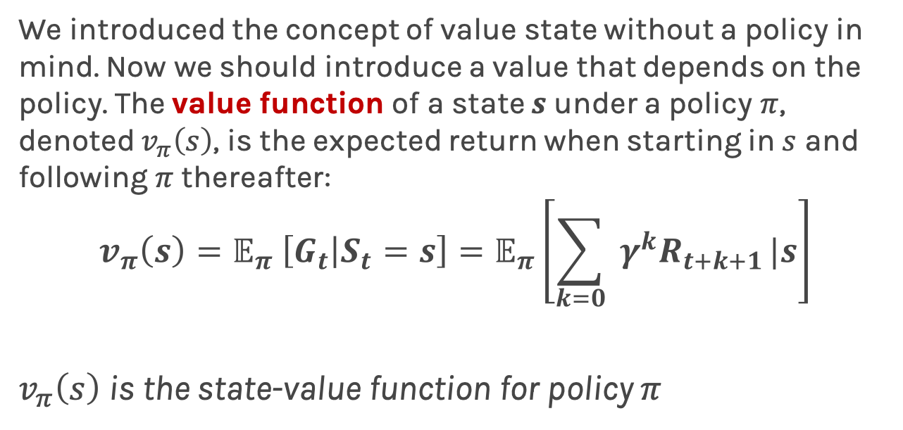
Value function
We introduced the concept of value state without a policy in mind. Now we should introduce a value that depends on the policy. The value function of a state $s$under a policy $π$, denoted $v_{π}\left(s\right)$, is the expected return when starting in $s$ and following $π$ thereafter:
$$v_{π}\left(s\right)=𝔼_{π} \left[G_{t} | S_{t}=s\right]=𝔼_{π}\left[\sum_{k=0}{ γ^{k}R_{t+k+1}}|s\right]$$
$v_{π}\left(s\right)$ is the state-value function for policy $π$

Slide 47
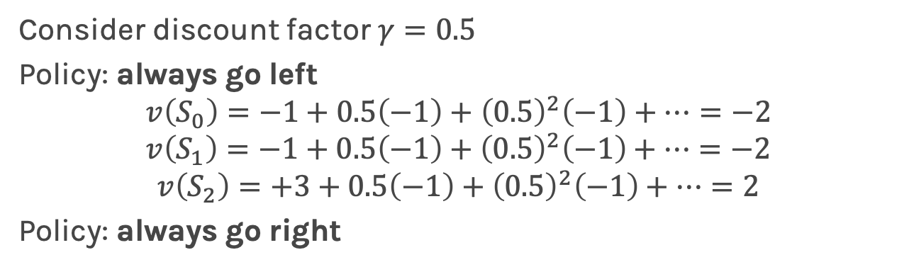
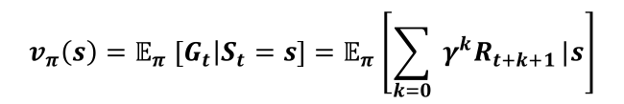
Value function - example
$$v_{π}\left(s\right)=𝔼_{π} \left[G_{t} | S_{t}=s\right]=𝔼_{π}\left[\sum_{k=0}{ γ^{k}R_{t+k+1}}|s\right]$$
S₀
S₁
+3
-1
-1
S₂
Consider discount factor $γ=0.5$
Policy: always go left
$$v\left(S_{0}\right)=−1+0.5\left(−1\right)+{\left(0.5\right)}^{2}\left(−1\right)+…=−2$$
$$v\left(S_{1}\right)=−1+0.5\left(−1\right)+{\left(0.5\right)}^{2}\left(−1\right)+…=−2$$
$$v\left(S_{2}\right)=+3+0.5\left(−1\right)+{\left(0.5\right)}^{2}\left(−1\right)+…=2$$
Policy: always go right

Slide 48
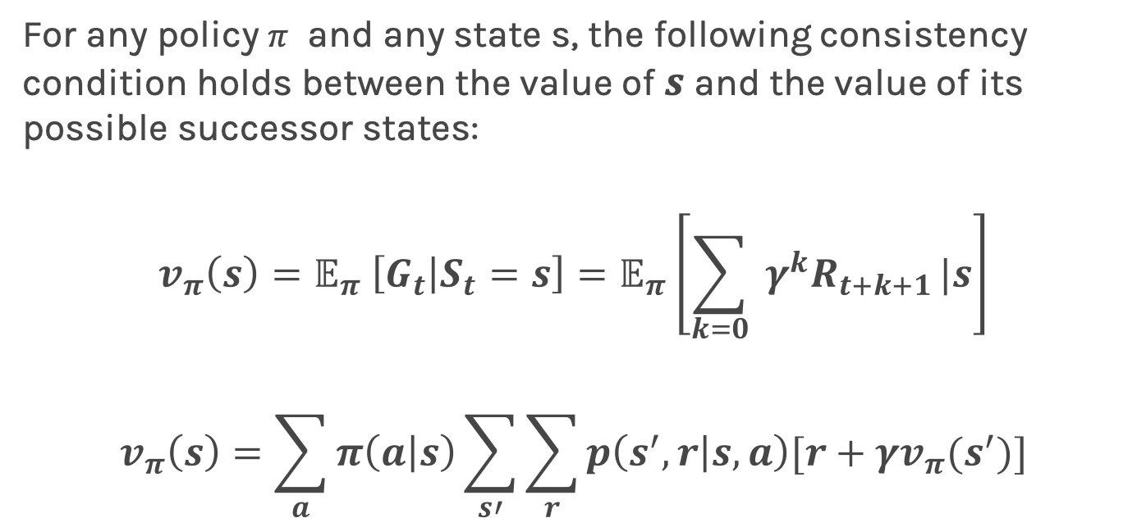
Dynamic Programming - Value function
For any policy $π$ and any state s, the following consistency condition holds between the value of $s$ and the value of its possible successor states:
$$v_{π}\left(s\right)=𝔼_{π} \left[G_{t} | S_{t}=s\right]=𝔼_{π}\left[\sum_{k=0}{ γ^{k}R_{t+k+1}}|s\right]$$
$$v_{π}\left(s\right)=\sum_{a}{π\left(a | s\right)\sum_{s′}{\sum_{r}{p\left(s^{′},r | s,a\right)[r+γv_{π}(s^{′})]}}}$$

Slide 49
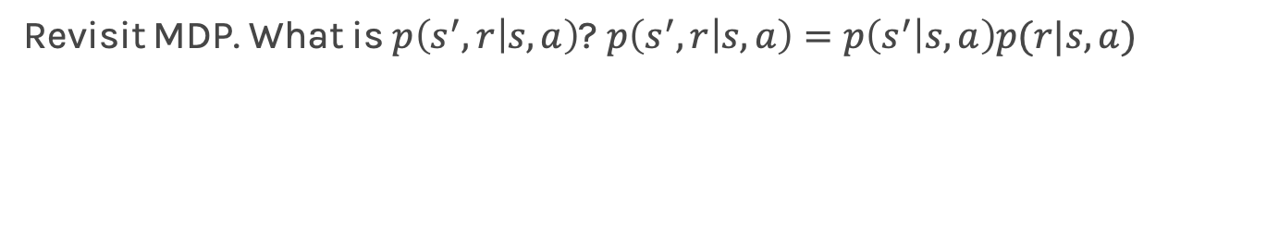

Dynamic Programming - Value function
Revisit MDP. What is $p\left(s^{′},r | s,a\right)$? $p\left(s^{′},r | s,a\right)=p\left(s^{′} | s,a\right)p(r|s,a)$
S₀
S₁
+3
-1
-1
S₂
Action: go left
Action: go right
$$p\left(s^{′} | s,a\right)$$
0 | 1 | 0 | 0
1 | 1 | 0 | 0
2 | 0 | 1 | 0
 | 0 | 1 | 2
0 | 0 | 1 | 0
1 | 0 | 0 | 1
2 | 0 | 0 | 1
 | 0 | 1 | 2
Initial state
Initial state
Final state
Final state

Slide 50
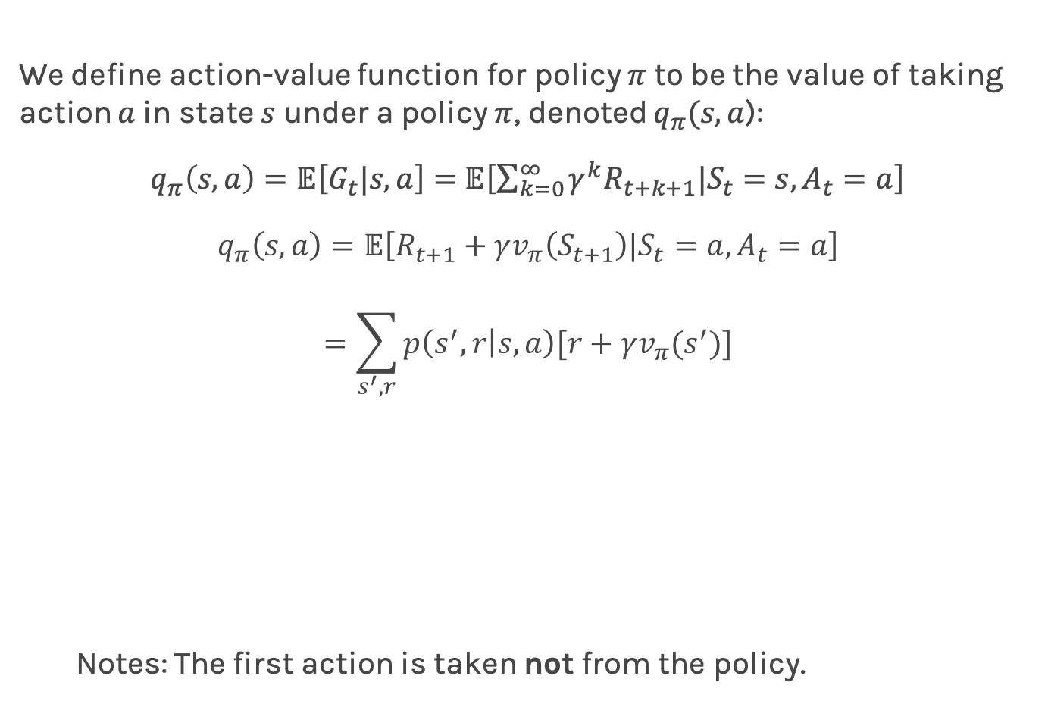
Value of Action $q_{π}(s,a)$
We define action-value function for policy $π$to be the value of taking action $a$in state $s$ under a policy $π$, denoted $q_{π}(s,a$):
$q_{π}\left(s,a\right)=𝔼\left[G_{t}|s,a\right]=$ $𝔼\left[\sum_{k=0}^{∞}{γ^{k}R_{t+k+1}|S_{t}=s,A_{t}}=a\right]$
$$q_{π}\left(s,a\right)=𝔼\left[R_{t+1}+γv_{π}\left(S_{t+1}\right)|S_{t}=a, A_{t}=a\right]$$
$$=\sum_{s^{′},r}{p\left(s^{′},r | s,a\right)[r+γv_{π}(s^{′})}]$$
Notes: The first action is taken not from the policy.
S₀
S₁
+3
-1
-1
S₂
Notes:
THIS NEEDS TO CHANGE

Slide 51
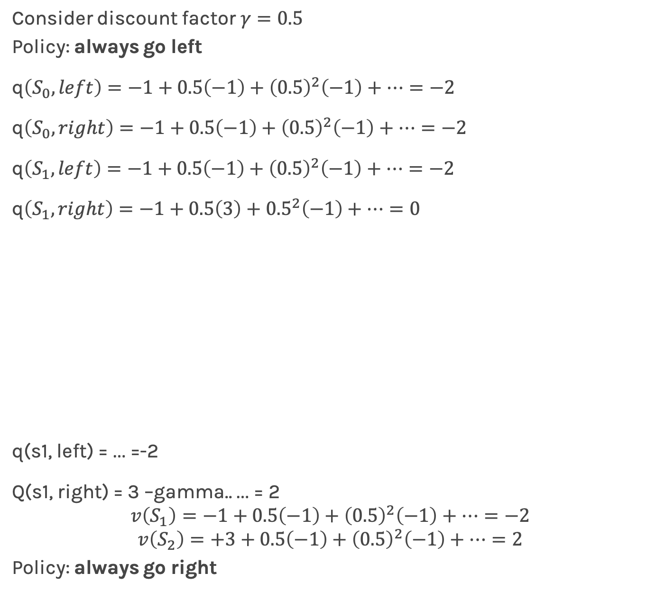
Value of Action $q_{π}(s,a)$
S₀
S₁
+3
-1
-1
S₂
Consider discount factor $γ=0.5$
Policy: always go left
q$\left(S_{0}, left\right)=−1+0.5\left(−1\right)+{\left(0.5\right)}^{2}\left(−1\right)+…=−2$
q$\left(S_{0}, right\right)=−1+0.5\left(−1\right)+{\left(0.5\right)}^{2}\left(−1\right)+…=−2$
q$\left(S_{1}, left\right)=−1+0.5\left(−1\right)+{\left(0.5\right)}^{2}\left(−1\right)+…=−2$
q$\left(S_{1}, right\right)=−1+0.5\left(3\right)+{0.5}^{2}\left(−1\right)+…=0$
q(s1, left) = … =-2
Q(s1, right) = 3 –gamma.. … = 2
$$v\left(S_{1}\right)=−1+0.5\left(−1\right)+{\left(0.5\right)}^{2}\left(−1\right)+…=−2$$
$$v\left(S_{2}\right)=+3+0.5\left(−1\right)+{\left(0.5\right)}^{2}\left(−1\right)+…=2$$
Policy: always go right
Notes:
THIS NEEDS TO CHANGE

Slide 52
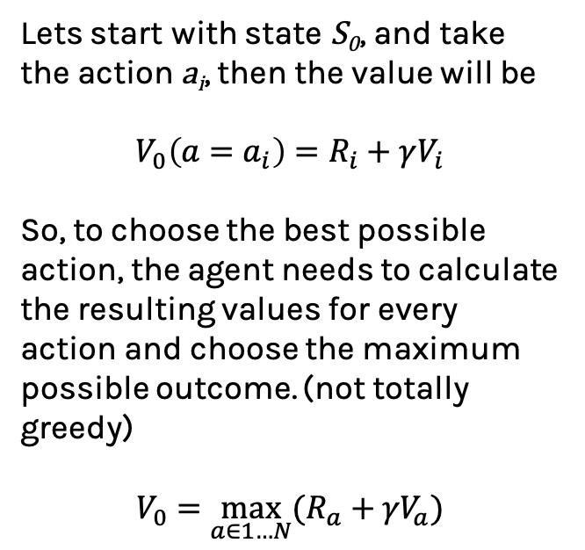
﻿Bellman equation (deterministic)
Lets start with state S₀, and take the action a_{i}, then the value will be
$$V_{0}\left(a=a_{i}\right)=R_{i}+γV_{i}$$
So, to choose the best possible action, the agent needs to calculate the resulting values for every action and choose the maximum possible outcome. (not totally greedy)
$$V_{0}=\max_{a∈1…N}{(R_{a}+{γV}_{a})}$$
Notes:
Clear notation

Slide 53
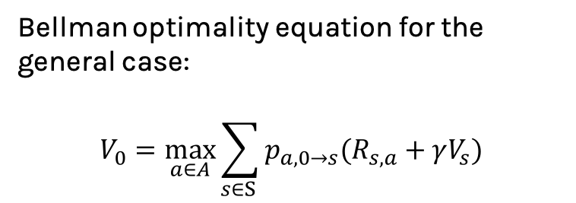
﻿Bellman equation (stochastic)
Bellman optimality equation for the general case:
$$V_{0}=\max_{a∈A}{\sum_{s∈S }{p_{a, 0→s}(R_{s,a}+γV_{s})}}$$

Slide 54
Model Based and Model Free Methods
Model Based:
Knowing the transition matrix.
Model Free:
Not knowing the transition matrix.

Slide 55
Model-Based Methods
Policy Iteration

Slide 56
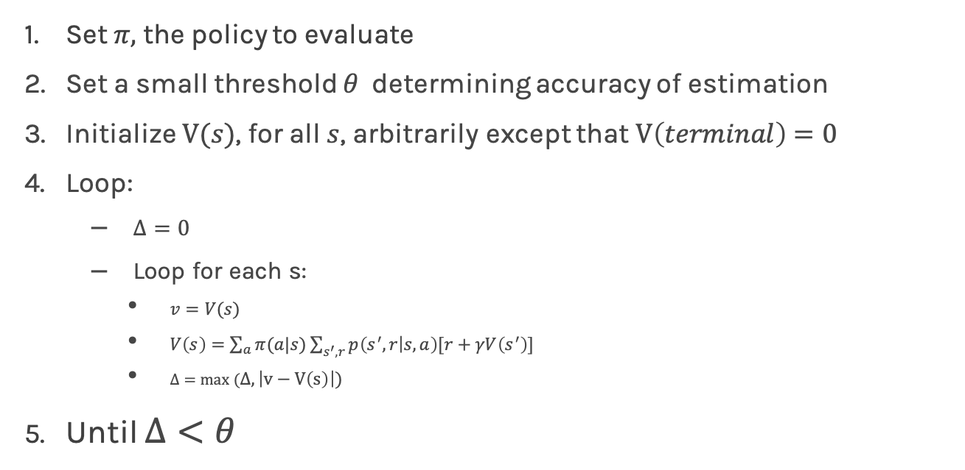
Policy Evaluation
Set $π,$ the policy to evaluate
Set a small threshold $θ$ determining accuracy of estimation
Initialize $V(s)$, for all $s$, arbitrarily except that $V\left(terminal\right)=0$
Loop:
$Δ=0$
Loop for each s:
$v=V(s)$
$V\left(s\right)=\sum_{a}{π(a|s)}\sum_{s^{′},r}{p\left(s^{′},r | s,a\right)[r+γV\left(s^{′}\right)]}$
$Δ=max (Δ,\left|v−V\left(s\right)\right|)$
Until $Δ<θ$

Slide 57
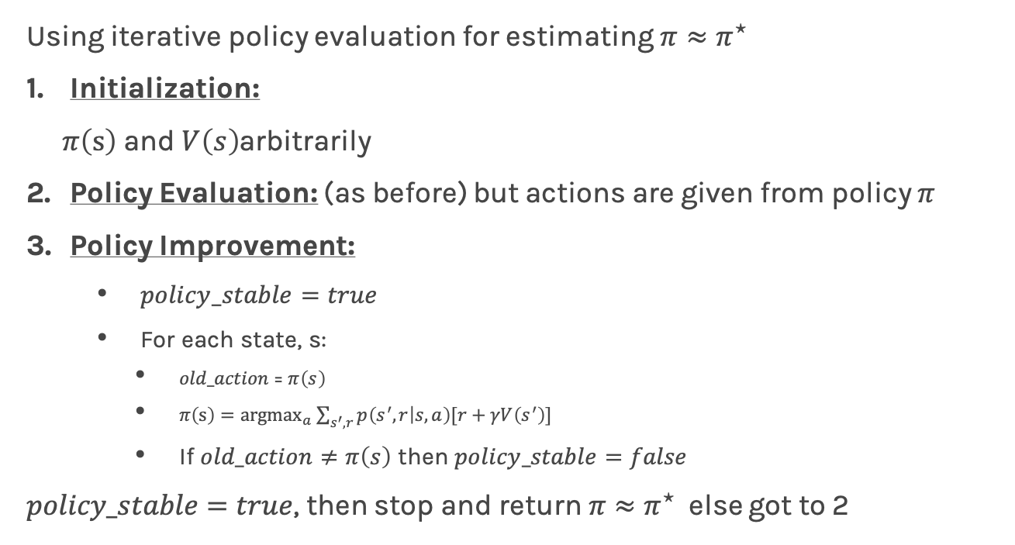
Policy Iteration
Using iterative policy evaluation for estimating $π≈π^{⋆}$
Initialization:
$π\left(s\right)$ and $V\left(s\right)$arbitrarily
Policy Evaluation: (as before) but actions are given from policy $π$
Policy Improvement:
$policy_stable=true$
For each state, s:
$old_action$= $π\left(s\right)$
$π\left(s\right)={argmax}_{a}\sum_{s^{′},r}{p\left(s^{′},r | s, a\right)[r+γV\left(s^{′}\right)]}$
If $old_action≠π\left(s\right)$ then $policy_stable=false$
$policy_stable=true$, then stop and return $π≈π^{⋆}$ else got to 2

Slide 58
References: Sutton and Barto, Reinforcement Learning (http://incompleteideas.net/book/RLbook2018.pdf) Maxim Lapam, Deep Reinforcement Learning Hands-On: Apply Modern RL Methods, with Deep Q-networks, Value Iteration, Policy Gradients, TRPO, AlphaGo Zero and More

Slide 59
Model Free Methods
SARSA and Q-learning Friday at a-sec by Javier Zazo

Slide 60
Uncertainty in model and prediction
Cross validation
Overfitting: Variance & Bias
Pandas
NumPy
Scikit-Learn
PCA & dimensionality reduction
Statistical Learning
Computing Tools
Matplotlib
Methods of regularization:
Lasso and Ridge
Regression
Classification
Logistic
Linear
Trees
KNN
Neural Networks
Experimental Design & Causal Inference

Slide 62
I am Pavlos Protopapas
Thank you!

