Slide 1


Lab 11: Reinforcement Learning
With a focus on Homework 8
Harvard IACS
CS109B
Chris Tanner, Pavlos Protopapas, Mark Glickman

Slide 2

RL Environment
Agent
The thing that operates within the environment

Slide 3
RL Environment
Agent
States
The thing that operates within the environment
Static representations that define the current environment

Slide 4

RL Environment
Agent
States
Actions
The thing that operates within the environment
Static representations that define the current environment
An agent’s operation that takes him/her from state s to state s’

Slide 5

RL Environment
Agent
States
Actions
Reward
The thing that operates within the environment
Static representations that define the current environment
An agent’s operation that takes him/her from state s to state s’
A real-valued # that represents the goodness for the agent’s being in a given state s

Slide 6
The agent starts in an initial state s

Slide 7
The agent starts in an initial state s
She performs an action a and becomes in state s’

Slide 8
The agent starts in an initial state s
She performs an action a and becomes in state s’
Being in each state s’ yields a reward r (e.g, 3.6)

Slide 9
The agent starts in an initial state s
She performs an action a and becomes in state s’
Being in each state s’ yields a reward r (e.g, 3.6)
How do we determine how to move from state-to-state so as to receive maximum reward r?

Slide 10
The agent starts in an initial state s
She performs an action a and becomes in state s’
That’s the entire crux of reinforcement learning!
Being in each state s’ yields a reward r (e.g, 3.6)
How do we determine how to move from state-to-state so as to receive maximum reward r?

Slide 11
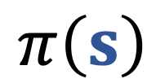
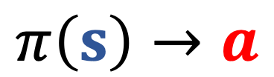
Given a state s, and an action a, estimate the reward r.
A policy takes a state s and executes an action a
$$π\left(s\right)$$
$$π\left(s\right)→a$$

Slide 12
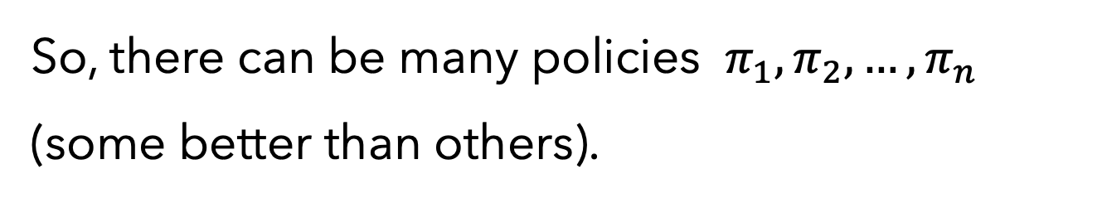
So, there can be many policies $π_{1},π_{2},…,π_{n}$ (some better than others).
which policy to execute?
How do we determine how to move from state-to-state so as to receive maximum reward r?
The one that gives us the highest reward! Let’s estimate each policy $π_{i}$ via a “value-function” $v_{π}\left(\text{s}\right)$, where s is our starting state

Slide 13
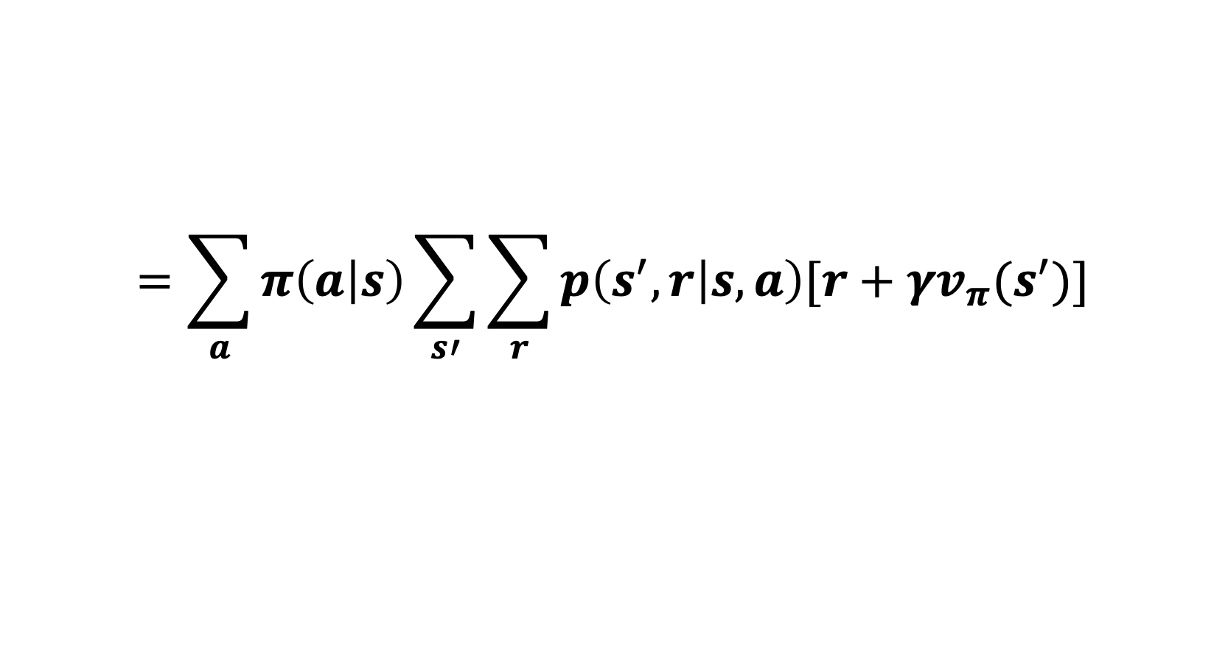
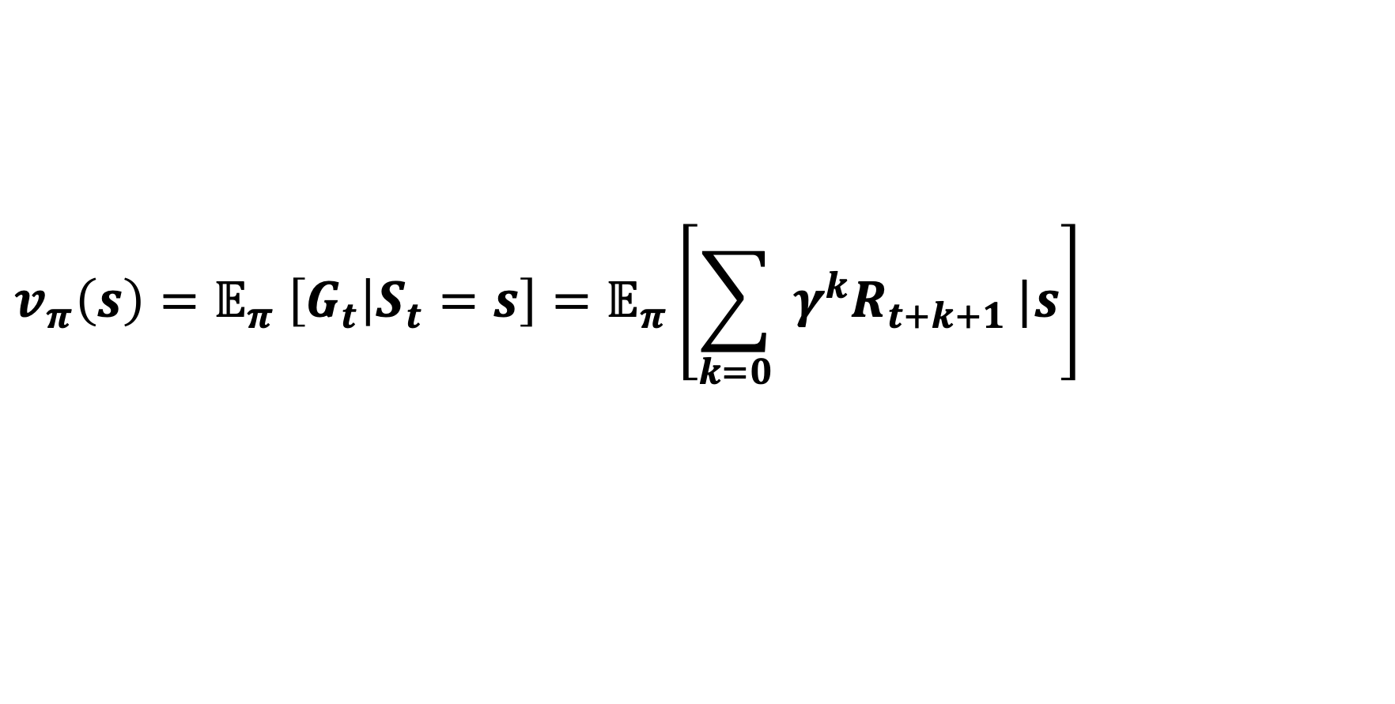
In class, we saw that:
$$v_{π}\left(s\right)=𝔼_{π} \left[G_{t} | S_{t}=s\right]=𝔼_{π}\left[\sum_{k=0}{ γ^{k}R_{t+k+1}}|s\right]$$
$$=\sum_{a}{π\left(a | s\right)\sum_{s′}{\sum_{r}{p\left(s^{′},r | s,a\right)[r+γv_{π}(s^{′})]}}}$$

Slide 14
In class, we saw that:
$$v_{π}\left(s\right)=𝔼_{π} \left[G_{t} | S_{t}=s\right]=𝔼_{π}\left[\sum_{k=0}{ γ^{k}R_{t+k+1}}|s\right]$$
The policy we’re interested in
$$=\sum_{a}{π\left(a | s\right)\sum_{s′}{\sum_{r}{p\left(s^{′},r | s,a\right)[r+γv_{π}(s^{′})]}}}$$

Slide 15
In class, we saw that:
Our starting state s
$$v_{π}\left(s\right)=𝔼_{π} \left[G_{t} | S_{t}=s\right]=𝔼_{π}\left[\sum_{k=0}{ γ^{k}R_{t+k+1}}|s\right]$$
The policy we’re interested in
$$=\sum_{a}{π\left(a | s\right)\sum_{s′}{\sum_{r}{p\left(s^{′},r | s,a\right)[r+γv_{π}(s^{′})]}}}$$

Slide 16
In class, we saw that:
Our starting state s
Cumulative reward
$$v_{π}\left(s\right)=𝔼_{π} \left[G_{t} | S_{t}=s\right]=𝔼_{π}\left[\sum_{k=0}{ γ^{k}R_{t+k+1}}|s\right]$$
The policy we’re interested in
$$=\sum_{a}{π\left(a | s\right)\sum_{s′}{\sum_{r}{p\left(s^{′},r | s,a\right)[r+γv_{π}(s^{′})]}}}$$

Slide 17
In class, we saw that:
Our starting state s
Cumulative reward
Unadjusted reward
$$v_{π}\left(s\right)=𝔼_{π} \left[G_{t} | S_{t}=s\right]=𝔼_{π}\left[\sum_{k=0}{ γ^{k}R_{t+k+1}}|s\right]$$
The policy we’re interested in
$$=\sum_{a}{π\left(a | s\right)\sum_{s′}{\sum_{r}{p\left(s^{′},r | s,a\right)[r+γv_{π}(s^{′})]}}}$$

Slide 18
In class, we saw that:
Weakened based on how far into the future it is
Our starting state s
Cumulative reward
Unadjusted reward
$$v_{π}\left(s\right)=𝔼_{π} \left[G_{t} | S_{t}=s\right]=𝔼_{π}\left[\sum_{k=0}{ γ^{k}R_{t+k+1}}|s\right]$$
The policy we’re interested in
$$=\sum_{a}{π\left(a | s\right)\sum_{s′}{\sum_{r}{p\left(s^{′},r | s,a\right)[r+γv_{π}(s^{′})]}}}$$

Slide 19
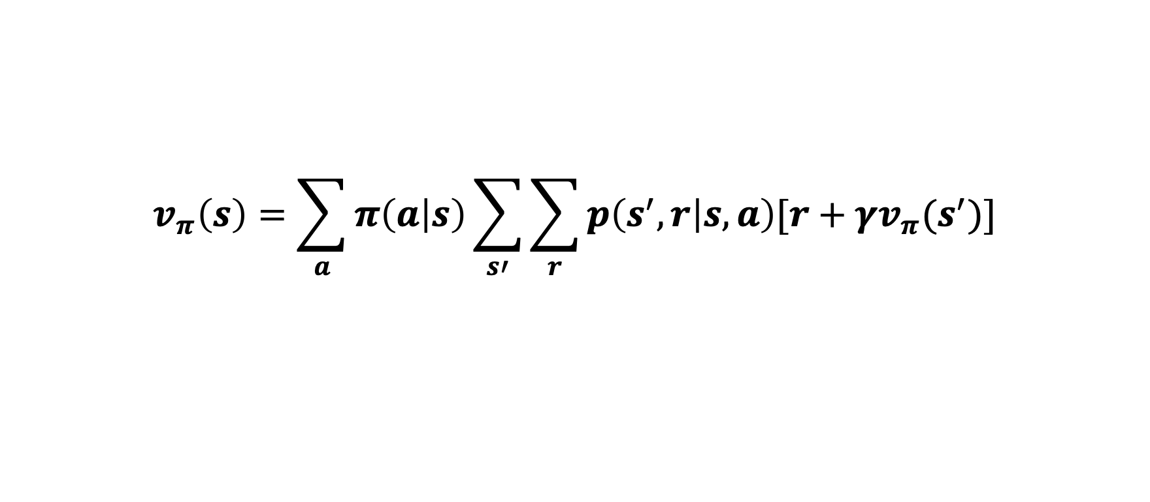
$$v_{π}\left(s\right)=\sum_{a}{π\left(a | s\right)\sum_{s′}{\sum_{r}{p\left(s^{′},r | s,a\right)[r+γv_{π}(s^{′})]}}}$$
HW #1.1
state-to-state transitions T
reward R
T=
R=

Slide 20
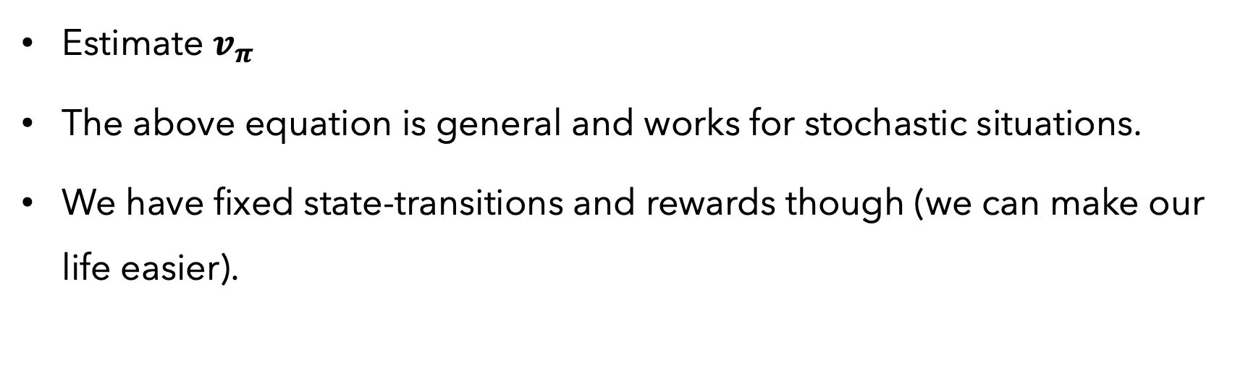
$$v_{π}\left(s\right)=\sum_{a}{π\left(a | s\right)\sum_{s′}{\sum_{r}{p\left(s^{′},r | s,a\right)[r+γv_{π}(s^{′})]}}}$$
HW #1.2
Estimate $v_{π}$
The above equation is general and works for stochastic situations.
We have fixed state-transitions and rewards though (we can make our life easier).

Slide 21

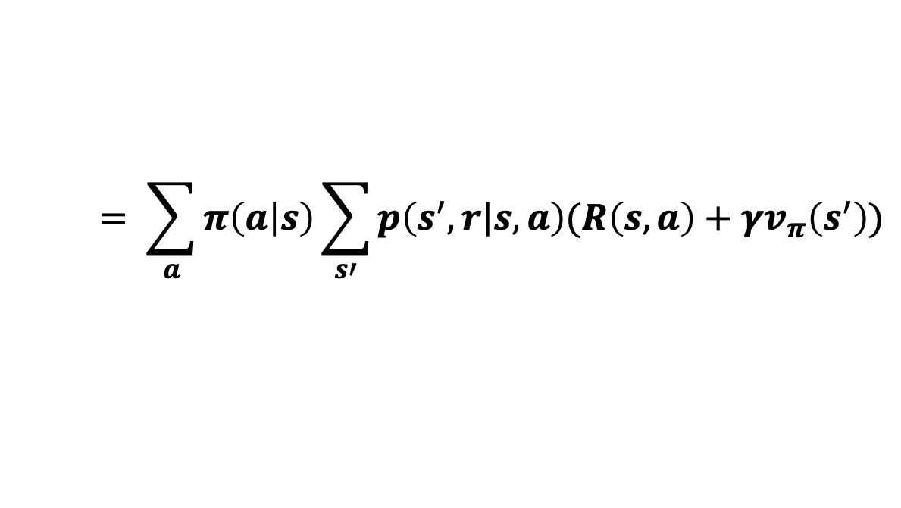
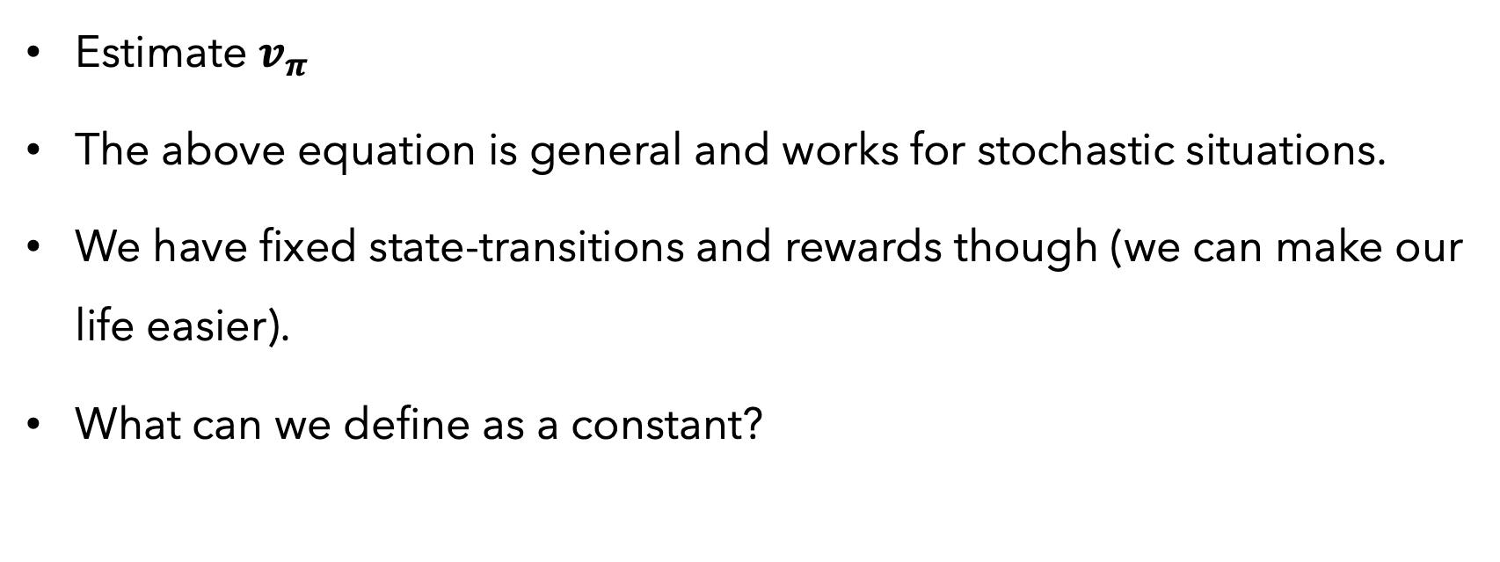
$$v_{π}\left(s\right)=\sum_{a}{π\left(a | s\right)\sum_{s′}{\sum_{r}{p\left(s^{′},r | s,a\right)[r+γv_{π}(s^{′})]}}}$$
$$= \sum_{a}{π\left(a | s\right)\sum_{s′}{p\left(s^{′},r | s,a\right)(R\left(s,a\right)+γv_{π}\left(s^{′}\right))}}$$
HW #1.2
Estimate $v_{π}$
The above equation is general and works for stochastic situations.
We have fixed state-transitions and rewards though (we can make our life easier).
What can we define as a constant?

Slide 22

$$v_{π}\left(s\right)=\sum_{a}{π\left(a | s\right)\sum_{s′}{\sum_{r}{p\left(s^{′},r | s,a\right)[r+γv_{π}(s^{′})]}}}$$
$$= \sum_{a}{π\left(a | s\right)\sum_{s′}{p\left(s^{′},r | s,a\right)(R\left(s,a\right)+γv_{π}\left(s^{′}\right))}}$$
HW #1.2
As a sanity check, a geometric series is defined to have a sum:

Slide 23
$$v_{π}\left(s\right)=\sum_{a}{π\left(a | s\right)\sum_{s′}{\sum_{r}{p\left(s^{′},r | s,a\right)[r+γv_{π}(s^{′})]}}}$$
$$= \sum_{a}{π\left(a | s\right)\sum_{s′}{p\left(s^{′},r | s,a\right)(R\left(s,a\right)+γv_{π}\left(s^{′}\right))}}$$
HW #1.3
What is a Q-function?

Slide 24
$$v_{π}\left(s\right)=\sum_{a}{π\left(a | s\right)\sum_{s′}{\sum_{r}{p\left(s^{′},r | s,a\right)[r+γv_{π}(s^{′})]}}}$$
$$= \sum_{a}{π\left(a | s\right)\sum_{s′}{p\left(s^{′},r | s,a\right)(R\left(s,a\right)+γv_{π}\left(s^{′}\right))}}$$
HW #1.3
What is a Q-function?

