Slide 1
Improving Postgraduate Learning
LaTeX Advanced –
Thesis Preparation
http://www.cse.cuhk.edu.hk/~yclaw/ipl_latex/
Dr. Yat-chiu LAW* (yclaw@cse.cuhk.edu.hk)
Lecturer, Dept of Comp. Sci. & Engg.
*Acknowledgment to Mr Michael Fung, who allowed me to adopt and adapt his slides for this workshop

Slide 2
Getting Started…
Boot up a computer
Choose English version Windows
Login: student-id@link.cuhk.edu.hk
Password: OnePass password
Wait…

Slide 3
Get Course Material
Visit:
http://www.cse.cuhk.edu.hk/~yclaw/ipl_latex/
Download and save the “Lab Materials” to D:\
IPL_LaTeX_Advanced_lab.zip
Extract the content of the zip file to D:\

Slide 4



LaTeX
A typesetting system for professional writing and publication
Commercial product
PCT_{E}X (www.pctex.com)
FREE open source software
MiKT_{E}X (www.miktex.org)
MacT_{E}X (www.tug.org/mactex/)

Slide 5
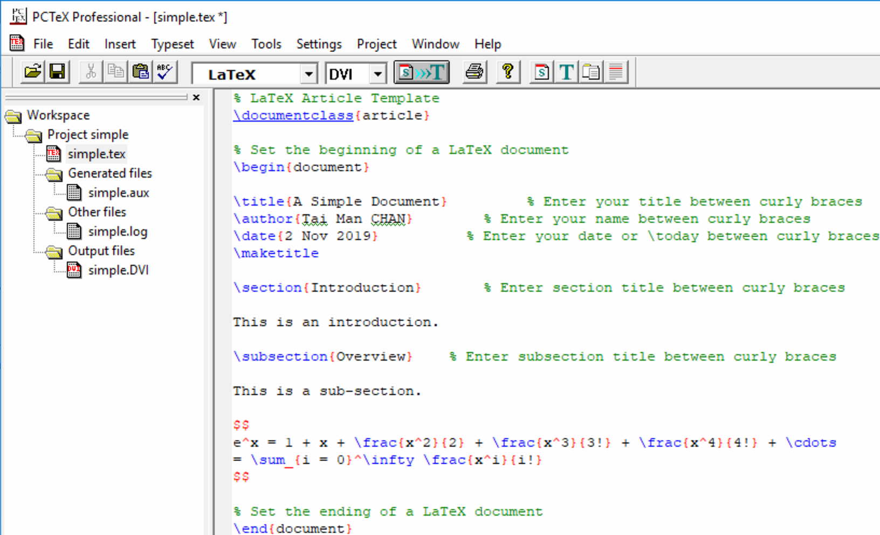
PCT_{E}X (This Workshop)
👍: Available in all computers in ITSC User Area
👎: Windows only. Not free. (Have to buy for your own computer)

Slide 6
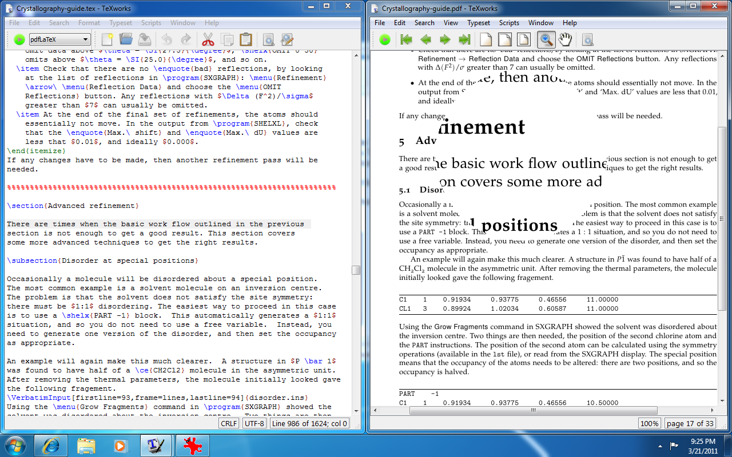
MiKT_{E}X and TeXworks
👍: Free of $ (open source). Extensible. TeXworks in multi-platform
👎: Not available in ITSC computers. Install and setup yourselves in your own computers

Slide 7
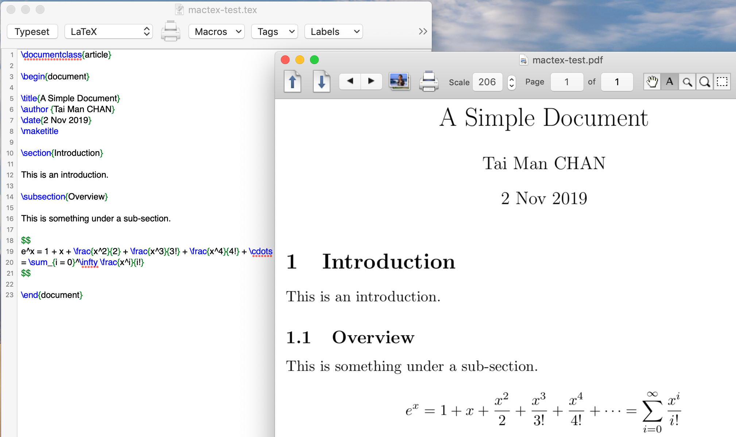
MacTeX
👍: Free of $. Extensible
👎: macOS only. Install and setup yourselves

Slide 8
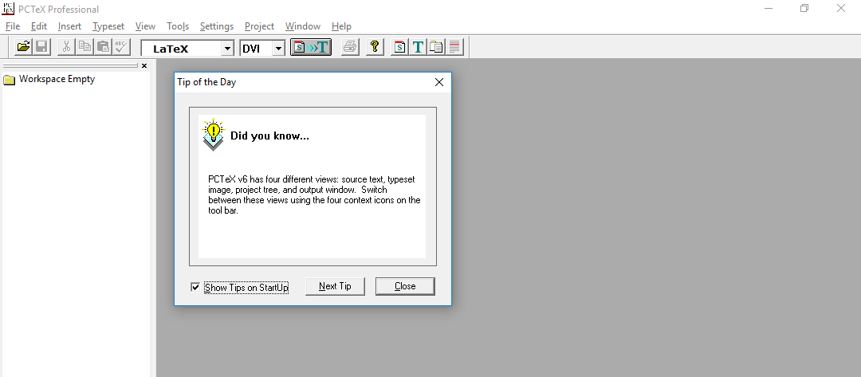
Start PCTeX
Start → All Programs → Authoring Tools → PCTeX32

Slide 9
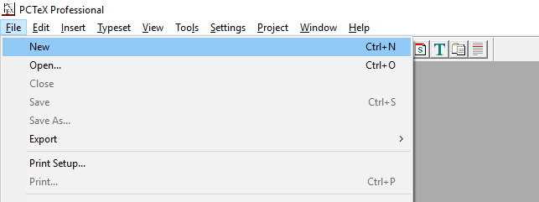
Creating a Simple Document in LaTeX
File → New

Slide 10
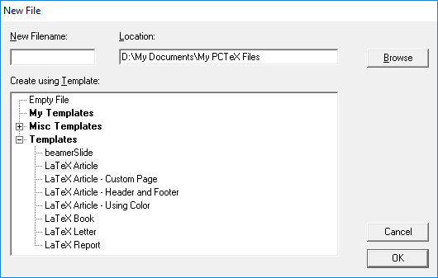
Creating a Simple Document in LaTeX
2. Click
Then…
1. Select “LaTeX Article”

Slide 11
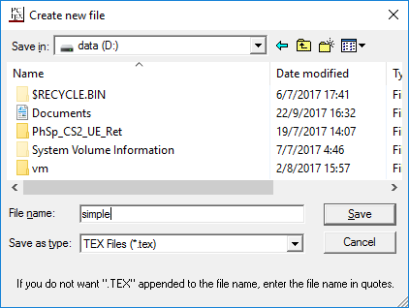
Creating a Simple Document in LaTeX
1. Choose D:
2. Type File name as
“simple” (without quotes)
LaTeX documents have a .tex file extension
3. Click

Slide 12
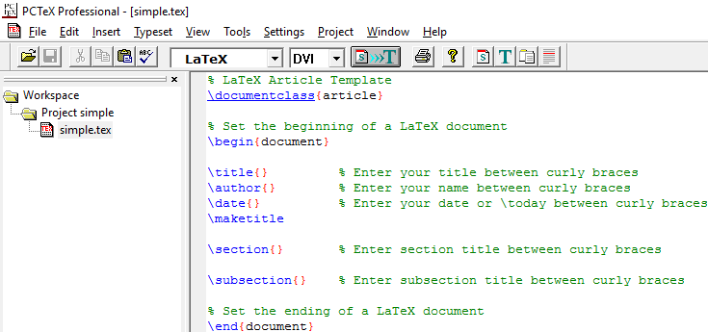
Your First Document
A file named simple.tex is created for you with some default contents

Slide 13
Editing Your Document
Type the following contents exactly:
Remember to _ Save (Ctrl-S) after typing

Slide 14
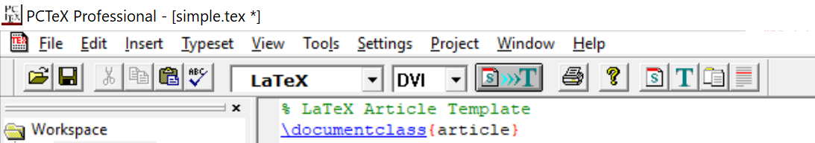
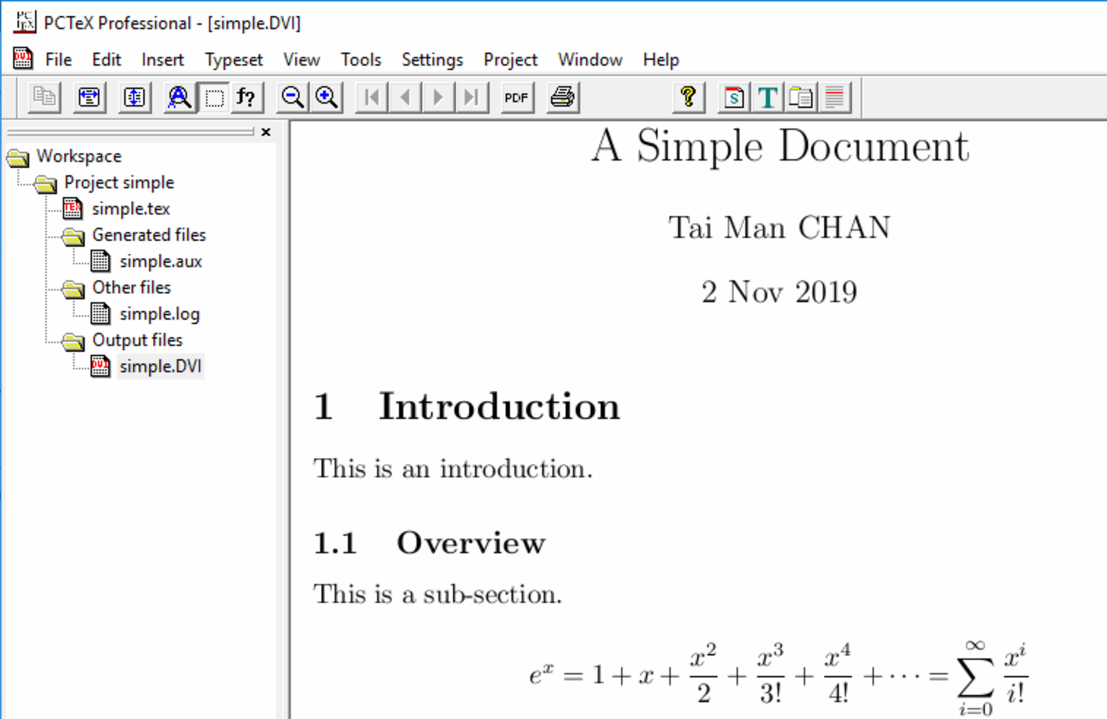
Typeset
Click (Ctrl-T) to do the first typeset
You should see the following:

Slide 15

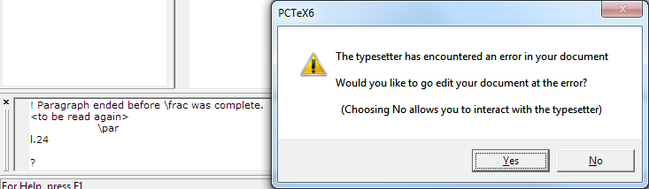
Error Message
If you type wrongly and then , you may get an error message
Do NOT click “No”!
Click “Yes”. Fix your error. Then typeset again

Slide 16
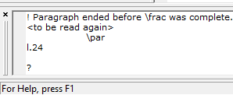
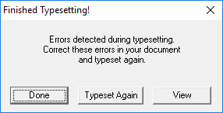
Error Message
If you (accidentally) clicked “No” in the last dialog:
1. Type here:
quit<Enter>
2. Then click

Slide 17
Final Document
When you complete your editing, you can generate a final pdf for publishing
2
1

Slide 18
Simple LaTeX Editing Cycle
Edit document
Typeset
Y
Error? Not yet finished?
N
Done. Export to pdf

Slide 19
Thesis Preparation
Before we really start…
What should be in a thesis?

Slide 20
Thesis
Title page
Abstract
Table of Contents
List of Figures
List of Tables
Text… (the Beef)
Bibliography

Slide 21
Thesis
Title page
Abstract
[Acknowledgments] (Optional)
Table of Contents
List of Figures
List of Tables
Text… (the Beef)
[Appendices] (Optional)
Bibliography

Slide 22
Course Material
Recall the “Lab Materials” that you downloaded and saved to D:\
D:\IPL_LaTeX_Advanced_lab.zip
Extract the zip content to D:\

Slide 23
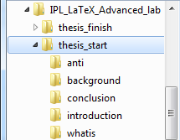
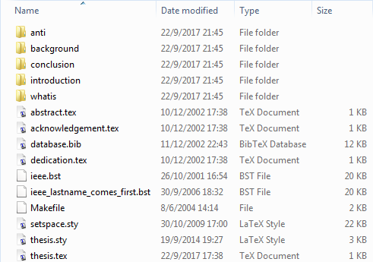
Thesis Template
The folder
D:\IPL_LaTeX_Advanced_lab\thesis_start
contains a LaTeX template for a thesis
(Be patient! Do NOT open the files yet!)

Slide 24
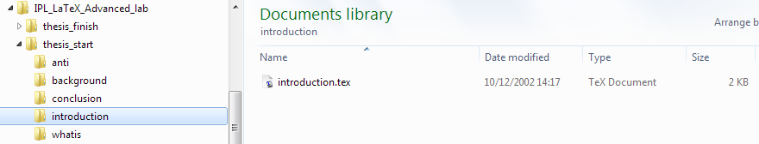
Thesis Template
When working on big documents (like your thesis), it is a good practice to split the input file into several .tex files for easier management
E.g., put each of your thesis chapters in its own sub-folder
D:\IPL_LaTeX_Advanced_lab\thesis_start\introduction\introduction.tex

Slide 25
Check Your Files
Each chapter is written in one .tex file
We assume that the thesis text, figures, tables, etc. have been prepared beforehand already
We are now going to bind them together into a thesis
The file thesis.tex will be the port of entry

Slide 26
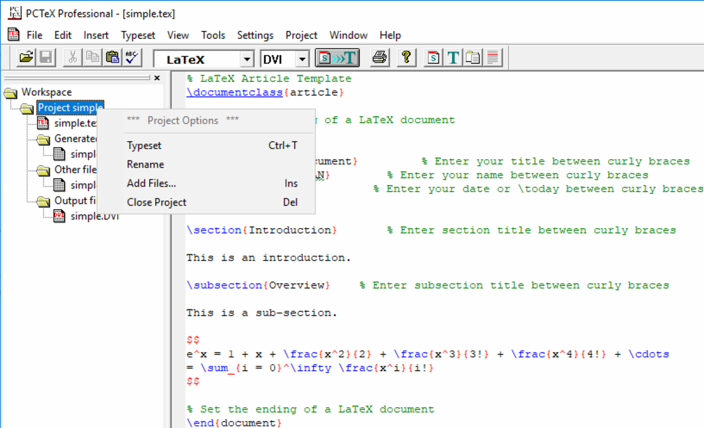
Back to PCTeX
You can close your previous project by:
1. Right
click
2. Select

Slide 27
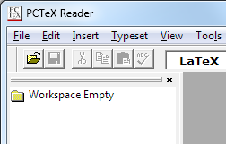
Look at the Master File
File → Open or
Go to:
D:\IPL_LaTeX_Advanced_lab\thesis_start
Select: thesis.tex and open
This is our master file
Let's start putting in the ingredients to make our sandwich

Slide 28
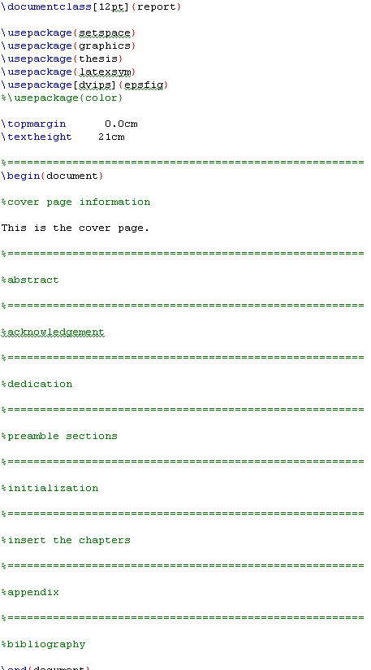
The Meat
The Master file glues other parts together
Check the Project window for other files
Cover Page
Thesis Chapters
\chapter
Preamble
Page Numbering and Style
Appendix
thesis.tex

Slide 29
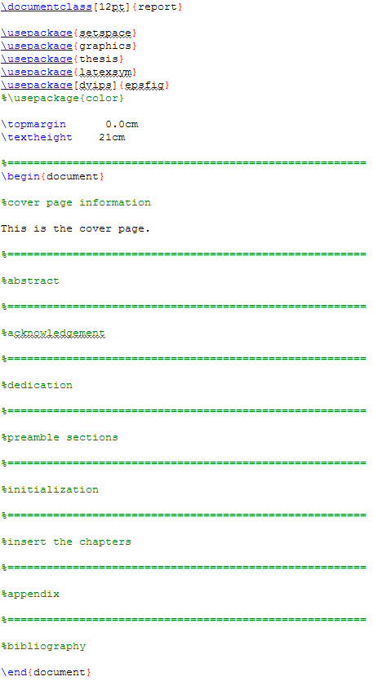
Preamble
\documentclass is now “report” (instead of “article”)
Use the “thesis” package (thesis.sty)
Recall that % means “comments” (i.e., skipped from typesetting)

Slide 30
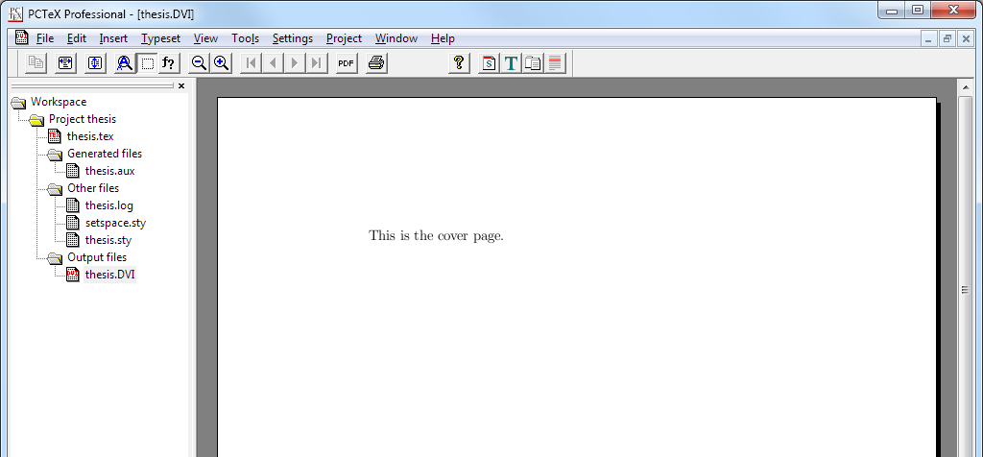
First Typesetting
Click (Ctrl-T) to typeset:
As you develop your documents further, you will see more and more files in your “Project”

Slide 31
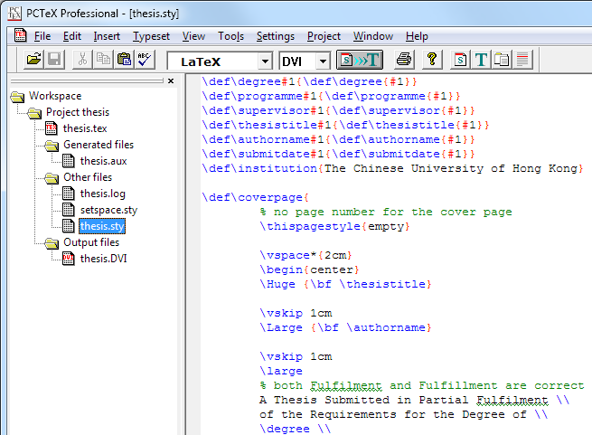
Style File
For example, going to the style file thesis.sty, you see many commands that help set your thesis layout properly
Do NOT modify this file!

Slide 32
Cover Page
Go back to thesis.tex.
Insert the following under “%cover page information":
Title: \thesistitle{…}
Author: \authorname{…}
Degree: \degree{…}
Programme: \programme{…}
Your boss: \supervisor{…}
Date: \submitdate{…}
\coverpage

Slide 33

Cover Page
Save
(Ctrl-S)
Typeset
(Ctrl-T)

Slide 34
Style File
The previous commands (\thesistitle, \authorname, etc.), and more coming, are non-standard LaTeX commands, self-defined in the thesis style file (thesis.sty)

Slide 35
Thesis Chapters
Recall our good practice:
Write each chapter in a separate file
Let’s insert the chapters one-by-one
Under “%insert the chapters”, type:
\input{./introduction/introduction.tex}
or: \input ./introduction/introduction.tex

Slide 36
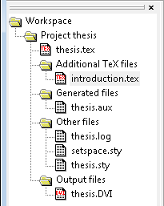
\input
\input{filename.tex}
Inserts the contents of another file named filename.tex to your document
E.g.:
\input{ ./introduction/introduction.tex }
current folder
path separator
folder name
file name
PCTeX will automatically detect any inserted files to your project

Slide 37
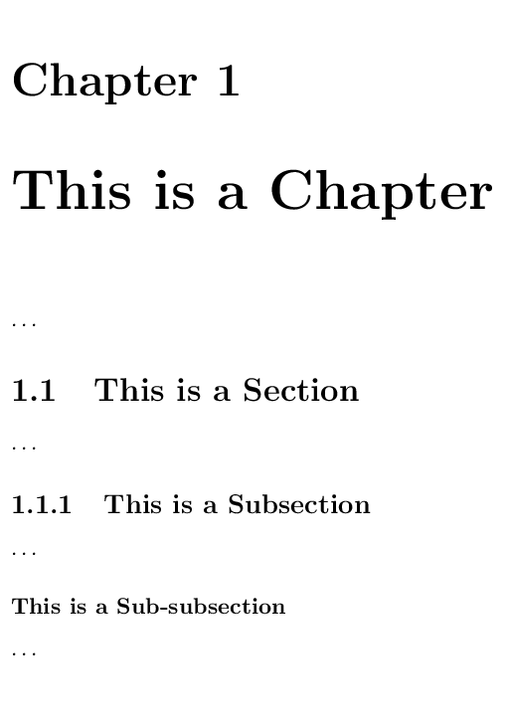
Thesis Chapters
The “report” document class allows an additional top-level sectioning command for chapters:
\chapter{…}
\section{…}
\subsecton{…}
\subsubsection{…}
\paragraph{…}
\chapter*{…} for a chapter without number

Slide 38
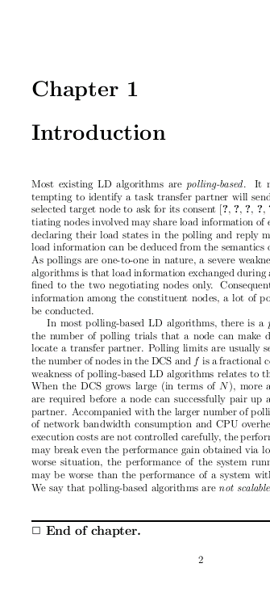
Thesis Chapters
Let’s go to the first chapter (introduction.tex) and start it with:
\chapter{Introduction}
Optionally, end each chapter with:
\chapterend

Slide 39
Thesis Chapters
Further insert the chapters in background.tex, anti.tex, and conclusion.tex
Add the chapter sectioning also (\section{…}, \subsection{…}, …)

Slide 40
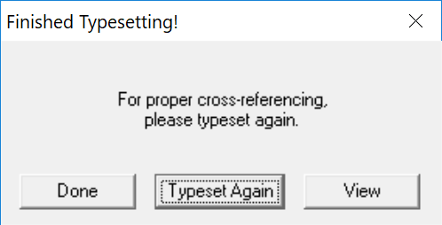
Multi-Pass Typeset
Sometimes, you may need to typeset your document multiple times to resolve cross-references
When prompted:
Click

Slide 41
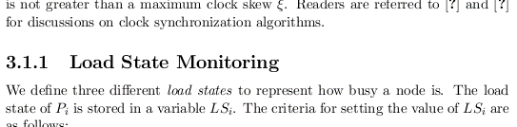

Cross-References
anti.tex
\subsection{Load State Monitoring}
\label{sec:anti.basic.monitor}
anti.tex
According to the load state definitions given in
Section~\ref{sec:anti.basic.monitor},
the workload of creator node …

Slide 42
\label and \ref
\label{…}: Setting a reference marker
E.g., in anti.tex:
\ref{…}: Referencing to a marker:
E.g., in anti.tex:
\subsection{Load State Monitoring}
\label{sec:anti.basic.monitor}
According to the load state definitions given in
Section~\ref{sec:anti.basic.monitor},
the workload of creator node …

Slide 43
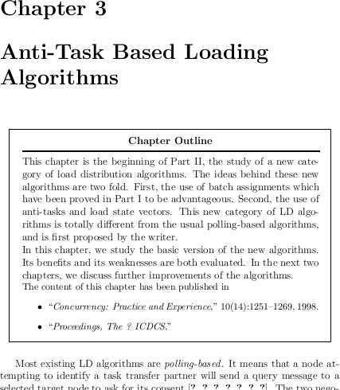
Chapter Outline
Some people would like to add, at the beginning of each chapter, a chapter outline
E.g., in anti.tex, try adding:
\note{Chapter Outline}{…}

Slide 44

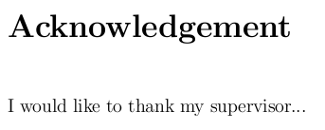

Preamble
Go back to thesis.tex, type:
Abstract:
\abstractpage
Acknowledgment:
\acknowledgementpage
Dedication:
\dedicationpage

Slide 45
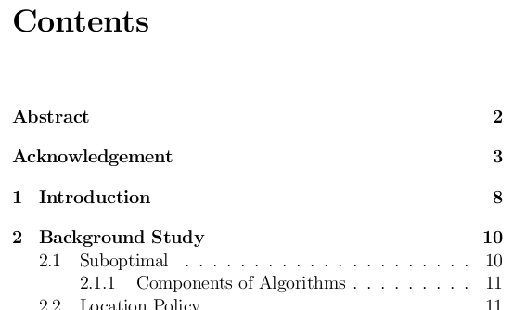
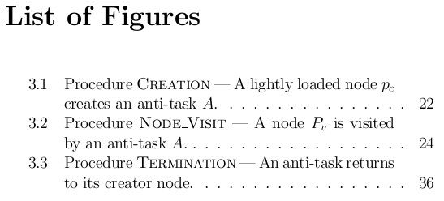
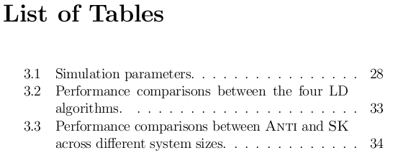
Preamble
Type under %preamble sections:
Table of Contents:
\tableofcontents
List of Figures:
\listoffigures
List of Tables:
\listoftables

Slide 46
Page Numbering
Roman number system, usually for the preamble
\pagenumbering{roman}
Arabic number system, usually for the main text
\newpage
\pagenumbering{arabic}
Put this before Abstract
Put them under Initialization

Slide 47
Page Numbering
If you want to set your own page number, use:
\setcounter{page}{x}
(where x is some number)

Slide 48
Page Style
Control how the headers and footers look like. Try (under %initialization) these one by one:
\pagestyle{headings}
\pagestyle{plain}
\pagestyle{empty}

Slide 49
Line Spacing
Control line spacing. Try (under %initialization):
\singlespacing
\onehalfspacing
\doublespacing

Slide 50
Appendix
To start producing appendixes:
\appendix
Section/chapter numbering will be automatically restarted and changed to alphabetic
E.g., Appendix A, Appendix B, …
Try including whatis.tex to see the effect

Slide 51
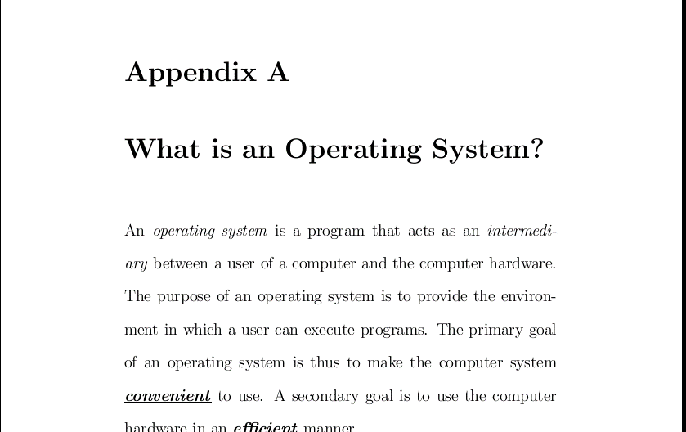
Appendix

Slide 52
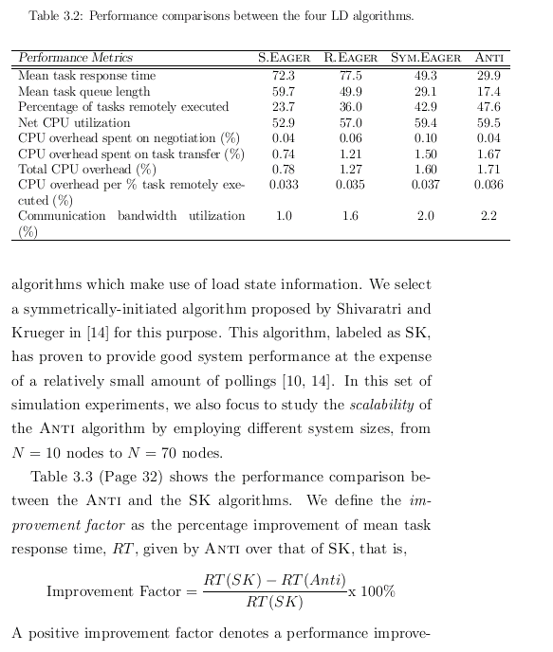
Tables
Table in anti.tex
In LaTeX, tables can easily grow beyond the margins
Tables can be resized using the \resizebox command:
Have to use the “graphicx” package at the preamble:
\usepackage{graphicx}
\resizebox{width}{height}{object}
(add in thesis.tex)

Slide 53
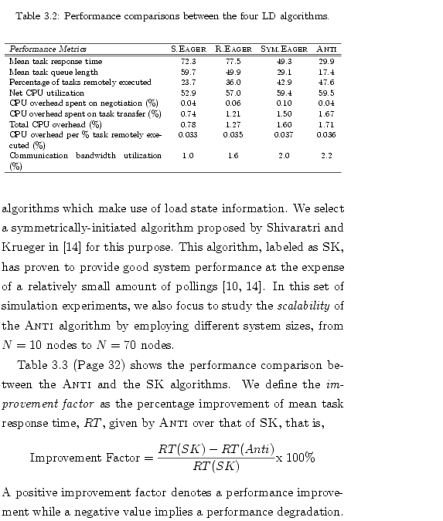
Resizing Tables
Find out the second table ({tabular}) in anti.tex, and type:
“Scale the whole table so that its width is the same as the text width, with the aspect ratio kept (!)”
\resizebox{\textwidth}{!}{
\begin{tabular}{…}
…
\end{tabular}
}

Slide 54
Tables
It is sometimes inconvenient to prepare LaTeX tables
Excel spreadsheets can be exported to LaTeX easily by using the following MS Office add-in:
Excel2LaTeX
http://www.ctan.org/tex-archive/support/excel2latex/

Slide 55
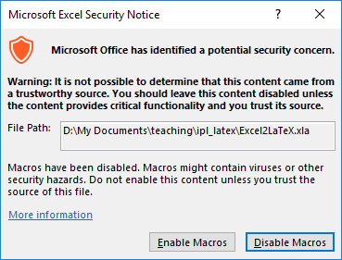
Excel2LaTeX
Download the file Excel2LaTeX.xla and open it in Excel
If prompted, enable the macro

Slide 56
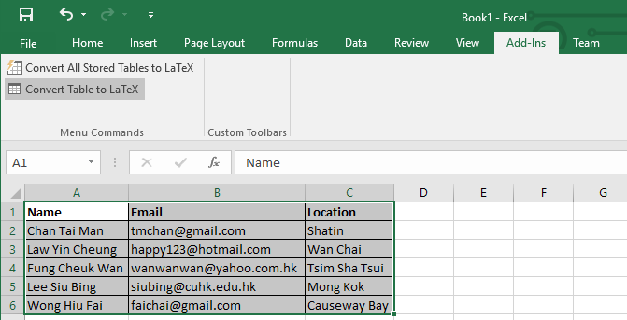
Excel2LaTeX
Create a table in Excel
Switch to the “Add-Ins” menu
3.
2.
1. Select the cells of your table and then click “Convert table to LaTeX”

Slide 57
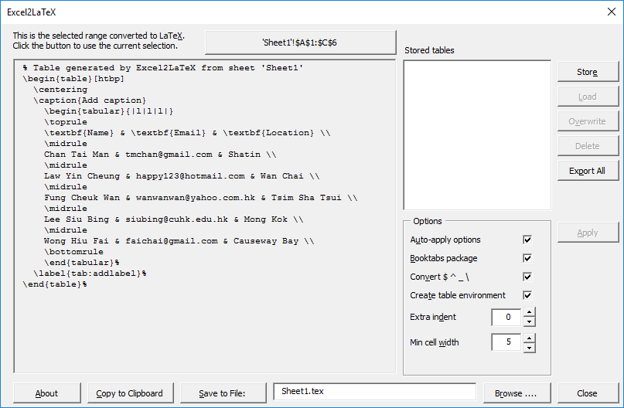
Excel2LaTeX
You can then copy the LaTeX table and paste to your thesis

Slide 58
Bibliography - BibTeX
BibTeX is a popular reference management tool for formatting list of references
You have to prepare a “database” file to contain the references you want to include in your document

Slide 59
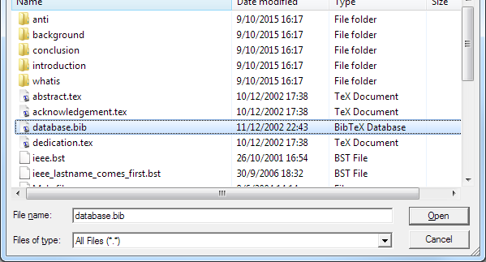
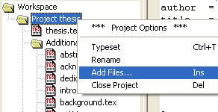
Bibliography - BibTeX
Glance the bibliography database
Right-click at “Project thesis” → “Add Files…”
In “Files of type:”, select “All Files”
Choose database.bib and “Open”
1. right click
2. select
4.
5.
3.

Slide 60
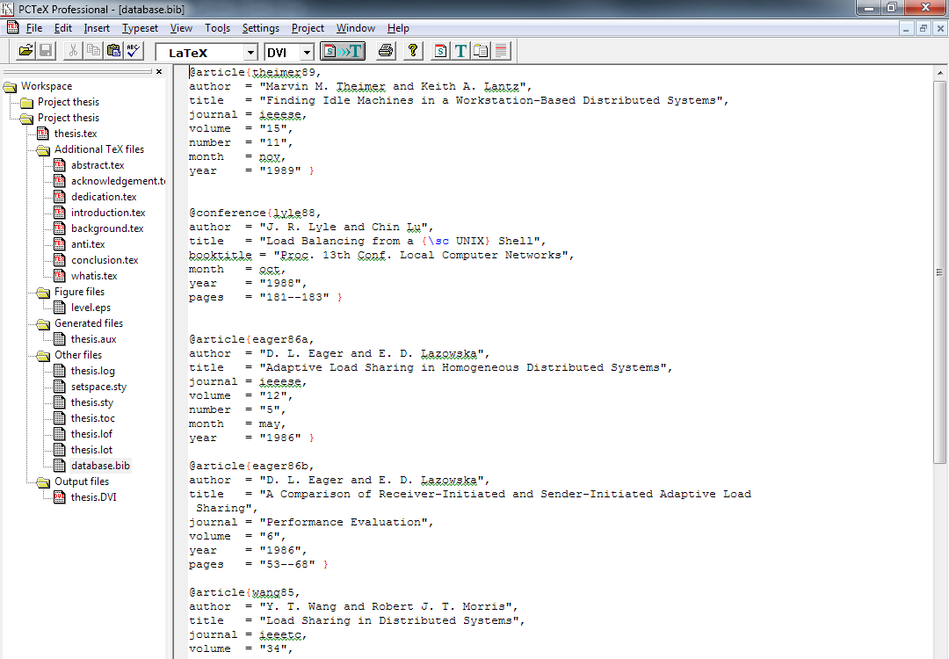
Bibliography - BibTeX
entries

Slide 61
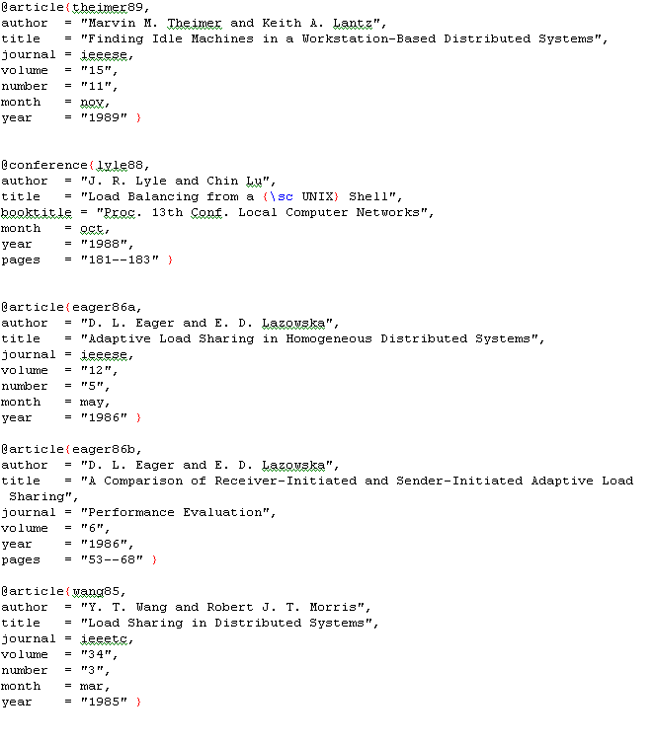
Bibliography - BibTeX
A journal paper entry
An entry in the database does not necessarily appear in your document’s bibliography section
You have to “\cite” it in order to appear
Citation key
A conference
paper entry

Slide 62
BibTeX Entry
Entry type
Fields
Each entry type has its own fields
E.g.: article type (for a journal or magazine article)
Required fields: author, title, journal, year
Optional fields: volume, number, pages, month, note, key

Slide 63
BibTeX Entry
Entry type
Fields
Each entry type has its own fields
E.g.: conference type (for a paper in a conference proceedings)
Required fields: author, title, booktitle, year
Optional fields: editor, volume/number, series, pages, address, month, organization, publisher, note, key

Slide 64
BibTeX Entry Types
Available entry types:
article, book, booklet, conference, incollection, inproceedings, manual, mastersthesis, misc, phdthesis, proceedings, techreport, unpublished
Different entry types have different required and optional fields
See: http://en.wikipedia.org/wiki/BibTeX

Slide 65
Bibliography - BibTeX
To use BibTeX in your thesis, go back to the master file thesis.tex
Type under “%bibliography”:
\newpage
\addcontentsline{toc}{chapter}{Bibliography}
\bibliographystyle{ieee}
\bibliography{database}
Citation style
Database file name
(.bib by default)

Slide 66
Bibliography - BibTeX
Adding a “Bibliography” entry to the Table of Contents (toc)
\addcontentsline{toc}{chapter}{Bibliography}
Bibliography style:
\bibliographystyle{ieee}
Requires the style file ieee.bst
(Try using \bibliographystyle{plain})
Database file
\bibliography{database}
Reads the database file database.bib

Slide 67

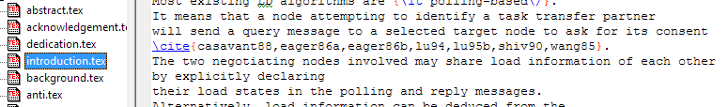
BibTeX
No space before and after “,”
To cite an entry in the database:
\cite{citation-key} or \cite{key1,key2,…}
(See introduction.tex for examples)
Typeset
Tools → Bibliography
Then typeset again

Slide 68
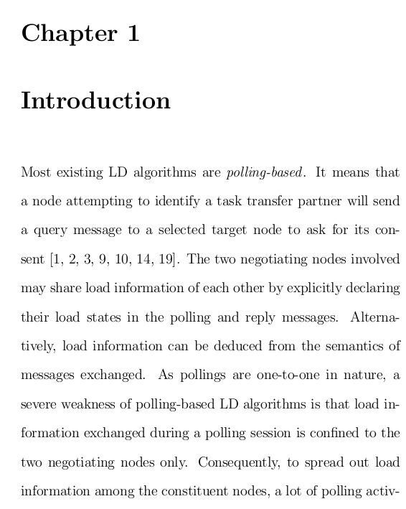
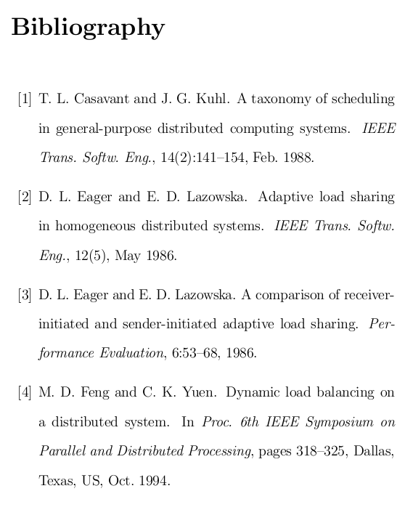
BibTeX

Slide 69
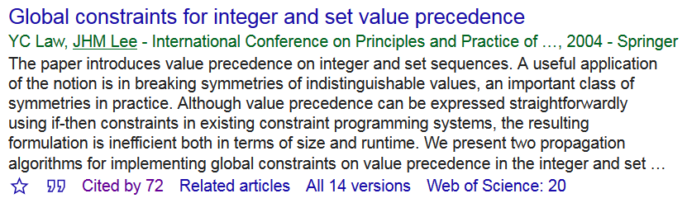
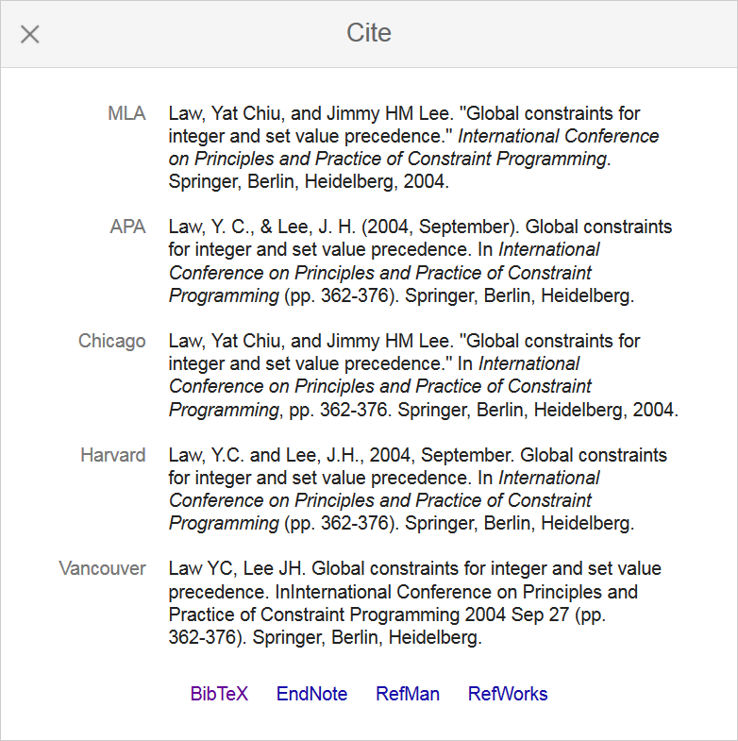
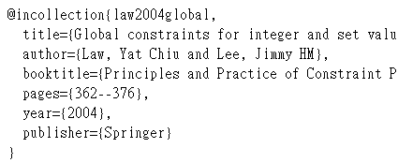
Google Scholar
Google Scholar (http://scholar.google.com) can help prepare the database!
1
2

Slide 70
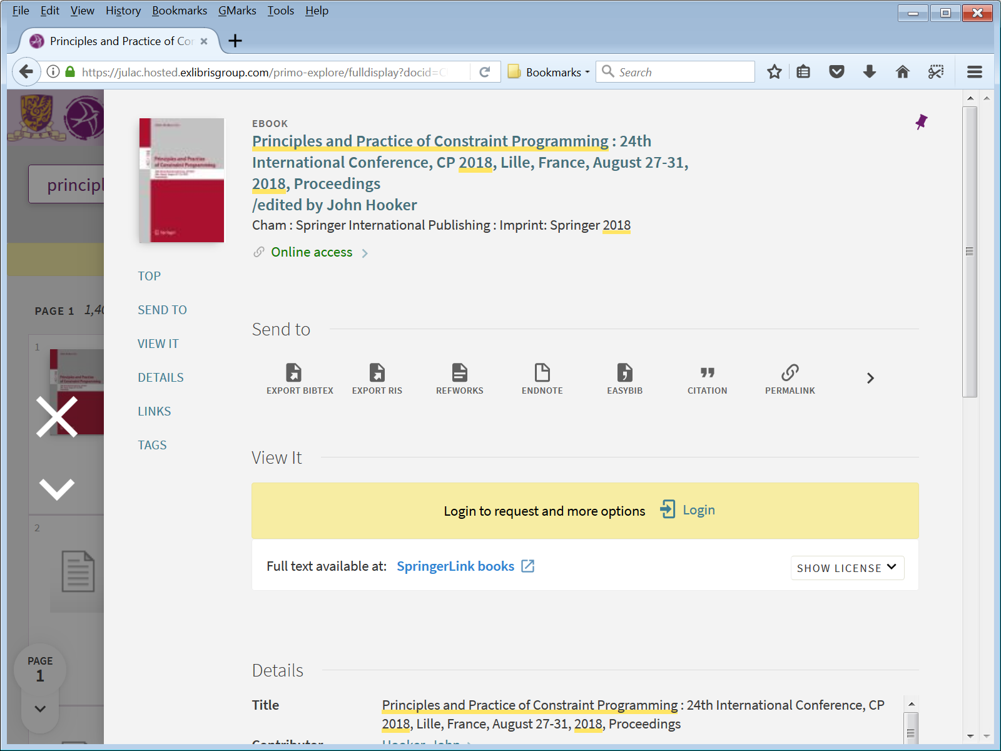
CUHK LibrarySearch

Slide 71
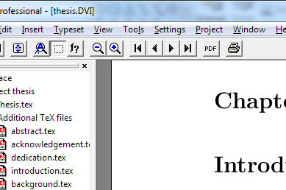
Printing and Publishing
You can print your thesis with PCTeX
There are tools for converting your thesis into different formats
PostScript (PS) and
Portable Document Format (PDF)
You are ready to publish your work!

Slide 72
Thank You
Wish you a smooth thesis writing!

