Slide 1


Slide 2
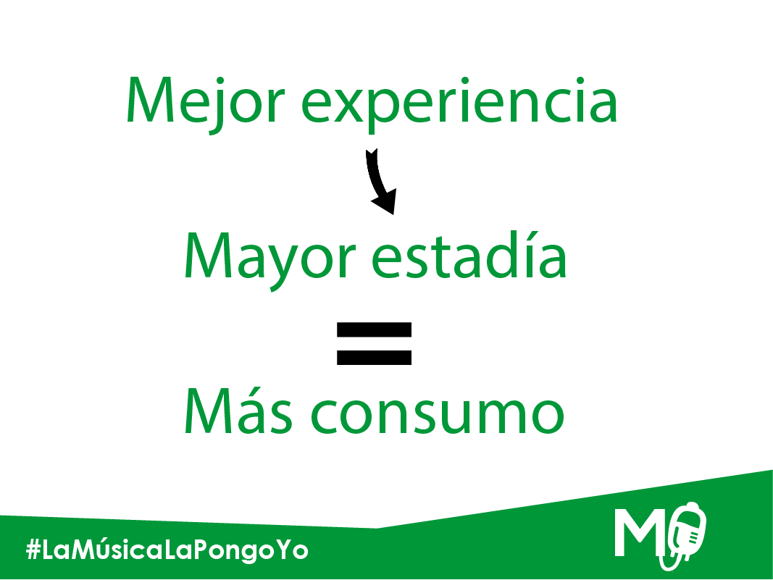

Slide 3


Slide 4


Slide 5


Slide 6


Slide 7


Slide 8


Slide 9


Slide 10


Slide 11


Slide 12

http://www.wideo.co/view/6356701416167136953

