Slide 1
Thesis meeting 16/04

Slide 2
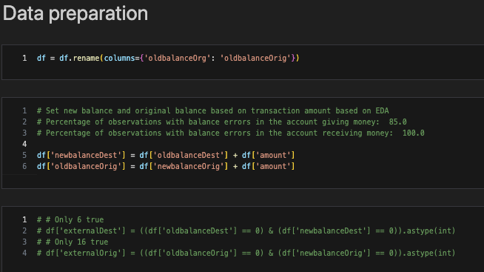
Data preparation

Slide 3
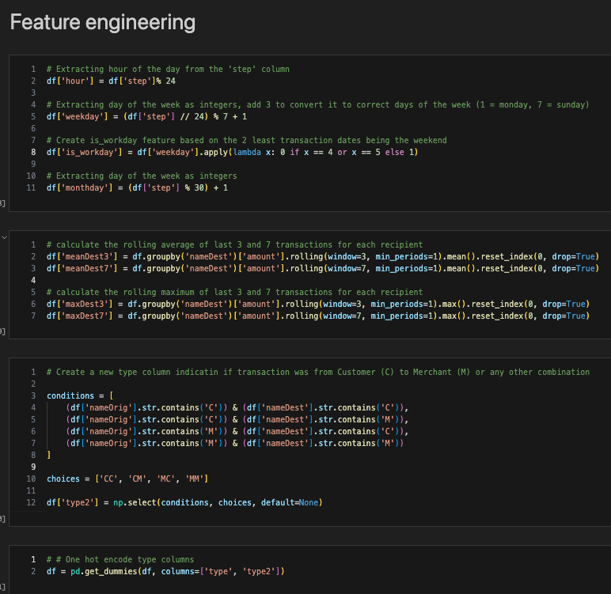
Feature engineering
Hour / day / workday
Rolling mean / max
Transaction classification
One-hot encode

Slide 4
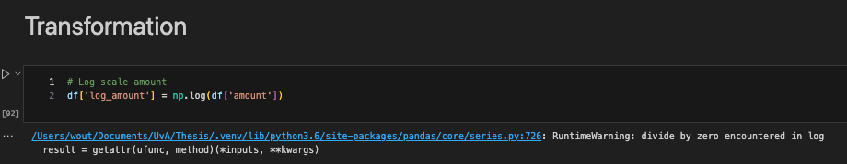
Transformation
Log transformation
What about adding noise?

Slide 5
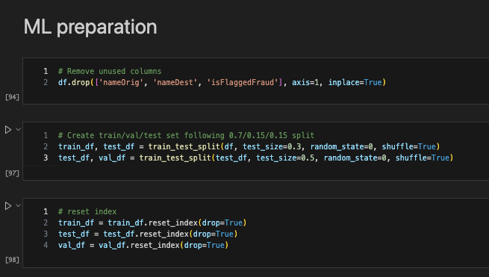
ML preparation
0.7/0.15/0.15 split

Slide 6
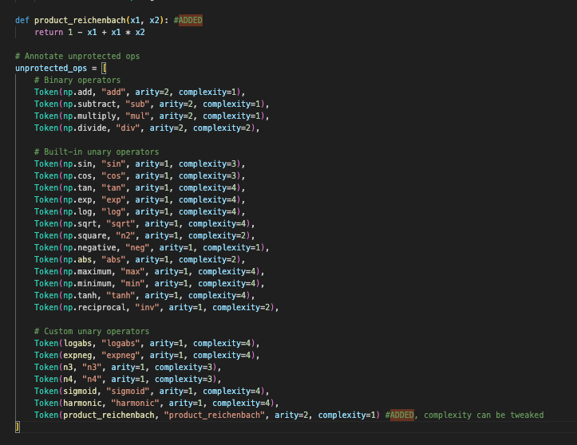
Reichenbach in DSR
Added Reichenbach with complexity 1 as UNARY
These new operators can now be chosen in the config file by incorporating them into the function set
Similar to product
Unprotected ops

Slide 7
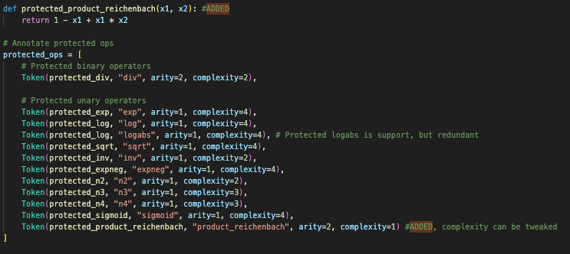
Reichenbach in DSR
Added Reichenbach with complexity 1 as UNARY
These new operators can now be chosen in the config file by incorporating them into the function set
Similar to product
Unprotected ops

Slide 8
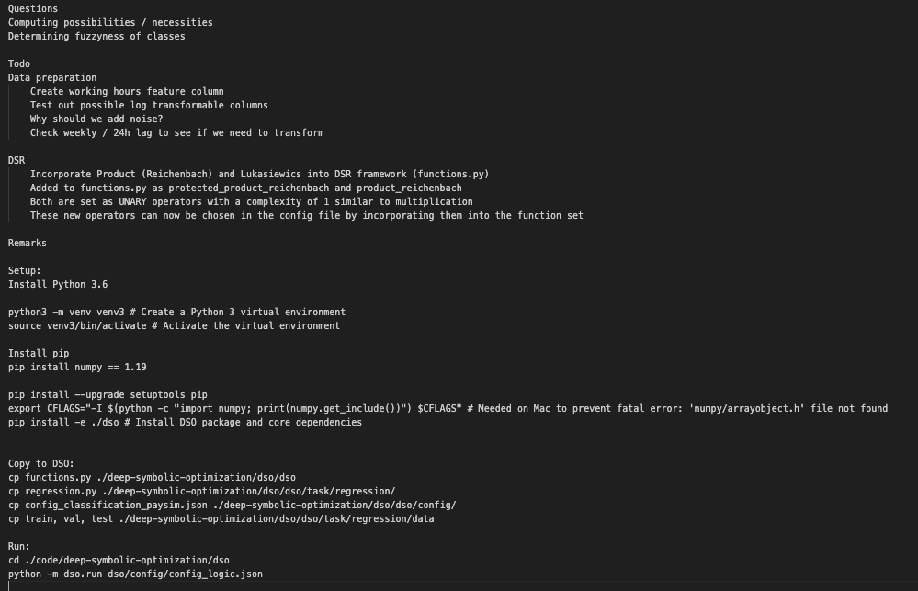
Readme / backlog
Run guide and backlog
Questions:
Computing possibilities / necessities
Determining fuzziness of classes
Adding noise

