Slide 1
TELCO
PRESENTATION

Slide 2
Agenda
Introduction
Problematic
Findings
Solution Approach
Recommendations
Next Steps

Slide 3
PART i. PROBLEMATIC

Slide 4
3,735,000 usd
PROBLEMATIC
Telco incurred last semester a loss of earnings of

Slide 5
What is the reason of this loss?
PROBLEMATIC

Slide 6
MAIN REASON : CUSTOMER CHURN
PROBLEMATIC
EACH CUSTOMER WHO CHURNS COSTS AN Average :
USD 1,956.41

Slide 7
Last semester promotion EndS up with as score of 7,073 Customers
PROBLEMATIC
Result of the last promotion
For the same period 1,909 customers churn
LeadING to a Churn rate of 27 %

Slide 8

1,909 CUSTOMERS TOOK THE EXIT
PROBLEMATIC
1,909

Slide 9
Financial loss of $ 3,735,000 ≈ 1,909 X 1,956.41
PROBLEMATIC
Financial Loss

Slide 10
Other consequence of CUSTOMER CHURN
Weakens the customer structure and therefore profitability in the long term

Slide 11
50% of the customer has less than 29 months of tenure vs 72 months of longest tenure
Customers Repartition | Percentage
Customers < 9 months | 25%
0 < Customers < 29 months | 50%
0 < Customers < 55 months | 75%
Max retention = 72 months

Slide 12
PART iI- A who churns?

Slide 13
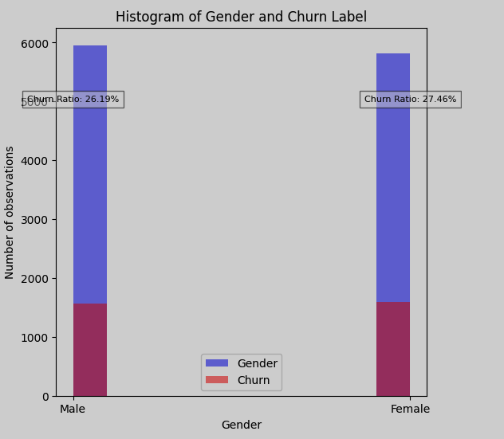
the difference between the unsubscribe percentages in men and women is not statistically significant
FINDINGS
Gender seems not to determine churn

Slide 14
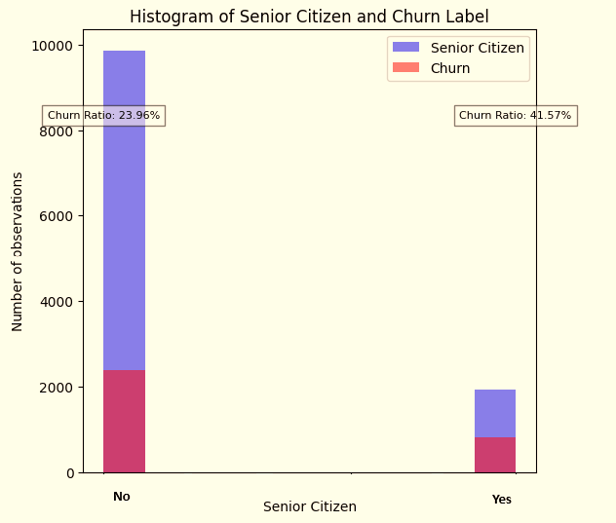
The tendency to unsubscribe is more marked among senior citizens
There is a 17.61% gap between the percentage of Seniors who churn and other customers.

Slide 15
PART iI- B why do customers churns?

Slide 16
4 main reasons were identified

Slide 17
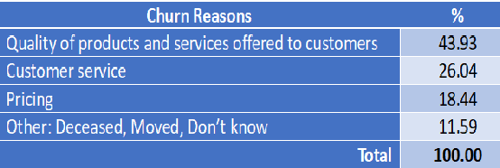


Slide 18
Breakdown these reasons

Slide 19
PART iI- c Does location influence the tendency to churn?

Slide 20
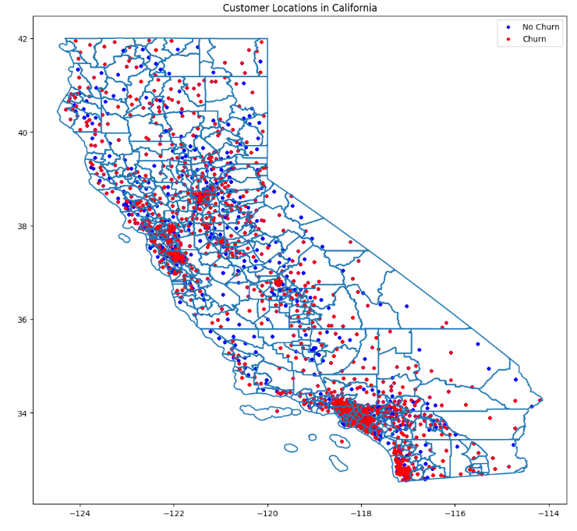
4
Clusters of churn have been identified, revealing the geographical dimension of the problem
- Yuba
- Butte
2
1
- Napa
- Solano
- Alama
3
- Los Angeles
4
- San Diego

Slide 21
PART iII What is our strategy?

Slide 22
Identify customers likely to churn.
strategy
Implement a loyalty program. (Next presentation)
Improve product quality and customer service. (Next presentation)

Slide 23
Identify customers likely to churn.
HOW ?
BY MEAN
OUR NEW SOFTWARE

Slide 24
NEW SOFTWARE
Named: CUSTOM_CHURN_1
Accuracy: 99,1%

Slide 25
RECOMMANDATIONS
Additional effort to collect the reasons why customers churn to improve the software
Automation of some calculations in the operating system (Ex: Total amount )
Special attention to senior citizens
Reengineering of products

Slide 26
Next steps
Validation of the model by executives
Training of the sales team that will have to use it
Definition of a commercial policy when a customer is identified as likely to unsubscribe
Deployment of the model and its regular evaluation

Slide 27
END

