Slide 1
TELCO
PRESENTATION

Slide 2
Agenda
Introduction
Problematic
Findings
Solution Approach
Recommendations
Next Steps

Slide 3
PART i. PROBLEMATIC

Slide 4

Churn rate
27%

Slide 5
Number of Customers reach 7,073
Result of the last promotion
Number of customers Churn :
1,909
Churn rate =27 %

Slide 6
Financial loss of 3,735,000 usd
Consequence #1
As
Average total amount by customer churn is :
usd 1,1956.41

Slide 7
Weakens the customer structure and therefore profitability in the long term
Consequence #2
Customers Repartition | Percentage
Customers < 9 months | 25%
0 < Customers < 29 months | 50%
0 < Customers < 55 months | 75%
Max retention = 72 months

Slide 8
PART iI- A who churns?

Slide 9
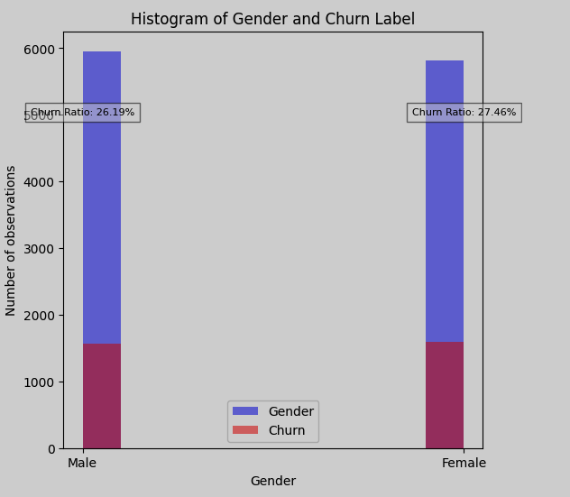
Gender seems not to determine churn

Slide 10
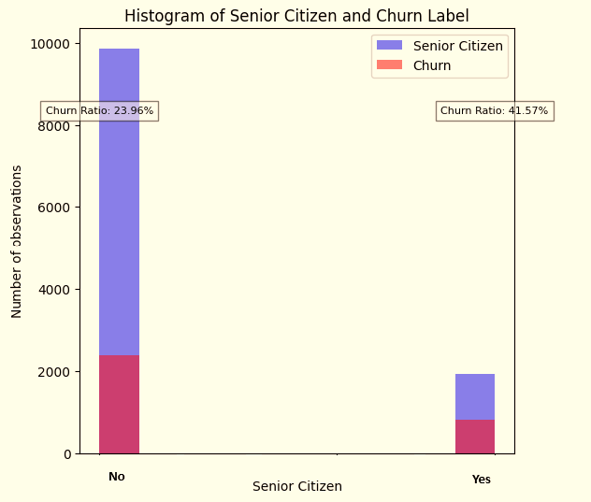
The tendency to unsubscribe is more marked among senior citizens

Slide 11
PART iI- B why do customers churns?

Slide 12
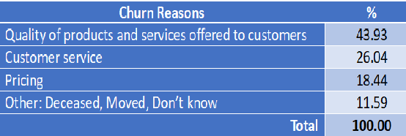


Slide 13
PART iI- c Does location influence the tendency to churn?

Slide 14
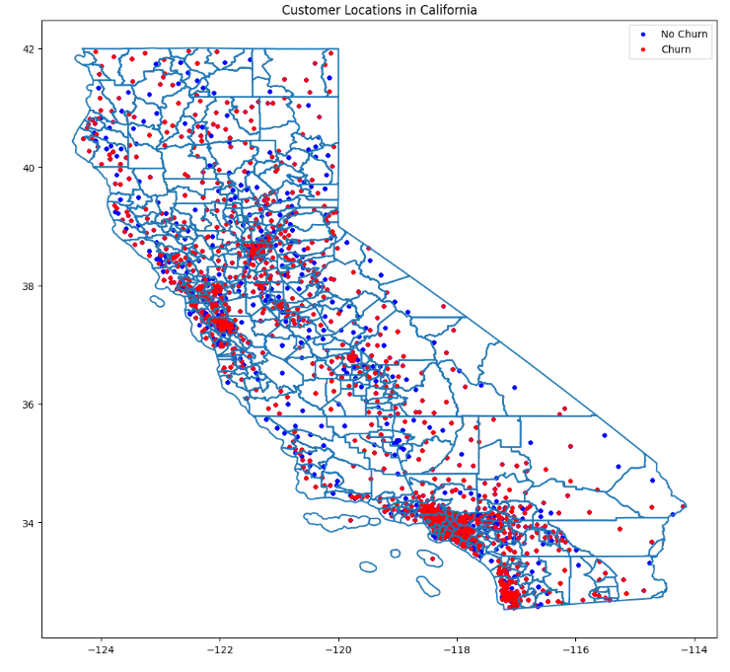
4
Clusters of churn have been identified
- Yuba
- Butte
2
1
- Napa
- Solano
- Alama
3
- Los Angeles
4
- San Diego

Slide 15
PART iII What is our strategy?

Slide 16
Identify customers likely to churn.
strategy
Implement a loyalty program. (Next presentation)
Improve product quality and customer service. (Next presentation)

Slide 17
Identify customers likely to churn.
HOW ?
BY MEAN
OUR NEW SOFTWARE

Slide 18
NEW SOFTWARE
Named: CUSTOM_CHURN_1
Accuracy: 99,1%

Slide 19
RECOMMANDATIONS
Additional effort to collect the reasons why customers churn to improve the software
Automation of some calculations in the operating system (Ex: Total amount )
Special attention to senior citizens
Reengineering of products

Slide 20
Next steps
Validation of the model by executives
Training of the sales team that will have to use it
Definition of a commercial policy when a customer is identified as likely to unsubscribe
Deployment of the model and its regular evaluation

