Slide 1
Smart Insole Project Handover (Wireless Transmission)
Jen-Hao Chiu
Department of Computer Science, National Tsing-Hua University, Taiwan

Slide 2
Outline
Progress Brief Summary
Experimental Settings
Detailed Implementation to Bluetooth Transmission System
Lab Practices and Trace Codes
Homework
Conclusion

Slide 3
Progress Brief Summary
Provide a Bluetooth Transmission System (BTS)
Bluetooth low energy (BLE)
Support up to N sensors data collection and transmission simultaneously
Compatible in a real time situation
Technical Challenges and Solutions
Multiple transmissions at the same time? Multi-thread programming.
Energy consumption of slave devices? Data encoding.
Packet loss? Linear interpolation.
Were the transmissions reliable? Three-way handshake protocol.
Were the signals synchronized? Time synchronization on feet mechanism.
Resource controls? Mutex and semaphore.
How to know packet generated time? Clock function and timestamp.
Clock drift effect? Time synchronization on clock mechanism.
Performance Analysis
Sample rates, 14kbps each insole.
Proved to run for half of day without significant packet loss.

Slide 4
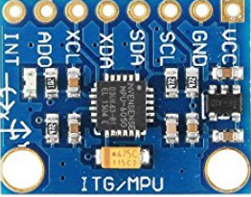
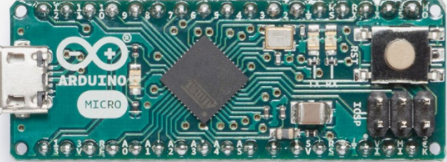
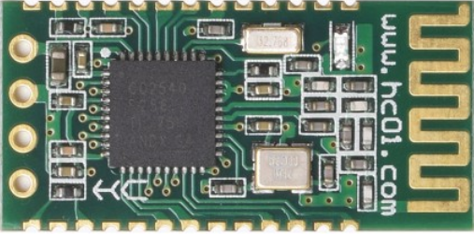



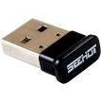
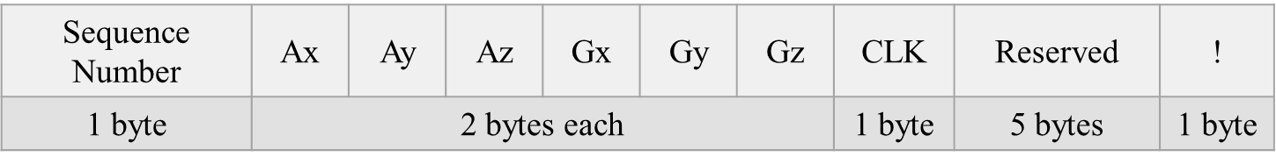
Experimental Settings
System Architecture
Details
Arduino Micro *2
MPU-6050 6-axis inertial sensor *2
HC-08 *2 (Role: Slave)
Dongle *1 (Role: Master)
Arduino
Bluetooth
Bluetooth
Dongle
Sensor
End Device
The packet format with a length of 20 bytes.

Slide 5
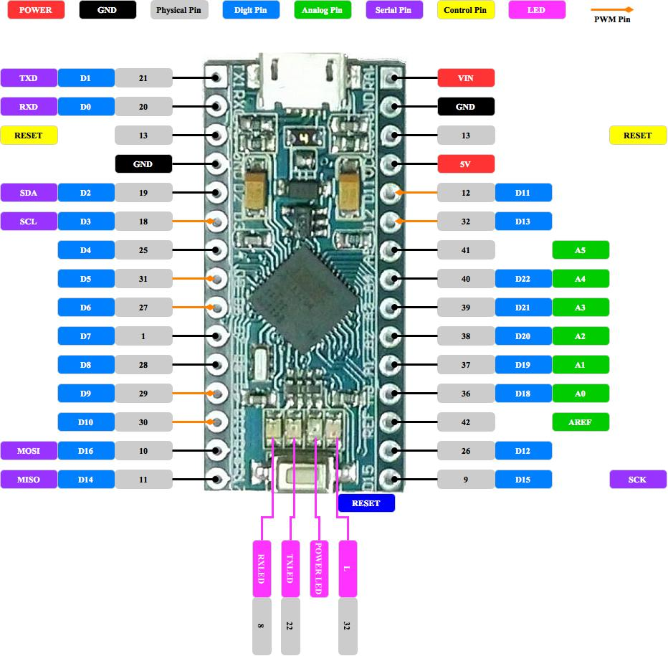
HC-08 ATmode
HC-08 --- Arduino
VCC --- 5V
GND --- GND
TXD --- PIN8
RXD --- PIN9
atmode.ino
Important functions: setup and loop.
How to control the speed of loop function?
Lab 1: Atmode practice
Set the baud rate to “115200”
Set the name to “HSCC_BLE_XX”

Slide 6
Arduino interfaced with MPU-6050
MPU-6050 --- Arduino
VCC --- 5V
GND --- GND
SDA --- PIN2
SCL --- PIN3
AD0 --- GND (0x68)
5V(0x69), why?
Lab 2: Data collection practice
Modify the slave.ino file
Print the 6-axis data on your monitor
Question: What is your sampling rates?

Slide 7
The Role of Slave
Goal: Transmit the 6-axis data to the end device through Bluetooth technology
Decide the packet size and the packet format.
Question 1: Why is 20 bytes long?
Question 2: What is the function of sequence number?
Question 3: What is the function of clock?
Question 4: What is the function of exclamation mark?
Decide the sampling rates.
What is the drawback if the sampling rates become faster?

Slide 8
Data Encoding
Goal: Save the energy consumption of slaves during transmission
What is the problem of our designed packet format?
Encoding process (idea: avoid the value of ‘0x21’)
Sequence Number and CLK
6-axis data
How to transmit 2 bytes data without distorted?
Modification policy: Rounding strategy.
Question 1: If the high byte and low byte of the sensed Ax data are 00100001 and 11010000, respectively, what will be the encoded data?
Question 2: If the high byte and low byte of the sensed Gx data are 00100001 and 01010000, respectively, what will be the encoded data?

Slide 9
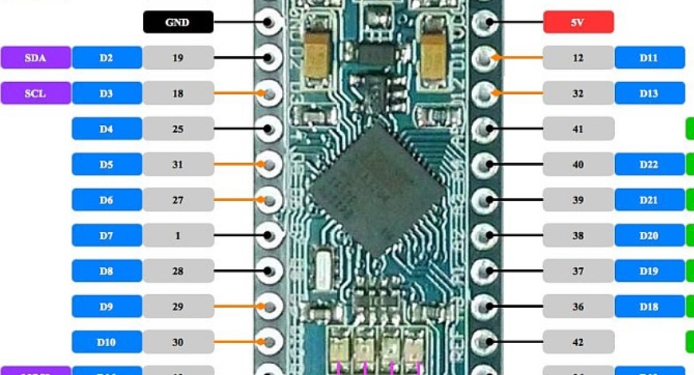
Clock Function
Goal: Know the packet generated time
Why it is needed? What is the difference between sequence number and clock?
Lab 3: Clock function practice
Modify the slave.ino file
Print the value of clock
Explain what you have seen
Arduino micro PWM pin: 3, 5, 6, 9, 10, 11
Arduino micro Interrupt pin: 0, 1, 2, 3, 7

Slide 10
The Role of Master
Goal: Receive the 6-axis data from slaves through Bluetooth technology
Preliminaries
Install bluepy module from https://github.com/IanHarvey/bluepy.
Experienced with Python language.
Multi-thread programming style. Why?
Make the transmission reliable. How?
Decoding of the streaming data based on the packet format.
Question 1: How to recover the original data?
Question 2: E.g., The sequence number of the received data are {0, 1, 2, 6}, and {3, 4, 5} are missing. How to solve this problem?

Slide 11
Lab 4: Multi-thread Practice
Goal: Be familiar with multi-thread programming in Python
Requirement:
Start two threads at the same time, and each thread is responsible for printing the sequence {1, 2, 3, 4, 5} and {6, 7, 8, 9, 10}, respectively.
Explain what you have seen, and why?
You can modify the master.py file.

Slide 12
Handshaking Protocol
Goal: Make the transmission reliable
Traditional 3-way handshaking protocol.
SYN, ACK, DATA
What is the problem of using 3-way handshake in our scenario?
Novel handshaking protocol.
Slave
Master
Slave
Master
SYN
Hello
HelloAck
ACK
Syn
DATA
SynAck
Data
Fig. 1. Three-way handshaking.
Fig. 2. Novel handshaking.

Slide 13
Data Decoding
Goal: Recover the original data
Designed packet format.
Decoding process
Sequence Number
CLK
6-axis data
Question 1: If the high byte and low byte of the received Ax data are 00101111 and 11010000, respectively, what is the original data?
Question 2: If the high byte and low byte of the received Gx data are 10101111 and 01010000, respectively, what is the original data?

Slide 14
Tracing Codes (Listen carefully! It is related to your homework!)

Slide 15
Homework
Goal: Be familiar with the Bluetooth communication technology.
Requirement:
A Real Time Multiple Slaves Enabled Bi-directional Bluetooth Transmission System.
Handshaking protocol is needed in your system.
Design the packet format and explain your throughput in theory e.g., 14kbps/ each slave.
Slave side
Arduino + HC-08 (Communication: Bluetooth)
Arduino + MPU6050 (Communication: I2C)
Set the delay time appropriately.
Master side
Any end devices e.g., Pi, PC, or laptop.
Print the corrected data in your console.
You need to demo the work to me.
Due: Thursday, July 25, 2019.

Slide 16
Conclusion
Provide a wireless communication module which can support up to N sensors data collection and transmission in a real time situation. Several novel techniques have been implemented to address the difficulties and challenges during the development stage.
The time synchronization problems should be carefully addressed when multiple slaves are transmitting simultaneously. Both the two synchronization mechanisms in our system can be improved for our future work.

Slide 17
Q&A

Slide 18
END

