Slide 1

Volatility and Spillover: Facts of Market Life
Bill Foote and Brian Wholey
Manhattan College,
The Bronx

Slide 2
Precis
‘
Volatility and the interaction of markets continue to beguile traders, managers, investors and regulators.
Working example from the renewable energy industry to develop three workflows for financial time series
Univariate empirical characterizations
Quantile regression spillover analysis
Bayesian multi-level hierarchical generation of a stratified industry risk structure
Pareto-smoothed importance sampling with leave-one-out cross-validation: investigate uncertainty and variability of market events
The complete workflow is maintained on GitHub at https://github.com/wgfoote/market-risk

Slide 3
First, imagine this
We are naive investors with three assets.
We know nothing at the outset but profit and loss.
We aim to use history to understand why we might gain or lose.

Slide 4
What is a stylized fact?
Spillover and other market observations are so common as to confer the status of fact.
The supposition of such an analysis would be that managers would ignore such regularly occurring observations at their peril.
Nicholas Kaldor in 1961:
the theorist, in choosing a particular theoretical approach, ought to start off with a summary of the facts which he regards as relevant to his problem. Since facts, as recorded by statisticians, are always subject to numerous snags and qualifications, and for that reason are incapable of being accurately summarized, the theorist, in my view, should be free to start off with a 'stylized' view of the facts - i.e. concentrate on broad tendencies, ignoring individual detail, and proceed on the 'as if' method, i.e. construct a hypothesis that could account for these 'stylized' facts, without necessarily committing himself on the historical accuracy, or sufficiency, of the facts or tendencies thus summarized.

Slide 5
What are the usual suspects?
Here is a short compendium of the usual suspects for univariate series.¹
Risk factor changes exhibit little or no memory, evidenced by significant but less impactful dependency on univariate autocorrelations at any lag.
The conditional expectation of returns is nearly always zero.
On the other hand, volatility of the same series exhibits very slowly decaying autocorrelations with power law tail thicknesses.
Return series are left skewed, while volatility series are naturally right skewed but witb persistently thick tails.
Return series tend to have thick tails with clusters of volatility.

Slide 6
Then the usual suspects conspire
Returns exhibit little or no non-contemporaneous cross-correlation.
Volatilities of returns (e.g., absolute values of returns) exhibit strong and weakly decaying, thus persistent, cross-correlations.
Correlations, like volatilities, vary across time.
Extreme returns on one market invariably relate to extreme returns in other markets.

Slide 7
Wrangling the suspects
Convert a time series object to a nice, and very tidy at first, data frame.
Monthly time series of correlations and volatilities from daily series.
Entangled markets as an endo-genous system of risk.
Impact of one market’s volatility on another through correlational entanglements between markets.

Slide 8
Some secret sauce
We will deploy a Quantile Regression view first.
Followed by a Bayesian inference
What we will be able to pull out of the data is the full joint distribution of cross-market impacts
As well as the marginal impacts within each market, especially as these markets communicate information among themselves.²

Slide 9
A working example to aid comprehension
We suppose that we work with the CFO of an aluminum recycling company. Here is a story we can use to make practical our insights into connected markets.
The aluminum recycling company just bought a renewable energy manufacturing and services company to expand its earnings opportunities.
The renewables division dabbles in wind, clean energy technologies (very similar to the aluminum recycling clean technologies), and solar, a very new field for the company.
The CFO would like to measure the impact of this new market on the earnings of the proposed renewables division. To do this she commissions a project team.

Slide 10
Just three questions
The CFO has three questions for the team:
How do we characterize renewables variability?
Does one market affect another?
What stylized facts of these markets matter to the generation of earnings in this new division?

Slide 11
Some data is in order
For the renewables sector we select exchange traded funds (ETF) from the global renewables sector
TAN for solar
ICLN for clean technologies
PBW for wind
These funds act as indices to effectively summarize the inputs, process, management, decisions, and outputs of various aspects of the renewables sector. Examining and analyzing these series will go a long way to helping the CFO understand the riskiness of these markets.
Our objective is to review the historical record for volatility and relationships among three repesentative markets. We load historical data on the market value of three ETFs, transform prices into returns, and then further transform the returns into within-month correlations and standard deviations.

Slide 12
Getting some data
options(digits = 4, scipen = 999999) library(ggplot2) library(GGally) library(lubridate) library(dplyr) library(tidyverse) library(quantreg) library(forecast) library(tidyquant) library(timetk) library(quantmod) library(matrixStats) # symbols <- c("TAN", "ICLN", "PBW") #c("ENE", "REP", "") price_tbl <- tq_get(symbols) %>% select(date, symbol, price = adjusted) # long format ("TIDY") price tibble for possible other work return_tbl <- price_tbl %>% group_by(symbol) %>% tq_transmute(mutate_fun = periodReturn, period = "daily", type = "log", col_rename = "daily_return") %>% mutate(abs_return = abs(daily_return)) #str(return_tbl) r_2 <- return_tbl %>% select(symbol, date, daily_return) %>% spread(symbol, daily_return) r_2 <- xts(r_2, r_2$date)[-1, ] storage.mode(r_2) <- "numeric" r_2 <- r_2[, -1] r_corr <- apply.monthly(r_2, FUN = cor)[,c(2, 3, 6)] colnames(r_corr) <- c("TAN_ICLN", "TAN_PBW", "ICLN_PBW") r_vols <- apply.monthly(r_2, FUN = colSds) # corr_tbl <- r_corr %>% as_tibble() %>% mutate(date = index(r_corr)) %>% gather(key = assets, value = corr, -date) vols_tbl <- r_vols %>% as_tibble() %>% mutate(date = index(r_vols)) %>% gather(key = assets, value = vols, -date) # corr_vols <- merge(r_corr, r_vols) corr_vols_tbl <- corr_vols %>% as_tibble() %>% mutate(date = index(corr_vols))

Slide 13
Here’s the Corrs
corr_tbl %>% group_by(assets) %>% summarise(mean = mean(corr), sd = sd(corr), skew = skewness(corr), kurt = kurtosis(corr), min = min(corr), q_25 = quantile(corr, 0.25), q_50 = quantile(corr, 0.50), q_75 = quantile(corr, 0.75), max = max(corr), iqr = quantile(corr, 0.75) - quantile(corr, 0.25) )
## # A tibble: 3 x 11 ## assets mean sd skew kurt min q_25 q_50 q_75 max iqr ## <chr> <dbl> <dbl> <dbl> <dbl> <dbl> <dbl> <dbl> <dbl> <dbl> <dbl> ## 1 ICLN_PBW 0.841 0.0967 -1.70 3.68 0.431 0.813 0.856 0.903 0.985 0.0906 ## 2 TAN_ICLN 0.723 0.180 -0.869 0.383 0.126 0.597 0.778 0.862 0.982 0.265 ## 3 TAN_PBW 0.793 0.134 -0.807 0.154 0.373 0.707 0.822 0.901 0.990 0.194

Slide 14
And for vols
vols_tbl %>% group_by(assets) %>% summarise(mean = mean(vols), sd = sd(vols), skew = skewness(vols), kurt = kurtosis(vols), min = min(vols), q_25 = quantile(vols, 0.25), q_50 = quantile(vols, 0.50), q_75 = quantile(vols, 0.75), max = max(vols), iqr = quantile(vols, 0.75) - quantile(vols, 0.25) )
## # A tibble: 3 x 11 ## assets mean sd skew kurt min q_25 q_50 q_75 max iqr ## <chr> <dbl> <dbl> <dbl> <dbl> <dbl> <dbl> <dbl> <dbl> <dbl> <dbl> ## 1 ICLN 0.0144 0.00764 3.23 17.4 0.00519 0.0101 0.0128 0.0167 0.0671 0.00664 ## 2 PBW 0.0183 0.00974 2.47 9.69 0.00803 0.0117 0.0160 0.0208 0.0763 0.00903 ## 3 TAN 0.0225 0.00981 1.61 5.82 0.00769 0.0152 0.0216 0.0274 0.0758 0.0122

Slide 15
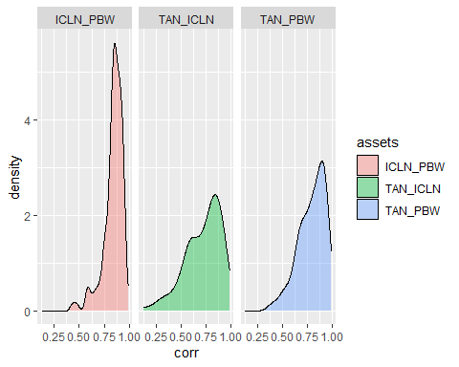
Visualize instead
corr_tbl %>% ggplot(aes(x = corr, fill = assets)) + geom_density(alpha = 0.4) + facet_wrap(~assets)

Slide 16
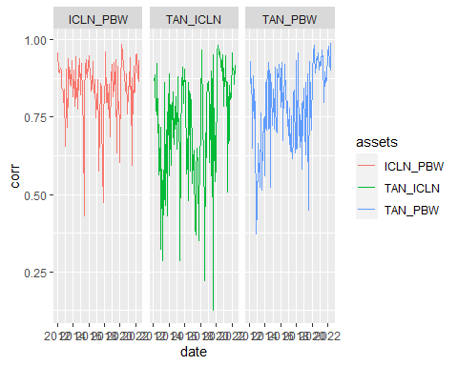
Now for the time domain
corr_tbl %>%
ggplot(aes(x = date, y = corr, color=assets)) + geom_line() + facet_wrap(~assets)

Slide 17
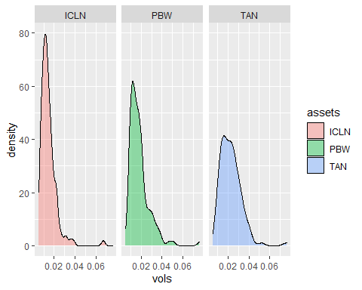
And there it is…
vols_tbl %>% ggplot(aes(x = vols, fill=assets)) + geom_density(alpha = 0.4) + facet_wrap(~assets)

Slide 18
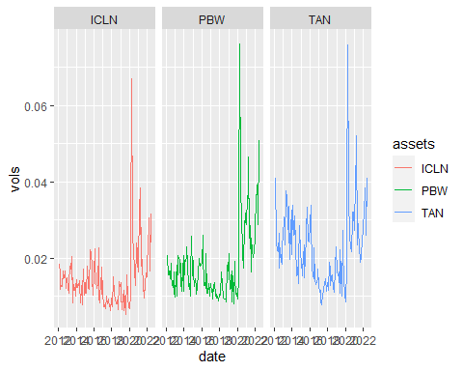
Vols away
vols_tbl %>% ggplot(aes(x = date, y = vols, color = assets)) + geom_line() + facet_wrap(~assets)

Slide 19
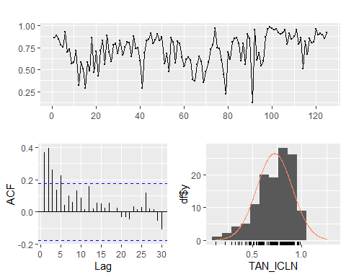
Do volatility and correlation persist?
TAN_ICLN <- r_corr$TAN_ICLN forecast::ggtsdisplay(TAN_ICLN, lag.max=30, plot.type = "histogram")

Slide 20
The verdict on correlation persistence?
There is some monthly persistence to 5 lags.
The variability of correlation varies only in the positive direction.
The distribution seems skewed to the left and non-normal.

Slide 21
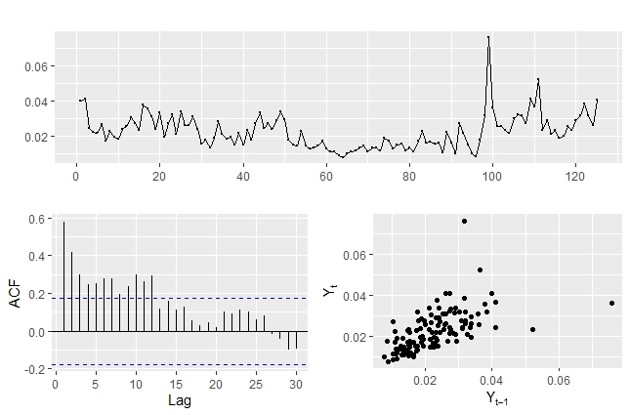
Volatilities next…
TAN <- r_vols$TAN forecast::ggtsdisplay(TAN,lag.max=30, plot.type = "scatter")

Slide 22
Verdict on volatility persistence?
Strong and persistent lags over 10 months shows slow decay. Is this some evidence of market memory of risk?
Perhaps, but it also indicates in this monthly time interval influences of outliers in the third scatter panel and variability seen in the first time series panel.

Slide 23
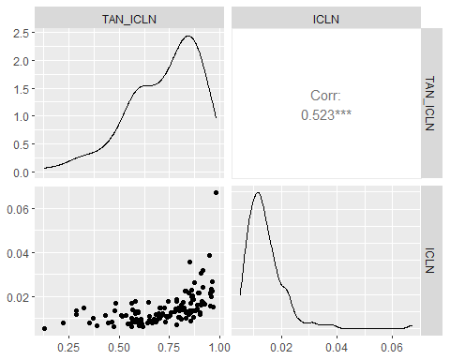
Do markets spill into one another?
corr_vols <- merge(r_corr, r_vols) corr_vols_tbl <- corr_vols %>% as_tibble() %>% mutate(date = index(corr_vols)) ggpairs(corr_vols_tbl[, c("TAN_ICLN", "ICLN")])

Slide 24
What do we observe?
Are they apparently normally distributed? Not at all, apparently. We observe a negative skew in correlation and the characteristically positive skew in volatility.
What do the outliers look like in a potential relationship between correlations and volatility? The scatter plot indicates potential outliers in very high and very low correlation market environments.
Are there potentially multiple regions of outliers? Yes, in very high and low correlation environments. The body of the relation appears to have a positive impact in line with a fairly high correlation of 0.513.

Slide 25
Dream in quantiles
library(quantreg) taus <- c(0.10, 0.25, 0.50, 0.75, 0.90) # quantiles of y for a 95% confidence interval y <- corr_vols_tbl$TAN_ICLN; x <- corr_vols_tbl$ICLN fit_corr_vols <- rq(log(y) ~ log(x), tau = taus) fit_summary <- summary(fit_corr_vols) fit_summary
## tau: [1] 0.5 ## ## Coefficients: ## coefficients lower bd upper bd ## (Intercept) 1.1664 0.8566 1.3194 ## log(x) 0.3356 0.2586 0.3716 ## tau: [1] 0.75 ## ## Coefficients: ## coefficients lower bd upper bd ## (Intercept) 1.0475 0.5476 1.4890 ## log(x) 0.2867 0.1655 0.3915 ## ## tau: [1] 0.9 ## ## Coefficients: ## coefficients lower bd upper bd ## (Intercept) 0.6544 0.5546 1.5559 ## log(x) 0.1825 0.1283 0.3839
## tau: [1] 0.1: ## coefficients lower bd upper bd ## (Intercept) 1.0690 1.0587 2.0193 ## log(x) 0.4011 0.3873 0.6402 ## ## tau: [1] 0.25 ## coefficients lower bd upper bd ## (Intercept) 1.1847 0.8995 1.7037 ## log(x) 0.3674 0.3229 0.5043

Slide 26
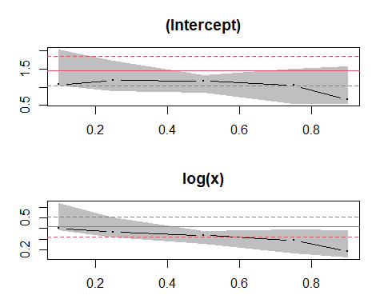
The plot thickens

Slide 27
Further questions
When is it likely for markets to spill over? Mostly across low to high correlation quantiles.
At what likelihood of correlations are market spillovers most uncertain? Again in very low and very high correlation quantile regions.
What about the other markets and their spillover effects?
What should the CFO glean from these results?
The last two questions deserve further analysis, which means more regressions. The CFO can get an idea that preparing for market risk is a very high risk management priority.

Slide 28
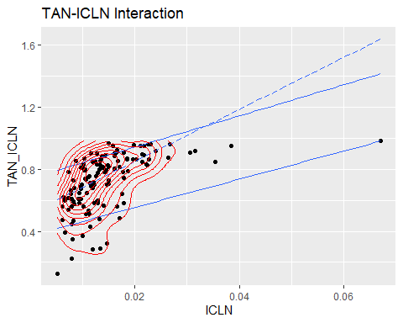
Yet another plot
p <- ggplot(corr_vols_tbl, aes(x = ICLN, y = TAN_ICLN)) + geom_point() + ggtitle("TAN-ICLN Interaction") + geom_quantile(quantiles = c(0.10, 0.90)) + geom_quantile(quantiles = 0.5, linetype = "longdash") + geom_density_2d(colour = "red") p

Slide 29
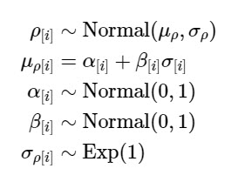
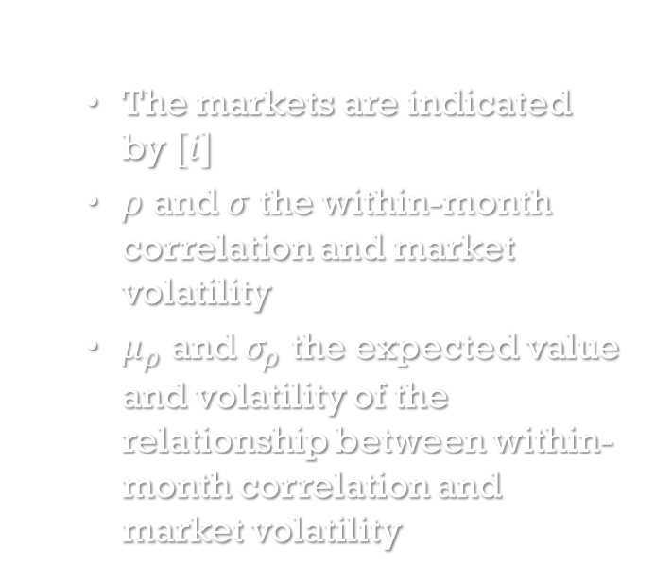
(Re)Thinking with Bayes
The markets are indicated by $[i]$
$ρ$ and $σ$ the within-month correlation and market volatility
$μ_{ρ}$ and $σ_{ρ}$ the expected value and volatility of the relationship between within-month correlation and market volatility

Slide 30
Levels and effects
library(rethinking) y <- corr_vols_tbl$TAN_ICLN; x <- corr_vols_tbl$ICLN d_1 <- tibble( tan_icln = y, icln = x ) m_1 <- quap( alist( tan_icln ~ dnorm( mu, sigma ), mu <- a + b*icln, a ~ dnorm( 0, 1 ), b ~ dnorm( 0, 1 ), sigma ~ dexp( 1 ) ), data = d_1 ) precis( m_1 )
## mean sd 5.5% 94.5% ## a 0.6873 0.02025 0.6549 0.7196 ## b 2.4813 0.93076 0.9938 3.9689 ## sigma 0.1696 0.01116 0.1518 0.1874

Slide 31
First Thoughts
Priors are proper to the generation of the dependent variable. They can also take on positive or negative signs.
Spillover is much in evidence here through size of impact and direction.

Slide 32
Rinse…repeat
#library(rethinking) y <- corr_vols_tbl$TAN_PBW; x <- corr_vols_tbl$PBW d_2 <- tibble( tan_pbw = y, pbw = x ) m_2 <- quap( alist( tan_pbw ~ dnorm( mu, sigma ), mu <- a + b*pbw, a ~ dnorm( 0, 1 ), b ~ dnorm( 0, 1 ), sigma ~ dexp( 1 ) ), data = d_2 ) precis( m_2 )
## mean sd 5.5% 94.5% ## a 0.7259 0.017694 0.6977 0.7542 ## b 3.6630 0.778993 2.4181 4.9080 ## sigma 0.1170 0.007853 0.1044 0.1295

Slide 33
Again
#library(rethinking) y <- corr_vols_tbl$ICLN_PBW; x <- corr_vols_tbl$PBW d_3 <- tibble( icln_pbw = y, pbw = x ) m_3 <- quap( alist( icln_pbw ~ dnorm( mu, sigma ), mu <- a + b*pbw, a ~ dnorm( 0, 1 ), b ~ dnorm( 0, 1 ), sigma ~ dexp( 1 ) ), data = d_3 ) precis( m_3 )
## mean sd 5.5% 94.5% ## a 0.78922 0.014097 0.76669 0.81175 ## b 2.80568 0.641496 1.78044 3.83091 ## sigma 0.08703 0.005638 0.07802 0.09605

Slide 34

Even more
Pareto-Smoothed Importance Sampling (PSIS) and cross validation (CV) with the Leave One Out (LOO) approach yields a trade-off between spillover variability and bias on the y-axis and uncertainty on the x-axis.
Thick-tailed, skewed returns distributions become intelligible with this analysis.
The extreme uncertainty of outliers contribute to the ability of the ICLN market to spill its uncertainty into the high variations of the TAN market all through the naive mechanism of correlation.³
known-unknowns from $k$ = 0 to 0.7
unknown-unknowns for $k$ > 0.7
tests reported by Gelman and Vehtari (2013) and Vehtari and Gabry (2015)

Slide 35
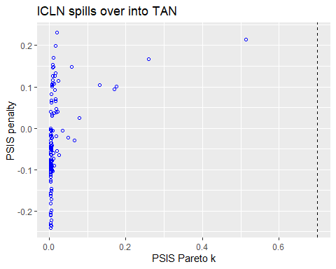
Penalty shot
#library( plotly ) options( digits=2, scipen=999999) d <- d_1 set.seed(4284) m <- m_1 PSIS_m <- PSIS( m, pointwise=TRUE ) PSIS_m <- cbind( PSIS_m, tan_icln=d$tan_icln, icln=d$icln ) set.seed(4284) #WAIC_m2.2 <- WAIC(m2.2,pointwise=TRUE) p1 <- PSIS_m %>% ggplot( aes( x=penalty, y=k ) ) + geom_point( shape=21, color = "blue" ) + xlab("PSIS Pareto k") + ylab("PSIS penalty") + geom_vline( xintercept = 0.7, linetype = "dashed") + ggtitle( "ICLN spills over into TAN" ) p1 #ggplotly( p1 )

Slide 36
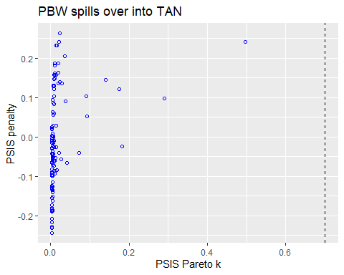
More results

Slide 37
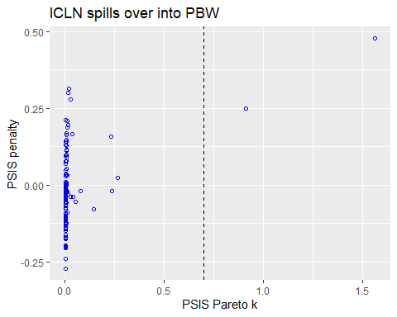
…and

Slide 38
(All-in)dustry risk structure
#library(rethinking) corr_vol_spill <- read_csv( "market-spillovers.csv" ) d_4 <- corr_vol_spill %>% tibble( corr = corrs, vol = vols , mid = mids )
m_4 <- quap( alist( corr ~ dnorm( mu, sigma ), mu <- a[mid] + b[mid] *vol, a[mid] ~ dnorm( 0, 1 ), b[mid] ~ dnorm( 0, 1 ), sigma[mid] ~ dexp( 1 ) ), data = d_4 ) precis( m_4, depth = 2 )
## mean sd 5.5% 94.5% ## a[1] 0.67 0.0170 0.64 0.70 ## a[2] 0.73 0.0184 0.71 0.76 ## a[3] 0.81 0.0184 0.78 0.84 ## b[1] 3.53 0.8691 2.14 4.92 ## b[2] 3.08 0.7956 1.81 4.36 ## b[3] 1.87 0.7940 0.60 3.14 ## sigma[1] 0.13 0.0086 0.12 0.15 ## sigma[2] 0.12 0.0081 0.11 0.14 ## sigma[3] 0.13 0.0087 0.12 0.15
#options( digits = 2 ) #cov2cor( vcov( m_4 ) )

Slide 39
What happened?
The Bayesian approach integrates the marginal parameters for each of the markets by using the total probability of observing the data across the markets and the range of potential parameter values.
Thus the parameters share information across markets for systematic and ideosyncratic components.

Slide 40
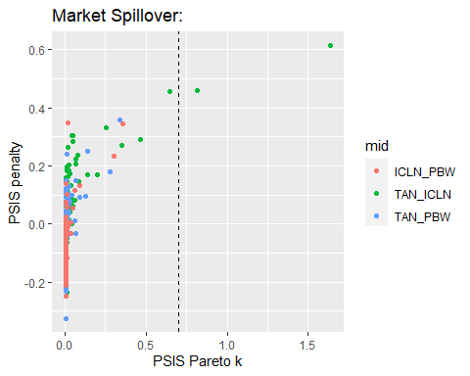
When Markets Collide
Most of the uncertainty is found in wind (PBW) volatility on solar (TAN: green).
The least uncertain market seems to be the relationship between PBW and ICLN.

Slide 41
And so it goes
#library(tidybayes.rethinking) m_draws <- m_4 %>% spread_draws( a[mid], b[mid], sigma[mid] ) mid <- as.factor(m_draws$mid) levels(mid) <- list( "TAN_ICLN"=1, "TAN_PBW"=2, "ICLN_PBW"=3 ) m_draws$mid <- mid # plot grid of two parameters p1 <- m_draws %>% ggplot(aes(x = b, y = as.factor(mid) ) ) + stat_halfeye( color = "blue") + xlab("volatility spill into correlation ") + ylab("market") + geom_vline( xintercept = 2.00 , linetype = "dashed") + geom_vline( xintercept = 4.00, linetype = "dashed") # build sigma_V comparison p2 <- m_draws %>% filter( sigma < 0.2) %>% ggplot(aes(x = sigma, y = as.factor(mid) ) ) + stat_halfeye( color = "blue") + xlab("unanticipated spillover") + ylab("market") + geom_vline( xintercept = 0.12 , linetype = "dashed") + geom_vline( xintercept = 0.14, linetype = "dashed") plot_2_grid( p1, p2, title_1 = "Impact of volatility on correlation") # ggsave( "compare.pdf" )

Slide 42
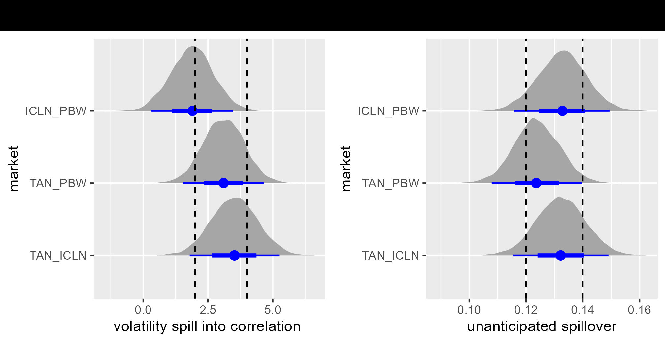
When Markets Collide … some more
ICLN-PBW has lowest systematic spillover impact, and it looks different from the other two markets.
YET, TAN-PBW has the lowest unsystematic risk in this trio.

Slide 43
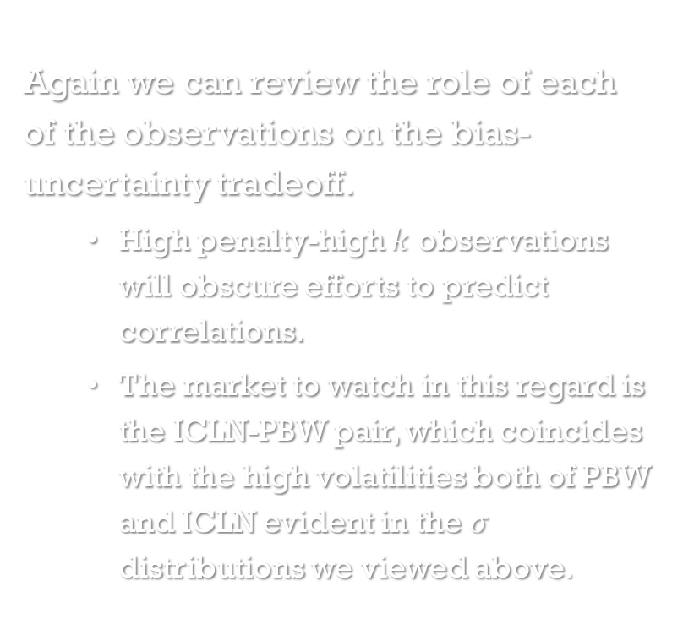
Once again
Again we can review the role of each of the observations on the bias-uncertainty tradeoff.
High penalty-high $k$ observations will obscure efforts to predict correlations.
The market to watch in this regard is the ICLN-PBW pair, which coincides with the high volatilities both of PBW and ICLN evident in the $σ$ distributions we viewed above.

Slide 44

What have we accomplished?
Some provisional answers to the CFO’s initial questions
Univariate volatility clustering is compatible with highly kurtotic, and thus highly volatile volatility.
Volatile volatility in each asset spills into each market separately. These affects are measured using both quantile regression and Bayesian statistical techniques. The two approaches seem to agree on the probable existence of market spillover.
We tested the hypothesis that one market’s riskiness affects another market, probably. They do, both in systematic, $β$, and idiosyncratic, $σ$, modes.
We find that a strongly coupled market risk structure persists across TAN, PBW and ICLN assets in each pair of market combinations.
TAN is the most sensitive market with highly volatile responses to ICLN and PBS volatility. Both ICLN and PBW are far less sensitive to moves within and across their markets.

Slide 45
But be-ware
Strong negative movements in one market will probably persist and spill over into negative movements across the three markets.
Earnings based on this model will themselves exhibit the results of volatility clustering and market spillover.

Slide 46
Next: GPD?
Our next step could well be to build volatility clustering, and other thick-tailed outcomes, to derive implied capital requirements through market risk channels.
Such requirements would inform the risk budgeting assignments that might be built into delegations of authority, portfolio limits, even into optimization constraints.

Slide 47
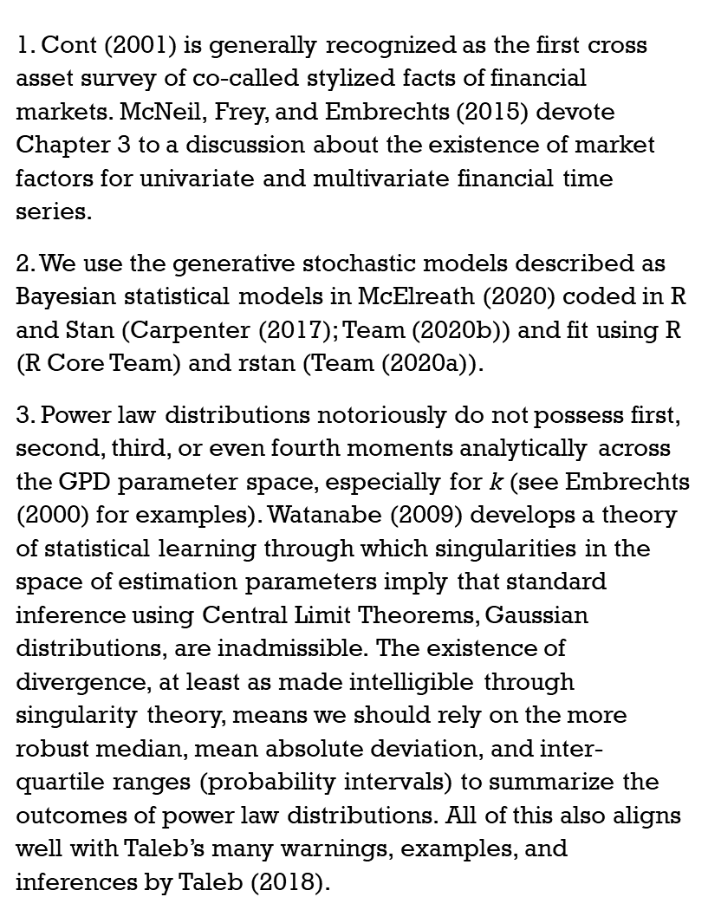
notes
1. Cont (2001) is generally recognized as the first cross asset survey of co-called stylized facts of financial markets. McNeil, Frey, and Embrechts (2015) devote Chapter 3 to a discussion about the existence of market factors for univariate and multivariate financial time series.
2. We use the generative stochastic models described as Bayesian statistical models in McElreath (2020) coded in R and Stan (Carpenter (2017); Team (2020b)) and fit using R (R Core Team) and rstan (Team (2020a)).
3. Power law distributions notoriously do not possess first, second, third, or even fourth moments analytically across the GPD parameter space, especially for k (see Embrechts (2000) for examples). Watanabe (2009) develops a theory of statistical learning through which singularities in the space of estimation parameters imply that standard inference using Central Limit Theorems, Gaussian distributions, are inadmissible. The existence of divergence, at least as made intelligible through singularity theory, means we should rely on the more robust median, mean absolute deviation, and inter-quartile ranges (probability intervals) to summarize the outcomes of power law distributions. All of this also aligns well with Taleb’s many warnings, examples, and inferences by Taleb (2018).

Slide 48
References
Koenker, R. and G. Bassett, Jr. 1978. “Regression Quantiles,” Econometrica, 46, 33-51.
Carpenter, J. and A. Gelman. 2017. “Stan: A Probabilistic Programming Language.” Journal of Statistical Software 76
Cont, R. 2001. “Empirical Properties of Asset Returns: Stylized Facts and Statistical Issues.” Quantitative Finance 1.
Embrechts, P. 2000. “Modelling Multivariate Extremes.” In Extremes and Integrated Risk Management, edited by Paul Embrechts, 59–67. RISK Publications.
Gelman, A., J. Hwang, and A. Vehtari. 2013. “Understanding Predictive Information Criteria for Bayesian Models.” Preprint.
Kaldor, N. 1961. “Capital Accumulation and Economic Growth,” In: E. A. Lutz and D. C. Hague, The Theory of Capital, St. Martins Press, New York, pp 177-222. http://gesd.free.fr/kaldor61.pdf
McElreath, R. 2020. Statistical Rethinking: A Bayesian Course with Examples in R and Stan. Second edition. CRC Press. https://xcelab.net/rm/statistical-rethinking/.
McNeil, A. J., R. Frey, and P. Embrechts. 2015. Quantitative Risk Management: Concepts, Techniques and Tools - Revised Edition. Princeton Series in Finance. Princeton University Press. https://books.google.com/books?id=SfJnBgAAQBAJ.
Taleb, Nassim Nicholas. 2018. “The Statistical Consequences of Fat Tails: Papers and Commentary.” Edited by Stem Academic Publishing. The Technical Inconcerto 1.
Team, Stan Development. 2020a. “RStan: The r Interface to Stan (r Package Version 2.17.3) [Computer Software].” http://mc-stan.org/.
———. 2020b. “The Stan Core Library (Version 2.18.0).” http://mc-stan.org/.
Vehtari, A. Gelman, A., and J. Gabry. 2015. “Efficient Implementation of Leave-One-Out Cross-Validation and WAIC for Evaluating Fitted Bayesian Models.” Preprint.
Watanabe, S. 2009. Algebraic Geometry and Statistical Learning Theory. Cambridge Monographs on Applied and Computational Mathematics. Cambridge University Press. https://books.google.com/books?id=GnnUHasAtUQC.

