Slide 1
Volatility and Spillover: Facts of Market Life

Slide 2
Precis
‘
Volatility and the interaction of markets continue to beguile traders, managers, investors and regulators.
Working example from the renewable energy industry to develop three workflows for financial time series:
Univariate empirical characterizations;
Quantile regression spillover analysis; and
Bayesian multi-level hierarchical generation of a stratified industry risk structure.
Pareto-smoothed importance sampling with leave-one-out cross-validation to investigate uncertainty and variability of market events, especially so-called outliers.
The complete workflow is maintained on GitHub at https://github.com/wgfoote/market-risk

Slide 3
First, imagine this
We are naive investors with an account at our favorite online brokerage with three assets.
We know nothing at the outset but profit and loss.
We aim to use history to understand why we might gain or lose.

Slide 4
What is a stylized facts?
Spillover and other market observations are so common as to confer the status of fact.
The supposition of such an analysis would be that managers would ignore such regularly occuring observations peril.

Slide 5
What are the usual suspects?
Here is a short compendium of the usual suspects for univariate series.¹
Risk factor changes exhibit little or no memory, evidenced by significant but less impactful dependency on univariate autocorrelations at any lag.
The conditional expectation of returns is nearly always zero.
On the other hand, volatility of the same series exhibits very slowly decaying autocorrelations with power law tail thicknesses.
Return series are left skewed, while volatility series are naturally right skewed but witb persistently thick tails.
Return series tend to have thick tails with clusters of volatility.

Slide 6
Then the usual suspects conspire
Returns exhibit little or no non-contemporaneous cross-correlation.
Volatilities of returns (e.g., absolute values of returns) exhibit strong and weakly decaying, thus persistent, cross-correlations.
Correlations, like volatilities, vary across time.
Extreme returns on one market invariable relate to extreme returns in other markets.

Slide 7
Wrangling the suspects
We build and visualize time series objects. We will also convert a time series object to a nice, and very tidy at first, data frame.
We will derive monthly time series of correlations and volatilities from daily series.
We then visualize to analyze the sensitivity of entangled (as measured with correlation) markets as an endogenous system of risk.
We are then in the position to analyze and visualize the impact of one market’s volatility on another through correlational entanglements between markets.

Slide 8
Some secret sauce
We will deploy a Quantile Regression view first.
Followed by a Bayesian inference
What we will be able to pull out of the data is the full joint distribution of cross-market impacts as well as the marginal impacts within each market, especially as these markets communicate information among themselves.²

Slide 9
A working example to aid comprehension
We suppose that we work with the CFO of an aluminum recycling company. Here is a story we can use to make practical our insights into connected markets.
The aluminum recycling company just bought a renewable energy manufacturing and services company to expand its earnings opportunities.
The renewables division dabbles in wind, clean energy technologies (very similar to the aluminum recycling clean technologies), and solar, a very new field for the company.
The CFO would like to measure the impact of this new market on the earnings of the proposed renewables division. To do this she commissions a project team.

Slide 10
Just three questions
The CFO has three questions for the team:
How do we characterize renewables variability?
Does one market affect another?
What stylized facts of these markets matter to the generation of earnings in this new division?

Slide 11
Some data is in order
For the renewables sector we select exchange traded funds (ETF) from the global renewables sector:
TAN for solar
ICLN for clean technologies
PBW for wind
These funds act as indices to effectively summarize the inputs, process, management, decisions, and outputs of various aspects of the renewables sector. Examining and analyzing these series will go a long way to helping the CFO understand the riskiness of these markets.
Our objective is to review the historical record for volatility and relationships among three repesentative markets. We load historical data on the market value of three ETFs, transform prices into returns, and then further transform the returns into within-month correlations and standard deviations.

Slide 12
Getting some data
options(digits = 4, scipen = 999999) library(ggplot2) library(GGally) library(lubridate) library(dplyr) library(tidyverse) library(quantreg) library(forecast) library(tidyquant) library(timetk) library(quantmod) library(matrixStats) # symbols <- c("TAN", "ICLN", "PBW") #c("ENE", "REP", "") price_tbl <- tq_get(symbols) %>% select(date, symbol, price = adjusted) # long format ("TIDY") price tibble for possible other work return_tbl <- price_tbl %>% group_by(symbol) %>% tq_transmute(mutate_fun = periodReturn, period = "daily", type = "log", col_rename = "daily_return") %>% mutate(abs_return = abs(daily_return)) #str(return_tbl) r_2 <- return_tbl %>% select(symbol, date, daily_return) %>% spread(symbol, daily_return) r_2 <- xts(r_2, r_2$date)[-1, ] storage.mode(r_2) <- "numeric" r_2 <- r_2[, -1] r_corr <- apply.monthly(r_2, FUN = cor)[,c(2, 3, 6)] colnames(r_corr) <- c("TAN_ICLN", "TAN_PBW", "ICLN_PBW") r_vols <- apply.monthly(r_2, FUN = colSds) # corr_tbl <- r_corr %>% as_tibble() %>% mutate(date = index(r_corr)) %>% gather(key = assets, value = corr, -date) vols_tbl <- r_vols %>% as_tibble() %>% mutate(date = index(r_vols)) %>% gather(key = assets, value = vols, -date) # corr_vols <- merge(r_corr, r_vols) corr_vols_tbl <- corr_vols %>% as_tibble() %>% mutate(date = index(corr_vols))

Slide 13
And for vols
vols_tbl %>% group_by(assets) %>% summarise(mean = mean(vols), sd = sd(vols), skew = skewness(vols), kurt = kurtosis(vols), min = min(vols), q_25 = quantile(vols, 0.25), q_50 = quantile(vols, 0.50), q_75 = quantile(vols, 0.75), max = max(vols), iqr = quantile(vols, 0.75) - quantile(vols, 0.25) )
## # A tibble: 3 x 11 ## assets mean sd skew kurt min q_25 q_50 q_75 max iqr ## <chr> <dbl> <dbl> <dbl> <dbl> <dbl> <dbl> <dbl> <dbl> <dbl> <dbl> ## 1 ICLN 0.0144 0.00764 3.23 17.4 0.00519 0.0101 0.0128 0.0167 0.0671 0.00664 ## 2 PBW 0.0183 0.00974 2.47 9.69 0.00803 0.0117 0.0160 0.0208 0.0763 0.00903 ## 3 TAN 0.0225 0.00981 1.61 5.82 0.00769 0.0152 0.0216 0.0274 0.0758 0.0122

Slide 14
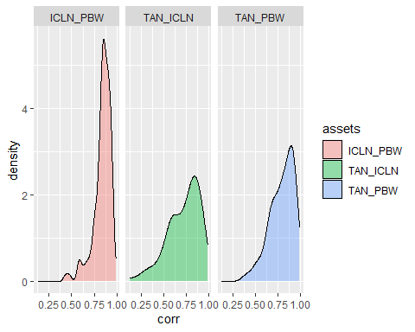
Visualize instead
corr_tbl %>% ggplot(aes(x = corr, fill = assets)) + geom_density(alpha = 0.4) + facet_wrap(~assets)

Slide 15
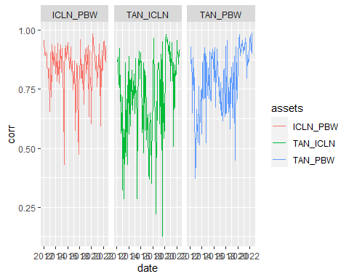
Now for the time domain
corr_tbl %>%
ggplot(aes(x = date, y = corr, color=assets)) + geom_line() + facet_wrap(~assets)

Slide 16
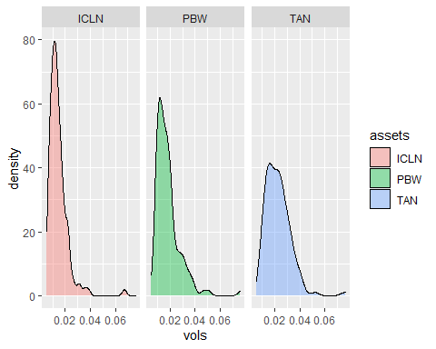
And there it is…
vols_tbl %>% ggplot(aes(x = vols, fill=assets)) + geom_density(alpha = 0.4) + facet_wrap(~assets)

Slide 17
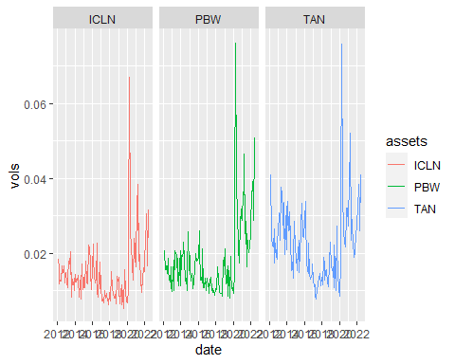
Vols away
vols_tbl %>% ggplot(aes(x = date, y = vols, color = assets)) + geom_line() + facet_wrap(~assets)

Slide 18
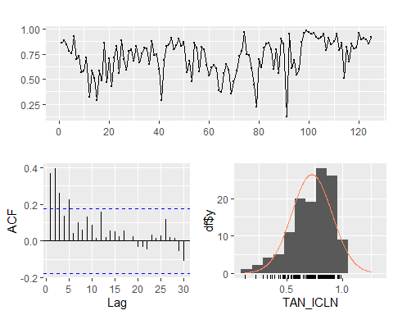
Do volatility and correlation persist?
TAN_ICLN <- r_corr$TAN_ICLN forecast::ggtsdisplay(TAN_ICLN, lag.max=30, plot.type = "histogram")

Slide 19
The verdict on correlation persistence?
There is some monthly persistence to 5 lags.
The variability of correlation varies only in the positive direction.
The distribution seems skewed to the left and non-normal.

Slide 20
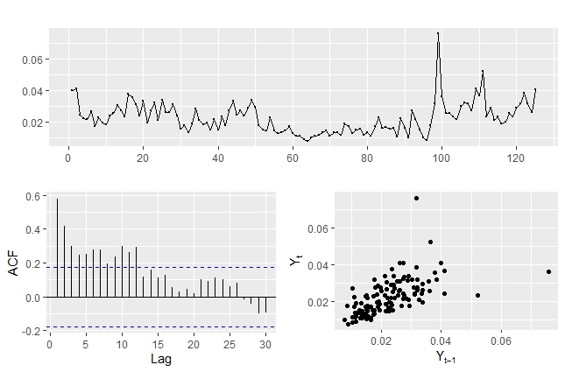
Volatilities next…
TAN <- r_vols$TAN forecast::ggtsdisplay(TAN,lag.max=30, plot.type = "scatter")

Slide 21
Verdict on volatility persistence?
Strong and persistent lags over 10 months shows slow decay. Is this some evidence of market memory of risk?
Perhaps, but it also indicates in this monthly time interval influences of outliers in the third scatter panel and variability seen in the first time series panel.

Slide 22
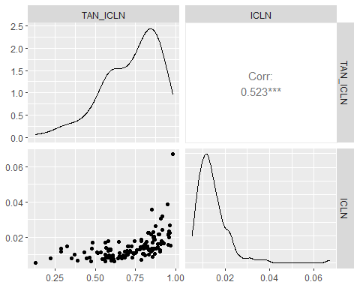
Do markets spill into one another?
corr_vols <- merge(r_corr, r_vols) corr_vols_tbl <- corr_vols %>% as_tibble() %>% mutate(date = index(corr_vols)) ggpairs(corr_vols_tbl[, c("TAN_ICLN", "ICLN")])

Slide 23
What do we observe?
Are they apparently normally distributed? Not at all, apparently. We observe a negative skew in correlation and the characteristically positive skew in volatility.
What do the outliers look like in a potential relationship between correlations and volatility? The scatter plot indicates potential outliers in very high and very low correlation market environments.
Are there potentially multiple regions of outliers? Yes, in very high and low correlation environments. The body of the relation appears to have a positive impact in line with a fairly high correlation of 0.513.

Slide 24
Dream in quantiles
library(quantreg) taus <- c(0.10, 0.25, 0.50, 0.75, 0.90) # quantiles of y for a 95% confidence interval y <- corr_vols_tbl$TAN_ICLN; x <- corr_vols_tbl$ICLN fit_corr_vols <- rq(log(y) ~ log(x), tau = taus) fit_summary <- summary(fit_corr_vols) fit_summary
## ## Call: rq(formula = log(y) ~ log(x), tau = taus) ## ## tau: [1] 0.1 ## ## Coefficients: ## coefficients lower bd upper bd ## (Intercept) 1.0690 1.0587 2.0193 ## log(x) 0.4011 0.3873 0.6402 ## ## Call: rq(formula = log(y) ~ log(x), tau = taus) ## ## tau: [1] 0.25 ## ## Coefficients: ## coefficients lower bd upper bd ## (Intercept) 1.1847 0.8995 1.7037 ## log(x) 0.3674 0.3229 0.5043 ## ## Call: rq(formula = log(y) ~ log(x), tau = taus) ##
## tau: [1] 0.5 ## ## Coefficients: ## coefficients lower bd upper bd ## (Intercept) 1.1664 0.8566 1.3194 ## log(x) 0.3356 0.2586 0.3716 ## tau: [1] 0.75 ## ## Coefficients: ## coefficients lower bd upper bd ## (Intercept) 1.0475 0.5476 1.4890 ## log(x) 0.2867 0.1655 0.3915 ## ## tau: [1] 0.9 ## ## Coefficients: ## coefficients lower bd upper bd ## (Intercept) 0.6544 0.5546 1.5559 ## log(x) 0.1825 0.1283 0.3839
plot(fit_summary)

Slide 25
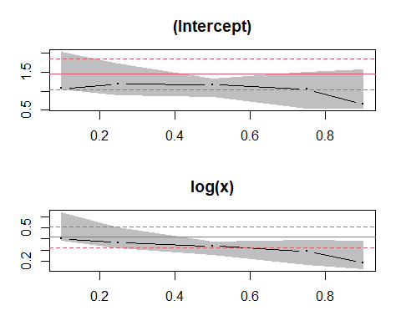
The plot thickens

Slide 26
Further questions
When is it likely for markets to spill over? Mostly across low to high correlation quantiles.
At what likelihood of correlations are market spillovers most uncertain? Again in very low and very high correlation quantile regions.
What about the other markets and their spillover effects?
What should the CFO glean from these results?
The last two questions deserve further analysis, which means more regressions. The CFO can get an idea that preparing for market risk is a very high risk management priority.

Slide 27
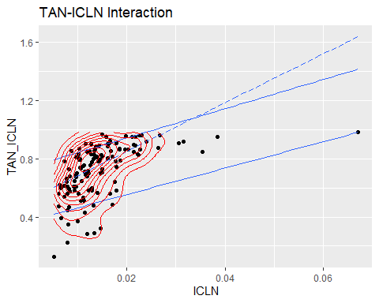
Yet another plot
p <- ggplot(corr_vols_tbl, aes(x = ICLN, y = TAN_ICLN)) + geom_point() + ggtitle("TAN-ICLN Interaction") + geom_quantile(quantiles = c(0.10, 0.90)) + geom_quantile(quantiles = 0.5, linetype = "longdash") + geom_density_2d(colour = "red") p

Slide 28
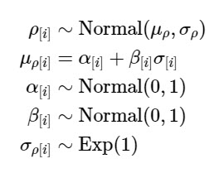
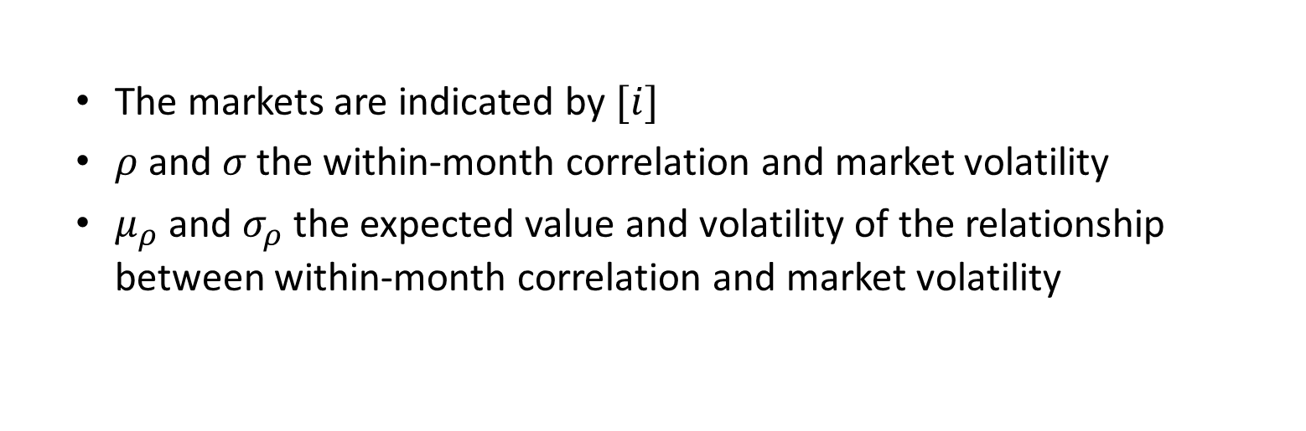
(Re)Thinking with Bayes
The markets are indicated by $[i]$
$ρ$ and $σ$ the within-month correlation and market volatility
$μ_{ρ}$ and $σ_{ρ}$ the expected value and volatility of the relationship between within-month correlation and market volatility

Slide 29
Levels and effects
library(rethinking) y <- corr_vols_tbl$TAN_ICLN; x <- corr_vols_tbl$ICLN d_1 <- tibble( tan_icln = y, icln = x ) m_1 <- quap( alist( tan_icln ~ dnorm( mu, sigma ), mu <- a + b*icln, a ~ dnorm( 0, 1 ), b ~ dnorm( 0, 1 ), sigma ~ dexp( 1 ) ), data = d_1 ) precis( m_1 )
## mean sd 5.5% 94.5% ## a 0.6873 0.02025 0.6549 0.7196 ## b 2.4813 0.93076 0.9938 3.9689 ## sigma 0.1696 0.01116 0.1518 0.1874

Slide 30
Thoughts
Priors are proper to the generation of the dependent variable. They can also take on positive or negative signs.
Spillover is much in evidence here through size of impact and direction.

Slide 31
Rinse…repeat
#library(rethinking) y <- corr_vols_tbl$TAN_PBW; x <- corr_vols_tbl$PBW d_2 <- tibble( tan_pbw = y, pbw = x ) m_2 <- quap( alist( tan_pbw ~ dnorm( mu, sigma ), mu <- a + b*pbw, a ~ dnorm( 0, 1 ), b ~ dnorm( 0, 1 ), sigma ~ dexp( 1 ) ), data = d_2 ) precis( m_2 )
## mean sd 5.5% 94.5% ## a 0.7259 0.017694 0.6977 0.7542 ## b 3.6630 0.778993 2.4181 4.9080 ## sigma 0.1170 0.007853 0.1044 0.1295

Slide 32
Again
#library(rethinking) y <- corr_vols_tbl$ICLN_PBW; x <- corr_vols_tbl$PBW d_3 <- tibble( icln_pbw = y, pbw = x ) m_3 <- quap( alist( icln_pbw ~ dnorm( mu, sigma ), mu <- a + b*pbw, a ~ dnorm( 0, 1 ), b ~ dnorm( 0, 1 ), sigma ~ dexp( 1 ) ), data = d_3 ) precis( m_3 )
## mean sd 5.5% 94.5% ## a 0.78922 0.014097 0.76669 0.81175 ## b 2.80568 0.641496 1.78044 3.83091 ## sigma 0.08703 0.005638 0.07802 0.09605

Slide 33
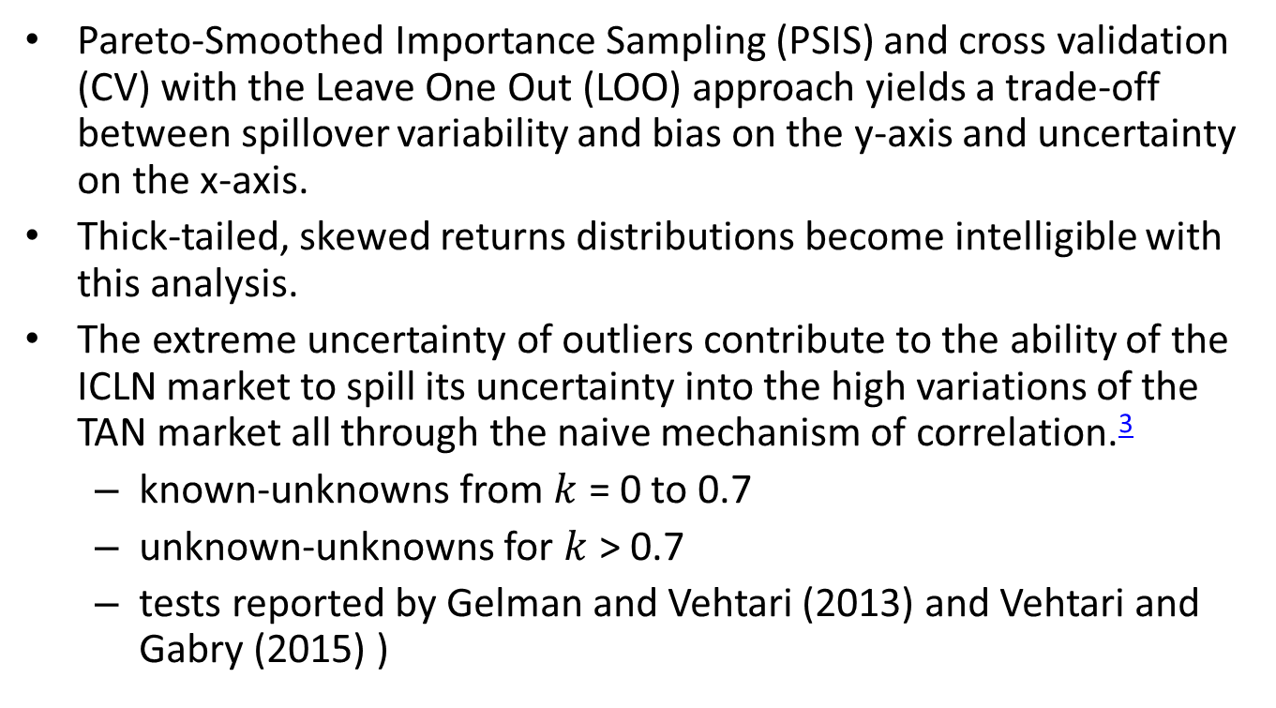
Even more
Pareto-Smoothed Importance Sampling (PSIS) and cross validation (CV) with the Leave One Out (LOO) approach yields a trade-off between spillover variability and bias on the y-axis and uncertainty on the x-axis.
Thick-tailed, skewed returns distributions become intelligible with this analysis.
The extreme uncertainty of outliers contribute to the ability of the ICLN market to spill its uncertainty into the high variations of the TAN market all through the naive mechanism of correlation.³
known-unknowns from $k$ = 0 to 0.7
unknown-unknowns for $k$ > 0.7
tests reported by Gelman and Vehtari (2013) and Vehtari and Gabry (2015) )

Slide 34
Penalty shot
#library( plotly ) options( digits=2, scipen=999999) d <- d_1 set.seed(4284) m <- m_1 PSIS_m <- PSIS( m, pointwise=TRUE ) PSIS_m <- cbind( PSIS_m, tan_icln=d$tan_icln, icln=d$icln ) set.seed(4284) #WAIC_m2.2 <- WAIC(m2.2,pointwise=TRUE) p1 <- PSIS_m %>% ggplot( aes( x=penalty, y=k ) ) + geom_point( shape=21, color = "blue" ) + xlab("PSIS Pareto k") + ylab("PSIS penalty") + geom_vline( xintercept = 0.7, linetype = "dashed") + ggtitle( "ICLN spills over into TAN" ) p1 #ggplotly( p1 )

Slide 35
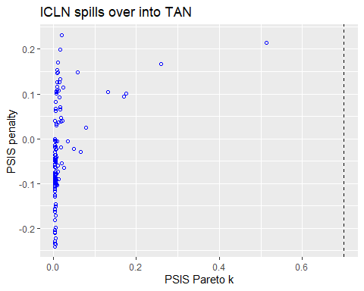

Slide 36
More results
## R code 7.34 McElreath2020 library( plotly ) options( digits=2, scipen=999999) d <- d_2 set.seed(4284) m <- m_2 PSIS_m <- PSIS( m, pointwise=TRUE ) PSIS_m <- cbind( PSIS_m, tan_pbw=d$tan_pbw, icln=d$pbw ) set.seed(4284) #WAIC_m2.2 <- WAIC(m2.2,pointwise=TRUE) p1 <- PSIS_m %>% ggplot( aes( x=penalty, y=k ) ) + geom_point( shape=21, color = "blue" ) + xlab("PSIS Pareto k") + ylab("PSIS penalty") + geom_vline( xintercept = 0.7, linetype = "dashed") + ggtitle( "PBW spills over into TAN" ) p1 #ggplotly( p1 )

Slide 37
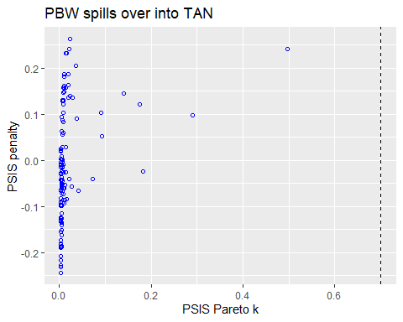

Slide 38
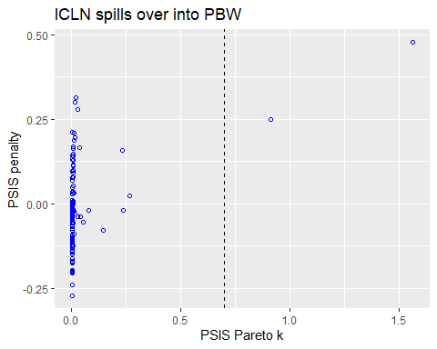
…and

Slide 39
(All-)industry risk structure
#library(rethinking) corr_vol_spill <- read_csv( "market-spillovers.csv" ) d_4 <- corr_vol_spill %>% tibble( corr = corrs, vol = vols , mid = mids )
m_4 <- quap( alist( corr ~ dnorm( mu, sigma ), mu <- a[mid] + b[mid] *vol, a[mid] ~ dnorm( 0, 1 ), b[mid] ~ dnorm( 0, 1 ), sigma[mid] ~ dexp( 1 ) ), data = d_4 ) precis( m_4, depth = 2 )
## mean sd 5.5% 94.5% ## a[1] 0.67 0.0170 0.64 0.70 ## a[2] 0.73 0.0184 0.71 0.76 ## a[3] 0.81 0.0184 0.78 0.84 ## b[1] 3.53 0.8691 2.14 4.92 ## b[2] 3.08 0.7956 1.81 4.36 ## b[3] 1.87 0.7940 0.60 3.14 ## sigma[1] 0.13 0.0086 0.12 0.15 ## sigma[2] 0.12 0.0081 0.11 0.14 ## sigma[3] 0.13 0.0087 0.12 0.15
#options( digits = 2 ) #cov2cor( vcov( m_4 ) )

Slide 40
What happened?
The Bayesian approach integrates the marginal parameters for each of the markets by using the total probability of observing the data across the markets and the range of potential parameter values. Thus the parameters share information across markets for systematic and ideosyncratic components.

Slide 41
And so it goes
#library(tidybayes.rethinking) m_draws <- m_4 %>% spread_draws( a[mid], b[mid], sigma[mid] ) mid <- as.factor(m_draws$mid) levels(mid) <- list( "TAN_ICLN"=1, "TAN_PBW"=2, "ICLN_PBW"=3 ) m_draws$mid <- mid # plot grid of two parameters p1 <- m_draws %>% ggplot(aes(x = b, y = as.factor(mid) ) ) + stat_halfeye( color = "blue") + xlab("volatility spill into correlation ") + ylab("market") + geom_vline( xintercept = 2.00 , linetype = "dashed") + geom_vline( xintercept = 4.00, linetype = "dashed") # build sigma_V comparison p2 <- m_draws %>% filter( sigma < 0.2) %>% ggplot(aes(x = sigma, y = as.factor(mid) ) ) + stat_halfeye( color = "blue") + xlab("unanticipated spillover") + ylab("market") + geom_vline( xintercept = 0.12 , linetype = "dashed") + geom_vline( xintercept = 0.14, linetype = "dashed") plot_2_grid( p1, p2, title_1 = "Impact of volatility on correlation") # ggsave( "compare.pdf" )

Slide 42
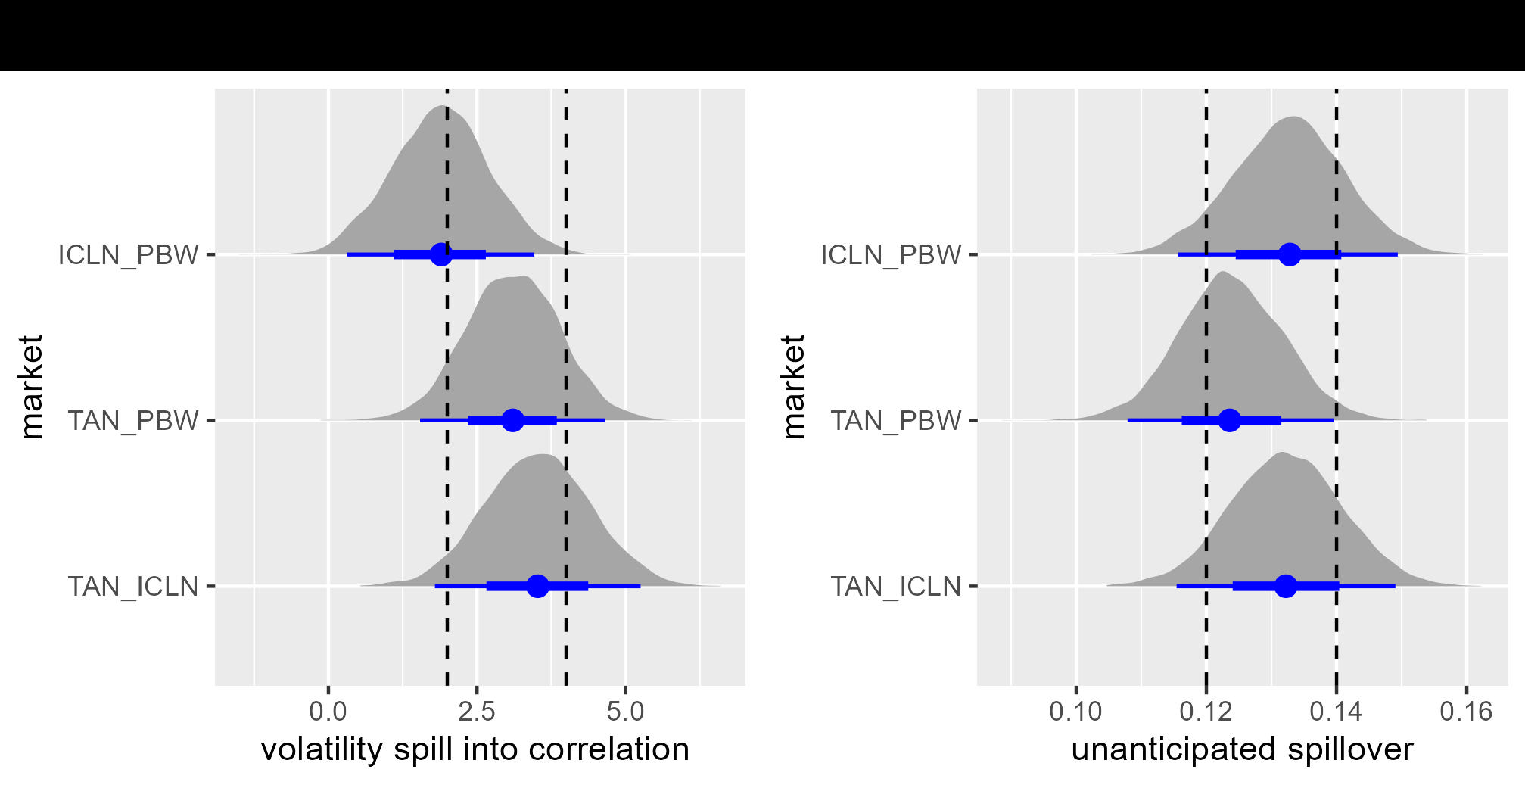
When Markets Collide
Most of the uncertainty is found in wind (PBW) volatility on solar (TAN: green). The least uncertain market seems to be the relationship between PBW and ICLN.

Slide 43
We can say that a 10% move either in ICLN or PBW volatility will induce at least a 30% in the volatility of TAN,
With moves as low as about 20% and as high as about 45%.
A 10% move in ICLN will induce a bit more than an 18% move in PBW, with moves as low as 6% and as high as over 30%.
These intervals are credible with 89% probability.

Slide 44
Once again
Again we can review the role of each of the observations on the bias-uncertainty tradeoff.
High penalty-high $k$ observations will obscure efforts to predict correlations.
The market to watch in this regard is the ICLN-PBW pair, which coincides with the high volatilities both of PBW and ICLN evident in the $σ$ distributions we viewed above.

Slide 45
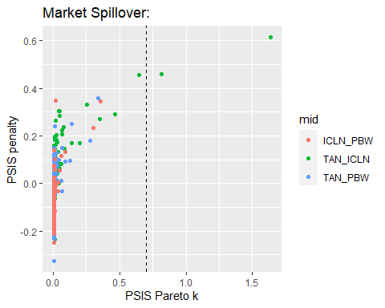
Tantalizing?

Slide 46
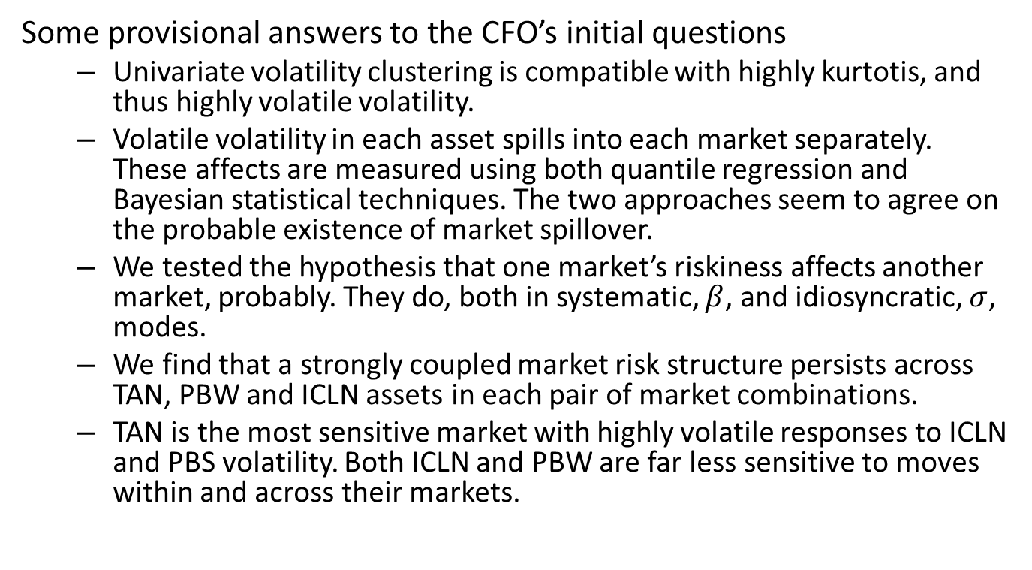
What have we accomplished?
Some provisional answers to the CFO’s initial questions
Univariate volatility clustering is compatible with highly kurtotis, and thus highly volatile volatility.
Volatile volatility in each asset spills into each market separately. These affects are measured using both quantile regression and Bayesian statistical techniques. The two approaches seem to agree on the probable existence of market spillover.
We tested the hypothesis that one market’s riskiness affects another market, probably. They do, both in systematic, $β$, and idiosyncratic, $σ$, modes.
We find that a strongly coupled market risk structure persists across TAN, PBW and ICLN assets in each pair of market combinations.
TAN is the most sensitive market with highly volatile responses to ICLN and PBS volatility. Both ICLN and PBW are far less sensitive to moves within and across their markets.

Slide 47
But be-ware
Strong negative movements in one market will probably persist and spill over into negative movements across the three markets.
Earnings based on this model will themselves exhibit the results of volatility clustering and market spillover.

Slide 48
Next: GPD?
Our next step could well be to build volatility clustering, and other thick-tailed outcomes, to derive implied capital requirements through market risk channels.
Such requirements would inform the risk budgeting assignments that might be built into delegations of authority, portfolio limits, even into optimization constraints.

Slide 49
References
Carpenter, Gelman, B. 2017. “Stan: A Probabilistic Programming Language.” Journal of Statistical Software 76 (1).
Cont, R. 2001. “Empirical Properties of Asset Returns: Stylized Facts and Statistical Issues.” Quantitative Finance 1.
Embrechts, Paul. 2000. “Modelling Multivariate Extremes.” In Extremes and Integrated Risk Management, edited by Paul Embrechts, 59–67. RISK Publications.
Gelman, J. Hwang, A., and A. Vehtari. 2013. “Understanding Predictive Information Criteria for Bayesian Models.”
McElreath, Richard. 2020. Statistical Rethinking: A Bayesian Course with Examples in R and Stan. Second edition. CRC Press. https://xcelab.net/rm/statistical-rethinking/.
McNeil, A. J., R. Frey, and P. Embrechts. 2015. Quantitative Risk Management: Concepts, Techniques and Tools - Revised Edition. Princeton Series in Finance. Princeton University Press. https://books.google.com/books?id=SfJnBgAAQBAJ.
Taleb, Nassim Nicholas. 2018. “The Statistical Consequences of Fat Tails: Papers and Commentary.” Edited by Stem Academic Publishing. The Technical Inconcerto 1.
Team, Stan Development. 2020a. “RStan: The r Interface to Stan (r Package Version 2.17.3) [Computer Software].” http://mc-stan.org/.
———. 2020b. “The Stan Core Library (Version 2.18.0).” http://mc-stan.org/.
Vehtari, A. Gelman, A., and J. Gabry. 2015. “Efficient Implementation of Leave-One-Out Cross-Validation and WAIC for Evaluating Fitted Bayesian Models.”
Watanabe, S. 2009. Algebraic Geometry and Statistical Learning Theory. Cambridge Monographs on Applied and Computational Mathematics. Cambridge University Press. https://books.google.com/books?id=GnnUHasAtUQC.

Slide 50
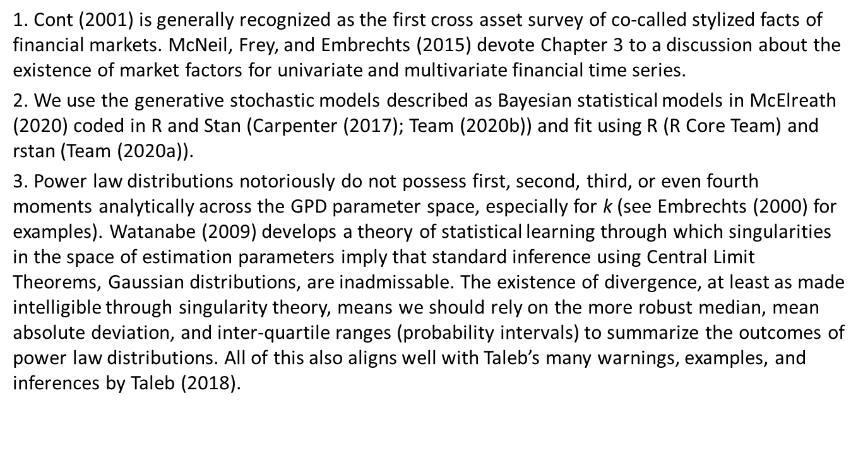
Notes
1. Cont (2001) is generally recognized as the first cross asset survey of co-called stylized facts of financial markets. McNeil, Frey, and Embrechts (2015) devote Chapter 3 to a discussion about the existence of market factors for univariate and multivariate financial time series.
2. We use the generative stochastic models described as Bayesian statistical models in McElreath (2020) coded in R and Stan (Carpenter (2017); Team (2020b)) and fit using R (R Core Team) and rstan (Team (2020a)).
3. Power law distributions notoriously do not possess first, second, third, or even fourth moments analytically across the GPD parameter space, especially for k (see Embrechts (2000) for examples). Watanabe (2009) develops a theory of statistical learning through which singularities in the space of estimation parameters imply that standard inference using Central Limit Theorems, Gaussian distributions, are inadmissable. The existence of divergence, at least as made intelligible through singularity theory, means we should rely on the more robust median, mean absolute deviation, and inter-quartile ranges (probability intervals) to summarize the outcomes of power law distributions. All of this also aligns well with Taleb’s many warnings, examples, and inferences by Taleb (2018).

