Slide 1

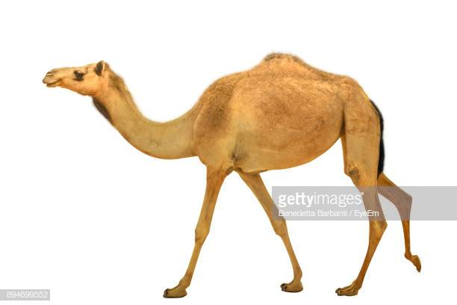
Welcome to Apache Camel Brown Bag

Slide 2
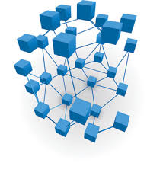
What is integration?
Connecting applications/systems

Slide 3
Terms used in integration
Applications or Systems
Components
Message channels
Connect endpoints
Messages are exchanged
Endpoints
Abstractions model end of message channel to send/receive message
HTTP, FTP, File, Messaging, Databases
Message
Contains actual data (business documents), JSON, XML, CSV,
Headers, Attachments, Bodies
Exchange
Message Wrappers
Input/output messages, CorrelationIDs, MEP, Properties

Slide 4
How is integration done without frameworks?
HTTP Server
Use HTTPClient object, build boiler plates for connection
JMS
Write a JMSConnection through Factory or Builder
Create a JMS session
Create a producer then send a message
Create a consumer then implement a listener
Database
Create a connection object using properties
Create a statement
Execute the statement, implement transaction if required

Slide 5
Challenges
Setting up connections are repeatable codes – Boiler plates
Need to cater for connectivity issues
Even if you design your systems as loosely coupled
Dive into individual components to implement exception handling
Need to implement foundations for translations
Set up some corporate patterns
Effectively implement your own integration patterns
Enterprise Integration Patterns
Comprehensive coverage of integration patterns to follow

Slide 6
Integration Frameworks/Platforms
Support and implement Enterprise Integration Patterns – EIPs
Authored by Gregor Hohpe & Bobby Woolf
Some have high level abstractions (business language)
Some support high level abstractions (Fluent APIs, DSLs)
Examples
MuleSoft (Commercial)
WSO2 (Open source & Commercial)
Spring Integration (Open source)
Apache Camel (Open Source)

Slide 7
What do Frameworks/Platforms offer?
Eliminate boiler plates
Provides language more related to integration
Integration Workflow
Abstract errors/exceptions at higher level
Some have integrations with Security Frameworks (IDP), API Consumptions (Commercial ones)
SAML/OAuth2.0 tokens
Track transactions

Slide 8
Challenges with Frameworks
Different methods of integration
Although the EIP patterns are the same
Use different terminologies
Although high level abstracted
There are occasions where you have to go lower to understand issues
DSLs are implemented in different languages
Java/Scala/Spring/Groovy, XML, Proprietary

Slide 9
Apache Camel Features
Routing and Mediation Engine
Define your own routing rules
Implements Enterprise Integration Patterns - EIPs
Domain Specific Language – Java, Spring, Scala, XML, Groovy, Ruby etc
Payload Agnostic – CSV, XML, JSON, Objects, Files
POJOs
Automatic Type Converters
Test Kit
Exception handling
Configuration

Slide 10

Integration with Camel
Messaging Channel
Camel Context

Slide 11
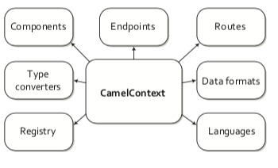
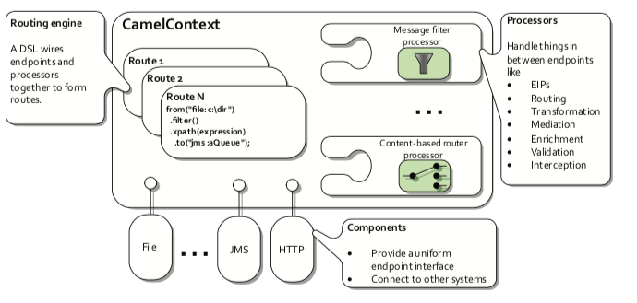
Architecture
Notes:
Camel Context is the integration world where messages are routed from one endpoint to another, possibly enriched/transformed.
Input messages are passed into this context and response messages are taken from this context
This is where you implement our integrations through use of EIPs.
Camel has implemented most of these EIPs and you wire them together

Slide 12
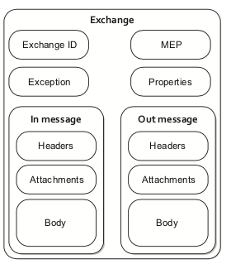
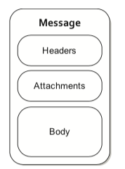
Exchange/Message Abstractions
ExchangeID - unique
Message Exchange Pattern - InOnly, InOut
Properties - name/value pairs
InMessage - Mandatory
OutMessage - Optional
Headers - name/value pairs
Attachments - e.g. email, image etc
Body - java.lang.Object
Fault Flag

Slide 13
Use Case – Orders API
Simple Order System API
A lean Order document (JSON) is passed to it from a web/mobile app
Order document must contain Customer Details and Item Details prior to being fulfilled
On Order Document validation
Order document to be fulfilled
Order passed to Invoice processing
For logging and auditing, there must be an event sourcing system that keeps track of status of each API call

Slide 14
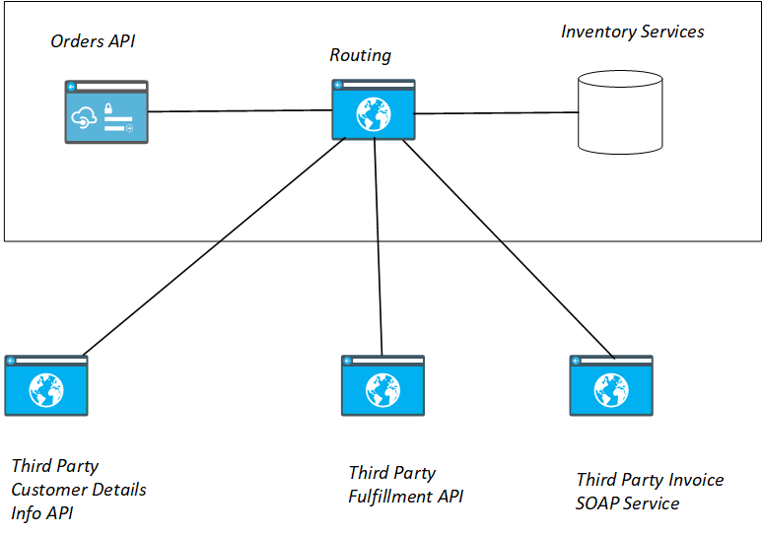
High Level

Slide 15
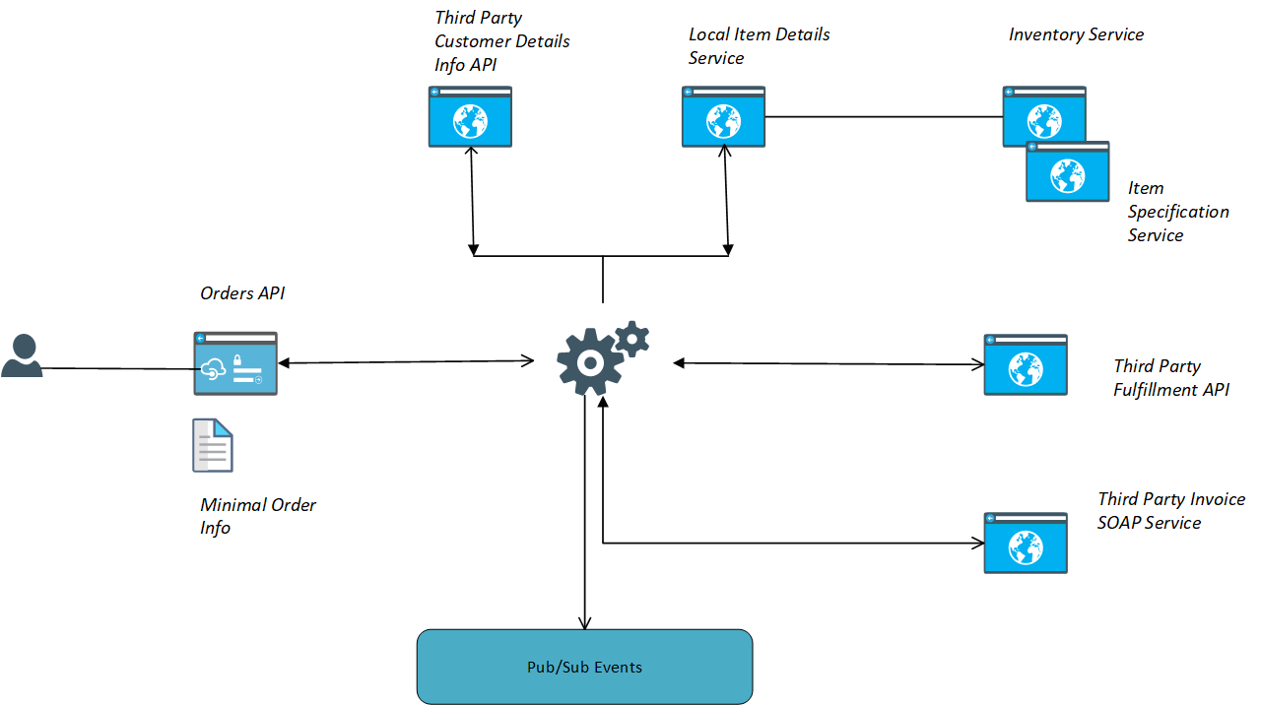
Integration Scenario
{
"customerId": "WGM123",
"orderDetails" : [{"code": "ITEM123", {"code": "ZXY456"}}]
}
Notes:
Orders API is a fictitious web site that contains imaginary catalogue whose items are shoes. The API is so lean that it relies on other third party APIs to complete the order details
Order details are broken into Customer Details which include, customer delivery address, customer payment details and details of the Order Items which include more detailed descriptions, and the availability of the items from a warehouse
There is an optional PubSub channel – Event Sourcing where the order is logged.

Slide 16
Requirements
Enrich the Lean Document
Add Customer Address and Customer Payment Method
Enrich the order item details to contain description of coded items
Include number of items to be purchased
Once order is complete, pass it to fulfillment and get an order reference
Pass the order for invoice processing
NFR – record the different process/state the order undergoes in an event processing channel so it can be reproduced for auditing purposes

Slide 17
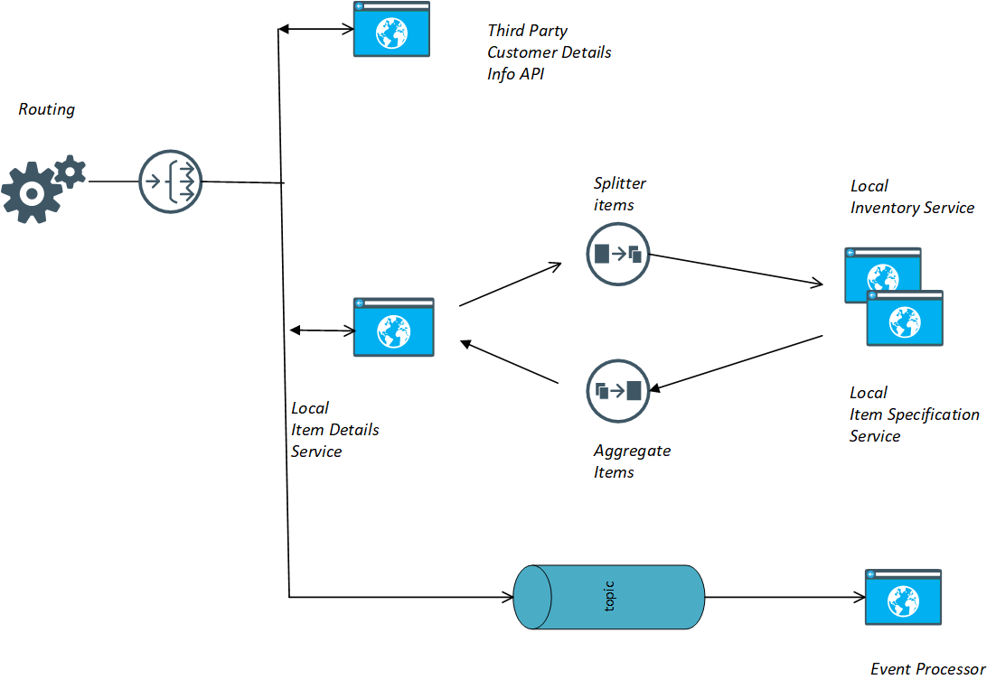
Routing Architecture
Third Party Customer Details Info API
DSLs used to integrate Http Component
Exception Handling – Global/Processor Level
Local Item Details Services
Service Activator EIP – bean DSL
Splitter
Aggregator – Immediate/Threaded
Multicast and ParallelProcessing DSL
Enrich DSL
Event Processor
How to write your own Component

Slide 18
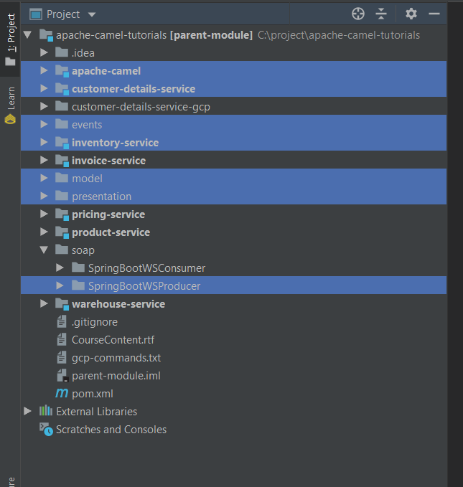
Project Layout

Slide 19
Integration Parts – Model
JSON Schema – POJO through Jackson-Binding
{ "customerId": "string", "customerDetails": { "deliveryDetails": { "address": "string", "city": "string", "state": "string", "postcode": "string" }, "paymentDetails": { "paymentType": "string", "paymentId": "string", "expiryDate": "date" } }, "orderDetails": { "items": [ { "code": "string", "description": "string", "quantity": "integer", "price": "decimal", "specification": { "description": "string", "dimension": "string", "materials": "string" }, "inventory": { "availableItems": "decimal", "location": "string" } } ] } }
Classes
Order
CustomerDetails
DeliveryDetails
Inventory
Item
OrderDetails
PaymentDetails
Specification
Each class has extra additionalProperty created by Jackson
Dictionary
Placeholder for anything extra

Slide 20
Integration Parts – Customer Details API
RESTful API
Receives a CustomerID request parameter
Returns CustomerDetails
Uses the AdditionalProperty Field if no CustomerDetails found

Slide 21
Integration Parts – Invoicing SOAP
<xs:schema xmlns:xs="http://www.w3.org/2001/XMLSchema" xmlns:tns="http://co.wgmartinez.wsdl/invoice-ws/" targetNamespace="http://co.wgmartinez.wsdl/invoice-ws/" elementFormDefault="qualified"> <xs:complexType name="invoice"> <xs:sequence> <xs:element name="invoiceReference" type="xs:string"/> <xs:element name="orderReference" type="xs:string"/> <xs:element name="customerReference" type="xs:string"/> <xs:element name="amount" type="xs:decimal"/> </xs:sequence> </xs:complexType> <xs:complexType name="serviceStatus"> <xs:sequence> <xs:element name="statusCode" type="xs:string"/> <xs:element name="message" type="xs:string"/> </xs:sequence> </xs:complexType> <xs:element name="addInvoiceRequest"> <xs:complexType> <xs:sequence> <xs:element name="orderReference" type="xs:string"/> <xs:element name="customerReference" type="xs:string"/> <xs:element name="amount" type="xs:decimal"/> </xs:sequence> </xs:complexType> </xs:element> <xs:element name="addInvoiceResponse"> <xs:complexType> <xs:sequence> <xs:element name="serviceStatus" type="tns:serviceStatus"/> <xs:element name="invoice" type="tns:invoice"/> </xs:sequence> </xs:complexType> </xs:element> </xs:schema>

Slide 22
Integration Parts – PubSub
Receives JSON Documents
Google Cloud PubSub – used on my Mac
Google Function is notified when a message is received
Containerised Kafka
Background Kafka client gets notified

Slide 23
Camel Context/RouteBuilder – Traditional Spring
Spring Camel Context
ApplicationContext applicationContext = new ClassPathXmlApplicationContext("SpringXMLRouteContext.xml"); CamelContext camelContext = SpringCamelContext.springCamelContext(applicationContext, true); try { camelContext.start(); ProducerTemplate template = camelContext.createProducerTemplate(); InputStream inputStream = new FileInputStream("src/main/resources/order.xml"); template.sendBody("direct:SpringXMLRouteStart", inputStream); }finally { camelContext.stop(); }

Slide 24
Camel Context/RouteBuilder – Traditional Spring
Spring Camel Context
ApplicationContext applicationContext = new ClassPathXmlApplicationContext("SpringXMLRouteContext.xml"); CamelContext camelContext = SpringCamelContext.springCamelContext(applicationContext, true); try { camelContext.start(); ProducerTemplate template = camelContext.createProducerTemplate(); InputStream inputStream = new FileInputStream("src/main/resources/order.xml"); template.sendBody("direct:SpringXMLRouteStart", inputStream); }finally { camelContext.stop(); }

Slide 25
Camel Context/RouteBuilder – Traditional Spring
<beans>
………
<bean id="executorService" class="java.util.concurrent.Executors" factory-method="newSingleThreadExecutor"/> <camelContext xmlns="http://camel.apache.org/schema/spring"> <route> <from uri="direct:SpringXMLRouteStart"/> <log message="Split by article element"/> <convertBodyTo type="String"/> <split> <xpath>//order[@product = 'electronics']/items</xpath> <to uri="activemq:queue:Q1"/> </split> <split> <xpath>//order[@product = 'books']/items</xpath> <to uri="activemq:queue:Q2"/> </split> </route> <route> <from uri="activemq:queue:Q1"/> <log message="Dequeud from Q1 and will be multicast to 3 more queues"/> <multicast parallelProcessing="true" executorServiceRef="executorService"> <to uri="activemq:queue:Q5"/> <to uri="activemq:queue:Q6"/> <to uri="activemq:queue:Q7"/> </multicast> </route> </camelContext> </beans>

Slide 26
Camel Context/RouteBuilder - Java
Add a route builder to the context
public static void main(String[] args) throws Exception { CamelContext camelContext = new DefaultCamelContext(); try { camelContext.addRoutes(new RouteBuilder() { @Override public void configure() throws Exception { from("file:src/main/resources/order.xml") .split(xpath("//order[@product = 'electronics']/items")) .process(new Processor() { @Override public void process(Exchange exchange) throws Exception { Message message = exchange.getIn(); message.setHeader("MyHeader", "Hello World"); System.out.println("Processing electronic products"); } }) .process(e -> { Message msg = e.getIn(); }) .log(body().toString()) .to("jms:queue:Q1"); } }); camelContext.start(); ProducerTemplate template = camelContext.createProducerTemplate(); template.sendBody(.....) Thread.sleep(5000); } catch (Exception e) { } finally { camelContext.stop(); } }

Slide 27
Camel Context/RouteBuilder - SpringBoot
@Component public class ProcessOrderRoute extends RouteBuilder { @Override public void configure() throws Exception { from("direct:processOrderStart") .to("direct:processOrder"); from("direct:processOrder") .log("Order Processed"); } }
<dependency> <groupId>org.apache.camel</groupId> <artifactId>camel-core</artifactId> <version>${camel-spring-boot-version}</version> </dependency>
@Autowire the context in the Service Class

Slide 28
Writing Type Converters - Steps
Step 1
Create a file called

Slide 29
The End

