Slide 1
Introduction to GenAI
Past > Present > Future
2024-11-16

Slide 2
Past - The "storm gathering"
- What is GenAI
- A brief history
- How it works
- Why it works

Slide 3

AI > ML > DL> GenAI

Slide 4

AI History
1984 - Apple Mac
1989 - WWW by Tim Berners-Lee @ CERN
1990 - Microsoft Windows
1991 - Linux
1998 - Google Search
2006 - AWS Cloud
2007 - Apple iPhone
2015 - OpenAI
2018 - Hinton, LeCunn, Bengio (Turing Award)
2022-11-30 - ChatGPT

Slide 5
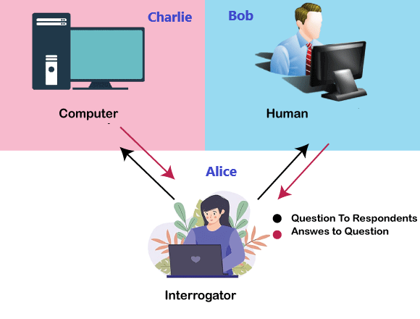
What is Turing Test ?
https://en.wikipedia.org/wiki/Chinese_room

Slide 6
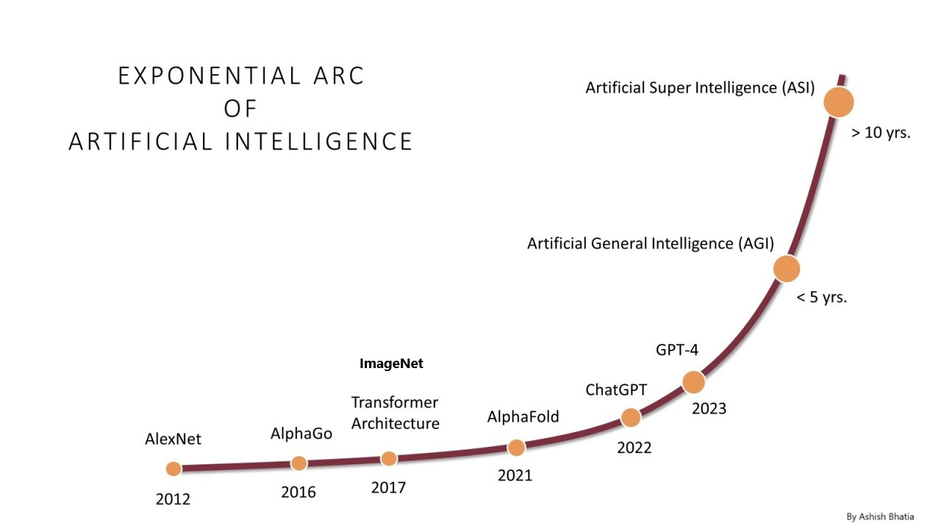
AI Growth & Milestones

Slide 7
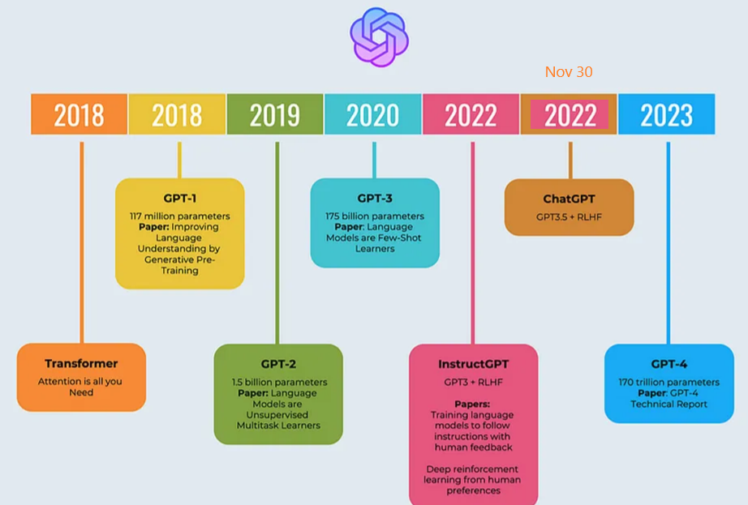
OpenAI: ChatGPT

Slide 8

How LLM Model is built

Slide 9

How GenAI works?

Slide 10
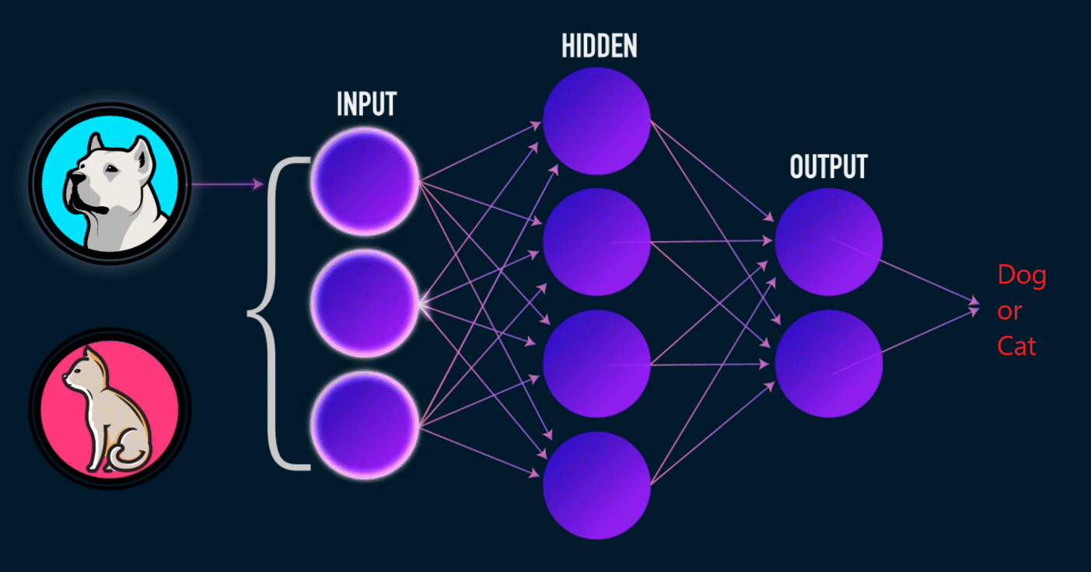
Training Neural Network

Slide 11
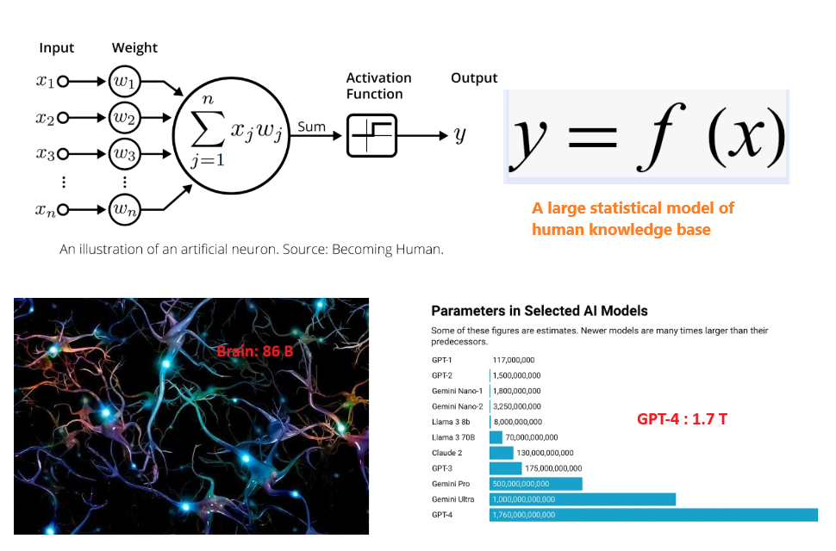
LLM: y = f(x)

Slide 12
LLM Explainability
- Generalization Theory
Explain why deep networks can learn effectively despite having more parameters than training examples;
- Representation Learning
Study how neural networks develop hierarchical internal representations similar to biological brains;
- Optimization Dynamics
Investigate why gradient descent consistently finds good solutions in highly complex parameter spaces
Tomaso Poggio
https://mcgovern.mit.edu/profile/tomaso-poggio/

Slide 13
Present - "Following the yellow brick road"
- State of 2024
- LLM model
- type
- benchmark
- Application
- chatbot
- agent
- demo

Slide 14

2024 Nobel Prizes in Physics & Chemistry

Slide 15

State of AI - 2024

Slide 16


LLM Model Type

Slide 17
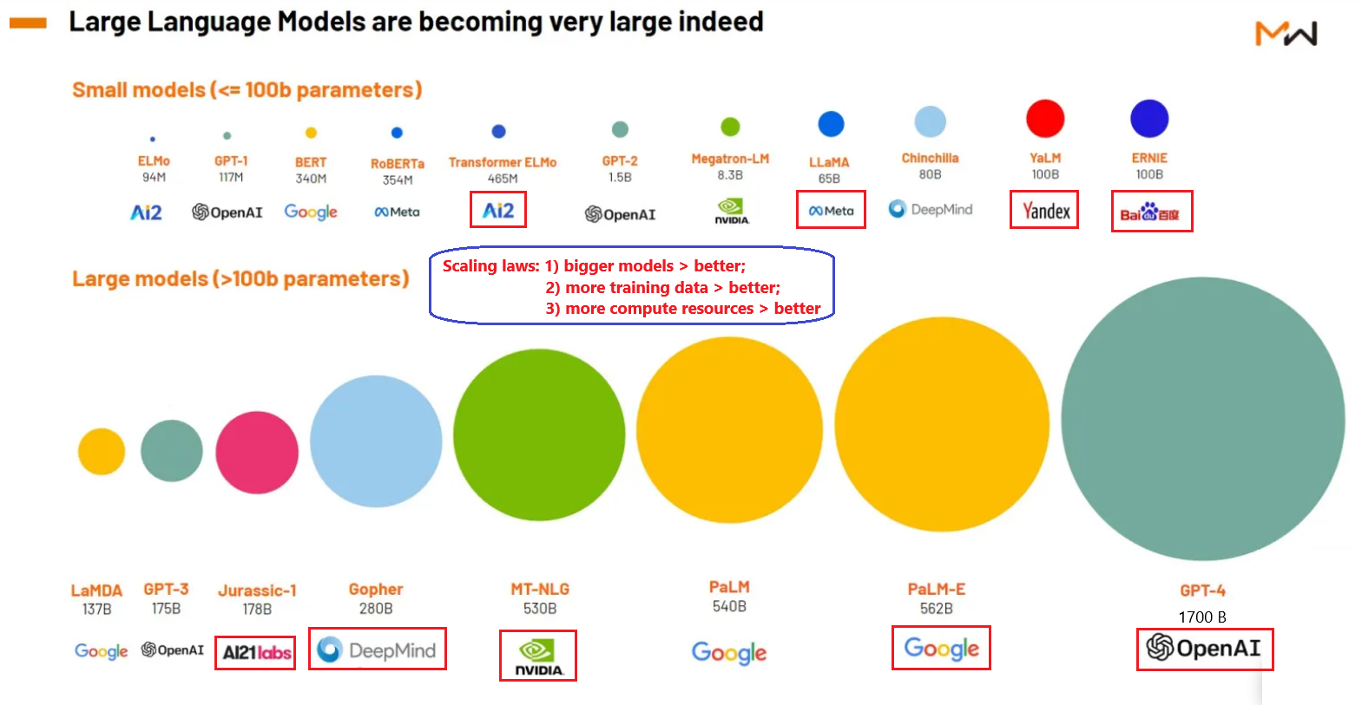
GenAI Leading Players

Slide 18
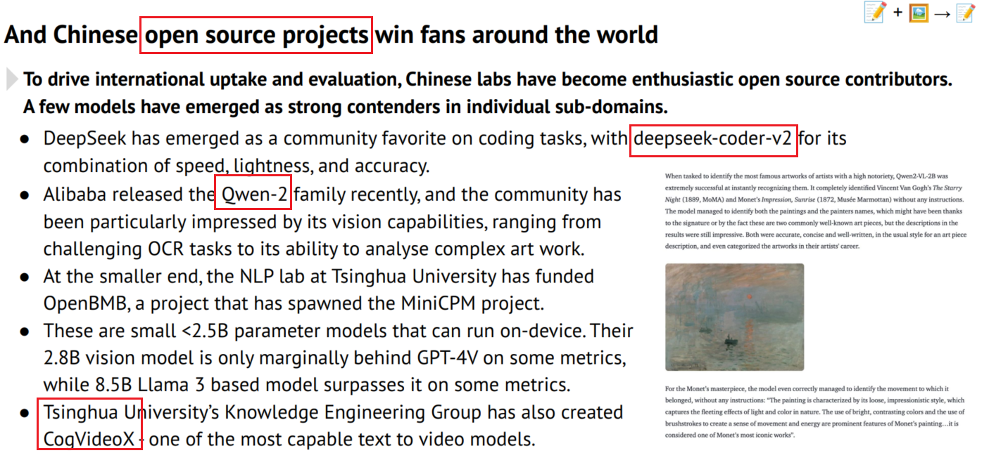
HuggingFace – Open Source LLM Hub
https://huggingface.co/

Slide 19
Ollama – Open Local Private LLM platform
Open
- Run SOTA open-source LLMs locally
- Easy model management (pull, run)
- Active community and growing model library
Local
- Simple setup
- Run on PC/Laptop
- No cloud dependencies or API costs
Private
- Data stays on your machine
- Full control over model interactions
- Ideal for research experimentation
https://ollama.com/

Slide 20

Model Leader Board

Slide 21

Model Benchmark

Slide 22
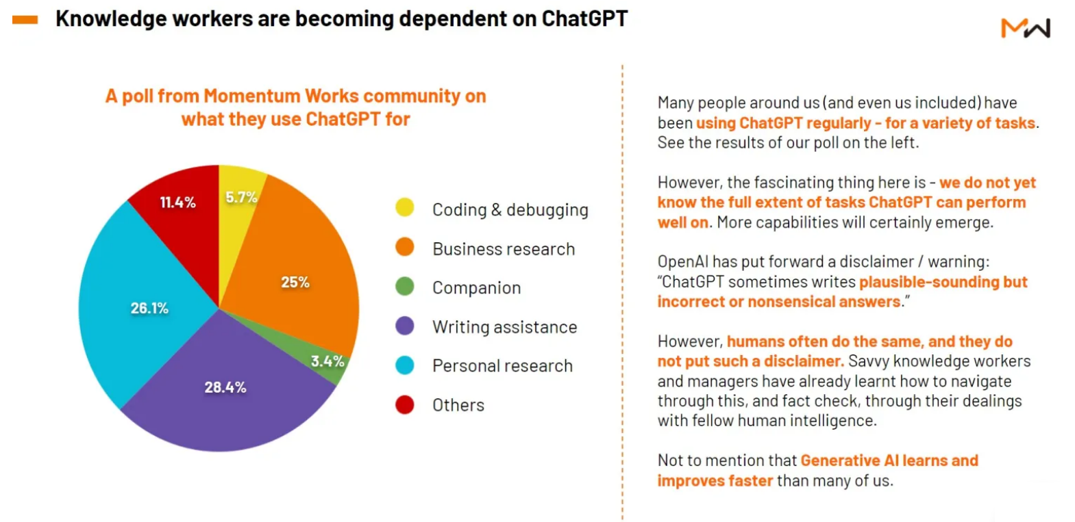
Chat Bot

Slide 23

Agent – Concept

Slide 24

Agent – Complex AI Systems
https://agpt.co/
https://www.crewai.com/
https://microsoft.github.io/autogen

Slide 25

AI for Math

Slide 26
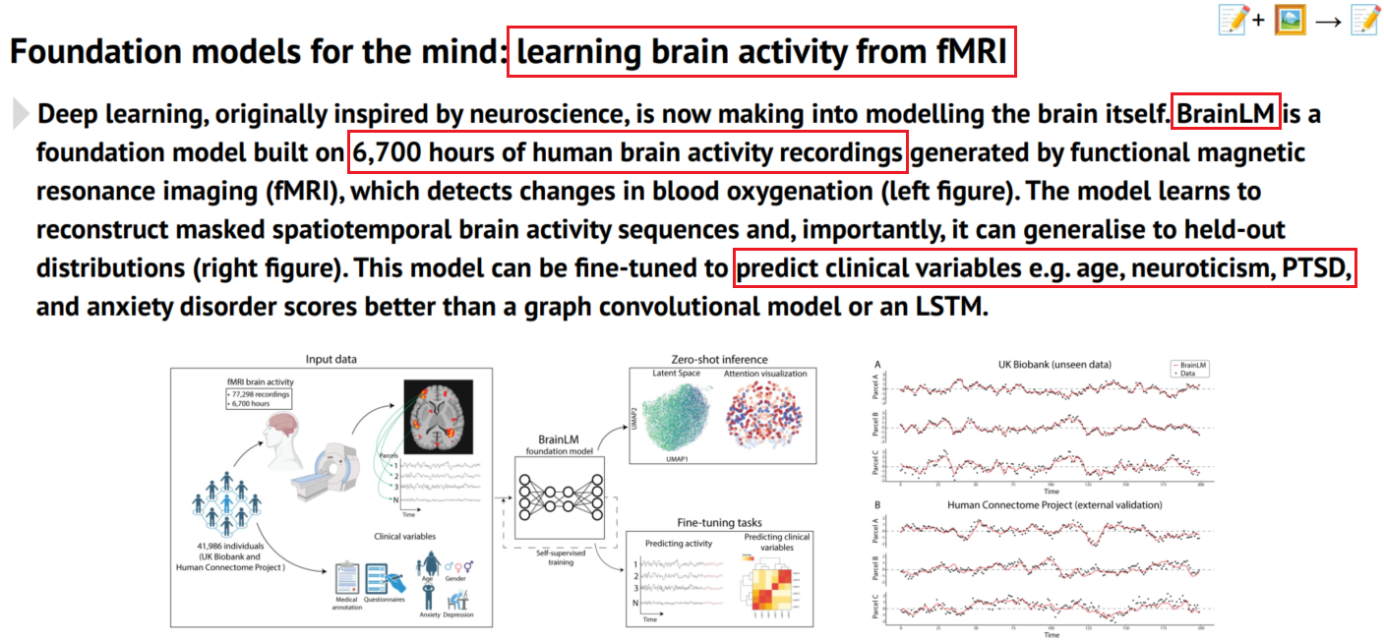
AI for Sciences

Slide 27
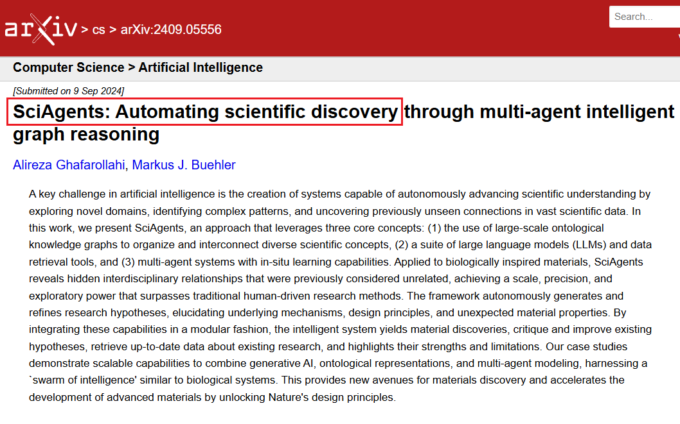
SciAgents – Automate Discovery

Slide 28
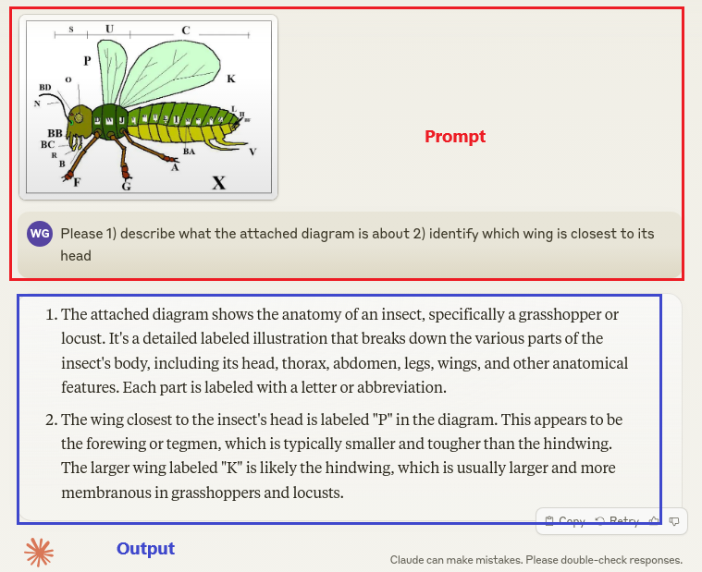
GenAI Demo

Slide 29

GenAI Demo

Slide 30
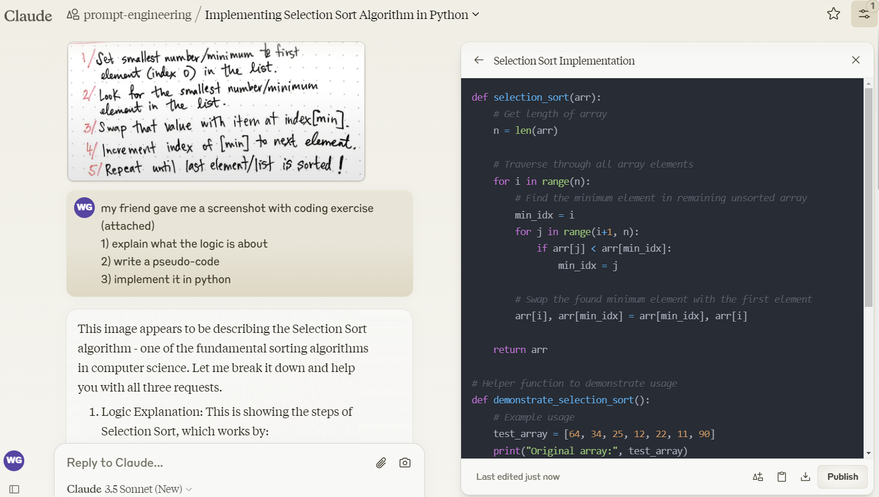
GenAI Demo
https://claude.ai/chat/97342cb8-5ba8-44b8-9c98-c080aaa62acc

Slide 31

GenAI Demo

Slide 32

GenAI Demo

Slide 33

GenAI Demo

Slide 34

GenAI Demo

Slide 35

GenAI Demo

Slide 36

GenAI Demo

Slide 37

GenAI Demo: Text2SQL (my work)
https://www.youtube.com/watch?v=RKSlUAFmbaM

Slide 38
Future - "Behind the curtain"
- Geopolics
- Robotics
- Social impact
- AGI
- HI (Higher Intelligence)

Slide 39

Geopolitics: GenAI Leading Powers

Slide 40

AI + Robotics

Slide 41
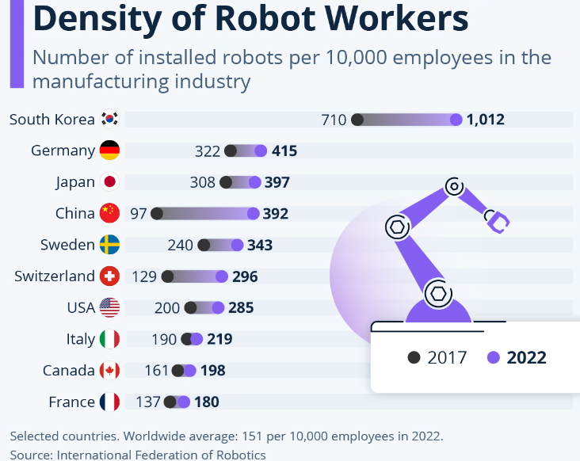
Robots

Slide 42

Robot & Us: Where is privacy?

Slide 43
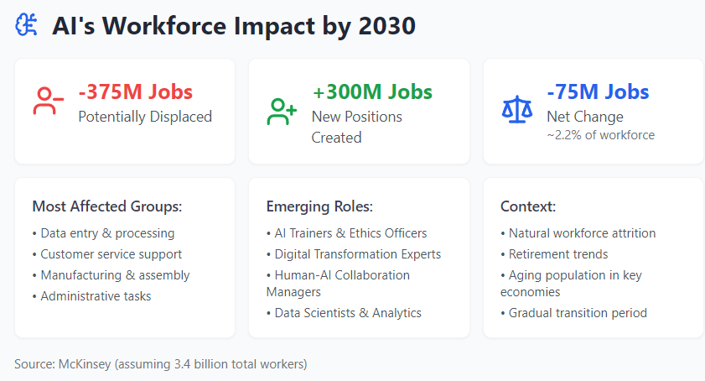
Social Impact

Slide 44
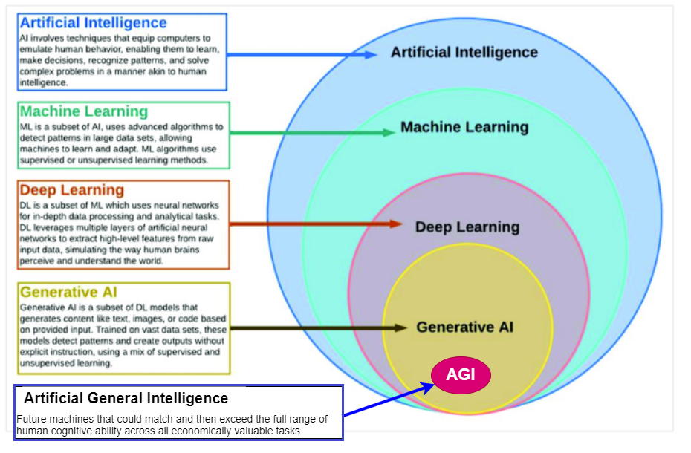
What is AGI ?

Slide 45
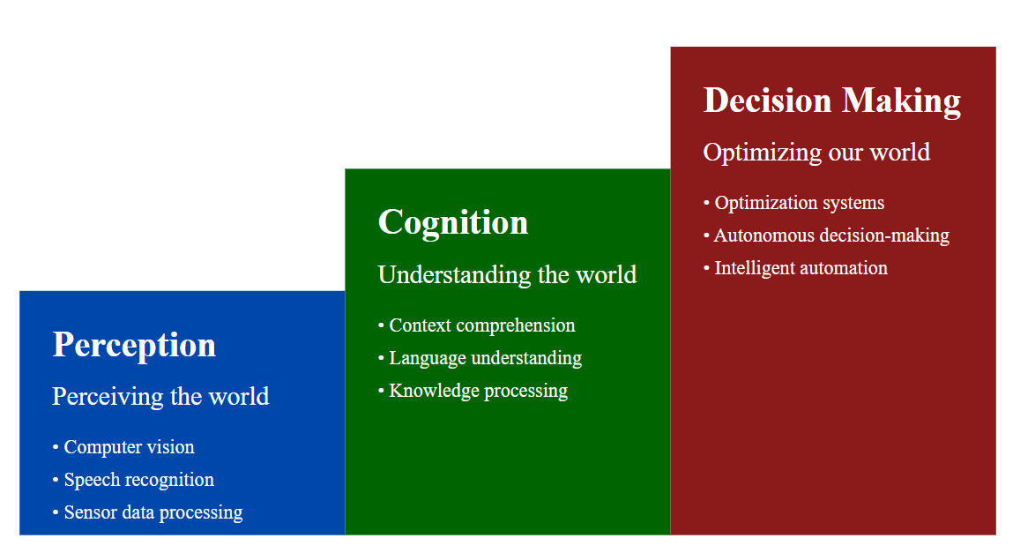
AI Evolution in 3 Stages

Slide 46
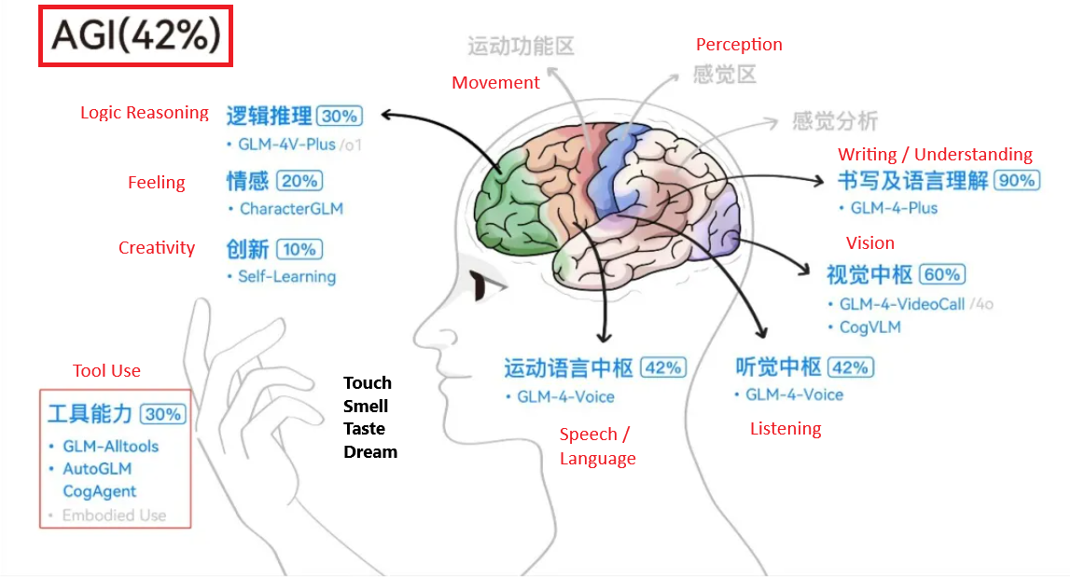
AutoGLM – Autonomous Foundation Agents
https://www.zhipuai.cn/

Slide 47

HI – AGI – GenAI - TT (1)

Slide 48
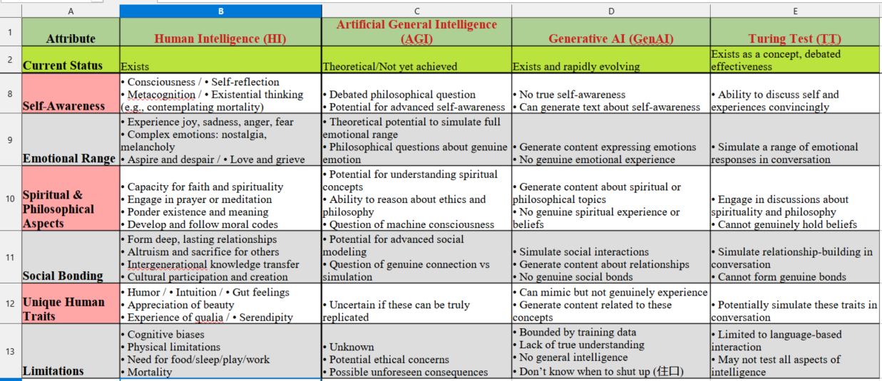
HI – AGI – GenAI - TT (2)
https://github.com/gongwork/data-copilot/blob/main/docs/GenAI-Intro/HI-AGI-GenAI-TT.xlsx

Slide 49

What makes us Human ?

Slide 50

https://www.linkedin.com/in/wen-g-gong/
https://github.com/gongwork/data-copilot/blob/main/docs/GenAI-Intro/EOA-slides.pdf

Slide 51
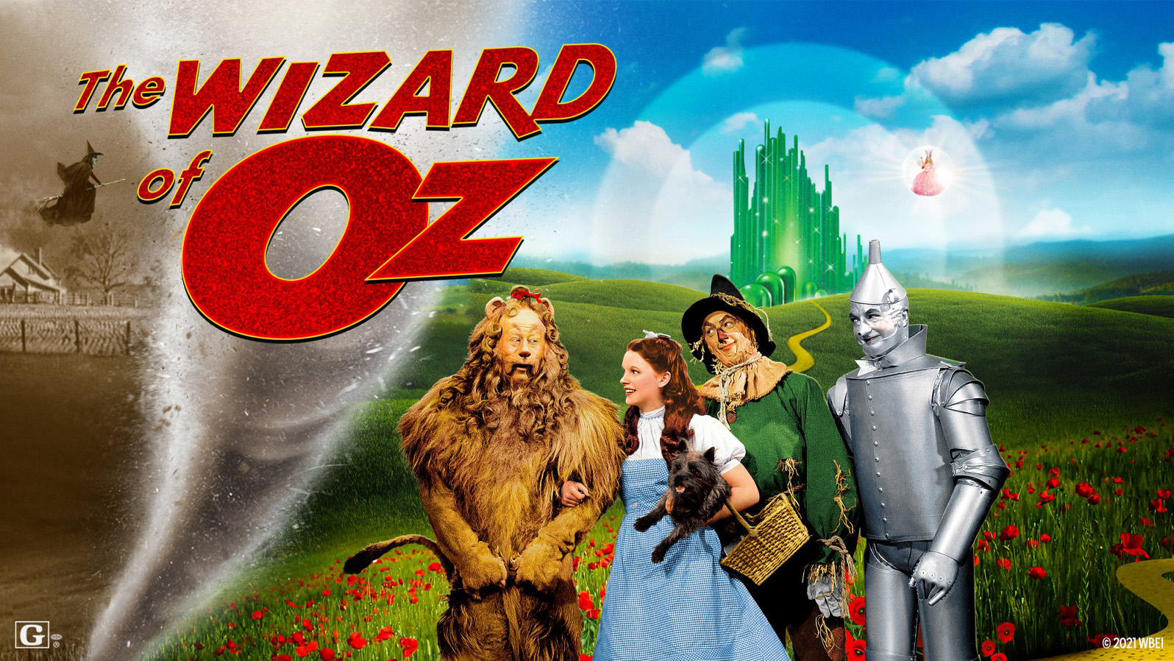
A Journey to Oz
Dorothy
- with innate power
Scarecrow
- seeking brain
Tin Man
- seeking heart
Cowardly Lion
- seeking courage

Slide 52
有问必答,不知闭嘴.
LLM can answer any question,
But does not know when to shut up.
https://claude.ai/chat/1b472508-e5a9-414b-aa39-afdc31917429

