Slide 1
Introduction to GenAI
Past > Present > Future
2024-11-16

Slide 2
Past - The "storm gathering"
- AI Concept
- Brief history
- How GenAI works
- Why it works

Slide 3

AI > ML > DL> GenAI

Slide 4

AI History

Slide 5
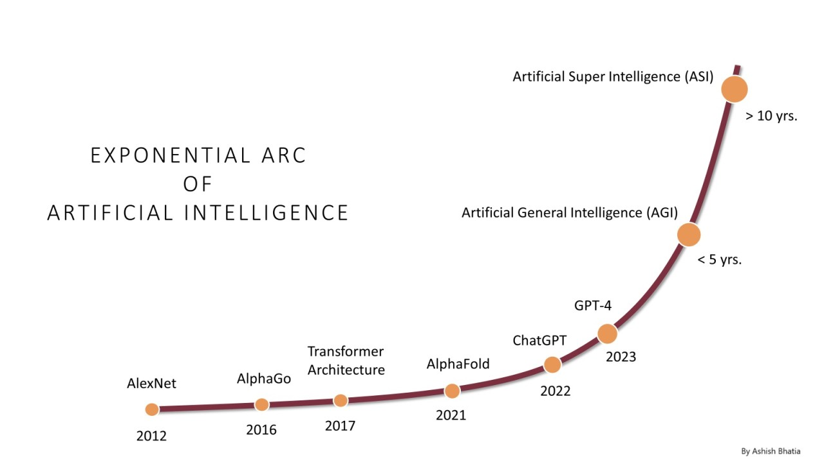
AI Growth & Milestones

Slide 6
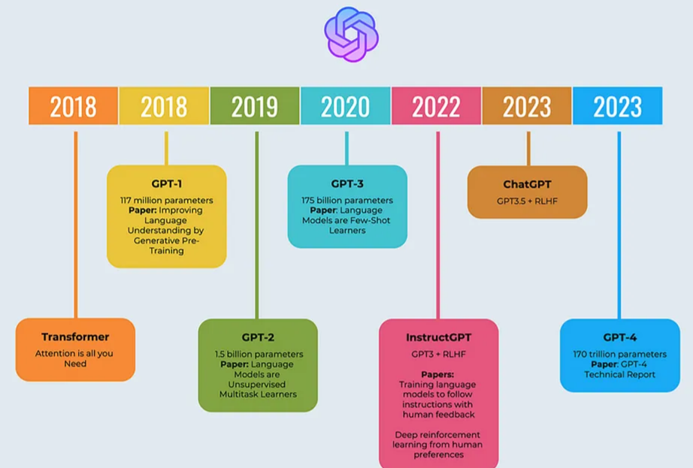
OpenAI: ChatGPT

Slide 7

LLMOps: Model Lifecycle

Slide 8

How GenAI works?

Slide 9
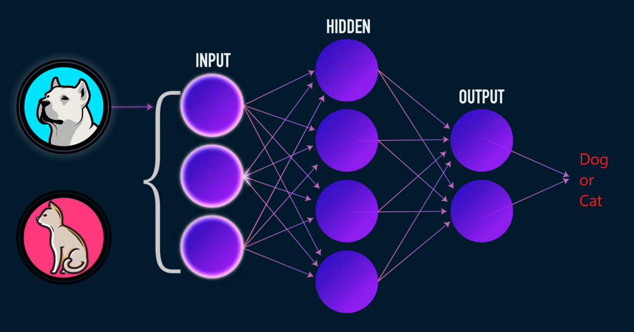
Learning: Neural Network

Slide 10
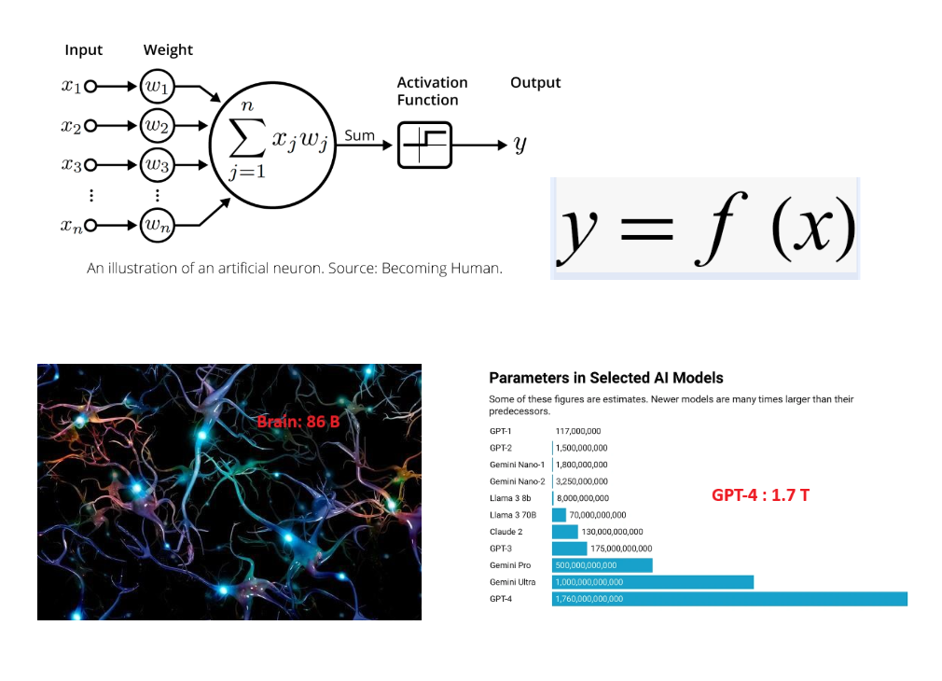
LLM: y = f(x)

Slide 11
LLM Explainability
- Generalization Theory
Explain why deep networks can learn effectively despite having more parameters than training examples;
- Representation Learning
Study how neural networks develop hierarchical internal representations similar to biological brains;
- Optimization Dynamics
Investigate why gradient descent consistently finds good solutions in highly complex parameter spaces
https://mcgovern.mit.edu/profile/tomaso-poggio/

Slide 12
Present - "Following the yellow brick road"
- Current state - 2024
- LLM model type
- LLM model benchmark
- Application
- Example

Slide 13

2024 Nobel Prizes in Physics & Chemistry

Slide 14

State of AI - 2024

Slide 15


LLM Model Types

Slide 16
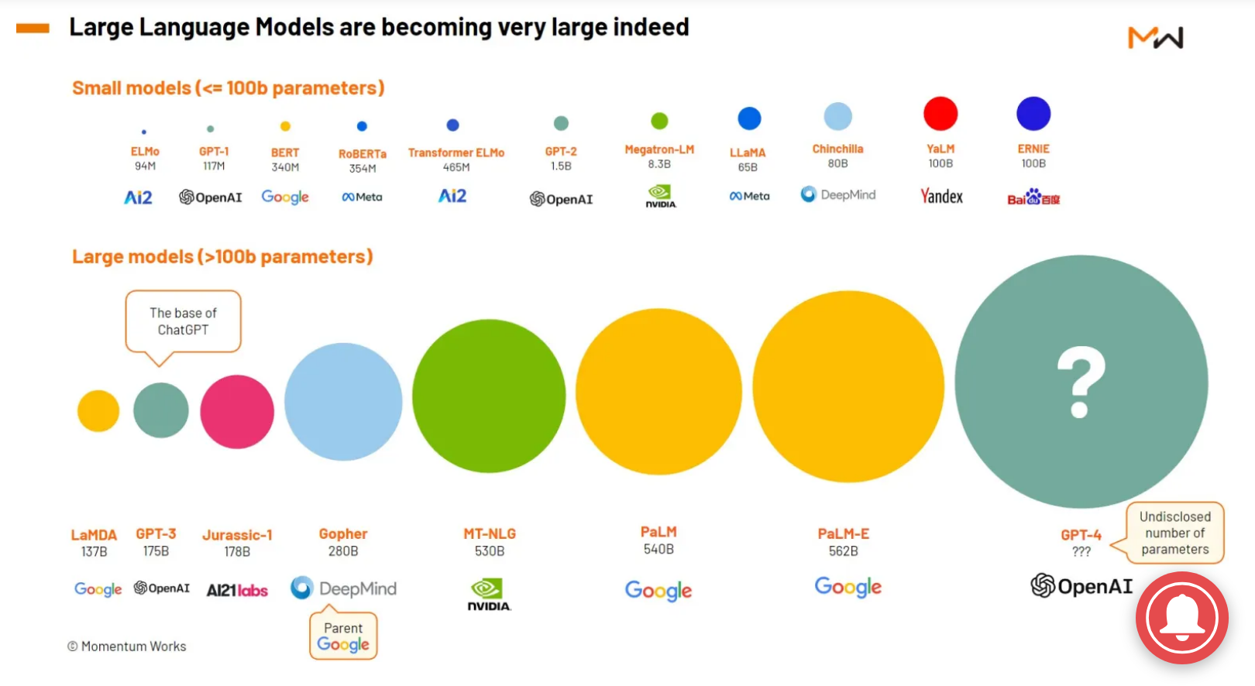
GenAI Leading Players

Slide 17
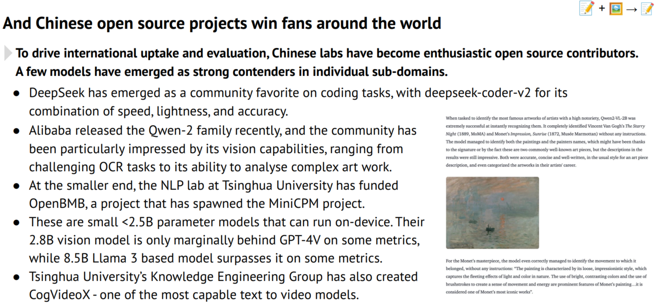
HuggingFace – Open Source LLM Hub

Slide 18

Model Leader Board

Slide 19

Model Benchmark

Slide 20
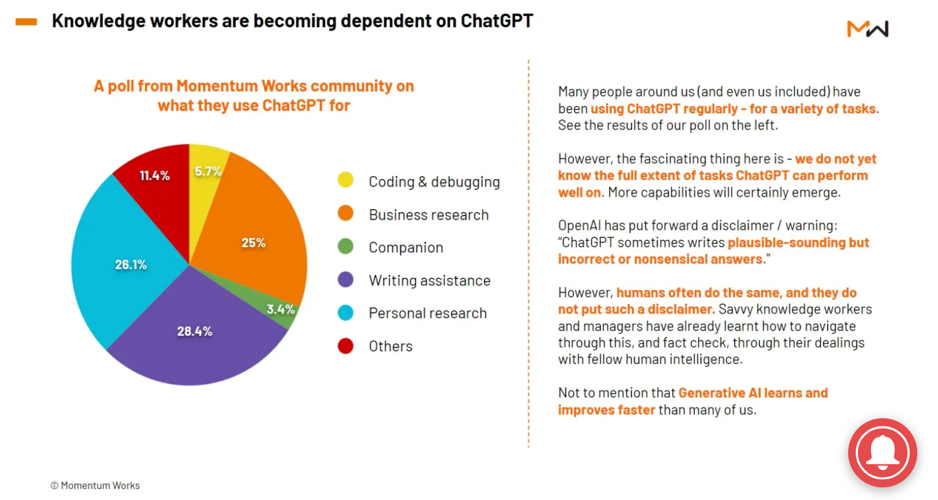
GenAI Use-Cases

Slide 21

Agent – Concept

Slide 22

Agent – Complex AI Systems

Slide 23

AI for Math

Slide 24
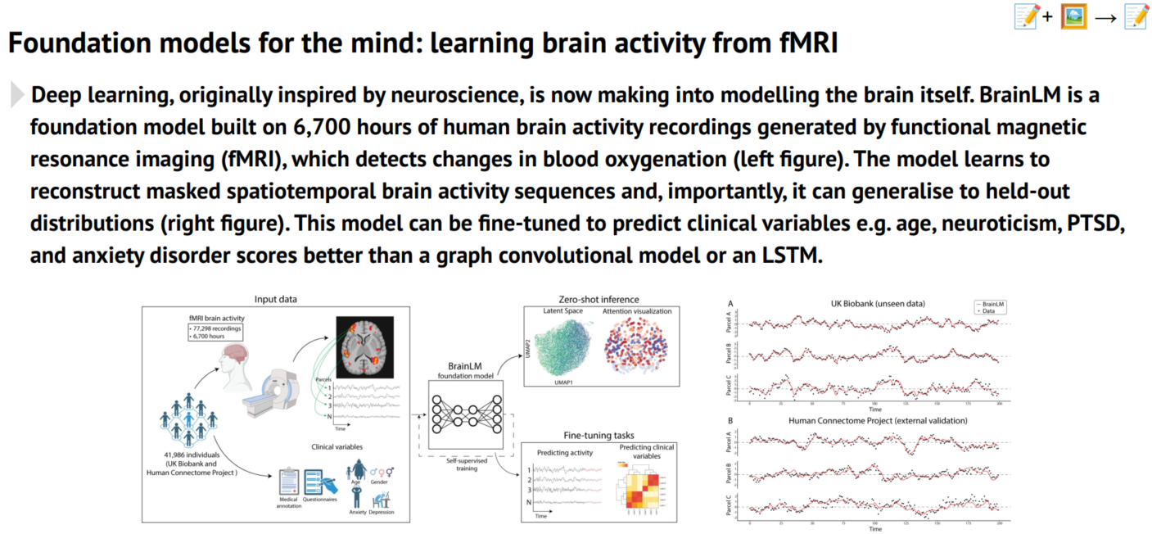
AI for Sciences

Slide 25
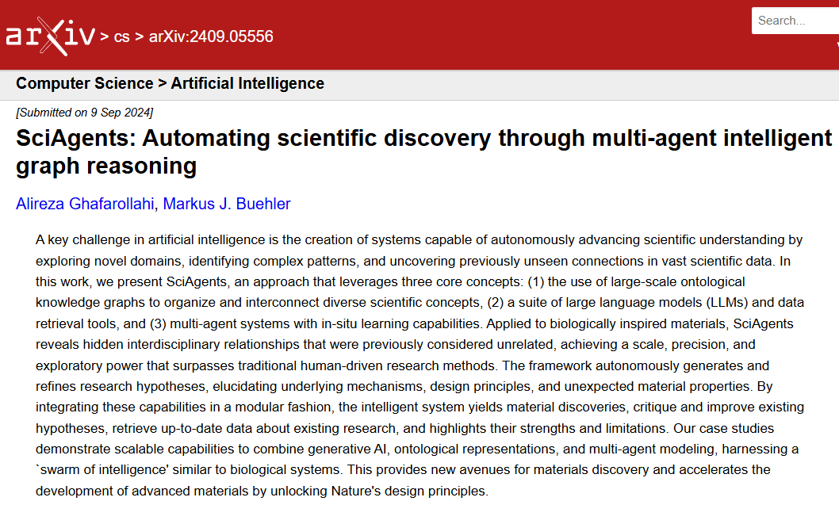
SciAgents – Automate Discovery

Slide 26
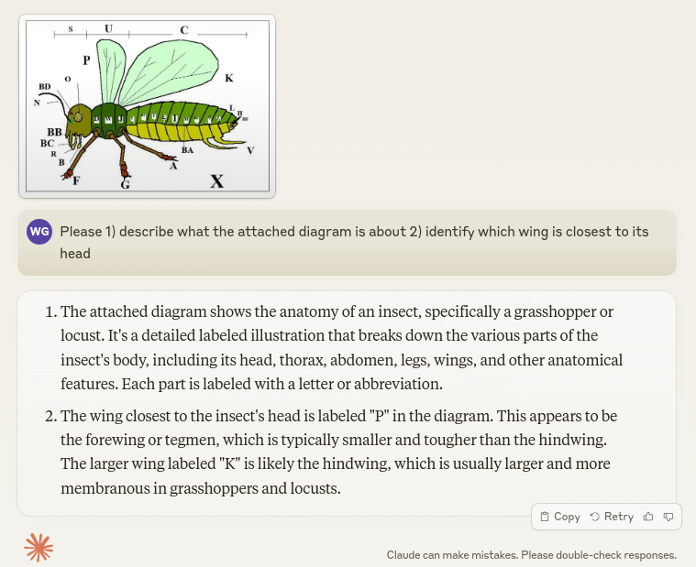
GenAI Examples

Slide 27

GenAI Examples

Slide 28

GenAI Examples

Slide 29

GenAI Examples

Slide 30

GenAI Examples

Slide 31

GenAI Examples

Slide 32

GenAI Examples

Slide 33

GenAI Examples

Slide 34

Self Service Analytics: Text2SQL (my work)
https://www.youtube.com/watch?v=RKSlUAFmbaM

Slide 35
Future - "Behind the curtain"
- Geopolics
- Robotics
- AGI
- HI (Higher Intelligence)

Slide 36

Geopolitics: GenAI Leading Powers

Slide 37

AI + Robotics

Slide 38
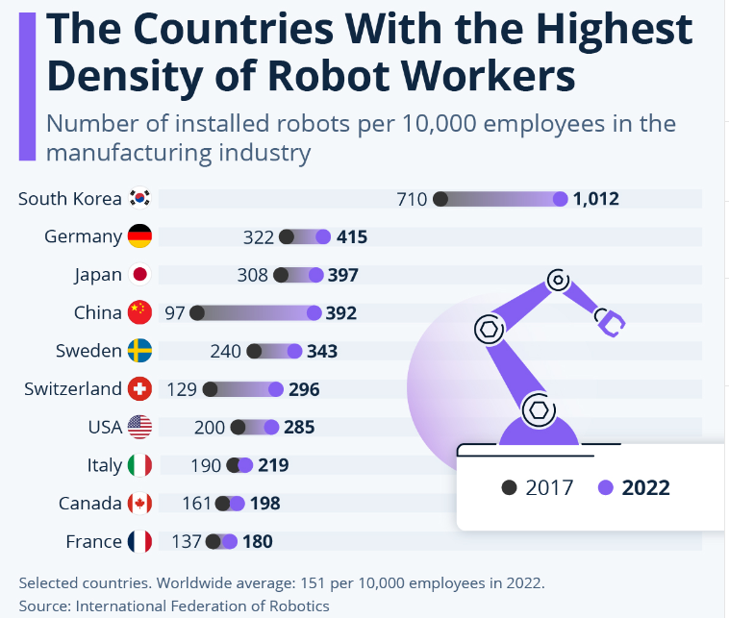
Robot Workers

Slide 39

Robot & Us: Where is privacy?

Slide 40
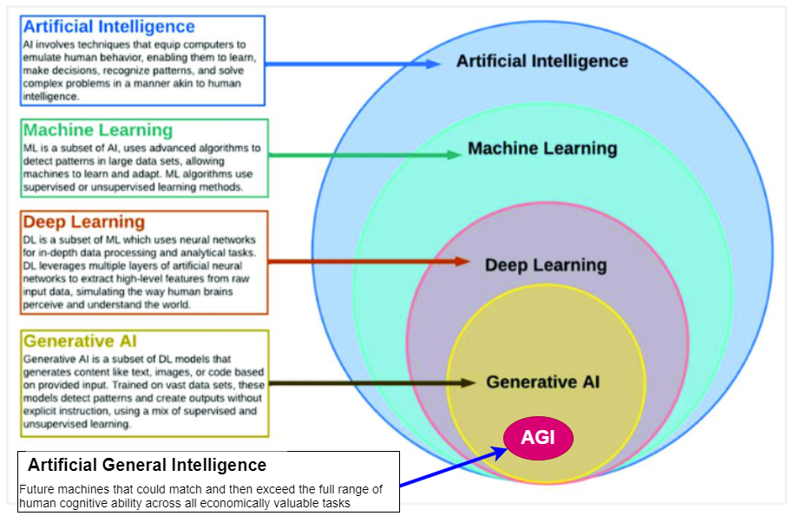
What is AGI ?

Slide 41
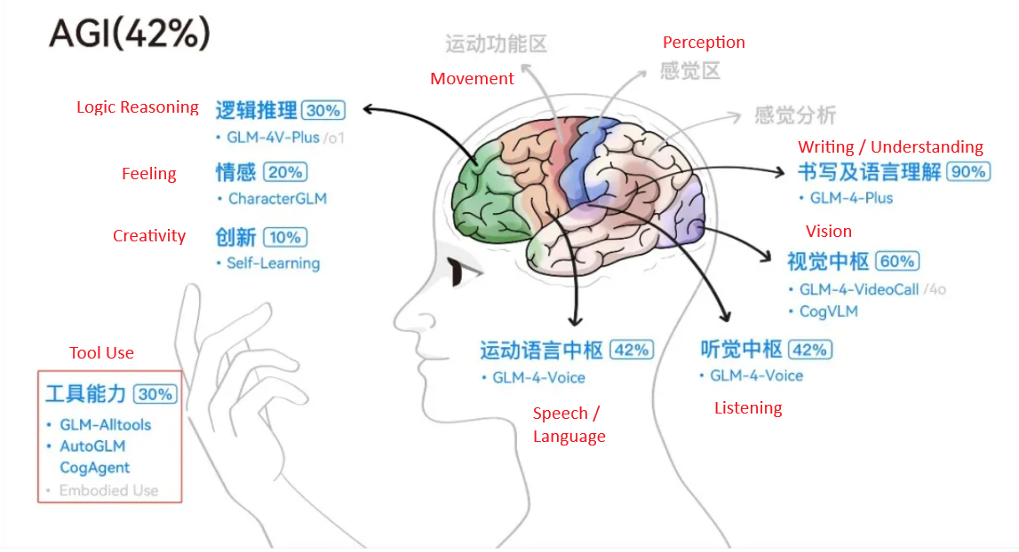
Path to AGI

Slide 42

HI – AGI – GenAI - TT (1)

Slide 43
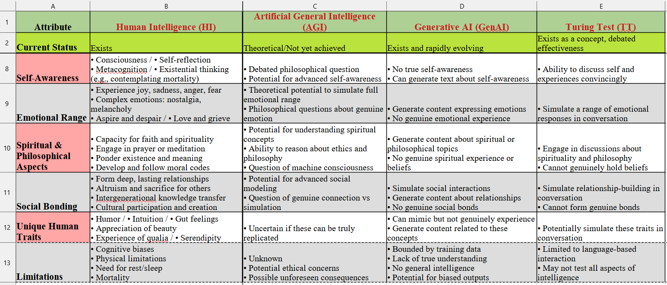
HI – AGI – GenAI - TT (2)

Slide 44

What makes us Human ?

Slide 45

Journey to the Unknown ?

Slide 46

wen.g.gong@gmail.com

