Slide 1
Introduction to GenAI
Past – Present – Future
wen.g.gong@gmail.com

Slide 2

AI > ML > DL> GenAI

Slide 3

AI History

Slide 4
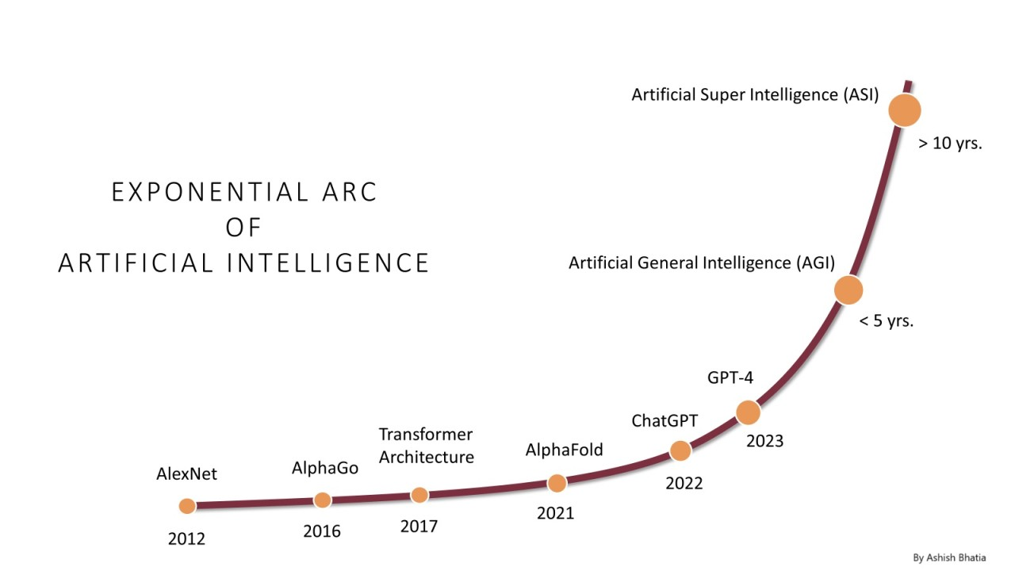
AI Growth & Milestones

Slide 5
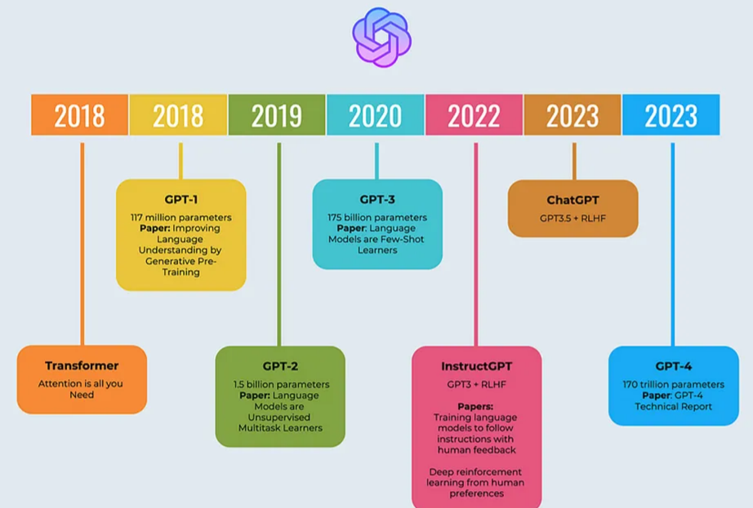
OpenAI: ChatGPT

Slide 6

LLMOps: Model Lifecycle

Slide 7
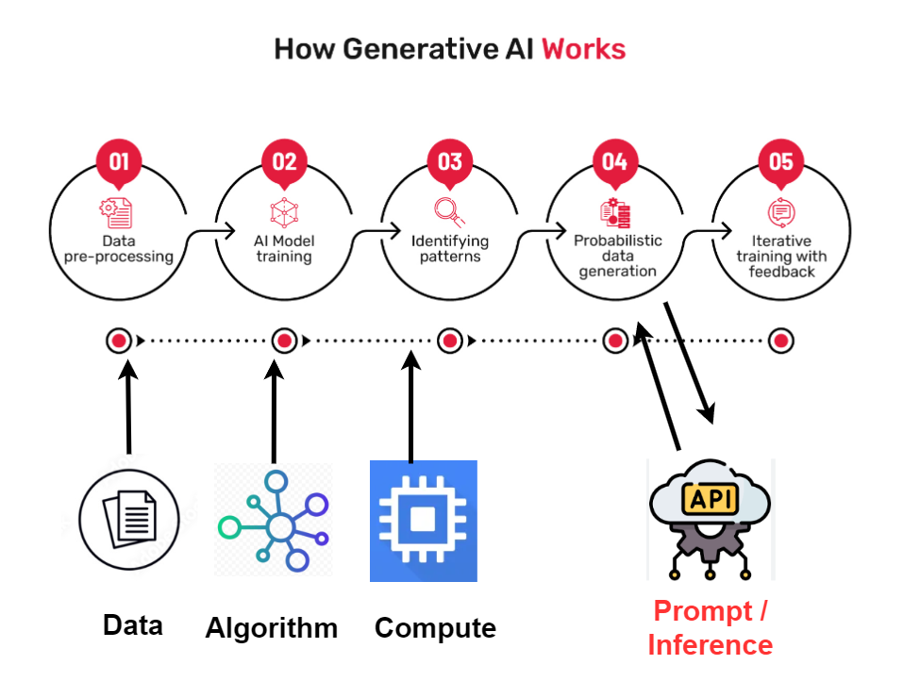
How does GenAI work?

Slide 8
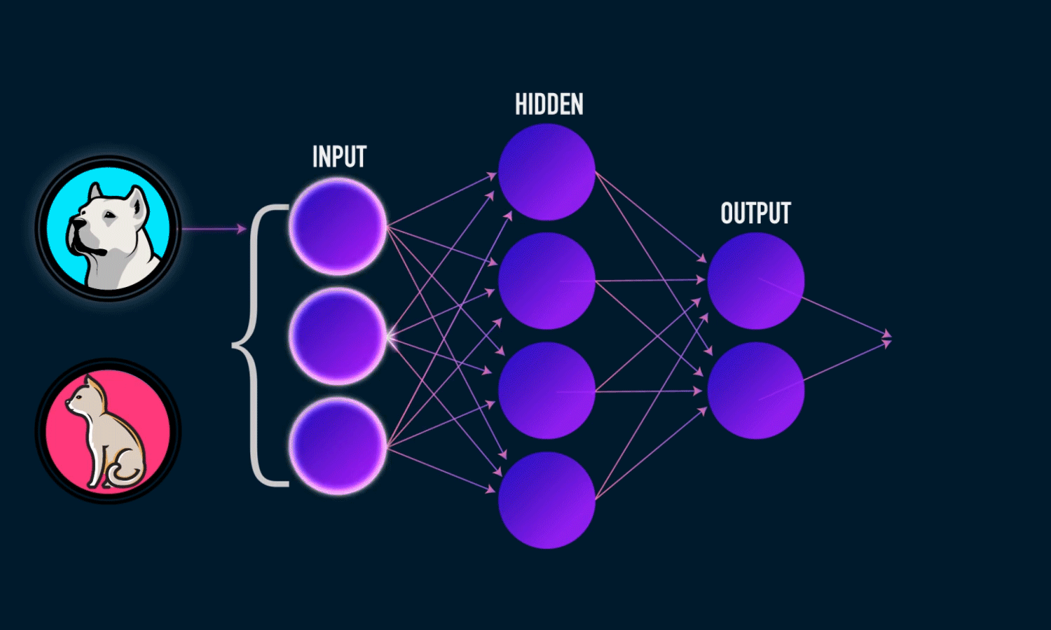
GenAI: Neural Network

Slide 9
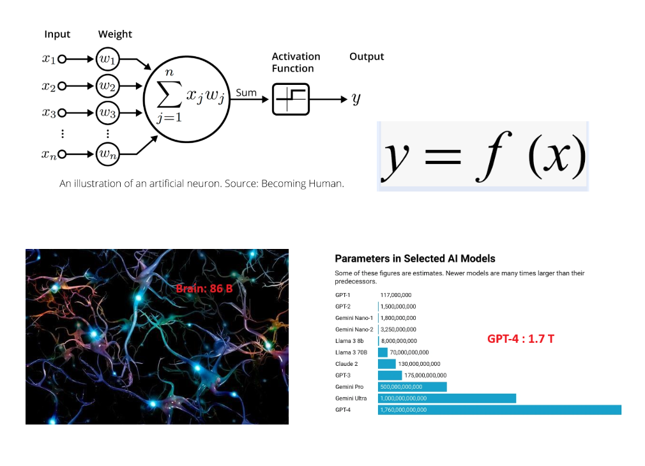
LLM: y = f(x)

Slide 10
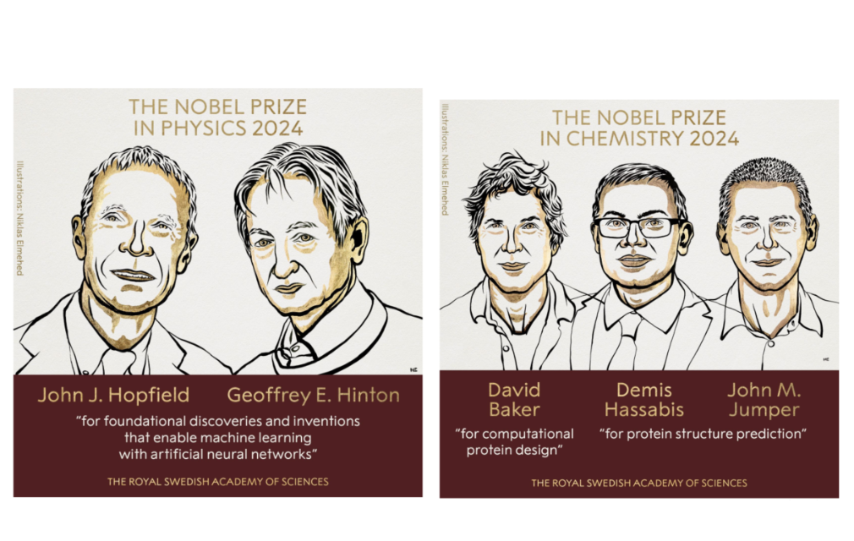
2024 Nobel Prizes in Physics & Chemistry

Slide 11
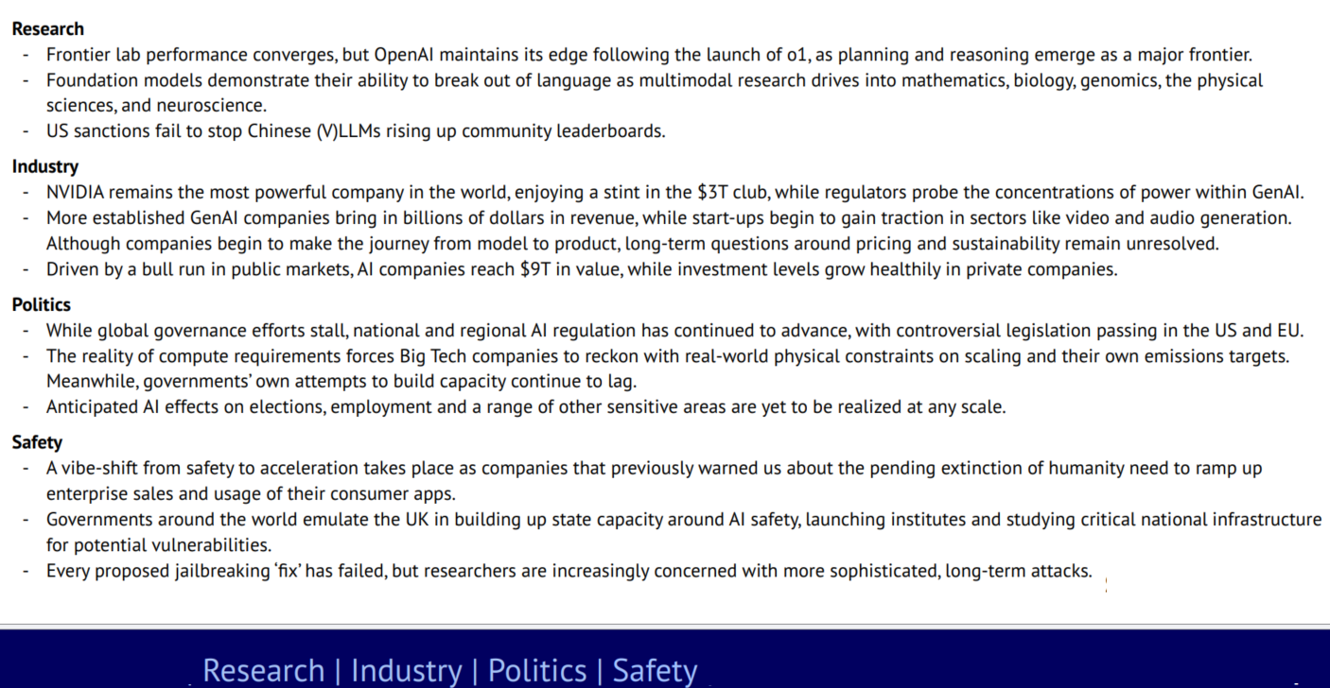
State of AI - 2024

Slide 12


LLM Model Types

Slide 13
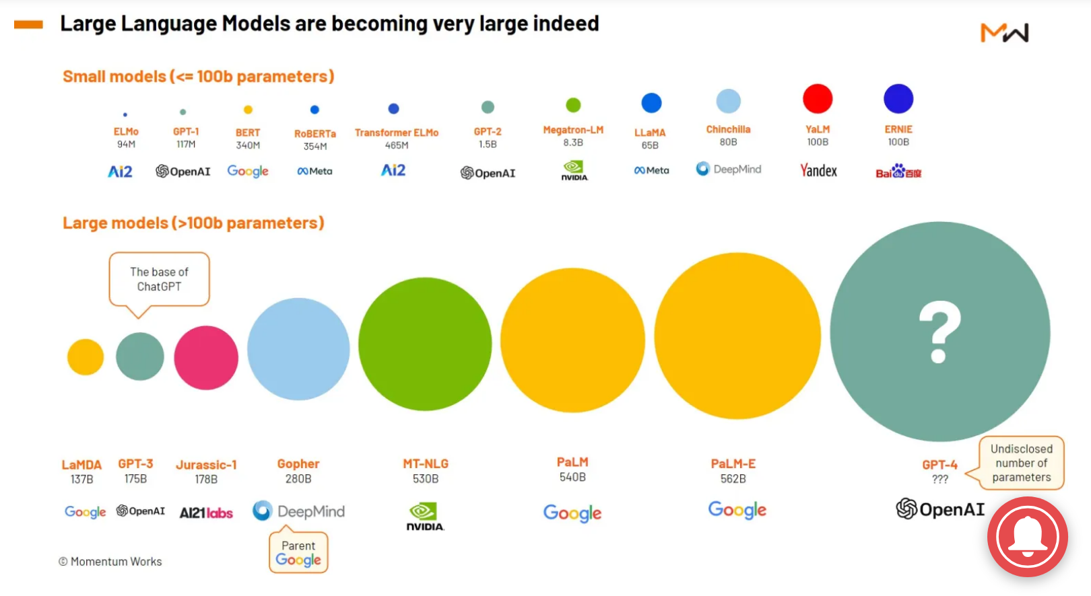
GenAI Leading Players

Slide 14
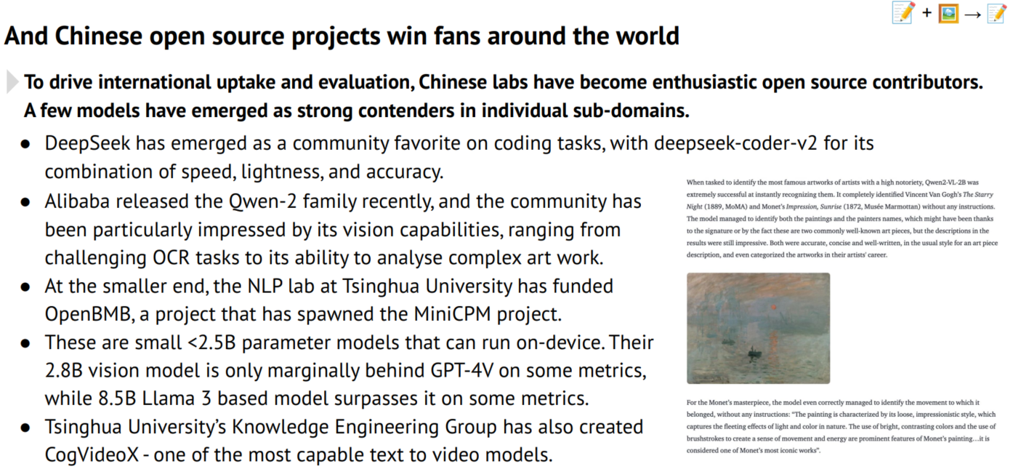
HuggingFace – Open Source LLM Hub

Slide 15

GenAI Leading Powers

Slide 16
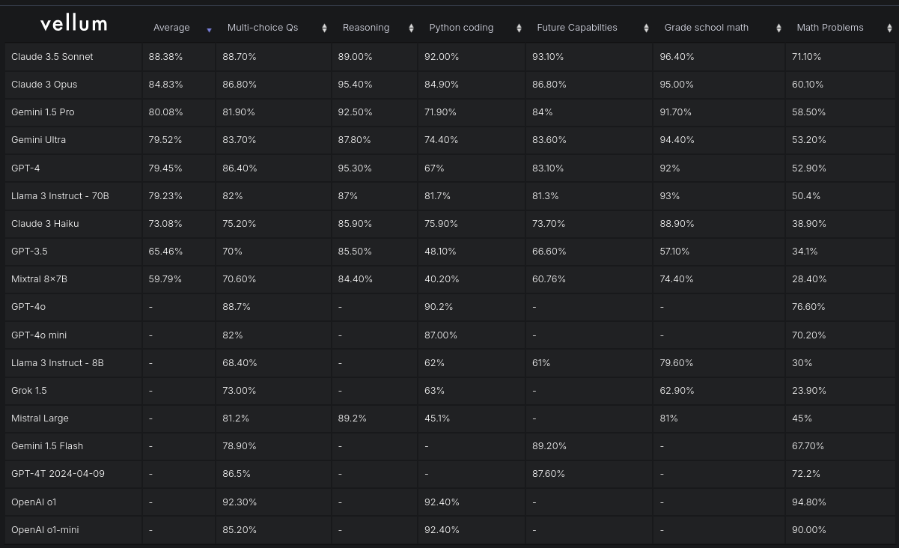
Model Leaderboard

Slide 17
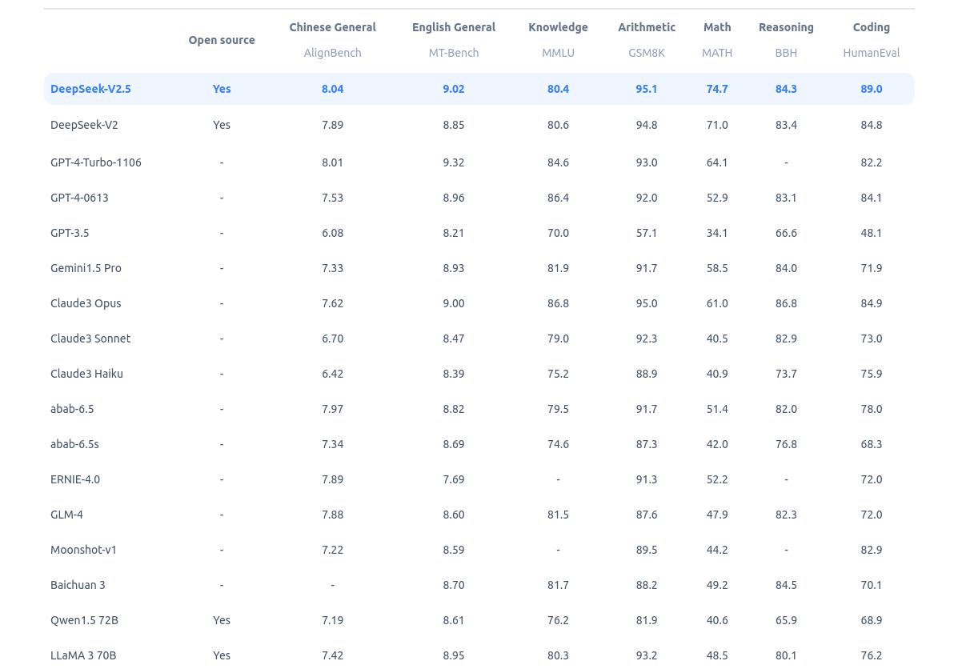
Model Benchmark

Slide 18
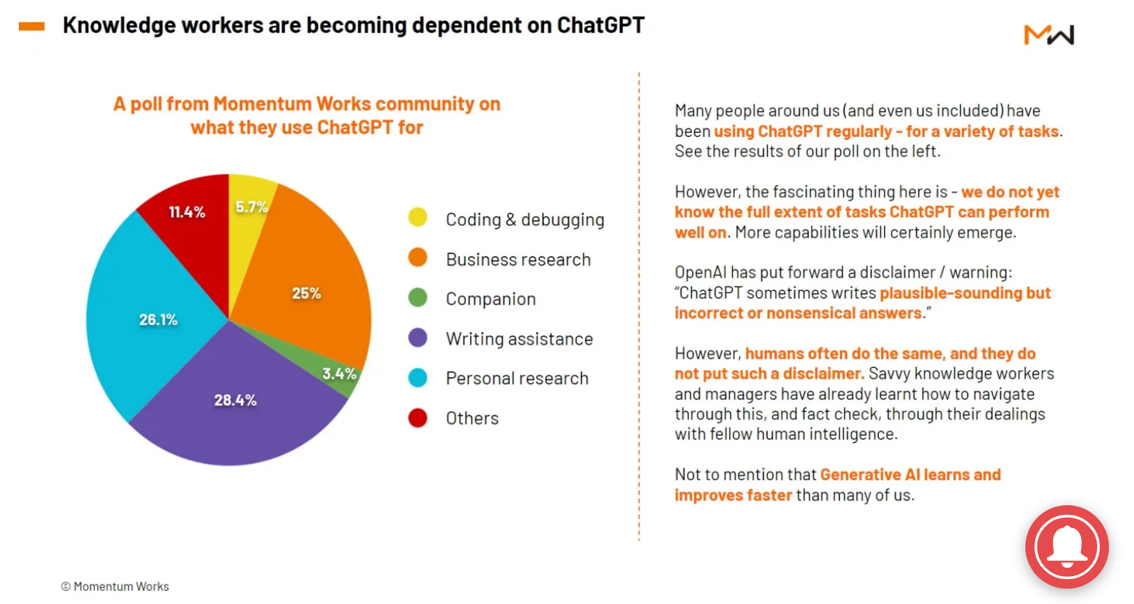
GenAI Use-Cases

Slide 19

Agents – Complex GenAI Systems

Slide 20

Agents – Complex GenAI Systems

Slide 21

AI for Math

Slide 22
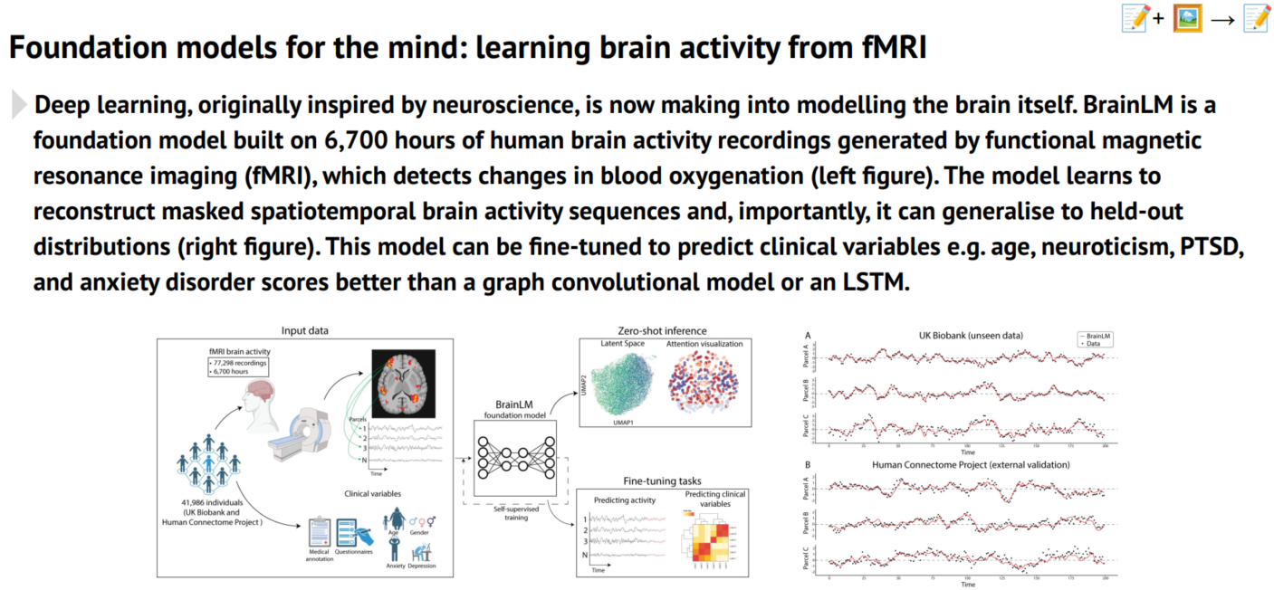
AI for Sciences

Slide 23
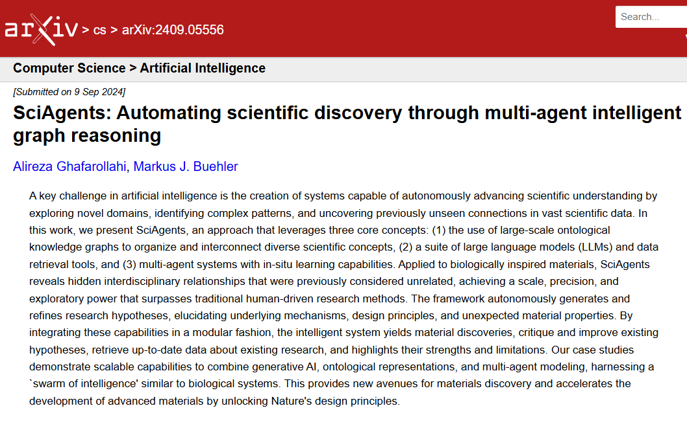
SciAgents – Automate Discovery

Slide 24
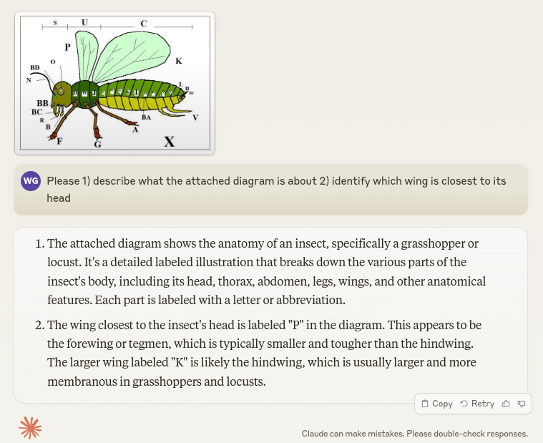
GenAI – Examples - 1

Slide 25

GenAI – Examples - 2

Slide 26

GenAI – Examples - 3

Slide 27

GenAI – Examples - 4

Slide 28

GenAI – Examples - 5

Slide 29

GenAI – Examples - 6

Slide 30

GenAI – Examples - 7

Slide 31

GenAI – Examples - 8

