Slide 1
Introduction to GenAI
Past > Present > Future
2024-11-16

Slide 2
Past - The "storm gathering"
- AI Concept
- Brief history
- How GenAI works
- Impact

Slide 3

AI > ML > DL> GenAI

Slide 4

AI History

Slide 5
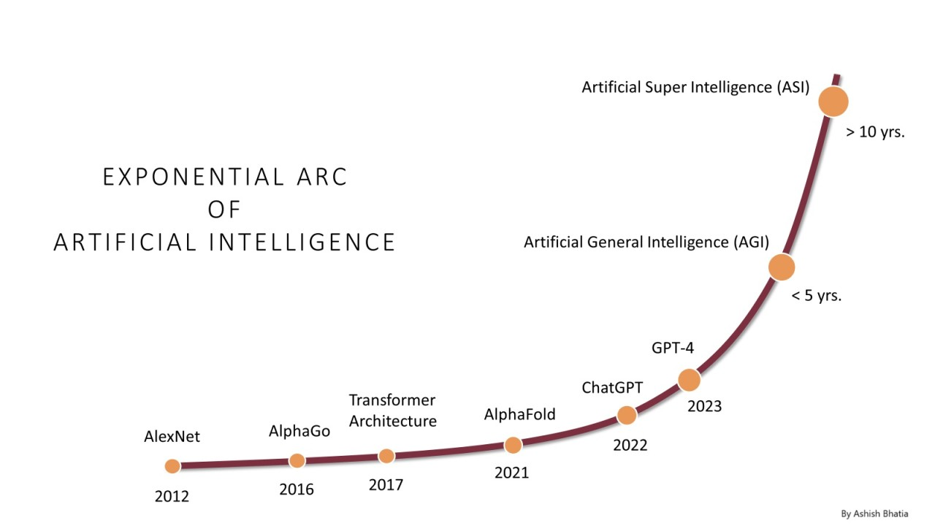
AI Growth & Milestones

Slide 6
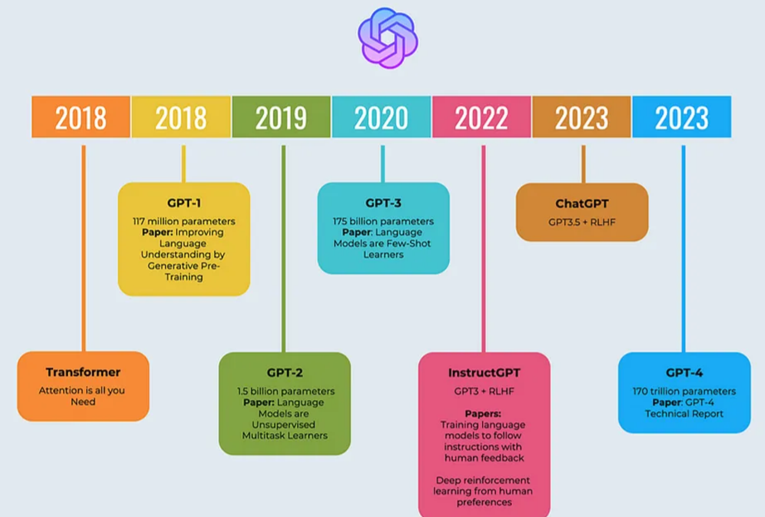
OpenAI: ChatGPT

Slide 7

LLMOps: Model Lifecycle

Slide 8

How GenAI works?

Slide 9
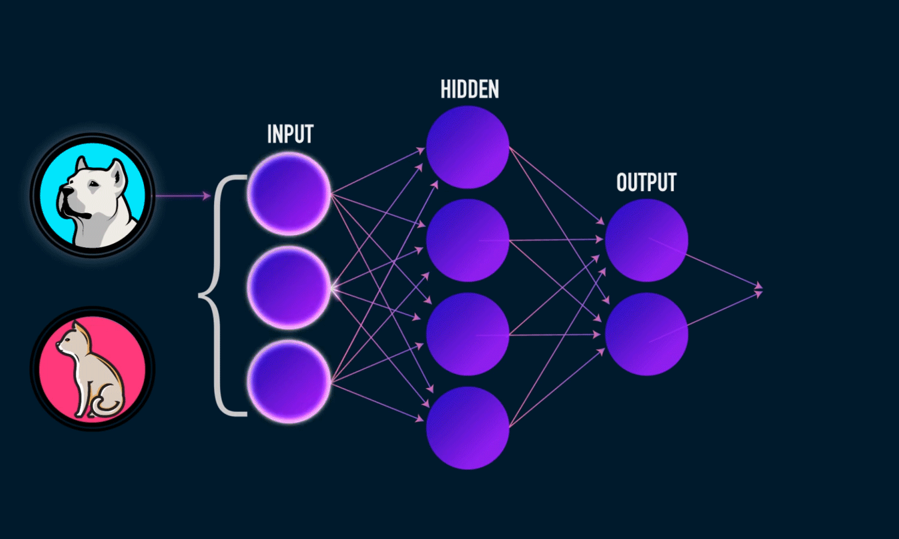
GenAI: Neural Network

Slide 10
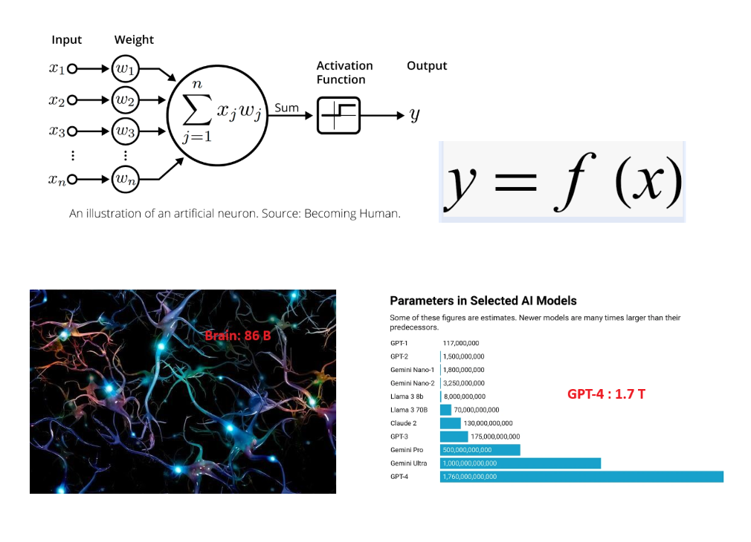
LLM: y = f(x)

Slide 11
Present - "Following the yellow brick road"
- Current state - 2024
- LLM model type
- LLM model benchmark
- Application
- Example

Slide 12

2024 Nobel Prizes in Physics & Chemistry

Slide 13

State of AI - 2024

Slide 14


LLM Model Types

Slide 15
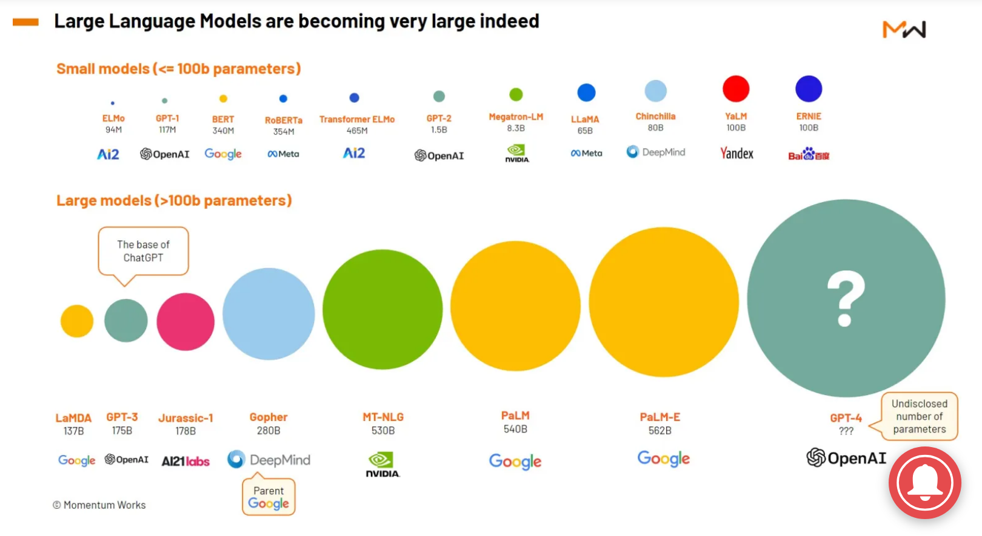
GenAI Leading Players

Slide 16
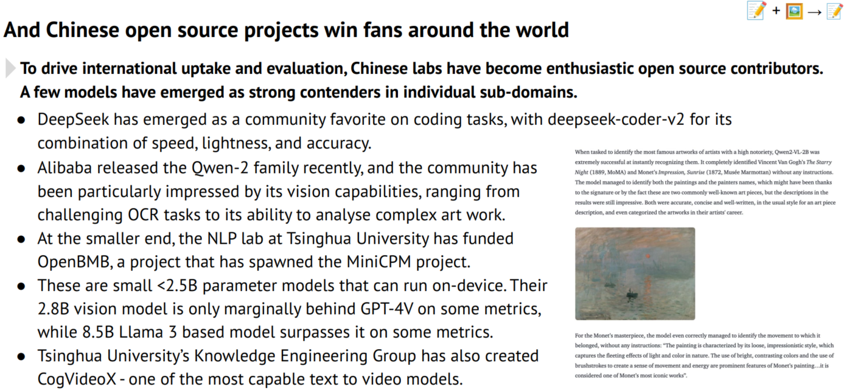
HuggingFace – Open Source LLM Hub

Slide 17

Model Leader board

Slide 18

Model Benchmark

Slide 19
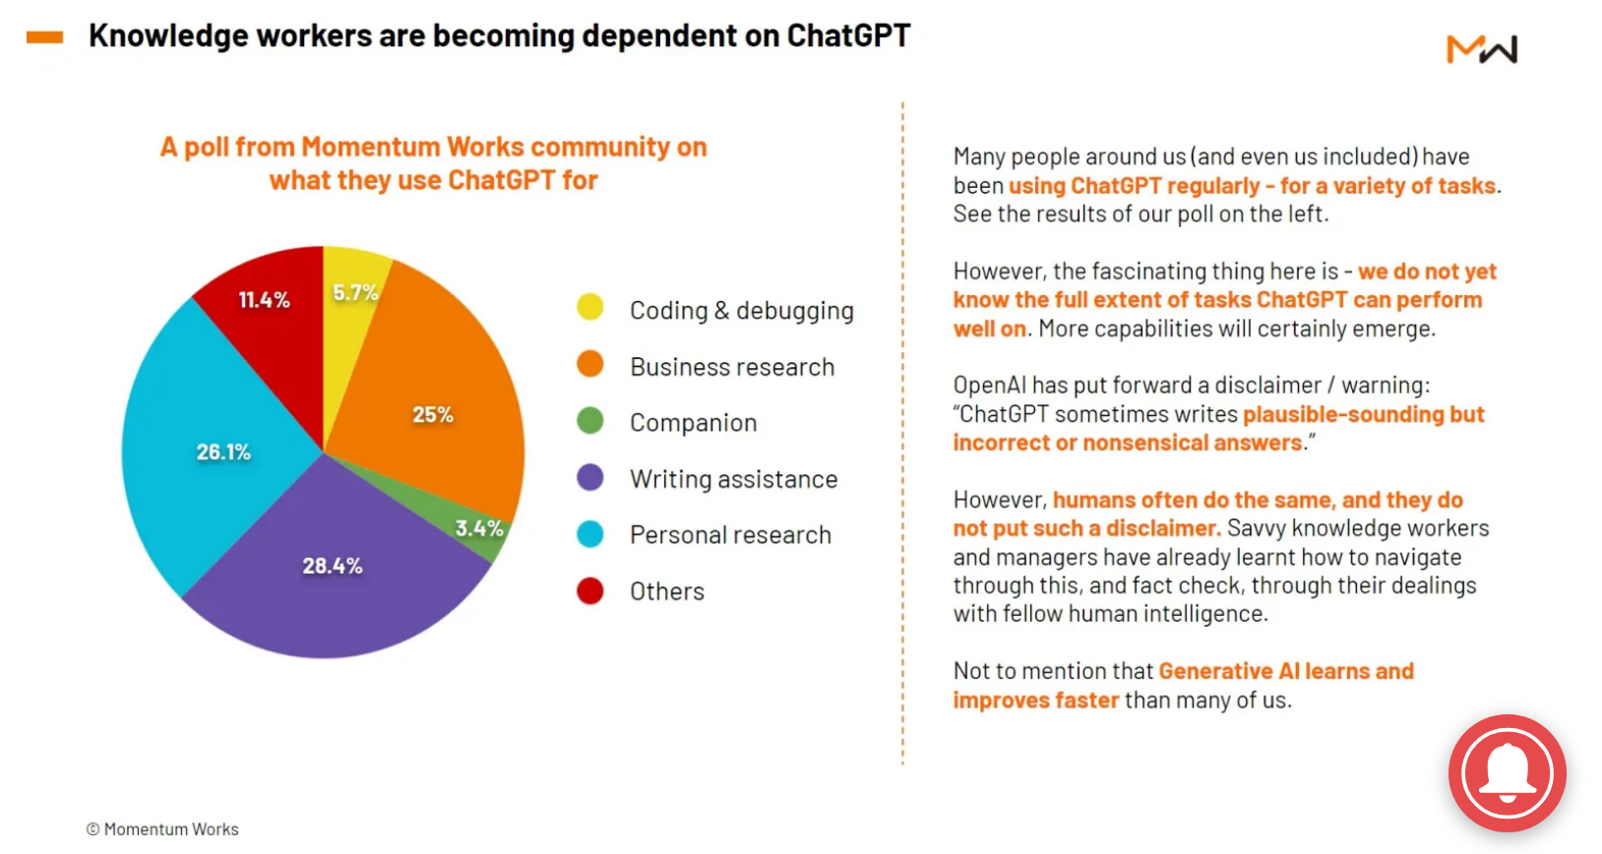
GenAI Use-Cases

Slide 20

Agent – Concept

Slide 21

Agent – Complex GenAI Systems

Slide 22

AI for Math

Slide 23
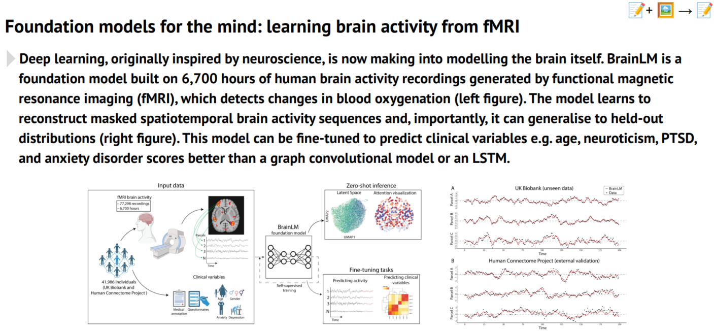
AI for Sciences

Slide 24
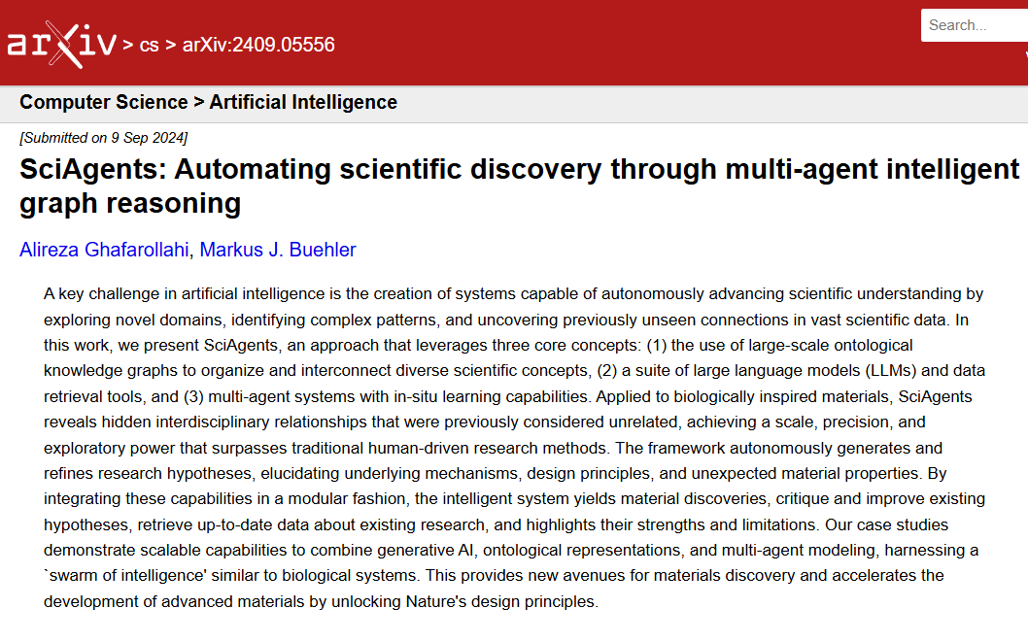
SciAgents – Automate Discovery

Slide 25
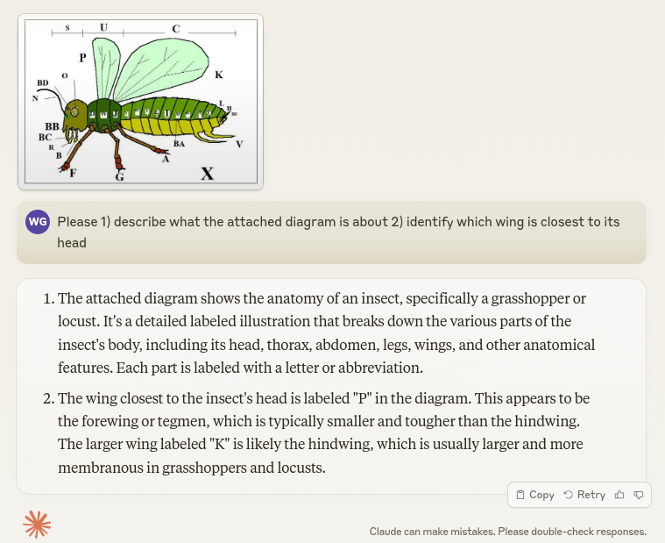
GenAI – Examples

Slide 26

GenAI – Examples

Slide 27

GenAI – Examples

Slide 28

GenAI – Examples

Slide 29

GenAI – Examples

Slide 30

GenAI – Examples

Slide 31

GenAI – Examples

Slide 32

GenAI – Examples

Slide 33

GenAI – my work (text2sql)

Slide 34
Future - "Behind the curtain"
- Geopolics
- Robotics
- AGI
- HI (Higher Intelligence)

Slide 35

Geopolitics: GenAI Leading Powers

Slide 36

AI + Robotics

Slide 37
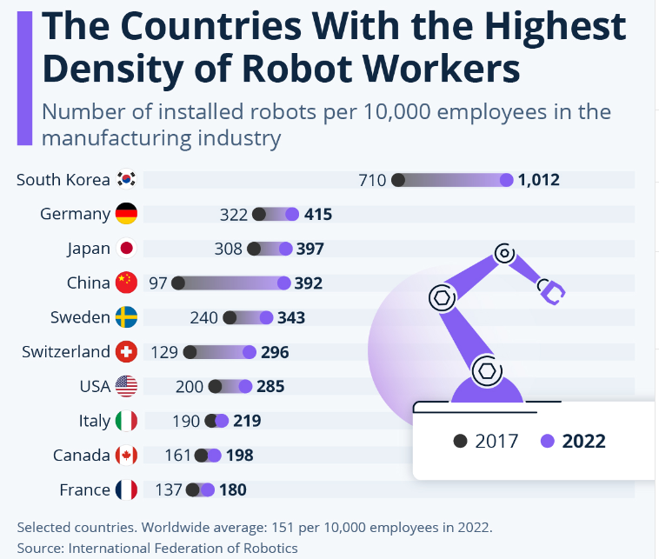
Robot Workers

Slide 38

Robot & Us: Where is privacy?

Slide 39
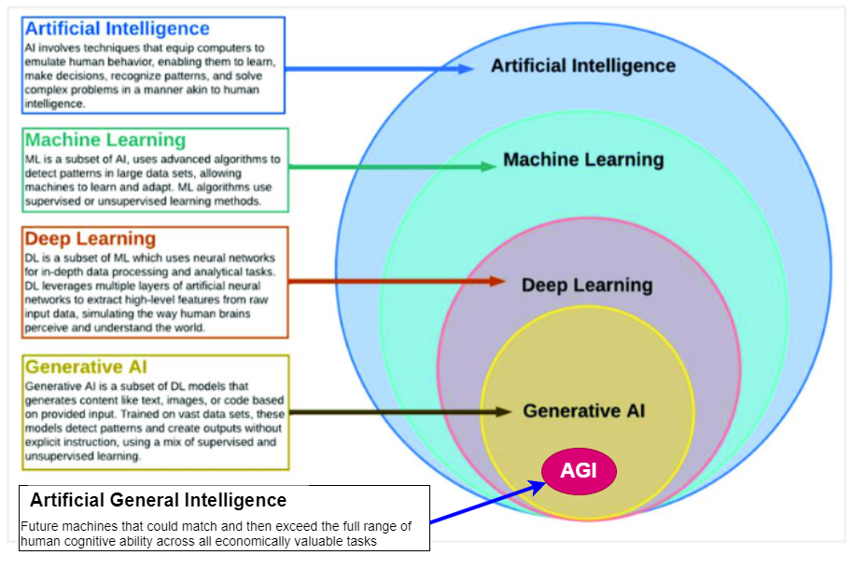
What is AGI ?

Slide 40
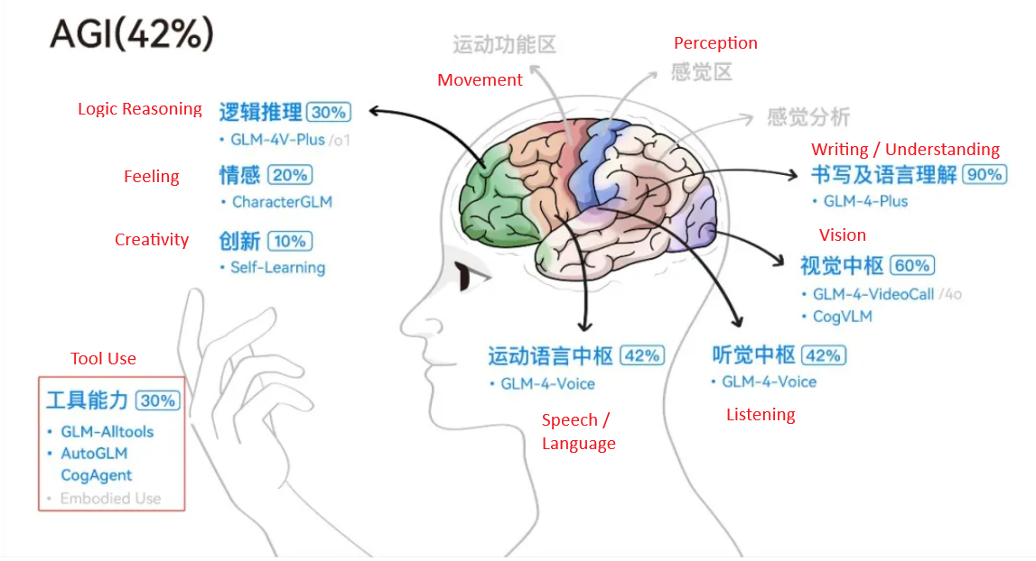
Path to AGI

Slide 41

HI – AGI – GenAI - TT (1)

Slide 42
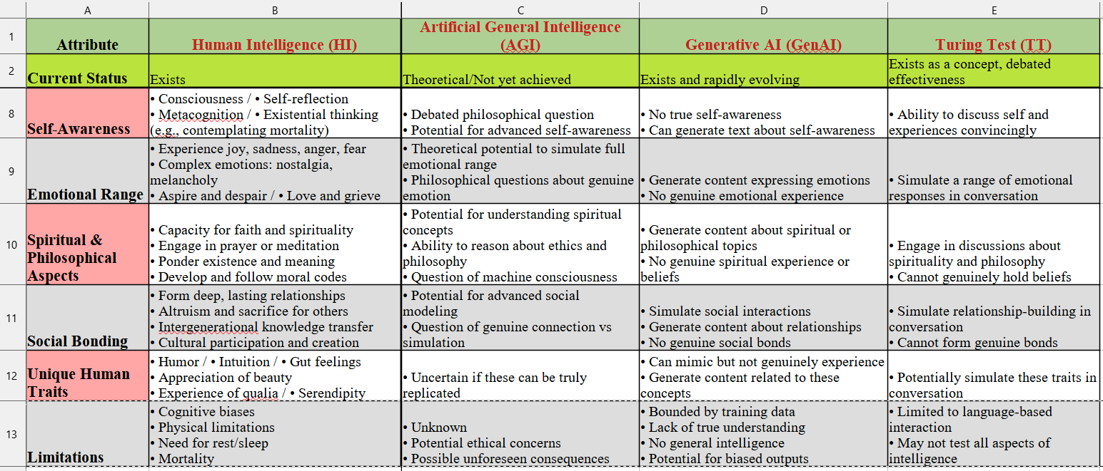
HI – AGI – GenAI - TT (2)

Slide 43

What makes us Human ?

Slide 44
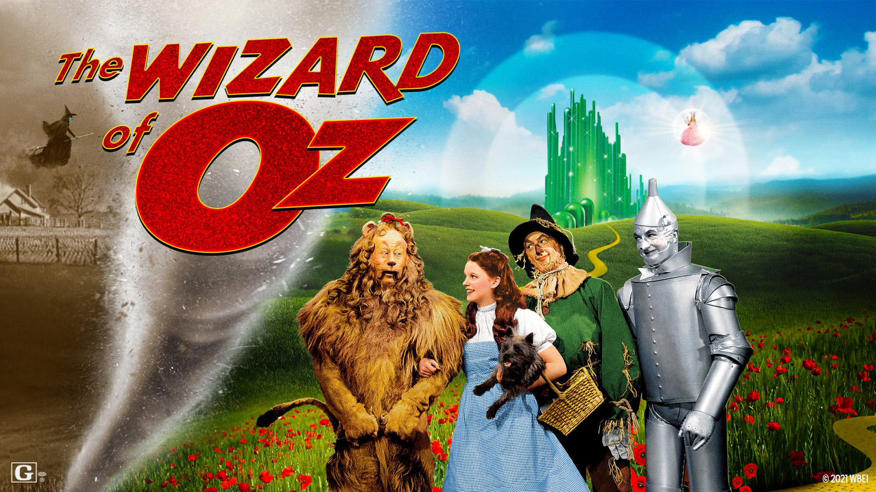
Journey to the Unknown ?

Slide 45

wen.g.gong@gmail.com

