Slide 1
Data Copilot for
Self-Service Analytics
Wen Gong

Slide 2
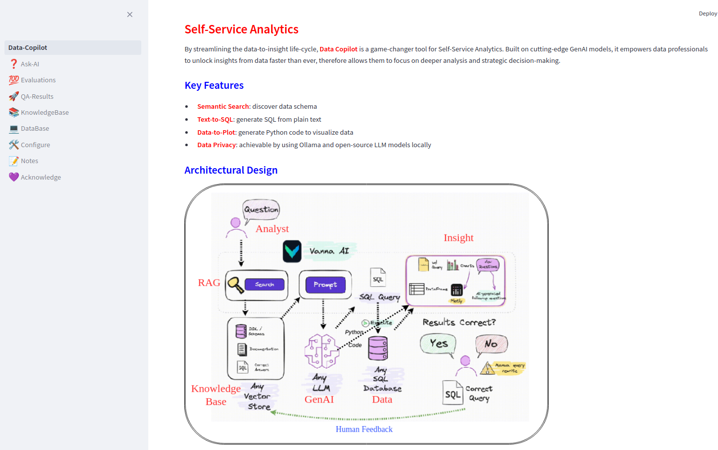

Slide 3
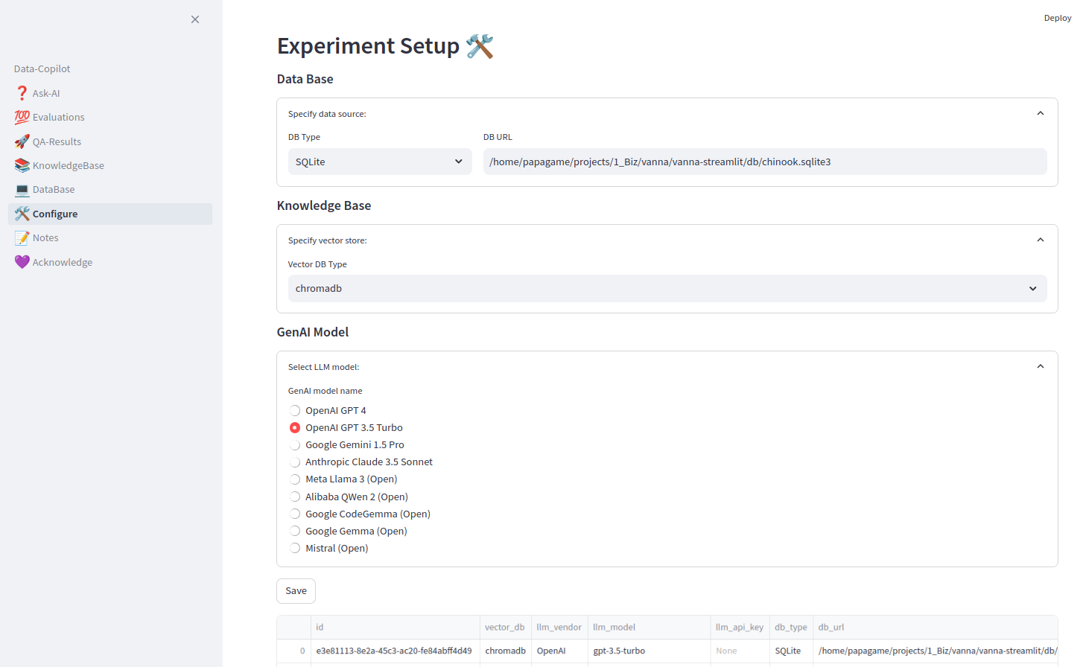

Slide 4
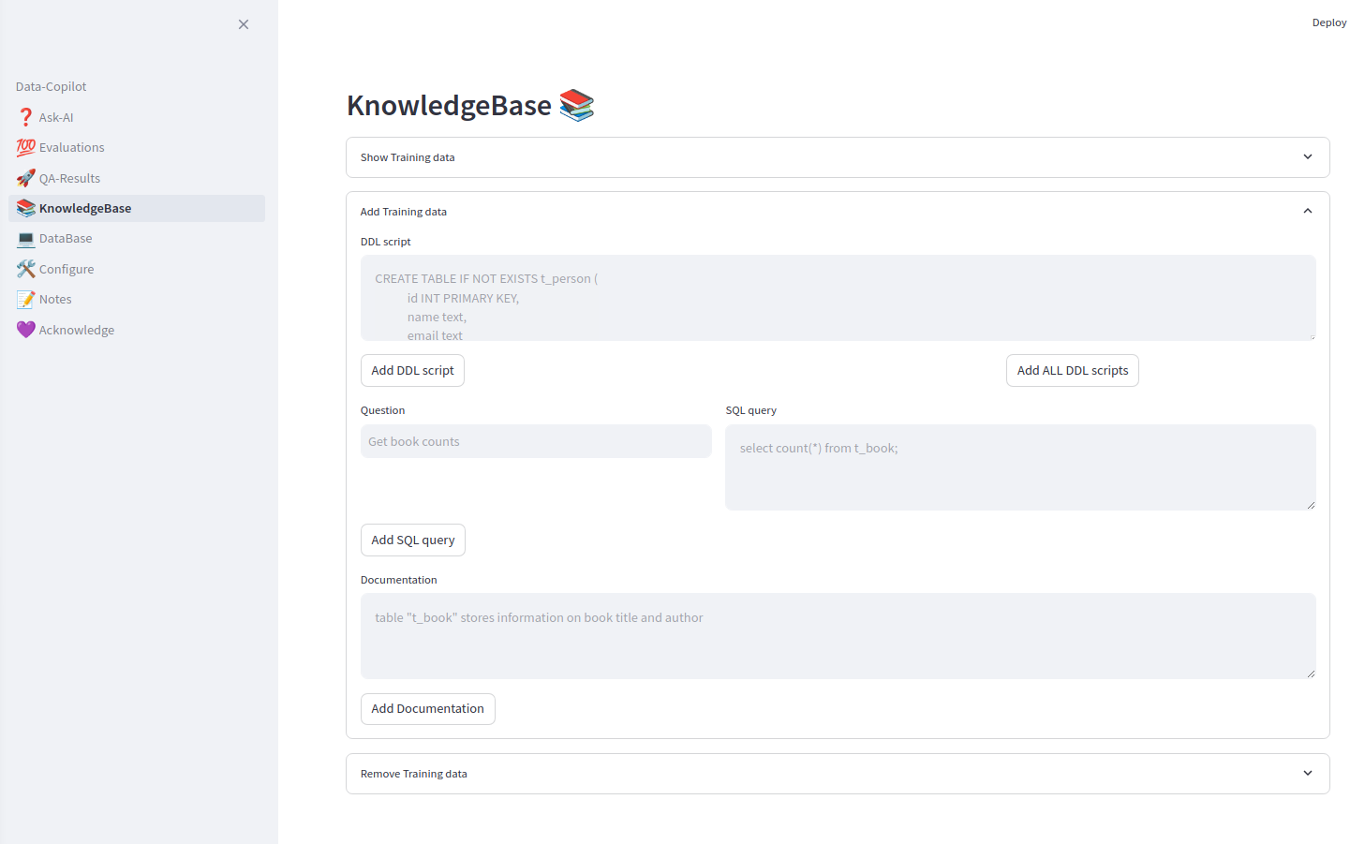
Prime the vector-store with database and table creation scripts
Prime it with working queries
Prime it with business terms and metadata info

Slide 5
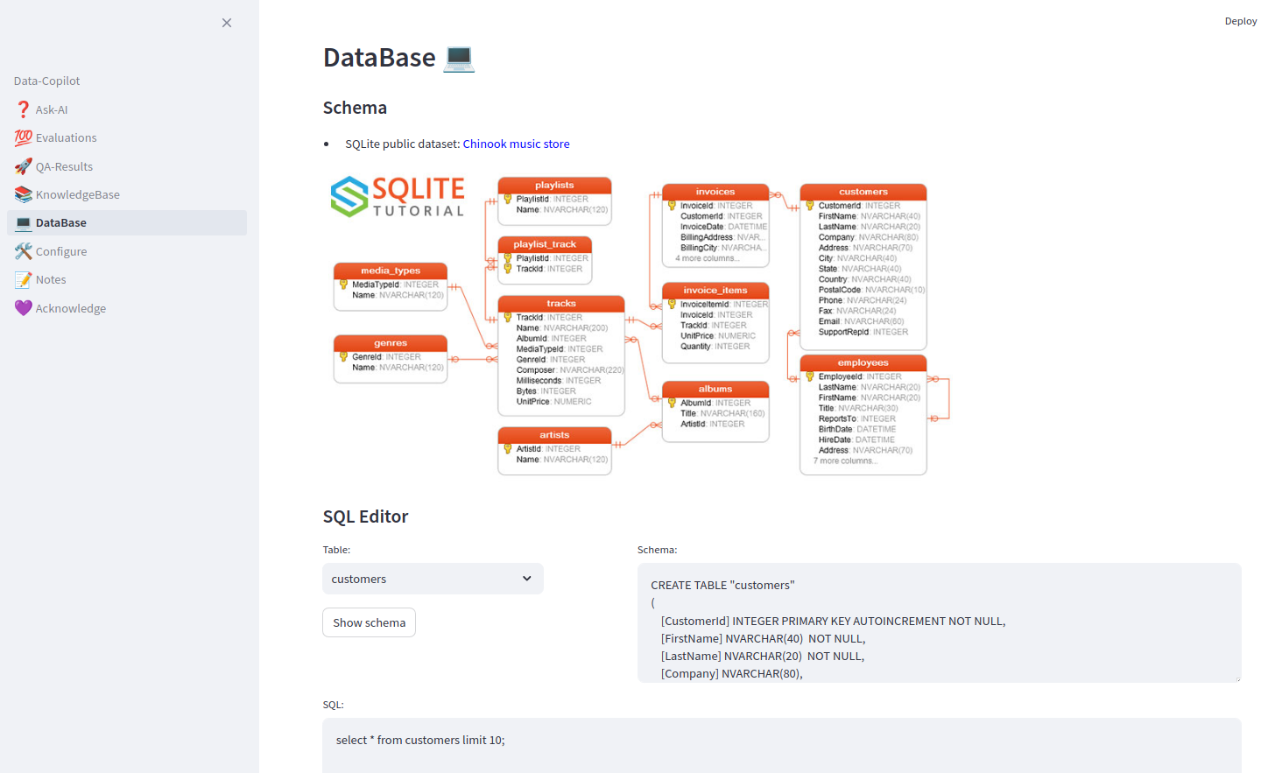
SQL Editor

Slide 6
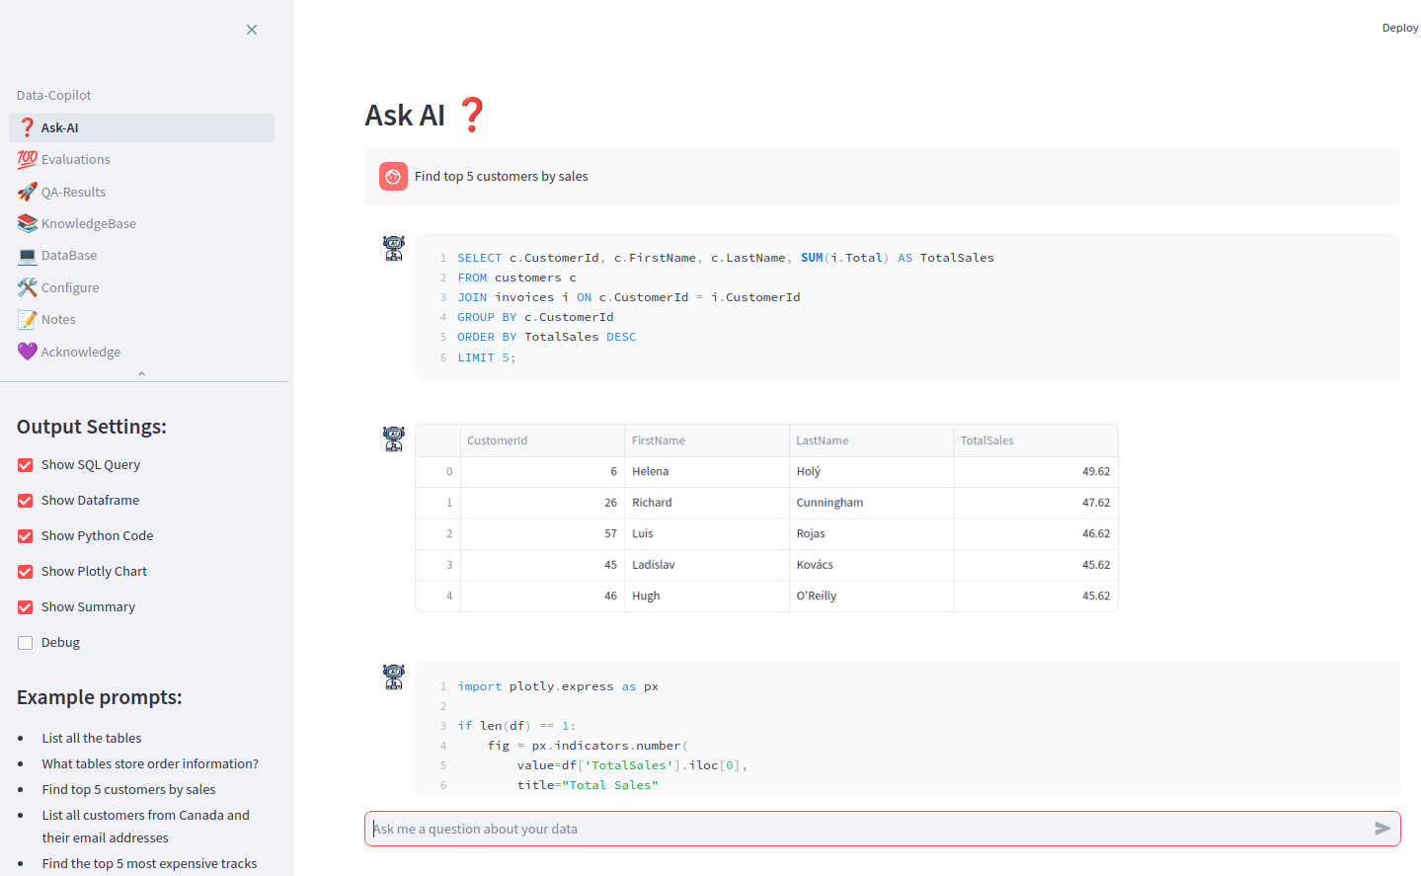
Question #1
Question asked
SQL generated
Dataframe
returned
Python
generated

Slide 7
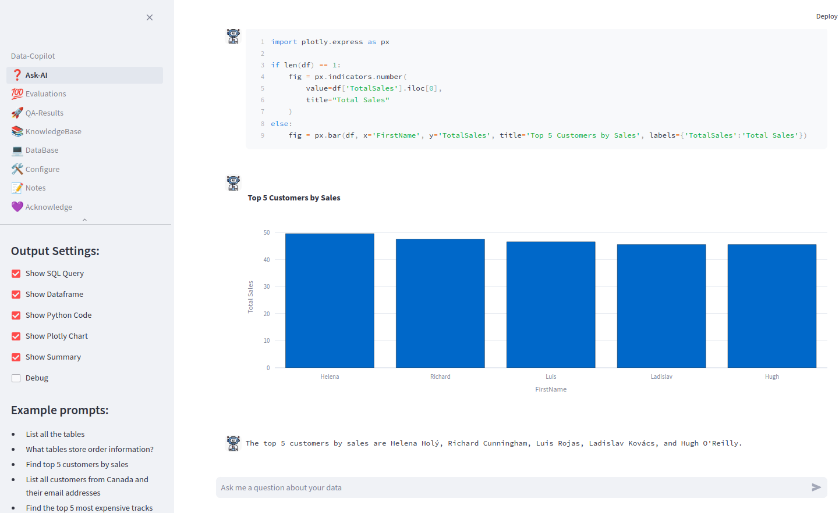
Question #1
plot
generated
summary

Slide 8
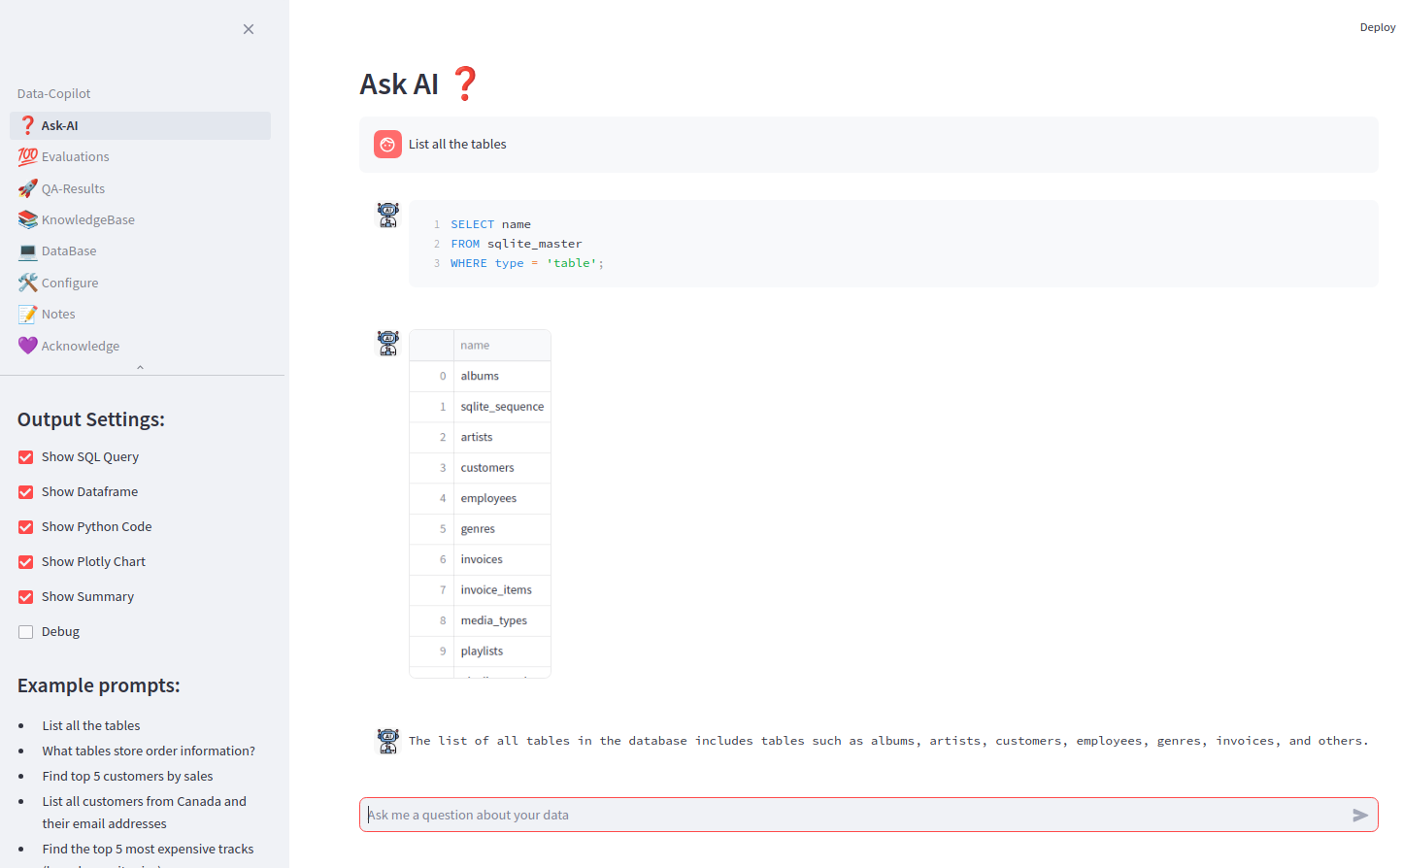
Question #2

Slide 9
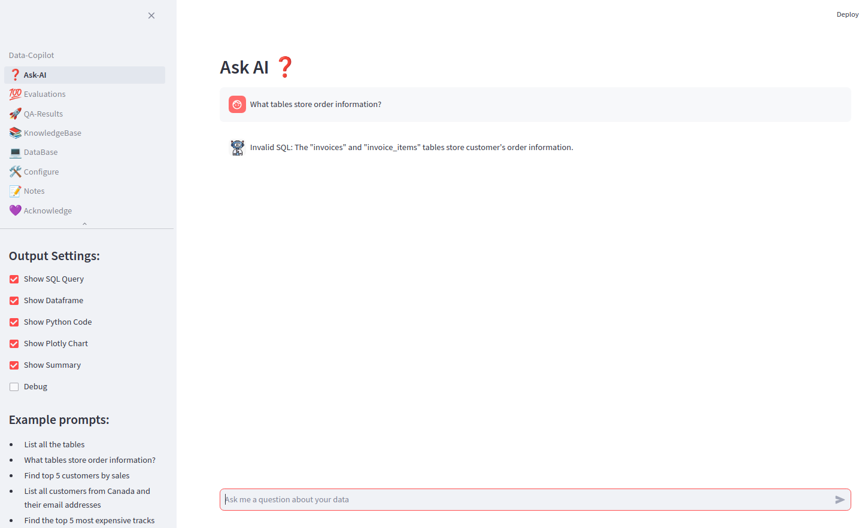
Question #3

Slide 10
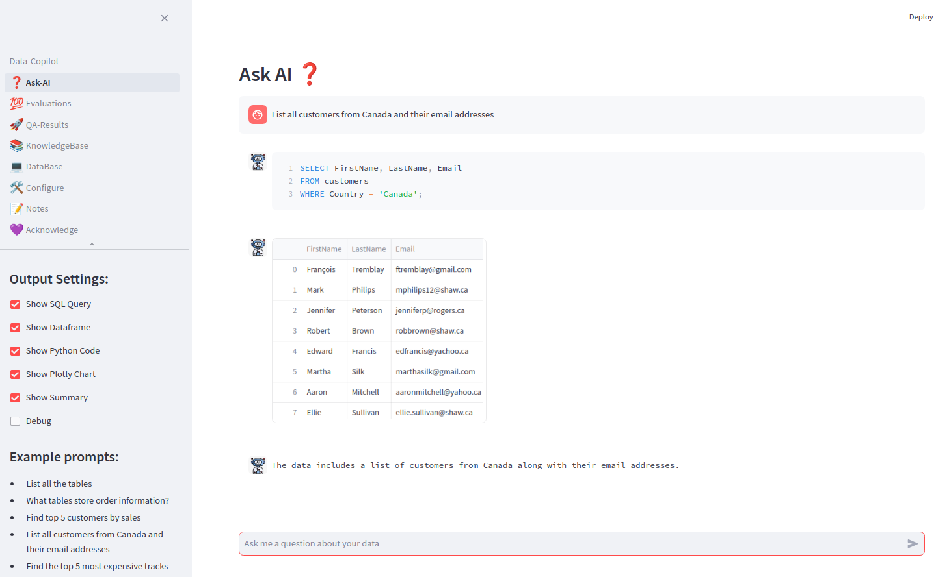
Question #4

Slide 11
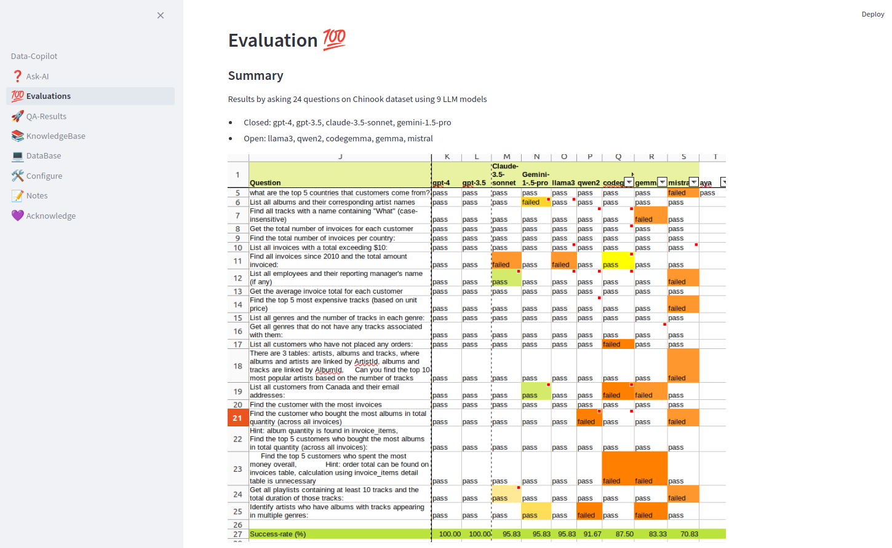
9 LLM models
24 questions
Great results

Slide 12
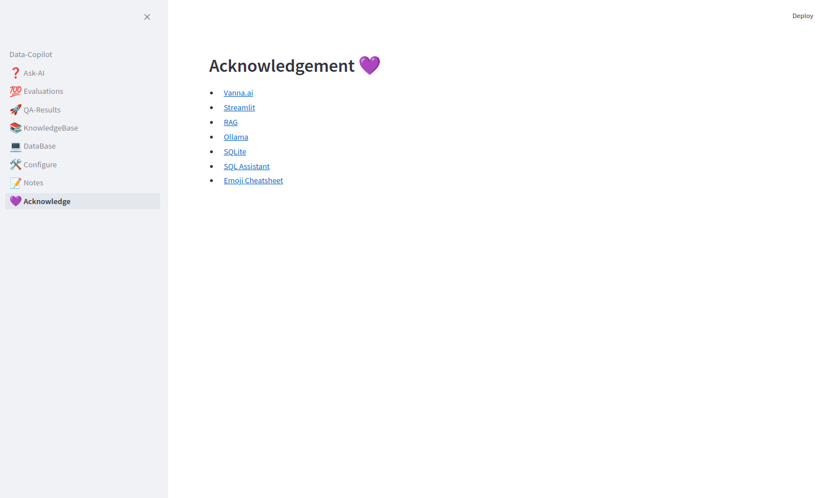

RAG App framework
Web UI
Serve LLM model locally
Database

