Slide 1
Introduction to GenAI
Past > Present > Future
2024-11-16

Slide 2
Past - The "storm gathering"
- AI Concept
- Brief history
- How GenAI works
- Why it works

Slide 3

AI > ML > DL> GenAI

Slide 4

AI History
1984 - Apple Mac
1989 - WWW by Tim Berners-Lee @ CERN
1990 - Microsoft Windows
1991 - Linux
1998 - Google Search
2006 - AWS Cloud
2007 - Apple iPhone
2015 - OpenAI
2018 - Hinton, LeCunn, Bengio (Turing Award)
2022-11-30 - ChatGPT

Slide 5
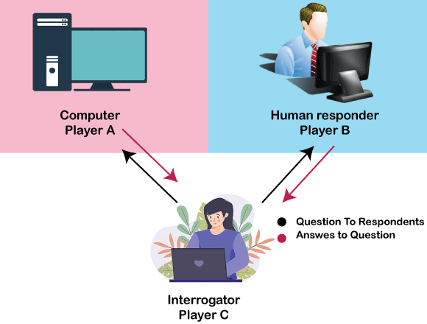
What is Turing Test ?

Slide 6
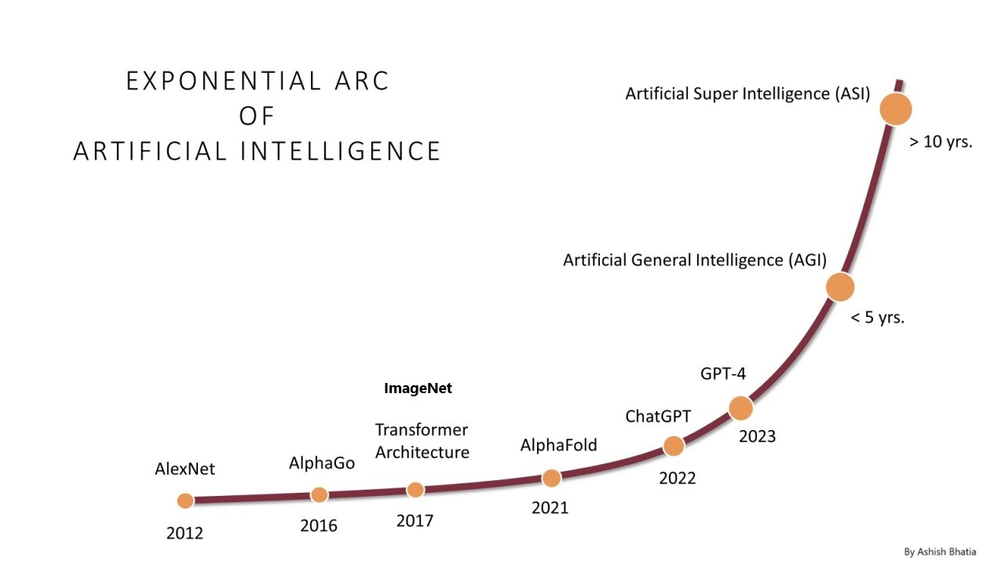
AI Growth & Milestones

Slide 7
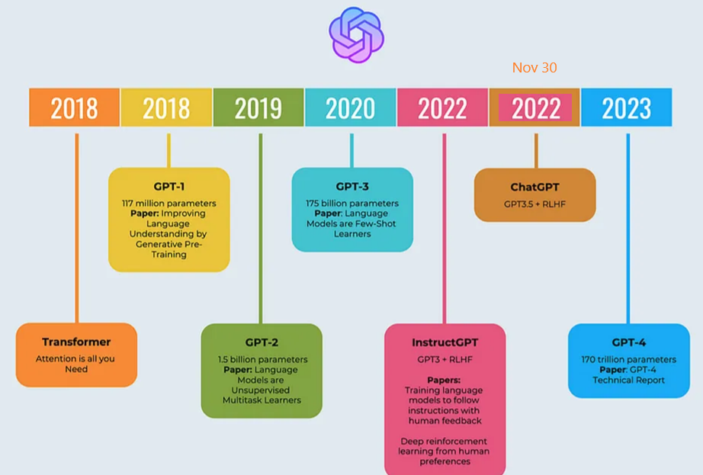
OpenAI: ChatGPT

Slide 8

LLMOps: Model Lifecycle

Slide 9

How GenAI works?

Slide 10
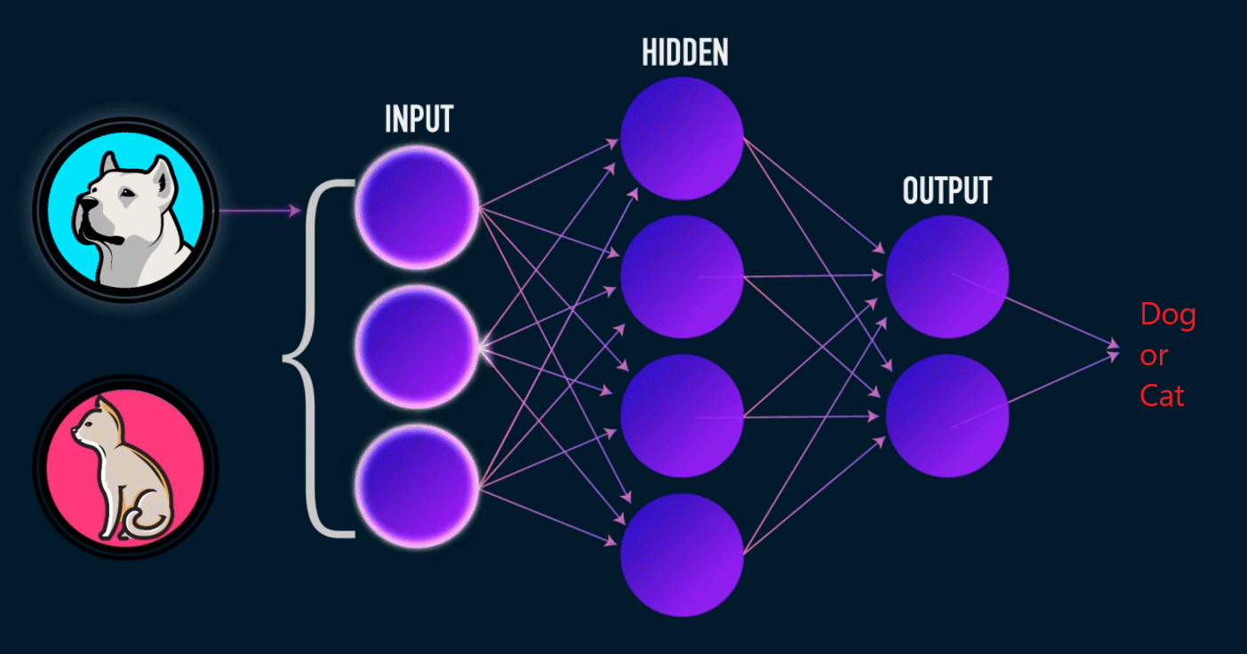
Training Neural Network

Slide 11
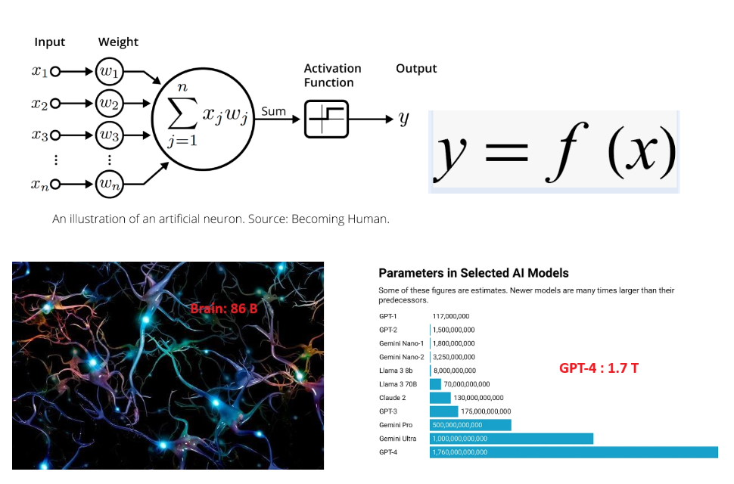
LLM: y = f(x)

Slide 12
LLM Explainability
- Generalization Theory
Explain why deep networks can learn effectively despite having more parameters than training examples;
- Representation Learning
Study how neural networks develop hierarchical internal representations similar to biological brains;
- Optimization Dynamics
Investigate why gradient descent consistently finds good solutions in highly complex parameter spaces
Tomaso Poggio
https://mcgovern.mit.edu/profile/tomaso-poggio/

Slide 13
Present - "Following the yellow brick road"
- Current state of 2024
- LLM model type
- LLM model benchmark
- ChatBot & Agent
- Application
- Example

Slide 14

2024 Nobel Prizes in Physics & Chemistry

Slide 15

State of AI - 2024

Slide 16


LLM Model Types

Slide 17
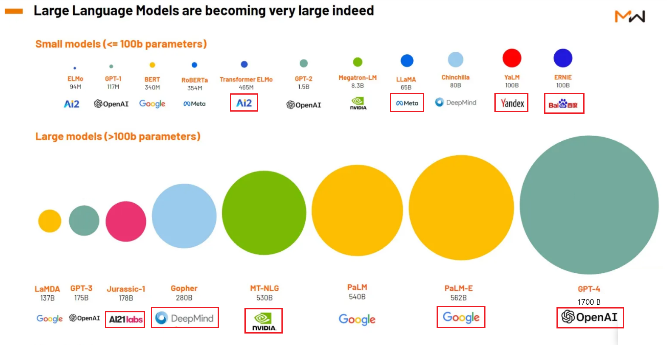
GenAI Leading Players

Slide 18
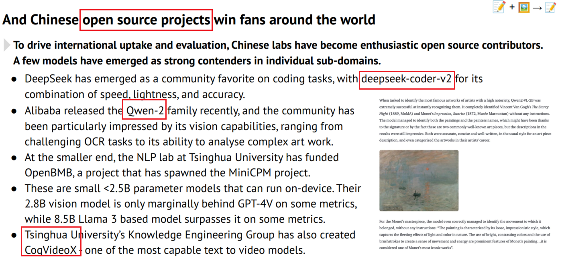
HuggingFace – Open Source LLM Hub
https://huggingface.co/

Slide 19
Ollama – Open Local Private LLM platform
Open
- Run SOTA open-source LLMs locally
- Easy model management (pull, run)
- Active community and growing model library
Local
- Simple setup
- Run on PC/Laptop
- No cloud dependencies or API costs
Private
- Data stays on your machine
- Full control over model interactions
- Ideal for research experimentation
https://ollama.com/

Slide 20

Model Leader Board

Slide 21

Model Benchmark

Slide 22
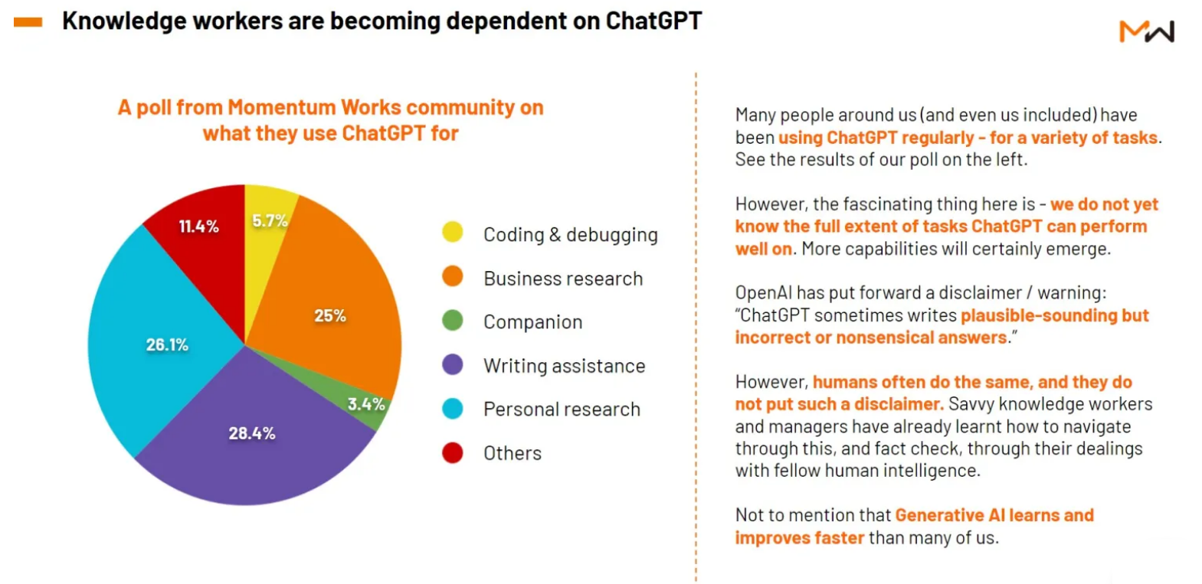
GenAI Use-Cases

Slide 23

Agent – Concept

Slide 24

Agent – Complex AI Systems
https://agpt.co/
https://www.crewai.com/
https://microsoft.github.io/autogen

Slide 25

AI for Math

Slide 26
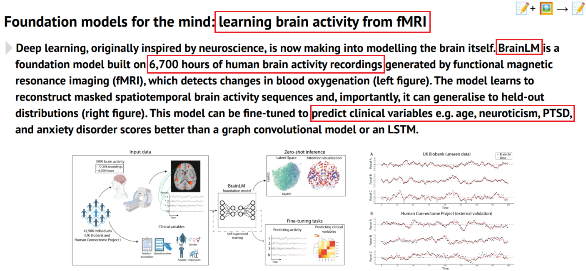
AI for Sciences

Slide 27
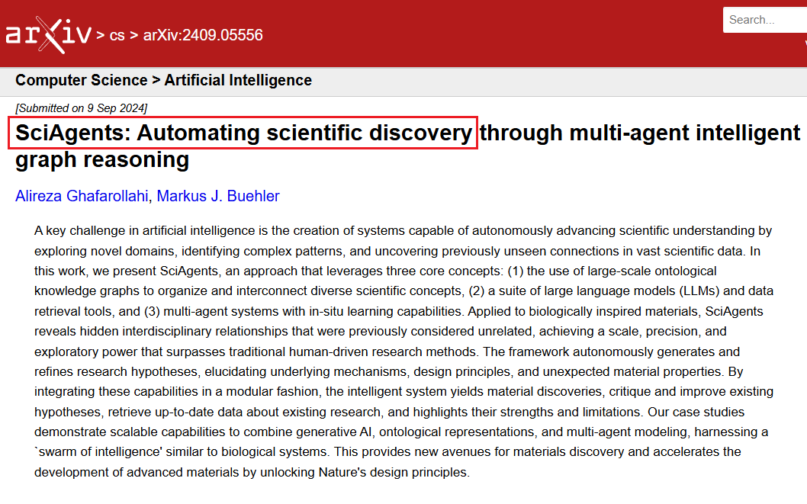
SciAgents – Automate Discovery

Slide 28
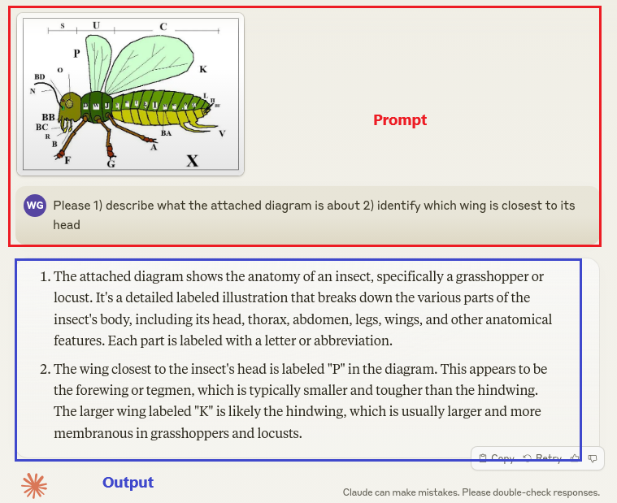
GenAI Examples

Slide 29

GenAI Examples

Slide 30
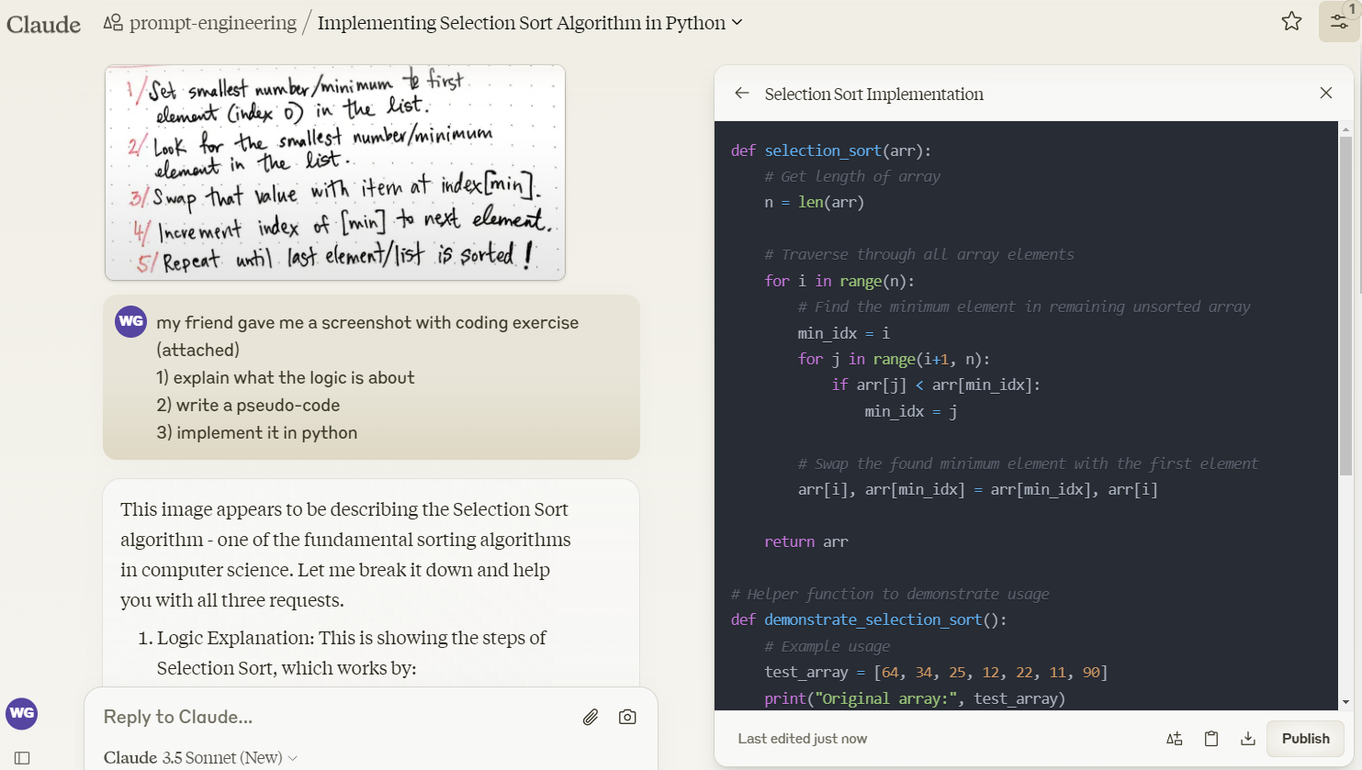
GenAI Examples
https://claude.ai/chat/97342cb8-5ba8-44b8-9c98-c080aaa62acc

Slide 31

GenAI Examples

Slide 32

GenAI Examples

Slide 33

GenAI Examples

Slide 34

GenAI Examples

Slide 35

GenAI Examples

Slide 36

GenAI Examples

Slide 37

Self Service Analytics: Text2SQL (my work)
https://www.youtube.com/watch?v=RKSlUAFmbaM

Slide 38
Future - "Behind the curtain"
- Geopolics
- Robotics
- Social impact
- AGI
- HI (Higher Intelligence)

Slide 39

Geopolitics: GenAI Leading Powers

Slide 40

AI + Robotics

Slide 41
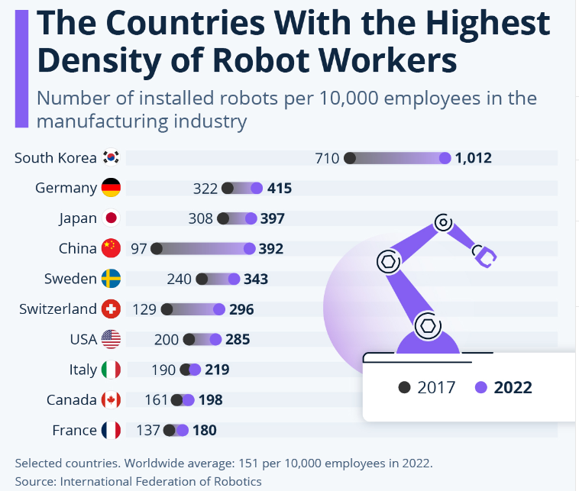
Robot Workers

Slide 42

Robot & Us: Where is privacy?

Slide 43
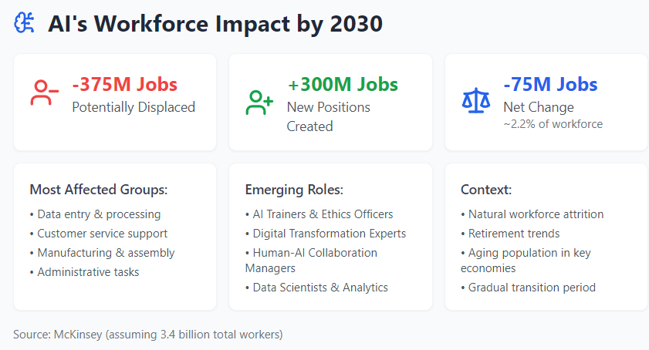
Social Impact

Slide 44
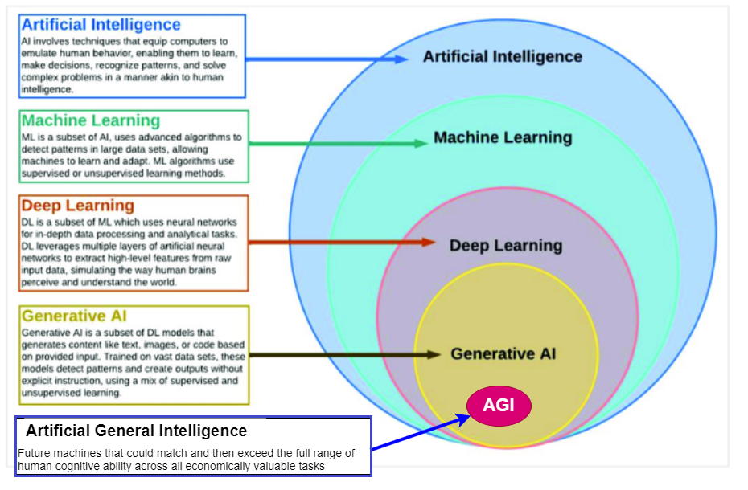
What is AGI ?

Slide 45
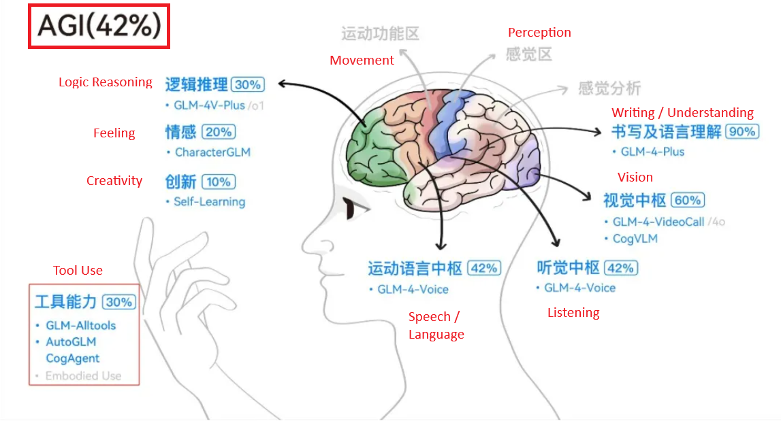
Path to AGI

Slide 46

HI – AGI – GenAI - TT (1)

Slide 47
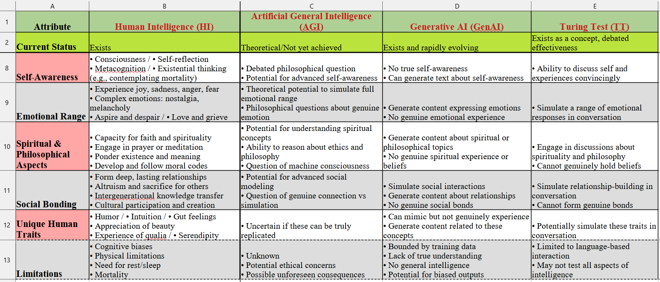
HI – AGI – GenAI - TT (2)

Slide 48

What makes us Human ?

Slide 49

Journey to the Unknown ?

Slide 50

wen.g.gong@gmail.com

