Slide 1
Introduction to GenAI
wen.g.gong@gmail.com

Slide 2
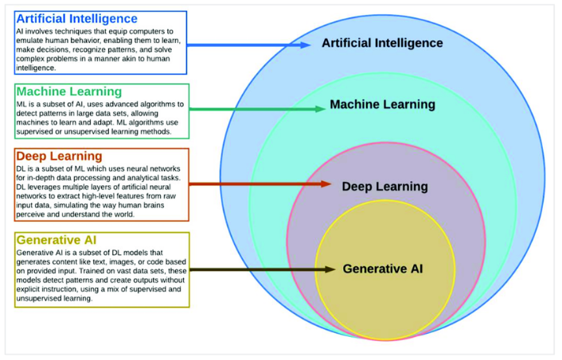
AI > ML > DL> GenAI

Slide 3
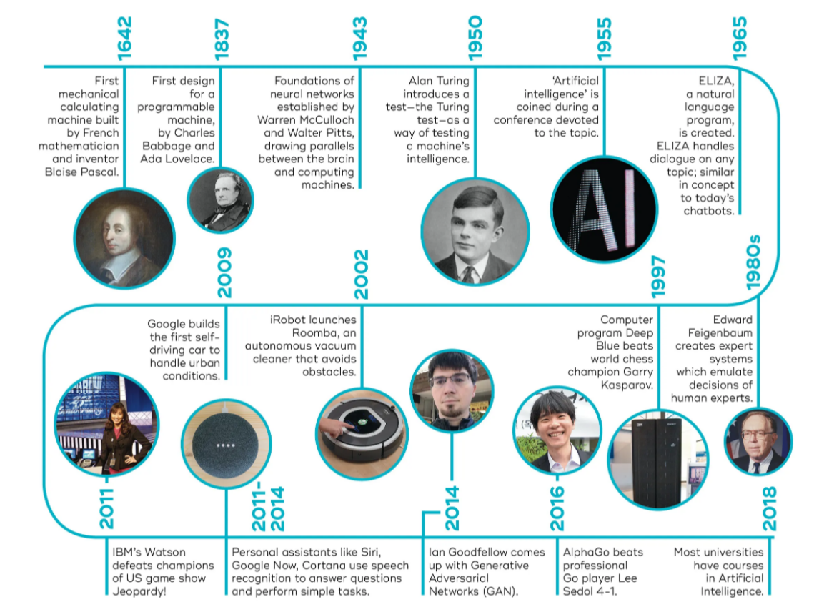
AI History

Slide 4
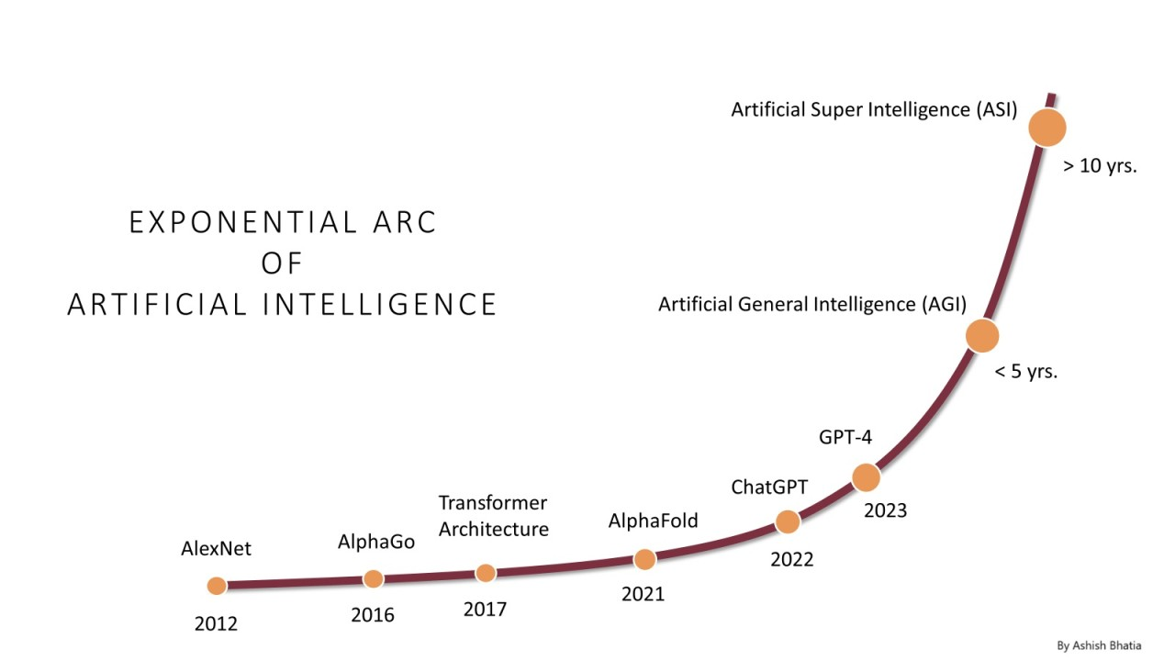
AI Growth & Milestones

Slide 5
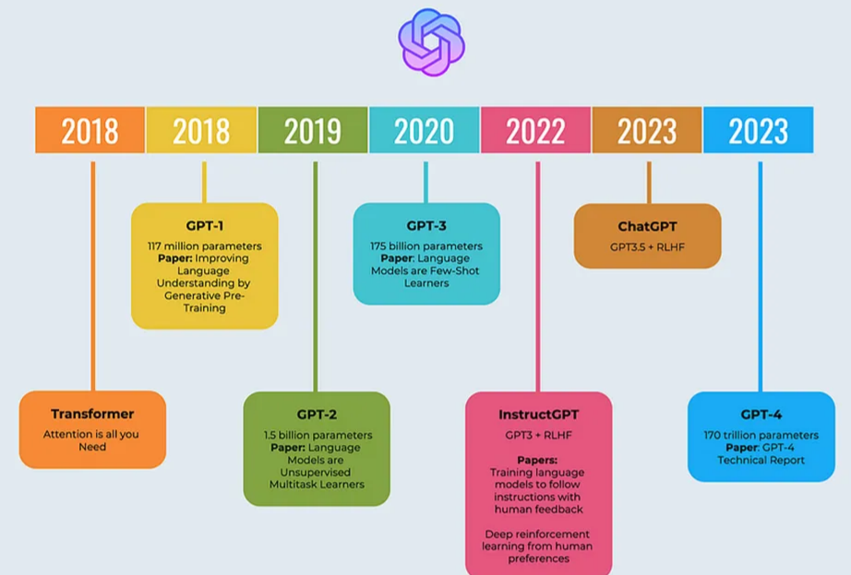
OpenAI: ChatGPT

Slide 6
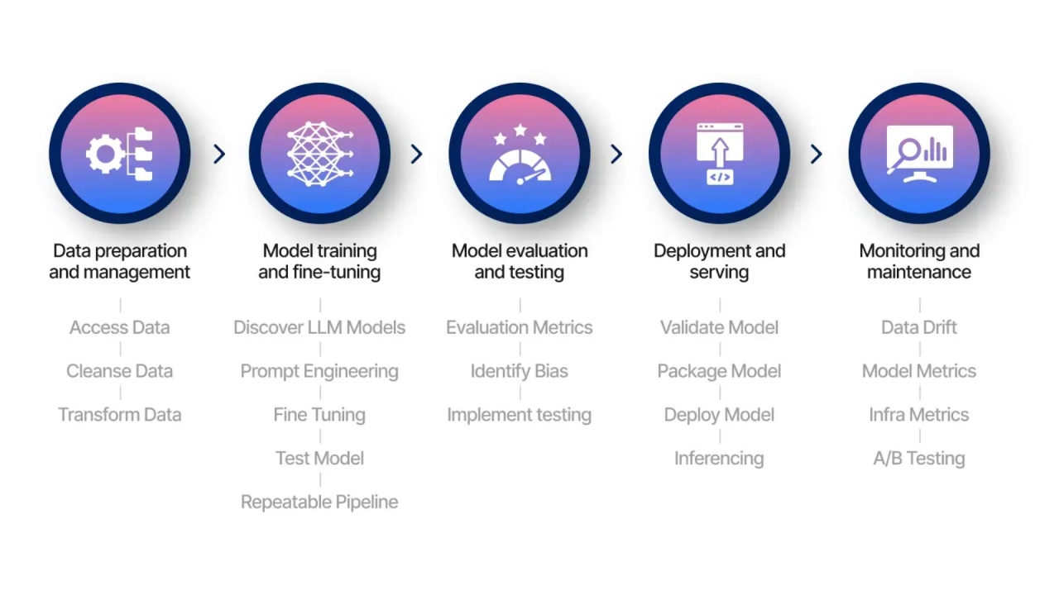
LLMOps: Model Lifecycle

Slide 7
GenAI: Neural Network

