Slide 1
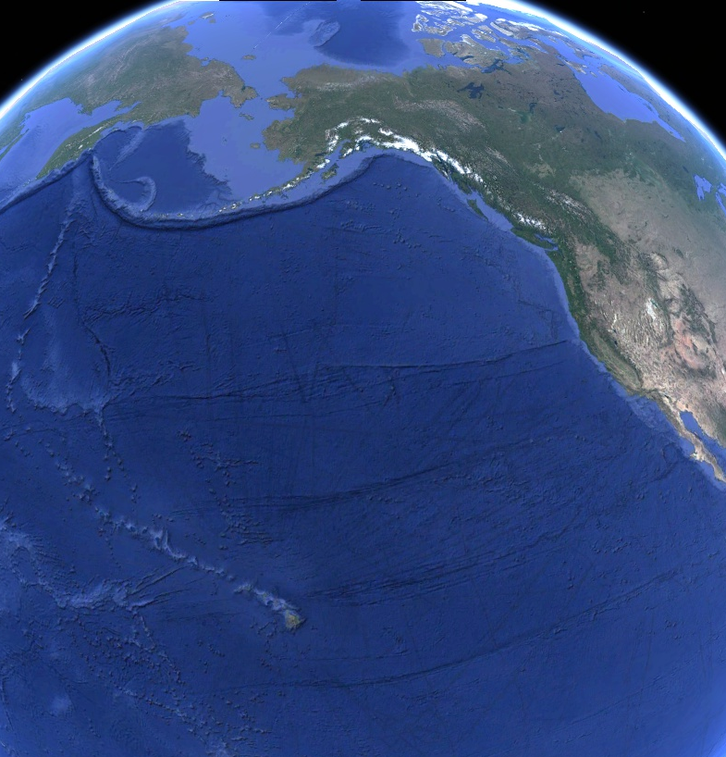

T_{ambient} = ~5°C
Alaska
Thermal Windows “Closed”
Appendage Temperature = T_{ambient}
Body Heat Loss = High
Appendage Heat Loss = Minimal
Annual
Migration
~4500 km
T_{ambient} = ~25°C
Hawaiʻi
Thermal Windows “Open”
Appendage Temperature = T_{body}
Body Heat Loss = High
Appendage Heat Loss = High
Notes:
As part of their capital breeding lifestyle, humpback whales (and many other mysticetes species) perform annual long-distance migrations between warm, low-latitude breeding grouds and cold, higher latitude feeding grounds. For our purposes, we are considering the migratory route between Alaska and Hawaii, which covers a distance of approximately 4500 km in each direction.
In order to make a migratory lifestyle like this feasible, cetaceans must be able to adapt to significant variation in water termperatures. Now, in colder waters, a thick layer of blubber helps to conserve body heat. In these environments, marine mammals such as cetaceans are also able to make use of a countercurrent heat exchange system in their extremities to keep warm blood farther from the skin, thereby “shutting off” these thermal windows and conserving additional heat.
In warm waters, on the other hand, the thermal windows can be “opened” by profusing warm blood close to the skin, allowing for maximal heat transfer from the body to the environment.

Slide 2
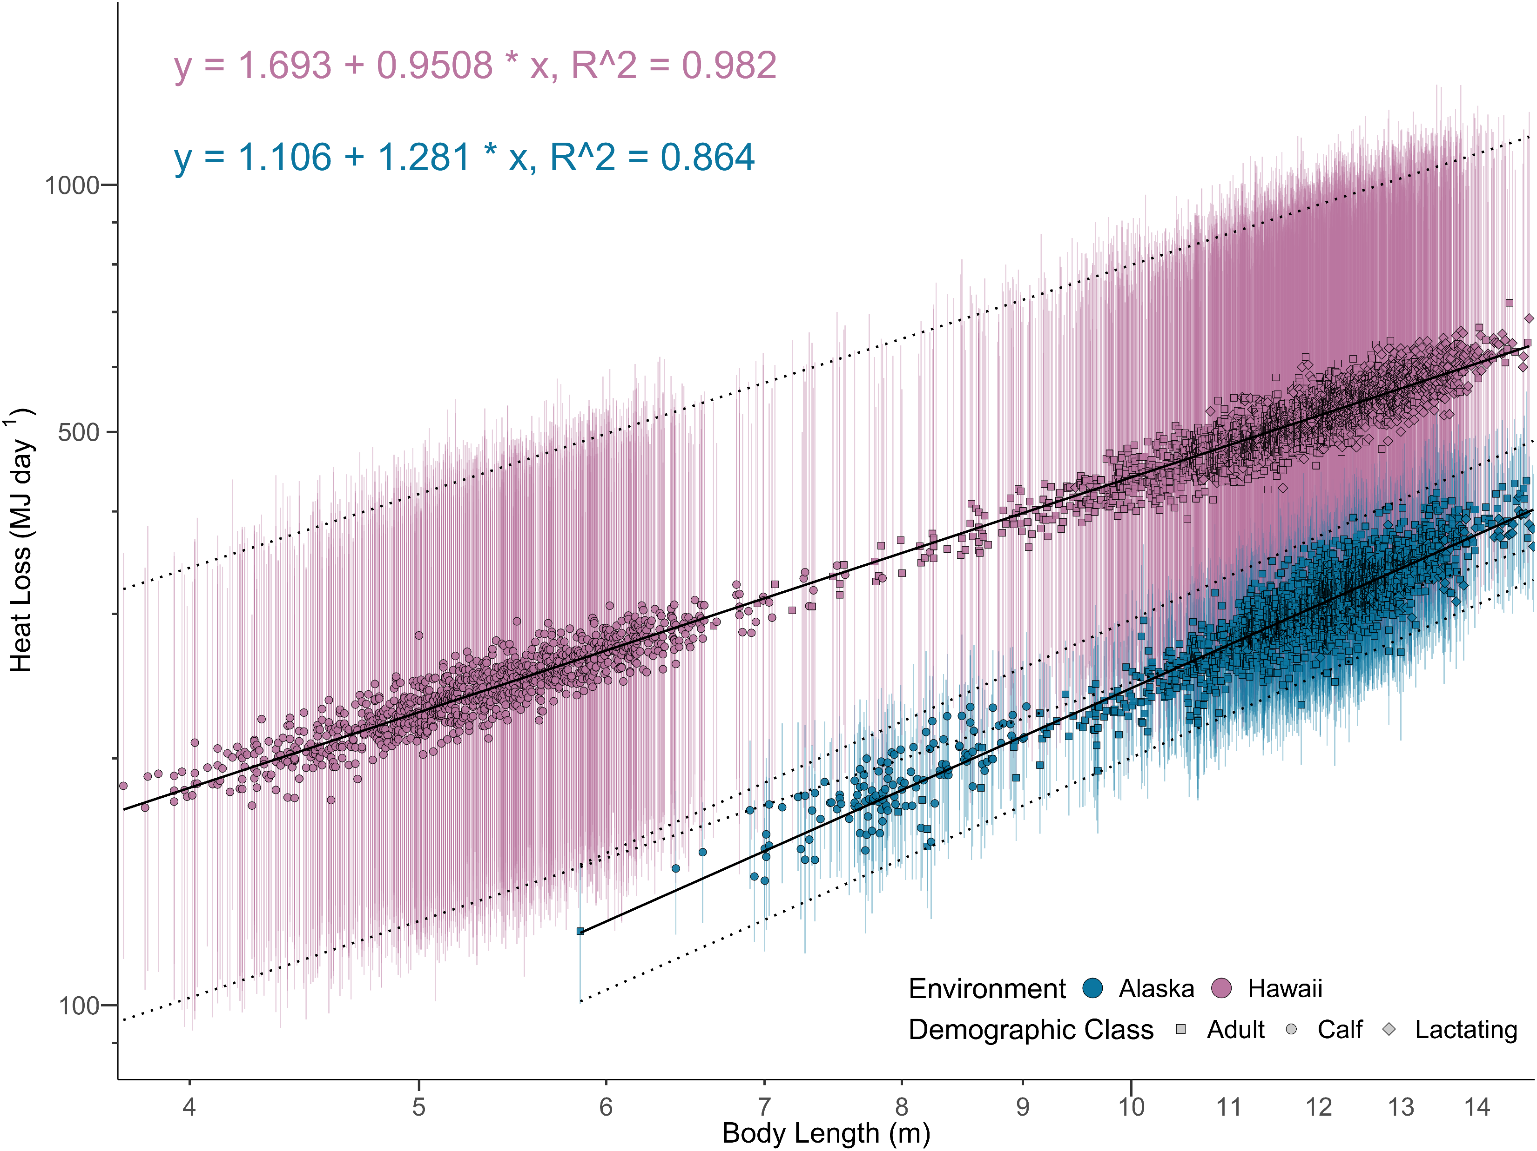


Hawaii w/ Thermal Windows Opened
Alaska w/ Thermal Windows Closed

Slide 3
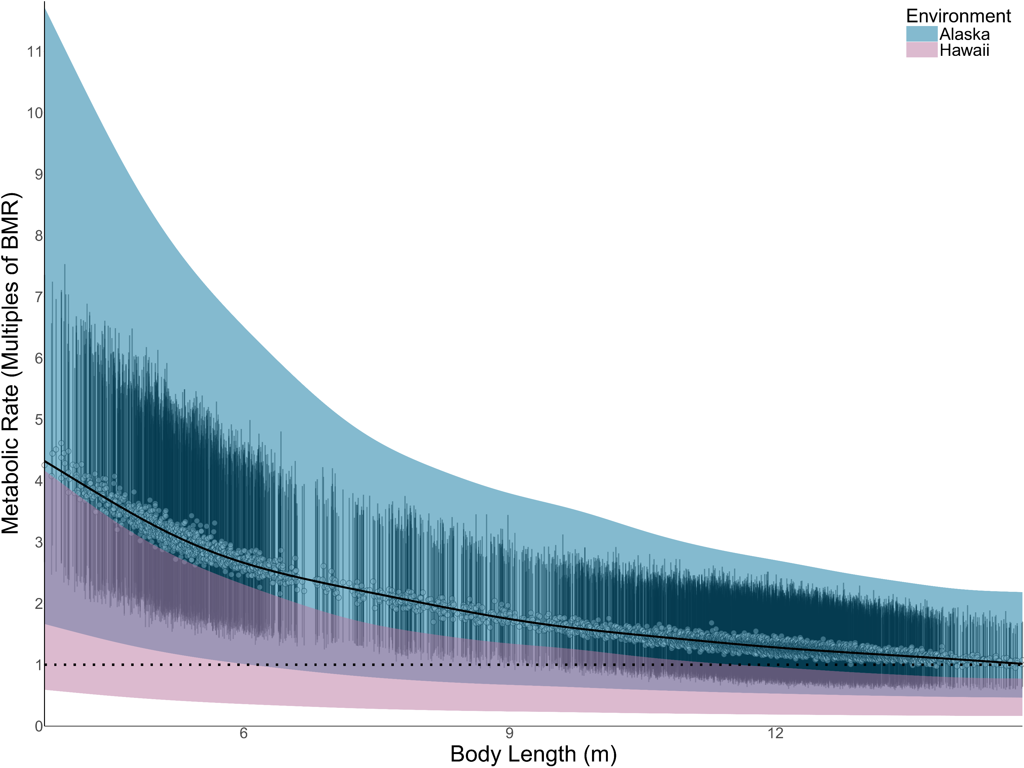
Calf
Adult
Metabolic “Scope”
Notes:
In all cases, the amount of metabolic heat generated by the body per second (also known as the field metabolic rate) must equal the amount of heat lost to the environment. If this is not the case, the animal will begin to experience either overheating or hypothermia.
The majority of studies that focus on heat loss in large cetaceans have historically focused on the heat loss of the main body and assumed that, so long as that number is below the field metabolic rate, then the animal will be able to open its thermal windows and offload any extra heat. But the heat loss potential of these extremities has never been directly tested, so we thought it would be interesting to test this hypothesis by modeling the heat loss potential of the entire animal. The upside of this more holistic model is that is should capture the full range of metabolic heat loss potential. And if heat loss must equal heat generated, this range should equal the range of field metabolic rates that an animal of a given size can sustain.
And so here, we’re showing body size versus metabolic rate, scaled as multiples of Kleiber BMR. The black line and bars correspond to field metabolic rate estimates derived using a morphometrics-based model. But, more importantly, the pink and blue regions correspond to the range of heat loss potential for animals in Hawaii and Alaska, respectively. The top line of each shaded region corresponds to the highest sustainable metabolic rate for an animal of that body size, which is equal to the highest heat loss with the thermal windows fully opened. The bottom line corresponds to the lowest sustainable metabolic rate, equal to the lowest heat loss with the thermal windows fully closed.
Smaller animals and calves generate less heat on an absolute basis, and therefore have less trouble maintaining thermal balance at higher field metabolic rates, but their minimum sustainable metabolic rates end up being a bit higher, especially in colder waters. So we can see that in Alaska, the minimum sustainable metabolic rate for a calf is around 1.5x Kleiber, which could be one reason why mothers come down to warmer waters to give birth.
Larger animals, meanwhile, are constrained on the upper end of the range. Even in Alaska, our model predicted that animals can only sustain a field metabolic rate of around 2-3x Kleiber, while that number is actually below 1x Kleiber in Hawaii. This could explain why animals on the breeding ground, with some notable exceptions, tend to rest for a significant portion of the time. Being more mobile might just generate too much heat and lead to overheating.
Now, our model is predicated on the best data that we have for the thermal dynamics of the extremities, but there is significant room for improvement of this model in future versions. But, to my mind, the ability to use morphology and physiological first principles to predict a feasible range of metabolic rates for a species is incredibly useful.

Slide 4
T_{ambient} = ~5°C
Cold Water
Alaska
Thermal Windows “Closed”
Appendage Temperature = T_{ambient}
Body Heat Loss = High
Appendage Heat Loss = Minimal
Annual
Migration
~4500 km
T_{ambient} = ~25°C
Warm Water
Hawaiʻi
Thermal Windows “Open”
Appendage Temperature = T_{body}
Body Heat Loss = High
Appendage Heat Loss = High
Notes:
As part of their capital breeding lifestyle, humpback whales (and many other mysticetes species) perform annual long-distance migrations between warm, low-latitude breeding grouds and cold, higher latitude feeding grounds. For our purposes, we are considering the migratory route between Alaska and Hawaii, which covers a distance of approximately 4500 km in each direction.
In order to make a migratory lifestyle like this feasible, cetaceans must be able to adapt to significant variation in water termperatures. Now, in colder waters, a thick layer of blubber helps to conserve body heat. In these environments, marine mammals such as cetaceans are also able to make use of a countercurrent heat exchange system in their extremities to keep warm blood farther from the skin, thereby “shutting off” these thermal windows and conserving additional heat.
In warm waters, on the other hand, the thermal windows can be “opened” by profusing warm blood close to the skin, allowing for maximal heat transfer from the body to the environment.

Slide 5
Maximal Potential Heat Loss
Calf
Adult
Metabolic “Scope”
Metabolic Heat Generated = Heat Lost
Minimum Potential Heat Loss
Notes:
In all cases, the amount of metabolic heat generated by the body per second (also known as the field metabolic rate) must equal the amount of heat lost to the environment. If this is not the case, the animal will begin to experience either overheating or hypothermia.
The majority of studies that focus on heat loss in large cetaceans have historically focused on the heat loss of the main body and assumed that, so long as that number is below the field metabolic rate, then the animal will be able to open its thermal windows and offload any extra heat. But the heat loss potential of these extremities has never been directly tested, so we thought it would be interesting to test this hypothesis by modeling the heat loss potential of the entire animal. The upside of this more holistic model is that is should capture the full range of metabolic heat loss potential. And if heat loss must equal heat generated, this range should equal the range of field metabolic rates that an animal of a given size can sustain.
And so here, we’re showing body size versus metabolic rate, scaled as multiples of Kleiber BMR. The black line and bars correspond to field metabolic rate estimates derived using a morphometrics-based model. But, more importantly, the pink and blue regions correspond to the range of heat loss potential for animals in Hawaii and Alaska, respectively. The top line of each shaded region corresponds to the highest sustainable metabolic rate for an animal of that body size, which is equal to the highest heat loss with the thermal windows fully opened. The bottom line corresponds to the lowest sustainable metabolic rate, equal to the lowest heat loss with the thermal windows fully closed.
Smaller animals and calves generate less heat on an absolute basis, and therefore have less trouble maintaining thermal balance at higher field metabolic rates, but their minimum sustainable metabolic rates end up being a bit higher, especially in colder waters. So we can see that in Alaska, the minimum sustainable metabolic rate for a calf is around 1.5x Kleiber, which could be one reason why mothers come down to warmer waters to give birth.
Larger animals, meanwhile, are constrained on the upper end of the range. Even in Alaska, our model predicted that animals can only sustain a field metabolic rate of around 2-3x Kleiber, while that number is actually below 1x Kleiber in Hawaii. This could explain why animals on the breeding ground, with some notable exceptions, tend to rest for a significant portion of the time. Being more mobile might just generate too much heat and lead to overheating.
Now, our model is predicated on the best data that we have for the thermal dynamics of the extremities, but there is significant room for improvement of this model in future versions. But, to my mind, the ability to use morphology and physiological first principles to predict a feasible range of metabolic rates for a species is incredibly useful.

