Slide 1
Hot Wings: Quantifying the Impact of Large Appendages on the Heat Loss Potential of Humpback Whales

Slide 2
Guiding Questions
What is the heat loss in a humpback across a range of body size, in both Hawaii and Alaska?
Most models of heat loss exclude the flippers and fins…can we include them and make our model more accurate?
Can we calculate the minimal and maximal heat loss potential of the body as a proxy for metabolic scope, assuming that heat loss must equal heat production?
Would calves suffer detrimental consequences if they were born in colder waters such as Alaska?
Do moms need to limit their expenditure to avoid overheating in the warmer waters of Hawaii?

Slide 3



$$Conductive = \frac{k × SA × (T_{body}−T_{water})}{BT}$$
$$Tcrit =T_{body}−\frac{BT ×Q_{admr}}{k × SA}$$
k = 0.2
T_{body} = 36
T_{water} = 25°C in Hawaii, 5°C in Alaska
SA = Dependent on Body Length
BT = Dependent on Body Length
$$Q_{admr}=BMR×β$$
BMR = Dependent on Body Length
β = 0.5 – 4.0
$$Respiratory =\frac{\text{RRi}\text{×}V_{T}}{60}×(143.5−1.37×T_{air}×T_{air}^{2})×0.0864$$
RRi = Dependent on Body Length
T_{air} = 25°C in Hawaii, 5°C in Alaska
V_{T} = Dependent on Body Mass
$$Heat Loss= Conductive+Respiratory$$

Slide 4
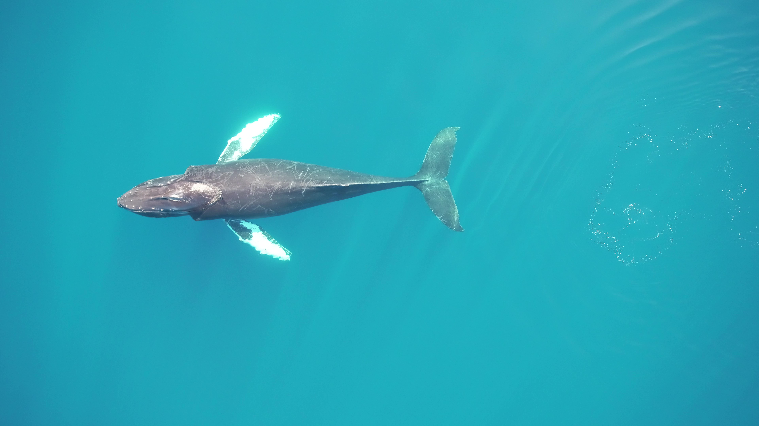

Slide 5
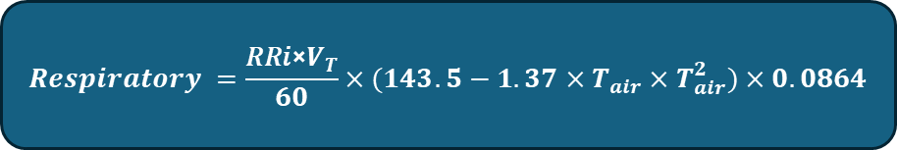
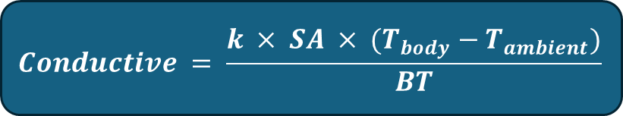
$$Conductive = \frac{k × SA × (T_{body}−T_{ambient})}{BT}$$
$$Respiratory =\frac{\text{RRi}\text{×}V_{T}}{60}×(143.5−1.37×T_{air}×T_{air}^{2})×0.0864$$

Slide 6


$$Conductive = \frac{k × SA × (T_{body}−T_{ambient})}{BT}$$
$$Respiratory =\frac{\text{RRi}\text{×}V_{T}}{60}×(143.5−1.37×T_{ambient}×T_{ambient}^{2})×0.0864$$
$$Heat Loss= {Conductive}_{body}+{Conductive}_{flippers}+{Conductive}_{flukes}+ Respiratory$$

Slide 7
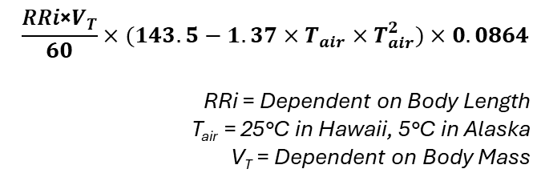
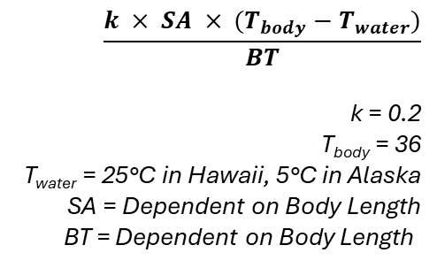
Respiratory
$$\frac{\text{RRi}\text{×}V_{T}}{60}×(143.5−1.37×T_{air}×T_{air}^{2})×0.0864$$
RRi = Dependent on Body Length
T_{air} = 25°C in Hawaii, 5°C in Alaska
V_{T} = Dependent on Body Mass
Convective
Morphometrics
Conductive
$$\frac{k × SA × (T_{body}−T_{water})}{BT}$$
k = 0.2
T_{body} = 36
T_{water} = 25°C in Hawaii, 5°C in Alaska
SA = Dependent on Body Length
BT = Dependent on Body Length
$$Heat Loss= Conductive+Respiratory$$

Slide 8
Morphometrics
Total Length
  Mass
  Volume
  Blubber Thickness
Flipper
  Span Length
  Chord Width
  Total Area
Fluke
  Span Length
  Chord Width
  Total Area

Slide 9
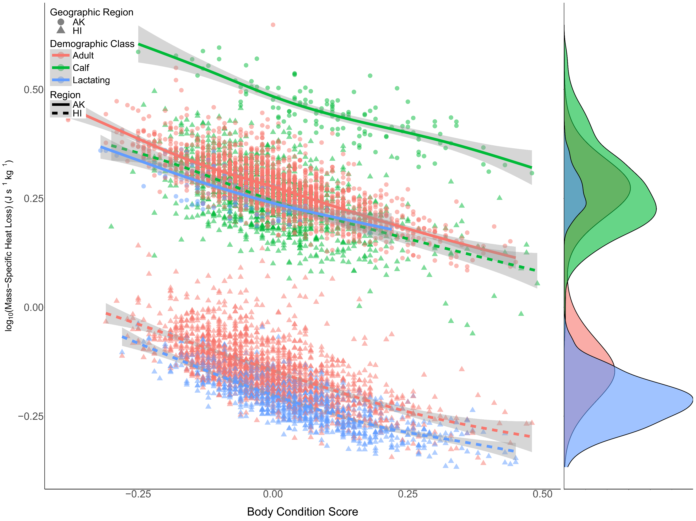

Slide 10
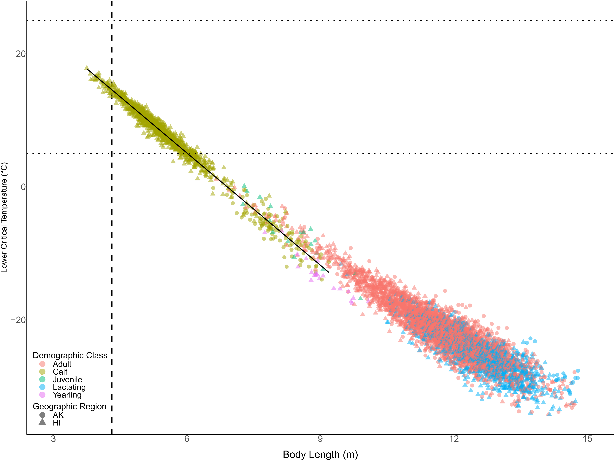

Slide 11


