Slide 1
資料庫設計概論

Slide 2
課程綱要
關聯式資料庫邏輯結構
資料庫邏輯設計
  Conceptual Design
Logical data model
  Broad data entities
  Relationships
Physical data model
  Map to tables, records, fields

Slide 3
關聯式資料庫邏輯結構
資料以橫列直欄的方式組織於二維表格（Table）之中，各資料表（Table）存放現實世界中的實體或概念上認定存在的東西，例如：學生資料表、班級資料表、員工資料表。
每一直欄稱為欄位（Field）。
每一橫列稱為記錄（Record）。
每個資料表都各有其主鍵（Primary Key，PK）。
必要時，以某個欄位為外鍵（Foreign Key，FK）關聯到另一資料表的主鍵以獲得進一步的相關資料。

Slide 4
關聯式資料庫邏輯結構
CityID
CityName
TP
台北
每一直欄稱為欄位（Field）。
TC
台中
KS
高雄
EmpID
LastName
FirstName
CtryID
Extension
LastMod
101
integer
Wang
longstring
Angle
varchar(20)
TP
char(2)
x19891
char(6)
\HR\KarlD
longstring
102
Chien
Wolfgang
TC
x19433
\HR\KarlD
103
Martin
Jose
TP
x21467
\HR\AmyL

Slide 5
關聯式資料庫邏輯結構
CityID
CityName
TP
台北
每一橫列稱為記錄（Record）。
TC
台中
KS
高雄
EmpID
LastName
FirstName
CtryID
Extension
LastMod
101
integer
Wang
longstring
Angle
varchar(20)
TP
char(2)
x19891
char(6)
\HR\KarlD
longstring
102
Chien
Wolfgang
TC
x19433
\HR\KarlD
103
Martin
Jose
TP
x21467
\HR\AmyL

Slide 6
關聯式資料庫邏輯結構
PK
CityID
CityName
每個資料表都各有其主鍵（Primary Key，PK）。
必要時，以某個欄位為外鍵（Foreign Key，FK）關聯到另一資料表的主鍵以獲得進一步的相關資料。
TP
台北
TC
台中
KS
高雄
PK
FK
EmpID
LastName
FirstName
CtryID
Extension
LastMod
101
integer
Wang
longstring
Angle
varchar(20)
TP
char(2)
x19891
char(6)
\HR\KarlD
longstring
102
Chien
Wolfgang
TC
x19433
\HR\KarlD
103
Martin
Jose
TP
x21467
\HR\AmyL

Slide 7





Phases in the MSF Process Model
Deployment
Complete
MSF
Release Readiness
Approved
Vision/Scope
Approved
Project Plans
Approved
Scope Complete

Slide 8


How to Use Iteration in Projects
The project develops in smaller steps
Each iteration is identified with specific deliverables
The team can produce versioned releases
Version 3
Version 2
Version 1
Functionality
Time

Slide 9
Phases in the MSF Process Model
Envision (Use Case Diagram)
Conceptual Design (Use Case / Sequence / Active / State Diagram)
  1-1 Research → 1-2Analysis → 1-3 Optimization
Logical Design (Class Diagram)
  2-1 Analysis → 2-2 Optimization
Physical Design (Component / Deploy / Package Diagram)
  3-1 Research → 3-2 Analysis →
  3-3 Rationalization → 3-4 Implementation

Slide 10

What Are the Steps in Conceptual Design?
Vision/Scope
Approved
Research Baseline
Baseline
Analysis Baseline
Project Plan
Approved
Optimization Baseline
Conceptual
Conceptual
Design
Baseline
Logical Design
Physical Design

Slide 11
Sources of Information
Artifacts
  Physical items in the business environment: training manuals, job aids
Systems
  Information systems and other processes that accomplish something: inventory tracking systems, intranets
People
  Stakeholders in the business who are sources of valuable insight and information

Slide 12
Techniques for Gathering Information
Technique | Description
Shadowing | Directly observe individuals doing their job to discover current practices and problems
Interviews | Gather specific information from individuals
Focus groups | Query a group to discover attitudes and shared perceptions
Surveys | Collect detailed and statistically significant data
User instruction | Ask end users to teach you how they work with a system
Prototyping | Simulate a system that would be impractical to test directly
Instrumented versions | Use an instrumented application to record how users perform tasks

Slide 13
Categories of Information
Business
  Interaction between goals and objectives, products and services, financial structures, and major organizational structures
Applications
  Automated and non-automated services that support the business processes
Operations
  Information needed to run business processes
Technology
  Technical services needed to perform and support the business mission

Slide 14
Logical Data Design
Entity
Attribute
Relationship
In this section...

Slide 15



Deriving Entities
Entities represent real-world objects about which information will be stored
When deriving entities, look for nouns or noun phrases during analysis
Rows in database tables
Common examples
  People
  Books

Slide 16

Deriving Attributes
Descriptive information about an entity
Attached to entity that they most closely describe
Columns in database tables
Example: Attributes of a car
  Color
  Make
  Model
  Year

Slide 17










Identifying Relationships Between Entities
Relationships represent associations among entities
Look for verbs or verb phrases that link
entities together

Slide 18
Overview of Cardinality and Existence
Cardinality determines the number of instances of an entity that are allowed in a relationship
Existence determines what entities must exist for the relationship to have meaning, given a specified cardinality

Slide 19
Determining Cardinality
Cardinality further defines a relationship by assigning it to one of three major categories:
  One-to-one
  One-to-many
  Many-to-many
#
#

Slide 20
Determining Existence
Depicts the conditions under which a relationship between two entities can exist
Necessary when one entity requires an instance of another entity
Can be one of two categories
  Mandatory
  Optional

Slide 21
Entity/Relationship Modeling
Syntax
Creating the Logical Data Model
Activity 4.2: Creating a Logical Data Model
In this section...

Slide 22
Syntax
Represented by the entity/relationship diagram
Entities and attributes are represented as rectangles
Relationships are represented as lines (with dots) between entities
Cardinality is denoted by a number at each end of the relationship
Existence is denoted as a solid or dashed line
1 .. ∞
1

Slide 23
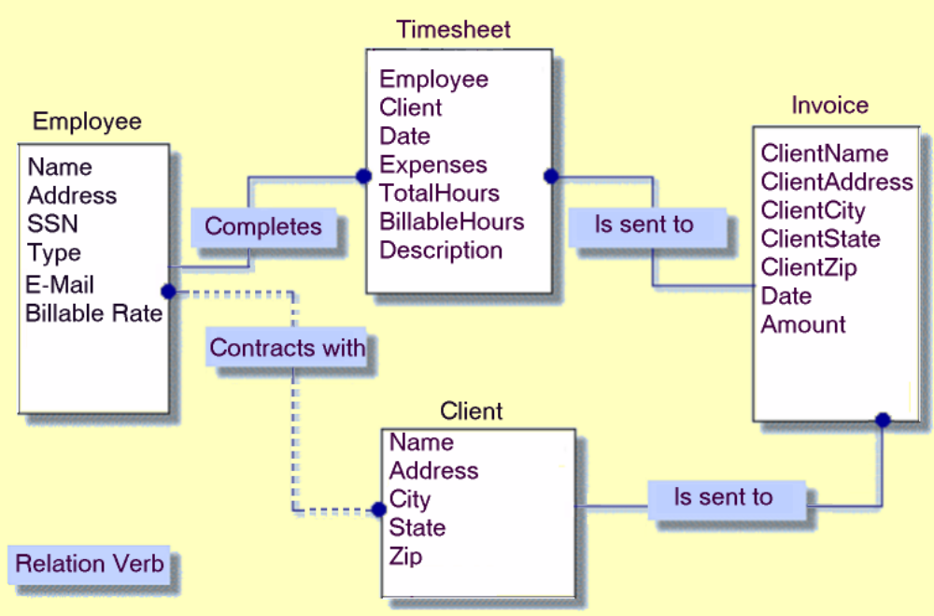
Creating the Logical Data Model

Slide 24
Normalization Basics
Normalizing Logical Models
Creating a First Normal Form Data Model
First Normal Form Example
Moving to a Second Normal Form Data Model
Creating a Third Normal Form Data Model
Third Normal Form Example
Benefits of Normalization
In this section...

Slide 25
Normalizing Logical Models
Process of eliminating duplicate data, and usually, defining relationships among tables
Normal forms
  First normal form
  Second normal form
  Third normal form
Normalized databases typically include more tables with fewer columns

Slide 26
Creating a First Normal Form Data Model
Create two-dimensional tables
Assign only one value to each cell
Assign a single meaning to each column

Slide 27
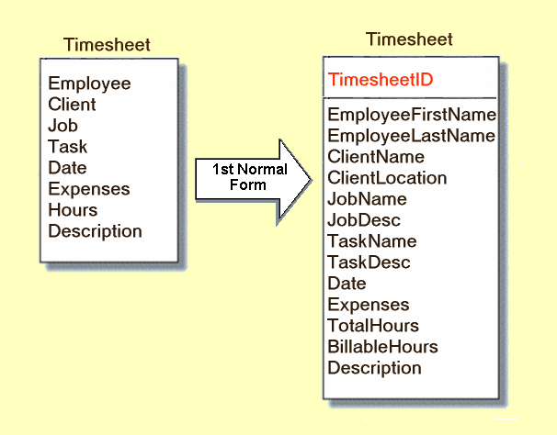
First Normal Form Example

Slide 28
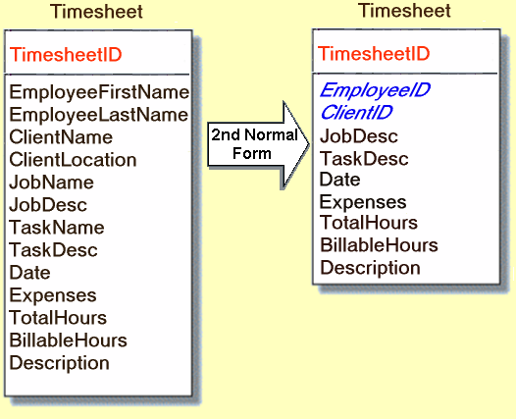
Moving a to Second Normal Form Data Model
Eliminate redundant data within an entity
Move attribute that depends on only part of a multivalue key to a separate table
Consolidate information when possible

Slide 29
Creating a Third Normal Form Data Model
Eliminate any columns that do not depend on a key value for their existence
Generally, move any data not directly related to entity to another table
Reduce or eliminate update and deletion anomalies
Verify that no redundant data remains

Slide 30
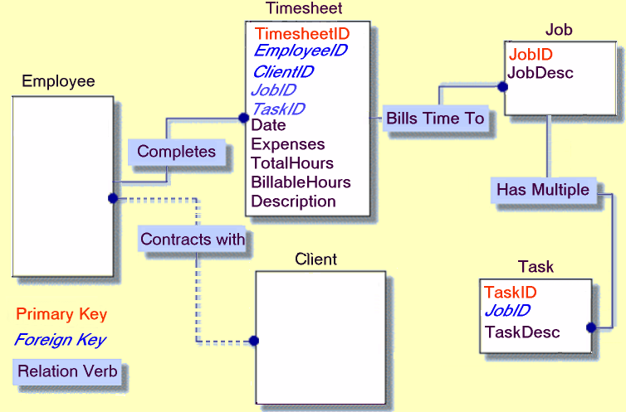
Third Normal Form Example

