Slide 1
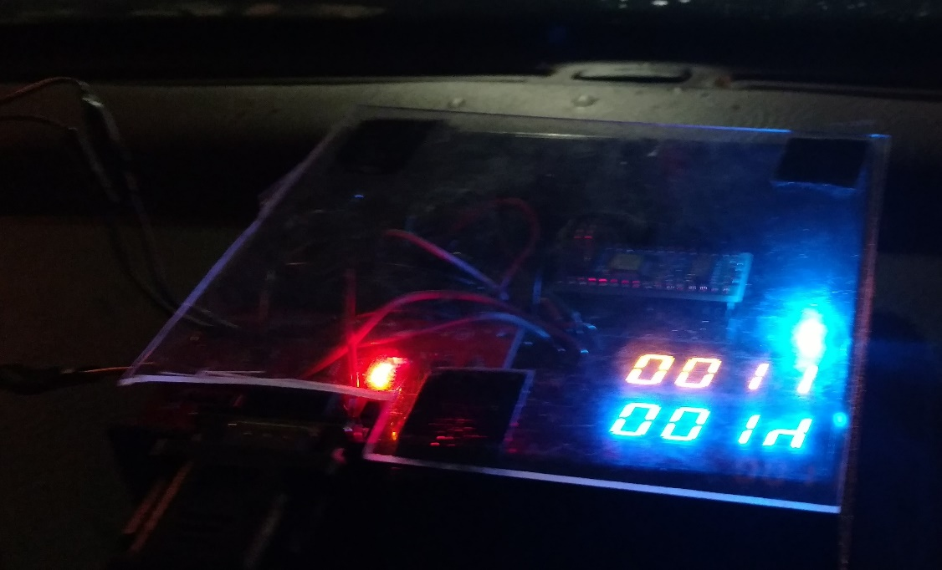
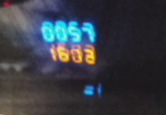
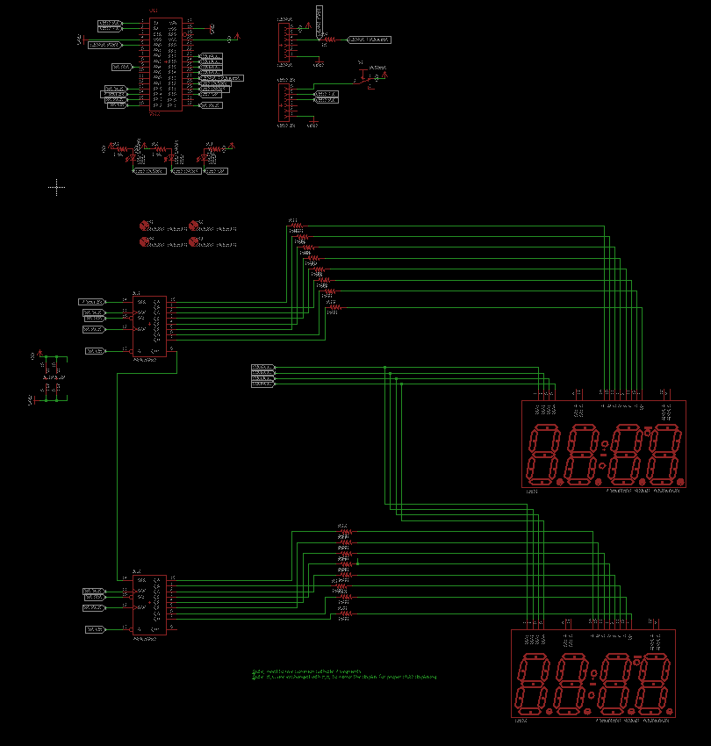
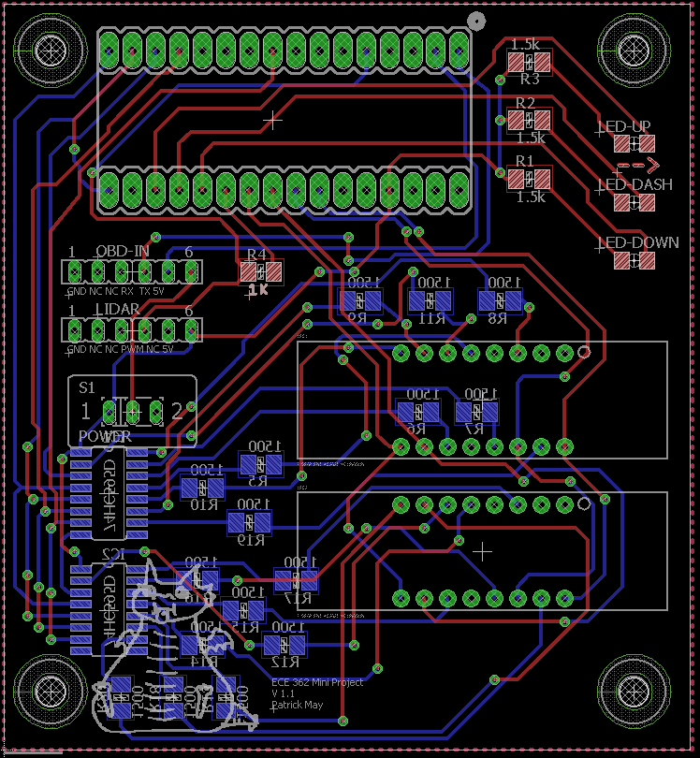
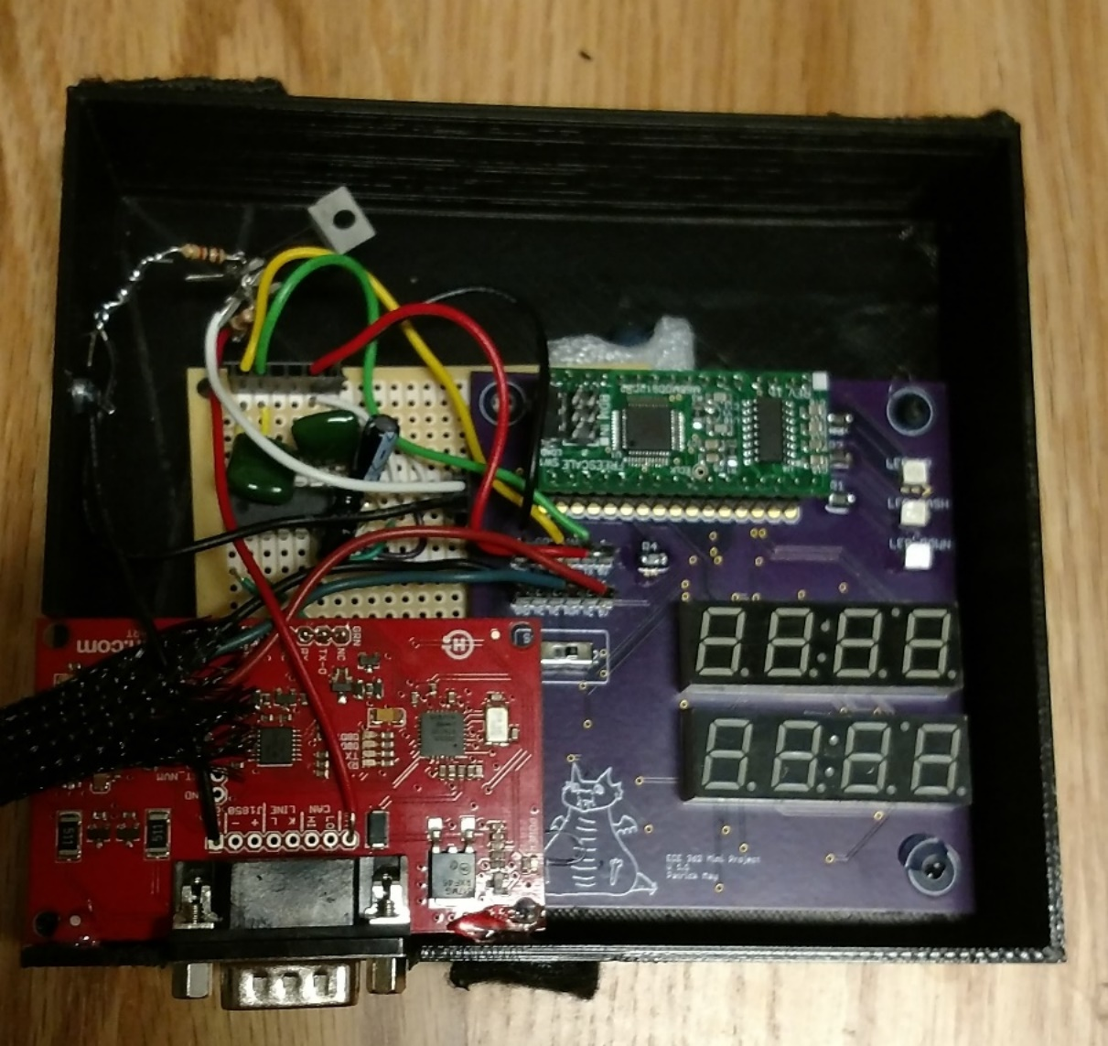
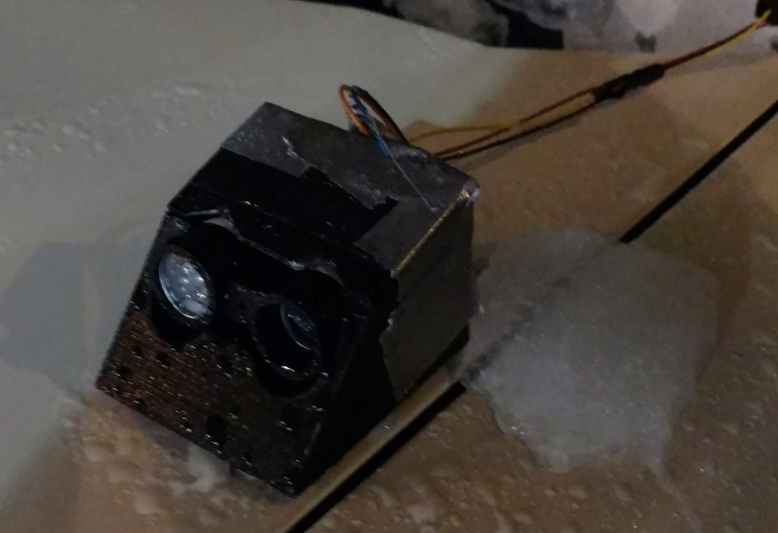

ECE 362 Embedded Microcontroller Mini-Project − Fall 2016
Team 01 – Cruise Control HUD
https://youtu.be/xGuQt2sF4p8
“The HUD that will help your BFFAM improve his driving skills”
Overview
Cruise control HUD aims to help drivers by dynamically displaying data about the car’s velocity, distance to oncoming cars, and whether to slow down or speed up.
Team Members: Patrick May, Will Pierce, Tyler Carter
Implementation
This project obtains its speed measurement by continuously polling a speed reading via SCI from the Engine Control Unit (ECU) of a car through the OBD port. Distance measurements are obtained by triggering a distance measurement on the LIDAR and then reading the value the LIDAR responds with using and ATD to calculate how long the pulse is and converting that to a distance. These inputs are then shifted out via SPI to external shift registers which drive 7-segment LEDs.
On-Chip Peripherals Detail
This project uses the ATD to receive a PWM signal from the LIDAR, the TIM module to control LED refresh rates and LIDAR sampling, the SCI to communicate with the car, and the SPI module to drive 7-segments through a shift register.
Project in Operation
The displays reflecting off the windshield
Additional Circuitry
The main board interfaces to a MAX232 mounted on a perfboard. This is then interfaced to a Sparkfun OBD-to-UART board.
LIDAR
ATD
PWM
Speed up/ Slow down LEDs
Future Work
For future work, we consider consolidating all circuitry to a single board and using solderless connectors to “foolproof” the design.
9S12C
Circuit Schematic
Board layout
SPI
Shift Registers
7 Segment Displays
SCI
Additional Design Work
The PCB was created in Eagle and produced at OSHPark. 3D-printed enclosures for both the LIDAR and boards were designed using Autodesk Fusion and printed on a Printrbot Simple Metal. The LIDAR is attached to the hood of a car using neodymium magnets
OBD-to-TTL converter
OBD Port
Car
Power
LIDAR in its enclosure attached to a car
Digijock(ette)-Strength Digital System DesignTM
All boards inside enclosure

