Slide 1
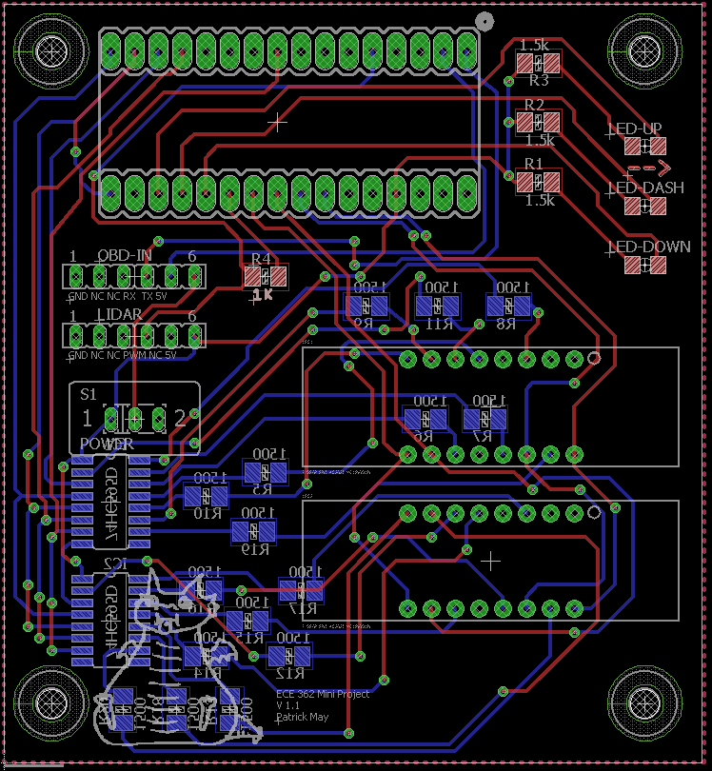
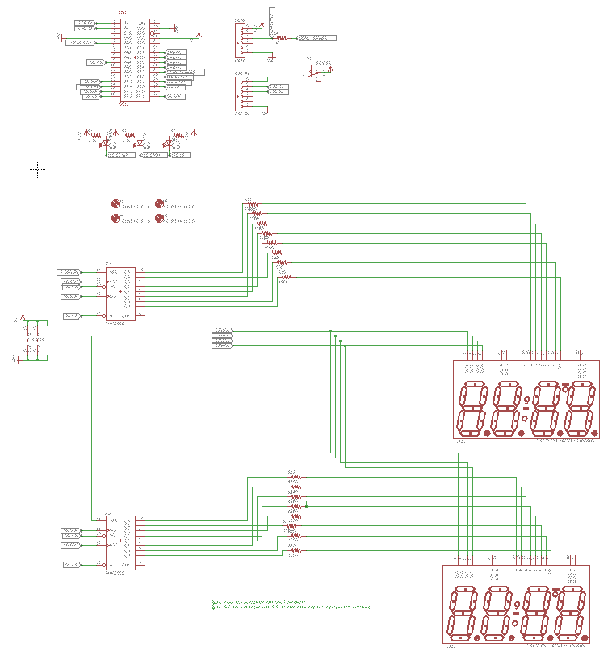

ECE 362 Embedded Microcontroller Mini-Project − Fall 2016
Team 01 – Cruise Control HUD
Overview:
Cruise control HUD aims to help drivers by dynamically displaying data about the car’s velocity, distance to oncoming cars, and whether to slow down or speed up.
Team Members: Patrick May, Will Pierce, Tyler Carter
Implementation
This project obtains its speed measurement by continuously polling a speed reading from the Engine Control Unit (ECU) of a car via the OBD port of a car.
This project
LEDs are displayed at varying brightness to tellt eh driver whether to slow down or speed up The display is reflected off of the windshield.
On-Chip Peripherals Detail
This project uses the ATD to receive a PWM signal from the LIDAR, a TIM module to control LED refresh rates, serial communication, and the SPI module to drive 7-segments through a shift register.
LIDAR
ATD
Speed up/ Slow down LEDs
GPIO
9S12C
SPI
Shift Registers
7 Segment Displays
SCI
OBD-to-TTL converter
OBD Port
Digijock(ette)-Strength Digital System DesignTM

