Slide 1

Electronic Data Interchange
Leading Shedrain into the Future
Meets Customers’ Demands
Speeds Order Processing
Saves Money

Slide 2
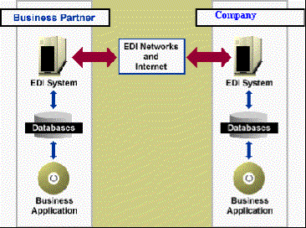

What Is EDI?
Electronic Data Interchange
is a set of standards that allows businesses to exchange documents:
  Purchase Orders
  Invoices
  Advance Ship Notices

Slide 3
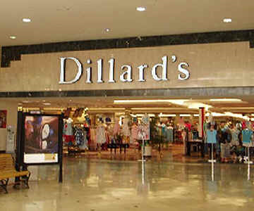
Who Uses EDI ?
Dillards
Fred Meyer
JC Penney
Dayton Hudson
ZCMI

Slide 4
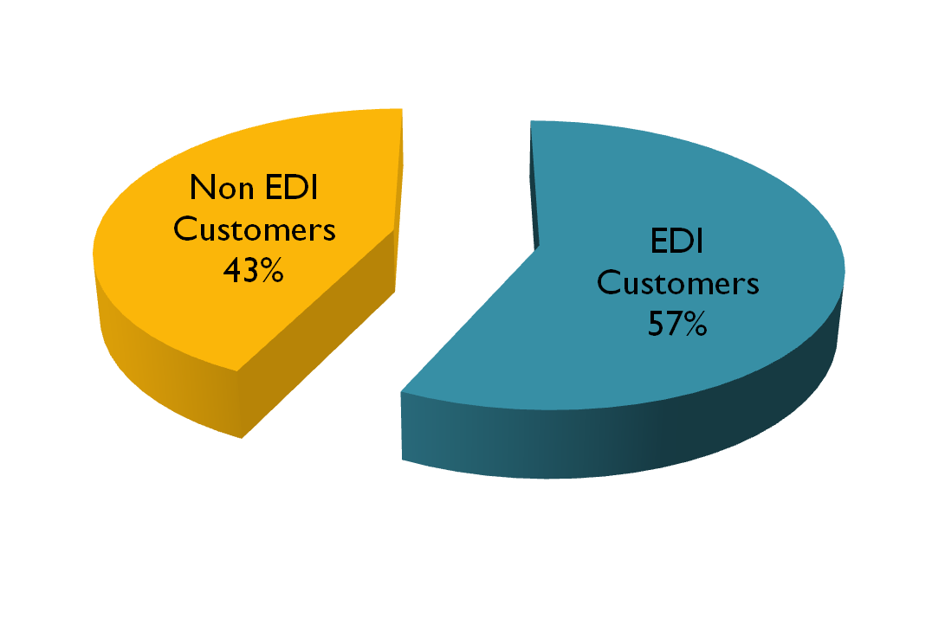
Percentage of EDI Business

Slide 5
Annual Revenue 1996
EDI Customers 1996 Revenue
Dillards 1,000,000
Fred Meyer 600,000
JC Penney 250,000
Dayton Hudson 100,000
ZCMI 50,000
Total 2,000,000
Non EDI Customers 1,500,000

Slide 6
Current P/O Processing
EDI customers send P/O electronically
Shedrain prints EDI P/O
Shedrain enters EDI P/O into accounting package (MCBA)‏

Slide 7

Current Invoice Processing
Instead of printing an invoice
for EDI customers, MCBA
prints a list of EDI invoices
Shedrain enters invoices
into EDI invoice package

Slide 8

Current ASN Processing
Advanced Shipping Notices (ASNs) are currently not being produced
Several of our largest customers (Dillards, Fred Meyers) are
requesting that ASNs be produced

Slide 9
Problems With Current Processing
Can take up to a week to enter one P/O
High cost of data entry
Difficult to respond to customer’s requests
Cannot now Provide ASN
Waste of Paper

Slide 10

What Shedrain Needs to Do
Replace P/O manual interface
with automated one.
  Order entered in minutes, not days
Eliminates printing P/Os
Can immediately respond to customer needs

Slide 11

What Shedrain Needs to Do
Replace Invoice manual interface
with automated one.
  Saves some Data Entry costs
  Eliminates printing Invoice list

Slide 12

What Shedrain Needs to Do
What Shedrain Needs to Do

Slide 13

Alternative Solutions
Adapt MCBA to EDI
Purchase new ERP (Enterprise Resource Planning) System with EDI capabilities

Slide 14

Cost Reductions Under EDI
(Both Strategies)‏
Reduces data entry
  Saves 5 positions @ $25,000 a year = $125,000 annually
Eliminates need
to print out P/Os
  Reduces paper costs by $10,000 annually

Slide 15
Cost / Benefit Analysis
Update MCBA
Development Costs $110,000
Annual Costs $15,000
Annual Benefits $135,000
Customer Good Will
New Customers

Slide 16
Cost / Benefit Analysis
New ERP
Development Costs $30,000
Annual Costs $60,000
Annual Benefits $135,000
Customer Good Will
New Customers

Slide 17
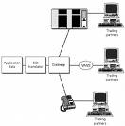
Recommendation
Add EDI Capabilities to MCBA System

Slide 18
In Conclusion
EDI is a must for Shedrain
Current processing
  Wastes Resources
  Prevents quick response to customer needs
Proposed new system
  Greatly reduces processing time
  Saves resources

