Slide 1

JavaScript as a dynamic, functional language
by:
Jan Sabbe &
Wouter Groeneveld
Notes:
Wouter

Slide 2
Context
Primitives & objects
Prototypal inheritance
Functions & closures
Scopes & contexts
Today we will talk about JavaScript as a language.
We will not talk about JavaScript as a way to manipulate the DOM
Notes:
DOM is voor de volgende cursus

Slide 3
How JavaScript is used ☹
<script>
function oops() {
doStuff();
i = 10;
copyPasta(this.i, 20);
}
function copypasta(i, j) {
alert(new Date(i).getTime());
return j;
}
</script>
<a onclick=“oei();”>lala</a>
JavaScript is just like Java!
Notes:
Quick and dirty, no tests, no refactoring, no encapsulation, try till it works

Slide 4
How JavaScript can be used ☺
<script>
$(document).ready(function() {
$(“#link”).click(MyStuff.oei);
});
var MyStuff = (function() {
function privateStuff() { ... }
return {
oei: function() {
...
}
};
})();
</script>
<a id=“link”>lala</a>
JavaScript is completely
different from Java!
Notes:
Apply all craftmanship techniques from Java on JavaScript. Unittesting, refactoring, encapsulation. Know why something works. Respect JavaScript specific conventions and idioms.

Slide 5
Primitives & objects

Slide 6
Variable declaration
var variabele = 5;
var hello = "hello";
var 1 = “one”; // syntax error
var _ = “omgh4x”; // ok
Primitives
number
string
boolean
Immutable & case sensitive!

Slide 7
Special values
undefined
var a;
a === undefined;
null
var a = null;
a === null;
NaN
isNaN(parseInt(“granny”)) === true
Infinity
1 / 0 === Infinity
Notes:
Undefined is an unknown value.
Null is an empty value
NaN is not a number
Note that NaN !== NaN Use isNaN to check
Infinity is bigger than all other numbers

Slide 8
typeof = keyword
returns strings:
“object”
“function”
“string”
“boolean”
“number”
“undefined”
Notes:
“object” <- typeof null returns “object”
typeof aFunction returns “function” even when a function is really an object
typeof Infinity,NaN returns “number”

Slide 9
String utility functions
str.split
str.indexOf
str.replace(regex)
str.toLowerCase
...
See API:
https://developer.mozilla.org/en/JavaScript/Reference/Global_Objects/String

Slide 10
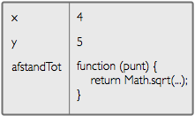
Objects:
a map of key - values
value can be a number, string, object, function

Slide 11
ways to create objects
literal
var location = {
x: 3,
y: 4,
distanceTo: function () {
var dx = this.x + this.y;
return Math.sqrt(dx);
}
}
var location = new Object();
location.x = 3;
location.y = 4;
location.distanceTo = function () { … };
new Object()
Notes:
Note use of this

Slide 12
ways to create objects
Literal object syntax – common rookie mistake
do this:
var obj = {
key1: value1,
key2: function () {..},
key3: value3
};
not this:
var obj = {
key1 = value1;
function key2(){..};
key3 = value3;
};
Notes:
key <colon> value <comma>
last key-value no comma

Slide 13
read
console.log(location.x);
console.log(location[‘x’];
iterate
for (var key in location) {
console.log(location[key]);
}
add
location.z = 1;
location[‘z’] = 1;
modify
location.x = 43;
location[‘x’] = 43;
delete
delete location.z;
delete location[‘zumba’];

Slide 14
function
function aFunction(name) {
console.log("Hello, " + name);
}
function literals
var aFunction = function(name) {
console.log("Hello, " + name);
}
Both definitions are equivalent!
Notes:
Note that functions are just values you can assign to variables
Question to ask:
is overloading possible?

Slide 15
function arguments:
function wow() {
console.log(arguments[1]);
}
wow("jos", "lowie"); // prints "lowie"

Slide 16
creating an object using a function
function createPoint(x,y) {
return {
x: x,
y: y,
distanceTo: function (otherPoint) {
return Math.sqrt(...);
}
};
}
Notes:
Easy way of creating objects that have something in common (in this case the distanceTo function)

Slide 17
Array
var arr = ["a", "b", "c"];
Iterate
x.forEach(function(i) {
console.log(i);
});
for(var i = 0; i < ...)

Slide 18
Array utility functions
arr.length
arr.push, pop
arr.splice, slice
arr.shift, unshift
arr.sort
arr.filter, arr.map
...
See API:
https://developer.mozilla.org/en/JavaScript/Reference/Global_Objects/Array

Slide 19
An array is just an object
var objArr = {
0: “dog”,
1: “cat”
};
var arr = [ “dog”, “cat” ];
Question: what does the following do?
for(a in arr){console.log(a)};
Notes:
In firebug laten zien, nulde index uithalen -> ook al firebug zever uitleggen

Slide 20



Lab 1
Notes:
Firebug volledig uitleggen:
debugging + console + local stack
syntax errors: klikken op rood onderaan rechts + in console tracen
DOM tab: window scope inspecten
evalueren van expressies: CTRL+ENTER

Slide 21
Prototypal inheritance
Notes:
Jan

Slide 22
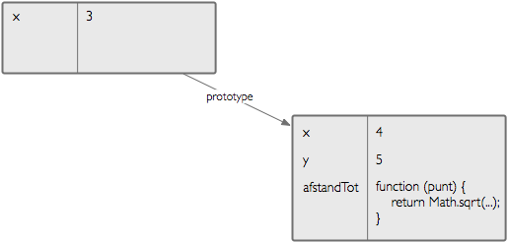
prototypes
location
myObject
object refers to another object (prototype)

Slide 23
looking for a property
location
first look in object
myObject

Slide 24
looking for a property
location
myObject
location.x

Slide 25
looking for a property
location
myObject
if nothing found,
look in prototype

Slide 26
looking for a property
location
myObject
location.y

Slide 27
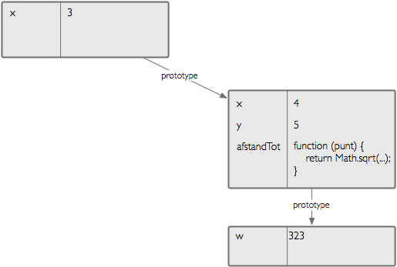
looking for a property
location
myObject
anotherObj
if nothing found look further in prototype chain

Slide 28
looking for a property
location
myObject
anotherObj
location.w

Slide 29
modifications
location
myObject
always in object

Slide 30

modifications
location
myObject
location.x = 4;

Slide 31
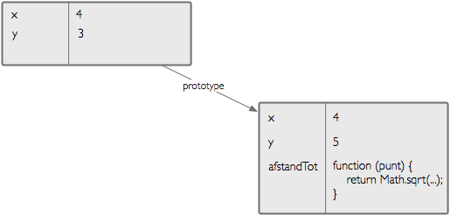
add
location
myObject
location.y = 3;

Slide 32
delete
location
myObject
delete location.y

Slide 33
How is this different from class inheritance? (like in Java)
classes don’t typically change at runtime
difference between inheriting methods and fields
difference between instance of class and class

Slide 34
Object.create
var point = {
distanceTo: function(otherPoint) {
return Math.sqrt(...);
}
};
var point1 = Object.create(point);
point1.x = 3;
point1.y = 4;
var point2 = Object.create(point);
Notes:
Teken een schema op bord

Slide 35
prototype is an object – so can be changed
var proto = {
wow: “wow man!”
};
var obj = Object.create(proto);
console.log(obj.wow);
proto.wow = “mind is blown”;
console.log(obj.wow);

Slide 36
prototype is an object – so can be changed
changing internal objects
Array.prototype.addFirstTwo = function () {
return this[0] + this[1];
}
[1,2].addFirstTwo();

Slide 37
Changing internal objects
advantages?
dangers?
when to use?
Notes:
interesting for making sure IE<9 implements standards
For example: IE<9 doesn’t implement Object.create or [abc

Slide 38
Lab 2

Slide 39
Closures
Notes:
Nog altijd Jan… (geeuw)

Slide 40
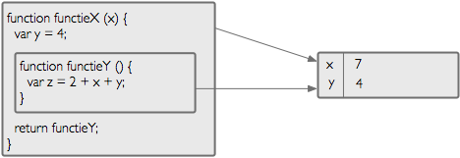
closure:
“a function that retains the environment in which it is created"
we define a function inside a function and return it

Slide 41

closure:
“a function that retains the environment in which it is created"
functieX(7)
when functieX is called, functieY will be created

Slide 42
closure:
“a function that retains the environment in which it is created"
functieX(7)
when a function is called, an environment is created which contains local variables and parameters

Slide 43
closure:
“a function that retains the environment in which it is created"
functieX(7)
when functieY is created and returned, it retains the environment in which it is created

Slide 44
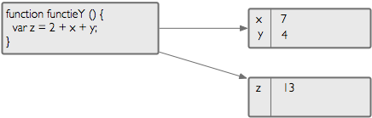
closure:
“a function that retains the environment in which it is created"
functieY()
when functieY is called, a new environment is created for the local variables and parameters
when looking for a variable, it will first look in this new environment, next it will look in the environment it has retained

Slide 45
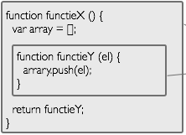



functieX()
when calling a function, the retained environment can be changed
functieY(3)
functieY(4)
Notes:
Closures kunnen omgeving ook aanpassen

Slide 46
every time you call a function, a new environment is created
functieX()
functieX()
Notes:
Closures kunnen omgeving ook aanpassen

Slide 47
example
var firstFunctionY = functieX();
firstFunction(3);
firstFunction(4); // array is [3, 4]
var secondFunctionY = functieX();
secondFunctionY(10); // array is [10]

Slide 48
Lab 3

Slide 49
Scope
Notes:
Wouter

Slide 50
So for how long is an environment used? or differently put:
For how long is the scope of a variable valid?

Slide 51
JavaScript does not have block level scope
... it does have function level scope

Slide 52
Java – block level scope
public void test() {
if (1 == 1) {
int x = 4;
}
System.out.println(x); //error
}
JavaScript – function level scope
function test() {
if (1 === 1) {
var x = 4;
}
console.log(x); // prints 4
}

Slide 53
var a = 3;
function f() {
console.log(a);
var a = 5;
}
hoisting: local variables automatically pulled up
var a = 3;
function f() {
var a;
console.log(a); //prints undefined not 3
a = 5;
}

Slide 54
best practice: define variables at start of function:
function a() {
var a, b, c, ...;
...
a = 5;
}
This makes it clearer what’s going on.
JSLint will give a warning if you don’t do this.

Slide 55
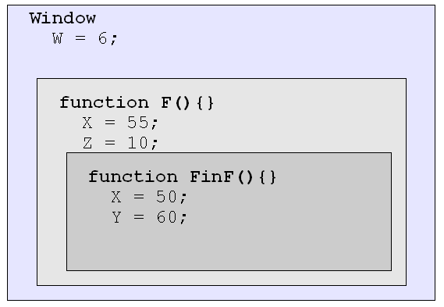
Scope chaining: toplevel scope = window!
w = 6; // same as ‘window.w = 6;’
// same as ‘var w = 6;’
function F() {
var X = 55;
var Z = 10;
function FinF(){
var X = 50;
var Y = 60;
}
}

Slide 56
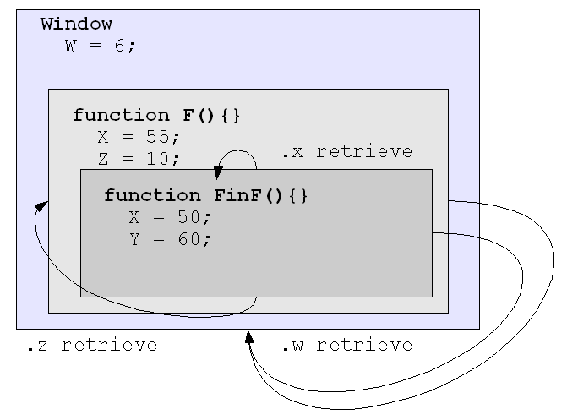
Scope chaining

Slide 57
Encapsulation

Slide 58
Remember closures?
an environment is “private”
we can use this to encapsulate variables

Slide 59
Private variables for an object
the environment will contain the “private” fields
function createPerson() {
var name = 'Jos';
return {
getName: function() {
return name;
},
setName: function(x) {
name = x;
}
};
}
name
“Jos”

Slide 60
Private variables for an object
function createPerson() {
var name = 'Jos';
return {
getName: function() {
return name;
}
};
}
var persoon = createPersoon();
persoon.getName(); // === “Jos”
persoon.naam // === undefined

Slide 61
I heard you like closures
… so I put a closure in a closure
function moduleCreator() {
function createPerson() {
var name = 'Jos';
return {
getName: function() {…}
};
}
function createDog() {…}
return {
createPerson: createPerson
}
}
var MOD = moduleCreator();
var person = MOD.createPerson();
createDog is not exposed

Slide 62
Avoid creating multiple modules that are the same
var MOD1 = moduleCreator();
var MOD2 = moduleCreator();
Define and immediately evaluate a function
(function(){})();
Notes:
Demo eval functie

Slide 63
Module pattern:
var MOD = (function(){
function createPerson(name) {
return {
getName: function() {
return name;
}
};
}
function createDog() {}
return {
createPersoon: createPersoon
};
})();

Slide 64
When do I create a module?
Avoid pollution of global namespace
Duplication
Plugin, framework, ...
Reuse (component-based)
When should I not create a module?
Code that is used only once on a single page
Not a lot of code, not a lot of pollution
Keep it simple!

Slide 65
function emulateBlockLevelScope() {
var a = 5;
if(a === 5) {
(function () {
var b = 555;
})();
}
console.log(b);
}

Slide 66
Context in functions
Notes:
Jan

Slide 67
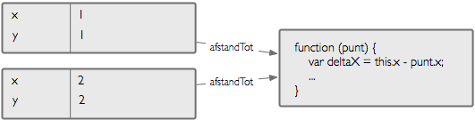
function standaloneDistanceTo(otherPoint) {
return this.x + this.y;
}
var point1 = {
x: 1,
y: 1,
distanceTo: standaloneDistanceTo
}
var point2 = {
x: 2,
y: 2,
distanceTo: standaloneDistanceTo
}
what does this refer to?

Slide 68
this is determined when calling function
point1.distanceTo(point2)
this = point1
point2.distanceTo(point1)
this = point2
standaloneDistanceTo(punt1)
this = window (global object in JavaScript)
this can be explicitly passed when calling a function
standaloneDistanceTo.apply(point1, [point2]);
standaloneDistanceTo.call(point1, point2);
this = punt1

Slide 69
using this in callbacks
var person = {
name: "jos",
shout: function() {
alert(“hey, ” + this.name);
}
}
setTimeout(person.shout, 1000);
why doesn’t it work?

Slide 70
look at it from the point of view of setTimeout
function setTimeout(myCallback,millis) {
//wait for millis
myCallback();
}
this will be bound to window object because
myCallback is called as a standalone function.
how do we fix this?

Slide 71
change setTimeout?
function setTimeout(myCallback,millis, context) {
//wait for millis
myCallback.call(context);
}
setTimeout(person.shout, 1000, person);

Slide 72
use a closure:
var person = {
name: "jos",
shout: function() {
alert(“hey,” + this.name);
}
}
setTimeout(function() {
person.shout()
}, 1000);

Slide 73
use bind method on Function:
var person = {
name: "jos",
shout: function() {
alert(“hey, ” + this.name);
}
}
setTimeout(person.shout.bind(person), 1000);

Slide 74
Lab 4

Slide 75
Using the new operator
Notes:
Jan

Slide 76
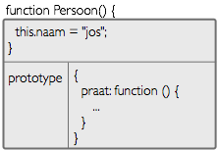
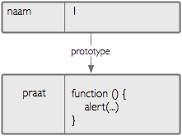
new operator: constructor functions
new
var jos = new Person()
is the same as
var jos = Object.create(Person.prototype);
Persoon.call(jos);

Slide 77
new operator: constructor functions
function Person() {
this.name = “jos”;
// no return statement
}
Person.prototype.talk = function () {...}
var jos = new Person();
jos.name === “jos";
jos.talk();
Notes:
Teken op bord een diagramma van jos

Slide 78
instanceof
var jos = new Person();
jos instanceof Person === true;
// is same as:
Person.prototype.isPrototypeOf(jos)

Slide 79
Warning: it might look like class-based inheritance, but it is still prototypal inheritance
That’s why we prefer Object.create over new.
It makes is clear that JavaScript uses prototypal inheritance

Slide 80
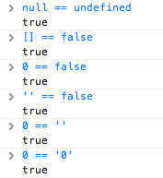
Why do we constantly use === instead of == ?
== (equality operator) and != tries to cast both sides to the same type
confusing!
=== (identity operator) and !== doesn’t try to cast to the same type.
Notes:
JSLint will give a warning about this

Slide 81

ECMAScript ?
ECMA
= European Computer Manufacturers Association
= standarisation
Modern browsers implement EcmaScript 5 = Javascript
For IE<9 use ES5 shim: https://github.com/kriskowal/es5-shim
Notes:
This includes Internet Explorer starting from version 9
Otherwise use a shim: implements standarised ES5 apis such as forEach, Object.create,…

Slide 82
Conclusion

Slide 83
How JS was used!!
<script>
function oei() {
doStuff();
i = 10;
copyPasta(this.i, 20);
}
function copypasta(i, j) {
alert(new Date(i).getTime());
return j;
}
</script>
<a onclick=“oei();”>lala</a>
room for improvement?

Slide 84
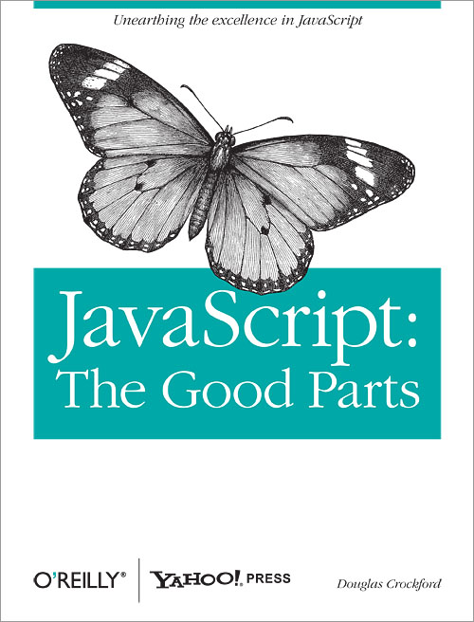
I want MORE!!
http://www.jefklak.be/wiki/code/javascript/home
Notes:
en een advanced cursus die vooral over GUI/DOM gaat

