Slide 1
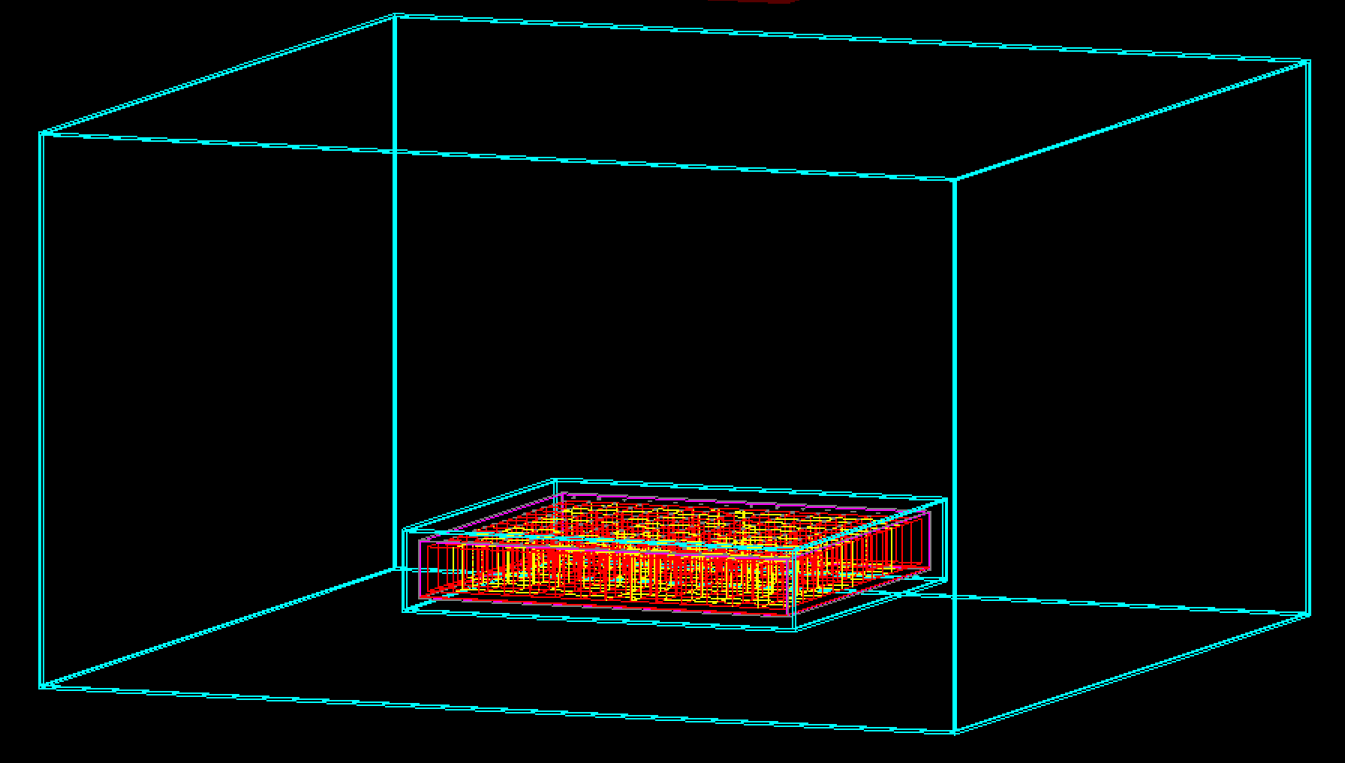
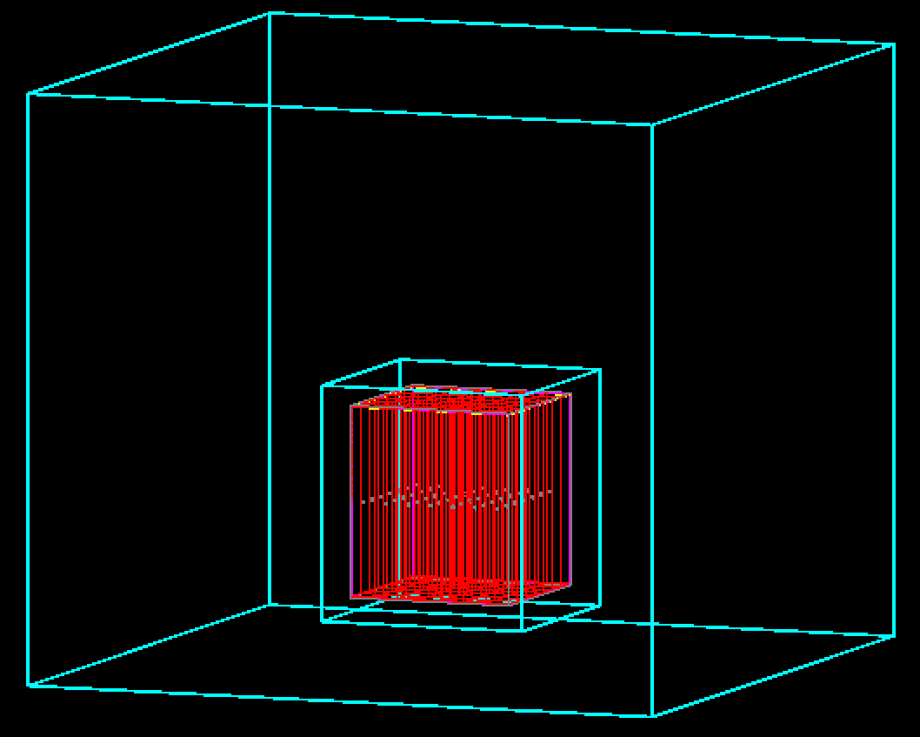
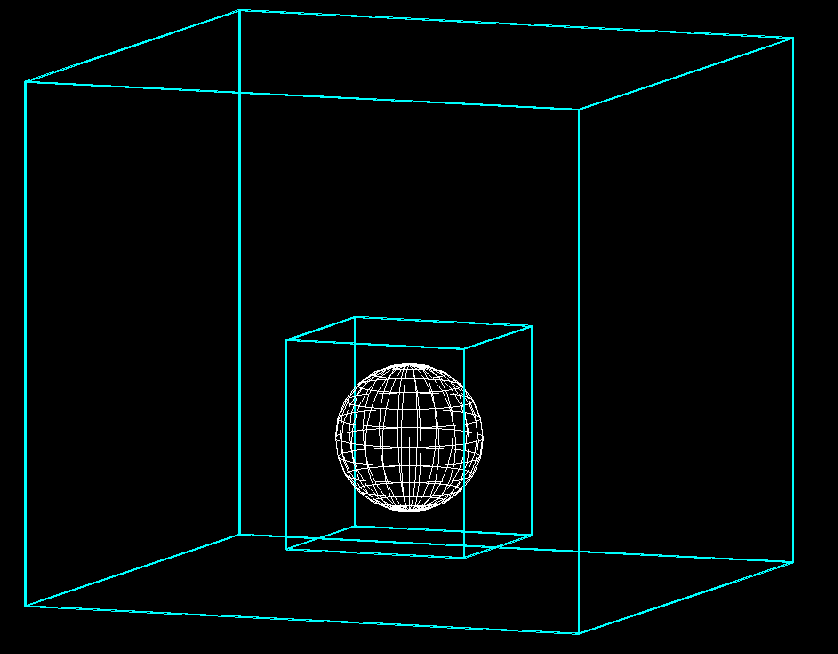
GramsG4 is fairly generic. I tried to omit as much detector- and physics-specific code as I could. It’s mostly controlled via external inputs.
GDML file
geometry, material properties
XML file
I/O, processing, physics
G4 macro file
primary particles, visualization
GramsSky
Command-line options
Optional
GramsG4
ROOT objects
Tracks
Hits (LAr and Scintillator)
Options
Geometry

