Slide 1
Progressive Web App

Slide 2
Agenda

Slide 3
Progressive Web Application
Type of Application
Delivered Through the Web
Using Web Technologies
Working on Any Platform
Supported by Google
Supported by Microsoft
Supported by Mobile Browsers
Available in Google Play Store
Available in Microsoft Store

Slide 4
PWA Characteristics
Progressive
Discoverable
App-Like
Conectivity-Independent
Installable
Fresh

Slide 5

PWA Introduction
https://youtu.be/fuhAmUpEEHA

Slide 6
PWA Training
https://youtu.be/DfFlBWCQjzA

Slide 7
PWA Example
https://youtu.be/UVcPyiRLcgU

Slide 8
PWA Requirements
PWA
Secure Connection HTTPS
Manifest File
Icons
Service Worker

Slide 9
Main App File
<!doctype html> <html lang="en"> <head> <meta charset="utf-8"> <title>Hello World</title> <meta name="viewport" content="width=device-width, initial-scale=1.0"> </head> <body> <div> <h1>Hello World!</h1> </div> </body> </html>

Slide 10
Web App Manifest
Nazwa aplikacji
Ikony aplikacji
URL do uruchomienia aplikacji
Domyślna orientacja okna aplikacji
Tryb wyświetlania

Slide 11
Manifest File Example
{ "short_name": "Hello", "name": "Hello World", "description": "My First PWA", "icons": [ { "src": "icons-192.png", "type": "image/png", "sizes": "192x192" }, { "src": "icons-512.png", "type": "image/png", "sizes": "512x512" } ], "start_url": "/index.html", "background_color": "white", "display": "standalone", "scope": "/", "theme_color": "white" }

Slide 12
Adding Manifest to App HTML Files
<link rel="manifest" href="manifest.json">

Slide 13
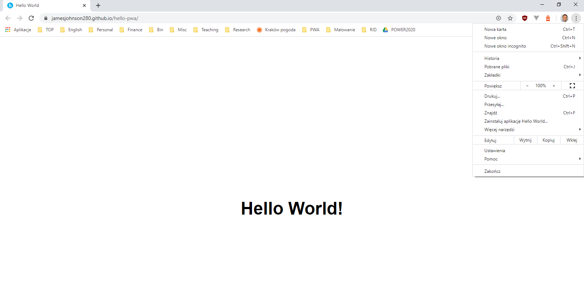
PWA Installation

Slide 14
PWA Examples
https://airly.eu/map/pl/
https://jamesjohnson280.github.io/hello-pwa/
https://github.com/jamesjohnson280/hello-pwa

Slide 15
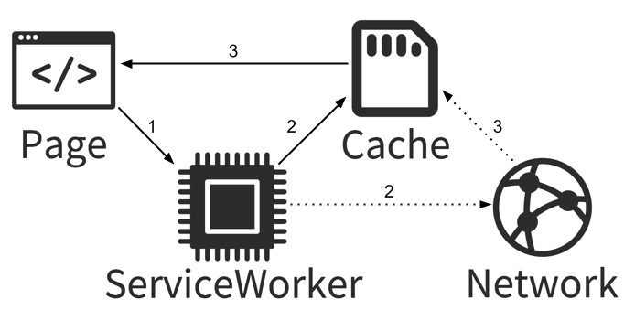
Service Worker
Offline first / Cache first
Virtual proxy between browser and network
Run on a separated thread
No access to DOM

Slide 16
Service Worker Registration
if ('serviceWorker' in navigator) { // Register a service worker hosted at the root of the // site using the default scope. navigator.serviceWorker.register('/sw.js').then(function(registration) { console.log('Service worker registration succeeded:', registration); }, /*catch*/ function(error) { console.log('Service worker registration failed:', error); }); } else { console.log('Service workers are not supported.'); }

Slide 17
Service Worker Registration
window.addEventListener('load', () => { if (!('serviceWorker' in navigator)) { // service workers not supported return } navigator.serviceWorker.register('/sw.js').then( () => { // registered! }, err => { console.error('SW registration failed!, err) } ) })
https://developer.mozilla.org/en-US/docs/Web/API/ServiceWorkerContainer/register

Slide 18
SW Events
INSTALL - is sent when the service worker is being installed.
ACTIVATE - is sent when the service worker has been registered and installed. This place is where you can clean up anything related to the older version of the service worker if it’s been updated.
FETCH - is sent whenever a page of your site requires a network resource. It can be a new page, a JSON API, an image, a CSS file, whatever.
SYNC - is sent if the browser previously detected that the connection was unavailable, and now signals the service worker that the internet connection is working.
PUSH - is invoked by the Push API when a new push event is received.

Slide 19
Serving Cached Resources
self.addEventListener('install', event => { event.waitUntil( caches .open('my-site-name') .then(cache => cache.addAll([ 'favicon.ico', 'style.css', 'script.js' ]) ) ) })

Slide 20
Fetching a cached resource
self.addEventListener('fetch', event => { event.respondWith( caches.match(event.request).then(response => { if (response) { //we found an entry in the cache! return response } return fetch(event.request) }) ) })

Slide 21
Introduction to Service Workers
https://youtu.be/jVfXiv03y5c

Slide 22
PWA From Scratch
https://www.freecodecamp.org/news/build-a-pwa-from-scratch-with-html-css-and-javascript/

Slide 23
PWA Builder
https://www.pwabuilder.com/

