Slide 1

2806 Neural Computation
Temporal Processing Lecture 11
2005 Ari Visa

Slide 2
Agenda
Some historical notes
Some theory
Some network architecture
Conclusions

Slide 3
Some Historical Notes
z-transform
A single neuron -> an adaptive filter
Widrow & Hoff (1960): least-mean square algorithm (LMS) = delta rule
The need for temporal processing arises in numerous applications [prediction modeling (Box & Jenkins, 1976), noise cancellation (Widrow and Stearns, 1985), adaptive equalization (Proakis, 1989), adaptive control (Narendra & Annaswamy, 1989), system identification (Ljung, 1987)]

Slide 4
Some Theory
How do we build time into the operation of a neural network?
Implicit representation The temporal structure of the input signal is embedded in the spatial structure of the network.
Explicit representation
Time is given its own particular representation.
For a neural network to be dynamic, it must be given memory.
Memory may be divided into short-term and long-term.
Long-term memory = neural network
Short-term memory = time delays

Slide 5
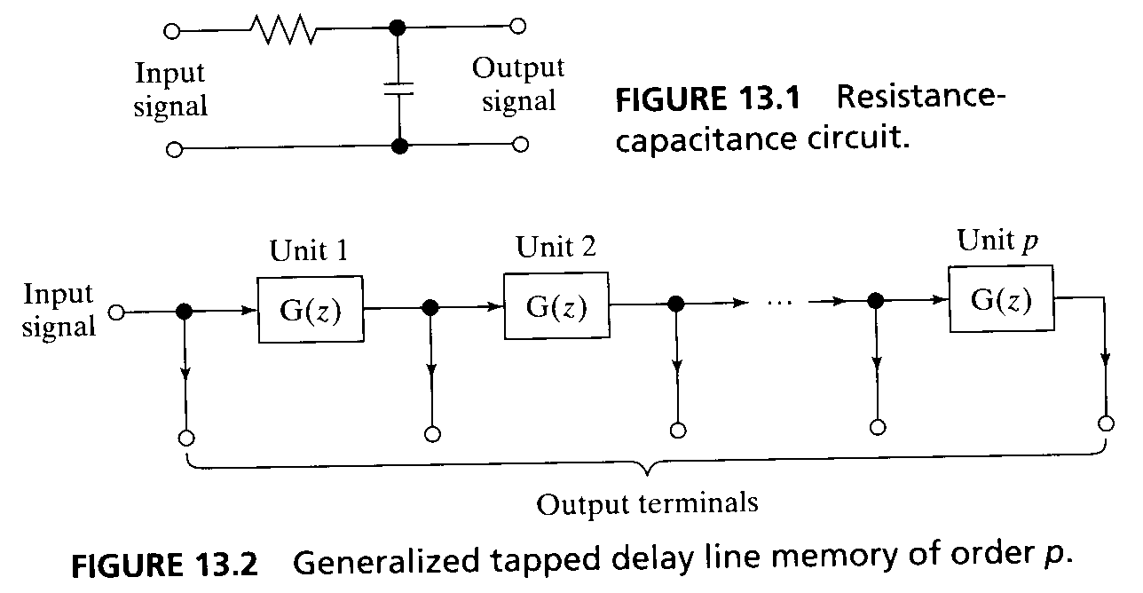
Some Theory
Short-time memory can be implemented in continuous time or in discrete time.
z-transform, z⁻¹ is the unit delay operator.
We may define a discrete-time memory as a linear time invariant, single input-multiple output system (causal, normalized).
The junction points, to which the output terminals of the memory are connexted, are commonly called taps.

Slide 6
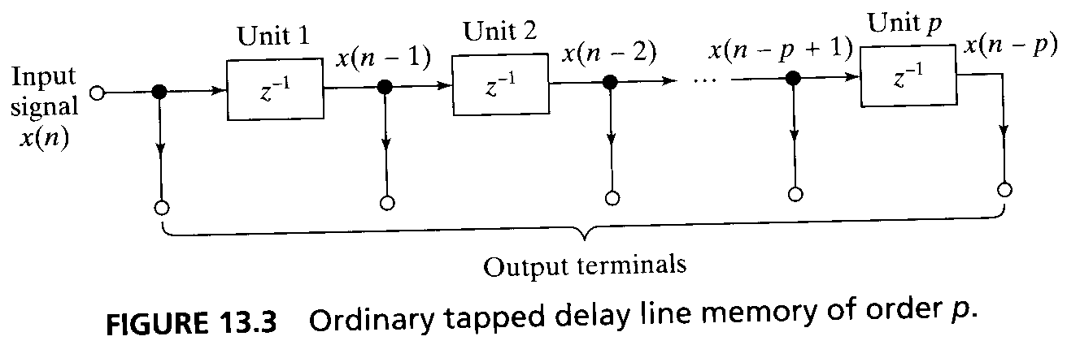
Some Theory
Memory depth is defined as the first time moment of g_{p}(n) (generating kernel).
Memory resolution is defined as the number of taps in the memory structure per unit time.
Most commonly used form of short-time memory is called a tapped delay line memory.
It consists of p unit delay operators. The generating kernel is g(n) = δ(n-1), where δ(n) is the unit impulse.

Slide 7
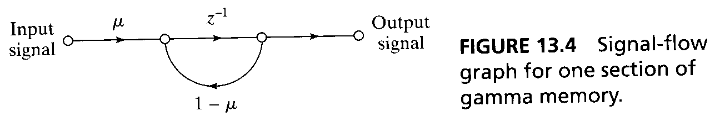
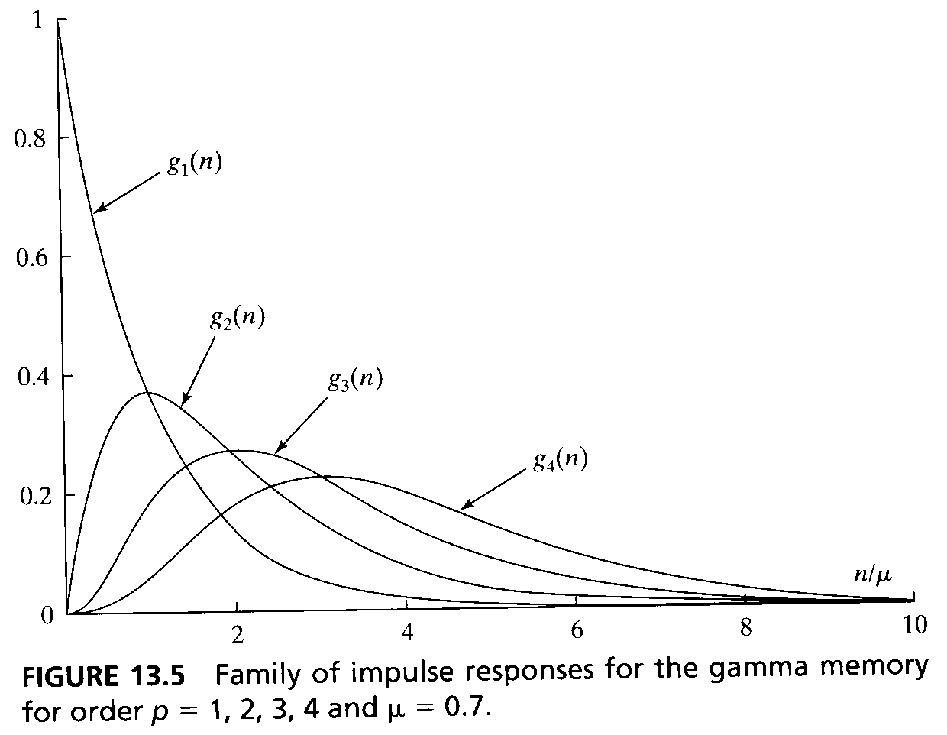
Some Theory
Gamma memory, each section of this memory structure consists of a feedback loop with unit delay and adjustable parameter μ.
g(n) = μ(1-μ)^{n-1}, 0< μ<2, n≥1
g_{p}(n) represents a discrete version of the integrand of the gamma function.

Slide 8
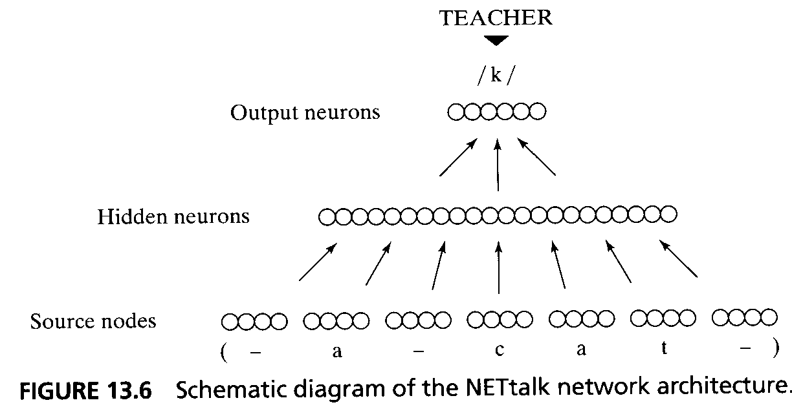
Some Network Architectures
NETtalk (Sejnowski and Rosenberg, 1987) was the first demonstration of a massively parallel distributed network that converts English speech to phonemes.
NETtalk was based on a multilayer perceptron with an input layer of 203 sensory nodes, a hidden layer of 80 neurons, and an output layer of 26 neurons. All the neurons used sigmoid activation functions. The synaptic connections in the network were specified by a total of 18629 weights. The standard back-propagation algorithm was used to train the network.

Slide 9
Some Network Architectures
The network had seven groups of nodes in the input layer, with each group encoding one letter of the input text. Strings of seven letters were thus presented to the input layer at any one time. The desired response for the training process was specified as the correct phoneme associated with the center letter in the seven-letter window.
The text was stepped through the window on a letter-by-letter basis.
The performance of NETtalk exhibited some similarities with observed human performance, but did not lead to practical applications.

Slide 10
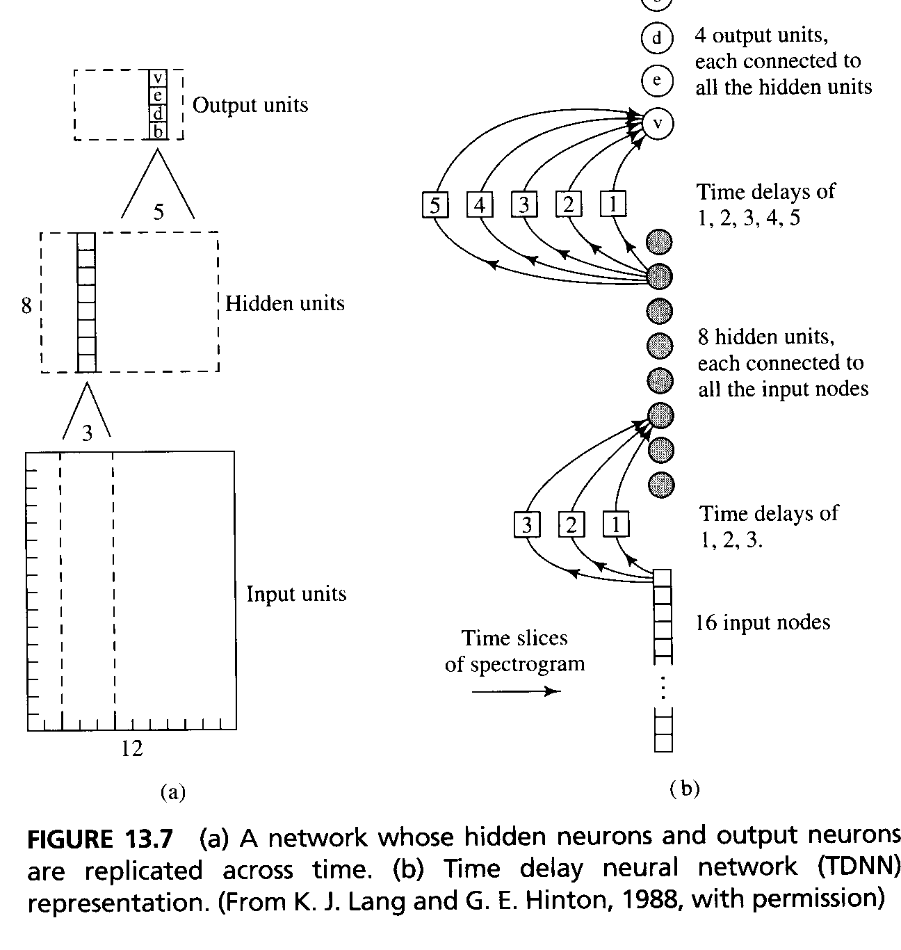
Some Network Architectures
Time-delay neural network(TDNN) (Lang and Hinton, 1988) is a multilayer feedforward network
The TDNN is a multilayer feedforward network whose hidden neurons and output neurons are replicated across time. It was devised to capture explicitly the concept of time symmetry as encountered in the recognition of isolated word (phoneme) using a spectrogram.

Slide 11
Some Network Architectures
The input layer consists of 192 (16 by 12) sensory nodes encoding the spectrogram, the hidden layer contains 10 copies of 8 hidden neurons; and the output layer contains 6 copies of 4 output neurons.
The various replicas of a hidden neuron apply the same set of synaptic weights to narrow (three-time-step) windows of the spectrogram; similarly, the various replicas of an output neuron apply the same set of synaptic weights to narrow (five-time-step) windows of the pseudospectrogram computed by hidden layer.
The network has a total of 544 synaptic weights.
Many hybrids of TDNN and HMM have been studied in the literature.

Slide 12
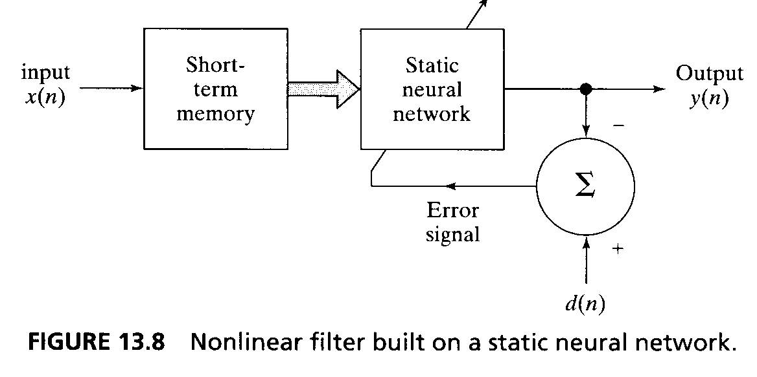
Some Network Architectures
Focused time lagged feedforward networks.
Temporal pattern recognition requires processing of patterns that evolve over time, with the response at a particular instant of time depending not only on the present value of the input but also on its past values.
A nonlinear filter can be built on a static neural network. The network is stimulated through a short-term memory.

Slide 13
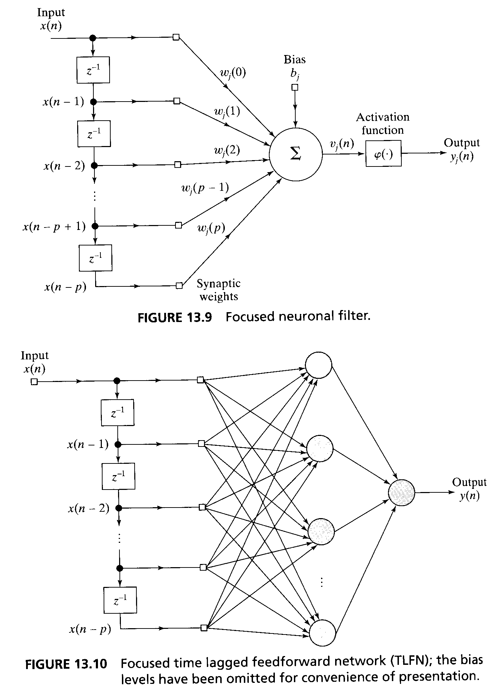
Some Network Architectures
The represented structure can be implemented at the level of a single neuron or a network of neurons.
The processing unit of Fig. 13.9 is called a focused neuronal filter, focused in the sense that the entirely memory structure is located at the input end of the unit. The output of the filter, in response to the input x(n) and its past values x(n-1),...,x(n-p), is given by y_{j}(n) = φ (Σ^{p}_{l=0}w_{j}(l) x(n-l) + b_{j} ) where φ(.) is the activation function of neuron j. the w_{j}(l) are its synaptic weights, and b_{j} is the bias.
A focused time lagged feedforward network (TLFN) of Fig. 13.10 is a more powerful nonlinear filter consisting of a tapped delay line memory of order p and a multilayer perceptron.

Slide 14
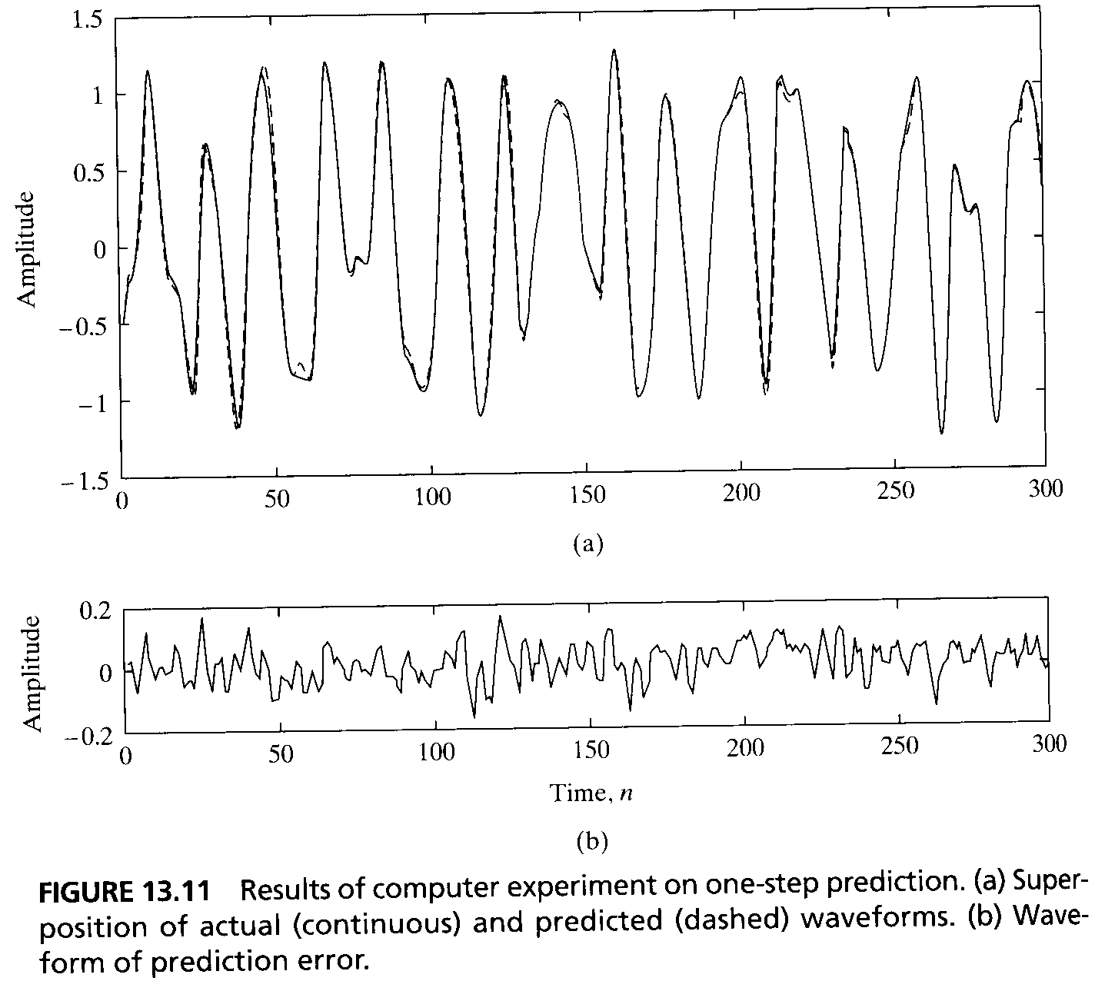
Some Network Architectures
To train the filter the standard back-propagation algorithms can be used.
At time n, the ”temporal pattern” applied to the input layer of the network is the signal vector x(n) = [x(n),x(n-1),...,x(n-p)]^{T} which may be viewed as a description of the state of the nonlinear filter at time n.
An epoch consists of a sequence of states, the number of which is determined by the memory order p and the size N of the training sample.
An example: x(n)= sin(n + sin(n²)) is approximated by the focused TLFN.
p = 20, hidden layer = 10 neurons, the activation function of hidden neurons is logistic, output layer = 1 neuron, activation function of output layer is linear, learning-rate parameter = 0.01, no momentum constant.

Slide 15
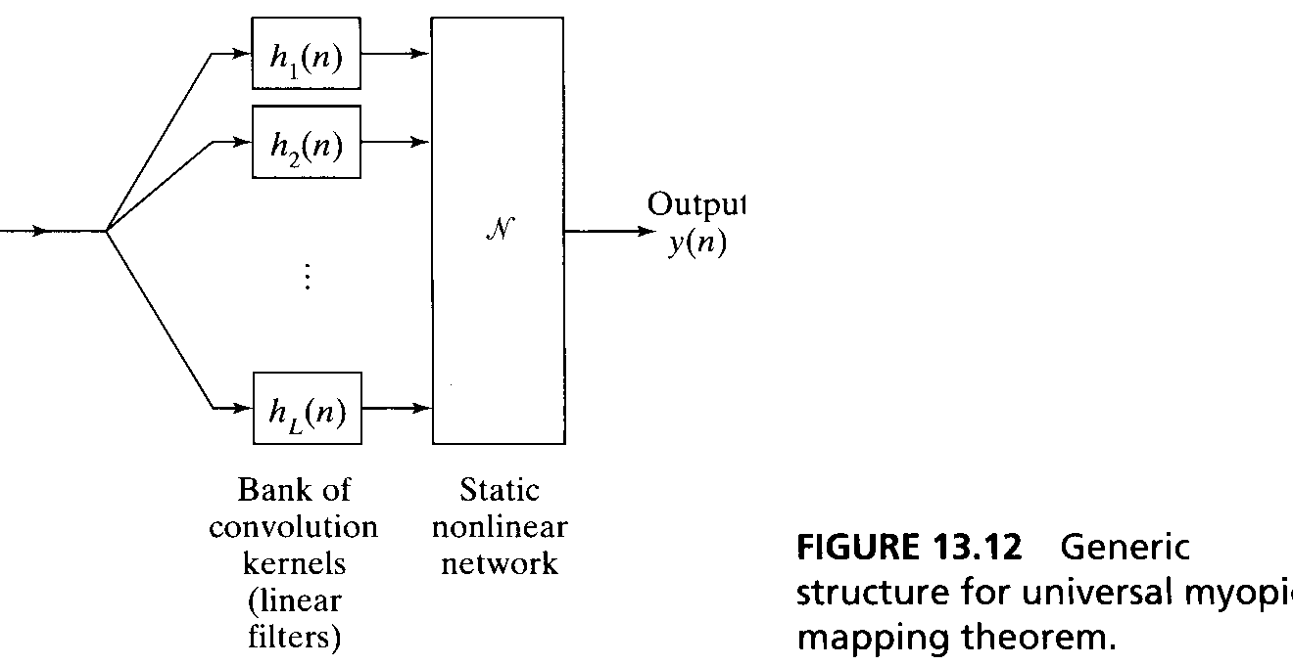
Some Network Architectures
Universal myopic mapping (myopic = uniform fading memory)
The structure of Fig. 13.12. is a universal dynamic mapper. Any shift-invariant myopic map can be uniformly approximated arbitrarily well by a structure consisting of two functional blocks: a bank of linear filters feeding a static neural network.
The structure is inherently stable, provided that the linear filters are themselves stable.

Slide 16
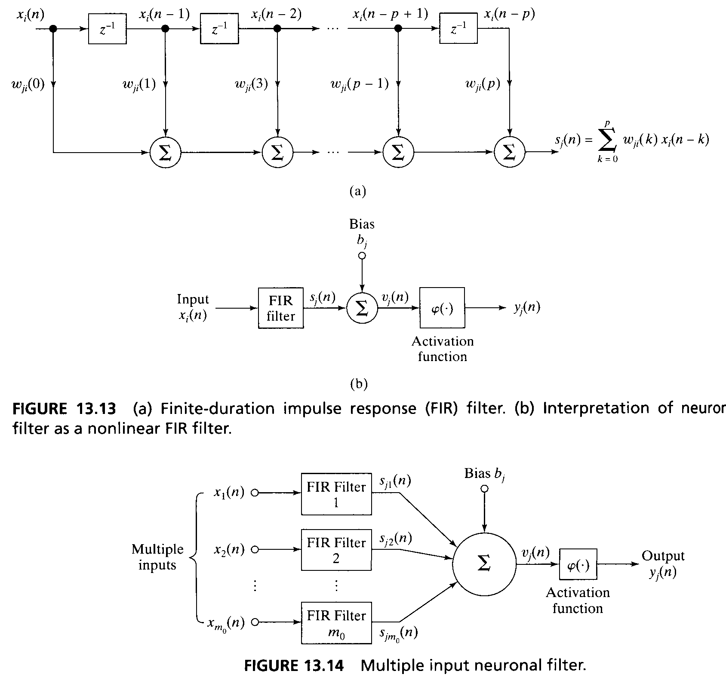
Some Network Architectures
The focused neuronal filter has an interesting interpretation. The combination of unit delay elements and associated synaptic weights may be viewed as a finite-duration impulse response filter (FIR) of order p.
The spatio-temporal model of Fig. 13.14. is referred to as a multiple input neuronal filter. It can also be considered as a distributed neuronal filter, in the sense that the filtering action is distributed across different points in space.

Slide 17
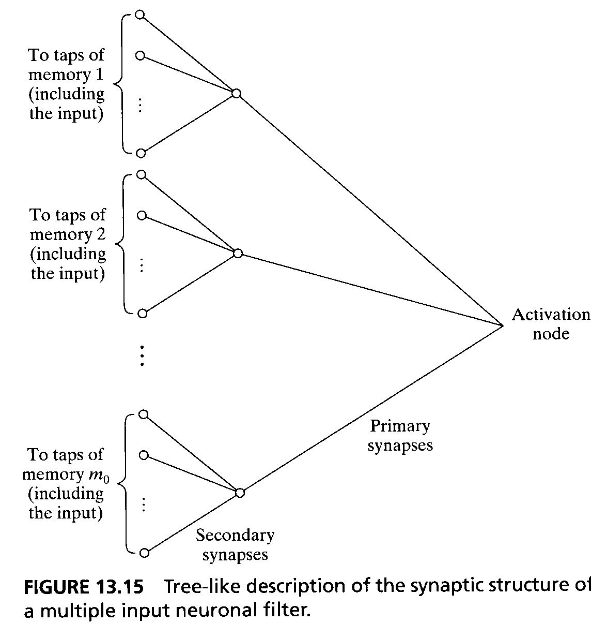
Some Network Architectures
The synaptic structure of the neuronal filter in fig. 13.14 is also a tree-like structure.
The total number of synaptic weights in the structure is m₀(p+1).

Slide 18
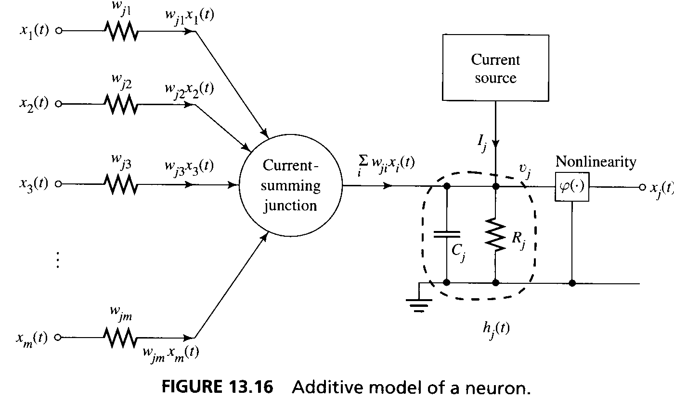
Some Network Architectures
The neuron can also represented by the additive model. It is a common hardware-oriented way to model a neuron. It is also a continuous time model.

Slide 19
Some Network Architectures
The univeral myopic mapping algorithm, which provides the mathematical justification for focused TLFNs, is limited to maps that are shift invariant.→the use of focused TLFNs is suitable for use in stationary environments. →
Distributed time lagged feedforward networks, distributed in the sense that the implicit influence of time is distributed throughout the network. the construction of such a network is based on the multiple input neuronal filter of Fif. 13.14 as the spatio-temporal model of a neuron.
Let w_{ji}(l) denote the weight connected to the lth tap of the FIR filter modeling the synapse that connects the output of neuron i to neuron j. The index l ranges from 0 to p, where p is the order of the FIR filter. According to this model, the signal s_{ji}(n) appearing at the output of the ith synapse of neuron j is given by the convolution sum.

Slide 20
Some Network Architectures
s_{ji}(n) = Σ^{p}_{l=0}w_{ji}(l)x_{i}(l-1) where n denotes discrete time.
It can be rewritten in the matrix form by introducing the following definitions for the state vector and weight vector for synapse i:
x_{i}(n) = [x_{i}(n),x_{i}(n-1),...,x_{i}(n-p)]^{T}
w_{ji} = [w_{ji}(0),w_{ji}(1),...,x_{ji}(p)]^{T}
s_{ji}(n) = w_{ji}^{T} x_{i}(n)
Summing the contributions of the complete set of m₀ synapses depicted in the model:
v_{j}(n) = Σ_{i=1}^{m0} s_{ji} + b_{j} = Σ_{i=1}^{m0} w_{ji}^{T} x_{i}(n) + b_{j}
y_{j}(n) = φ (v_{j}(n) )
where v_{j}(n) denotes the induced local field of neuron j, b_{j} is the externally applied bias, and φ (.) denotes the nonlinear activation function of the neuron.

Slide 21
Some Network Architectures
To train a distributed TLFN network, we need a supervised learning algorithm in which the actual response of each neuron in the output layer is compared with a desired response at each time instant.
We may define an instantaneous value for the sum of squared errors produced by the network : E(n) =½ Σ_{j} e_{j}²(n), where the index j refers to a neuron in the output layer only, and e_{j}(n) is the error signal
e_{j}(n) = d_{j}(n)-y_{j}(n)
The goal is to minimize a cost function defined as the value of E(n) computed over all time
E _{total} = Σ_{n} E(n)

Slide 22
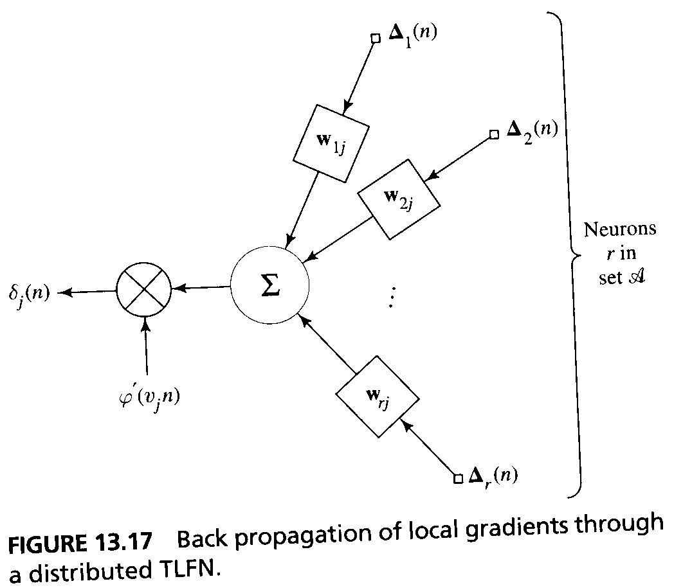
Some Network Architectures
The approach is based on an approximation to the method of deepest descent.
∂E _{total} /∂w_{ji} =∑_{n} ∂E _{total} /∂v_{j}(n) ∂v_{j}(n)/∂w_{ji}
w_{ji}(n+1) = w_{ji}(n) - η∂E _{total}/∂v_{j}(n) ∂v_{j}(n)/∂w_{ji}
→ w_{ji}(n+1) = w_{ji}(n) - η δ_{j}(n)x_{i}(n) where the explicit form of the local gradient δ_{j}(n) depends on wether or not neuron j lies in the output layer or in a hidden layer of the network.
δ_{j}(n) = e_{j}(n) φ’(v_{j}(n)), neuron j in the output layer
δ_{j}(n) = φ’(v_{j}(n))∑_{r∈A}∆^{T} _{r} (n) w_{rj}, neuron j in a hidden layer
a vector generalization of the standard backpropagation algorithm.

Slide 23
Some Network Architectures
The symmetry between the forward propagation of states and the backward propagation of error terms is preserved, and the sense of parallel distributed processing is therby maintained.
Each unique weight of synaptic filter is used only once in the calculation of the δs; there is no redundant use of terms experienced in the instantaneous gradient method.
We may formulate the causal form of the temporal back-propagation algorithm.

Slide 24
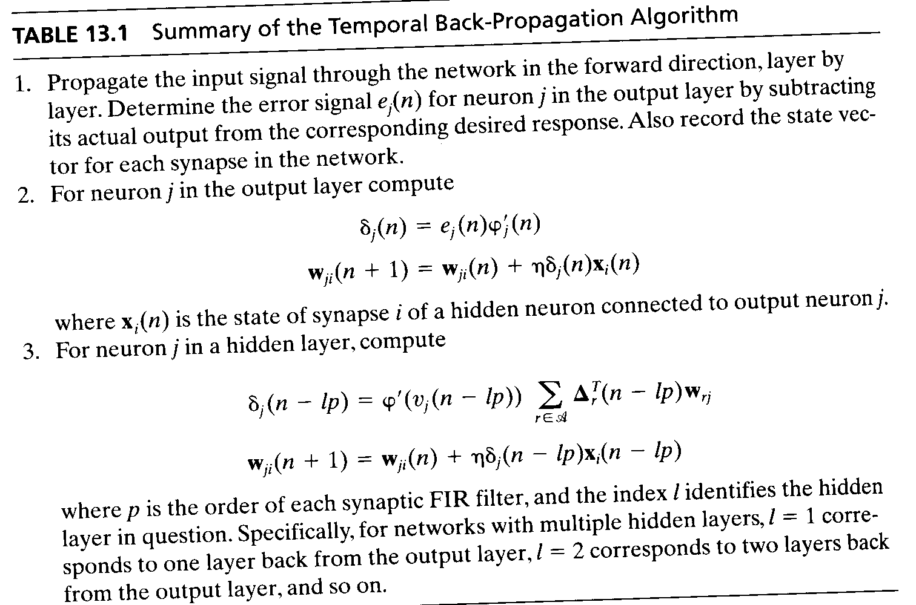
Some Network Architectures

Slide 25
Summary
When the system or physical mechanism is nonlinear, we have a more difficult task.
In the context of neural network, we have two candidate networks for temporal processing
Time lagged feed forward networks (focused, distributed)
Recurrent networks

