Slide 1
Artificial Neurons, Neural Networks and Architectures
Fall 2007
Instructor: Tai-Ye (Jason) Wang
Department of Industrial and Information Management
Institute of Information Management

Slide 2
Neuron Abstraction
Neurons transduce signals—electrical to chemical, and from chemical back again to electrical.
Each synapseis associated with what we call the synaptic efficacy —the efficiency with which a signal is transmitted from the presynaptic to postsynaptic neuron
S

Slide 3
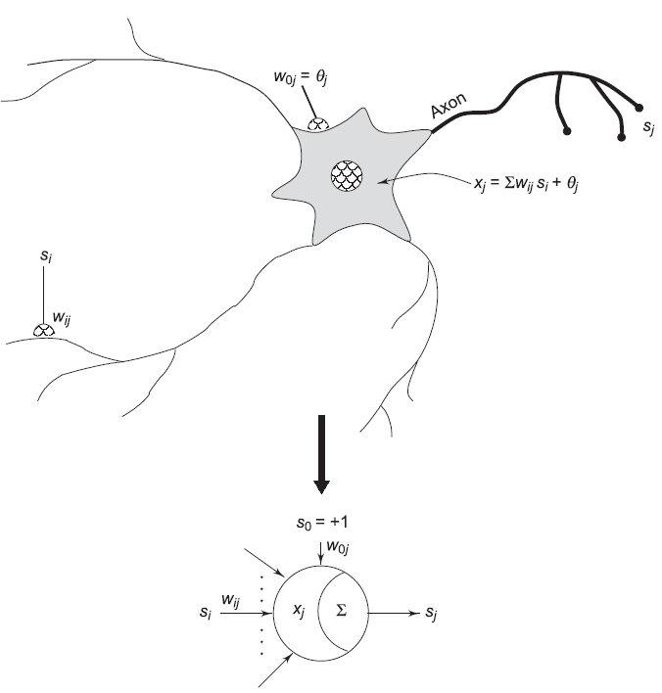
Neuron Abstraction
S

Slide 4
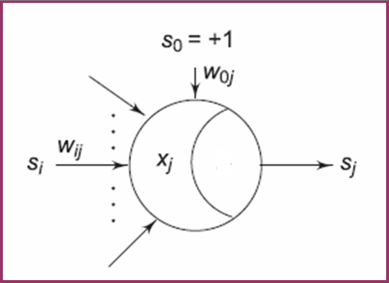
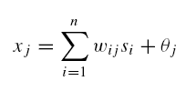
Neuron Abstraction:
Activations and Weights
the j^{th} artificial neuron that receives input signals s_{i} , from possibly n different sources
an internal activation x_{j} which is a linear weighted aggregation of the impinging signals, modified by an internal threshold, θ_{j}
S

Slide 5
Neuron Abstraction:
Activations and Weights
the j ^{th} artificial neuron that connection weights w_{ij} model the synaptic efficacies of various interneuron synapses.
S

Slide 6
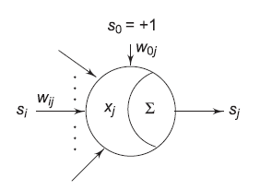
Notation:
w_{ij} denotes the weight from neuron i to neuron j .
S

Slide 7
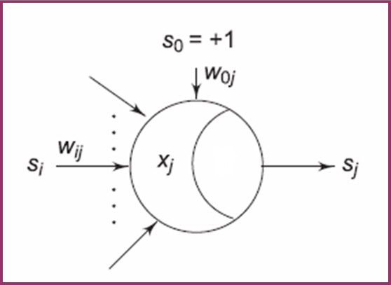
Neuron Abstraction: Signal Function
The activation of the neuron is subsequently transformed through a signal function S(·)
Generates the output signal
s_{j} = S(x_{j} ) of the neuron.
S

Slide 8
Neuron Abstraction: Signal Function
a signal function may typically be
  binary threshold
  linear threshold
  sigmoidal
  Gaussian
  probabilistic.
S

Slide 9
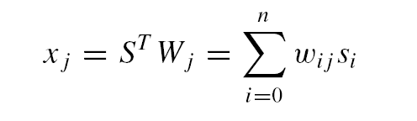
Activations Measure Similarities
The activation x_{j} is simply the binner product of the impinging signal vector
S = (s₀, . . . , s_{n})^{T} , with the neuronal weight vector W_{j} = (w_{0j} , . . . ,w_{nj} )^{T}
Adaptive
Filter

Slide 10
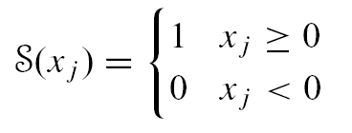
Neuron Signal Functions:
Binary Threshold Signal Function
Net positive activations translate to a +1 signal value
Net negative activations translate to a 0 signal value.

Slide 11
Neuron Signal Functions:
Binary Threshold Signal Function
The threshold logic neuron is a two state machine
  s_{j} = S(x_{j} ) ∈ {0, 1}

Slide 12
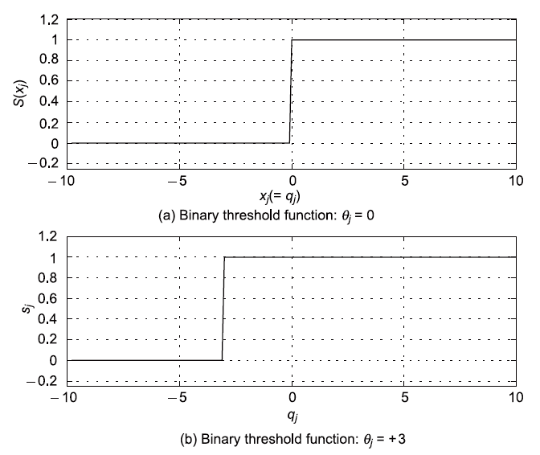
Neuron Signal Functions:
Binary Threshold Signal Function

Slide 13
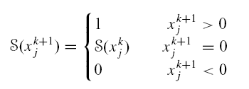

Threshold Logic Neuron (TLN) in Discrete Time
The updated signal value S(x_{j}^{k+1}) at time instant k + 1 is generated from the neuron activation x_{i}^{k+1} , sampled at time instant k + 1.
The response of the threshold logic neuron as a two-state machine can be extended to the bipolar case where the signals are
  s_{j} ∈ {−1, 1}

Slide 14
Threshold Logic Neuron (TLN) in Discrete Time
The resulting signal function is then none other than the signum function, sign(x) commonly encountered in communication theory.

Slide 15
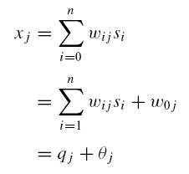
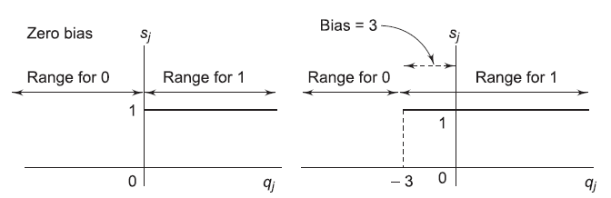
Interpretation of Threshold
From the point of view of the net activation x_{j}
  the signal is +1 if x_{j} = q_{j} + θ_{j} ≥ 0, or q_{j} ≥ −θ_{j} ;
  and is 0 if q_{j} < −θ_{j} .

Slide 16
Interpretation of Threshold
The neuron thus “compares” the net external input q_{j}
  if q_{j} is greater than the negative threshold, it fires +1, otherwise it fires 0.

Slide 17
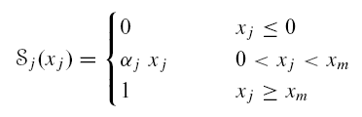
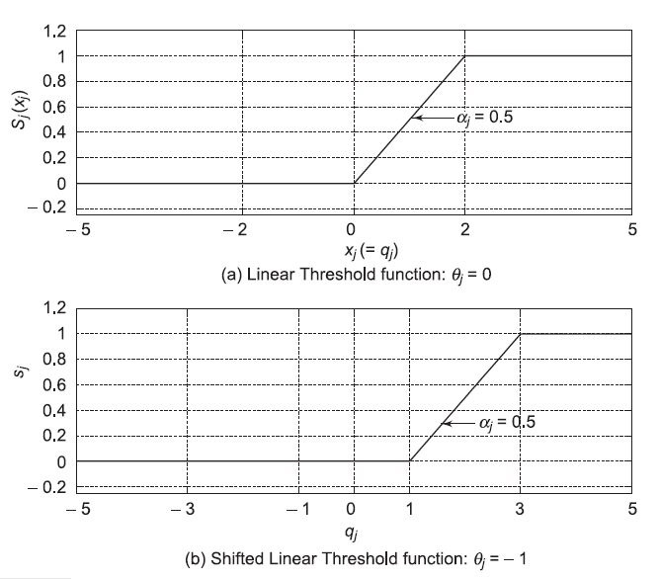
Linear Threshold Signal Function
α_{j} = 1/x_{m} is the slope parameter of the function
Figure plotted for x_{m} = 2 and α_{j} = 0.5. .

Slide 18
Linear Threshold Signal Function
S_{j} (x_{j} ) = max(0, min(α_{j}x_{j} , 1))
Note that in this course we assume that neurons within a network are homogeneous.

Slide 19

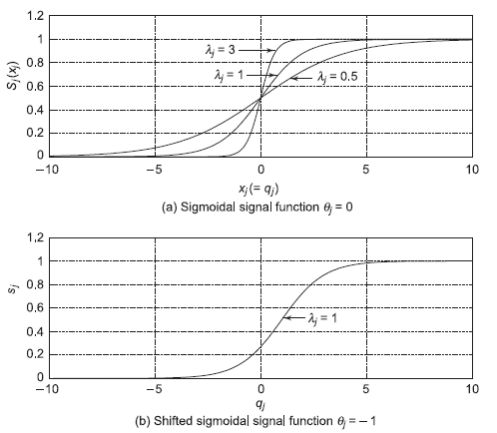
Sigmoidal Signal Function
λ_{j} is a gain scale factor
In the limit, as λ_{j} →∞ the smooth logistic function approaches the non-smooth binary threshold function.

Slide 20
Sigmoidal Signal Function
The sigmoidal signal function has some very useful mathematical properties. It is
  monotonic
  continuous
  bounded

Slide 21

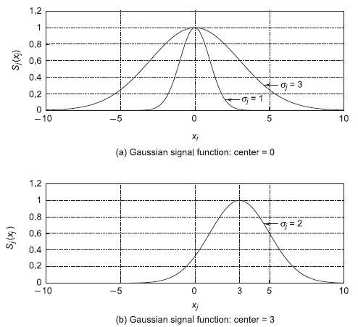
Gaussian Signal Function
σ_{j} is the Gaussian spread factor and c_{j} is the center.
Varying the spread makes the function sharper or more diffuse.

Slide 22
Gaussian Signal Function
Changing the center shifts the function to the right or left along the activation axis
This function is an example of a non-monotonic signal function

Slide 23

Stochastic Neurons
The signal is assumed to be two state
  s_{j} ∈ {0, 1} or {−1, 1}
Neuron switches into these states depending upon a probabilistic function of its activation, P(x_{j} ).

Slide 24
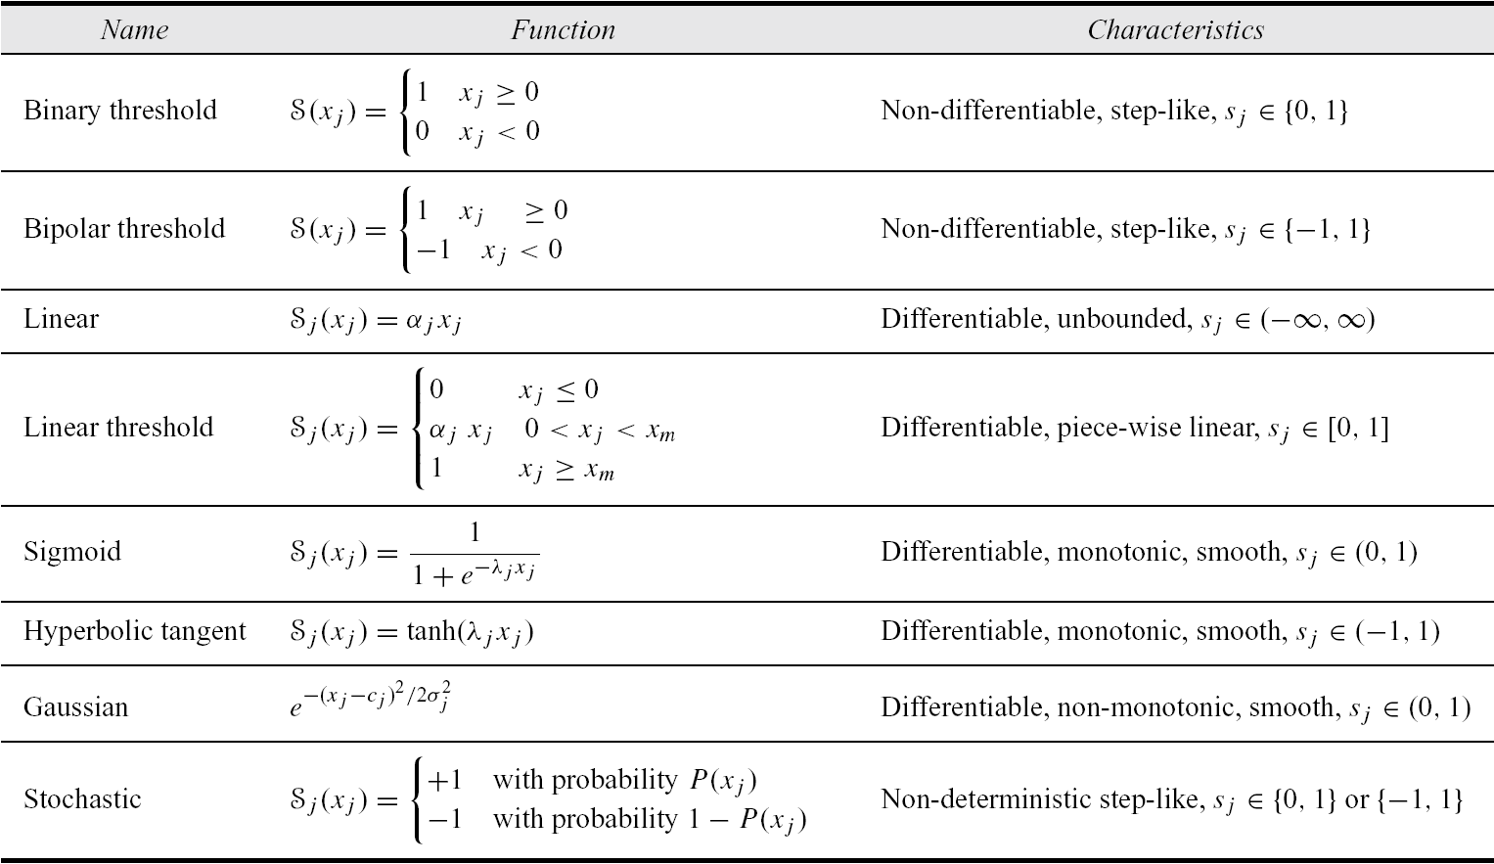
Summary of Signal Functions

Slide 25
Neural Networks Defined
Artificial neural networks are massively parallel adaptive networks of simple nonlinear computing elements called neurons which are intended to abstract and model some of the functionality of the human nervous system in an attempt to partially capture some of its computational strengths.

Slide 26
Eight Components of Neural Networks
Neurons. These can be of three types:
  Input: receive external stimuli
  Hidden: compute intermediate functions
  Output: generate outputs from the network
Activation state vector. This is a vector of the activation level x_{i} of individual neurons in the neural network,
  X = (x₁, . . . , x_{n})^{T} ∈ R^{n}.

Slide 27
Eight Components of Neural Networks
Signal function. A function that generates the output signal of the neuron based on its activation.
Pattern of connectivity. This essentially determines the inter-neuron connection architecture or the graph of the network. Connections which model the inter-neuron synaptic efficacies, can be
  excitatory (+)
  inhibitory (−)
  absent (0).

Slide 28
Eight Components of Neural Networks
Activity aggregation rule. A way of aggregating activity at a neuron, and is usually computed as an inner product of the input vector and the neuron fan-in weight vector.

Slide 29
Eight Components of Neural Networks
Activation rule. A function that determines the new activation level of a neuron on the basis of its current activation and its external inputs.
Learning rule. Provides a means of modifying connection strengths based both on external stimuli and network performance with an aim to improve the latter.

Slide 30
Eight Components of Neural Networks
Environment. The environments within which neural networks can operate could be
  deterministic (noiseless) or
  stochastic (noisy).

Slide 31
Architectures:
Feedforward and Feedback
Local groups of neurons can be connected in either,
  a feedforward architecture, in which the network has no loops, or
  a feedback (recurrent) architecture, in which loops occur in the network because of feedback connections.

Slide 32
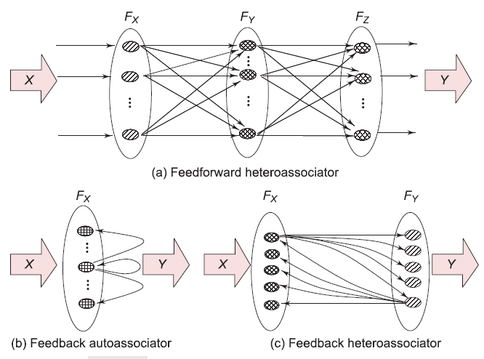
Architectures:
Feedforward and Feedback

Slide 33
Neural Networks Generate Mappings
f : R^{n} → R^{p}
Multilayered networks that associate vectors from one space to vectors of another space are called heteroassociators.
  Map or associate two different patterns with one another—one as input and the other as output. Mathematically we write, f : R^{n} → R^{p}.

Slide 34
Neural Networks Generate Mappings
When neurons in a single field connect back onto themselves the resulting network is called an autoassociator since it associates a single pattern in R^{n} with itself.
f : R^{n} → R^{n}

Slide 35
Activation and Signal State Spaces
For a p-dimensional field of neurons, the activation state space is R^{p}.
The signal state space is the Cartesian cross space,
  I^{p} = [0, 1]×· · ·×[0, 1] p times = [0, 1]^{p} ⊂ R^{p} if the neurons have continuous signal functions in the interval [0, 1]
  [−1, 1]^{p} if the neurons have continuous signal functions in the interval [−1, 1].

Slide 36
Activation and Signal State Spaces
For the case when the neuron signal functions are binary threshold, the signal state space is
  B^{p} = {0, 1}×· · ·×{0, 1} p times = {0, 1}^{p} ⊂ I^{p} ⊂ R^{p}
  {−1, 1}^{p} when the neuron signal functions are bipolar threshold.

Slide 37
Feedforward vs Feedback:
Multilayer Perceptrons
Organized into different layers
Unidirectional connections
memory-less: output depends only on the present input
X ∈ R^{n}
S = f (X)

Slide 38
Feedforward vs Feedback:
Multilayer Perceptrons
Possess no dynamics
Demonstrate powerful properties
  Universal function approximation
Find widespread applications in pattern classification.
X ∈ R^{n}
S = f (X)

Slide 39
Feedforward vs Feedback:
Recurrent Neural Networks
Non-linear dynamical systems
New state of the network is a function of the current input and the present state of the network

Slide 40
Feedforward vs Feedback:
Recurrent Neural Networks
Possess a rich repertoire of dynamics
Capable of performing powerful tasks such as
  pattern completion
  topological feature mapping
  pattern recognition

Slide 41

More on Feedback Networks
Network activations and signals are in a flux of change until they settle down to a steady value
Issue of Stability: Given a feedback network architecture we must ensure that the network dynamics leads to behavior that can be interpreted in a sensible way.

Slide 42
More on Feedback Networks
Dynamical systems have variants of behavior like
  fixed point equilibria where the system eventually converges to a fixed point
  Chaotic dynamics where the system wanders aimless in state space

Slide 43
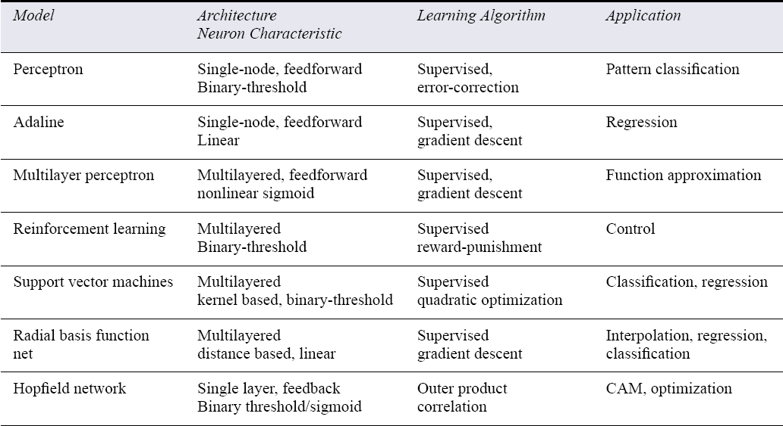
Summary of Major Neural Networks Models

Slide 44
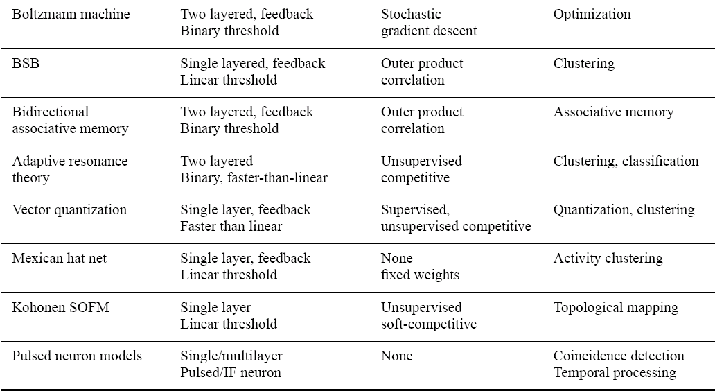
Summary of Major Neural Networks Models

Slide 45
Salient Properties of Neural Networks
Robustness Ability to operate, albeit with some performance loss, in the event of damage to internal structure.
Associative Recall Ability to invoke related memories from one concept.
  For e.g. a friend’s name elicits vivid mental pictures and related emotions

Slide 46
Salient Properties of Neural Networks
Function Approximation and Generalization Ability to approximate functions using learning algorithms by creating internal representations and hence not requiring the mathematical model of how outputs depend on inputs. So neural networks are often referred to as adaptive function estimators.

Slide 47
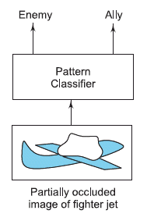
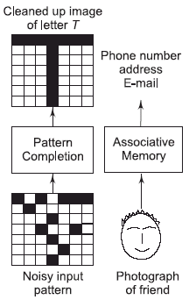
Application Domains of Neural Networks
Fault Tolerance
Associative Recall

Slide 48
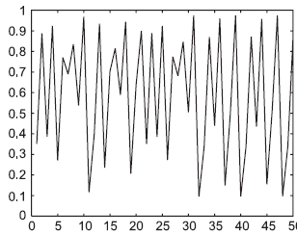
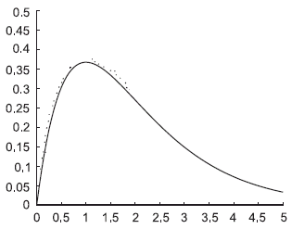
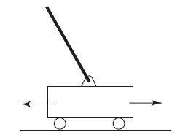
Application Domains of Neural Networks
Prediction
Function Approximation
Control

