Slide 1
ADALINE (ADAptive LInear NEuron) Network and
Widrow-Hoff Learning
(LMS Algorithm)

Slide 2
ADALINE (ADAptive LInear NEuron) Network and
Widrow-Hoff Learning (LMS Algorithm)
Widrow and his graduate student Hoff introduced ADALINE network and learning rule which they called the LMS(Least Mean Square) Algorithm.

Slide 3
ADALINE (ADAptive LInear NEuron) Network and
Widrow-Hoff Learning
(LMS Algorithm)
The linear networks (ADALINE) are similar to the perceptron, but their transfer function is linear rather than hard-limiting.
This allows their outputs to take on any value, whereas the perceptron output is limited to either 0 or 1.
Linear networks, like the perceptron, can only solve linearly separable problems.

Slide 4
ADALINE (ADAptive LInear NEuron) Network and
Widrow-Hoff Learning
(LMS Algorithm)
The error is the difference between an output vector and its target vector. We would like to find values for the network weights and biases such that the sum of the squares of the errors is minimized or below a specific value.
We can always train the network to have a minimum
error by using the Least Mean Squares (Widrow-Hoff) algorithm.

Slide 5
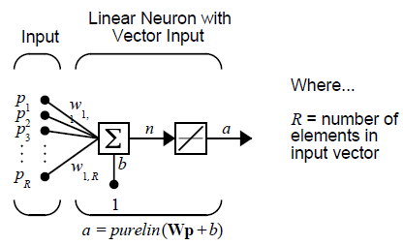
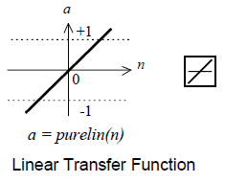
Linear Neuron Model

Slide 6
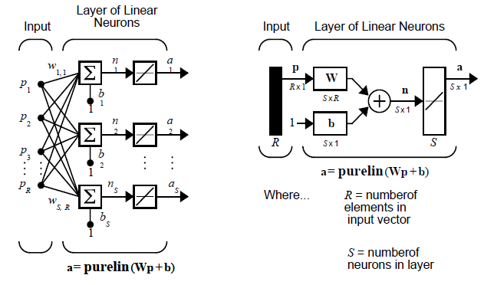
Network Architecture
Singler-Layer Linear Network

Slide 7
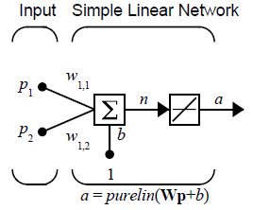
Simple Linear Network
a=?

Slide 8
LMS or Widrow-Hoff
The least mean square error (LMS or Widrow-Hoff) algorithm is an example of supervised training, in which the learning rule is provided with a set of examples of desired network behavior:
{p1, t1} , {p2, t2} , …, {pQ, tQ}

Slide 9

LMS or Widrow-Hoff
Mean Square Error
As each input is applied to the network, the network output is compared to the target. The error is calculated as the difference between the target output and the network output.
We want to minimize the average of the sum of these errors.
The LMS algorithm adjusts the weights and biases of the linear network so as to minimize this mean square error.

Slide 10
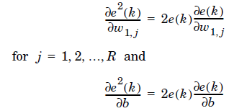
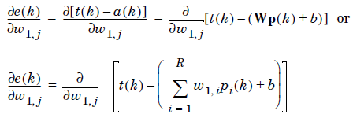
LMS or Widrow-Hoff
Widrow and Hoff had the insight that they could estimate the mean square error by using the squared error at each iteration. The LMS algorithm or Widrow-Hoff learning algorithm, is based on an approximate steepest descent procedure.
Next look at the partial derivative with respect to the error.

Slide 11



LMS or Widrow-Hoff
Here pi(k) is the ith element of the input vector at the kth iteration.
Finally, the change to the weight matrix and the bias will be

Slide 12

LMS or Widrow-Hoff
These two equations form the basis of the Widrow-Hoff (LMS) learning
algorithm.
These results can be extended to the case of multiple neurons, and written in
matrix form as
the error e, W and b are vectors and
α is a learning rate (0.2..0.6).

