Slide 1
Intrusion Detection Using Hybrid Neural Networks
Vishal Sevani (07405010)

Slide 2
Intrusion Detection System (IDS)
Definition
  Intrusion Detection System (IDS) is a system that identifies, in real time, attacks on a network and takes corrective action to prevent those attacks.

Slide 3
Types of Intrusions
Denial of Service (DoS)
Remote to User Attacks (R2L)
User to Root Attacks (U2R)
Probing

Slide 4
Intrusion Detection Methods
Misuse detection
  matches the activities occurring on an information system to the signatures of known intrusions
Anomaly detection
  compares activities on the information system to the norm behaviour

Slide 5
Motivation for using AI for Intrusion Detection
Drawbacks of conventional techniques
  constant update of database with new signatures
  false alarm
Advantages of AI based techniques
  Flexibility
  Adaptability
  Pattern recognition and possibly detection of new patterns
  Learning abilities

Slide 6
AI techniques used for Intrusion Detection
Support Vector Machines (SVMs)
Artificial Neural Networks (ANNs)
Expert Systems
Multivariate Adaptive Regression Splines (MARS)

Slide 7
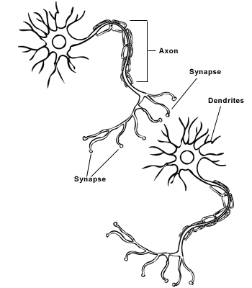
Neural Network Fundamentals
Neuron is fundamental information processing unit of brain
Information exchange between neurons is via pulses of electrical activitiy
Axons act as transmission lines
Syntaptic interconnections impose excitation or inhibition of receptive nerons

Slide 8
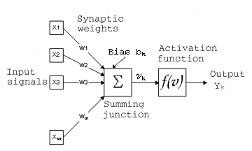
Model of a Neuron
Weigthed connecting links
Adder
Activation function
_{m}
v_{k} = Σ w_{kj} x_{j}
^{j = 1}
    y_{k} = f (v_{k} + b_{k})

Slide 9
Neural Network Classification
Capability of the neural network largely depends on the learning algorithm and the network architecture used
Learning algorithms typically used
  Error Correction learning
  Hebbian learning
  Competitive learning, etc.
Network architectures typically used
  Single layer feedforward
  Multilayer feedforward
  Recurrent networks, etc.

Slide 10
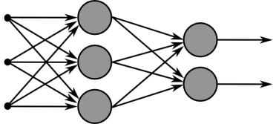
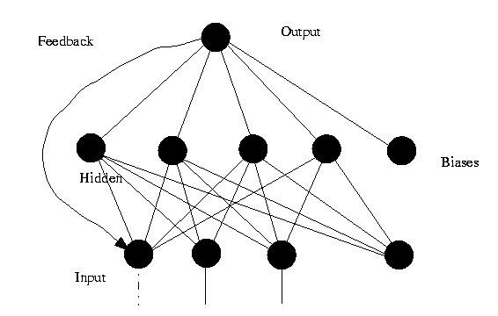
Multilayer feedforward network
Recurrent network

Slide 11
Traditional Neural Network Based IDS
Typically consist of a single neural network based on either misuse detection or anomaly detection
Neural network with good pattern classification abilities typically used for misuse detetction, such as
  Multilayer Perceptron
  Radial Basis function networks, etc
Neural network with good classification abilities typically used for anomaly detetction, such as
  Self organizing maps (SOM)
  Competitive learning neural network, etc

Slide 12
Hybrid Neural Network Approach
Combination of Misuse detection and anomaly detection based systems
  Clustering results in dimensionality reduction
  Classification attains attack identification
Advantages
  Improved accuracy
  Enhanced flexibility
Examples
  SOM and MLP using back propagation
  SOM and RBF
  SOM and CNN, etc

Slide 13
Hybrid Neural Network Approach 1
(Using SOM and MLP)
SOM employing unsupervised learning used for clustering
MLP emplying Back Propagation Algorithm used for classification
Output from SOM is given as input to MLP

Slide 14
Self Organizing Maps
Based on competitive learning
Winner takes all neuron
Forms a topographic map of input patterns
  ie. spatial locations of neurons in the lattice are indicative of statistical features contained in the input patterns

Slide 15
SOM Procedure
Initialization of synaptic weigths
Competition
  Euclidean distance
Cooperation
  topological neighbourhood
Adaptation
  learning rate

Slide 16
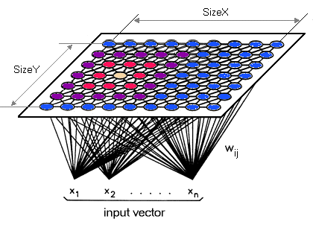
A Self Organizing Map

Slide 17
Back-Propagation Algorithm
A case of supervised learning
Typically used for multilayer perceptrons
Two stages, forward pass and backward pass
  In forward pass input signal propagtes forward to produce the output
  In backward pass, synaptic weights are updated in accordance with the error signal, which is then propagated backwards

Slide 18
Weight Correction for BPA
Error signal at output neuron j
e_{j}(n) = d_{j}(n) – y_{j}(n)
Weight correction factor,
∆ w_{ji} (n) = η δ_{j}(n) y_{i}(n)
where, δ_{j}(n) = ej(n)Φ'(v_{j}(n)) → j is o/p neuron
        = Φ'(v_{j}(n) Σ δ_{k}(n)w_{kj}(n) → j is hidden neuron

Slide 19
Operational Procedure
Selection of input and output variables
Data prepocessing and representation
Data normalization
Selection of network structure, training and testing

Slide 20
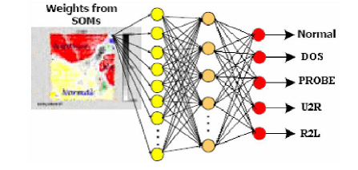
Proposed hybrid SOM_BPN Neural Network

Slide 21
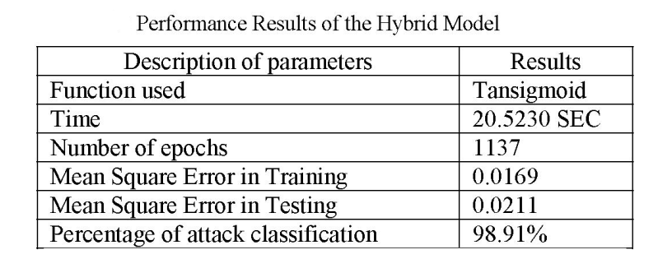
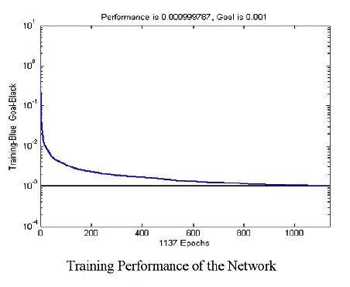
Simulation Results

Slide 22
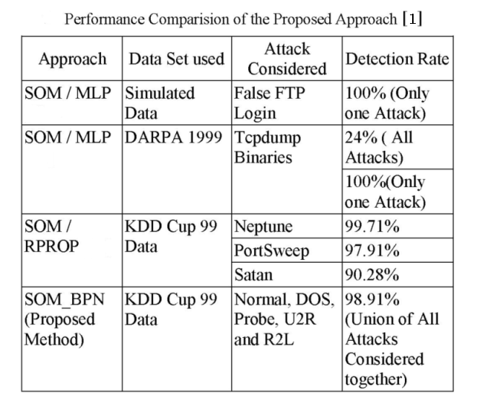
Simulation Results (contd)

Slide 23
Hybrid Neural Network Approach 2
(Using SOM and RBF)
SOM employing unsupervised learning used for clustering
RBF for classification
Output from SOM is given as input to RBF network

Slide 24
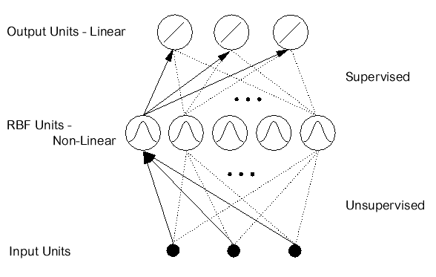
Basics of RBF Network
Typically used for function approximation, pattern classification, etc
Two layer feed-forward structure with each hidden unit implementing radial activated function
Training involves updating centers of network for hidden neuron and output layer weights

Slide 25
Training of RBF network
Unsupervised learning to update centers of hidden neurons
      k' = arg(min_{k} ||X(n) – C_{k}(n)||)
C_{k}(n + 1) = C_{k}(n) + μ[X(n) – C_{k}(n)] ... if k = k'
= C_{k}(n) ... otherwise
Supervised learning to update output layer weights
w_{k}(n + 1) = w_{k}(n) + μ[d(n) – Y(n)] e^{-ζ}
        where ζ = ||X - C_{k}||²/(σ²_{k})

Slide 26
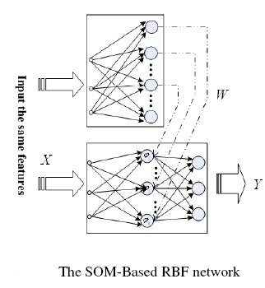
Proposed Network

Slide 27
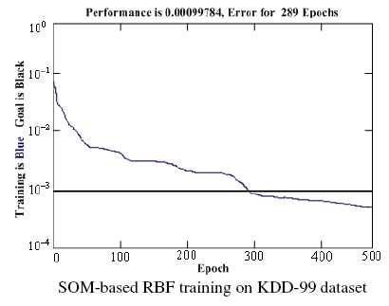
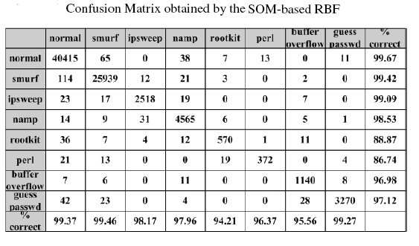
Simulation Results

Slide 28
Summary
What is Intrusion Detection System?
AI and Intrusion Detection
Neural Network fundamentals
Hybrid neural network approach for Intrusion Detection using
  (i) SOM and BPN
  (ii) SOM and RBF

Slide 29
References
[1] “Network Intrusion Detection using Hybrid Neural Network”, P. Ganesh Kumar, et al., IEEE – ICSCN 2007, India, pp. 563 – 569
[2] “A Hybrid Neural Network Approach to Classification of Novel Attacks for Intrusion Detection”, Wei Pan, et. al., LNCS 3758, 2005, pp. 562 – 675
[3] “Neural Networks – A Comprehensive Foundation”, Simon Haykin, 2nd Edition, Prentice Hall, 1999

Slide 30
References (contd)
[4] “A Comparative Study of Techniques for Intrusion Detection”, Srinivas Mukkamal, et al., Proceedings of the 15th IEEE International Conference on Tools with Artificial Intelligence (ICTAI'03), 2003
[5] “Applications of Neural Networks in Network Intrusion Detection”, Neural Network Applications in Electrical Engineering, Aleksandar Lazarevic, et al., 2006. NEUREL 2006. 8th Seminar on 25-27 Sept. 2006 pp. 59 - 64

