Slide 1
Adaptive Neural Network Predator/Prey Scenario
SEIS 761
John Morgan

Slide 2
Goal
Build a Neural Network optimized by a genetic algorithm to chase an object through 2D space.

Slide 3
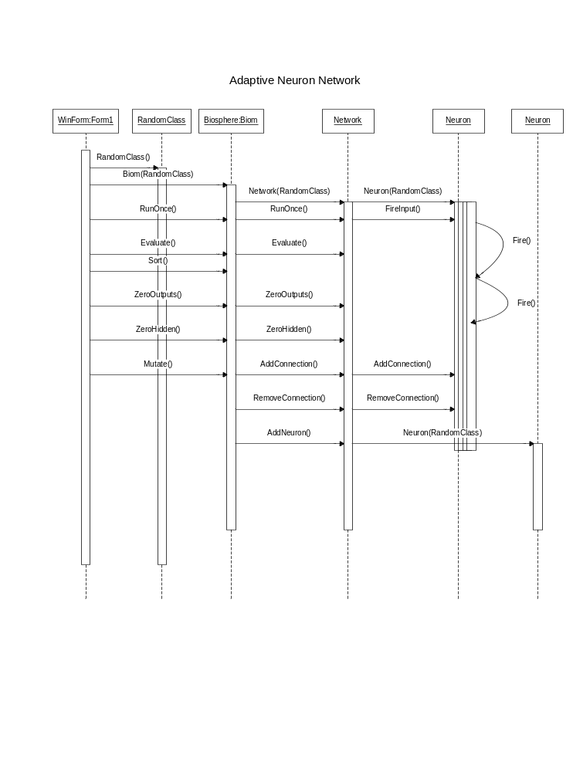
Sequence

Slide 4
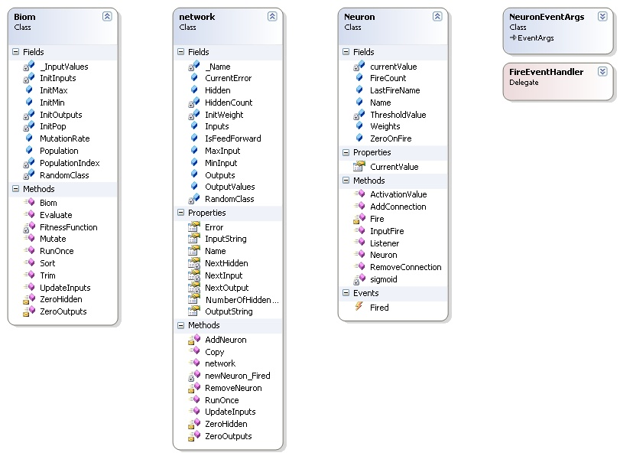
Class Diagram

Slide 5
