Slide 1
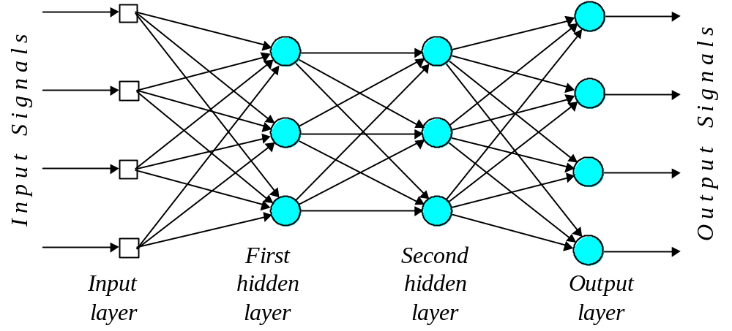
Artificial Neural Networks

Slide 2
Commercial ANNs
Commercial ANNs incorporate three and sometimes four layers, including one or two hidden layers. Each layer can contain from 10 to 1000 neurons. Experimental neural networks may have five or even six layers, including three or four hidden layers, and utilise millions of neurons.

Slide 3
Example
Character recognition

Slide 4
Problems that are not linearly separable
Xor function is not linearly separable
Using Multilayer networks with back propagation training algorithm
There are hundreds of training algorithms for multilayer neural networks

Slide 5
Multilayer neural networks
A multilayer perceptron is a feedforward neural network with one or more hidden layers.
The network consists of an input layer of source neurons, at least one middle or hidden layer of computational neurons, and an output layer of computational neurons.
The input signals are propagated in a forward direction on a layer-by-layer basis.

Slide 6
Multilayer perceptron with two hidden layers

Slide 7
What do the middle layers hide?
A hidden layer “hides” its desired output. Neurons in the hidden layer cannot be observed through the input/output behaviour of the network. There is no obvious way to know what the desired output of the hidden layer should be.

Slide 8
Back-propagation neural network
Learning in a multilayer network proceeds the same way as for a perceptron.
A training set of input patterns is presented to the network.
The network computes its output pattern, and if there is an error − or in other words a difference between actual and desired output patterns − the weights are adjusted to reduce this error.

Slide 9
In a back-propagation neural network, the learning algorithm has two phases.
First, a training input pattern is presented to the network input layer. The network propagates the input pattern from layer to layer until the output pattern is generated by the output layer.
If this pattern is different from the desired output, an error is calculated and then propagated backwards through the network from the output layer to the input layer. The weights are modified as the error is propagated.

Slide 10
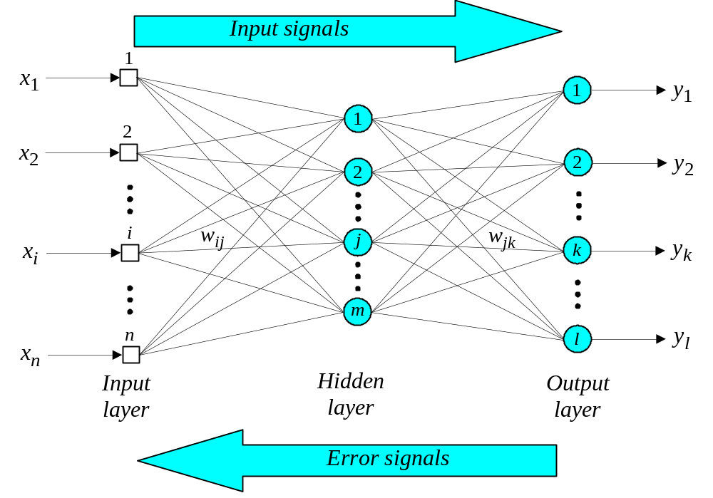
Three-layer back-propagation neural network

Slide 11
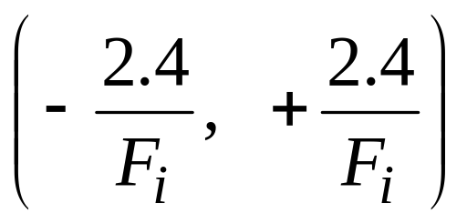
The back-propagation training algorithm
Step 1: Initialisation
Set all the weights and threshold levels of the network to random numbers uniformly distributed inside a small range:
where F_{i} is the total number of inputs of neuron i in the network. The weight initialisation is done on a neuron-by-neuron basis.

Slide 12
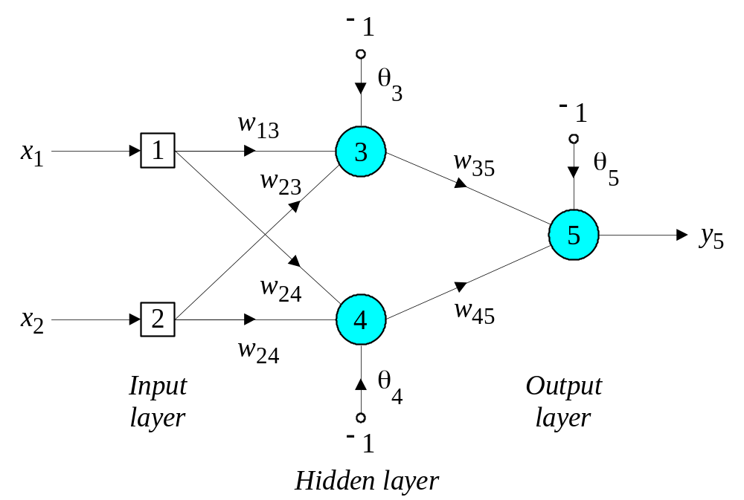
Three-layer network
w13 = 0.5, w14 = 0.9, w23 = 0.4, w24 = 1.0,
w35 = −1.2, w45 = 1.1, θ3 = 0.8, θ4 = −0.1 and
θ5 = 0.3

Slide 13
The effect of the threshold applied to a neuron in the hidden or output layer is represented by its weight, θ, connected to a fixed input equal to −1.
The initial weights and threshold levels are set randomly e.g., as follows:
w₁₃ = 0.5, w₁₄ = 0.9, w₂₃ = 0.4, w₂₄ = 1.0, w₃₅ = −1.2, w₄₅ = 1.1, θ₃ = 0.8, θ₄ = −0.1 and θ₅ = 0.3.

Slide 14
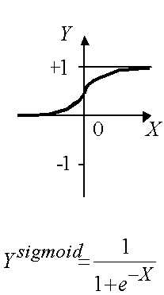
Assuming the sigmoid activation Function

Slide 15
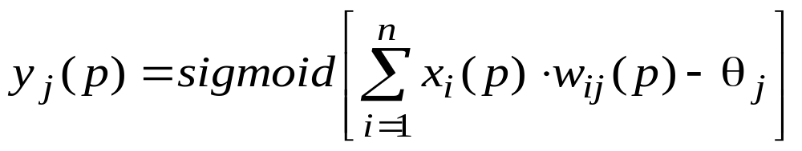
Step 2: Activation
Activate the back-propagation neural network by applying inputs x₁(p), x₂(p),…, x_{n}(p) and desired outputs y_{d,1}(p), y_{d,2}(p),…, y_{d,n}(p).
(a) Calculate the actual outputs of the neurons in the hidden layer:
where n is the number of inputs of neuron j in the hidden layer, and sigmoid is the sigmoid activation function.

Slide 16
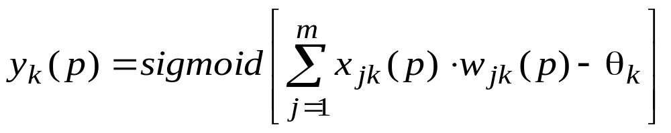
Step 2: Activation (continued)
(b) Calculate the actual outputs of the neurons in the output layer:
where m is the number of inputs of neuron k in the output layer.

Slide 17
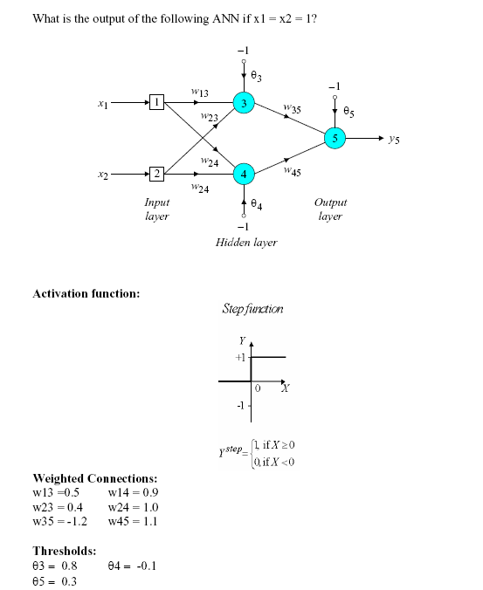
Class Exercise

Slide 18

If the sigmoid activation function is used the output of the hidden layer is
And the actual output of neuron 5 in the output layer is
And the error is

Slide 19
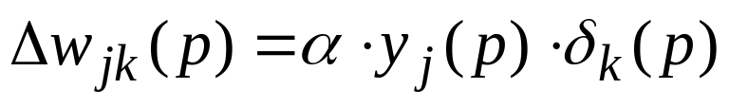
What learning law applies
in a multilayer neural network?

Slide 20
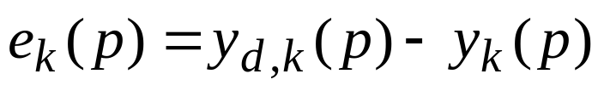
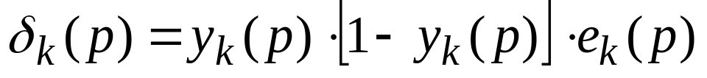
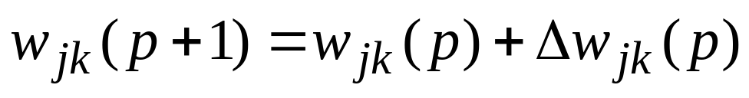
Step 3: Weight training output layer
Update the weights in the back-propagation network propagating backward the errors associated with output neurons.
(a) Calculate the error
and then the error gradient for the neurons in the output layer:
Then the weight corrections:
Then the new weights at the output neurons:

Slide 21
Three-layer network for solving the Exclusive-OR operation

Slide 22
The error gradient for neuron 5 in the output layer:
Determine the weight corrections assuming that the learning rate parameter, α, is equal to 0.1:

Slide 23
Apportioning error in the hidden layer
Error is apportioned in proportion to the weights of the connecting arcs.
Higher weight indicates higher error responsibility

Slide 24
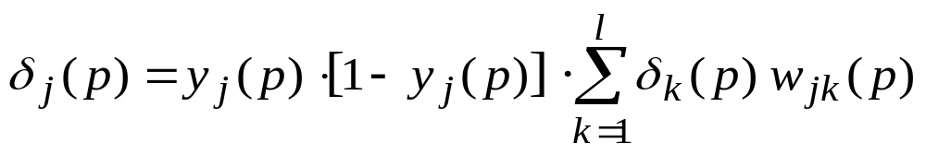
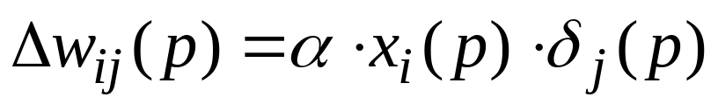
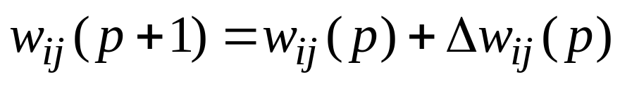
Step 3: Weight training hidden layer
(b) Calculate the error gradient for the neurons in the hidden layer:
Calculate the weight corrections:
Update the weights at the hidden neurons:

Slide 25
The error gradients for neurons 3 and 4 in the hidden layer:
Determine the weight corrections:

Slide 26
At last, we update all weights and threshold:
w
=
w
+
Δ
w
=
0
.
5
+
0
.
0038
=
0
.
5038
13
13
13
w
=
w
+
Δ
w
=
0
.
9
−
0
.
0015
=
0
.
8985
14
14
14
w
=
w
+
Δ
w
=
0
.
4
+
0
.
0038
=
0
.
4038
23
23
23
w
=
w
+
Δ
w
=
1
.
0
−
0
.
0015
=
0
.
9985
24
24
24
w
=
w
+
Δ
w
=
−
1
.
2
−
0
.
0067
=
−
1
.
2067
35
35
35
w
=
w
+
Δ
w
=
1
.
1
−
0
.
0112
=
1
.
0888
45
45
45
θ
=
θ
+
Δ
θ
=
0
.
8
−
0
.
0038
=
0
.
7962
3
3
3
θ
=
θ
+
Δ
θ
=
−
0
.
1
+
0
.
0015
=
−
0
.
0985
4
4
4
θ
=
θ
+
Δ
θ
=
0
.
3
+
0
.
0127
=
0
.
3127
5
5
5
The training process is repeated until the sum of squared errors is less than 0.001.

Slide 27
Step 4: Iteration
Increase iteration p by one, go back to Step 2 and repeat the process until the selected error criterion is satisfied.
As an example, we may consider the three-layer back-propagation network. Suppose that the network is required to perform logical operation Exclusive-OR. Recall that a single-layer perceptron could not do this operation. Now we will apply the three-layer net.

Slide 28
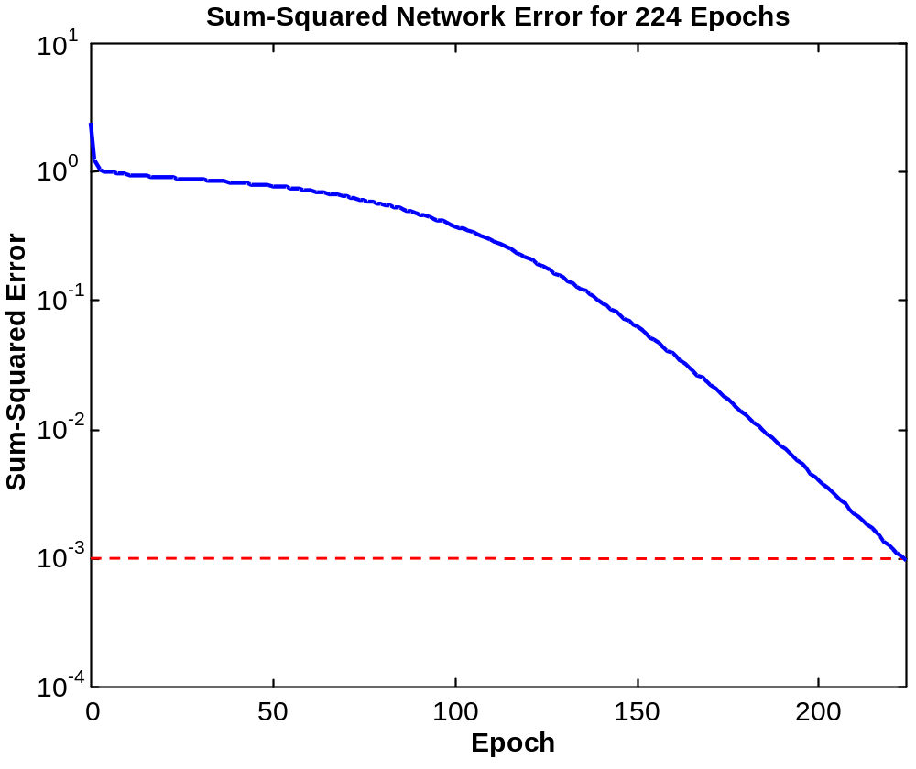
Typical Learning Curve

Slide 29
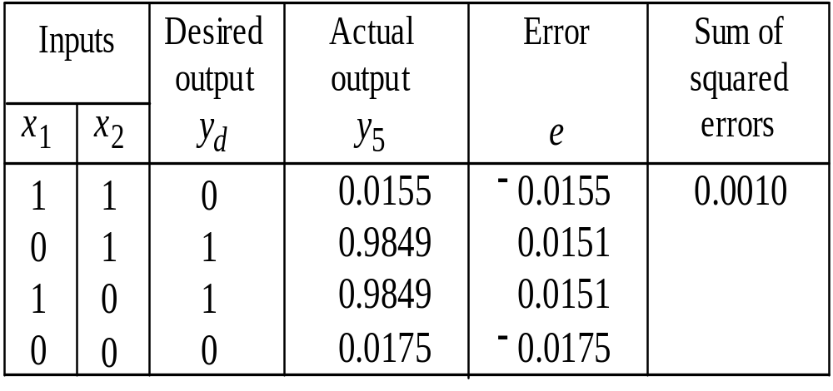
Final results of three-layer network learning

Slide 30
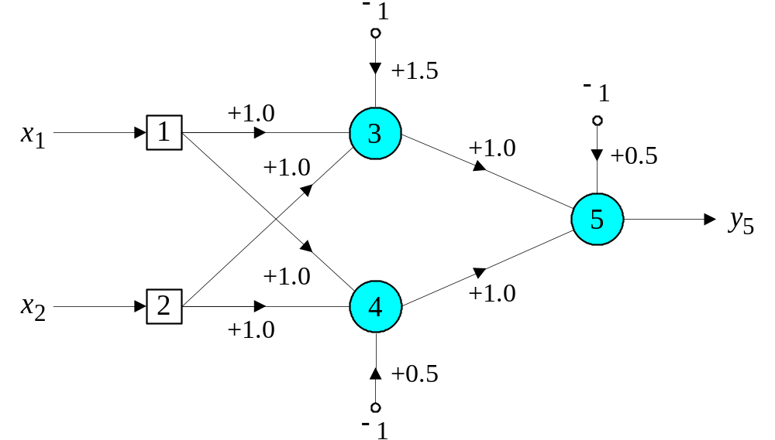
Network represented by McCulloch-Pitts model for solving the Exclusive-OR operation

Slide 31
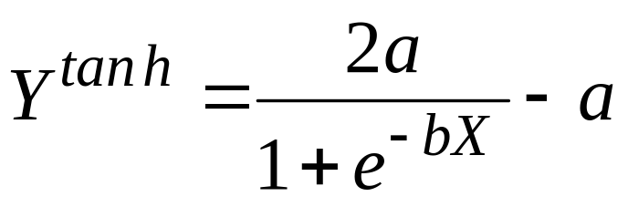
Accelerated learning in multilayer neural networks
A multilayer network learns much faster when the sigmoidal activation function is represented by a hyperbolic tangent:
where a and b are constants.
Suitable values for a and b are:
a = 1.716 and b = 0.667

Slide 32
We also can accelerate training by including a momentum term in the delta rule:
where β is a positive number (0 ≤ β < 1) called the momentum constant. Typically, the momentum constant is set to 0.95.
This equation is called the generalised delta rule.

Slide 33
Learning with an adaptive learning rate
To accelerate the convergence and yet avoid the
danger of instability, we can apply two heuristics:
Heuristic
If the error is decreasing the learning rate α, should be increased.
If the error is increasing or remaining constant the learning rate α, should be decreased.

Slide 34
Adapting the learning rate requires some changes in the back-propagation algorithm.
If the sum of squared errors at the current epoch exceeds the previous value by more than a predefined ratio (typically 1.04), the learning rate parameter is decreased (typically by multiplying by 0.7) and new weights and thresholds are calculated.
If the error is less than the previous one, the learning rate is increased (typically by multiplying by 1.05).

Slide 35
Typical Learning Curve

Slide 36
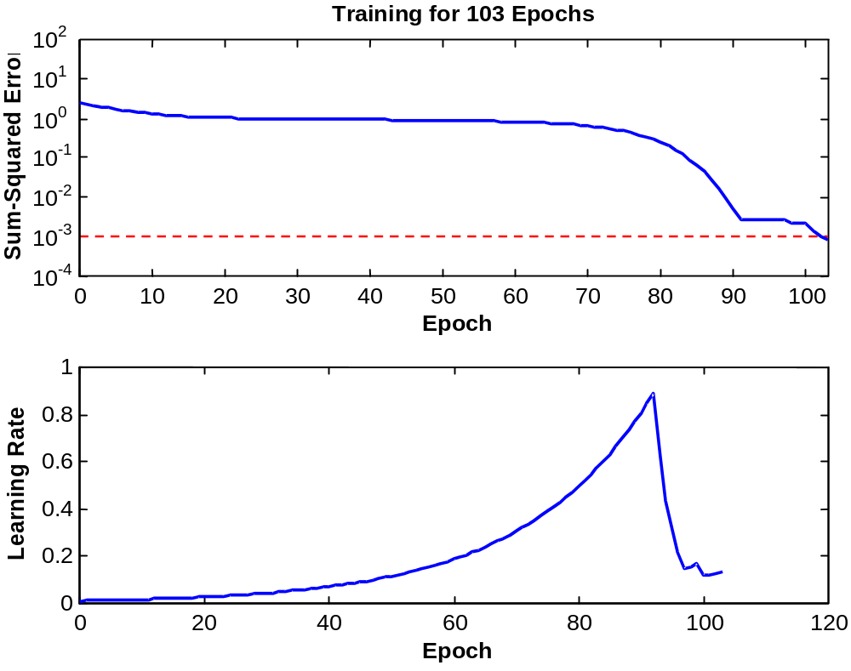
Typical learning with adaptive learning rate

Slide 37
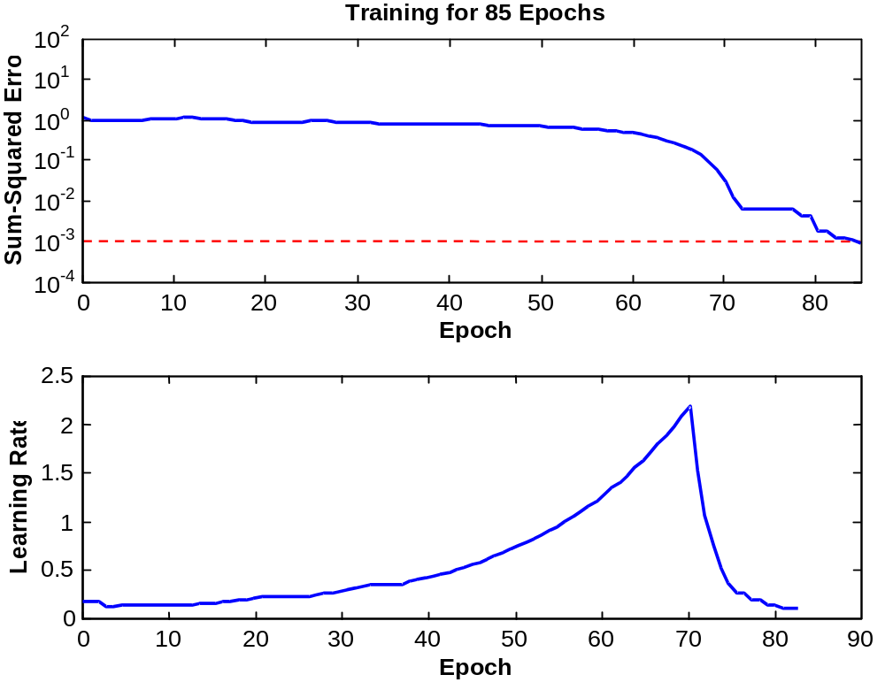
Typical Learning with
adaptive learning rate plus momentum

