Slide 1
Chapter 2
Single Layer Feedforward Networks

Slide 2
Perceptrons
By Rosenblatt (1962)
  For modeling visual perception (retina)
  A feedforward network of three layers of units:
  Sensory, Association, and Response
  Learning occurs only on weights from A units to R units (weights from S units to A units are fixed).
  Each R unit receives inputs from n A units
  For a given training sample s:t, change weights between A and R only if the computed output y is different from the target output t (error driven)
w_{SA}
w_{AR}
S
A
R

Slide 3
Perceptrons
A simple perceptron
  Structure:
    Sing output node with threshold function
    n input nodes with weights w_{i}, i = 1 – n
  To classify input patterns into one of the two classes (depending on whether output = 0 or 1)
  Example: input patterns: (x₁, x₂)
    Two groups of input patterns
    (0, 0) (0, 1) (1, 0) (-1, -1);
    (2.1, 0) (0, -2.5) (1.6, -1.6)
    Can be separated by a line on the (x₁, x₂) plane x₁ - x₂ = 2
    Classification by a perceptron with
    w₁ = 1, w₂ = -1, threshold = 2

Slide 4
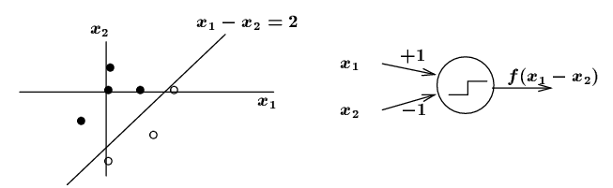
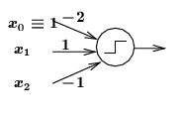
Perceptrons
(-1, -1)
(1.6, -1.6)
Implement threshold by a node x₀
  Constant output 1
  Weight w₀ = - threshold
  A common practice in NN design

Slide 5
Perceptrons
Linear separability
  A set of (2D) patterns (x₁, x₂) of two classes is linearly separable if there exists a line on the (x₁, x₂) plane
    w₀ + w₁ x₁ + w₂ x₂ = 0
    Separates all patterns of one class from the other class
  A perceptron can be built with
    3 input x₀ = 1, x₁, x₂ with weights w₀, w₁, w₂
  n dimensional patterns (x₁,…, x_{n})
    Hyperplane w₀ + w₁ x₁ + w₂ x₂ +…+ w_{n} x_{n} = 0 dividing the space into two regions
  Can we get the weights from a set of sample patterns?
    If the problem is linearly separable, then YES (by perceptron learning)

Slide 6
Examples of linearly separable classes
- Logical AND function
patterns (bipolar) decision boundary
x1 x2 output w1 = 1
-1 -1 -1 w2 = 1
-1 1 -1 w0 = -1
1 -1 -1
1 1 1 -1 + x1 + x2 = 0
- Logical OR function
patterns (bipolar) decision boundary
x1 x2 output w1 = 1
-1 -1 -1 w2 = 1
-1 1 1 w0 = 1
1 -1 1
1 1 1 1 + x1 + x2 = 0
o
x
o
o
x: class I (output = 1)
o: class II (output = -1)
x
x
o
x
x: class I (output = 1)
o: class II (output = -1)

Slide 7
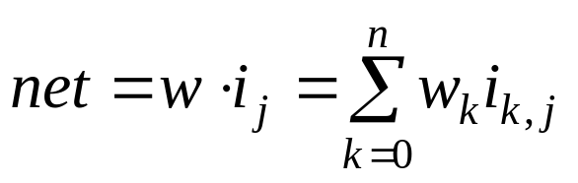
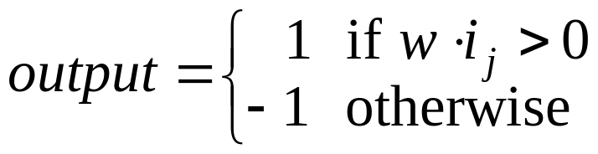
Perceptron Learning
The network
  Input vector i_{j} (including threshold input = 1)
  Weight vector w = (w₀, w₁,…, w_{n} )
  Output: bipolar (-1, 1) using the sign node function
Training samples
  Pairs (i_{j} , class(i_{j})) where class(i_{j}) is the correct classification of i_{j}
Training:
  Update w so that all sample inputs are correctly classified (if possible)
  If an input i_{j} is misclassified by the current w
  class(i_{j}) · w · i_{j} < 0
  change w to w + Δw so that (w + Δw) · i_{j} is closer to class(i_{j})

Slide 8
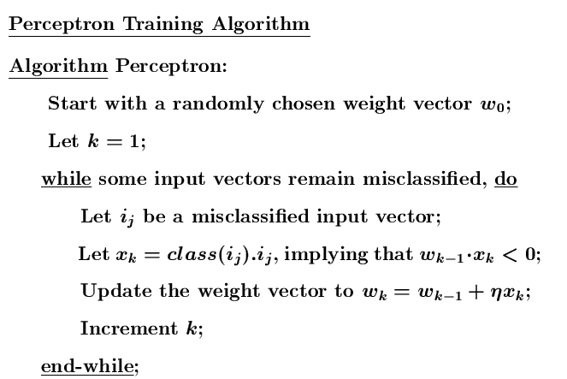
Perceptron Learning
Where η > 0 is the learning rate

Slide 9
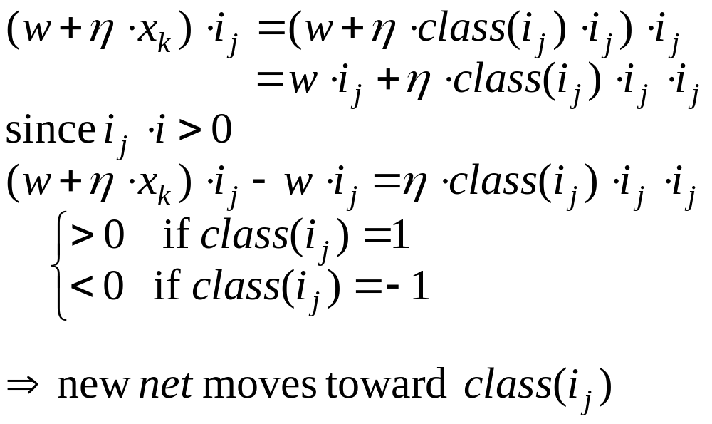
Perceptron Learning
Justification

Slide 10

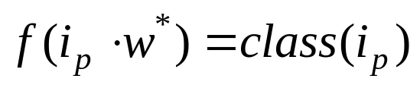
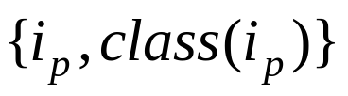


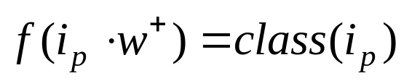
Perceptron learning convergence theorem
  Informal: any problem that can be represented by a perceptron can be learned by the learning rule
  Theorem: If there is a such that for all P training sample patterns , then for any start weight vector , the perceptron learning rule will converge to a weight vector such that for all p
  ( and may not be the same.)
  Proof: reading for grad students (Sec. 2.4)

Slide 11

Perceptron Learning
Note:
  It is a supervised learning (class(i_{j}) is given for all sample input i_{j})
  Learning occurs only when a sample input misclassified (error driven)
Termination criteria: learning stops when all samples are correctly classified
  Assuming the problem is linearly separable
  Assuming the learning rate (η) is sufficiently small
Choice of learning rate:
  If η is too large: existing weights are overtaken by Δw =
  If η is too small (≈ 0): very slow to converge
  Common choice: η = 1.
Non-numeric input:
  Different encoding schema
  ex. Color = (red, blue, green, yellow). (0, 0, 1, 0) encodes “green”

Slide 12
Perceptron Learning
Learning quality
  Generalization: can a trained perceptron correctly classify patterns not included in the training samples?
    Common problem for many NN learning models
  Depends on the quality of training samples selected.
  Also to some extent depends on the learning rate and initial weights (bad choices may cause learning too slow to converge to be practical)
  How can we know the learning is ok?
    Reserve a few samples for testing

Slide 13
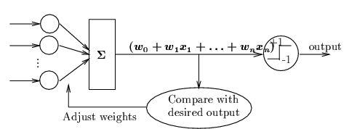
Adaline
By Widrow and Hoff (~1960)
  Adaptive linear elements for signal processing
  The same architecture of perceptrons
  Learning method: delta rule (another way of error driven), also called Widrow-Hoff learning rule
  Try to reduce the mean squared error (MSE) between the net input and the desired out put

Slide 14
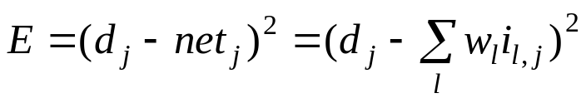


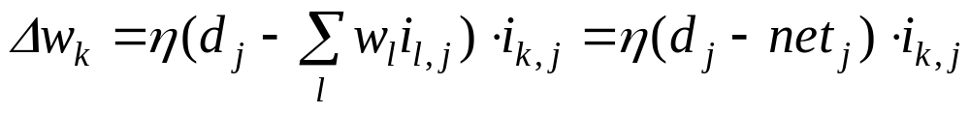
Adaline
Delta rule
  Let i_{j} = (i_{0,j}, i_{1,j},…, i_{n,j} ) be an input vector with desired output d_{j}
  The squared error
    Its value determined by the weights w_{l}
  Modify weights by gradient descent approach
    Change weights in the opposite direction of

Slide 15
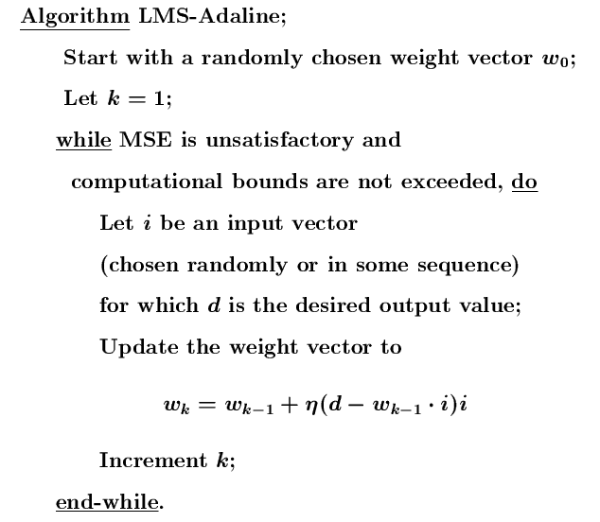
Adaline Learning Algorithm

Slide 16
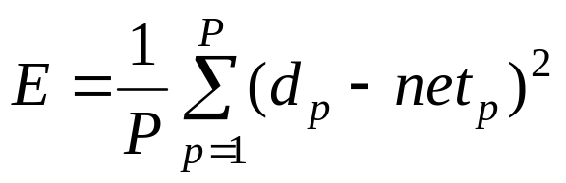
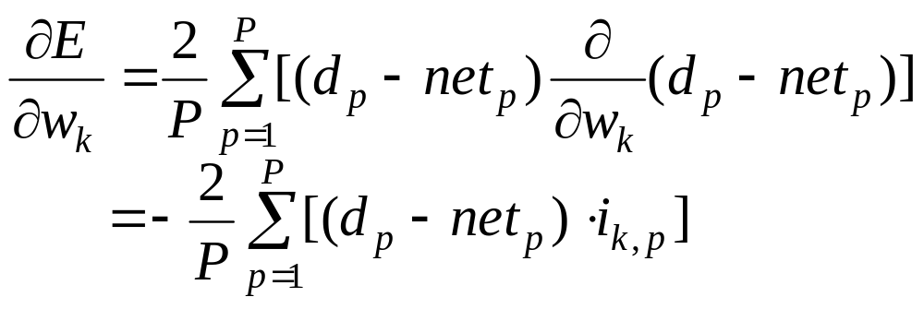
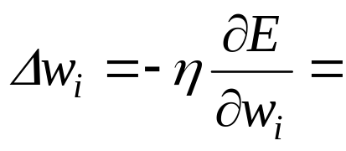
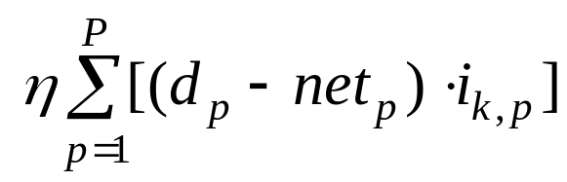
Adaline Learning
Delta rule in batch mode
  Based on mean squared error over all P samples
    E is again a function of w = (w₀, w₁,…, w_{n} )
    the gradient of E:
    Therefore

Slide 17

Adaline Learning
Notes:
  Weights will be changed even if an input is classified correctly
  E monotonically decreases until the system reaches a state with (local) minimum E (a small change of any w_{i} will cause E to increase).
  At a local minimum E state, , but E is not guaranteed to be zero (net_{j} != d_{j})
    This is why Adaline uses threshold function rather than linear function

Slide 18
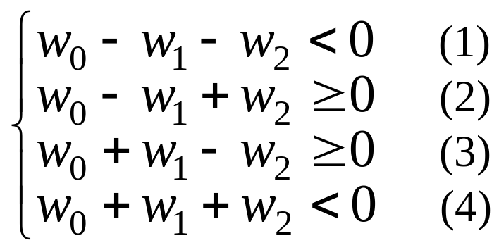
Linear Separability Again
Examples of linearly inseparable classes
- Logical XOR (exclusive OR) function
patterns (bipolar) decision boundary
x1 x2 output
-1 -1 -1
-1 1 1
1 -1 1
1 1 -1
No line can separate these two classes, as can be seen from the fact that the following linear inequality system has no solution
because we have w₀ < 0 from
(1) + (4), and w₀ >= 0 from
(2) + (3), which is a
contradiction
x
o
o
x
x: class I (output = 1)
o: class II (output = -1)

Slide 19
Why hidden units must be non-linear?
Multi-layer net with linear hidden layers is equivalent to a single layer net
  Because z1 and z2 are linear unit
  z1 = a1* (x1*v11 + x2*v21) + b1
  z1 = a2* (x1*v12 + x2*v22) + b2
  net_{y} = z1*w1 + z2*w2
  = x1*u1 + x2*u2 + b1+b2 where
  u1 = (a1*v11+ a2*v12)w1, u2 = (a1*v21 + a2*v22)*w2
  net_{y} is still a linear combination of x1 and x2.
x1
v11
z1
w1
threshold = 0
v12
Y
v21
x2
z2
w2
v22

Slide 20
  XOR can be solved by a more complex network with hidden units
Threshold = 1
x1
2
z1
2
Threshold = 0
-2
Y
-2
x2
z2
2
2
(-1, -1) (-1, -1) -1
(-1, 1) (-1, 1) 1
(1, -1) (1, -1) 1
(1, 1) (-1, -1) -1

Slide 21
Summary
Single layer nets have limited representation power (linear separability problem)
Error driven seems a good way to train a net
Multi-layer nets (or nets with non-linear hidden units) may overcome linear inseparability problem, learning methods for such nets are needed
Threshold/step output functions hinders the effort to develop learning methods for multi-layered nets

